Slide 1


Slide 2
ACTION:
Conduct an Introduction to Complex Engagement
CONDITION:
In a classroom and field environment, given a M4-Series rifle, M4 Rifle magazine, PAS-13 Thermal, M150 RCO and small arms maintenance equipment.
STANDARD:
Apply the Shot Process to Complex Engagements during training with an M4 Rifle, PAS-13 Thermal and M150 RCO IAW TC 3-22.9 Rifle and Carbine to engage targets at ranges from 100-600 meters. Achieve an 80% on the written exam.

Slide 3
INTRODUCTION
Safety Considerations:
Risk Assessment:
Environmental Considerations:
Evaluation:
Notes:
Safety Considerations: Fire escape plan should be reference
Risk Assessment: Low
Environmental Considerations: Keep tops on bottles when not in use and remember to remove all trash from the classroom.
Evaluation: You will be evaluated formally on written examinations which you must achieve a minimum of 70% to continue the course.

Slide 4
TARGET CONDITIONS
■ Range to target.
■ Moving targets.
■ Oblique targets.
■ Evasive targets.
■ Limited exposure targets.
COMPLEX ENGAGEMENTS
SHOOTER CONDITIONS
ENVIRONMENTAL CONDITIONS
■ Moving firing position.
■ Canted weapon engagements.
■ CBRN operations engagements.
■ Wind.
■ Angled firing.
■ Limited visibility.
Notes:
A complex engagement includes any shot that cannot use the CoVM as the point of aim to ensure a target hit. Complex engagements require a Soldier to apply various points of aim to successfully defeat the threat.
Conditions that make up these engagements:
Target, Environment, and shooter.

Slide 5
FUNCTIONAL ELEMENTS
AIM
COMMON ENGAGEMENT ACTIONS
1. Weapon Orientation | 2. Sight Alignment | 3. Sight Picture
4. Point of Aim (POA) |  | 5. Desired Point of Impact (POI)
SIGHT PICTURE
Pre-Shot | Post Shot
DESIRED POINT OF IMPACT
Sighting system employed | Shooter movement | Target movement
Angles (elevation) | Distance | Wind
Notes:
The aim element of employment is the continuous process of orienting the weapon correctly, aligning the sights, aligning on the target, and the application of the appropriate lead and elevation (hold-off or aim-off) during a target engagement. Aiming is a continuous process conducted through pre-shot, shot, and post-shot, to effectively apply lethal fires in a responsible manner with accuracy and precision.
The aiming process for engaging stationary targets consist of the following Soldier actions, regardless of the optic, sight, or magnification used by the aiming device:
● Weapon orientation – the direction of the weapon as it is held in a stabilized manner.
● Sight alignment – the physical alignment of the aiming device:
■ Iron sight/back-up iron sight and the front sight post.
■ Optic reticle.
■ Ballistic reticle (day or thermal).
● Sight picture – the target as viewed through the line of sight.
● Point of aim (POA) – the specific location where the line of sight intersects the target.
● Desired point of impact (POI)–the desired location of the strike of the round to achieve the desired outcome (incapacitation or lethal strike)

Slide 6
Soldier Function
Ballistic Computer during Shot Process
Holds
Soldiers Calculated Point of Aim
Conditions may determine a point of aim that is not CoVM
Hold Determinations
Immediate | Deliberate
Complex Engagement Refinements/ Alteration of POA
Range to target.
Lead for targets based on their direction and speed of movement.
Counter-rotation lead required when the Soldier is moving in the opposite direction of the moving target.
Wind speed, direction, and duration between the shooter and the target at ranges greater than 300 meters.
Greatest lethal zone presented by the target to provide the most probable point of impact to achieve immediate incapacitation.
Notes:
The aim element of employment is the continuous process of orienting the weapon correctly, aligning the sights, aligning on the target, and the application of the appropriate lead and elevation (hold-off or aim-off) during a target engagement. Aiming is a continuous process conducted through pre-shot, shot, and post-shot, to effectively apply lethal fires in a responsible manner with accuracy and precision.
The aiming process for engaging stationary targets consist of the following Soldier actions, regardless of the optic, sight, or magnification used by the aiming device:
● Weapon orientation – the direction of the weapon as it is held in a stabilized manner.
● Sight alignment – the physical alignment of the aiming device:
■ Iron sight/back-up iron sight and the front sight post.
■ Optic reticle.
■ Ballistic reticle (day or thermal).
● Sight picture – the target as viewed through the line of sight.
● Point of aim (POA) – the specific location where the line of sight intersects the target.
● Desired point of impact (POI)–the desired location of the strike of the round to achieve the desired outcome (incapacitation or lethal strike)

Slide 7
IMMEDIATE HOLD DETERMINATION
Close quarters engagements
Laser range finder
Front sight post method
Recognition method
100-meter unit-of-measure method

Slide 8
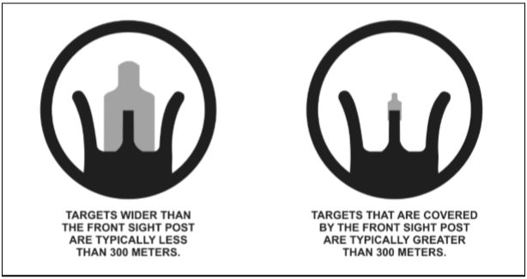
IMMEDIATE HOLD DETERMINATION
FRONT SIGHT POST METHOD

Slide 9
IMMEDIATE HOLD DETERMINATION
RECOGNITION METHOD
100 meters – the target can be clearly observed in detail, and facial features can be distinguished.
200 meters – the target can be clearly observed, although there is a loss of facial detail. The color of the skin and equipment is still identifiable.
300 meters – the target has a clear body outline, face color usually remains accurate, but remaining details are blurred.
400 meters – the body outline is clear, but remaining detail is blurred.
500 meters – the body shape begins to taper at the ends. The head becomes indistinct from the shoulders.

Slide 10
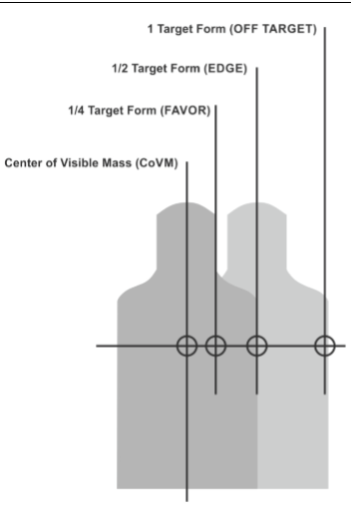
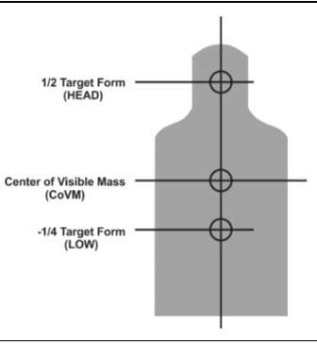
IMMEDIATE HOLD DETERMINATION
Notes:
Each of these firing conditions may require the Soldier to determine an appropriate aim point that is not the CoVM. This Soldier calculated aim point is called the hold. During any complex engagement, the Soldier serves as the ballistic computer during the shot process. The hold represents a refinement or alteration of the center of visible mass point of aim at the target to counteract certain conditions during a complex engagement for—
● Range to target.
● Lead for targets based on their direction and speed of movement.
● Counter-rotation lead required when the Soldier is moving in the opposite direction of the moving target.
● Wind speed, direction, and duration between the shooter and the target at ranges greater than 300 meters.
● Greatest lethal zone presented by the target to provide the most probable point of impact to achieve immediate incapacitation.

Slide 11
Notes:
Each of these firing conditions may require the Soldier to determine an appropriate aim point that is not the CoVM. This Soldier calculated aim point is called the hold. During any complex engagement, the Soldier serves as the ballistic computer during the shot process. The hold represents a refinement or alteration of the center of visible mass point of aim at the target to counteract certain conditions during a complex engagement for—
● Range to target.
● Lead for targets based on their direction and speed of movement.
● Counter-rotation lead required when the Soldier is moving in the opposite direction of the moving target.
● Wind speed, direction, and duration between the shooter and the target at ranges greater than 300 meters.
● Greatest lethal zone presented by the target to provide the most probable point of impact to achieve immediate incapacitation.

Slide 12
DELIBERATE HOLD DETERMINATION
Reticle relationship (mil or MOA).
Recognition method.
Bracketing method.
Halving method.
Notes:
Deliberate hold points of aim are derived from applying the appropriate ballistic math computation. Deliberate hold determinations are required for precise shots beyond 300 meters for wind, extended range, moving, oblique, or evasive targets.

Slide 13
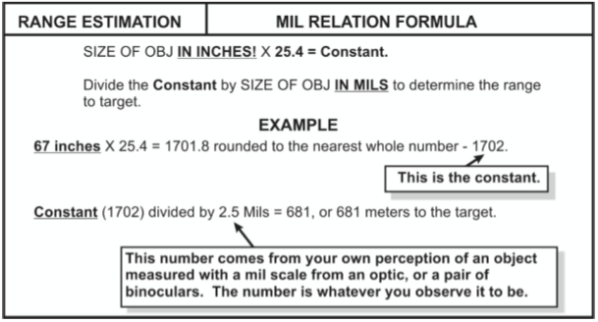
RETICLE RELATIONSHIP (MIL OR MOA).
Notes:
The deliberate methods afford the shooter a reliable means of determining the range to a given target; however, these methods require additional time.

Slide 14
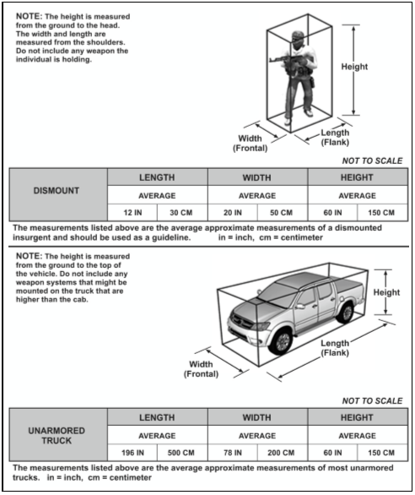
Recognition Method
Notes:
Reticle Relationship Method
With this method, shooters use their aiming device’s reticle to determine the range to target based on standard target information. To use the appearance of objects method based on how they align to an aiming device’s reticle, shooters must be familiar with the sizes and details of personnel and equipment at known distances as shown in figure C-2.

Slide 15
Recognition Method

Slide 16
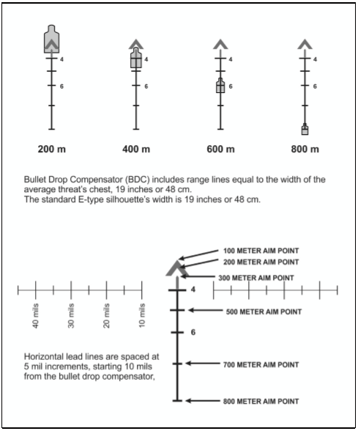
Bracketing Method
Notes:
Knowing the standard dimensions to potential targets allows for the Soldier to assess those dimensions using the aiming device’s reticle. The Soldier will apply the mil or MOA relationship as they pertain to the aiming device and the target. Figure C-3 and figure C-4 on page C-5, show various reticle relationship examples.

Slide 17
Bracketing Method

Slide 18
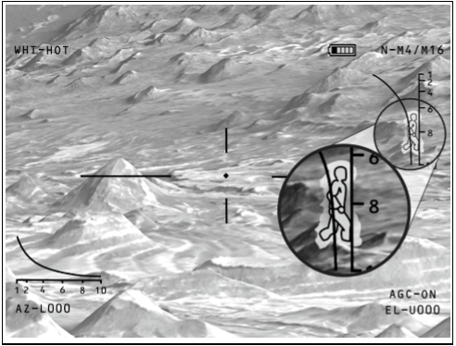
Recognition Method

Slide 19
Moving Targets
Immediate Lead

Slide 20
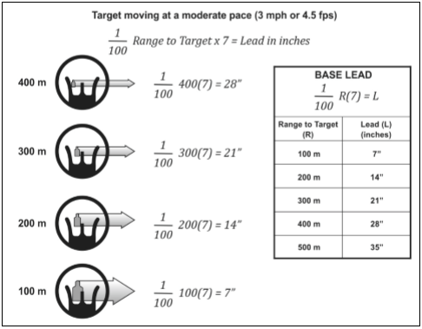
Moving Targets
Deliberate Lead Formula

Slide 21
Oblique Targets

Slide 22
Environmental Conditions
Notes:
The time the projectile is exposed to the wind (range).
The direction from which the wind is blowing.
The velocity of the wind on the projectile during flight.

Slide 23
Environmental Conditions
Notes:
The time the projectile is exposed to the wind (range).
The direction from which the wind is blowing.
The velocity of the wind on the projectile during flight.

Slide 24
Wind Indicators
0 to 3 mph = Hardly felt, but smoke drifts
3 to 5 mph = Felt lightly on the face
5 to 8 mph = Keeps leaves in constant movement
8 to 12 mph = Raises dust and loose paper
12 to 15 mph = Causes small trees to sway.

Slide 25
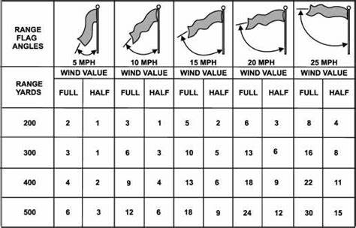

Slide 26
Immediate Wind Hold

Slide 27
Deliberate Wind Hold

Slide 28
Angled Firing

Slide 29
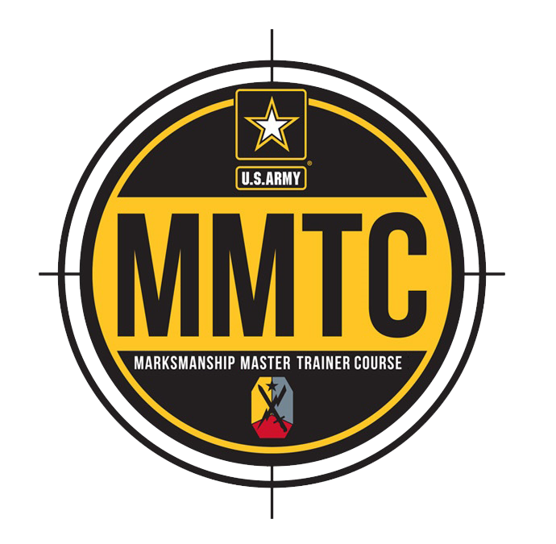
QUESTIONS?

