Slide 1
Identification and wear of the
Army Uniform
805-BT805065

Slide 2
Identification and Wear of
Army Uniform
Purpose and history of the military uniforms
The Army Combat Uniform (ACU)
  Occasions for wear
  Restrictions on wear
805-BT805065

Slide 3
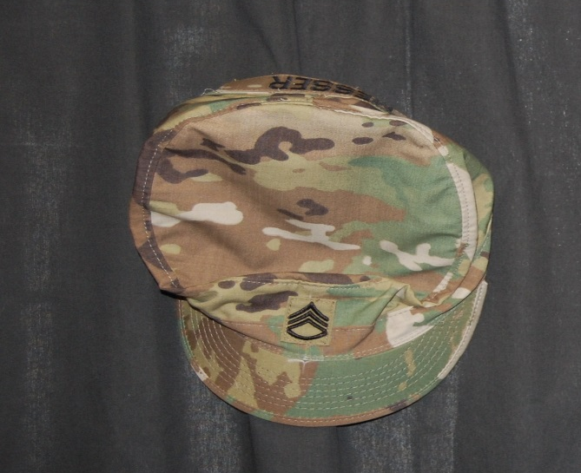

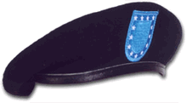
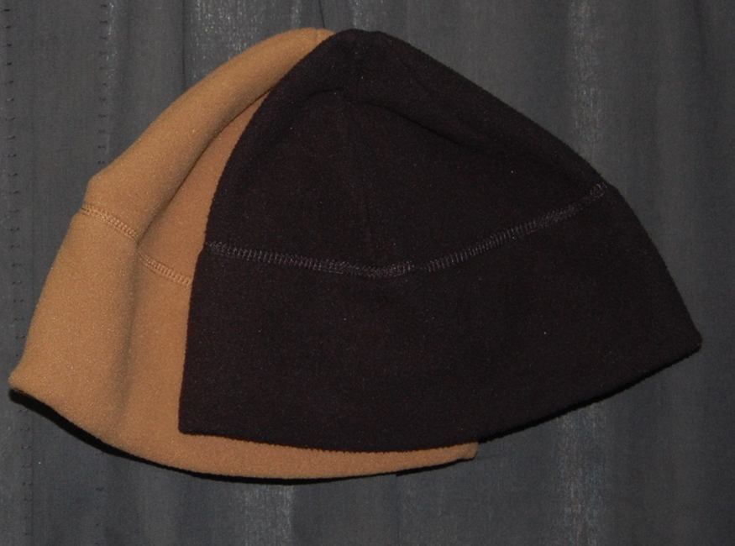
Army Combat Uniform
Head Gear
Patrol Cap
Fleece Cap
805-BT805065

Slide 4
Army Combat Uniform
COAT, ACU TOP
  Coat Description
  Wearing Guidelines
TROUSERS, ACU BOTTOM
  Trouser Description
  Wearing Guidelines
805-BT805065

Slide 5
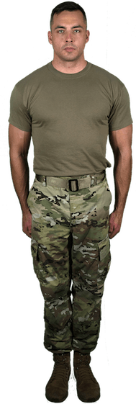
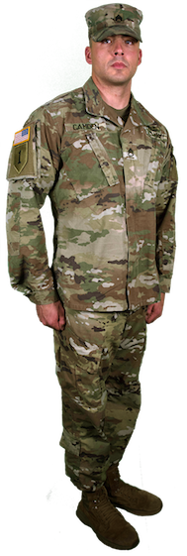
Army Combat Uniform

Slide 6
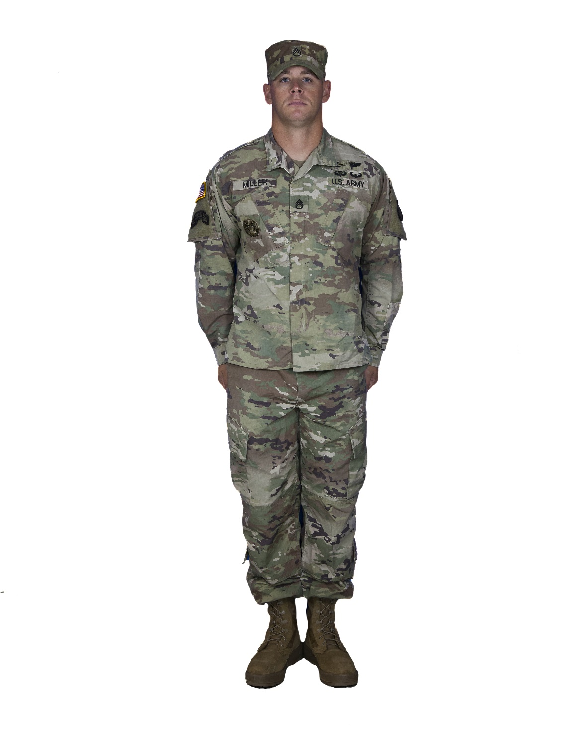
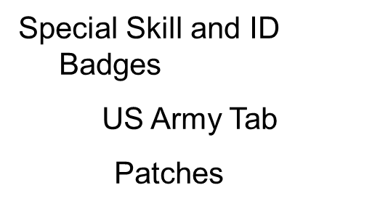

Army Combat Uniform
Name Tab
US Flag Insignia
Former Wartime Insignia Patch
Rank Insignia
805-BT805065

Slide 7
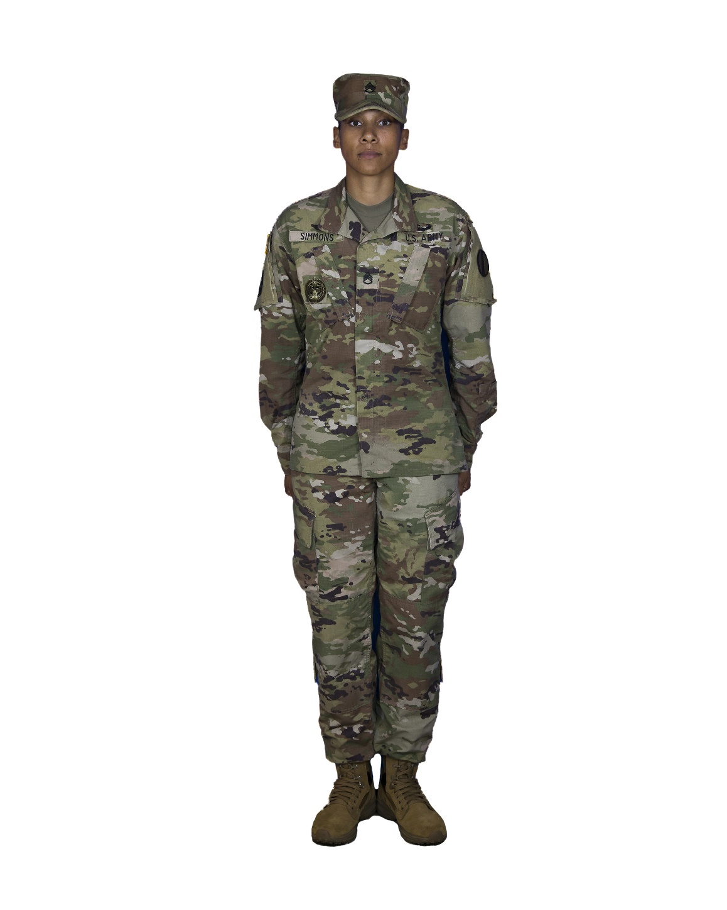
Army Combat Uniform
Name Tab
US Flag Insignia
Former Wartime Insignia Patch
Rank Insignia
805-BT805065

Slide 8
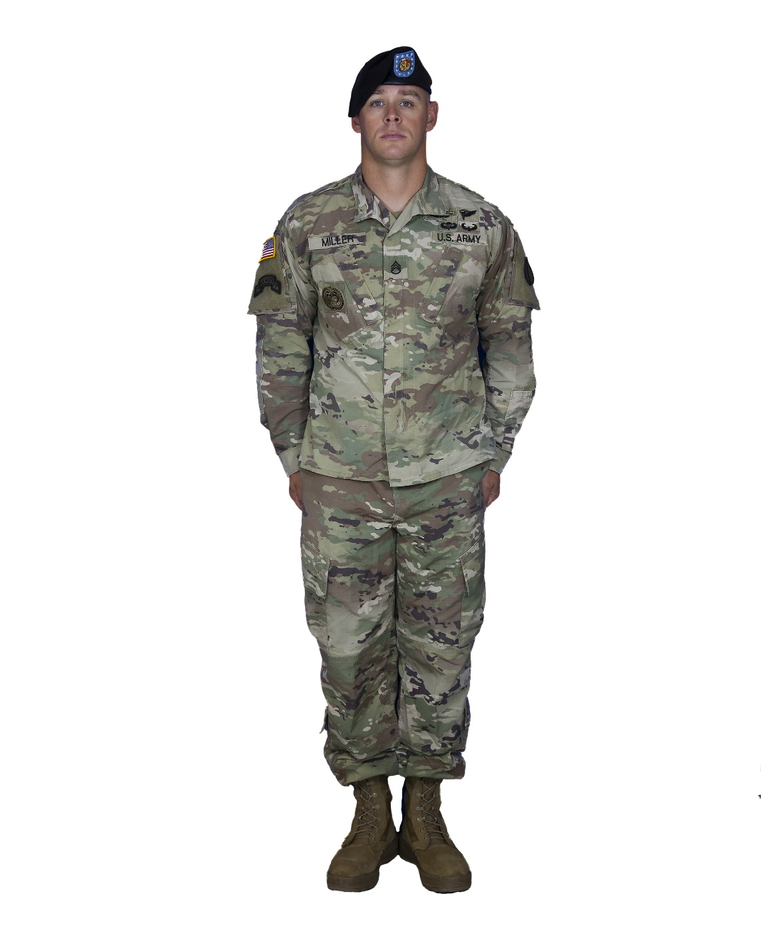
Army Combat Uniform
Name Tab
US Flag Insignia
Former Wartime Insignia Patch
Rank Insignia
805-BT805065

Slide 9
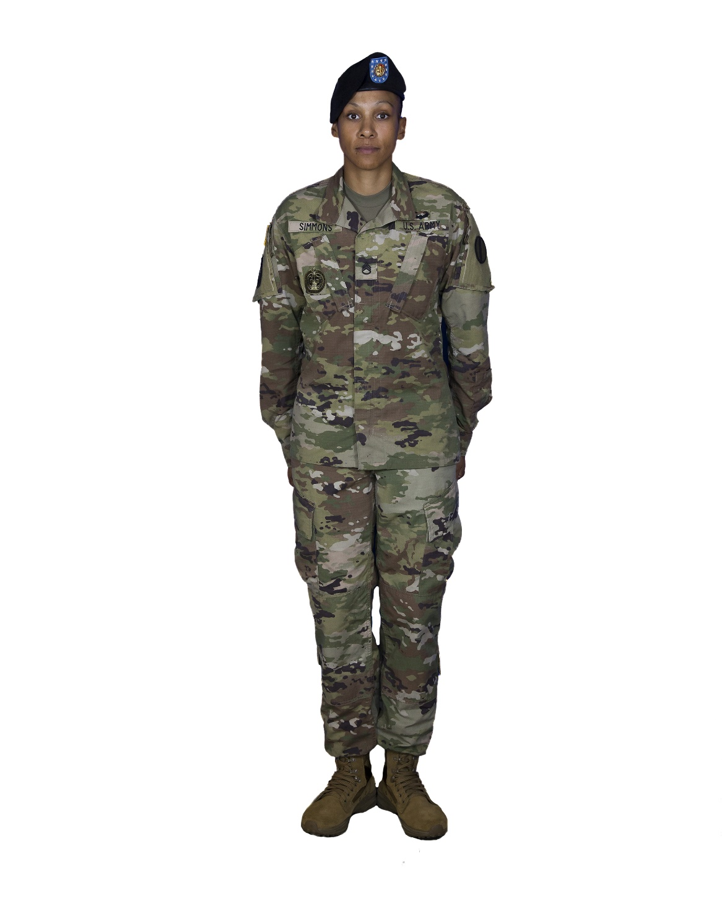
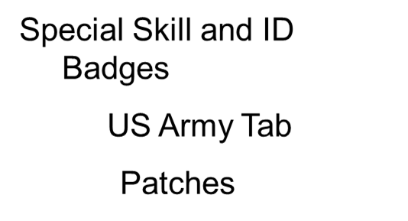
Army Combat Uniform
Name Tab
US Flag Insignia
Former Wartime Insignia Patch
Rank Insignia
805-BT805065

Slide 10
Army Combat Uniform
(CONT)
ACU Composition
Accessories
805-BT805065

Slide 11
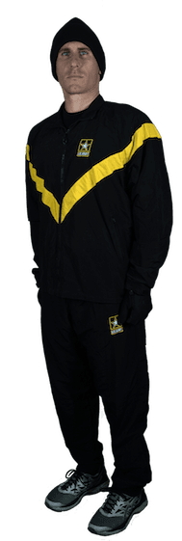
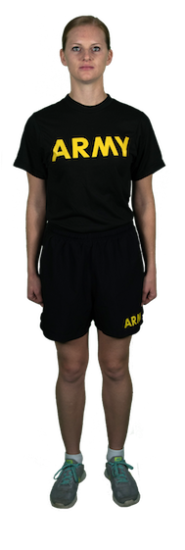
Physical Fitness Uniform
805-BT805065

Slide 12
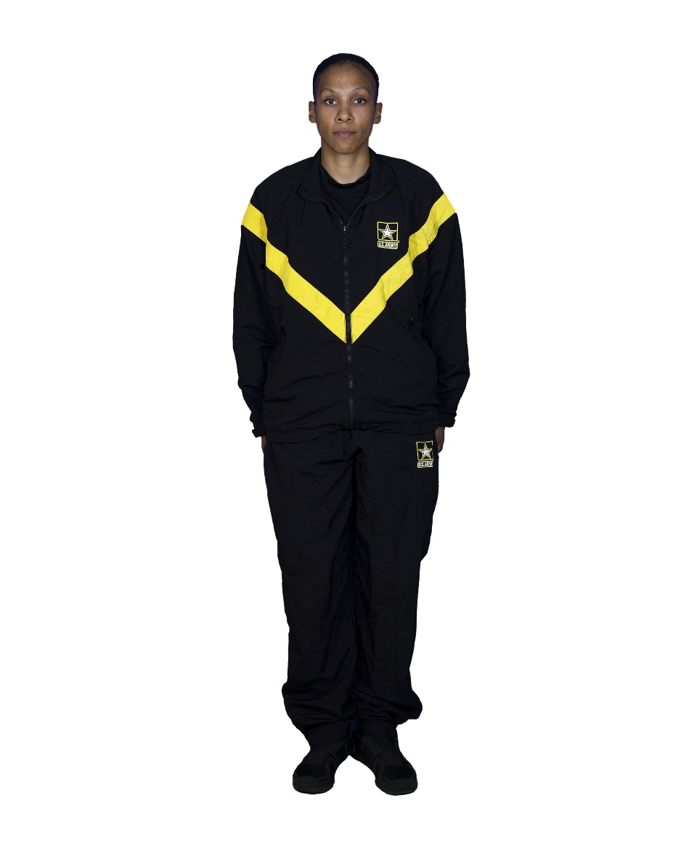
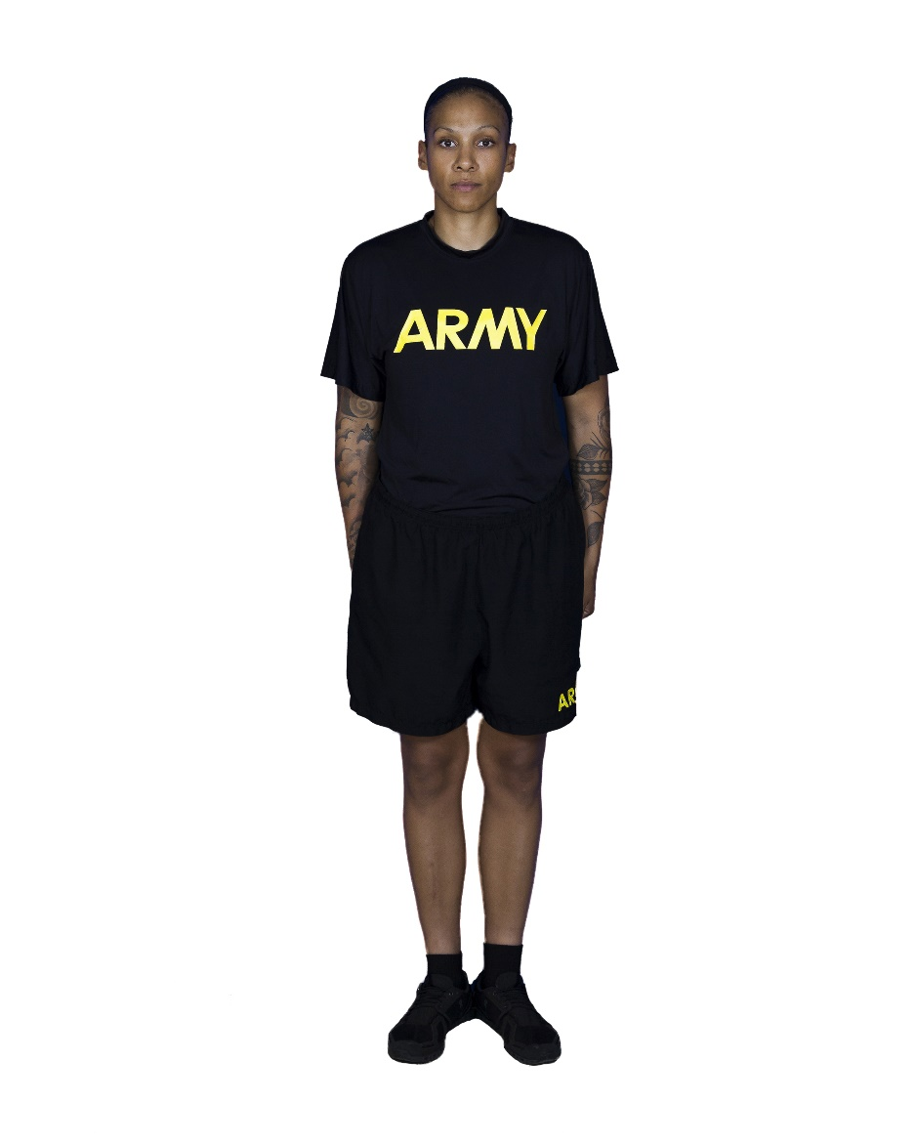
Physical Fitness Uniform
805-BT805065

Slide 13
Dress Uniforms
Male
Army Green Service Uniform
  Occasions for Wear
  Coat
  Slacks
  Skirt (optional for females)
  Necktie
  Undergarments
805-BT805065

Slide 14
Dress Uniforms (Cont)
  Belt
  Headgear
  Footwear
  Socks
805-BT805065

Slide 15
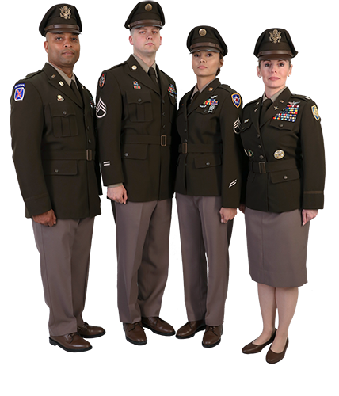
Army Green Service
Uniforms
805-BT805065

Slide 16
IDENTIFICATIONS AND WEAR OF MILITARY UNIFORM
Clothing Maintenance Allowance
Care and Maintenance of Army Uniforms
805-BT805065

