Slide 1
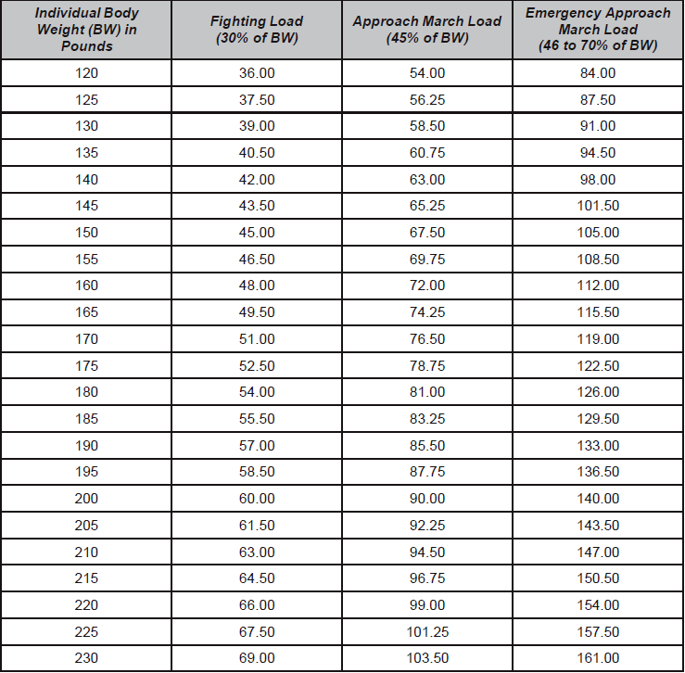
Ruck March Criteria
 | Distance | Speed
Foot March 1 | 2 Miles | 3-5km/hr
Foot March 2 | 5 Miles | 3-5km/hr
Foot March 3 | 7.5 Miles | 3-5km/hr
Foot March 4 | 10 Miles | 3-5km/hr
Per TRADOC 350-6
Weight standards are non-gender specific.
Table 3-4. Body weight percentage for combat loads. from ATP 3-21x18 April 2017

