Slide 1

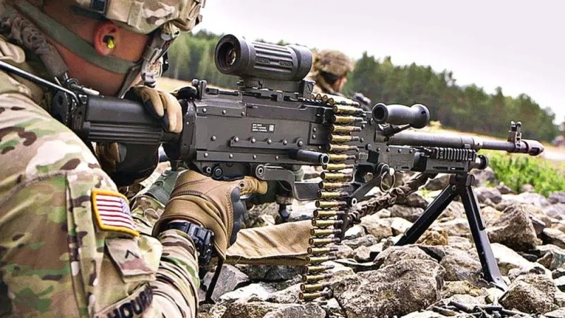
Employ Machine Guns
071-NRRAC104
Developed by:​
Maneuver COE, DOTD, TEDD​
for Infantryman ALC
Last Revised: 1 MAY 2023

Slide 2
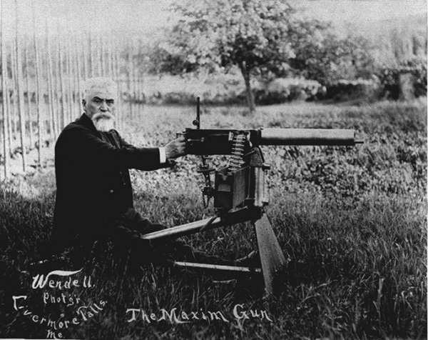
“IF ANY SINGLE EVENT CAN BE SAID TO HAVE TRANSFORMED THE HISTORY OF WARFARE, IT WAS THE PERFECTION OF THE TRUE AUTOMATIC MACHINE-GUN BY HIRAM MAXIM IN 1885.
“OF ALL THE HIDEOUS WEAPONS OF WAR PRODUCED IN THE TWENTIETH CENTURY, NONE HAS EXTRACTED A MORE DREADFUL TOLL OF HUMAN LIFE THAN THE MACHINE GUN”.

Slide 3
Terminal Learning Objective
ACTION: Employ Platoon and Company weapon systems.
CONDITIONS: As a small unit leader in a classroom
environment, given a block of instruction, ATP 3-21.8, TC-3-22.19, TC 3-22.50, TC 3-22.240, TC 3-22.249 and a
requirement to participate in classroom discussion.
STANDARD: Students must score at least 70% (14 of 20) on the Machine Gun written assessment. Students will have to demonstrate their ability to employ machine guns during the machine gun range (SBF) and STX.

Slide 4
Administration
Safety
Risk Assessment
Environmental
Evaluation

Slide 5
Machine Gun Facts
WW1
  KIA 9 million
  WIA 12.5 million
  Total approx 22 million casualties
  25% = 5.5 million
BATTLE OF THE SOMME (01 JUL 1916)
  Commonwealth KIA 19, 000
  Commonwealth WIA 38, 000
  British III Corps lost 80%
SOMALIA 1993 AAR
Battle of Somme: Many troops were killed or wounded the moment they stepped out of the front lines into No Man's Land. Many men walked slowly towards the German lines, laden down with supplies, expecting little or no opposition. They made for incredulously easy targets for the German machine-gunners.

Slide 6
Enabling Learning Objective A
Action: Identify the characteristics and capabilities of
Platoon and Company weapon systems.
Conditions: As a small unit leader in a classroom
environment, given a block of instruction, ATP 3-21.8, TC 3-22.19, TC 3-22.50, TC 3-22.240, TC 3-22.249 and a
requirement to participate in classroom discussion.
Standards: Identify the characteristics and capabilities of
Platoon and Company weapon systems.

Slide 7
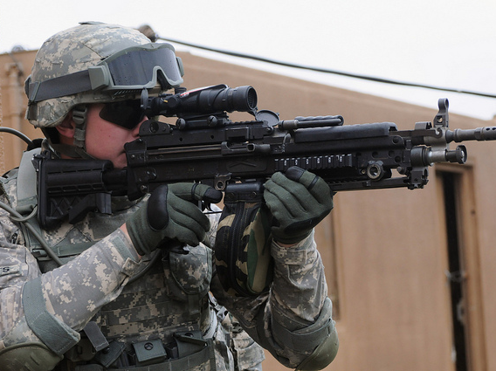
M249 Squad Automatic Weapon
Notes:
TC 3-22.249
The M249 is a gas-operated, belt or magazine-fed, air-cooled, fully automatic weapon that fires from the open-bolt position.
The M249 has a maximum rate of fire of 850 rounds per minute.
Primarily, ammunition feeds into the weapon from a 200-round ammunition box containing a disintegrating, metallic split-link belt.
As an emergency means of feeding, the M249 can use an M16-series rifle or an M4-series carbine magazine, but doing so increases the chances of malfunctions.
The gunner can fire the M249 from the shoulder, with a bipod or tripod, or on a machine gun mount.
The weapon system has a standardized mounting surface for various optics, pointers, illuminators, and equipment to secure items with common mounting and adjustment hardware.
ATP 3-21.8, App F, Pg F-3
The M249 light machine gun is organic to the Infantry platoon and squads.
It provides rifle squads with a light automatic weapon for employment during assault.
The M249 also can be used in the medium machine gun role in defensive missions or support-by-fire position.
The M249 fires from the bipod, the shoulder, the hip, or from the underarm position.
The hip and underarm positions normally are used for close-in fire during an assault when the M249 gunner is on the move and does not have time to set the gun in the bipod position. It is best used when a high rate of fire is needed immediately.
Accuracy of fire is decreased when firing from either the hip or shoulder.

Slide 8
M249 Capabilities
Caliber: 5.56mm
Maximum Range: 3600m
Maximum Effective Range:
Bipod/Point Targets: 600m
Bipod/Area Targets: 800m
Tripod/Area Targets:1000m
Grazing Fire: 600m
Tracer Burnout: 900m
Rates of Fire:
SUSTAINED:
50 rounds per minute, Fired in 6- to 9-round bursts, 4-5 seconds between bursts (barrel change every 10 minutes).
RAPID:
100 rounds per minute, Fired in 6- to 9-round bursts, 2-3 seconds between bursts (barrel change every two minutes).
CYCLIC: 850 rounds per minute,
Continuous burst (barrel change every minute).
Notes:
ATP 3-21.8, Appendix F, Table F-1, Machine gun specifications
Maximum Effective Ranges
Bipod/point: 600 m
Bipod/area: 800 m
Tripod/area: 1,000 m
Grazing: 600 m
Maximum Range: 3600 m
TC 3-22.249, Chapter 8, Pg 8-4 thru 8-5
RATE OF FIRE
8-17. The shooter must determine how to engage the threat with the weapon on the current burst as well as subsequent bursts.
Following the direction of the team leader, the Soldier controls the rate of fire to deliver consistent, lethal, and precise fires against the threat.
SUSTAINED FIRE
8-18. Sustained fire is moderately paced at the discretion of the Soldier.
Typically, Soldiers use sustained fire in a training environment or a secure defensive position.
Sustained fire is approximately 50 rounds per minute in 6 to 9-round bursts with 4 to 5 seconds between bursts including a barrel change after 10 minutes of sustained firing.
Sustained firing is the Soldier’s normal rate of fire and allows the most time to focus on the functional elements in the shot process. Sustained fire reinforces all previous training.
RAPID FIRE
8-19. Rapid fire is approximately 100 rounds per minute, fired in 6- to 9-round bursts with 2 to 3 seconds between bursts, including a barrel change every 2 minutes.
Typically, Soldiers use rapid fire for multiple targets or combat scenarios where they do not have overmatch of the threat.
Soldiers should be well-trained in all aspects of sustained firing before attempting any rapid-fire training.
8-20. Soldiers who display a lack of knowledge of employment skills should not advance to rapid fire training until these skills are learned and mastered.
CYCLIC FIRE
8-21. Cyclic is approximately 850 rounds per minute, fired in continuous bursts, with a barrel change every minute.
Soldiers use cyclic fire to apply suppressive fires with accuracy and when the need for precise fires, although desired, is not as important.
Automatic or burst fires drastically decrease the probability of a hit due to the rapid succession of recoil impulses and the inability of the Soldier to maintain proper sight alignment and sight picture on the target.
8-22. Soldiers should be well-trained in all aspects of sustained firing before attempting any cyclic training.

Slide 9
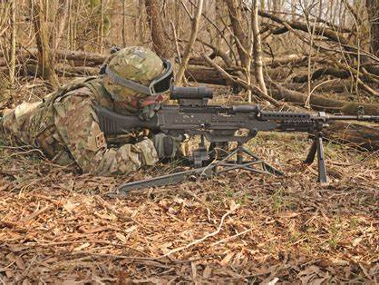
M240 Machinegun
Notes:
TC 3-22.240, Chapter 2, Pg 2-1
The M240 is a gas-operated, belt-fed, air-cooled, fully automatic weapon that fires from the open-bolt position.
The weapon system has a standardized mounting surface for various optics, pointers, illuminators, and equipment, to secure those items with common mounting and adjustment hardware.
ATP 3-21.8, App F, Pg F-5
Two medium machine guns and crews are found in the weapons squad. (See figure F-2.)
The M240B can be fired in the assault mode in emergencies, but normally is fired from the bipod or tripod platform. It also can be vehicle mounted.
The platoon leader (through his weapons squad leader ) employs his M240B medium machine guns with a rifle squad to provide long range, accurate, sustained fires against dismounted Infantry,
apertures in fortifications, buildings, and lightly-armored vehicles.
The M240B also provides a high volume of short-range fire in self-defense against aircraft.
Machine gunners use point, traversing, searching, or searching and traversing fire to kill or suppress targets.

Slide 10
M240 Capabilities
Caliber: 7.62mm
Maximum Range: 3,725m
Area Targets (tripod): 1800m
Point Targets (tripod): 800m
Tracer Burnout: 900 m
Grazing Fire: 600m
Rates of Fire:
Sustained: 100 RPM in 6-9 round bursts. Change Barrell every 10 minutes.
Rapid: 200 RPM in 10-12 round bursts. Change Barrell every 2 minutes.
Cyclic: 650-950 RPM continuous burst.
Notes:
TC 3-22.240, Chapter 2, Pg 2-3
Table 2-1
MEDIUM MACHINE GUN WEIGHT
M240/M240C 10.34 kilograms/22.8 pounds
M240B 12.29 kilograms/27.1 pounds
M240D 10.39 kilograms/22.9 pounds
M240E1 11.66 kilograms/25.7 pounds
M240H 11.70 kilograms/25.8 pounds
M240L 10.12 kilograms/22.3 pounds
M240N 10.93 Kilograms/24.1 pounds
RATE OF FIRE ROUNDS PER MINUTE
Sustained 100 rounds per minute (four to five seconds between bursts). Change barrel every 10 minutes.
Rapid 200 rounds per minute (two to three seconds between bursts). Change barrel every two minutes.
Cyclic 650 to 950 rounds per minute. Not intended to fire at 950 rounds per minute. This will cause accelerated wear/damage to the barrel and rest of weapon.
550 to 650 rounds per minute – M240B/M240L/M240N with hydraulic buffer.
RANGE METERS
Maximum range 3725 meters.
Maximum effective area 1800 meters with M122A1 tripod or M192 tripod (M240B/M240L).
Maximum effective point 800 meters M122A1 tripod or M192 tripod
(M240B/M240L).
Tracer burnout Approximately 900 meters.

Slide 11
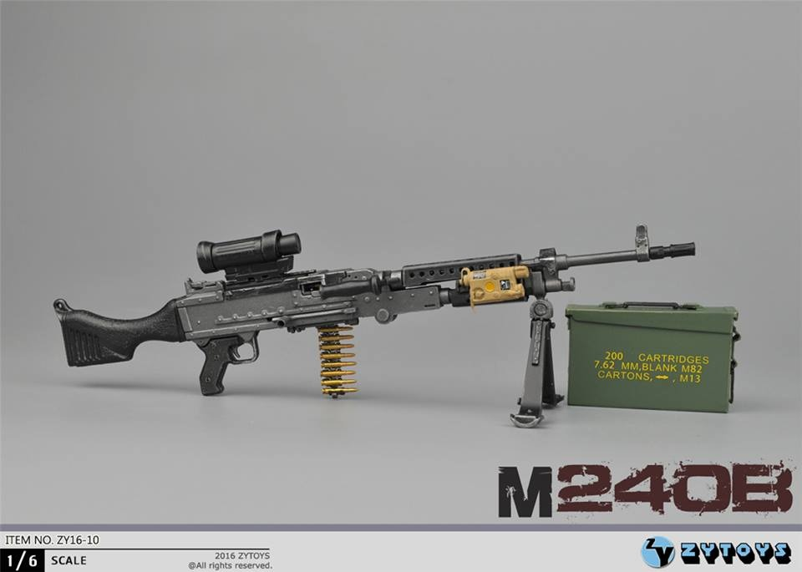
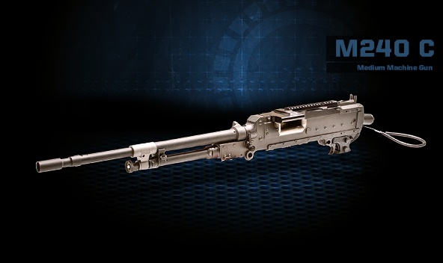
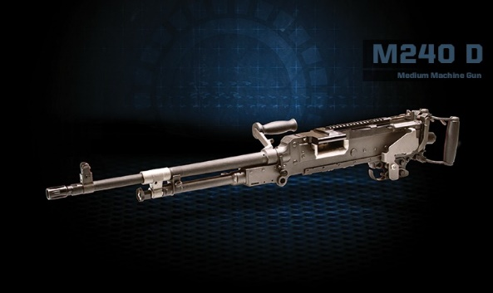
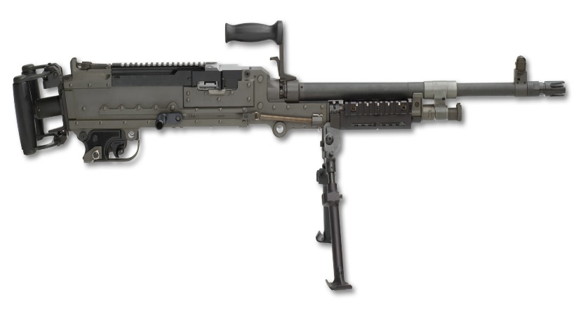
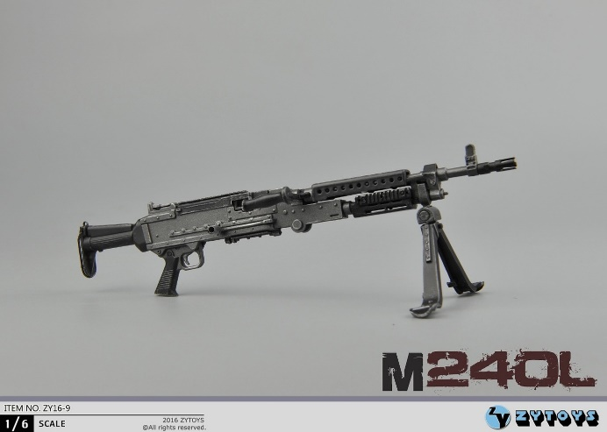
M240 Variations
M240H
Notes:
TC 3-22.240, Chapter 2, Pg 2-3 thru 2-6.
MODELS
2-7. The theory of operations for all M240-series MMGs is relatively the same, but there are some slight differences between each model. All M240-series MMGs (see figures 2-2a and 2-2b on pages 2-4 and 2-5) have the following properties:
- All models recoil with gas-assist boost. Three gas settings help maintain a consistent rate of fire(with the exception of M240B/M240H).
- The firing pin is part of bolt and operating rod assembly and cannot strike the primer until the bolt is fully locked.
- Fires from open bolt position prevent the explosion of a cartridge (cook-off) after prolonged firing.
MOUNTED ON A COAXIAL MOUNT (M240/M240C)
2-8. The M240/M240C model is designed as a coaxial machine gun for tanks and 7.62-mm fire power on light armored vehicles. It has the following properties:
- Fires parallel to turret main gun.
- No sights on barrel.
- Can be fired manually or electrically.
- Fired manually from turret ring mount (M240 with optical top cover).
GROUND-MOUNTED (M240B/M240L)
2-9. The M240B/M240L model is designed as a tripod-mounted or bipod-supported MMG for use by ground forces and has the following properties:
- Mounted on tripod (M122A1/M192).
- Ground supported with integral bipod assembly.
- Has front and rear sights on machine gun and barrel.
- Optical accessory top cover and forward rail system.
MOUNTED ON EXTERIOR PINTLE LOCATION (M240D/M240H) (AVIATION) AND (M240E1)
2-10. M240D/M240H is designed as a pintle-mounted window or door gun for use in rotary aircraft. The M240E1 is designed with front and rear sights and a spade-grip trigger device and is pintle-mounted on light armored vehicles. The MMGs have the following properties:
Mounted in pintle socket.
- Front and rear sights on machine gun.
- Optical accessory top cover.
- Forward rail system (M240H).
MOUNTED ON SPECIAL PURPOSE MOUNTS (M240N)
2-11. The M240N is designed with front and rear sights and is configured for mounting on watercraft. It has the following properties:
- Authorized use of right-hand feed cover assembly, and tray as authorized additional list (AAL) to primary configuration.
- Front and rear sights on machine gun and barrel.
- Primary U.S. Navy small boat gun.
- Optical accessory top cover.

Slide 12
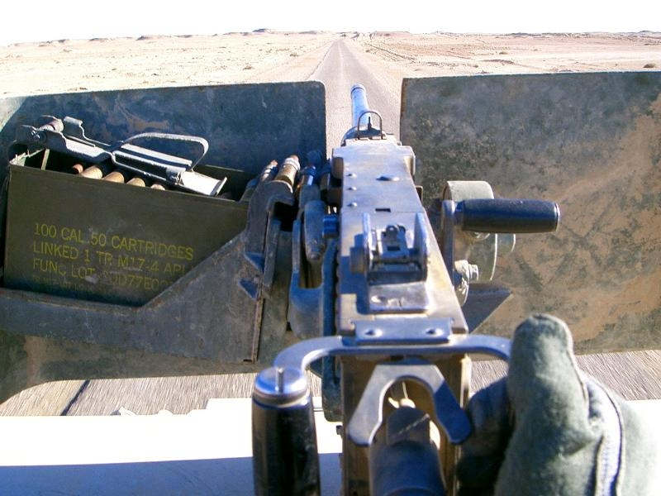
M2 Browning
Notes:
TC 3-22.50, Chapter 2, Pg 2-1
DESCRIPTION
2-1. The M2 (flexible) is a belt-fed, recoil-operated, air-cooled, crew-served machine gun.
It provides automatic suppressive fire for offensive and defensive purposes.
It can be used effectively against personnel, light armored vehicles, and low/slow flying aircraft.
It can fire single shot and automatic, left- or right-hand feed.
It can be ground mounted on the M3 tripod or the newer M205 lightweight tripod.
The MK 93 Mod 0 and Mod 1 mounts can also be incorporated for use with the tripods.
2-2. The M2A1 has fixed headspace and timing.
M2A1 parts should never be installed on the M2 at operator level.
Also, the barrel extension assembly and bolt have been serialized and are unique to one particular weapon that shares the last four digits of the serial number on the receiver.
If a new barrel extension or bolt is required, the headspace and timing must be adjusted
ATP 3-21.8, App F, Pg F-8
The M2 .50-caliber heavy machine gun is not organic to the Infantry platoon or squad, but as there are many times when Infantry Soldiers use it, it is described in this
appendix
F-14. The M2A1 .50-caliber machine gun with Quick Change Barrel is an enhancement to the M2 .50-caliber machine gun offering Soldiers increased performance as well as
new features and design improvements that make it easier and safer to use.
The M2A1 provides a fixed headspace and timing configuration, flash hider, and removable carrying handle, which increase the performance of the battle-proven M2.
The M2A1 speeds target engagement and improves survivability and safety by reducing the time required to change the barrel and eliminating the timely procedure of setting headspace.
The flash hider reduces muzzle flash by 95 percent, making the M2A1 less detectable in limited visibility.

Slide 13
M2 Capabilities
Rates of Fire:
Single Shot: 12-15 RPM
Sustained: 40 RPM in 6-9 round burst, fired 10-15 second intervals
Rapid: 40 RPM in 6-9 round bursts, fired 5-10 second intervals
Cyclic: 450-600 RPM
Caliber: .50 Cal.
Ammunition: Ball/Tracer AP/Inced. (API)/APIT
Maximum Range: 7400m
Maximum Effective Range:1829m
Tracer Burnout: 1800m
Grazing Fire: 700m
Notes:
TC 3-22.50, Chapter 8, Pg 8-3 thru 8-4
The gunner must determine HOW to engage the threat with the weapon, on the current shot or burst as well as subsequent shots or bursts.
Following the direction of the leader, the Soldier controls the rate of fire to deliver consistent, lethal, and precise fires against the threat.
M2 and M2A1 weapon Data
Weight of gun (approximate) .................................84 pounds (38.10 kilograms)
Weight of barrel .....................................................26 pounds (11.79 kilograms)
Length of gun (M2A1) ............................................67 inches (172.10 centimeters)
Length of gun.........................................................65 inches (165.43 centimeters)
Length of barrel with flash suppressor (M2A1) ......47 inches (119.38 centimeters)
Length of barrel .....................................................45 inches (114.30 centimeters)
Length of rifling (approximate) ...............................41.88 inches (106.38 centimeters)
Number of lands and grooves................................Eight
Twist, right hand ....................................................One turn in 15 inches (38.10 centimeters)
Feed ......................................................................Link belt
Operation...............................................................Recoil
Cooling ..................................................................Air
Muzzle velocity (approximate) ...............................3,050 feet per second (929.64 meters per second)
Maximum range (approximate)..............................7,400 yards (6,767 meters)
Maximum effective range (approximate) ...............2,000 yards (1,829 meters)
Head space (M2) ...................................................Manually set and checked
Head space (M2A1)...............................................Fixed
Machine Gun Rate of Fire Frequency of Barrel Change
Rounds per minute Burst Interval
M2/M2A1
Single Shot 12-15 RPMs
Sustained: < 40 6 – 9 Rounds 10 – 15 Seconds End of the firing day / barrel damaged
Rapid: > 40 6 – 9 Rounds 5 – 10 Seconds One hour / barrel damaged
Cyclic: 450 – 600 Continuous Continuous 200 rounds / barrel damaged
Grazing Fire: 700 meters

Slide 14
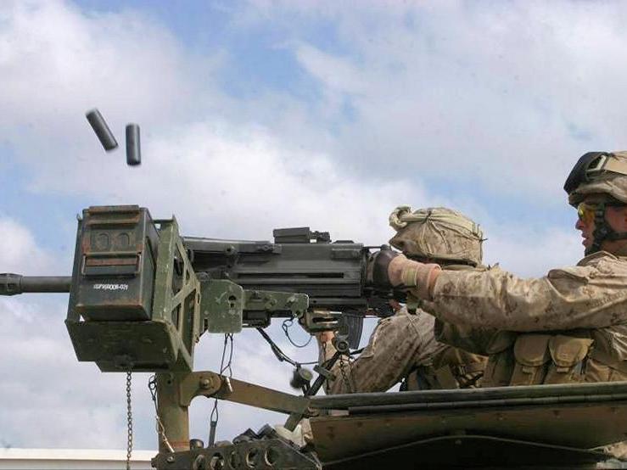
MK 19 Automatic Grenade
Launcher
Notes:
DESCRIPTION
TC 3-22.19, Chapter 2, Pg 2-1
2-1. The MK 19 is an air-cooled, blowback-operated machine gun with six major assemblies.
A disintegrating metallic link belt feeds ammunition from the left.
The MK 19 provides automatic weapon suppressive fire for offensive and defensive purposes.
The MK 19 can be used effectively against personnel, light armored vehicles, and hovering rotary aircraft.
The weapon system is used as a ground gun mounted on the M3 tripod or the M205 lightweight tripod.
ATP 3-21.8, App F, Pg F-6
The MK19 is not organic to the weapons company, not the Infantry platoon or squad, but because there are many times when Infantry Soldiers use it, it is described in
this appendix.
The MK19 supports the Soldier in both the offense and defense.
It gives the unit the capability of laying down a heavy volume of close, accurate, and continuous fire.

Slide 15
MK19 Capabilities
Caliber: 40mm
Maximum Range: 2212m
Maximum Effective Range:
1500m (Point)
2212m (Area)
Weight (Gun, barrel and tripod): 140.6 Lbs.
Ammunition HEDP: 15m Casualty Radius
Rates of Fire:
Sustained: 40 RPM, in bursts of 6-9 rds, fired at 10-15 second intervals
Rapid: 60 RPM, in bursts of 6-9 rds, fired at 8-10 second intervals
Cyclic: 325-375 RPM
Notes:
TC 3-22.19, Pg 1-10, Para 1-27
PRECISION
1-27. The MK 19 is designed with a specific level of accuracy out to its maximum effective range of 1500 meters point target and 2212 meters area target. This level of accuracy is more consistent and reliable with
magnified aiming devices and superior ammunition. The Soldier must build the skills to use the magnified aiming devices to effectively deliver precision fires during tactical engagements.
TC 3-22.19, Chapter 8, Pg 8-6
RATE OF FIRE
8-18. The gunner must determine how to engage the threat with the weapon, on the current shot as well as subsequent shots. Following the direction of the leader, the Soldier controls the rate of fire to deliver
consistent, lethal, and precise fires against the threat.
SUSTAINED FIRE
8-19. Sustained rate of fire consists of less than 40 rounds per minute, in bursts of six to nine rounds, fired at 10- to 15-second intervals, which equals out to 4 ½ bursts every minute. Sustained fire is used when the
enemy is suppressed and maintains fire superiority. Soldiers should be well-trained in all aspects of sustained rate of fire before attempting any rapid-fire training.
RAPID FIRE
8-20. Rapid rate of fire consists of less than 60 rounds per minute, in bursts of six to nine rounds, fired at 8-to 10-second intervals, which equals about 6 ½ bursts per minute. Once the enemy has been suppressed,
machine gunners fire at the sustained rate of fire. Sustained rate of fire conserves ammunition and requires only infrequent barrel changes, but it might not be enough volume of fire to effectively suppress or destroy.
8-21. Rapid fire places an exceptionally high volume of fire on an enemy position. MK 19 gunners normally engage targets at the rapid rate to suppress the enemy quickly. Rapid fire requires much more ammunition
than a sustained rate of fire. Rapid fire is when the Soldier is required to provide suppressive fires with accuracy, and the need for precise fires, although desired, is not as important. Rapid fire drastically decreases
the probability of hits due to the rapid succession of recoil impulses and the Soldier’s inability to maintain proper sight alignment and sight picture on the target.
CYCLIC FIRE
8-22. The cyclic rate of fire represents the maximum amount of ammunition that can be expended by a gun without a break in firing. The cyclic rate of the MK 19 is 325 to 375 rounds per minute.
8-23. Cyclic rate of fire is for emergency use only. Cyclic rate of fire uses ammunition very quickly and also can overheat the weapon system to the point of taking the weapon out of action to allow it to cool down.
Cyclic rate of fire should be used only when necessary to gain fire superiority after a surprise attack or ambush. Cyclic rate of fire is the most inaccurate of all rate of fires. It also can cause damage to the system if the weapon is not properly cleaned, cooled down, or lubricated after the engagement.

Slide 16
Enabling Learning Objective B
Action: Identify techniques used to deliver effective
Machine gun fire.
Conditions: As a small unit leader in a classroom
environment, given a block of instruction, ATP 3-21.8, and
a requirement to participate in classroom discussion.
Standards: Identify techniques used to deliver effective
Machine gun fire.

Slide 17
Characteristics of Fire
- Line of Sight is an imaginary line, from the firers’ eye, through the
sights, to the point of aim on the target.
- A burst of fire is a number of successive rounds fired with the same
elevation and point of aim, when the trigger is held to the rear.
- The number of rounds in a burst can vary depending on the rate of
fire employed.
- Factors that affect a burst of fire:
  The gunner and rate of fire.
  The gun and ammunition.
  Clarity of target.
  Air / weather.
  Distance.

Slide 18
Characteristics of Fire Trajectory
- Trajectory is the curved path the round takes during its flight.
The major factors influencing trajectory are the velocity of the round, gravity, rotation of the round, and air resistance.
- As the range to the target increases, so does the curve of trajectory.
m= meter

Slide 19

Characteristics of Fire
Maximum Ordinate
Maximum ordinate is the highest point above the line of sight which a projectile rises during its’ flight.
- It occurs about two-thirds of the distance from the weapon to the target and increases with the range.
m= meter

Slide 20
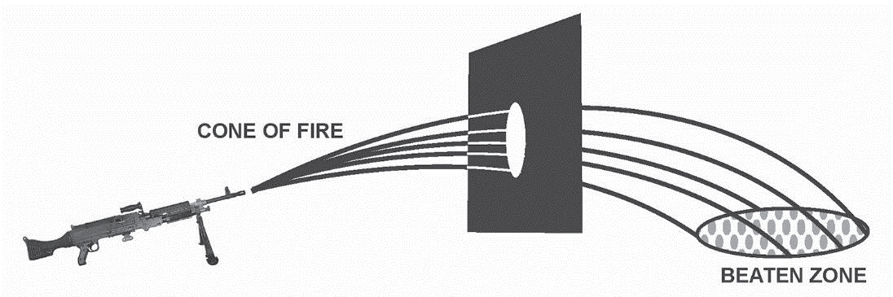
Characteristics of Fire
Cone of Fire
- The pattern made by a group of rounds resulting from a burst of fire is the Cone of Fire.
- The pattern is caused mostly by the vibration of the machine gun and variations in ammunition and atmospheric conditions.

Slide 21
Characteristics of Fire
Beaten Zone
- The Beaten Zone is the elliptical pattern formed on the ground or target by the striking rounds.
- Oval or Cigar shaped.
- Density decreases towards the edges.
- Effective beaten zone = 85% of rounds.

Slide 22
Characteristics of Fire
Range Effects on Beaten Zone
AS RANGE INCREASES…………
M240B
RANGE: 500m 1 X 110 m
RANGE: 1000m 2 X 75 m
RANGE: 1500m 3 X 55 m
RANGE: 2000m 4 X 50 m

Slide 23
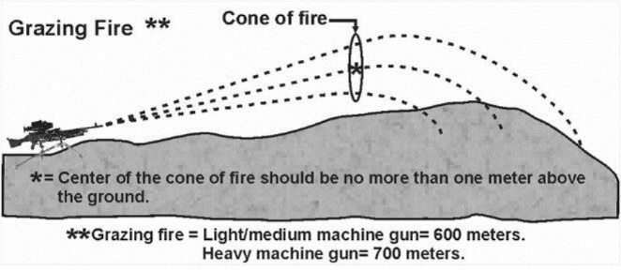
Characteristics of Fire
Danger Space
The Danger Space is between the muzzle of the weapon and the target where the trajectory rises less than 1.8 meters (the average height of a standing Soldier) above the ground, including the beaten zone.
DANGER SPACE
MAX 1.8m

Slide 24
Classes of MG Fire
Respect to the Ground
  Grazing Fire
  Plunging Fire
Respect to the Target
  Frontal Fire
  Flanking Fire
  Oblique Fire
  Enfilade Fire
Respect to the Machine Gun
  Fixed Fire
  Traversing Fire
  Searching Fire
  Traversing and Searching Fire
  Swinging Traverse
  Free Gun Fire

Slide 25
Respect to Ground
Grazing Fire
- Cone of fire rises less than 1 meter above ground.
- On level terrain, grazing fire out to 600 meters.
- Danger space is from the end of the barrel out to the last round in the beaten zone.

Slide 26
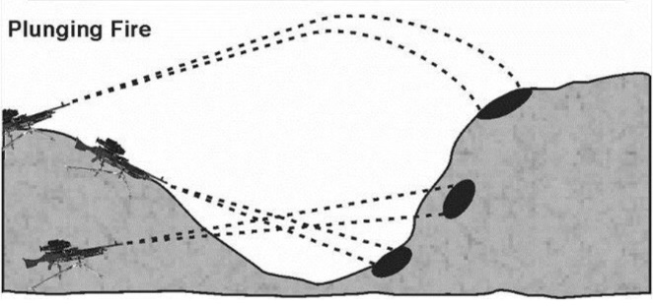
Respect to Ground
- Plunging fire occurs when the danger space is within the beaten zone.
- Results in a loss of grazing fire at any point along the trajectory.

Slide 27
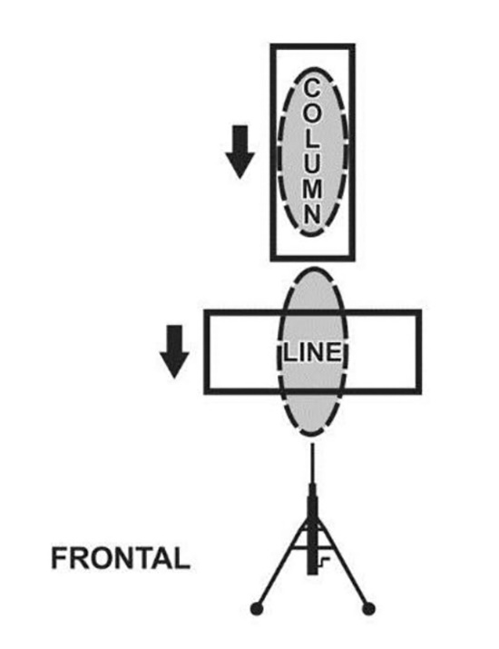
Respect to Target
Frontal fire occurs when the long axis of the beaten zone is at a right angle to the front of the target.

Slide 28
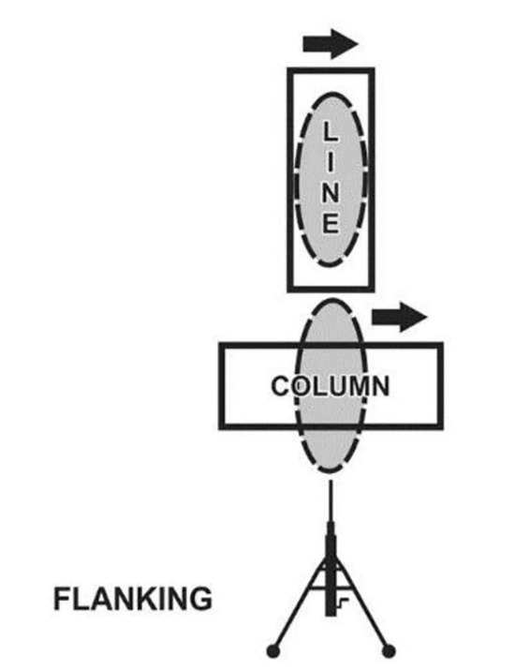
Respect to Target
Flanking fire occurs when the gunner fires at the side of the target.

Slide 29
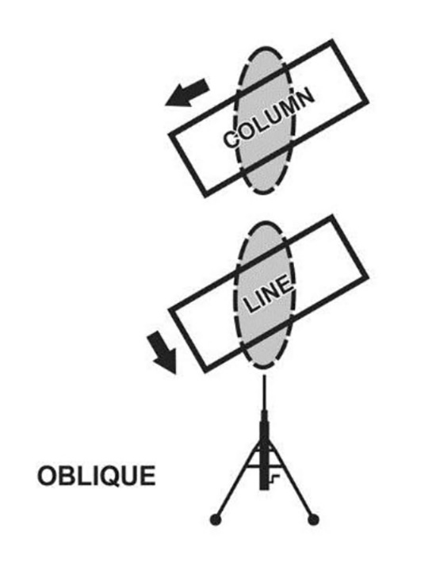
Respect to Target
Oblique fire occurs when the long axis of the beaten zone is at an angle other than a right angle to the front of the target.

Slide 30
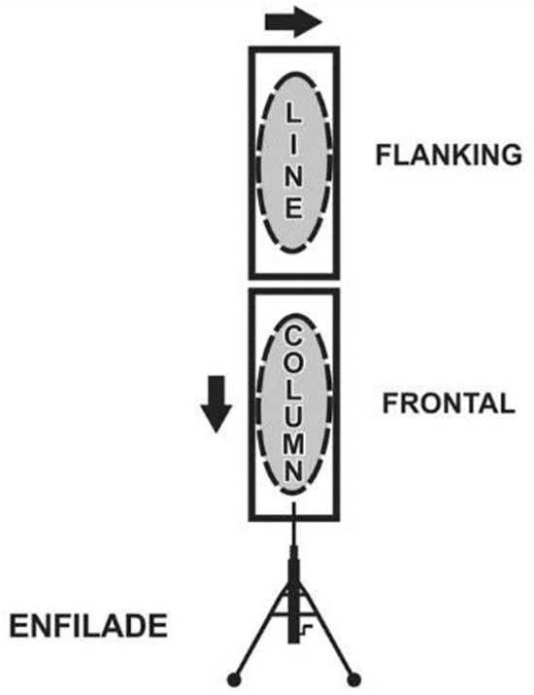
Respect to Target
Enfilade fire occurs when the long axis of the beaten zone coincides or nearly coincides with the long axis of the target.

Slide 31
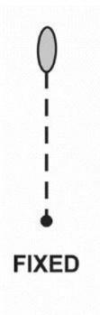
Respect to Weapon
Fixed Fire delivered against a stationary point target when the depth and width of the beaten zone covers the target.

Slide 32
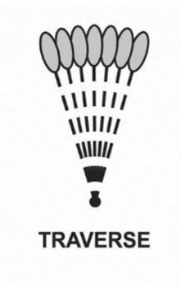
Respect to Weapon
Traversing fire distributes in width by successive changes in direction.

Slide 33

Respect to Weapon
Searching fire is distributed in depth by successive changes in elevation.

Slide 34

Respect to Weapon
Traversing and searching fire is a combination in which successive changes in direction and elevation.

Slide 35
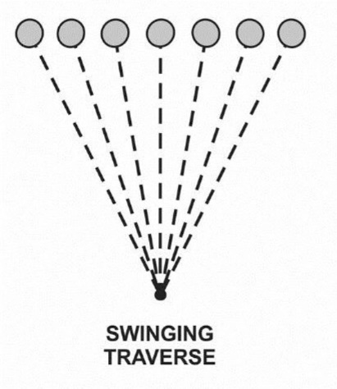
Respect to Weapon
Swinging traverse fire is employed against targets requiring major changes in direction but little or no change in elevation.

Slide 36
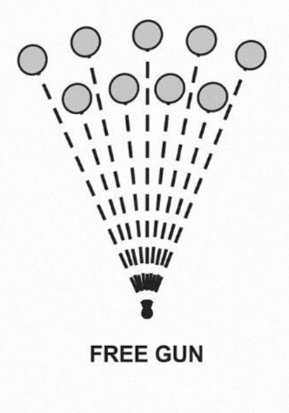
Respect to Weapon
Free-gun fire is delivered against targets requiring major changes in direction and elevation that cannot be applied with the T&E mechanism.

Slide 37
Enabling Learning Objective C
Action: Identify control measures for machine gun fire.
Conditions: As a small unit leader in a classroom
environment, given a block of instruction, ATP 3-21.8, and
a requirement to participate in classroom discussion.
Standards: Identify control measures for machine gun fire.

Slide 38
Control of MG Fire
Types of Targets
Point Targets-Fixed fire.
  Enemy troops, bunkers, weapon emplacements and lightly armored vehicles.
Area Targets-Traversing, Searching, and Swinging Travers.
  Linear Targets-Traversing Fire
  Deep Targets-Searching Fire
  Linear Targets with Depth-Traversing and Searching Fire

Slide 39
Control of MG Fire
Distribution and Concentration of Fire
The size and nature of the target determines how machine gun fire is applied.
Distribute fire in width and depth on large targets.
Concentrate fire on point targets.
  Weapons emplacement
  Enemy fighting positions

Slide 40
Control of MG Fire
Rate of Fire
Sustained Fire-Normal rate of fire for the gunner.
Rapid Fire-Barrel change after 2 minutes allows an exceptionally high volume of fire, but only for short period of time.
Cyclic Fire-uses the most ammunition that can be used in 1 minute.
  Cyclic rate is achieved when the trigger is held to the rear uninterrupted for 1 minute.

Slide 41
Predetermined MG Fire
Predetermined Fire organizes the battlefield for the Platoon and gunner.
Sector of Fire.
Final Protective Fire.
Final Protective Line.
Principal Direction of Fire.
Grazing Fire.
Dead Space.
Primary Sector of Fire.
Secondary Sector of Fire.

Slide 42
Fire Control
Leader initiated methods of Fire Control.
Verbal.
Arm and Hand Signals.
Prearranged Signals.
Personal Contact.
Range Cards.
Standard Operating Procedures.

Slide 43
Fire Control
Gun Team initiated methods of Fire Control
(SOP).
Observation.
Fire.
Check.
Return Fire.
Shift Fire.
Rate of Fire.
Mutual Support.

Slide 44
Fire Control
Fire Commands
Initial Fire Commands.
Subsequent Fire Commands.
Doubtful Elements and Corrections.
Abbreviated Fire Commands.

Slide 45
Fire Control
Initial Fire Commands
Alert-Fire Mission or Gun number one, Fire mission.
Direction-Multiple techniques
  Verbal, pointing finger or weapon, marking with tracers and/or giving reference points.
Description.
Range.
Method of Fire.
Command to Open Fire.

Slide 46
Fire Control
Subsequent Fire Commands:
Leader gives subsequent commands to adjust
direction and elevation, to change current rates
of fire, to interrupt fire or terminate the alert.
Direction and Elevation.
Rate of Fire.
Fire Command.
Termination.

Slide 47
Fire Control
Doubtful Elements and Corrections:
If gunner is in doubt about any element, gunner replies “Say again range, target”.
  Leader repeats command, saying “ THE COMMAND WAS” repeating element in question.
If Leader makes an error, he immediately says “CORRECTION”, gives corrected element.

Slide 48
Fire Control
Abbreviated Fire Commands:
Methods.
  Oral Signals
  Arm and Hand Signals
Commands.
  Ready
  Commence Fire or Change Rate of Fire
  Change Direction or Elevation
  Interruption or Cessation of Fire
  Other Signals

Slide 49
Enabling Learning Objective D
Action: Identify the elements of a machine gun
range card.
Conditions: As a small unit leader in a classroom
environment, given a block of instruction, ATP 3-
21.8, and a requirement to participate in classroom
discussion.
Standards: Identify the elements of a machine gun
range card.

Slide 50
Range Card
Range Card preparation:
Gunner prepares as soon as he occupies and continually revises.
Elements included.
  Weapon symbol
  Sector of Fire
  PDF or FPL
  Range, azimuth, and number to targets
  Dead Space
  Reference point/Location of Gun position
  Magnetic North arrow
  Data section

Slide 51
MG Weapons Symbols
Weapon Type | (Blue) Friend | (Red) Hostile | (Green) Neutral | (Yellow) Unknown
Rifle
Light Machine Gun
Medium Machine Gun
Heavy Machine Gun

Slide 52
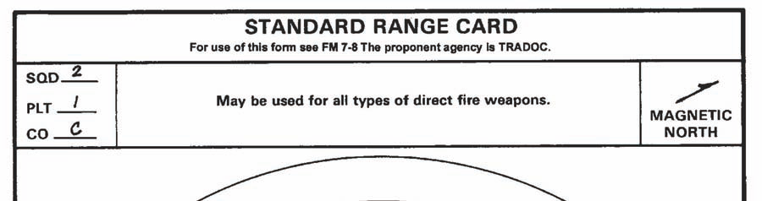
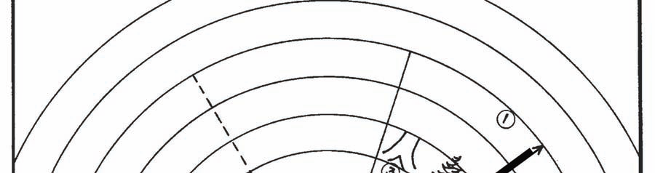
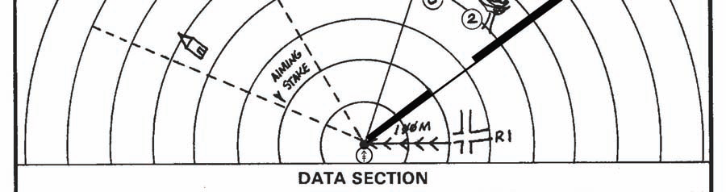
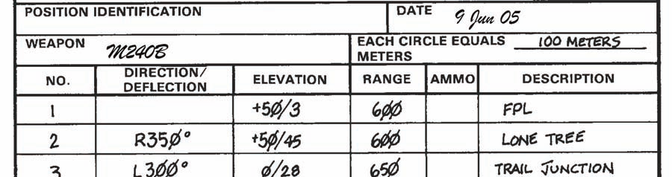
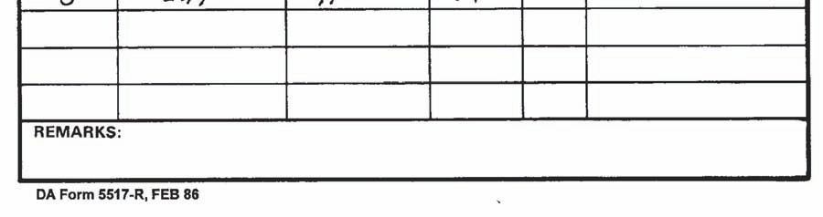
FPL:
Aims MG along left or right limit.
#1 Target/Drawn as Weapon Symbol
Determines Range
Dead Space along FPL
Grazing Fire
FPLs Magnetic azimuth
Opposite Sector limit
Secondary Sector
Magnetic North arrow
Positions Location
Gunners Unit Info
Identify Targets/Data

Slide 53
PDF:
Locks MG T&E on zero
Weapon Symbol in center of sector
Determines Range
Dead Space along FPL
Grazing Fire
FPLs Magnetic azimuth
Opposite Sector limit
Secondary Sector
Magnetic North arrow
Positions Location
Gunners Unit Info
Identify Targets/Data

Slide 54
Enabling Learning Objective E
Action: Discuss TTPs and Lessons Learned.
Conditions: As a small unit leader in a classroom
environment, given a block of instruction, ATP 3-21.8, and a requirement to participate in classroom discussion.
Standards: Discuss TTPs and Lessons Learned.

Slide 55
Questions?

Slide 56
Terminal Learning Objective
ACTION: Employ Platoon and Company weapon systems.
CONDITIONS: As a small unit leader in a classroom
environment, given a block of instruction, ATP 3-21.8, TC-3-22.19, TC 3-22.50, TC 3-22.240, TC 3-22.249 and a
requirement to participate in classroom discussion.
STANDARD: Students must score at least 70% (14 of 20) on the Machine Gun written assessment. Students will have to demonstrate their ability to employ machine guns during the machine gun range (SBF) and STX.

