Slide 1
Rifle Marksmanship
RM 1

Slide 2
TERMINAL LEARNING OBJECTIVE
ACTION: | Perform Introductory Rifle Marksmanship Training on the M4-Carbine
CONDITIONS: | In a classroom, given an overview of the US Army RM process; an M4 Carbine; one 30-round magazine; 3 5.56mm dummy rounds; disassembly mat (GTA 07-01-0369 or GTA 07-01-045); a cleaning kit with the following cleaning materials: swabs, pipe cleaner; and cleaner, lubricant and preservative (CLP); and wearing the prescribed uniform.
STANDARDS: | Comprehend weapon handling/safety, identify the characteristics of the M4 Carbine, 5.56mm Ammunition, the BUIS, M68 CCO; maintain the M4 Carbine and magazine, load and unload an M4 Carbine, perform immediate and remedial action drills, identify ammunition types, and understand basic ballistics.

Slide 3
ENABLING LEARNING OBJECTIVE - A
ACTION: | Perform Safe Weapons Handling
CONDITIONS: | In a classroom, given an individual weapon and instruction on weapon safety.
STANDARDS: | Trainees will demonstrate the four rules of weapon safety: -Treat every weapon as if it were loaded -Never point the weapon at anything you do not intend to shoot -Keep finger off the trigger until ready to fire -Ensure positive identification of the target and its surroundings
Notes:
TC 3-22.9 para 1-3
Stress can be countered using the principles associated with Soldier resilience and performance enhancement. The Comprehensive Soldier and Family Fitness (CSF2) is designed to increase a Soldier’s ability and willingness to perform an assigned task or mission and enhance his performance by assessing and training mental resilience, physical resilience, and performance enhancement techniques and skills. This initiative introduces many resources used to train Soldiers on skills to counter stress. For more information about CSF2, see http://csf2.army.mil/.

Slide 4
Weapons Safety
Four Rules of Weapon Safety
Treat every weapon as if it were loaded.
Never point the weapon at anything you do not intend to shoot.
Keep finger off the trigger until ready to fire.
Ensure positive identification of the target and its surroundings.
Notes:
Failure to follow these rules can result in…

Slide 5
Safe Weapons Handling
Weapons handling is built on three components:
Soldier- The Soldier must maintain situational understanding of friendly forces, the status of the weapon, and the environment.
Weapon- The weapon is the primary tool the Soldier uses to defeat threats in combat.
Environment- The environment is the Soldier’s surroundings and mindset.
Notes:
The Soldier must know how to operate the mechanical safeties built into the weapons they employ, as well as the principles of operation.

Slide 6
Safe Weapons Handling
The weapons handling measures are:
Rules of firearms safety
Weapon safety status
Weapons control status
Notes:
The Soldier must know how to operate the mechanical safeties built into the weapons they employ, as well as the principles of operation.

Slide 7

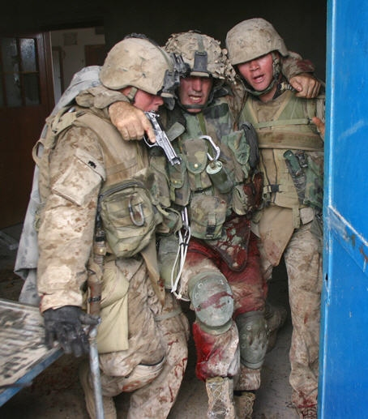
Notes:
What’s wrong in this picture?

Slide 8
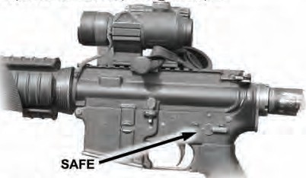
Safe Weapons Handling
Ensure the weapon is clear upon possession.
The weapon remains on safe except when preparing to engage a target.

Slide 9
Safe Weapons Handling
Weapon Status is described by one of four conditions. The steps in the loading and unloading process revolves through these four specific conditions of readiness.
• Green – Selector switch is set to SAFE
– Magazine removed from weapon
– Bolt forward, ejection port cover closed
• Amber – Selector switch is set to SAFE
– Magazine with ammunition inserted in weapon
– Bolt forward, no round in chamber, ejection port cover closed
• Red – Selector switch is set to SAFE
– Magazine locked into the magazine well
– Bolt is FORWARD and locked with a round in the chamber
– Ejection port cover closed
• Black – Magazine locked into the magazine well
– Bolt is FORWARD and locked with a round in the chamber
– Ejector port cover may be closed
– Firer is authorized to enter the SHOT PROCESS
– Selector switch is set to FIRE
Notes:
TC 3-22.9, pg1-4

Slide 10
Safe Weapons Handling
Weapon Control Status | Definition
Weapons hold | Engage only if engaged or ordered to engage.
Weapons tight | Engage only if target is positively identified as enemy.
Weapons free | Engage targets not positively identified as friendly.

Slide 11
Prevention of Negligent Discharge
Negligent discharge is the unintentional firing of a weapon.
• Negligent discharges are UNACCEPTABLE!
• Negligent discharges are a result of improper safety procedures and can be punishable under the Uniform Code of Military Justice.
Notes:
This redundancy allows for multiple fail-safe measures to provide the maximum level of safety in both training and operational environments. A Soldier would have to violate two of the rules of firearms safety or violate a weapon safety status in order to have a negligent discharge

Slide 12
CHECK ON LEARNING

Slide 13
ENABLING LEARNING OBJECTIVE - B
ACTION: | Identify the Characteristics of the M4 Carbine
CONDITIONS: | In a classroom, given an M4 Carbine and presentation.
STANDARDS: | Identify the characteristics of the M4-Carbine by: Identifying the components of the M4 Carbine. Identifying the 8 cycles of function.
Notes:
TM 9-1005-319-10
TC 3-22.9, pg 2-4

Slide 14
Weapon Characteristics
Major Components
M4 is a lightweight, 5.56-mm, magazine-fed, gas operated, air-cooled, shoulder-fired rifle or carbine. They fire in semiautomatic (single shot), three-round burst, or in automatic mode using a selector lever, depending on the variant.
The two major components of the M4/M16 series weapon are:
  Upper Receiver
  Lower Receiver

Slide 15
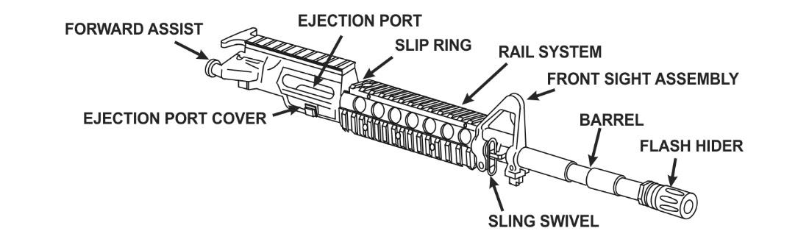
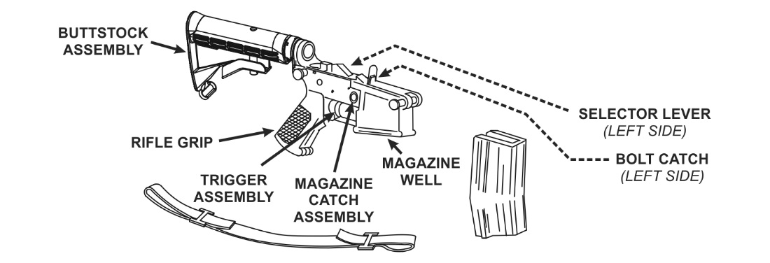
Primary function:
Personal weapon
Length Buttstock closed: 29.75 inches
Length Buttstock open: 33.0 inches
Weight, with 30 round magazine: 7.50 pounds
Bore diameter: 5.56mm
Maximum effective range: 3600m
Area target: 600 meters
Point target: 500 meters
M4A1 Upper Receiver
M4A1 Lower Receiver
Notes:
M4A1 Series Carbine is magazine-fed, gas-operated, air-cooled, shoulder-fired 5.56-millimeter weapon. This section describes the general characteristics and components of the M4A1 Series Carbine.
M4/M4A1 CARBINE Characteristics
Caliber ................................. 5.56 mm
Weight ................................... w/30 (loaded) round mag 7.5 lb
Length ................................... Buttstock Closed 29.75 in
Buttstock Opened 33.0 in
Mechanical Features:
Riffling . . . . . . . . . . . . . . . . . . . . . . . . . . . . . . . . (RH 1/7 twist)
Detachable carrying handle w/integral accessory mounting rail
Buttstock has four positions; closed, 1 R open, 3/4 open, and fully Open.
Firing Characteristics:
Muzzle Velocity . . . . . . . . . . . . . . . . . . . . 2,970 fps
Chamber pressure . . . . . . . . . . . . . . . . . . . 52,000 psi
Cyclic Rate of Fire................. 700-970 rpm (approx.)
Fire Selector ............................ SAFE-SEMI-BURST (M4)
SAFE-SEMI-AUTO (M4A1)
Max Effective Rate of Fire:
Semi . . . . . . . . . . . . . . . . . . . . . . . . . . . . . . 45rpm
Burst/Auto . . . . . . . . . . . . . . . . . . . . . . 90 rpm
Sustained Rate of Fire 12/15 rpm
Max Effective Range 500 meters (individual/point targets)
600 meters (area targets)
Max Range 3600 meter
Each weapon consists of two major components: the upper receiver and the lower receiver. These components are described below including their associated assemblies, subassemblies, and parts.
UPPER RECEIVER
An aluminum receiver helps reduce the overall weight of the rifle/carbine and allows for mounting of equipment and accessories. The upper receiver consists of the following:
Barrel assembly.
Barrel. The bore and chamber of the barrel are chrome-plated to reduce wear and fouling over the life of the weapon.
Flash hider or compensator. Located at the end of the barrel, is provided to reduce the signature of the weapon during firing and reduce barrel movement off target during firing.
Sling swivel. The attachment hardware for the sling system used to properly carry the weapon.
Front sight assembly. Includes an adjustable front sight post that facilitates zeroing the weapon, serves as the forward portion of the iron sight or back up iron sight, and assists with range determination.
Adapter rail system (ARS). Provided in varying lengths, depending on the variant applied. Used to attach common aiming devices or accessories.
Slip ring. Provides a spring loaded locking mechanism for the weapon?s hand guards.
Hand Guards. Provides protection for your hands.
Ejection port. Provides an opening in the upper receiver to allow ammunition or spent casing ejection from the weapon.
Ejection port cover. Provides a dust cover for the ejection port, protecting the upper receiver and bolt assembly from foreign objects.
Forward assist assembly. Provides a Soldier applied mechanical assist to the bolt assembly during operations.
Charging Handle
Bolt Carrier
Bolt
Bolt Cam Pin
Firing Pin
Firing Pin Retaining Pin
Extractor
Extractor Retaining Pin
LOWER RECEIVER
The lower receiver consists of the following components, assemblies, and parts:
Trigger assembly. Provides the trigger, pins, springs, and other mechanical components necessary to fire the weapon.
Bolt catch. A mechanical lever that can be applied to lock the bolt to the rear by the Soldier, or automatically during the cycle of function when the magazine is empty.
Pistol grip. An ambidextrous pistol-type handle that assists in recoil absorption during firing.
Magazine catch assembly. Provides a simple, spring-loaded locking mechanism to secure the magazine within the magazine well. Provides the operator an easy to manipulate, push-to-release textured button to release the magazine from the magazine well during operation.
Buttstock assembly. Contains the components necessary for proper shoulder placement of the weapon during all firing positions, returning the bolt assembly to battery, and managing the forces of recoil during operation.
The M4-/M4A1-series carbine has a four position collapsible buttstock assembly:
Closed, ½ open, ¾ open, and fully-open.
Buffer
Buffer Action spring. Provides the stored energy to return the bolt carrier assembly back into battery during operation.
Buffer Tube. Provides space for the action spring and buffer assembly during operation.
Adjustable Buttstock

Slide 16
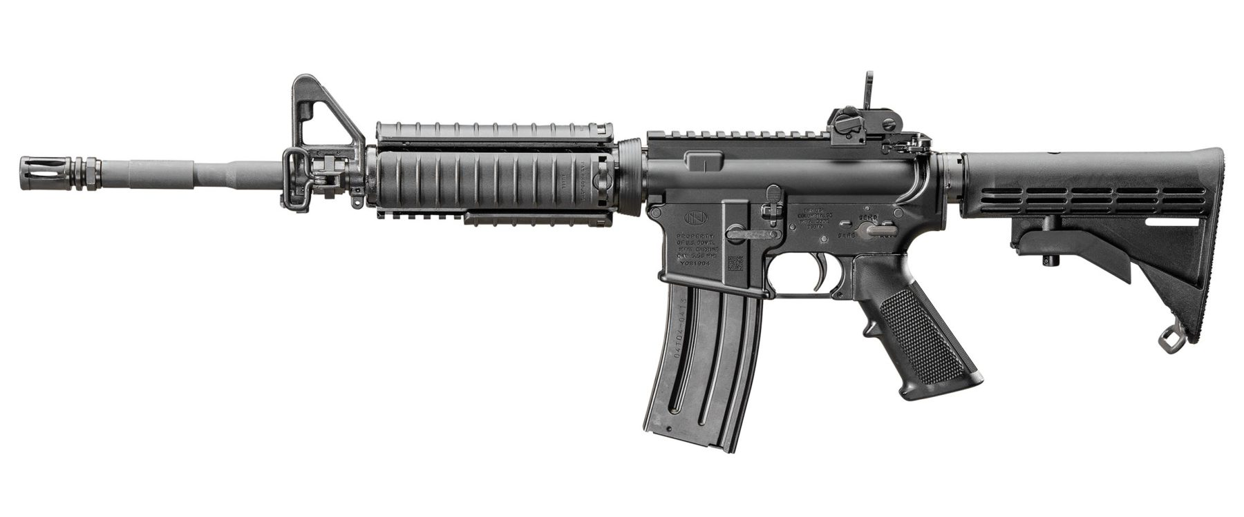
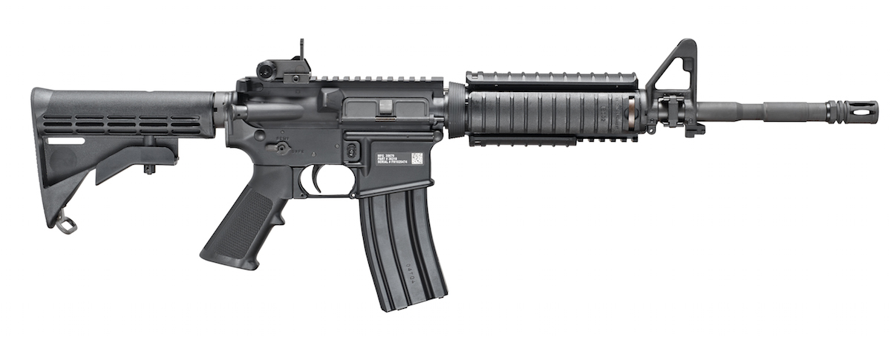
M4A1 Series Carbine
Notes:
Check on learning. Have the students to identify the parts.

Slide 17
Weapon Characteristics
8 Cycles of Function
Feeding
Chambering
Locking
Firing
Unlocking
Extracting
Ejecting
Cocking
Notes:
TC 3-22.9, pg 2-4

Slide 18
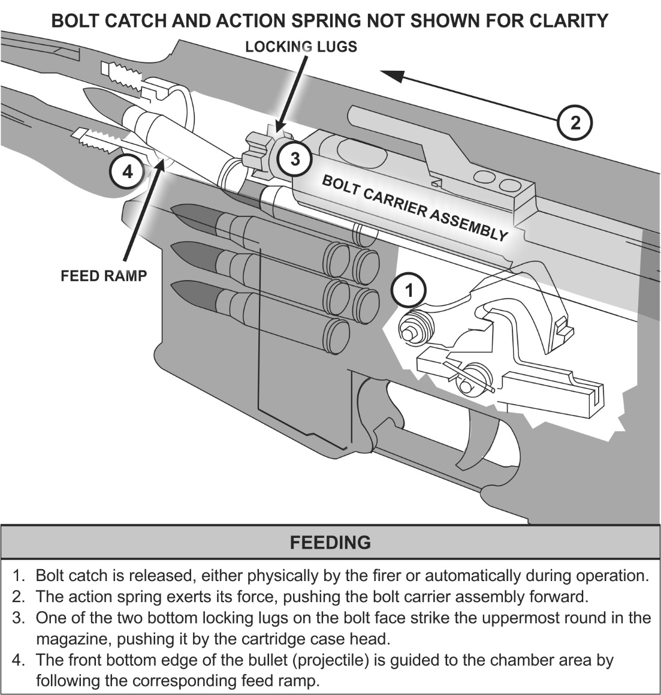
Weapon Characteristics
8 Cycles of Function
Feeding
Chambering
Locking
Firing
Unlocking
Extracting
Ejecting
Cocking

Slide 19
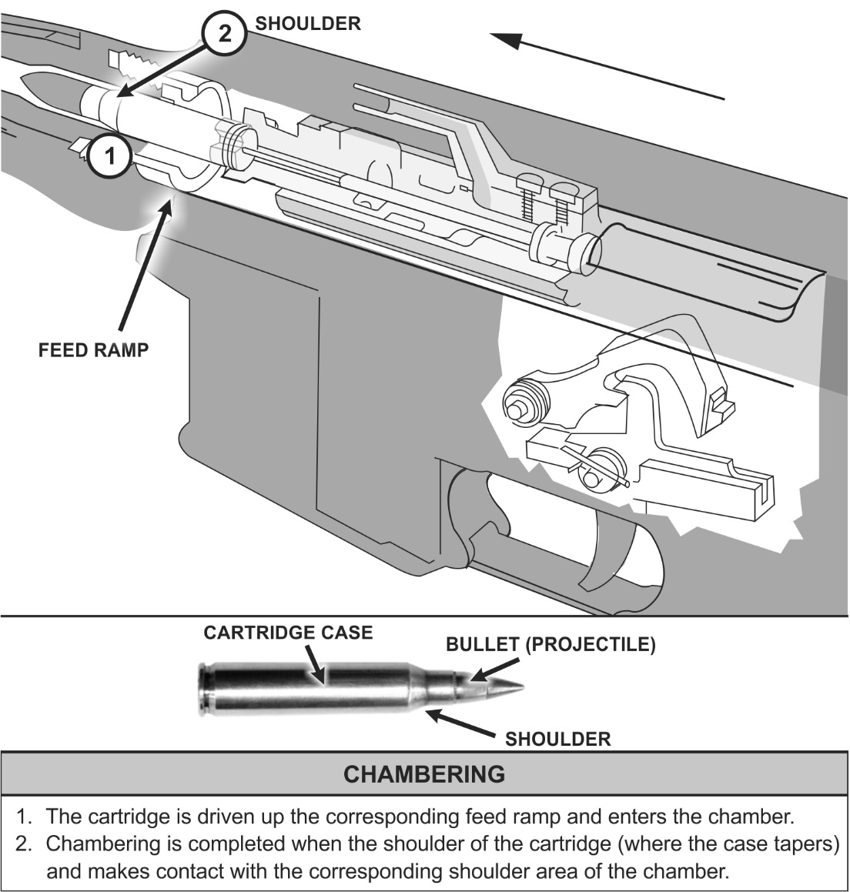
Weapon Characteristics
8 Cycles of Function
Feeding
Chambering
Locking
Firing
Unlocking
Extracting
Ejecting
Cocking

Slide 20
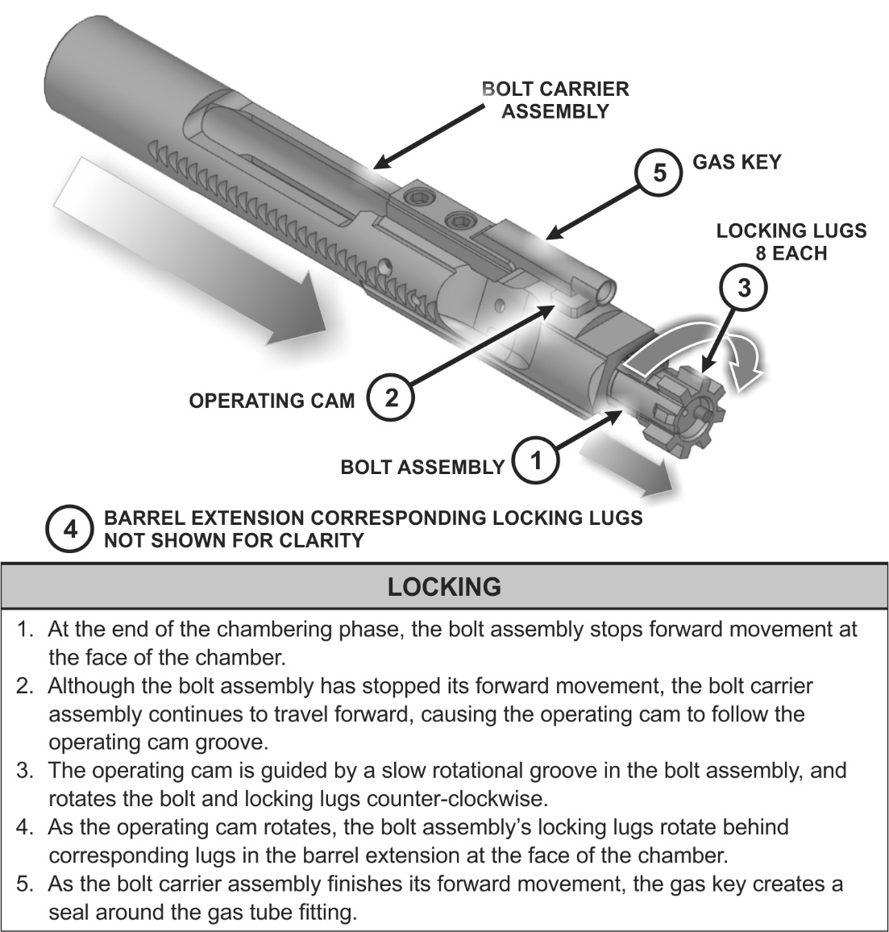
Weapon Characteristics
8 Cycles of Function
Feeding
Chambering
Locking
Firing
Unlocking
Extracting
Ejecting
Cocking

Slide 21
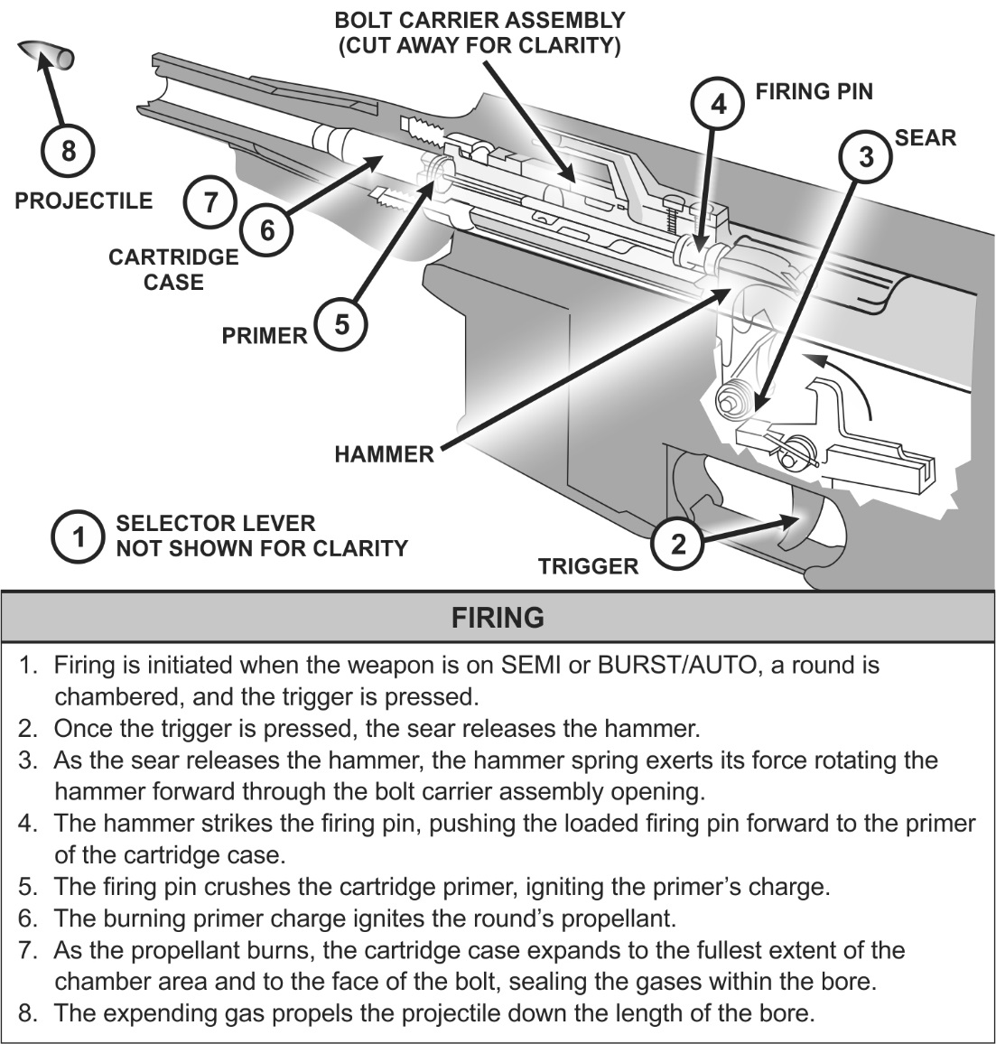
Weapon Characteristics
8 Cycles of Function
Feeding
Chambering
Locking
Firing
Unlocking
Extracting
Ejecting
Cocking

Slide 22
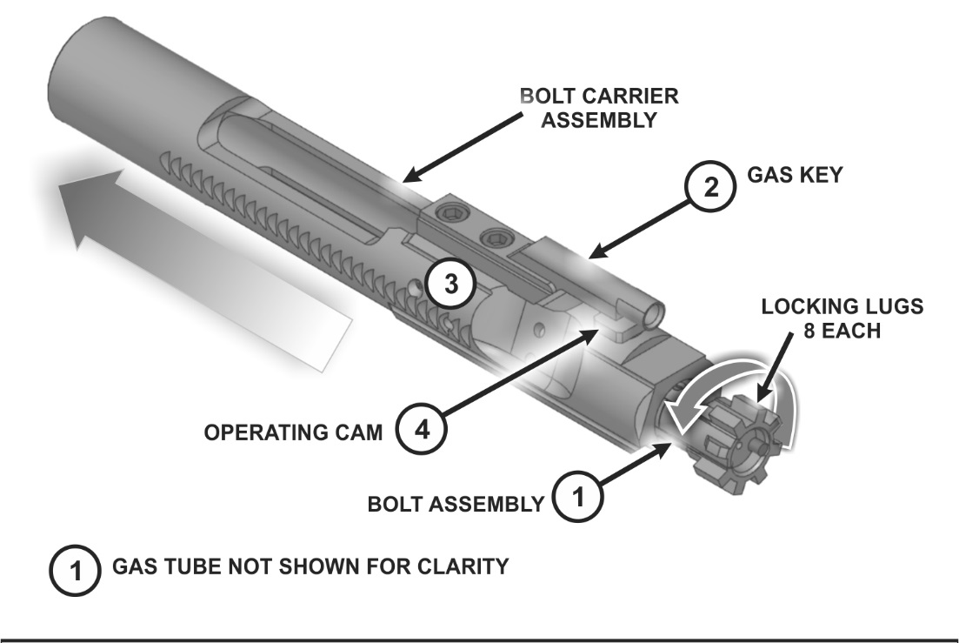
Weapon Characteristics
8 Cycles of Function
Feeding
Chambering
Locking
Firing
Unlocking
Extracting
Ejecting
Cocking

Slide 23
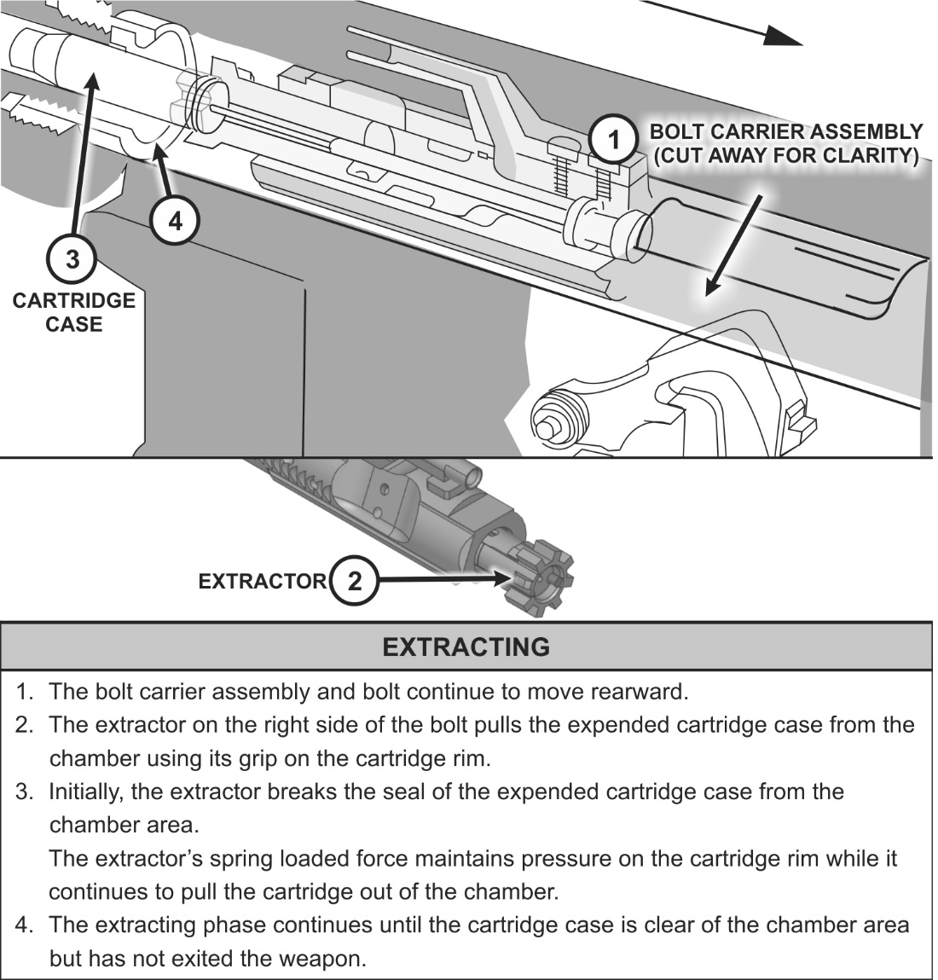
Weapon Characteristics
8 Cycles of Function
Feeding
Chambering
Locking
Firing
Unlocking
Extracting
Ejecting
Cocking

Slide 24
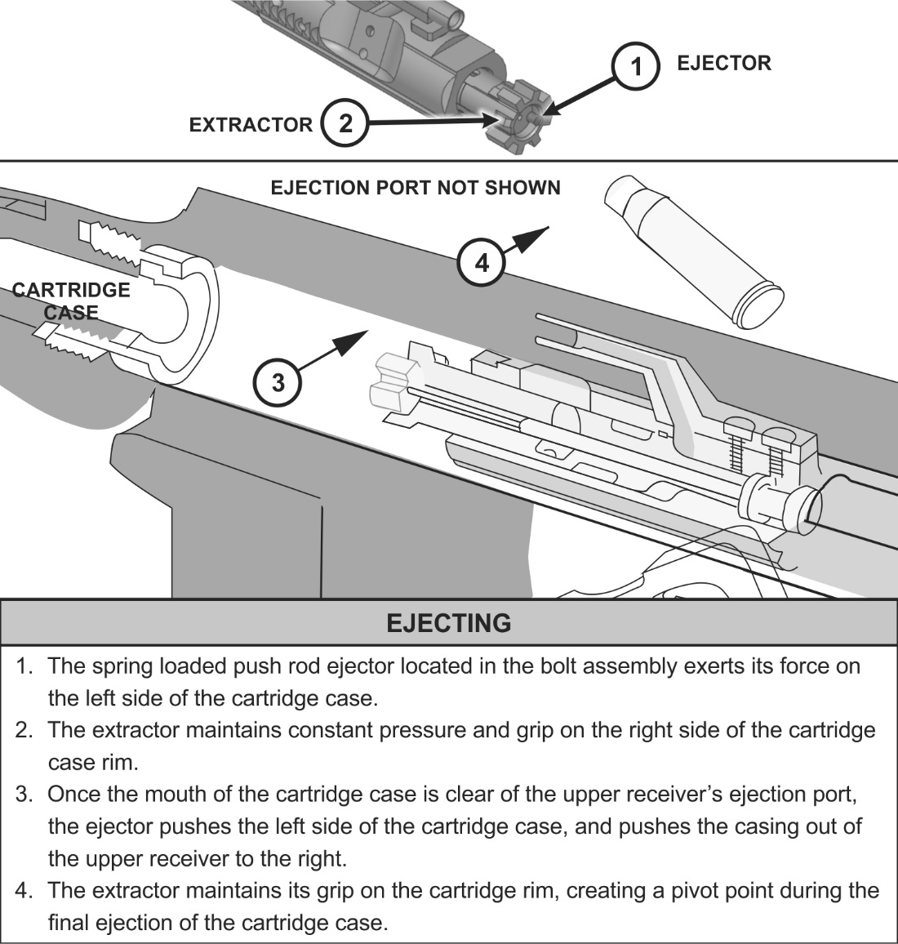
Weapon Characteristics
8 Cycles of Function
Feeding
Chambering
Locking
Firing
Unlocking
Extracting
Ejecting
Cocking

Slide 25
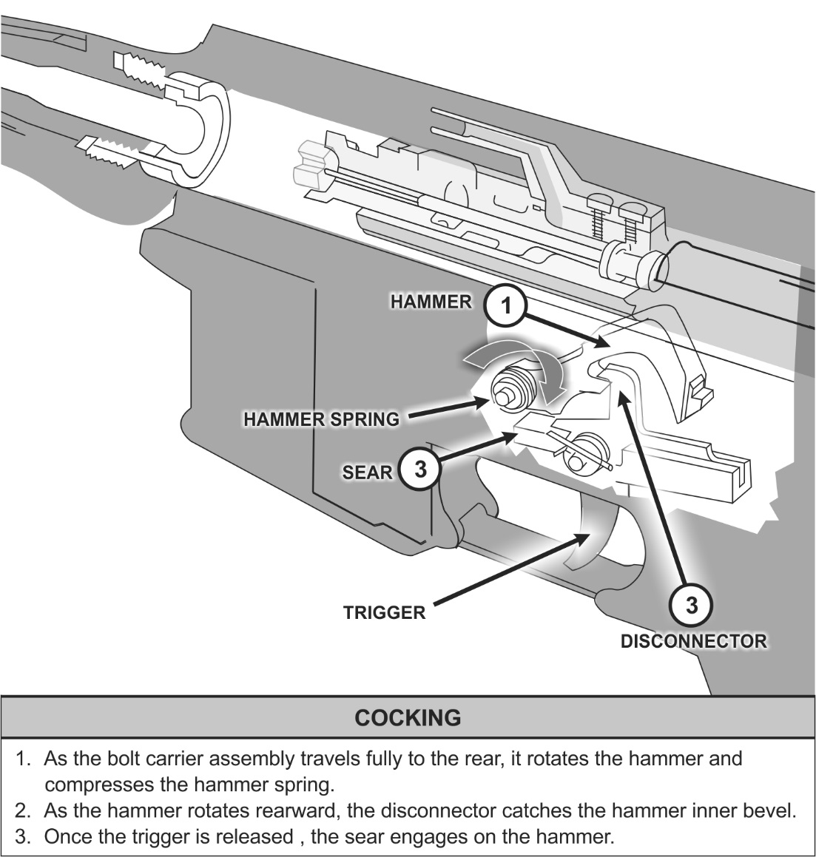
Weapon Characteristics
8 Cycles of Function
Feeding
Chambering
Locking
Firing
Unlocking
Extracting
Ejecting
Cocking

Slide 26
CHECK ON LEARNING

Slide 27



Types of Ammunition for the
M4-Series Rifle
M855, 5.56-mm
Ball
M856, 5.56-mm
Tracer
M196, 5.56-mm
Tracer
Red or Orange Tip: The M196 cartridge is used only in the M16A1 rifle. Its main uses are for observation of fire, incendiary effect, and signaling.
Green Tip: The M855 cartridge is used in the M16A2/3/4 and in M4-series weapons
Red tip (orange when linked 4 to 1 for the M249):
The M856 tracer cartridge is used in the M16A2/3/4 and M4-series weapons.
Notes:
27

Slide 28



Types of Ammunition for the
M4-Series Rifle
M199A1, 5.56-mm
Dummy
M200, 5.56-mm
Blank
M193, 5.56-mm
Ball
Six grooves along the sides of the case beginning about 1/2 inch from its tip: The M199 dummy cartridge is used in all M16-/M4-series weapons during dry-firing and other training.
Case mouth is closed with a seven-petal rosette crimp, violet tip: The M200 blank cartridge is used in all M16-/M4-series weapons.
5.56-mm Plain Tip: The M193 is the standard cartridge for field use with the M16A1 rifle. The M193 cartridge is a center-fire cartridge with a 55-grain, gilded metal-jacketed, lead alloy core bullet.
Notes:
CCMCK-TM 9-6920-3700-10-Minimum engagement distance when using CCMCK ammunition in converted weapons is 5 meters (16.4 ft). Personnel injury may occur if shots are taken at less than 5 meters (16.4 ft). No personnel will be allowed within a radius of 75 meters (246 ft) of the CCMCK Training Area when Force-On-Force training is being conducted without meeting the minimum safety requirements for CCMCK use. Serious injury could occur if a participant is struck by a CCMCK projectile in the eyes or on exposed skin.
AB09 - Cartridge, 5.56 Millimeter, Blue UTM: XM1042; AB10 - Cartridge, 5.56 Millimeter, Red UTM: XM1042
28

Slide 29
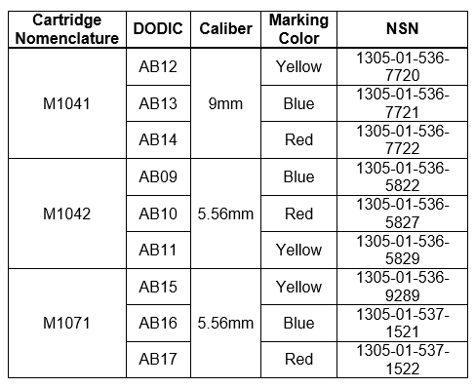
Types of Ammunition for the
M4-Series Rifle
CCMCK Full Material Release Ammunition
Notes:
CCMCK-TM 9-6920-3700-10-Minimum engagement distance when using CCMCK ammunition in converted weapons is 5 meters (16.4 ft). Personnel injury may occur if shots are taken at less than 5 meters (16.4 ft). No personnel will be allowed within a radius of 75 meters (246 ft) of the CCMCK Training Area when Force-On-Force training is being conducted without meeting the minimum safety requirements for CCMCK use. Serious injury could occur if a participant is struck by a CCMCK projectile in the eyes or on exposed skin.
AB09 - Cartridge, 5.56 Millimeter, Blue UTM: XM1042; AB10 - Cartridge, 5.56 Millimeter, Red UTM: XM1042
29

Slide 30
MAINTAIN AMMUNITION
Keep dry and clean
Do not fire if:
- Seriously corroded ammunition
- Dented cartridges
- Cartridges with loose bullets
- Cartridges exposed to extreme heat (135 degrees) until
they have cooled

Slide 31
CHECK ON LEARNING

Slide 32
ENABLING LEARNING OBJECTIVE - C
ACTION: | Identify the Functional Elements of the Shot Process
CONDITIONS: | Given an M4-Carbine in a classroom environment
STANDARDS: | The trainee will identify the Four Functional Elements of the Shot Process by: Demonstrating Proper Workspace Management. Demonstrating Proper Stability. Demonstrating Proper Aim Demonstrating Proper Control. Demonstrating Proper Movement Identifying the primary RM firing positions.

Slide 33
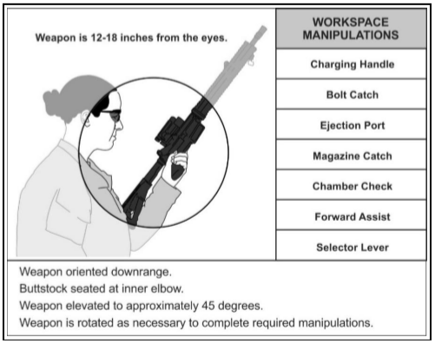
Workspace Management
The workspace is a spherical area, 12 to 18 inches in diameter centered on the Soldier’s chin and approximately 12 inches in front of their chin
Notes:
Workspace management includes the Soldier’s ability to perform the following functions:
Selector lever – to change the weapon’s status from safe to semiautomatic, to burst/automatic from any position.
Note. Some models will have ambidextrous selectors.
Charging handle – to smoothly use the charging handle during operation. This includes any corrective actions to overcome malfunctions, loading, unloading, or clearing procedures. Bolt catch – to operate the bolt catch mechanism on the weapon during operations. Ejection port – closing the ejection port cover to protect the bolt carrier assembly, ammunition, and chamber from external debris upon completion of an engagement. This includes observation of the ejection port area during malfunctions and clearing procedures. Magazine catch – the smooth functioning of the magazine catch during reloading procedures, clearing procedures, or malfunction corrective actions. Chamber check – the sequence used to verify the status of the weapon’s chamber. Forward assist – the routine use of the forward assist assembly of the weapon during loading procedures or when correcting malfunctions.

Slide 34
Stability
Four functions
Support
Muscle relaxation
Natural Point of Aim
Recoil Management
Notes:
TC 3-22.9 pg 6-1

Slide 35
Stability
Support can be natural or artificial or a combination of both. Natural support comes from a combination of the shooter’s bones and muscles. Artificial support comes from objects outside the shooter’s body.
Leg position
Stance/Center of Gravity
Firing Elbow
Non-Firing Elbow
Firing Hand
Non-Firing Hand
Buttstock
Stock Weld
Notes:
TC 3-22.9 pg 6-1

Slide 36
Stability
Four functions
Muscle Relaxation is the ability of the Soldier to maintain orientation of the weapon appropriately during the shot process while keeping the major muscle groups from straining to maintain the weapon system’s position. Relaxed muscles contribute to stability provided by support.
Strained or fatigued muscles detract from stability.
As a rule, the more support from the shooter’s bones the less he requires from his muscles.
The more skeletal support, the more stable the position, as bones do not fatigue or strain.
As a rule, the less muscle support required, the longer the shooter can stay in position.
Notes:
TC 3-22.9 pg 6-1

Slide 37
Stability
Four functions
Natural Point of Aim is the point where the barrel naturally orients when the shooter’s muscles are relaxed and support is achieved. The natural point of aim is built upon the following principles:
The closer the natural point of aim is to the target, the less muscle support required.
The more stable the position, the more resistant to recoil it is.
More of the shooter’s body on the ground equals a more stable position.
More of the shooter’s body on the ground equals less mobility for the shooter.
Notes:
TC 3-22.9 pg 6-1

Slide 38
Stability
Four functions
Recoil Management
Recoil management is the result of a Soldier assuming and maintaining a stable firing position which mitigates the disturbance of one's sight picture during the cycle of function of the weapon.
The Soldier’s firing position manages recoil using support of the weapon system, the weight of their body, and the placement of the weapon during the shot process. Proper recoil management allows the sights to rapidly return to the target and allows for faster follow up shots.
Notes:
TC 3-22.9 pg 6-1

Slide 39
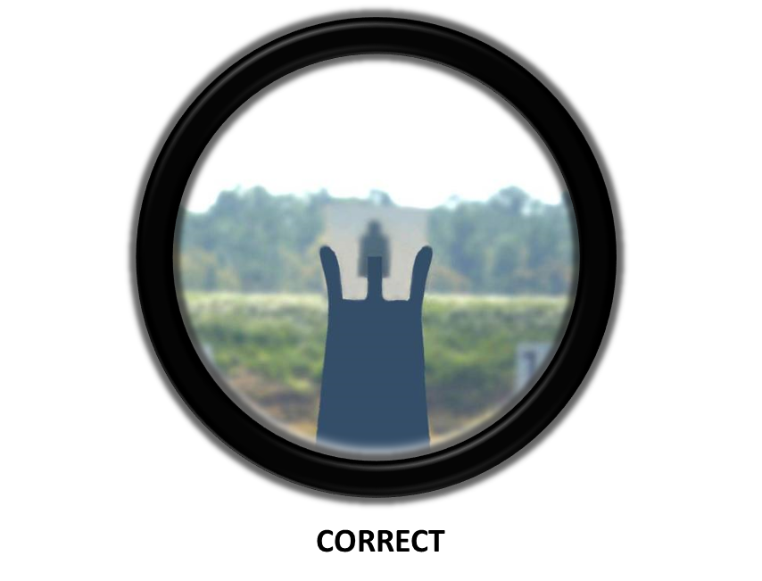
Aim
  Focus should be on the front sight post
  The target should be blurry when the eye is focused correctly.
Notes:
Your eye must remain in the same position behind the sights in order to achieve consistent sight alignment in relationship to the target
A Proper Stockweld is necessary for proper sight alignment
The aiming process for engaging stationary targets consist of the following Soldier actions, regardless of the optic, sight, or magnification used by the aiming device:
Weapon orientation – the direction of the weapon as it is held in a stabilized manner.
Sight alignment – the physical alignment of the aiming device:
-Iron sight/back-up iron sight and the front sight post.
-Optic reticle.
-Ballistic reticle (day or thermal).

Slide 40
Aim
  Sight picture – the target as viewed through the line of sight.
  Point of aim (POA) – the specific location where the line of sight intersects the target.
  Desired point of impact (POI)–the desired location of the strike of the round to achieve the desired outcome (incapacitation or lethal strike).
Notes:
TC 3-22.9 Chp 7

Slide 41
Control
  Control consists of all the conscious actions of the Soldier before, during, and after the shot process that the Soldier specifically is in control of. The first of which is trigger control. This includes whether, when, and how to engage. It incorporates the Soldier as a function of safety, as well as the ultimate responsibility of firing the weapon.
Notes:
TC 3-22.9 Chp 7

Slide 42
Control
  The control element consists of several supporting Soldier functions, and include all the actions to minimize the Soldier’s induced arc of movement. Executed correctly, it provides for the best engagement window of opportunity to the firer. The Soldier physically maintains positive control of the shot process by managing:
  Trigger control
  Breathing control
  Workspace management
  Calling the shot (firing or shot execution)
  Follow-through
Notes:
TC 3-22.9 Chp 8-2

Slide 43
Movement
  Movement is the process of the Soldier’s physical actions during the engagement process. It includes the Soldier’s ability to move laterally, forward, diagonally, and in a retrograde manner while maintaining stabilization, appropriate aim, and control of the weapon.
Notes:
TC 3-22.9 Chp 7

Slide 44
Movement
  Vertical movements are those actions taken to change their firing posture or negotiate terrain or obstacles while actively seeking, orienting on, or engaging threats.
  Horizontal movements are actions taken to negotiate the battlefield while actively seeking, orienting on, or engaging threats.
Notes:
TC 3-22.9 Chp 7
Change between any of the primary firing positions; standing, crouched, kneeling, sitting, or prone.
Negotiate stairwells in urban environments.
Travel across inclined or descending surfaces, obstacles, or terrain.

Slide 45
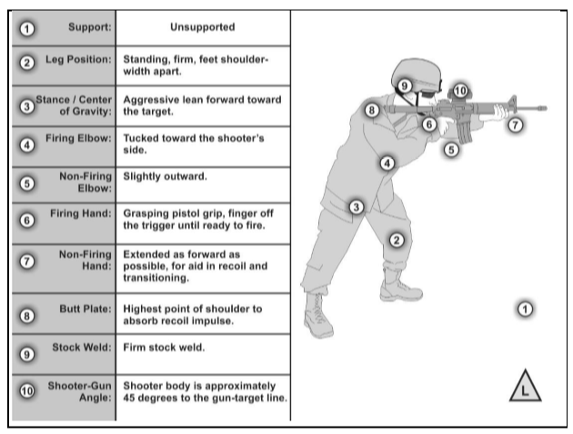
Standing Unsupported

Slide 46
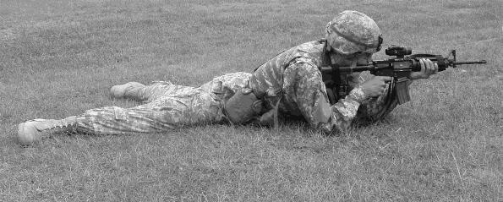
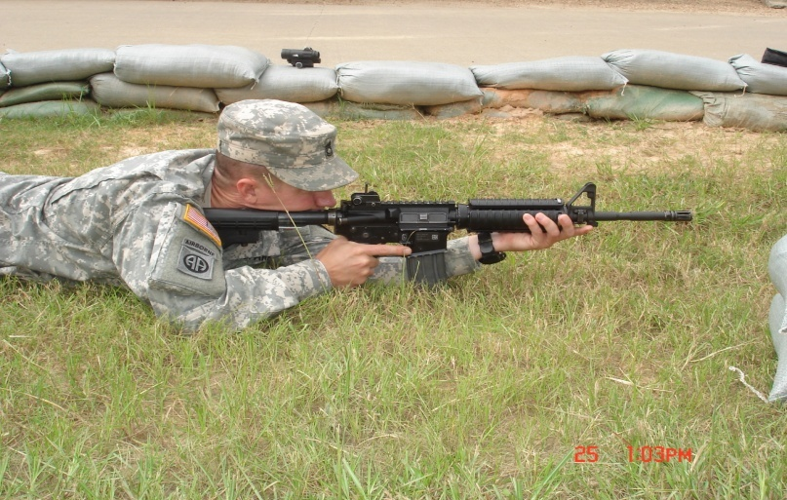
Prone unsupported
The prone position depends on a number of factors. Each variation can help or hinder the firer’s success rate. The main goal is to find a position that focuses on the following key areas and to be consistent:
Stock-weld
Rifle butt-plate/butt-stock position
Firing hand
Non-firing hand Firing elbow
Nonfiring elbow Leg position Sandbags (prone supported
Notes:
Stock-weld. The firer’s head is as upright as possible with the full weight of the head resting on the stock.
Rifle butt-plate/butt-stock position. The butt plate/butt-stock should be placed high enough in the shoulder to allow for consistent stock weld.
Firing hand. The firer should have a firm handshake grip on the pistol grip and place their finger on the trigger where it naturally falls.
Non-firing hand. The hand guard should be placed in the ‘V’ formed between the thumb and index finger on the nonfiring hand. Enough grip pressure should be applied to control the rifle during recoil. The nonfiring hand can be moved forward or back on the handguards to adjust the elevation of the position. For prone supported, the back of the nonfiring hand will rest on the sandbags.
Firing elbow. Place the firing elbow where it naturally falls.
Nonfiring elbow. Place the nonfiring elbow directly underneath the rifle as much as possible. For prone unsupported, proper use of bone support is more critical in this position due to the lack of artificial support from the sandbag in the supported position.
Leg position. The firer’s legs may be either spread with heels as flat as possible on ground or the firing side leg may be bent at the knee to relieve pressure on the stomach.
Sandbags (prone supported). The sandbags should be at a height that allows for support without interfering with the other elements of the position.

Slide 47
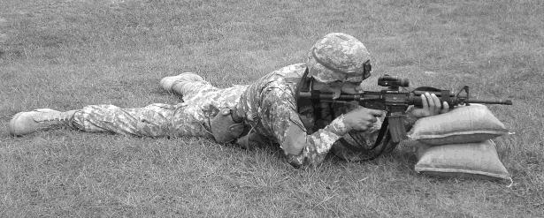
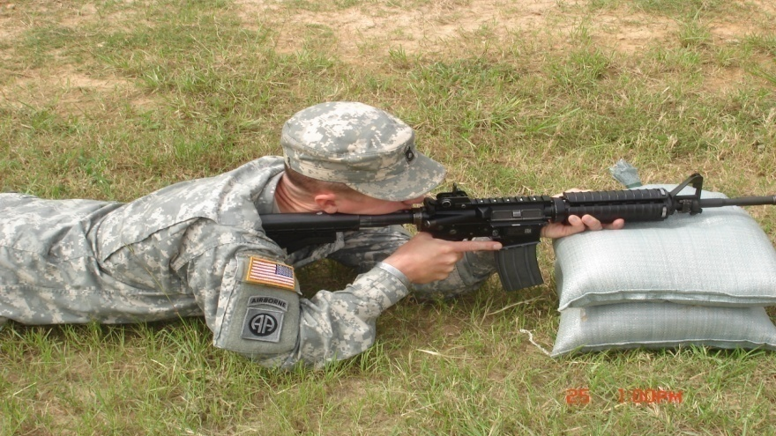
Prone supported
Stock-weld Rifle butt-plate/butt-stock position
Firing hand Non-firing hand
Firing elbow
Nonfiring elbow
Leg position
Sandbags (prone supported)
Notes:
Stock-weld. The firer’s head is as upright as possible with the full weight of the head resting on the stock.
Rifle butt-plate/butt-stock position. The butt plate/butt-stock should be placed high enough in the shoulder to allow for consistent stock weld.
Firing hand. The firer should have a firm handshake grip on the pistol grip and place their finger on the trigger where it naturally falls.
Non-firing hand. The hand guard should be placed in the ‘V’ formed between the thumb and index finger on the nonfiring hand. Enough grip pressure should be applied to control the rifle during recoil. The nonfiring hand can be moved forward or back on the handguards to adjust the elevation of the position. For prone supported, the back of the nonfiring hand will rest on the sandbags.
Firing elbow. Place the firing elbow where it naturally falls.
Nonfiring elbow. Place the nonfiring elbow directly underneath the rifle as much as possible. For prone unsupported, proper use of bone support is more critical in this position due to the lack of artificial support from the sandbag in the supported position.
Leg position. The firer’s legs may be either spread with heels as flat as possible on ground or the firing side leg may be bent at the knee to relieve pressure on the stomach.
Sandbags (prone supported). The sandbags should be at a height that allows for support without interfering with the other elements of the position.

Slide 48
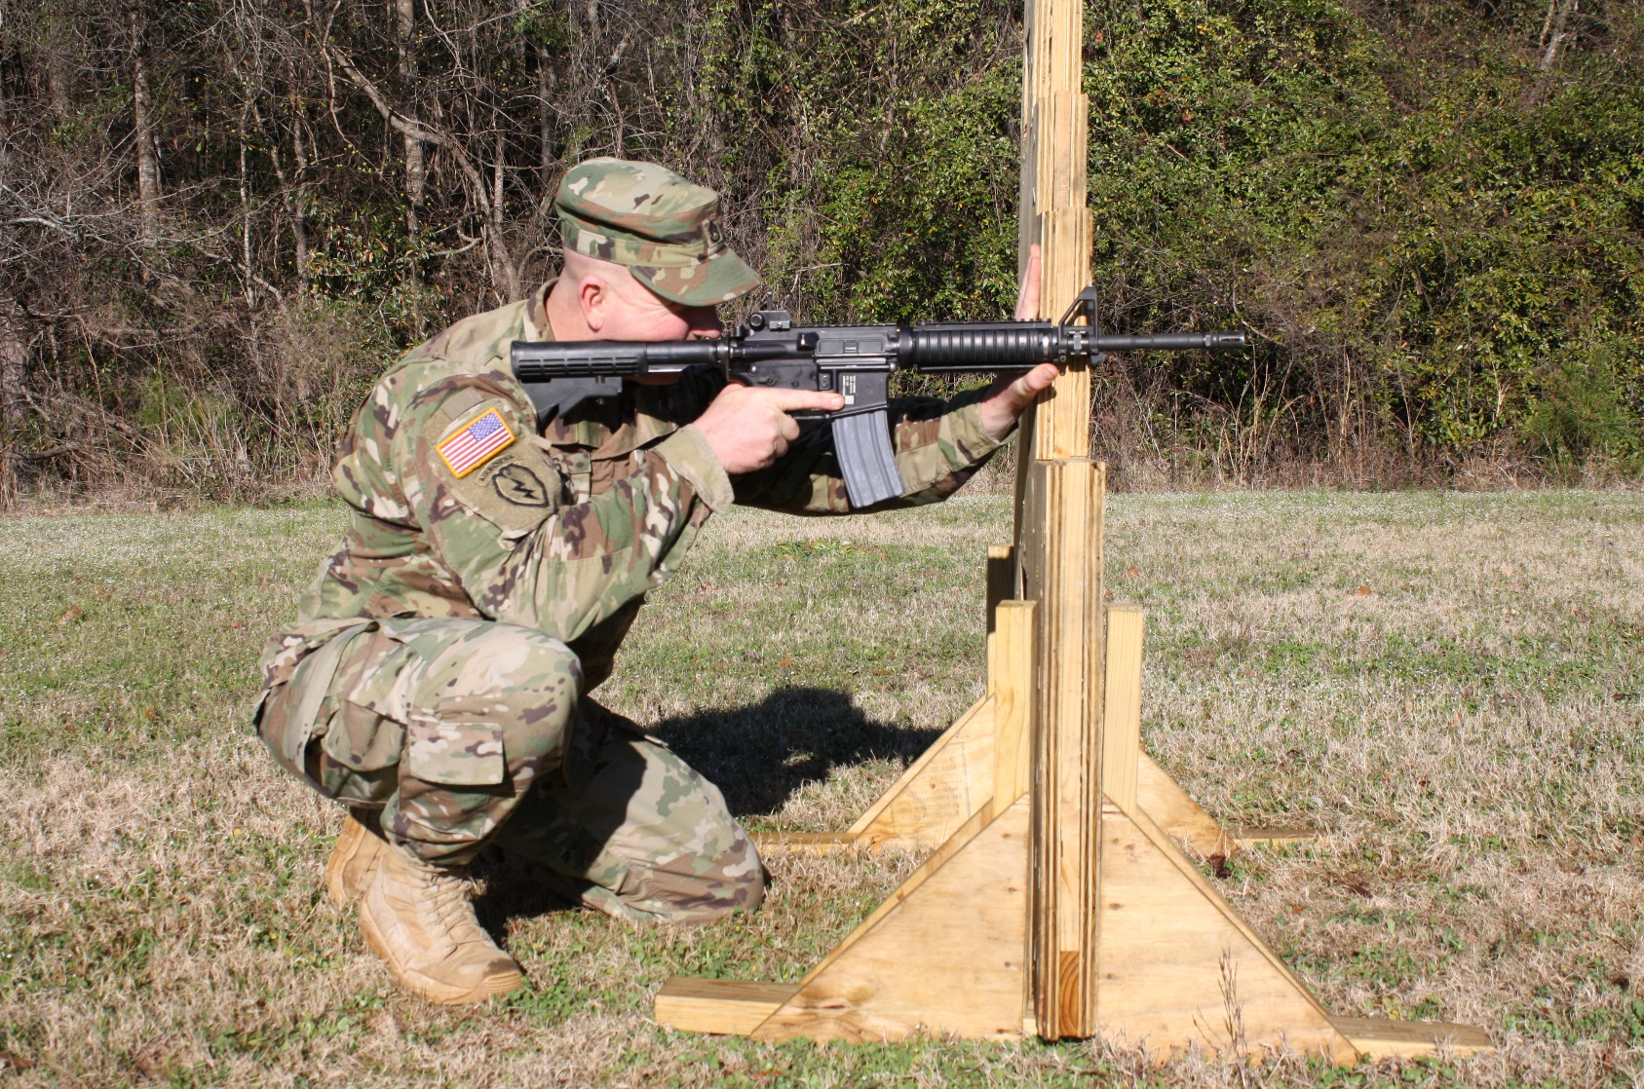
Kneeling supported
(Barricade)
Notes:
Stockweld. The firer’s head is as upright as possible with the full weight of the head resting on
the stock.
Rifle buttplate/buttstock position. The buttplate/buttstock will be higher in the shoulder than in the prone position.
Firing hand. The firer should have a firm handshake grip on the pistol grip and place their finger on the trigger where it naturally falls.
Nonfiring hand. The nonfiring hand will hold the handguards firmly and will also be pushed against the artificial support. Hand positioning will vary depending on the type of support used.
Nonfiring elbow. The nonfiring elbow and forearm may be used to assist with the weapon’s stability by pushing against the artificial support. The contact of the nonfiring elbow and forearm with the structure will vary depending on the support used and the angle to the target.
Firing elbow. Place the firing elbow directly underneath the rifle as much as possible. The elbow should be placed either in front of or behind the kneecap. Placing the elbow directly on the kneecap will cause it to roll and increases the wobble area. The firing elbow may need to be raised slightly to create a pocket for the rifle buttplate/buttstock to be placed in.
Leg position. The firing leg should be bent approximately 90 degrees at the knee and used as support for the firing elbow. The nonfiring leg is used as support for the weight of the body. The firer may rest their body weight on the heel. Some firers lack the flexibility to do this and may have a gap between their buttocks and the heel.

Slide 49
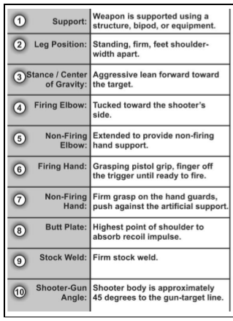
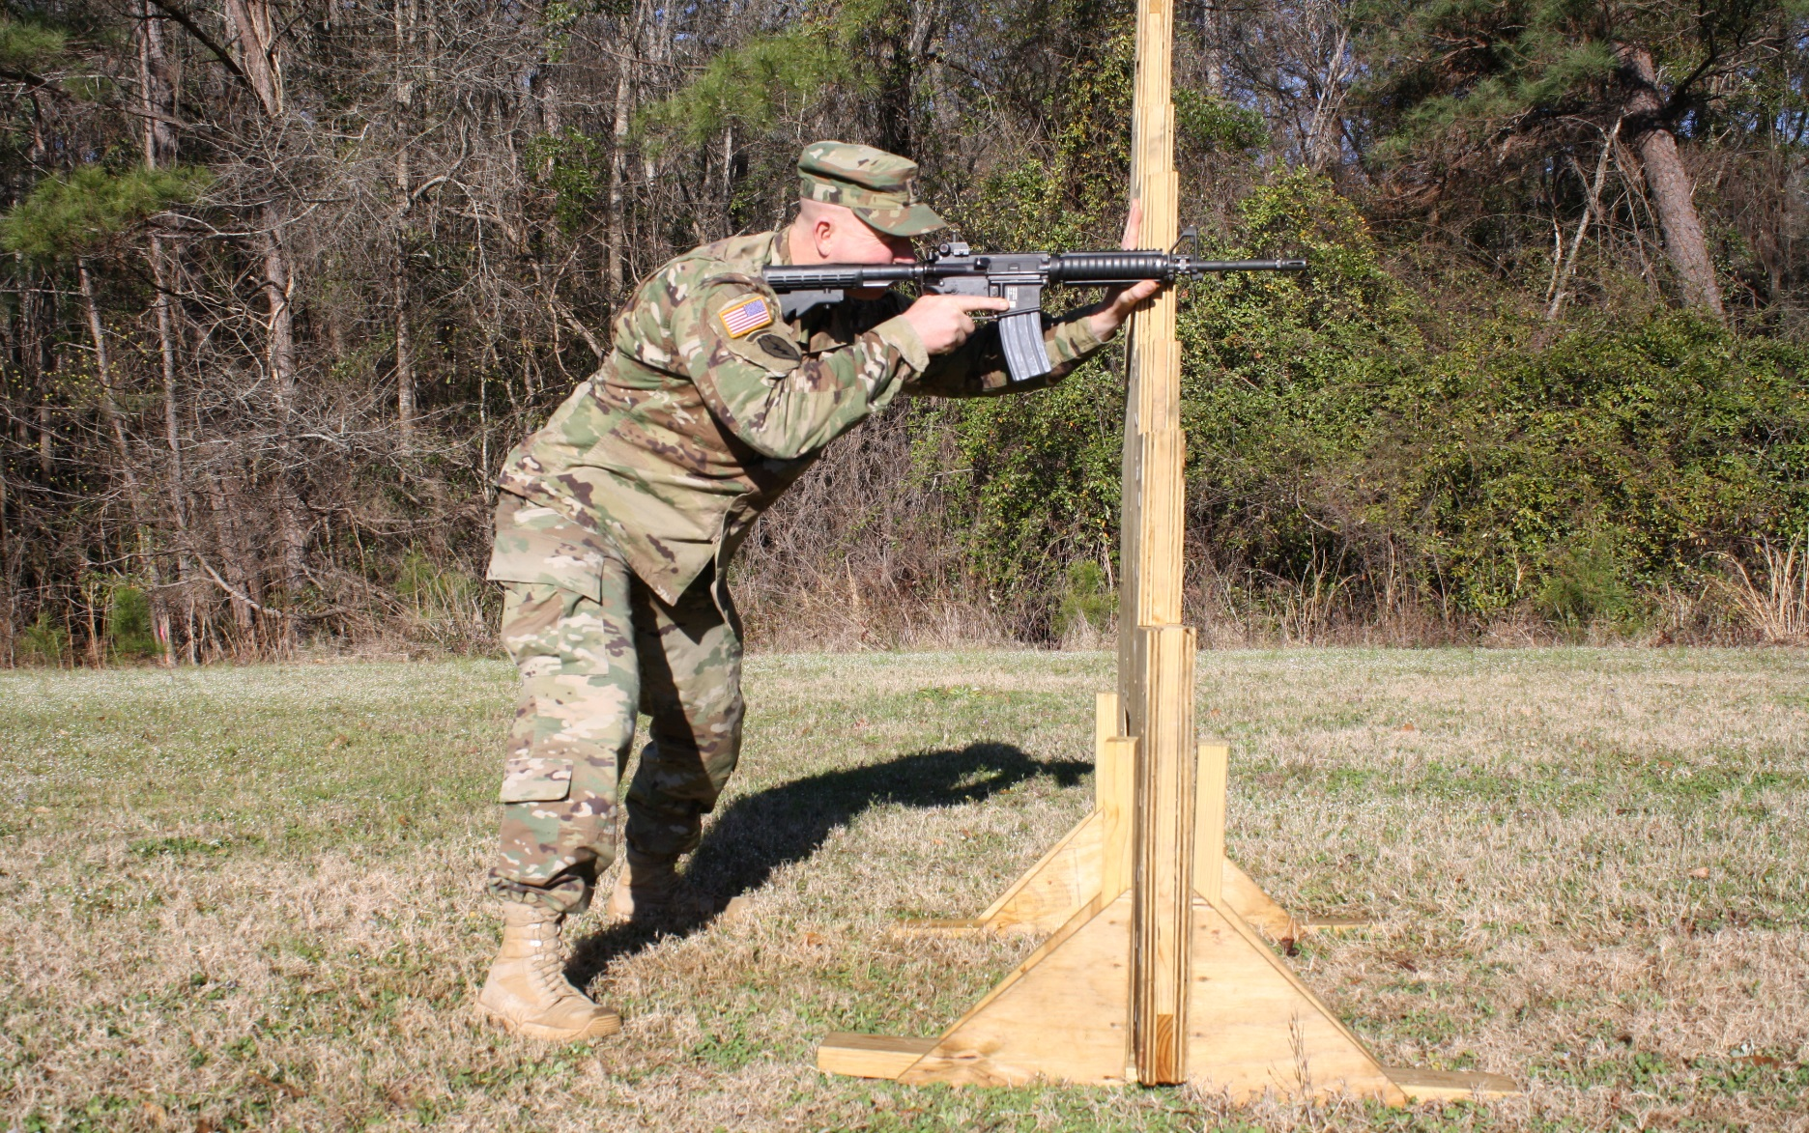
Standing supported
(Barricade)

Slide 50
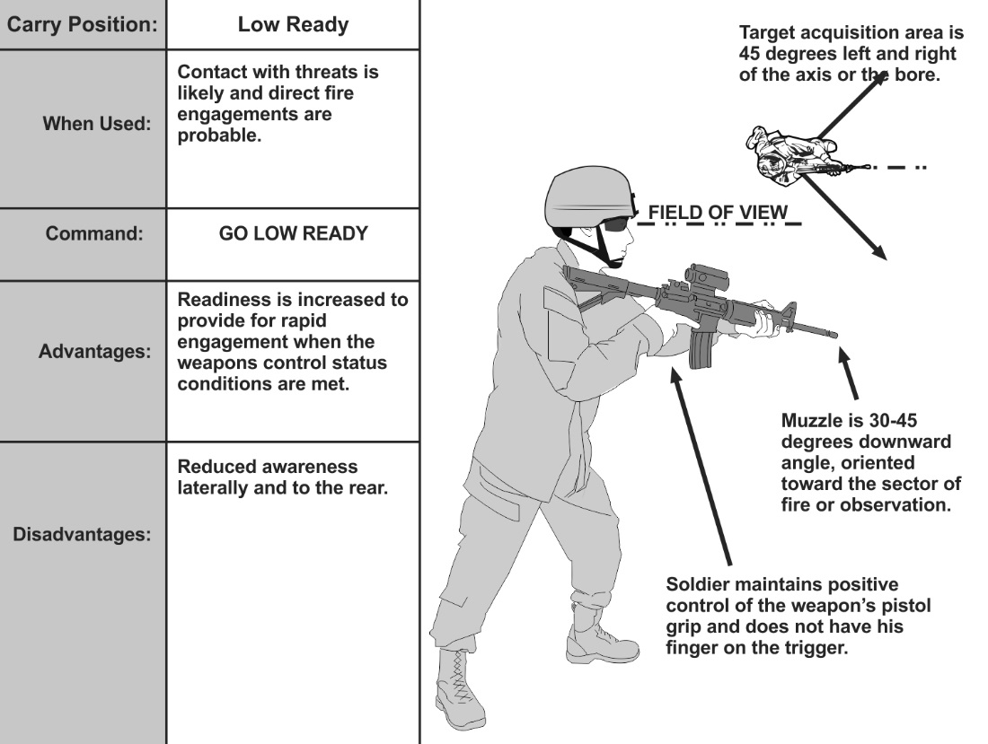
Low Ready Position
Notes:
Low Ready Position: The low ready position is used when contact is likely. In the low ready position, the weapon is slung, the buttstock is in the Soldier’s shoulder, the muzzle is angled down at a 30- to 45-degree angle and oriented towards the Soldier’s sector of fire. Firing hand position is the same as in the safe hang and the collapsed low ready. From this position, the Soldier is ready to engage threats within a very short amount of time, with minimal movement. The Soldier looks over the top of his optics or sights to maintain situation awareness of his sector. The Soldier’s head remains upright.

Slide 51
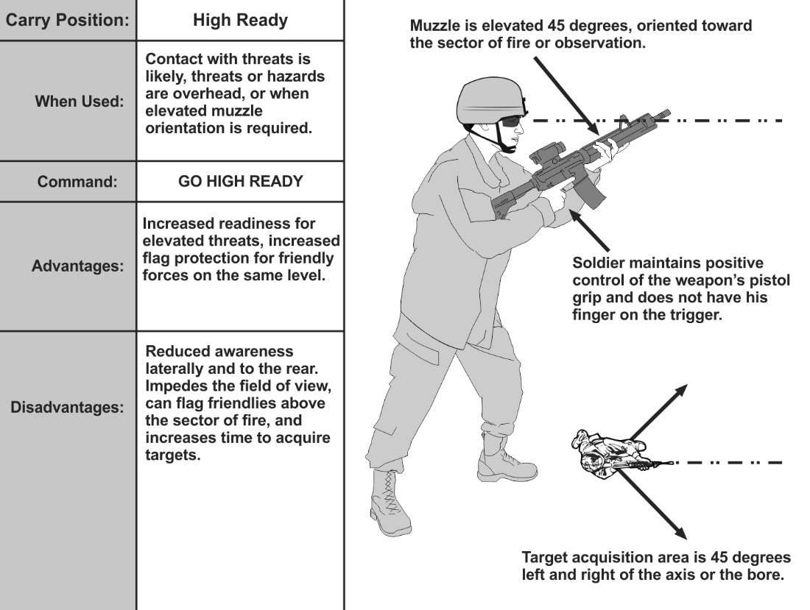
High Ready Position
Notes:
High Ready Position: The high ready position is used when the Soldier’s sector of fire includes areas overhead, or when an elevated muzzle orientation is appropriate for safety. The high ready position is Similar to the low ready in that it is used when contact is likely. In the high ready, the weapon is slung, buttstock is under the armpit, the muzzle angled up to at least a 45-degree angle and oriented toward the Soldier’s sector of fire—ensuring no other Soldiers are flagged. The firing hand remains in the same position as the low ready. The nonfiring side hand can be free as the weapon is supported by the firing side hand and armpit. This position is not as effective as the low ready for several reasons: it impedes the field of view, flags friendly's above the sector of fire, and typically takes longer to acquire the target.

Slide 52
CHECK ON LEARNING

Slide 53
ENABLING LEARNING OBJECTIVE - D
ACTION: | Load a M4-Carbine
CONDITIONS: | Given a M4-Carbine, dummy rounds, and a magazine in a classroom environment.
STANDARDS: | Correctly load the M4 Carbine by: Loading a magazine. Keeping the weapon pointed in a safe direction. Ensuring the chamber was clear. Placing the weapon on Safe. Locking the bolt to the rear. Inserting the magazine into the magazine well. Allowing the bolt to go forward chambering a round.

Slide 54
Load a M4 Carbine
Load a Magazine:
Single Load
Speed Load
Load a M4-Carbine:
  The magazine may be loaded with the bolt assembly open or closed.
  Load weapon with bolt open
  Load weapon with bolt closed
Notes:
Demonstrate loading the M4 and allow the trainee to develop safe techniques TC 3-22.9, App D-6, ICTL 071-COM-0028 Load an M16-Series Rifle/M4-Series Carbine

Slide 55
Practice
CHECK ON LEARNING

Slide 56
ENABLING LEARNING OBJECTIVE - E
ACTION: | Unload a M4-Carbine
CONDITIONS: | Given an fully loaded M4-Carbine in a classroom environment.
STANDARDS: | Correctly Unload the M4 Carbine by: Attempting to place the weapon on safe. Removing the source of ammunition, (magazine). Locking the bolt to the rear. (If it is not already place the weapon on safe.) Conducting (three point safety check) inspection ensuring weapon is cleared. Pressing bolt release (allowing the bolt to go forward). Closing ejection port cover.

Slide 57
Unload A Magazine & M4 Carbine
Unload an M4 Carbine:
Remove the Magazine
Remove the Ammunition

Slide 58
Practice
CHECK ON LEARNING

Slide 59
ENABLING LEARNING OBJECTIVE - F
ACTION: | Correct a malfunction of an M4 Carbine
CONDITIONS: | Given an M4-Carbine that has a malfunction and has stopped firing.
STANDARDS: | Correct a malfunction with the M4 Series Carbine by: -Properly applying CSPORTS -Properly performing Remedial Action when immediate Action fails.

Slide 60
Immediate Action
Immediate action involves quickly applying a possible correction to a malfunction without determining the actual cause. It does not involve observation, diagnosis of the malfunction, or decision-making beyond recognition that there is a problem. As the term suggests, it is performed immediately and quickly, taking no more than a few seconds.
Confirm that the Selector is set to the SEMI, AUTO, or BURST position
Slap - Slap upward on the bottom of the magazine
Pull - Pull the charging handle to the rear
Observe - Observe the ejection of a live or expended cartridge
Release - Release the charging handle
Tap - Tap the forward assist
Squeeze - Squeeze the trigger
Notes:
"Confirm that the Selector is set to the SEMI, AUTO, or BURST position" to TM 9-1005-319-10, changing "SPORTS" to "CSPORTS".
GROUND PRECAUTIONARY ACTION MESSAGE TACOM LCMC #GPA19-001, 16 OCT 18 *******Summary of Problem: On 29 MAR 2018 SOUM #18-004 alerted the field of an unintended discharge on an M4A1 that occurred when the operator pulled the trigger with the selector switch between the SEMI and AUTO detents (outside of detent). The weapon did not fire when the operator pulled the trigger and instead fired when the selector was moved further. On 23 APR 2018, SOUM #18-005 alerted the field, as a result of this incident, ongoing investigation determined that there is the potential for all carbines and rifles to behave in this way. Both messages required performing a modified functions inspection and reporting those findings.******

Slide 61
REMEDIAL ACTION
Correct an Obstructed Chamber
(1) Attempt to place the weapon on SAFE.
(2) Remove the magazine.
(3) Lock the charging handle to the rear.
(4) Place the selector lever on SAFE, if not already done.
(5) Visually inspect the chamber.
Notes:
An obstructed chamber (stove piped round or double feed) are the only malfunctions covered under this task. The field expedient method for correcting charging handle impingement or bolt override can potentially damage equipment or injure personnel. If the weapon experiences a bolt override or charging handle impingement, evacuate the weapon to maintainer when tactical situation permits.

Slide 62
REMEDIAL ACTION
Correct a mechanical malfunction
(1) Angling the ejection port downward and shaking the rifle to remove cartridge.
(2) Using a cleaning rod to push out a cartridge case stuck in the chamber.
(3) Insert a new loaded magazine.
Note: When the magazine is fully seated, you should hear an audible click.
(4) Press bolt catch to release the bolt.
(5) Visually observe the round enter the chamber.
(6) Reacquire target.
(7) Press the trigger.
(a) Continue the engagement if the weapon fires.
(b) If weapon fails to fire, evacuate weapon to maintainer when tactical situation permits.
Notes:
An obstructed chamber (stove piped round or double feed) are the only malfunctions covered under this task. The field expedient method for correcting charging handle impingement or bolt override can potentially damage equipment or injure personnel. If the weapon experiences a bolt override or charging handle impingement, evacuate the weapon to maintainer when tactical situation permits.

Slide 63
CHECK ON LEARNING

Slide 64
ENABLING LEARNING OBJECTIVE - G
ACTION: | Identify the Ballistics associated with 5.56mm ammunition.
CONDITIONS: | In a classroom, given TM 9-1005-319-10, TC 3-22.9 and student handouts.
STANDARDS: | Identify the ballistics associated with 5.56mm ammunition by: -Defining Ballistics -Identifying Internal Ballistics -Identifying External Ballistics -Identifying Terminal Ballistics -Identifying the parts of a Trajectory

Slide 65
Ballistics
Ballistics is the science of the processes that occur from the
time a firearm is fired to the time the bullet impacts its target.
The flight path of a bullet includes three stages:
- The travel down the barrel
- The path through the air to the target
- The actions the bullet takes upon impact with the target.
Notes:
Internal:
Everything that happens to the bullet from the time the primer is struck until it reaches the muzzle of the barrel.
External:
Everything that happens to the bullet from the time it exits the muzzle until it reaches the target.
Terminal:
Everything that happens to the projectile once it comes in contact with the target.

Slide 66
Ballistics
Countermeasures
1. Gravity
-Causes the bullet to fall towards the earth immediately after exiting the barrel.
-A common cylindrical bullet has no loft capabilities. It never rises under its own power.
2. Air Resistance
-Causes the bullet to slow down
-Causes the bullet to fly erratically and tumble
Notes:
A common cylindrical bullet has no loft capabilities, as does an airplane wing.
The sole purpose of the spin that is imparted upon a bullet is to keep the projectile from tumbling end over end.
A bullet fired from a true horizontal barrel begins to slow down and fall towards the earth immediately upon leaving the muzzle of the weapon.

Slide 67
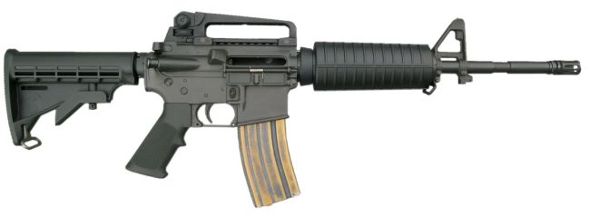
Trajectory
Trajectory is the path that the bullet will take when it is fired from the rifle.
Path of Bullet
This is what happens when a bullet leaves the muzzle, when the barrel and line of sight are parallel to the ground.
Notes:
The bullet has no loft capability and begin to fall as soon as it leaves the barrel.

Slide 68
Parts of Trajectory
Line of Sight:
This is what the shooter sees behind the sights and can be illustrated by drawing a straight imaginary line from your eye through the rear and front sights out to the target. This is how you aim.
Line of Sight
Notes:
In order to align our weapon with the projectile path,or trajectory, we need to understand a couple of definitions.

Slide 69
Trajectory
Line of Bore:
This is a straight imaginary line that is drawn from the muzzle of the rifle out to the target. It is also the path a bullet would take if gravity and wind resistance weren’t a factor.
Line of Bore

Slide 70


Trajectory
What has to change to hit each target?
50m
150m
300m
Line of sight
Line of bore
Path of round
---------------------------------------------------------------------------------------------------------------------
Target Point of aim

Slide 71




Trajectory
IF
Lower Front Sight Post
High low Center mass
**Remember to keep the same point of aim before and after sight post adjustments.
Notes:
If you move the front sight post in the direction of the up arrow, the post will physically move downward, as the arrow determines change in impact. You are still going to acquire proper sight alignment even though the post has moved. Since the front sight is attached to the end of the barrel, the barrel will be lifted to acquire proper sight alignment.

Slide 72
CHECK ON LEARNING

Slide 73
ENABLING LEARNING OBJECTIVE - H
ACTION: | Manipulate BUIS to achieve Zero
CONDITIONS: | Given an M4 Carbine with BUIS and instructions on operating procedures for BUIS manipulation.
STANDARDS: | Each Trainee will manipulate an M4 Series Carbine and properly adjust their BUIS by: -Identifying all components of the Back Up Iron Sights. -Ensuring the Bullet Drop Compensator (BDC) is set on the 300 Meter Setting. -Identifying the Front Sight Post Elevation increments of 2 (2) Minutes of Angle. -Identifying the Windage Adjustments are ¾ (.75) Minutes of Angle.

Slide 74
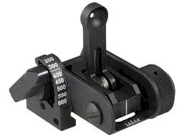
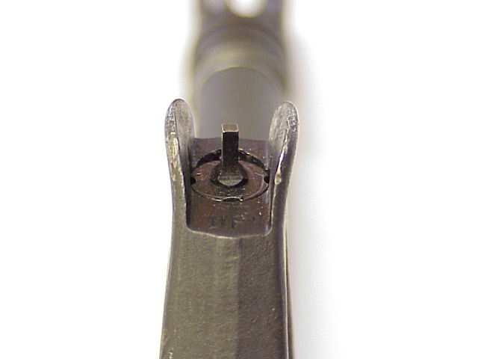
BACKUP IRON SIGHT (BUIS)
The BUIS is a semi-permanent flip-up sight equipped with a rail-grabbing base. The BUIS provides a backup capability effective out to 600 meters and can be installed on M16A4 rifles and M4 carbines.
Front sight post is not bent or damaged and the base of the sight post is flush with the front sight base.
Armorer mounted in last slot on upper receiver

Slide 75
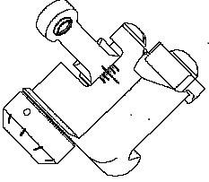
MAJOR COMPONENTS
SIGHT LEAF
SIGHT APERATURE
WINDAGE SCREW
BUTTON HEAD
CAP SCREW
WINDAGE KNOB
INDEX LINES

Slide 76
What is Zeroing?
The average answer is:
“Adjusting the sights so that the bullets impact where we are aiming.”
TC 3-22.9 C1 states: The purpose of zeroing is to align the sights with the weapon’s barrel given standard issue ammunition.
Both answers are correct.

Slide 77

Zeroing
Fire two 5-round groups before making any adjustments
Place five of six rounds from two consecutive 5-round groups in the four centimeter circle

Slide 78
Zeroing
Pre-range departure/post weapons draw checks
Armorer mounted in last slot on upper receiver
Notes:
Q:Do you need to set the rifle to Mechanical Zero every time you go to the range?
A:These presets should be set on a rifle if it is the soldiers first time firing that specific weapon.
If it is the soldiers assigned weapon that has already been zeroed by that individual, this step should be waived.

Slide 79
Zeroing
The Army has developed methods for engaging targets based on the following two scenarios:
Unknown distance = Battle Sight Zero (BSZ)
  BUIS and M68 CCO
Known distance = Bullet Drop Compensator (BDC)
  BUIS, and M68 CCO

Slide 80
BattleSight Zero
To achieve a Battlesight Zero:
If available, use a laser borelight to get on paper at 25m
Zero rifle at 25m
*Confirm and/or refine zero at 300 meters
If possible, engage targets from 100m-300m to confirm point of impact versus point of aim
Notes:
*The most important step in the zeroing process is zero confirmation out to 300 meters. Having a 25 m zero does not guarantee a center hit at 300 meters. The only way to rely on a 300-m hit, is to confirm a 300-m zero. E-2, TC 3-22.9

Slide 81
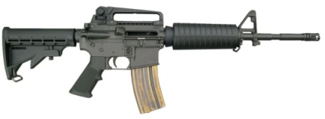
BattleSight Zero
A Battle Sight Zero allows you to aim center mass on a target and achieve a hit from zero to 300m. A correctly zeroed rifle will impact within 10 inches of your point of aim.
Trajectory
10 inches
Line of Sight
25m
180m
300m
350m = 10” below point of aim
400m = 20” below point of aim
300m
350m
400m

Slide 82
Which is CENTER MASS?
Center Mass
Including head
Center Mass
NOT Including the head
Be Consistent
Notes:
Use a paper e-type and have a student come up and show where they perceive center mass to be.
Then fold the target in half to demonstrate where true center mass is.
True center mass would be aiming higher, at 300 meters the probability of getting the target is reduced because you are always higher than your point of aim with a 300 meter zero.
Q:Which target is most commonly missed on a pop-qual?
A:150M, because the trajectory is at its highest pint.
Q:How much is it above point of aim?
A:7-10 inches.
Q:Where does that place the bullets on the target?
A:In the neck or head, depending on the quality of the zero. It may in fact be more due to shooter error. This is why alternate points of aim are recommended for the highest probability of hits out to 300M, in 23-9 (Find Ref.)
Consistency should be stressed. Do not change your idea of center mass.

Slide 83
Minute of Angle (MOA)
What is Minute of Angle?
MOA is an angular unit of measure in fractions of degrees.
1 MINUTE OF ANGLE=1/60 of DEGREE
0
1 degree
270
90
180

Slide 84
Minute of Angle (MOA)
1 minute of angle = 1 inch at 100 yards/meters
1 minute of angle = 2 inches at 200 yards/meters
1 minute of angle = 3 inches at 300 yards/meters
4”
3”
2”
1”
1 MOA
100 y/m
200 y/m
300 y/m
400 y/m

Slide 85
Minute of Angle (MOA) Worksheet
1) 6” @ 600m= ?MOA
2) 3 MOA @ 200m= ?inch
3) 6” @ 400m= ?MOA
4) 4 MOA @300m= ?inch
5) 20” @ 500m= ?MOA
6) 5 MOA @ 300m= ?inch
6”/ (6)00m=1 MOA
3 x (2)00= 6 inches
6”/4= 1.5 MOA
4 x (3)00= 12 inches
20”/ 5= 4 MOA
5 x 3= 15 inches
Notes:
There is a 3 step process to facilitate zeroing. Knowledge in each step area will expedite the zeroing process, saving time and bullets.

Slide 86
Minute of Angle
The standard ‘E-Type’ Silhouette is 40” tall and 20” wide. This is to represent a human target in the kneeling position.
Using known dimensions like these will make your Inch / MOA conversions much easier.
Round your result to the nearest practical measurement.
10”
40”
30”
Inch ÷ (Distance ÷ 100) = MOA
MOA x (Distance ÷ 100)= Inch
20”

Slide 87
Minute of Angle Practical Exercise
300m
Elevation adjustment?
a. Need to come up 30”
b. 30”/3(00)m = 10 MOA
40”
c. 1 click on front sight = 1 ¾ MOA
d. 10 MOA = about 6clicks on front sight
Windage adjustment?
a. aligned
20”

Slide 88
Minute of Angle Practical Exercise
500m
Elevation adjustment?
aligned
Windage adjustment?
40”
a. Need to come left 10”
b. 10”/5(00)m = 2 MOA
c. 1 click of windage = ¾ MOA
d. 2 MOA = 3 clicks of windage
20”

Slide 89
Minute of Angle Practical Exercise
400m
Elevation adjustment?
a. Need to come down 24”
b. 24”/4(00)m = 6 MOA
c. 1 click on front sight = 1 ¾ MOA
d. 6 MOA= approx 3 clicks on front
sight
40”
Windage adjustment?
a. Need to come left 20”
b. 20”/4(00)m = 5 MOA
c. 1 click of windage = ¾ MOA
d. 5 MOA = 7 clicks of windage
20”
89

Slide 90
Minute of Angle Practical Exercise
600m
Elevation adjustment?
a. Need to come up 18”
b. 18”/6(00)m = 3 MOA
c. 1 click on front sight = 1 ¾ MOA
d. 3 MOA = approx 2 clicks on front sight
40”
Windage adjustment?
a. Need to come right 30”
b. 30”/6(00)m = 5 MOA
c. 1 click of windage = ¾ MOA
d. 5 MOA = 7 clicks of windage
20”

Slide 91
Minute of Angle
Emphasize zeroing in the lower half of the 4 cm circle. This will ensure a higher probability of hits from 150-250 meters.

Slide 92
Minute of Angle
If possible, 5 shot groups are recommended
Makes triangulation more accurate
3 Shot vs 5 Shot

Slide 93
Environmental Conditions
Wind- the most common variable and has the greatest effect on ballistic trajectories, where it physically pushes the projectile during flight off the desired trajectory.
The elements of wind effects are:
-The time the projectile is exposed to the wind (range).
-The direction from which the wind is blowing.
-The velocity of the wind on the projectile during flight.
Limited Visibility- limits the viewable size of a threat, or cause targets to be lost after acquisition.

Slide 94
CHECK ON LEARNING

Slide 95
ENABLING LEARNING OBJECTIVE - I
ACTION: | Boresight the M68 CCO (Close Combat Optic) to the M4-Carbine
CONDITIONS: | In a classroom, given an M4-Carbine, Laser Borelight System, 10 meter target, weapon support (i.e. sandbag, rucksack), TM 9-1240-413-13&P, TC 3-22.9, and small arms cleaning materials.
STANDARDS: | Demonstrate the steps of zeroing the M68 CCO by: Zero the borelight to the weapon. Boresight the CCO to the weapon. Remove the borelight from the weapon.
Notes:
Individual task- 071-705-0011 Mount the M68
Individual task- 071-705-0013Boresight the M68

Slide 96
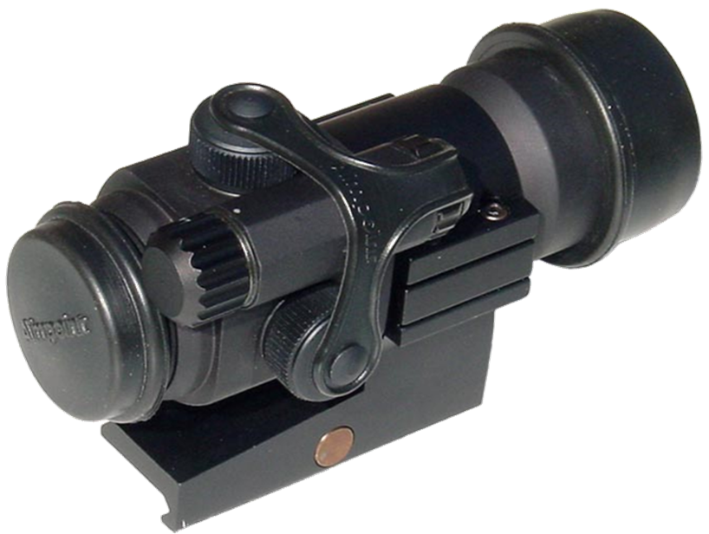
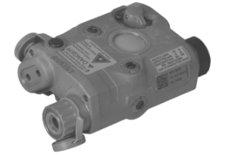
Optic’s and Laser’s
M68 Close Combat Optic (CCO)
AN/PEQ-15 Advanced Target Pointer/Illuminator/Aiming Light (ATIPAL)
AN/PEM-1 Laser Borelight System

Slide 97
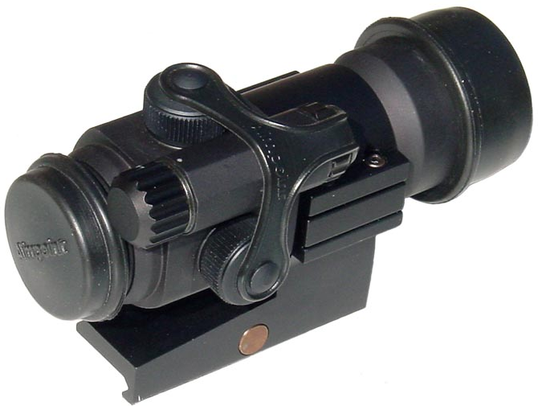
Introduction to the
M68 Close Combat Optic (CCO)

Slide 98
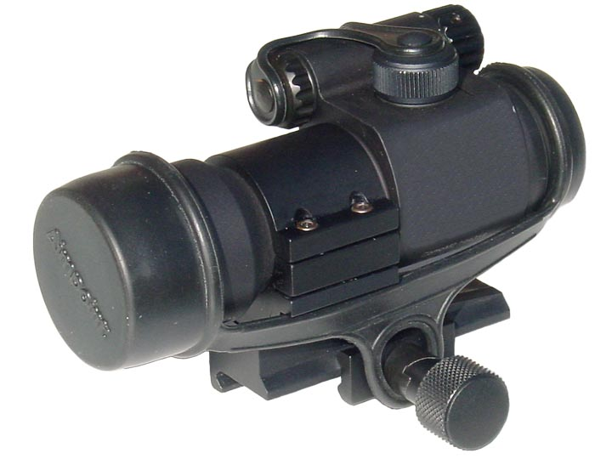
MAJOR COMPONENTS
ELEVATION/ WINDAGE
CAP AND SCREW
ROTARY SWITCH
BATTERY
CAP
REAR LENS COVER
FRONT LENS COVER
TORQUE LIMITING KNOB

Slide 99
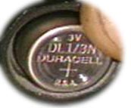
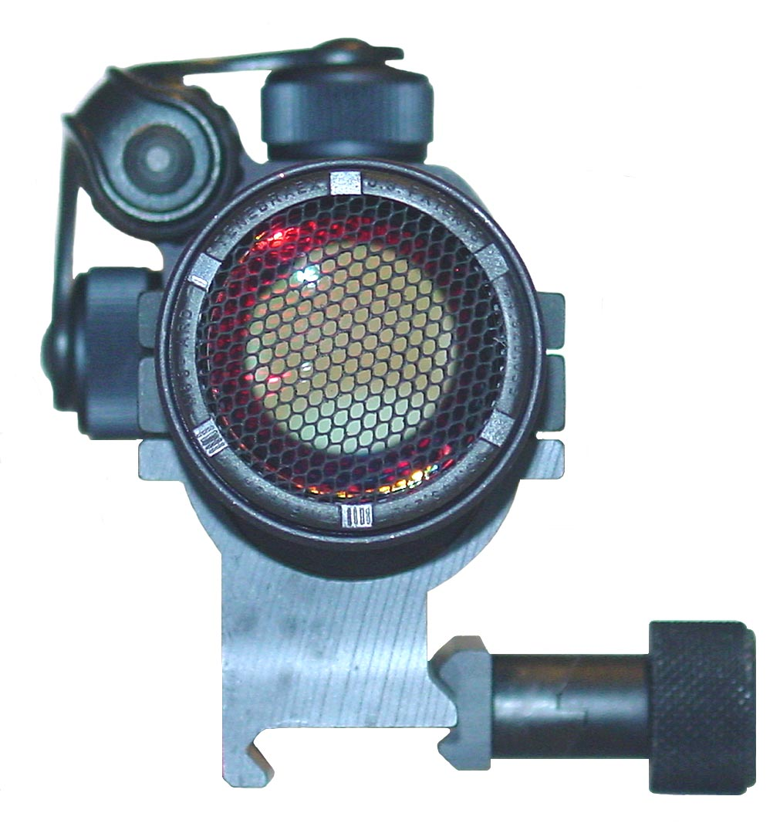
MAJOR COMPONENTS
BATTERY
ORIENTATION
BATTERY
COMPARTMENT
Anti Reflective Device
(ARD)

Slide 100
M68 CHARACTERISTICS
Description: Electrical Red Dot Sight for the M16A1/A2 Rifle, M4 Series Carbine or the Modular Weapons Systems.
M68 Close Combat Optic (CCO): Becomes 100% Parallax Free at 50 Meters and beyond, Features an Anti-Reflective Coated Lens System
LENGTH: 4.9 INCHES (125 mm)
WEIGHT: 6.2 Ozs (175 gms)
BATTERY LIFE: 3-20 DAYS
RED DOT DIAMETER: 2.2 cm @ 25 M
8.8 cm @ 100 M
26.4 cm @ 300 M

Slide 101
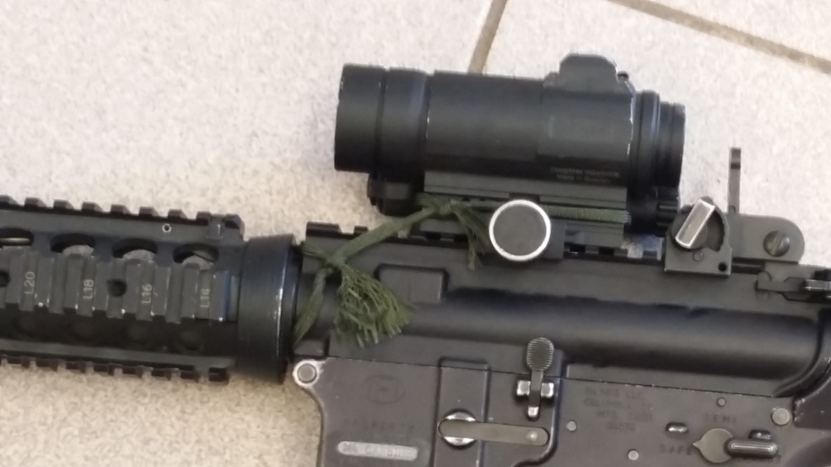
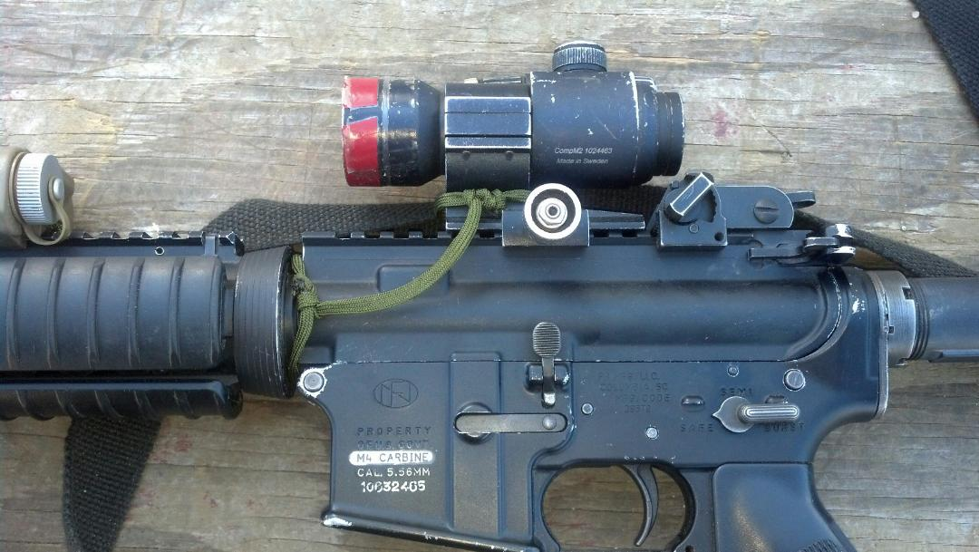
Mounting the CCO
Mount the CCO to the flattop receiver rail (M4, M4A1, M16A4).
a. Ensure base of CCO does not extend past the end of the mounting rail.
b. Ensure the grabber edges wrap around the mounting rail.
c. Ensure torque bar is in slot on mounting rail.
d. Applying finger pressure only, rotate the torque knob counter clockwise until it snaps two times
e. Ensure to burn ends of five fifty cord to eliminate fraying.
Wrong
Right

Slide 102
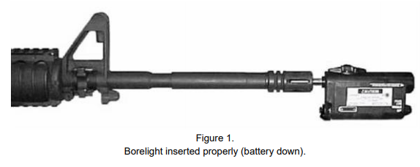
Boresight the M68 CCO to an M4- Carbine
(1) Zero the borelight to the weapon.
a. Ensure the weapon is clear.
b. Stabilize the weapon on the sandbag without a cant.
The weapon does not have to be perfectly level with the ground when boresighting.
c. Attach the 5.56-millimeter mandrel to the borelight.
d. Insert the mandrel into the weapon's muzzle.
Note: The borelight is seated properly when the mandrel cannot be moved any further into the muzzle and the mandrel spins freely.
Notes:
Note: It is best to use two Soldiers to boresight. The firer zeros the borelight by making adjustments on the optic or
aiming laser being used. The target holder matches the beam and zeroing mark, secures the target straight up and down
(aligned with the cant of the weapon) 10 meters from the borelight, and directs the firer to make necessary adjustments.

Slide 103
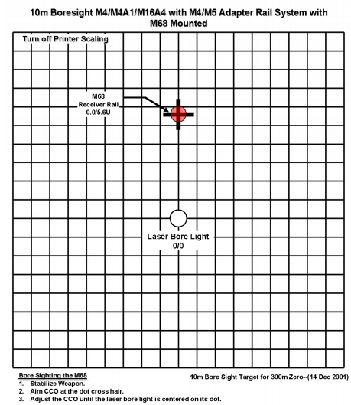
Boresight the M68 CCO to an M4- Carbine
(2) Prepare the target
a. Secure a target that includes the correct boresight offset.
Notes:
Note: It is best to use two Soldiers to boresight. The firer zeros the borelight by making adjustments on the optic or aiming laser being used. The target holder matches the beam and zeroing mark, secures the target straight up and down (aligned with the cant of the weapon) 10 meters from the borelight, and directs the firer to make necessary adjustments. Both Soldiers must clearly communicate their actions.
Note: If possible, use the established 10-meter boresighting target from FM 3-22.9, Appendix F. If not available, then ensure the target used is properly marked with a laser borelight zero mark and the M68 CCO boresight offset (Figure 2). Mark the offset by first identifying the correct offset then starting from the center of the borelight zero mark, count the number of squares (up 5.6) to the M68 CCO 10-meter borelight offset and mark the spot.
(4) Note: If the visible laser cannot be located on the target or does not remain on the target as it is spun, then boresight at 2 meters instead of 10 meters. When the visible laser is zeroed at 2 meters, restart the procedure at 10 meters.

Slide 104
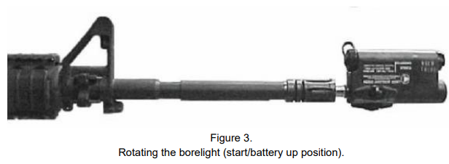
Boresight the M68 CCO to an M4- Carbine
b. Measure 10 meters
c. Turn on the borelight.
d. Ensure the laser strikes the target.
e. Place the borelight in the start position by rotating the borelight counter-clockwise (CCW) 180 degrees until the battery compartment is facing upward.
Notes:
Note: It is best to use two Soldiers to boresight. The firer zeros the borelight by making adjustments on the optic or aiming laser being used. The target holder matches the beam and zeroing mark, secures the target straight up and down (aligned with the cant of the weapon) 10 meters from the borelight, and directs the firer to make necessary adjustments. Both Soldiers must clearly communicate their actions.
Note: If possible, use the established 10-meter boresighting target from FM 3-22.9, Appendix F. If not available, then ensure the target used is properly marked with a laser borelight zero mark and the M68 CCO boresight offset (Figure 2). Mark the offset by first identifying the correct offset then starting from the center of the borelight zero mark, count the number of squares (up 5.6) to the M68 CCO 10-meter borelight offset and mark the spot.
(4) Note: If the visible laser cannot be located on the target or does not remain on the target as it is spun, then boresight at 2 meters instead of 10 meters. When the visible laser is zeroed at 2 meters, restart the procedure at 10 meters.

Slide 105
Boresight the M68 CCO to an M4- Carbine
f. Secure the boresighting target with the laser striking the zeroing mark or draw a zeroing mark (small dot) on the target, where the laser strikes the target.
g. Determine the boresighting reference point.
1. Place the borelight in the half turn position by rotating the borelight CCW 180 degrees until the battery compartment is facing down and the adjusters are on the bottom (Figure 4).
Notes:
Note: It is best to use two Soldiers to boresight. The firer zeros the borelight by making adjustments on the optic or aiming laser being used. The target holder matches the beam and zeroing mark, secures the target straight up and down (aligned with the cant of the weapon) 10 meters from the borelight, and directs the firer to make necessary adjustments. Both Soldiers must clearly communicate their actions.
Note: If possible, use the established 10-meter boresighting target from FM 3-22.9, Appendix F. If not available, then ensure the target used is properly marked with a laser borelight zero mark and the M68 CCO boresight offset (Figure 2). Mark the offset by first identifying the correct offset then starting from the center of the borelight zero mark, count the number of squares (up 5.6) to the M68 CCO 10-meter borelight offset and mark the spot.
(4) Note: If the visible laser cannot be located on the target or does not remain on the target as it is spun, then boresight at 2 meters instead of 10 meters. When the visible laser is zeroed at 2 meters, restart the procedure at 10 meters.

Slide 106
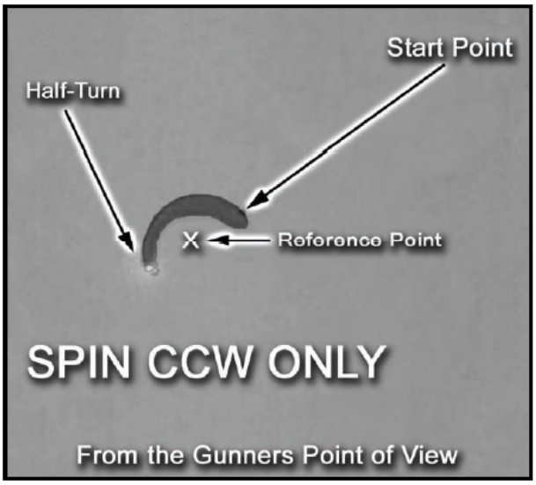
Boresight the M68 CCO to an M4- Carbine
2. Identify the point half way between the start point (battery up) and the half-turn point (battery down) as the reference point.
3. Determine if the borelight is boresighted (zeroed) to the weapon.
Note: A 1cm or less circle means the borelight has been boresighted to the weapon.
Notes:
Note: It is best to use two Soldiers to boresight. The firer zeros the borelight by making adjustments on the optic or aiming laser being used. The target holder matches the beam and zeroing mark, secures the target straight up and down (aligned with the cant of the weapon) 10 meters from the borelight, and directs the firer to make necessary adjustments. Both Soldiers must clearly communicate their actions.
Note: If possible, use the established 10-meter boresighting target from FM 3-22.9, Appendix F. If not available, then ensure the target used is properly marked with a laser borelight zero mark and the M68 CCO boresight offset (Figure 2). Mark the offset by first identifying the correct offset then starting from the center of the borelight zero mark, count the number of squares (up 5.6) to the M68 CCO 10-meter borelight offset and mark the spot.
(4) Note: If the visible laser cannot be located on the target or does not remain on the target as it is spun, then boresight at 2 meters instead of 10 meters. When the visible laser is zeroed at 2 meters, restart the procedure at 10 meters.
Determine if the borelight is boresighted (zeroed) to the weapon. Note: A 1 cm or less circle means the borelight has been boresighted to the weapon.

Slide 107
Boresight the M68 CCO to an M4- Carbine
(3) Boresight the CCO to the weapon
a. Rotate switch knob clockwise to desired brightness level.
b. Aim the red dot in the CCO reticle at the 10-meter boresighting target.
c. Make adjustments to the windage and elevation of the CCO until the borelight is centered with the circle on the boresighting target.
d. Turn the borelight off.
e. Move the weapon off of the boresight point of aim.
f. Realign the red dot in the CCO on the boresight point of aim.
g. Turn the borelight back on.
h. Verify that the borelight laser is in the borelight circle and that CCO red dot is aligned with the boresight point of aim.
Notes:
Note: It is best to use two Soldiers to boresight. The firer zeros the borelight by making adjustments on the optic or aiming laser being used. The target holder matches the beam and zeroing mark, secures the target straight up and down (aligned with the cant of the weapon) 10 meters from the borelight, and directs the firer to make necessary adjustments. Both Soldiers must clearly communicate their actions.
Note: If possible, use the established 10-meter boresighting target from FM 3-22.9, Appendix F. If not available, then ensure the target used is properly marked with a laser borelight zero mark and the M68 CCO boresight offset (Figure 2). Mark the offset by first identifying the correct offset then starting from the center of the borelight zero mark, count the number of squares (up 5.6) to the M68 CCO 10-meter borelight offset and mark the spot.
(4) Note: If the visible laser cannot be located on the target or does not remain on the target as it is spun, then boresight at 2 meters instead of 10 meters. When the visible laser is zeroed at 2 meters, restart the procedure at 10 meters.
Determine if the borelight is boresighted (zeroed) to the weapon. Note: A 1 cm or less circle means the borelight has been boresighted to the weapon.

Slide 108
Boresight the M68 CCO to an M4- Carbine
(4) Remove the borelight from the weapon.
a. Turn the borelight off.
b. Carefully remove the borelight and mandrel from the muzzle of the weapon.
c. Remove the borelight from the mandrel
Notes:
Note: It is best to use two Soldiers to boresight. The firer zeros the borelight by making adjustments on the optic or aiming laser being used. The target holder matches the beam and zeroing mark, secures the target straight up and down (aligned with the cant of the weapon) 10 meters from the borelight, and directs the firer to make necessary adjustments. Both Soldiers must clearly communicate their actions.
Note: If possible, use the established 10-meter boresighting target from FM 3-22.9, Appendix F. If not available, then ensure the target used is properly marked with a laser borelight zero mark and the M68 CCO boresight offset (Figure 2). Mark the offset by first identifying the correct offset then starting from the center of the borelight zero mark, count the number of squares (up 5.6) to the M68 CCO 10-meter borelight offset and mark the spot.
(4) Note: If the visible laser cannot be located on the target or does not remain on the target as it is spun, then boresight at 2 meters instead of 10 meters. When the visible laser is zeroed at 2 meters, restart the procedure at 10 meters.
Determine if the borelight is boresighted (zeroed) to the weapon. Note: A 1 cm or less circle means the borelight has been boresighted to the weapon.

Slide 109
ENABLING LEARNING OBJECTIVE - J
ACTION: | Maintain an M4 Carbine
CONDITIONS: | In a classroom, given an M4-Carbine, magazine, 5.56mm ammunition, TM 9-1005-319-10, TC 3-22.9, and small arms cleaning materials.
STANDARDS: | Demonstrate the steps of maintaining the M4 Carbine by: 1. Clearing 2. Disassembling 3. Cleaning 4. Inspecting 5. Lubricating 6. Assembling 7. Performing a Function Check

Slide 110
Maintain an M4- Carbine
Step 1 Clear the Weapon
The first step in maintaining your weapon is to ensure it is unloaded and cleared.
- Point the weapon in a safe direction
- Attempt to place the weapon on SAFE
- Remove the magazine
- Lock the bolt open
- Inspect the receiver and chamber
- Allow the bolt to go forward
- Close the ejection port cover

Slide 111
CLEAR THE M4
PRACTICE

Slide 112
Maintain an M4
Step 2 Disassemble the Weapon
The second step in maintaining your weapon is to ensure it is disassembled.
Remove the Sling
Remove the hand guards
Separate the Upper and Lower Receiver
Remove the Bolt Carrier Group and the Charging Handle
Disassemble the Bolt Carrier Group
Remove the Buffer and Buffer Spring

Slide 113
Maintain an M4
Step 3 Clean the weapon
-Clean the rifle by removing carbon buildup and lubricating according to lubrication instructions.
-Make sure you remove any excessive oil from the bore before firing.

Slide 114
Maintain an M4
Step 4 Inspect the weapon for Serviceability
Upper Receiver Group
Lower Receiver
Bolt Carrier Group
Note: Report and turn in unserviceable parts for maintenance

Slide 115
Maintain an M4
Step 5 Lubricate the weapon
NOTE: Lightly lubricate means apply a film of lubricant barely visible to the eye.
Generously lube means apply the lubricant heavily enough so that it can be
spread with the finger.
Clean the following rifle parts lightly lubricating with CLP
-Upper receiver and carrying handle
-Lower Receiver Group
-Bolt Carrier Group

Slide 116
Maintain an M4
Step 6 Assemble the Weapon
Reassemble the Buffer and Buffer Spring
Reassemble the Bolt Carrier Group
Replace the Bolt Carrier Group and the Charging Handle
Reassemble the Upper and Lower Receiver
Replace the handguards
Replace the Sling

Slide 117
Maintain an M4
Step 7 Perform a Function Check
The final step in maintaining your weapon is to ensure it functions properly.
-Check to ensure the weapon is clear and the selector lever is on SAFE.
-Conduct SAFE Position Checks
-Conduct SEMI Position Checks
-Conduct BURST Position Checks

Slide 118
MAINTAIN MAGAZINE
Disassemble Magazine
Clean Magazine
Reassemble Magazine

Slide 119
MAINTAIN THE M4 Carbine
PRACTICE
Perform a Function Check

Slide 120
ENABLING LEARNING OBJECTIVE - K
ACTION: | Conduct Preventive Maintenance Checks and Services (PMCS) on an M4-Carbine.
CONDITIONS: | In a classroom environment, given an M4-Carbine; DA Form 2404; demonstration, and practical exercise on conducting Preventive Maintenance Checks and Services.
STANDARDS: | Conduct a proper PMCS on assigned M4-Carbine IAW the appropriate TM 9-1005-310-319-10.

Slide 121
PREVENTIVE MAINTENANCE CHECKS AND SERVICES (PMCS)
-Item # column
-Interval column
-Item to be inspected
-Equipment is not ready / available column

Slide 122
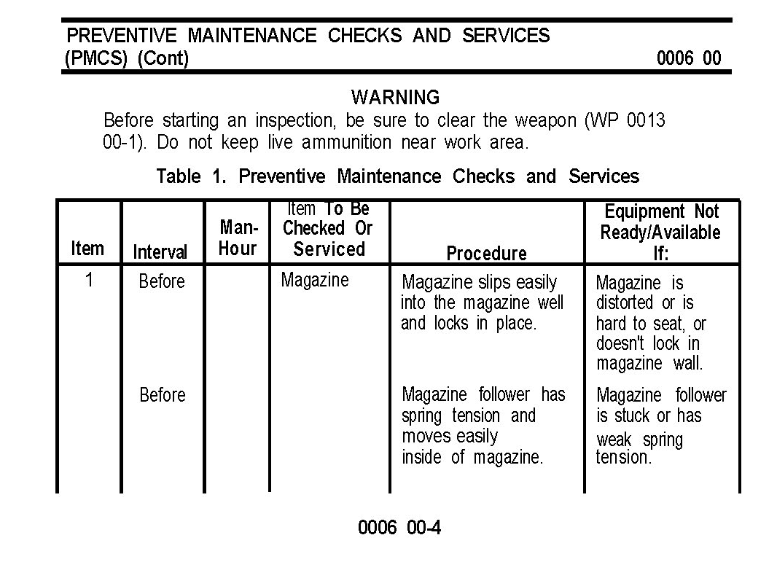
PREVENTIVE MAINTENANCE CHECKS AND SERVICES (PMCS)

Slide 123
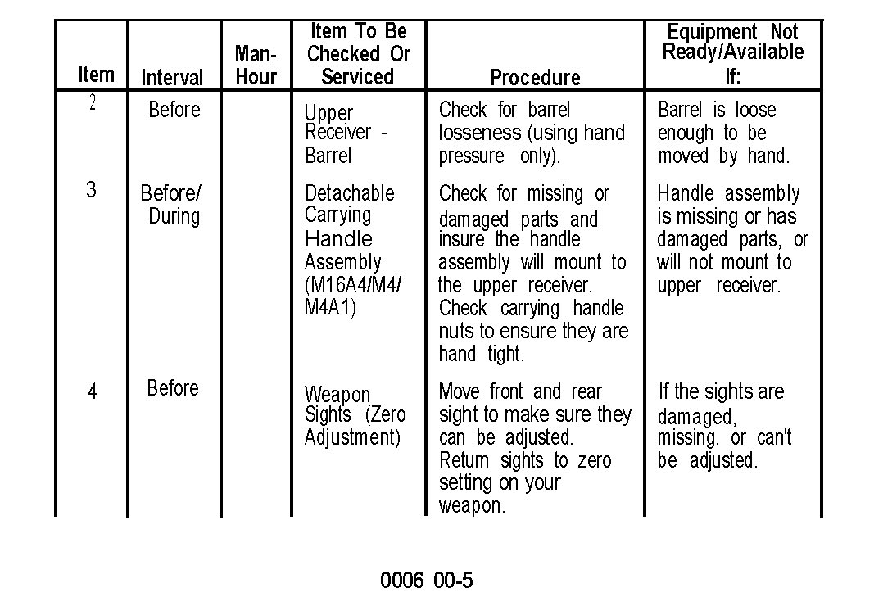
PREVENTIVE MAINTENANCE CHECKS AND SERVICES (PMCS)

Slide 124
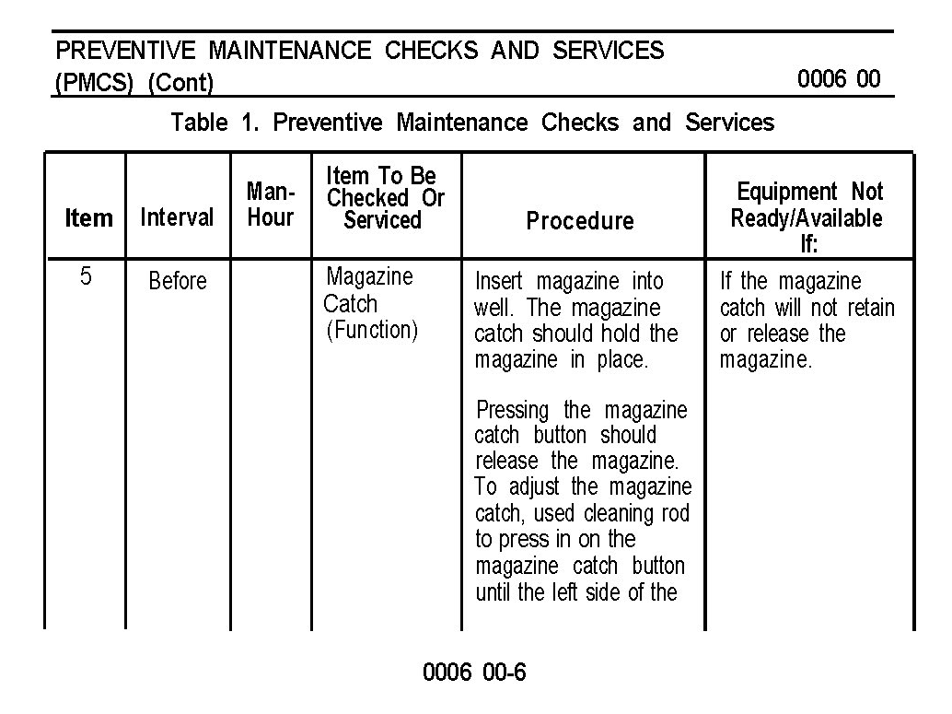
PREVENTIVE MAINTENANCE CHECKS AND SERVICES (PMCS)

Slide 125
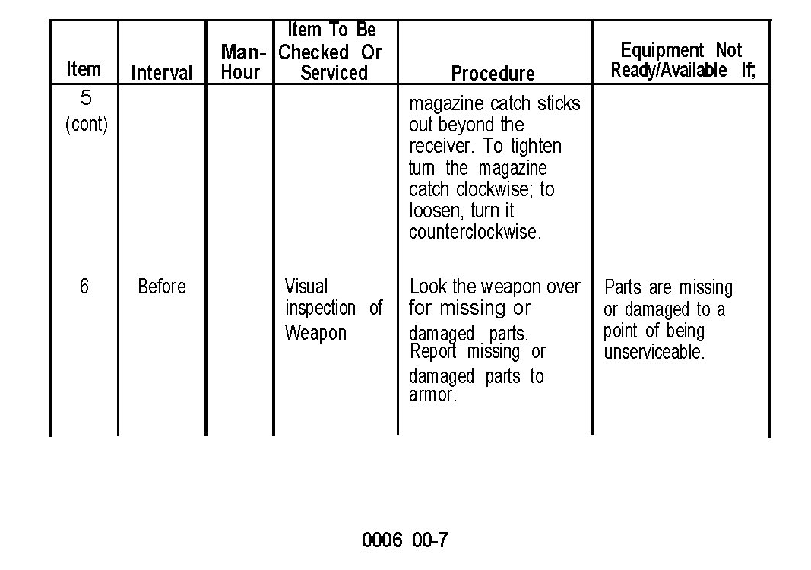
PREVENTIVE MAINTENANCE CHECKS AND SERVICES (PMCS)

Slide 126
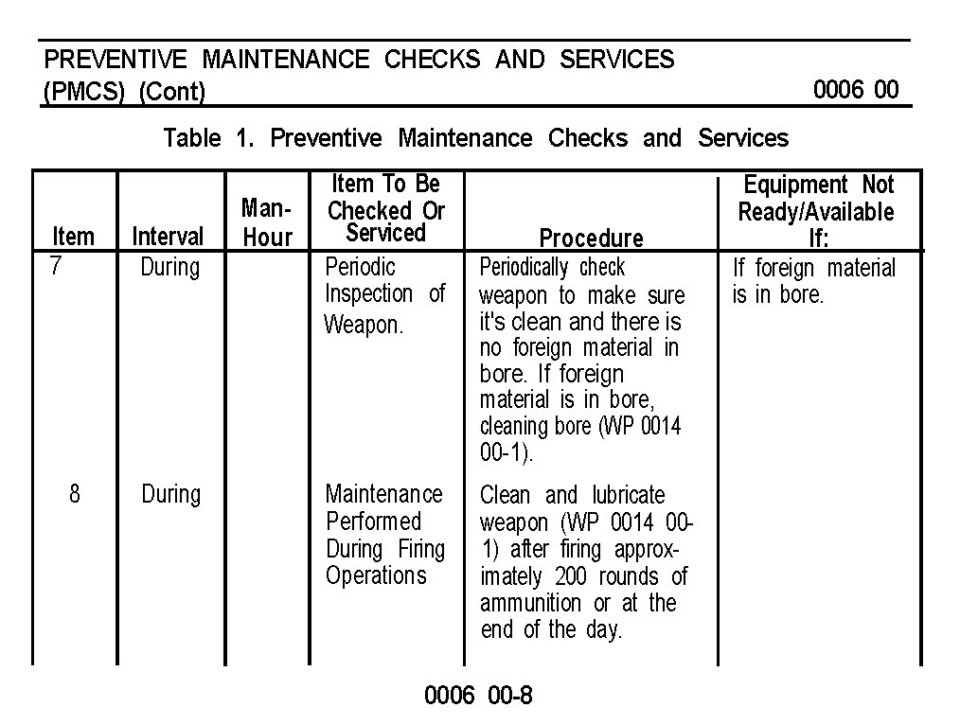
PREVENTIVE MAINTENANCE CHECKS AND SERVICES (PMCS)

Slide 127
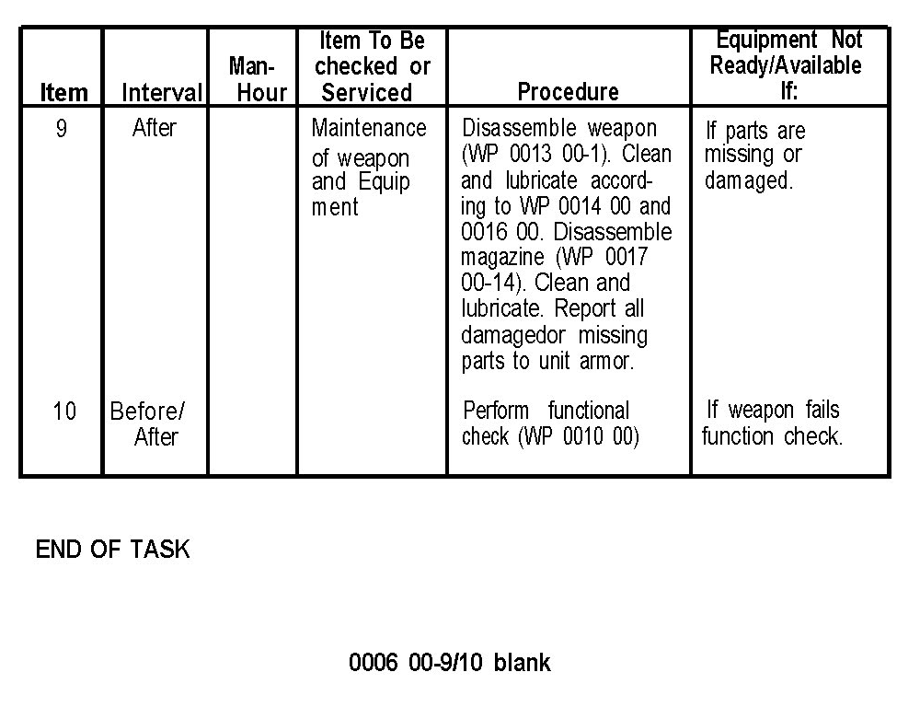
PREVENTIVE MAINTENANCE CHECKS AND SERVICES (PMCS)

Slide 128
CHECK ON LEARNING
&
SUMMARY

