Slide 1
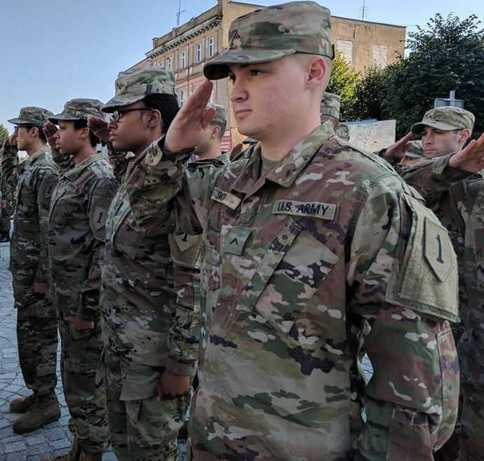
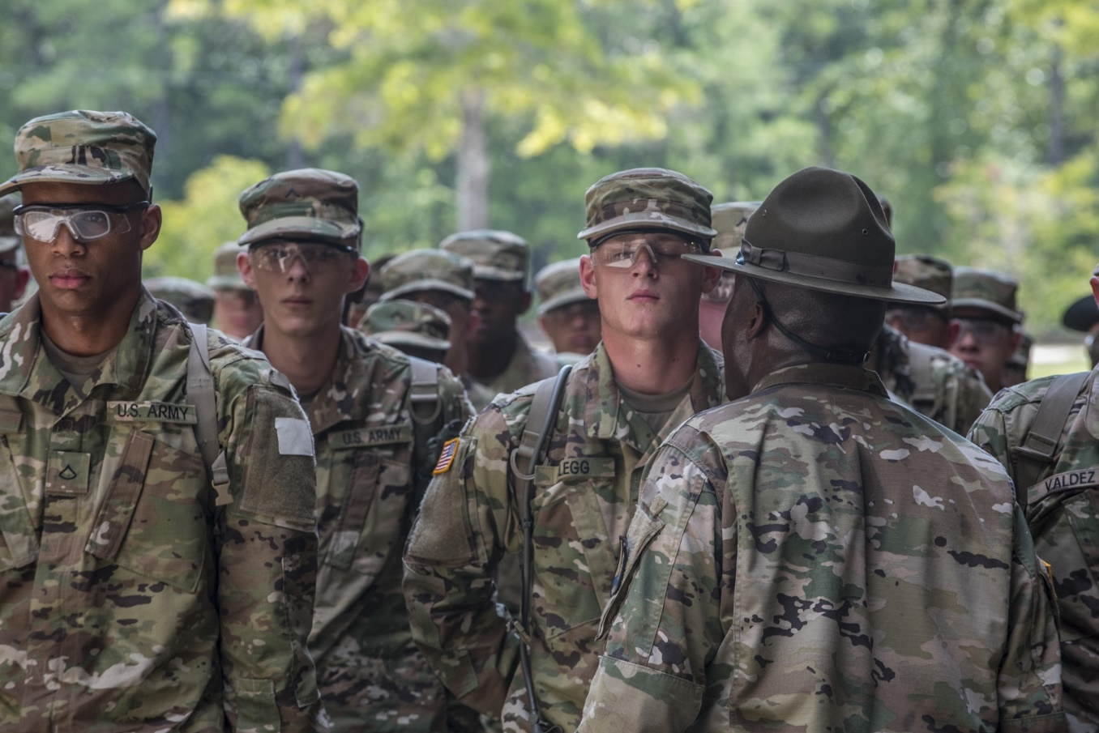
Initial Entry Training/ Basic Combat Training (IET/BCT)

Slide 2
Terminal Learning Objective
Action | Identify the fundamentals of the Sexual Harassment/Assault Response & Prevention (SHARP) program.
Conditions | Given a classroom environment with facilitated discussion, student handouts, applicable DoD and Army policies, and simulated real-life scenarios involving potential and actual sexual harassment and sexual assault situations.
Standards | Identifying the fundamentals of the Army’s Sexual Harassment/Assault Response & Prevention (SHARP) program by defining Army sexual harassment and sexual assault policies, applying appropriate response techniques to sexual harassment and sexual assault incidents, identifying prevention strategies in support of the Army’s SHARP Program to create a culture of Prevention in the Army. Students will have met the standard when they participate in classroom discussions, complete checks on learning, and complete the following without error: 1. Define sexual harassment, including punishment and accountability under the UCMJ. 2. Define sexual assault, including punishment and accountability under the UCMJ. 3. Define consent, intervention, reprisal, retaliation, and whistleblower protection.

Slide 3
The Impact
COMMUNITY
Higher Rates of
Violent Crime
Instability
Degradation
to Community
Diminishes
Community
Relations
UNIT
Disrupts Good Order
and Discipline
Loss of
Safety
Loss of Unit
Cohesion and
Teamwork
Undermines
Readiness
Low
Morale
INDIVIDUAL
Loss of
Personnel
Individual
Self Blame
Isolation
Avoidance
Anxiety
Fear
Depression
Anger
Reduction in
Performance
Less
Productive
Bottom Line:
Sexual harassment and sexual assault endanger lives of
individuals and threaten the Army’s mission.

Slide 4
Definition of Sexual Harassment
Conduct that:
  involves unwelcome sexual advances, requests for sexual favors, and deliberate or repeated offensive comments or gestures of a sexual nature when:
    Submission to such conduct is made either explicitly or implicitly a term or condition of a person's job, pay, or career;
    Submission to, or rejection of such conduct by a person is used as a basis for career or employment decisions affecting that person; or
    Such conduct has the purpose or effect of unreasonably interfering with an individual's work performance or creates an intimidating, hostile, or offensive environment; and
  is so severe or pervasive that a reasonable person would perceive, and the victim does perceive, the environment as hostile or offensive.
Any use or condonation, by any person in a supervisory or command position, of any form of sexual behavior to control, influence, or affect the career, pay, or job of a member of the armed forces or a civilian employee of the Department of Defense.
Any deliberate or repeated unwelcome verbal comment or gesture of a sexual nature by any member of the armed forces or civilian employee of the Department of Defense.
Ref: USC Title 10, Section 1561

Slide 5
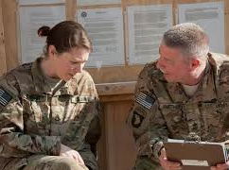

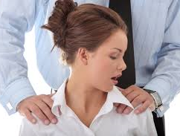
Categories of Sexual Harassment
  Verbal
  Non-Verbal
  Physical Contact

Slide 6

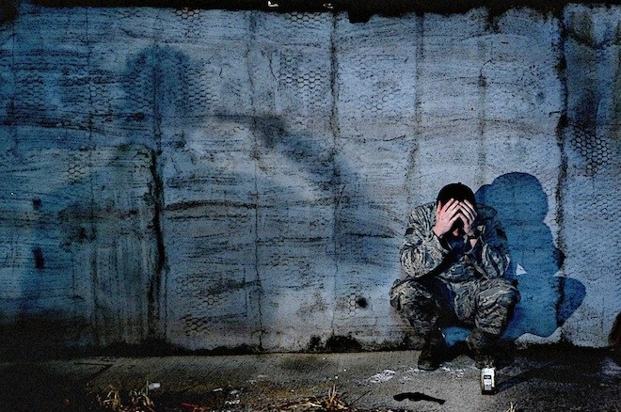
Types of Sexual Harassment
AR 600-20 outlines two types of sexual harassment:
  Quid Pro Quo
  Hostile Environment
Remember, a third party – not just the object of the attention - can also view behaviors as sexually harassing!

Slide 7
Responses to Sexual Harassment
  1. Anonymous complaint
    Encourages the reporting of sexual harassment while maintaining anonymity
  2. Informal:
    Direct approach - Confront the harasser (in person, email, or text) and inform the person that the behavior is not appreciated or welcomed and that it must stop
    Third-party – Ask someone else to talk to the harasser, to accompany the complainant, or to intervene on behalf of the complainant to resolve the conflict
    Chain of command - Report the behavior to your immediate supervisor, or others in the chain of command, and ask for assistance in resolving the situation
  3. Formal complaint
      Filed in writing using DA Form 7279, CDR is notified, and requires a reprisal plan
      Civilians may file an EEO complaint IAW AR 690-600
References: AR 600-20/ DoDI 1020.03

Slide 8


Sexual Harassment Checklist
Key Questions:
Key Questions:
Is the behavior sexual in nature?
Is the behavior unwelcomed?
Would a reasonable person find the behavior inappropriate?
Does one or more of the following exist?
Power, control and influence
Note: All the elements of this
checklist may not be present
or exhibited for Sexual
Harassment to exist
Hostile or offensive working environment

Slide 9

Online Misconduct
Think, Type, Post:
“THINK” what message will be sent, who will potentially view it and its impact.
“TYPE” messages consistent with Army Values.
“POST” if the message demonstrates dignity and respect for self and others.

Slide 10
Admin & UCMJ Sexual Harassment Penalties
Administrative
Administrative reduction
Administrative withholding of privileges
Admonition
Adverse performance evaluations
Bar to re-enlistment
Discharge from service
Mandatory counseling
Rehabilitative transfer to another unit
Relief for cause
Reprimand
Uniform Code of Military Justice (UCMJ) Details
Offense | Article | Maximum Assessment
Violation of a General Regulation | 92 | Dishonorable Discharge, 2 years confinement, and forfeiture of all pay and allowances
Cruelty and Maltreatment of Subordinate | 93 | Dishonorable Discharge, 1 year confinement, and forfeiture of all pay and allowances
Provoking Speeches or Gestures | 117 | 6 months confinement and forfeiture of 2/3 of pay for 6 months
Stalking | 130 | Dishonorable Discharge, 3 years confinement, and forfeiture of all pay and allowances
Indecent Language | 134 | Bad Conduct Discharge, 6 months confinement, and forfeiture of all pay and allowances

Slide 11

Checks on Learning
What are the three categories of sexual harassment?
Verbal
  Telling sexual jokes
  Using sexually explicit profanity or threats
  Using terms such as honey, babe, sweetheart, etc.
Nonverbal
  Undressing someone with one’s eyes
  Displaying inappropriate printed material
  Sending sexually oriented notes, letters, faxes, e-mail, texts, etc
Physical Contact
  Touching, patting, pinching, bumping, or grabbing
  Cornering or blocking a passageway
  Providing unsolicited back or neck rubs
What are the two types of sexual harassment?
1. Quid pro quo 2. Hostile environment

Slide 12
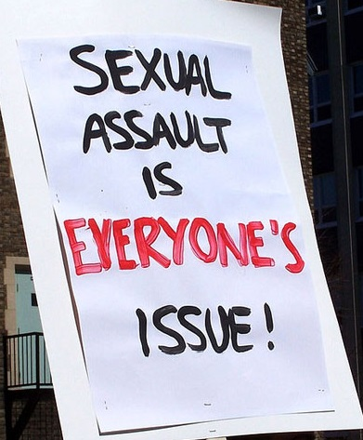
Definition of Sexual Assault
Sexual assault is a crime
Sexual assault is defined as: Intentional sexual contact characterized by the use of force, threats, intimidation or abuse of authority or when the victim does not or cannot consent
The term includes a broad category of sexual offenses of the following specific UCMJ offenses: rape, sexual assault, aggravated sexual contact, abusive sexual contact, or attempts to commit these offenses
Reference: DoDI 6495.02, Change 3

Slide 13
Reporting Options
Restricted Report | Unrestricted Report
Who can accept a report: Sexual Assault Response Coordinator (SARC) SHARP Victim Advocate (VA) Healthcare Personnel | Who can accept a report: Commander CID JAG IG SARC VA Healthcare Personnel
Limitations Chaplains and Special Victim Counsel – cannot file a report, but information shared remains confidential | Limitations More people will know about the sexual assault Investigation may require discussion of personal matters Cannot change to Restricted Report
If someone in the victim’s chain of command has knowledge of the sexual assault, the option for a restricted report is no longer available and they are required to take action

Slide 14
Restricted vs. Unrestricted Reporting
Restricted Report | Unrestricted Report
Benefits Access to medical, advocacy, legal, and counseling services Receive the Sexual Assault Forensic Examination (SAFE) Control the release of personal information Can change to Unrestricted Report at any time Special Victims’ Counsel | Benefits Access to medical, advocacy, legal, and counseling services Receive the SAFE Alleged offender may be held accountable Command support Can receive protective order (Military Protective Order [MPO] or Civilian Protective Order [CPO]) Special Victims’ Counsel
Limitations The alleged offender will not be held accountable Ineligible for expedited transfer or reassignment No command support Cannot receive a protective order | Limitations More people will know about the sexual assault Investigation may require discussion of personal matters Cannot change to Restricted Report

Slide 15
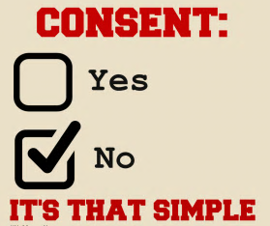
Army Sex Rules
As part of the I. A.M. Strong Campaign, the Army has developed ten Sex Rules to create awareness and as a reminder tool to keep you and your fellow Soldiers out of harm's way.
These ten rules correspond to the seven Army Values.
Rule No. 1: Sexual assault is a crime.
Rule No. 2: No always means no.
Rule No. 3: Without consent, it’s sexual assault.
Rule No. 4: Unwanted physical contact is wrong.
Rule No. 5: Sexually offensive remarks are sexual harassment.
Rule No. 6: Silence doesn’t mean consent.
Rule No. 7: Assess, discern, and mitigate risk.
Rule No. 8: Set the standard of conduct.
Rule No. 9: Stop sexual hazing, bullying, and assault.
Rule No. 10: Be a leader, not a passive bystander.

Slide 16

Checks on Learning
What are the two types of sexual assault reporting?
(1) Restricted report and (2) unrestricted report
Who can receive a restricted report?
Sexual Assault Response Coordinator (SARC), Victim Advocate (VA), and Healthcare Personnel
What are the benefits of filing an unrestricted report of sexual assault?
1. Access to medical, advocacy, legal, and counseling services
2. Receive the Sexual Assault Forensic Exam (SAFE)
3. Alleged offender may be held accountable
4. Command support
5. Expedited transfers
6. Can receive a protective order - Military Protective Order (MPO) or Civilian Protective Order (CPO)

Slide 17

Definition of Consent
What is Consent?
The term “consent” means a freely given agreement to the conduct at issue by a competent person.
An expression of lack of consent through words or conduct means there is no consent
Lack of verbal or physical resistance or submission resulting from the use of force, threat of force, or placing another person in fear does not constitute consent
A current or previous dating or social or sexual relationship by itself, or the manner of dress of the person involved with the accused in the conduct at issue, does not constitute consent
A sleeping, unconscious, or incompetent person cannot consent
All the surrounding circumstances are to be considered in determining whether a person gave consent
Reference: Manual for Courts-Martial, Article120(g)(7)

Slide 18

Bystander Intervention Process
Notice the event
Interpret the event as a problem
Accept personal responsibility for doing something
Decide how to intervene (3Ds)
  Direct
  Distract
  Delegate
5. Take Action!

Slide 19
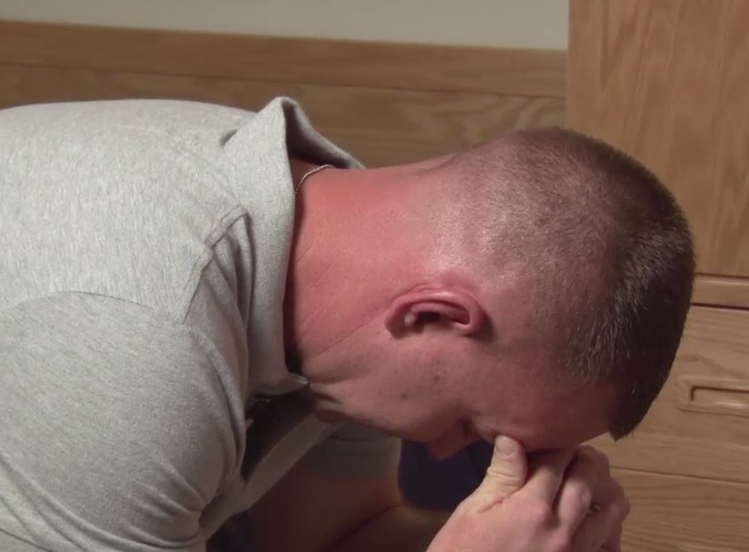
Reprisal
Free to make protected communications
No person may take or threaten to take an unfavorable personnel action
No person may withhold or threaten to withhold a favorable personnel action
DoD Directive 7050.6 Military Whistleblower Protection

Slide 20
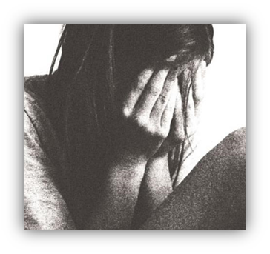
Policy on Retaliation
As per Army Directive 2014-20 (Prohibition of Retaliation Against Soldiers for Reporting a Criminal Offense).
No Soldier may retaliate against a victim, an alleged victim or another member of the Armed Forces based on that individual's report of a criminal offense.
Retaliation can take on 3 types of actions.
Taking or threatening to take an adverse or unfavorable personnel action, or withholding or threatening to withhold a favorable personnel action.
Ostracism. excluding from social acceptance, privilege, or friendship
Acts of cruelty, oppression or maltreatment.

Slide 21
Your SARC/VA
SARC/ VA contact information, phone #, & location
Insert
SARC/ VA
picture(s) here
DoD Safe Helpline: 877.995.5247

Slide 22
Summary
In this lesson, we:
Defined sexual harassment, including punishment and accountability under the UCMJ.
Defined sexual assault, including punishment and accountability under the UCMJ.
Defined consent, intervention, reprisal, retaliation, and whistleblower protection.

