Slide 1
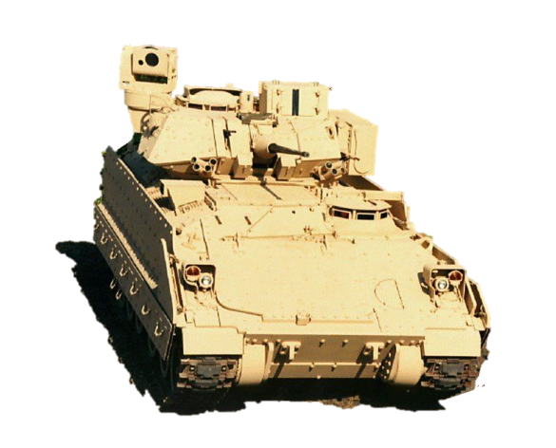
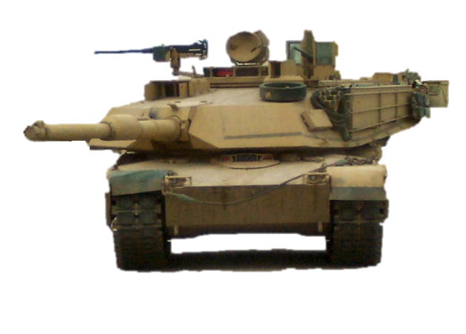
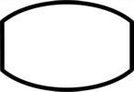
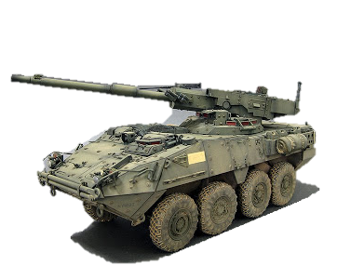



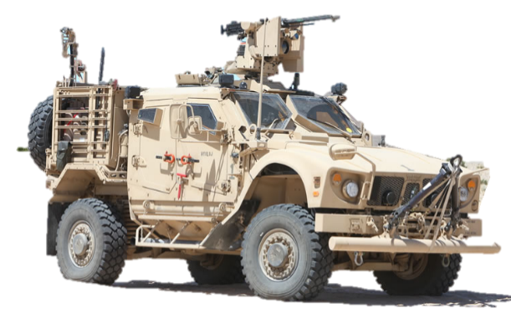
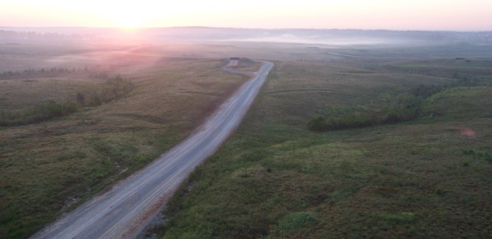
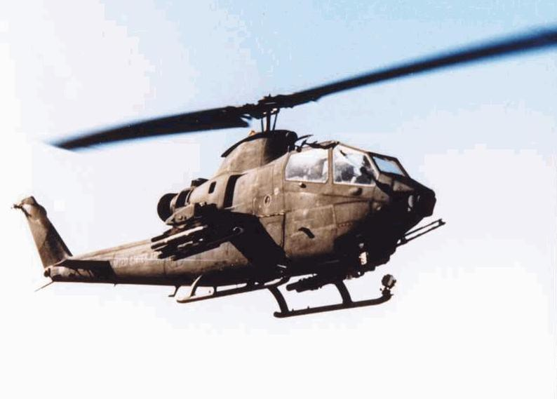
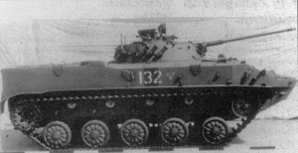
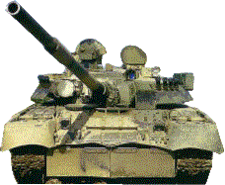
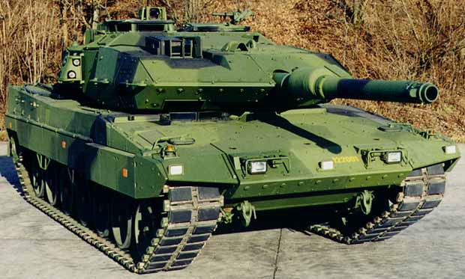
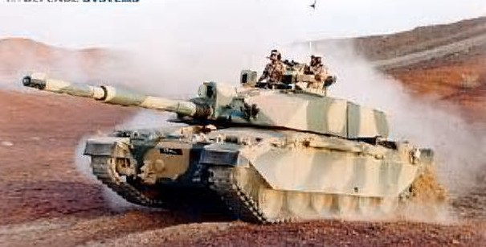
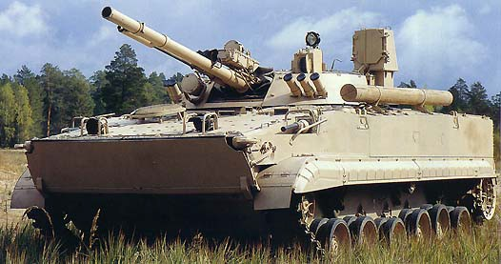
IDENTIFY
Student Study Guide
COMM ON
M_{C}A_{O}S_{R}T_{E}E
R GUNNE R

Slide 2
MASTER GUNNER COMMON CORE
VEHICLE IDENTIFICATION STUDY GUIDE
1.
Key identifiable features for all vehicles tested during MGCC.
2.
1.
2.
3.
Testable Material will include: Vehicle Name (Top of Slide)
Primary and Secondary Armament (Highlighted in Red Box) Ranges for Primary and Secondary Armament (Highlighted in Red
Box)

Slide 3

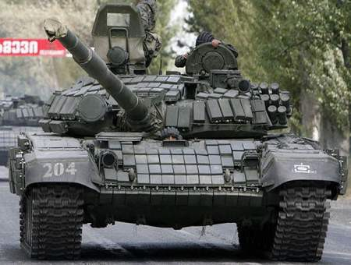






T-72
125mm MER: 3000m AT-11 Sniper MER: 4000m
Gunner’s night optics
Brick shaped ERA
Grenade launchers on the R/S
Loading…
Engine exhaust on the L/S
7.62mm Coax
Gunner’s day optics
Single Driver periscope
22 round carousel auto-loader underneath crew compartment of turret

Slide 4


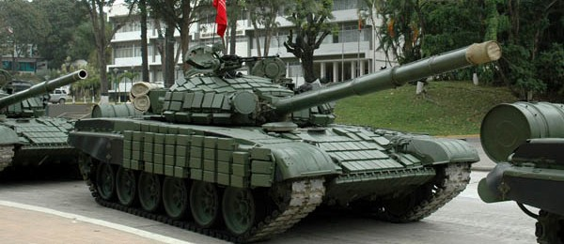




T-72
Vehicle commander on the R/S with
12.7mm MG
Bore evacuator 1/3 away from the end of muzzle
IR search light No grenade launchers
on right side
Extended range fuel tanks
Single driver periscope
Skirts has 4 rows of Brick shaped ERA
Rear sprocket drive and supported track
Brick shaped ERA
6 evenly spaced road wheels

Slide 5
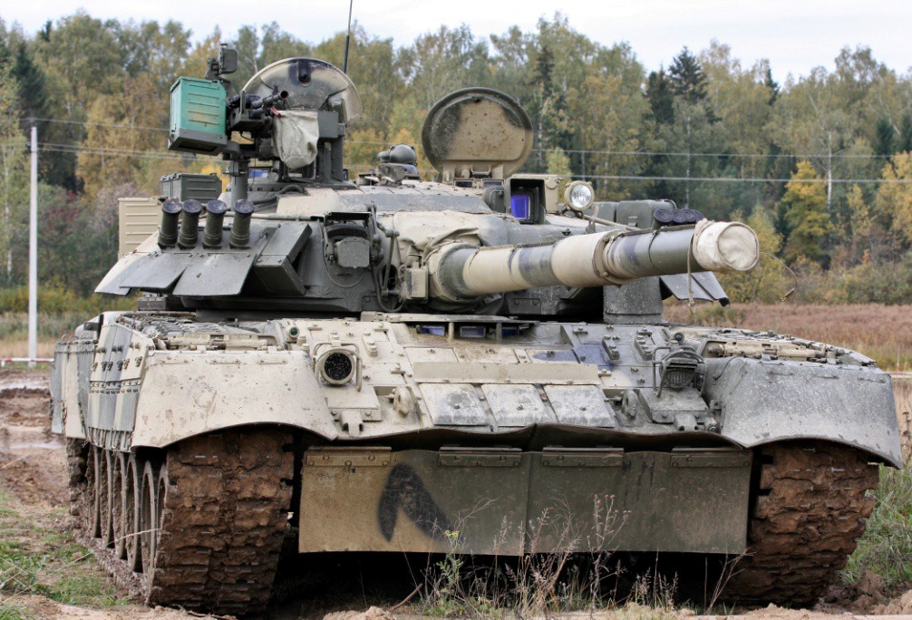




T-80
Vehicle commander on the R/S wit
12.7mm MG
Gunner’s night optics behind day optics
4 smoke grenade launchers on both sides
Gunner’s day optics
Loading…
Add on armor & anti- armor RPG plates to protect turret ring
125mm MER: 3000m
AT-8 Songster MER: 4000m
7.62mm Coax
3 driver periscopes
Add-on armor plates front hull
28 round carousel auto-loader underneath crew compartment of turret

Slide 6
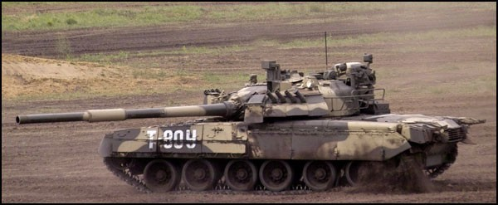








T-80
Gunner’s night optics
Anti-armor RPG plates to protect turret ring
125mm gun can fire a radio guided missiles. Bore evacuator 1/3 from the end of the muzzle.
Gunner’s day optics
Extended range fuel tank racks
Add-on armor plates on front skirts
Turbine engine exhaust center rear
1 & 2 paired road wheels
3 & 4 paired road wheels
Supported track rear sprocket drive

Slide 7
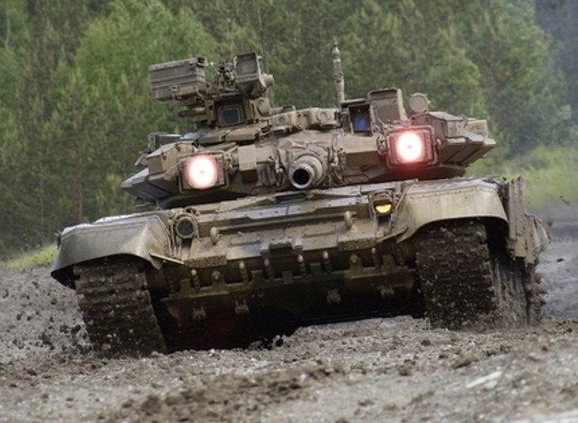




T-90
Vehicle commander on the R/S with
12.7mm MG
Laser warning receivers
Gunner’s night optics
SHTORA optical jammer counter-measure vs. ATGMs
Gunner’s day optics
7.62mm Coax
125mm MER: 3000m
AT-11b Sniper MER: 5000m
Bulldozer blade
V-shaped cut add on armor around driver periscope
22 round carousel auto-loader underneath crew compartment of turret

Slide 8
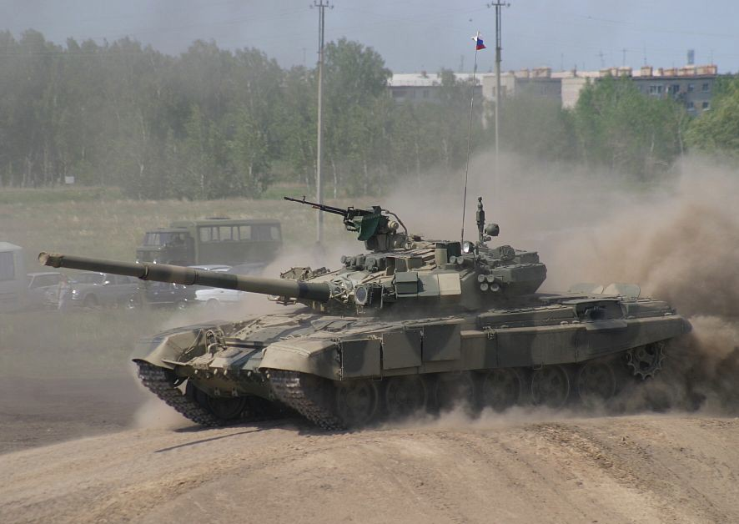


T-90
SHTORA optical jammer counter-measure vs. ATGMs
KONTAKT 5 ERA on
front turret shape of a wedge
125mm gun can fire a laser
guided missile that can shoot down helicopters
Meteorological data collector
Engine exhaust on the L/S
V-shaped cut add on armor around driver periscope
Rear sprocket drive and supported track
3 segmented add-on armor plates on front skirts
6 evenly spaced road wheels

Slide 9


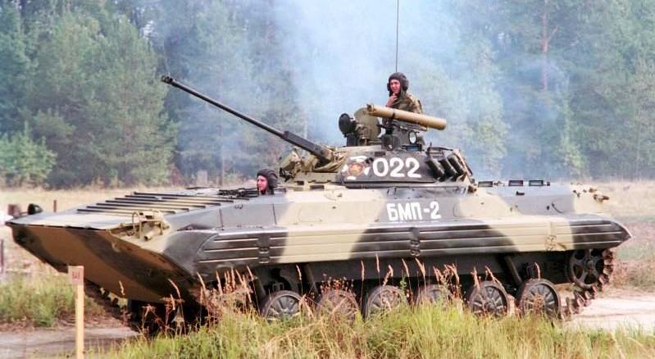



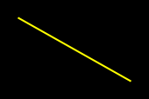
BMP-2
30mm MER: 1500m
AT-5 Spandrel MER: 4000m
Tube launch anti-tank guided missile
Two man larger turret shape of a fry pan
Muzzle break on the end
Troop periscopes for the gun ports
Speed boat shaped
Bullet deflectors
hull with trim vane
Front sprocket drive supported track
Top of the track is high in relationship to the hull
Gap between #4, 5, & 6 road wheel

Slide 10
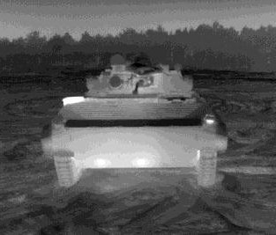


BMP-2
Two man larger wide turret shape of a fry pan
IR search light
30mm MER: 1500m
AT-5 Spandrel MER: 4000m
Engine exhaust
Bullet deflectors
Trim vane
Skinny or thin tracks

Slide 11

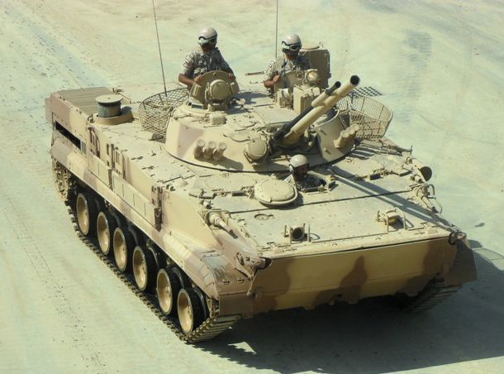







BMP-3
Vehicle commander Gunner
Two man flat wide turret shape of a fry pan
30mm MER: 2000m
100mm HE & AT-10 Stabber MER: 4000m
Square rear end
Bow gunner hatch & 7.62mm MG
Engine exhaust
Loading…
Bow gunner hatch & 7.62mm MG
Driver center of hull
Trim vane folds down
6 road wheels that have western style appearance

Slide 12
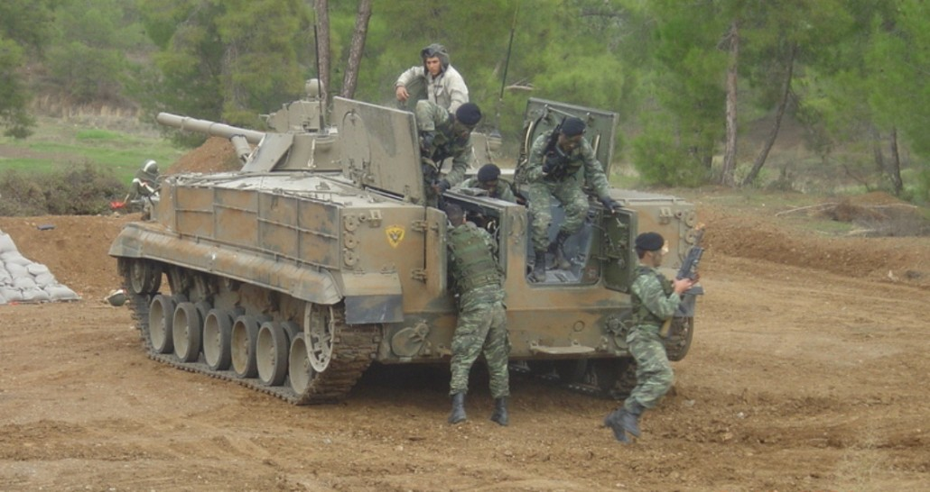



BMP-3
Gunner’s optics
Can carry 6 troops
Square rear end
6 road wheels that have western style appearance
Rear sprocket drive supported track
Hydro propulsion system

Slide 13
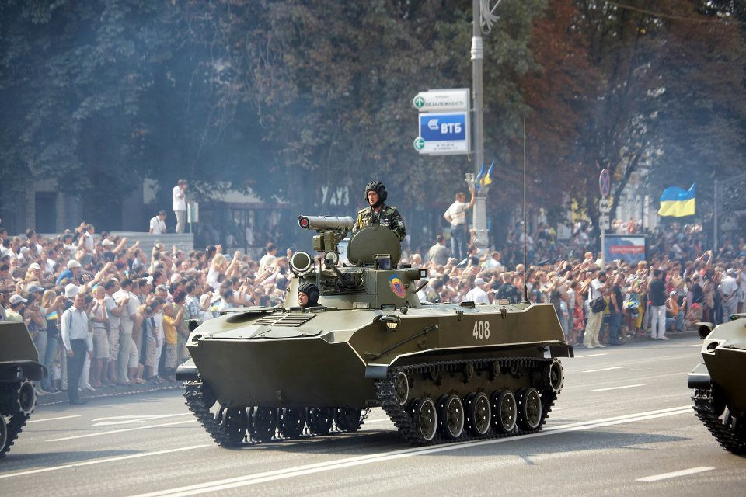





BMD-2
One man small turret for VC/Gunner
30mm MER: 1200m
AT-5 Spandrel MER: 4000m
30mm long skinny gun and tube launch ATGM
Bullet deflectors in front of driver
Sloped rear end
Bow gunner MG port
Rear sprocket drive supported track
5 road wheels that are evenly spaced
4 track support rollers

Slide 14
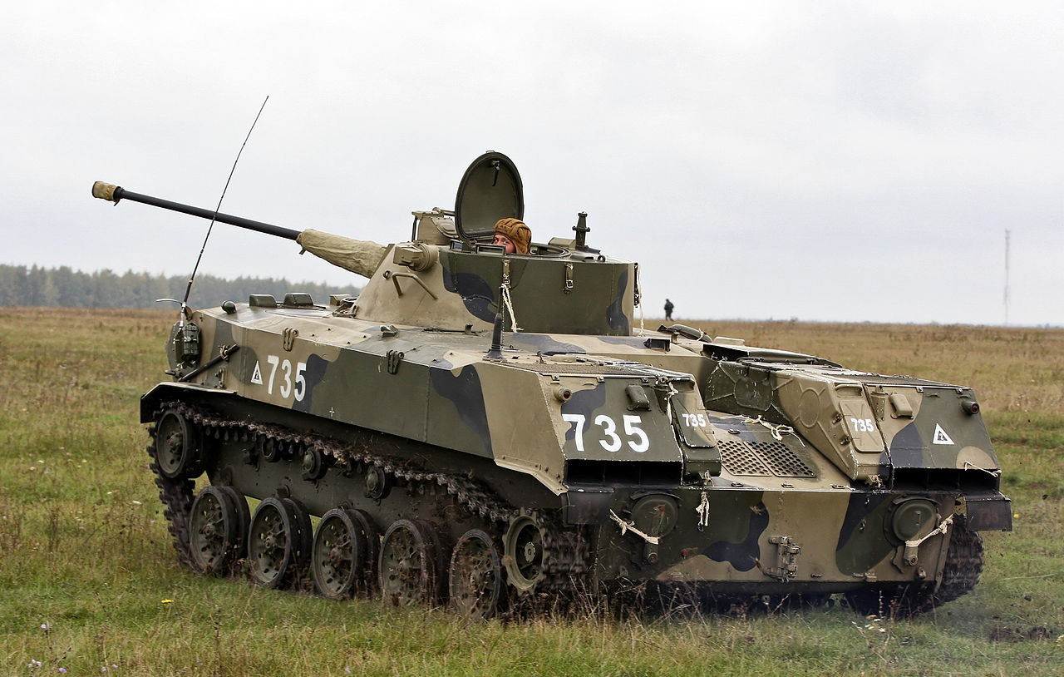





BMD-2
30mm long skinny gun and tube launch ATGM
One man small turret for VC/Gunner
Distinct truck bed appearance in the rear
Muzzle break on the end
Sloped rear end
Engine exhausts
5 road wheels that are evenly spaced
4 track support rollers
Rear sprocket drive supported track
Hydro propulsion system

Slide 15
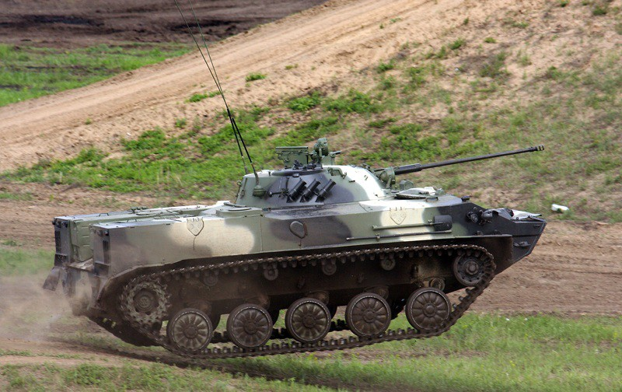





BMD-3
Two man turret with a lower profile
Distinct truck bed appearance in the rear
30mm MER: 1200m
AT-5 Spandrel MER: 4000m
30mm long skinny gun
Squared rear end
Distinct duck bill front slope
Engine exhausts
Rear sprocket drive supported track
4 track support rollers
5 road wheels that look like trash can lids

Slide 16
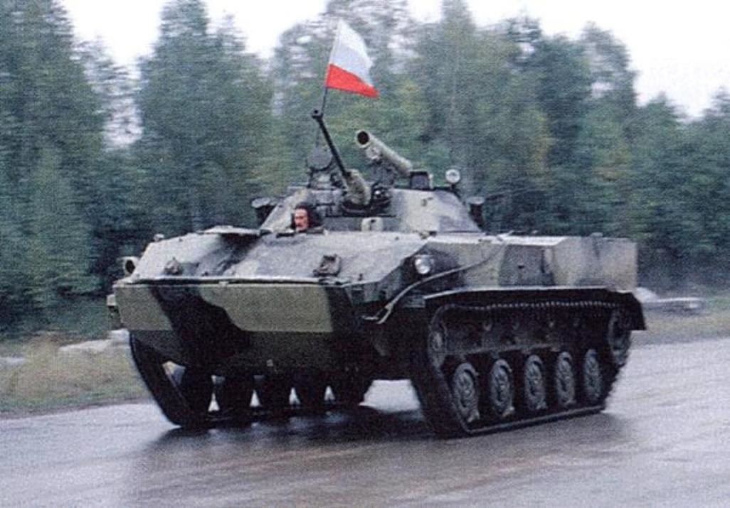



BMD-3
30mm long skinny gun
Two man turret with a lower profile
Tube launch ATGM
Squared rear end
Driver center of hull
Distinct duck bill front slope and it’s straight edge
Rear sprocket drive supported track
Trim vane folds on top
5 road wheels that look like trash can lids
4 track support rollers

Slide 17
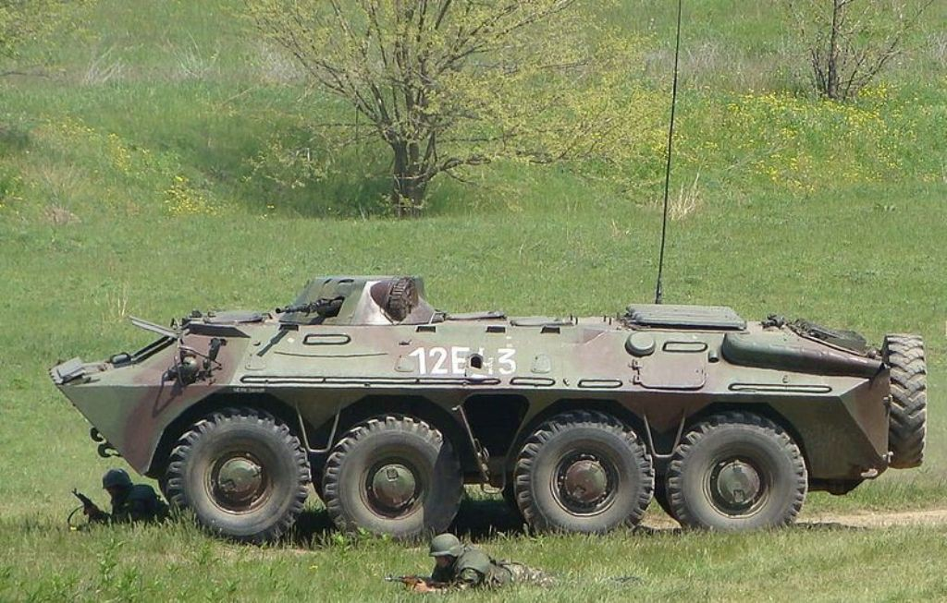




BTR-70
One man turret with no over head hatch
Distinct duck bill front slope and it’s straight edge. Trim vane folds on top
14.5mm MER: 2000m
Distinct sloped rear- end and exhaust
Troop step up in between #1 & 2 wheels
Troop step up in between #3 & 4 wheels
Troop exit door

Slide 18
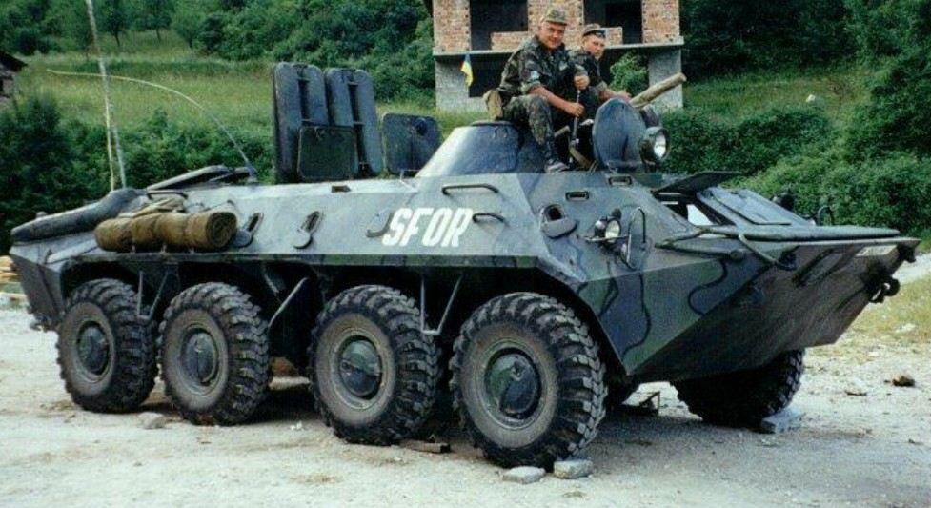




BTR-70
One man turret with no over head hatch
14.5mm MG
Distinct duck bill front slope and it’s straight edge. Trim vane folds on top
Distinct sloped rear- end and exhaust
Twin eyelet windshields
Troop step up in between #3 & 4 wheels
Troop step up in between #1 & 2 wheels
Troop exit door

Slide 19
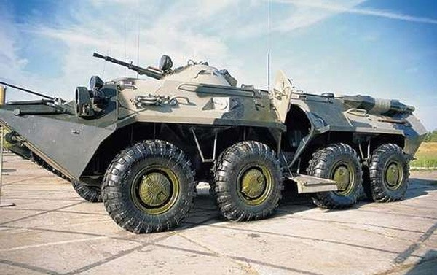


BTR-80
One man turret with no over head hatch
14.5mm MER: 2000m
Distinct duck bill front slope and it’s straight edge. Trim vane folds on top
Exhaust rear-end is horizontally straight
Troop step up in between #1 & 2 wheels
Troop step up in between #3 & 4 wheels
Improved troop exit doors

Slide 20
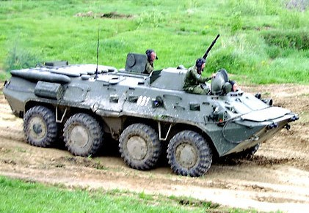
BTR-80
One man turret with no over head hatch
14.5mm MG
Exhaust rear-end is horizontally straight
Distinct duck bill front slope and it’s straight edge. Trim vane folds on top
Twin eyelet windshields
Troop step up in between #3 & 4 wheels
Improved troop exit doors
Troop step up in between #1 & 2 wheels

Slide 21
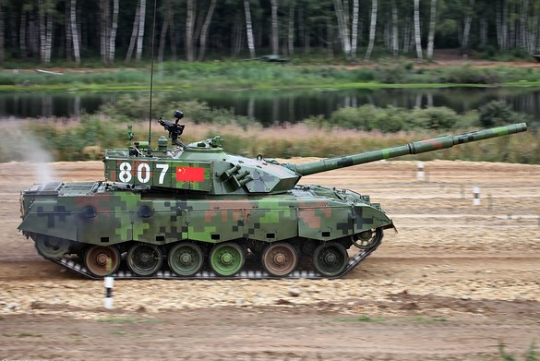








TYPE 96
125mm gun with a bore evacuator 1/3 from the end of the muzzle
Both sides of the turret has 6 smoke grenade launchers
ERA side turret
Type 96 only has 2 engine exhausts on the R/S
ERA front glacis
125mm MER: 3000m
12.7mm MER: 1800m
Rear sprocket drive supported track
6 road wheels with gap between #1, 2 & 3

Slide 22

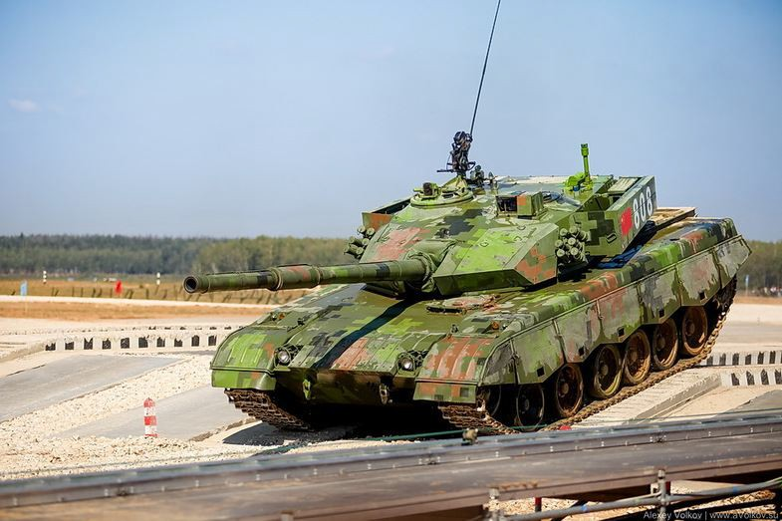
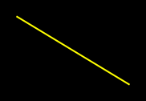




TYPE 96
Vehicle commander’s hatch w. 12.7mm MER 1800m
Gunner optics housing
Meteorological data collector
Both sides of the turret has 6 smoke grenade launchers
125mm gun with a bore evacuator 1/3 from the end of the muzzle
ERA front glacis
ERA side turret
Utilizes a T-72 design carousel auto-loader
NO engine exhaus on L/S
ERA front slope
6 road wheels with gap between #1, 2 & 3
Driver sits on the L/S of hull

Slide 23
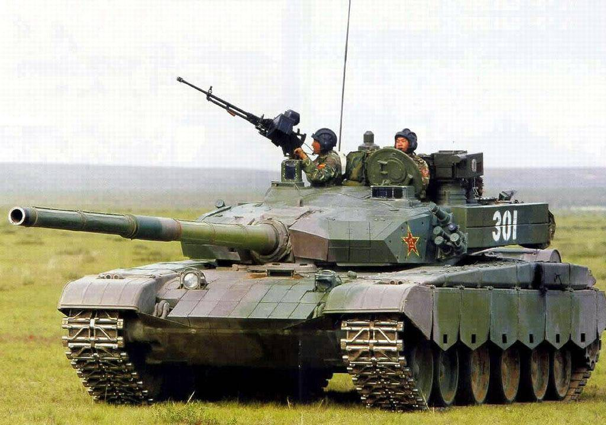









TYPE 99
Gunner optics housing smaller
VC independent optics
Active high powered laser counter-measure vs. missiles
125mm gun with a bore evacuator 1/3 from the end of the muzzle
Both sides of the turret has 5 smoke grenade launchers
Distinct design of ERA on L/S of front glacis. Designed this way for driver exit clearance
ERA side turret
Both sides has 1 engine exhausts
125mm MER: 3000m
AT-11b Sniper MER: 5000m
Utilizes a T-72 design carousel auto-loader
ERA front slope
Driver sits center of the hull with 1 periscope
6 road wheels with #1 & 2 closely paired

Slide 24
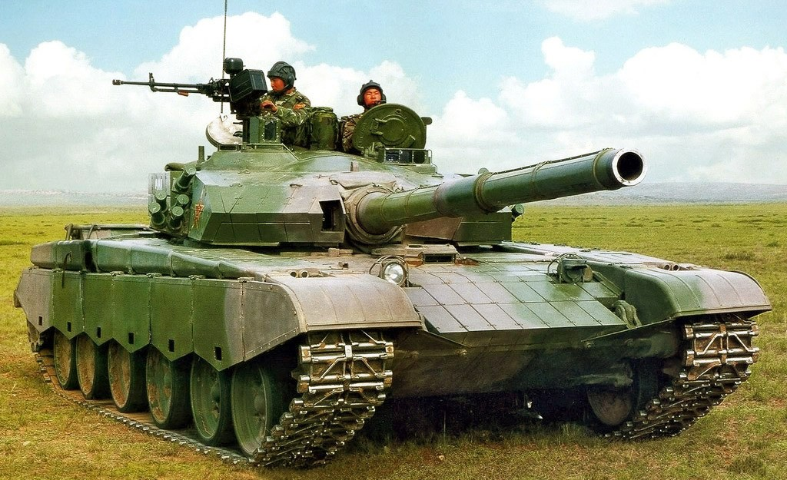





TYPE 99
VC independent optics
Gunner optics housing smaller
125mm gun with a bore
evacuator 1/3 from the end of the muzzle
Both sides of the turret has 5 smoke grenade launchers
Both sides has 1 engine exhausts
7.62mm Coax MG
Utilizes a T-72 design carousel auto-loader
Driver sits center of the hull with 1 periscope
6 road wheels with #1 & 2 closely paired
ERA front slope

Slide 25
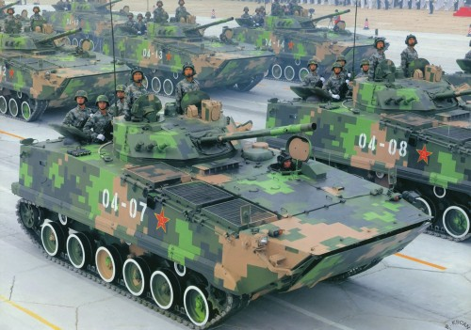




TYPE 97
Vehicle commander
Gunner optics
Two man flat wide turret shape of a fry pan
30mm MER: 2000m
100mm HE & AT-10 Stabber MER: 4000m
Driver center L/S of hull
Engine exhaust
Trim vane folds down
6 road wheels that has a gap between #4, 5, and 6
Front sprocket drive supported track

Slide 26
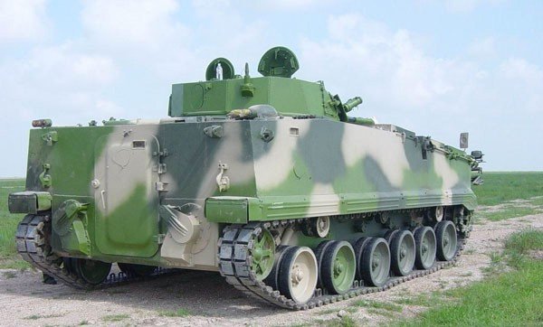



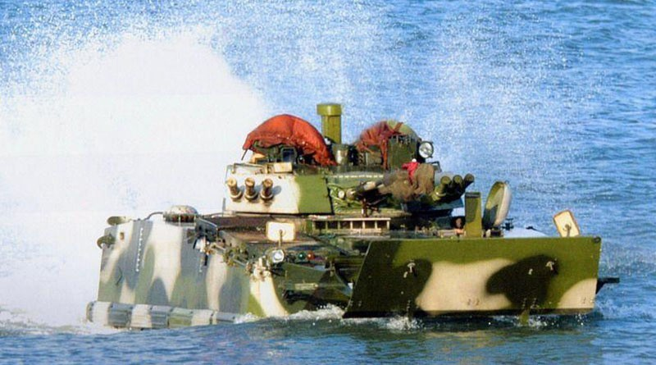

TYPE 97
Troop exit door
Engine exhaust
Front sprocket drive supported track
Hydro propulsion system
6 road wheels that has a gap between #4, 5, and
Trim vane Up

Slide 27


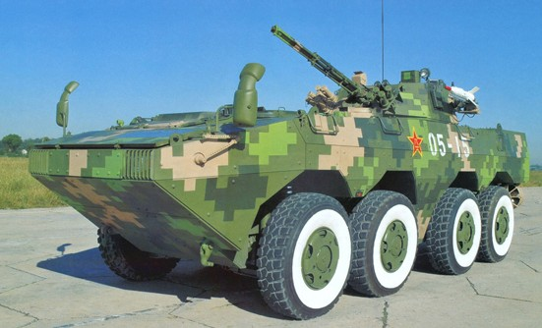



ZBL 09
30mm MER: 2000m
Red Arrow-8 MER: 4000m
Side view mirrors
Speed boat type front hull
Trim vane folds on top
Each wheel has an individual wheel well
Headlights
Distinct hull gap separating the #2 & 3 wheels

Slide 28
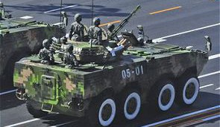



ZBL 09
30mm auto-cannon
Side view mirrors
Driver L/S of hull
Troop exit door
Engine exhaust
Red Arrow-8 ATGM
Propellers for amphibious operations

Slide 29
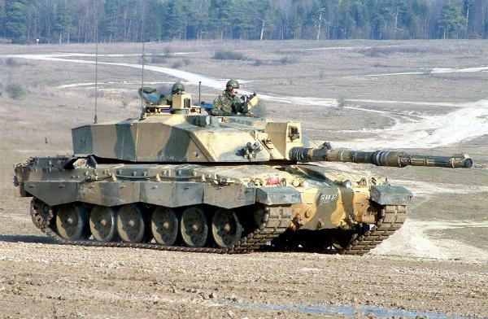







CHALLENGER 2
Sharp angle front armor turret
Stowage boxes wrap around back of turret. Vertical side armor
VC independent viewer
Gunner thermal optics on gun mantle
Bore evacuator 1/3 from the end of the muzzle
Engine exhaust on both sides of hull
Loading…
120mm MER: 4000m
7.62mm MER: 900m
Rear sprocket drive supported track
Gap between #5 & 6 road with 6 sets of road wheels on both sides
Driver sits center of the hull

Slide 30
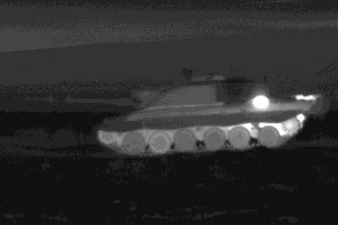

CHALLENGER 2
Sharp angle front armor turret
Stowage boxes wrap around back of turret. Vertical side armor
120mm gun with bore evacuator 1/3 from the end of the muzzle
Gunner thermal optics on gun mantle
Engine exhaust on both sides of hull
Rear sprocket drive supported track
Gap between #5 & 6 road with 6 sets of road wheels on both sides

Slide 31
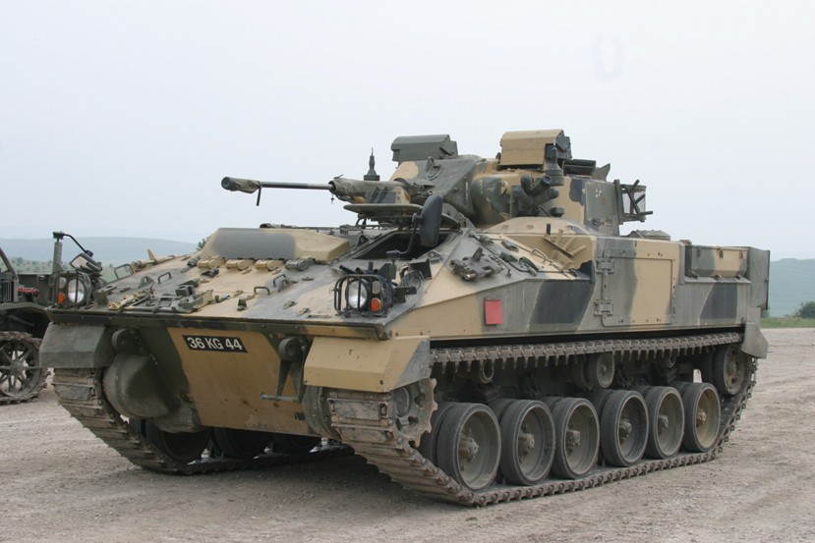



WARRIOR
VC & Gunner optics
Driver L/S of hull 30mm MER: 1500m
7.62mm MER: 900m
Crew escape hatch
Sharp sloped front end
Front sprocket drive supported track
Gap between #3 & 4 road wheels

Slide 32
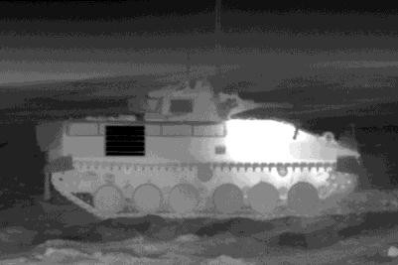

WARRIOR
Engine exhaust R/S
Rear stowage boxes are square
Sharp sloped front end
Combat Identification Panel (CIP)
Front sprocket drive supported track
Gap between #3 & 4 road wheels

Slide 33
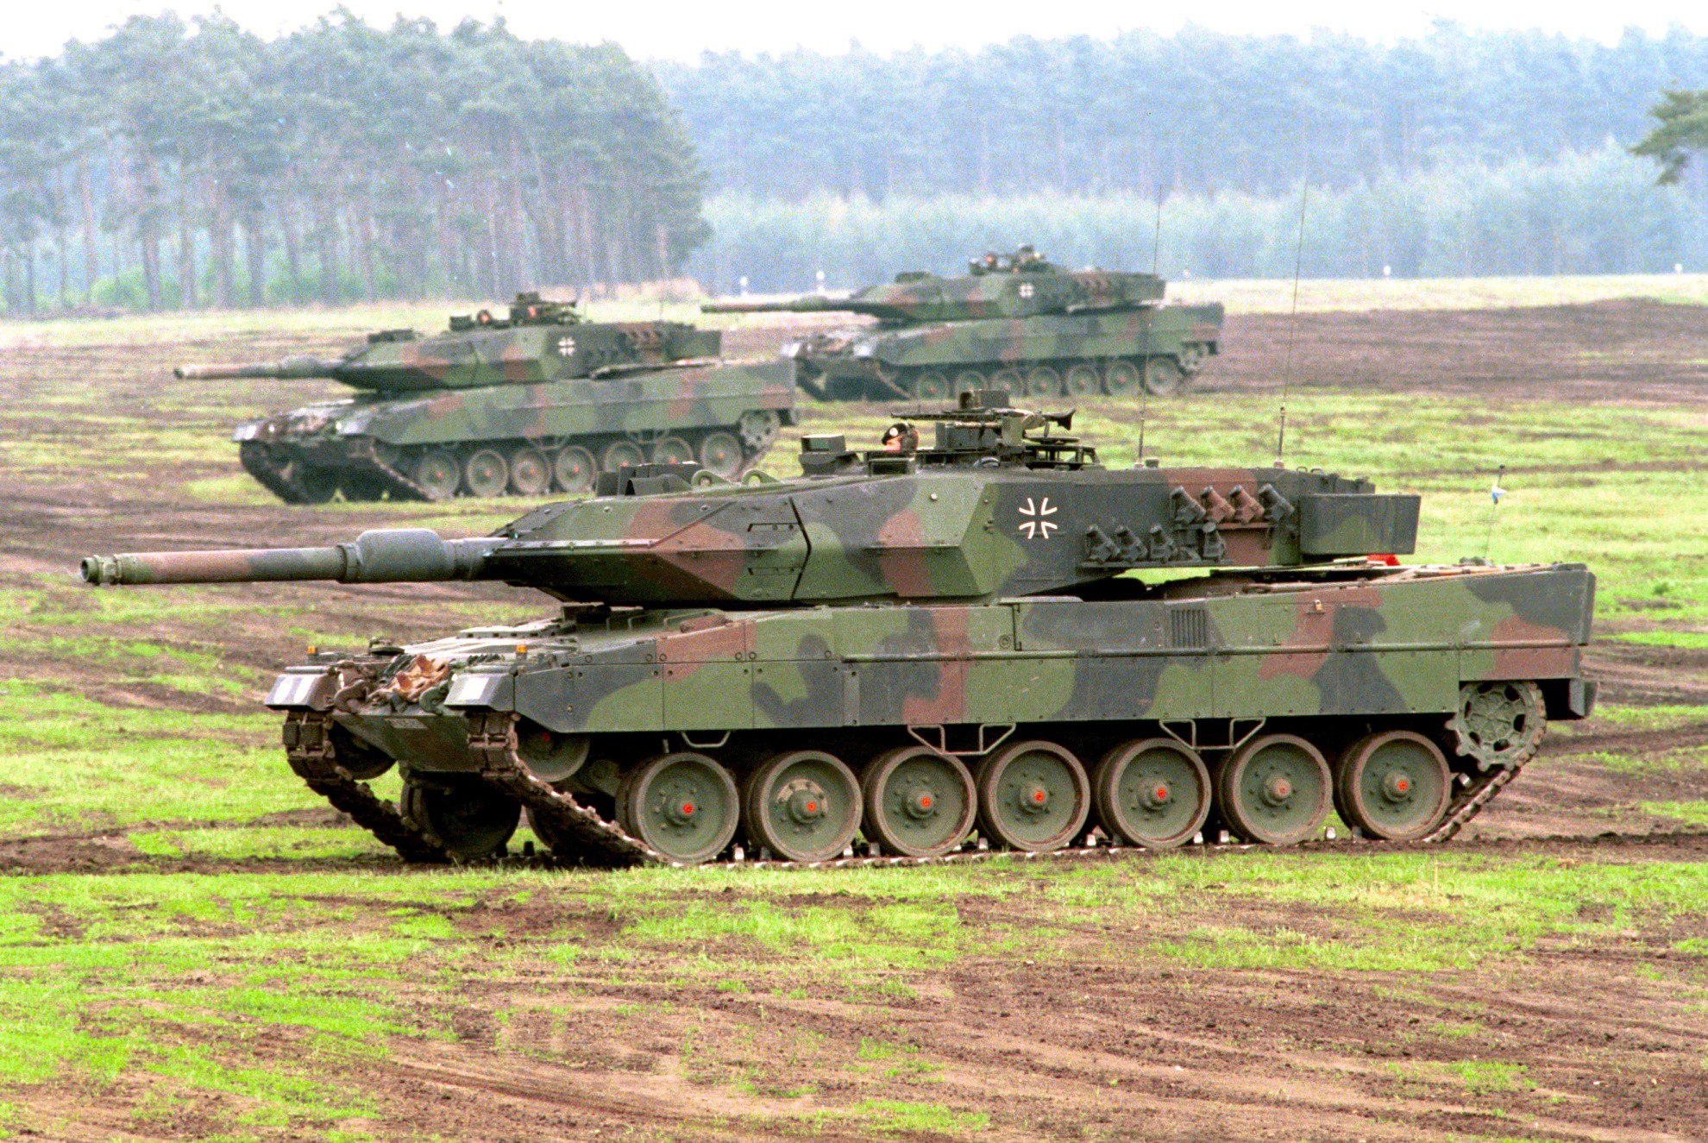


LEOPARD 2
Bore evacuator 2/3 from the end of the muzzle
Leo 2A5 wedge shaped front armor
Gunner’s optics housing
Driver’s hatch R/S of hull
120mm MER: 4000m
7.62mm MER: 900m
7 sets of road wheels evenly spaced
Rear sprocket drive supported track

Slide 34
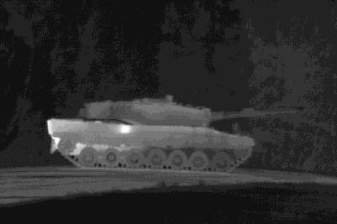

LEOPARD 2
Leo 2A4 flat vertical front armor
120mm gun with bore evacuator 2/3 from the end of the muzzle
Heater exhaust
Rear engine exhaust
Rear sprocket drive supported track
7 sets of road wheels evenly spaced

Slide 35
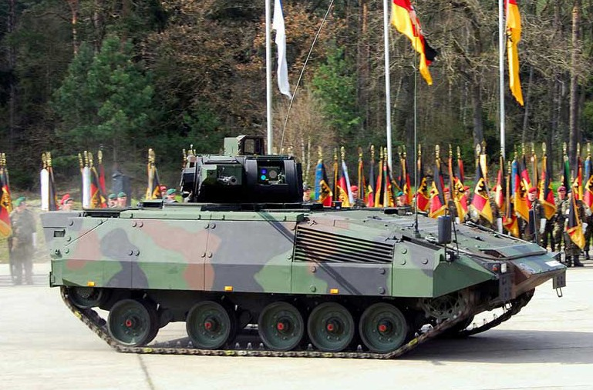





PUMA
Remote operated turret
VC independent optronic camera
Gunner optics
Driver L/S of hull
30mm MER: 3000m 5.56mm MER: 800m
Engine exhaust R/S
Sharp sloped front end
Non-amphibious IFV
Gap between #3, 4 & 5 sets road wheels
Front sprocket drive supported track

Slide 36
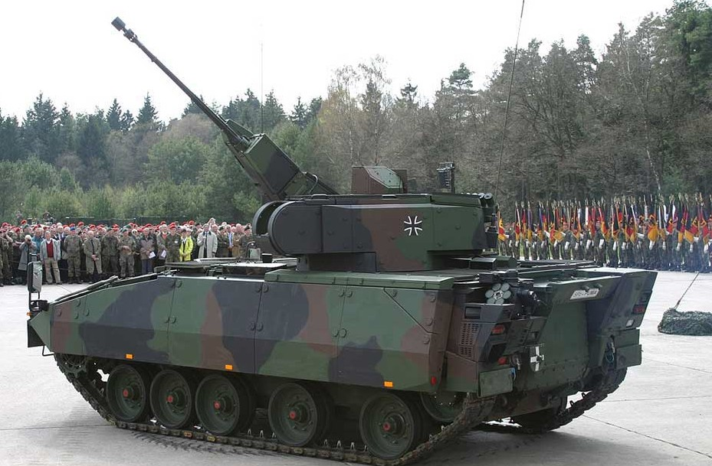




PUMA
VC independent optronic camera
Remote operated turret with 30mm cannon
Gunner optics
Driver L/S of hull
Sharp sloped front end
Drop down troop ram
Front sprocket drive
Non-amphibious IFV
supported track
Gap between #3, 4 & 5 sets of road wheels

Slide 37

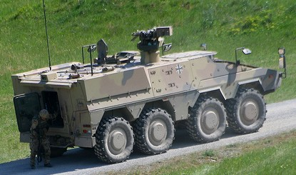



GTK BOXER
Remote operated, can be equipped with 12.7mm or
Modular crew compartment design. It can be removed from the wheel base.
VC hatch
Grenade launcher
Sharp sloped front end
12.7mm MER: 1800m
40mm MER: 2212m
8x8 wheeled APC distinct hull gap separating the #2 &3 wheels

Slide 38


GTK BOXER
Driver hatch has ballistic windshield when driving open hatch
.50 cal MG manually operated
12.7mm MER: 1800m
40mm MER: 2212m
Modular crew compartment design. It can be removed from the wheel base.
Engine exhaust L/S
Sharp sloped front end
8x8 wheeled APC distinct hull gap separating the #2 &3 wheels

Slide 39







LECLERC
VC L/S of turret with an independent thermal camera
Gunner R/S of turret with
his optics
No bore evacuator segmented
thermal shrouds
MRS collimator
Utilizes an auto-loader
Driver L/S of hull
120mm MER: 3000m
12.7mm MER: 1800m
Rear sprocket drive supported track
6 sets of road wheels evenly spaced
Modular armor, designed to be unbolted and replaced if damaged in combat

Slide 40




LECLERC
120mm gun no bore evacuator segmented thermal shrouds
Gunner R/S of turret with his optics
VC L/S of turret with an independent thermal camera
Utilizes an auto-loader
Engine exhaust L/R
Driver L/S of hull
6 sets of road wheels evenly spaced
Rear sprocket drive supported track
Modular armor, designed to be unbolted and replaced if damaged in combat

Slide 41








VBCI
Non-amphibious IFV
DRAGAR one man turret that can be placed in automatic air defense mode using
25mm chain gun
Driver hatch positioned on the down slope of the hull L/S
Modular armor designed to be unbolted and replaced if damaged in combat
Rear smoke grenade launchers
25mm MER: 3000m
7.62mm MER: 900
VC hatch L/S of hull
8x8 wheeled APC with individual wheel wells for each wheel

Slide 42



VBCI
DRAGAR one man turret that
Non-amphibious IFV
can be placed in automatic air defense mode using 25mm chain gun & 7.62mm coax
Modular armor designed to be unbolted and replaced if damaged in combat
VC hatch L/S of hull
Driver hatch positioned on the down slope of the hull L/S
Rear smoke grenade launchers
Engine exhaust
Bottom front end is shaped like a hammerhead shark

Slide 43



K1A1
120mm MER: 4000m
.50 CAL MER: 1800m
Bore evacuator 2/3 from the end of the muzzle
Vehicle commander on the R/S with an independent viewer
Turret lower silhouette in comparison to an Abrams
Gunner’s optics housing
Smoke grenade launchers mounted in front of turret armor
Rear sprocket drive supported track
Driver’s L/S of the hull
6 sets of road wheels on both sides

Slide 44


K1A1
120mm gun with bore evacuator 2/3 from the end of the muzzle
Vehicle commander on the R/S of the turret
Turret is tapered in the rear comparison to an Abrams
Driver’s L/S of the hull
6 sets of road wheels on both sides #3 & 5 are paired together
2 rear diesel engine exhausts
Rear sprocket drive supported track

Slide 45





K21
Fully amphibious
VC independent viewer
40mm MER: 3000m
7.62mm MER: 900m
Gunner optics
2 ATGM launchers
Sharp sloped front end
Driver L/S of hull
Trim vane folds down from the bottom
6 sets of road wheels evenly spaced
Front sprocket drive supported track

Slide 46


K21
Fully amphibious
VC independent viewer
Gunner optics
40mm auto-cannon with cone muzzle break
Drop down troop ram door
Driver L/S of hull
Front sprocket drive supported track
6 sets of road wheels evenly spaced

Slide 47




M1A1 ABRAMS
120mm MER: 4000m
.50 CAL MER: 1800M
Angular large slab armored turret
Vehicle commander on the R/S with
.50 CAL MG
Cylinder smoke grenade launchers indicate this is a Marine Abrams
120mm with bore evacuator 2/3 from the end of the muzzle
Gunner’s optics housing
Driver’s hatch center of hull
Rear sprocket drive supported track
Gap between #1 & 2 road with 7 sets of road wheels on both sides

Slide 48



M1A1 ABRAMS
Angular large slab armored turret
Combat Identification Panels (CIP)
Bustle rack and stowage boxes
120mm gun with bore evacuator 2/3 from the end of the muzzle
Turbine rear engine exhaust
Gap between #1 & 2 road with 7 sets of road wheels on both sides
Rear sprocket drive supported track

Slide 49




M2/M3 BRADLEY
VC independent viewer
VC hatch
Gunner’s optics housing
Tow launchers in stowed position on L/S of turret
7.62mm Coax MG
25mm chain gun
Driver’s hatch
Engine exhaust
25mm MER: 2000m
TOW MER: 3750m
Final drive housings

Slide 50


M2/M3 BRADLEY
Gunner’s optics housing
Tow launchers in stowed position on L/S of turret
25mm chain gun
Driver’s hatch
Front sprocket drive supported track
Gap between #3 & 4 road wheels
Combat Identification Panel (CIP)

Slide 51





LAV-25 COYOTE
Gunner’s optics housing
Turret is longer or turret overhang
25mm MER: 2000m
7.62mm MER: 900m
Muffler on R/S of hull only
Driver L/S of hull
Boat shape hull
Trim vane
Propellers on both rear ends of the hull
Long continuous wheel well, no hull partitions

Slide 52



LAV-25 COYOTE
Turret is longer or turret overhang
25mm chain gun
Boat shape hull
Long continuous wheel well, no hull partitions
Propellers on both rear ends of the hul

Slide 53



STRYKER
(M1126 ICV)
.50cal MER: 1800m MK19 MER: 2212m
Remote Weapon Station (RWS)
VC hatch
Squad leader hatch
Winch
Driver L/S of hull
Slat/Bar armor standard feature in Iraq & Afghanistan
Inner ring in the wheel are troop step rings
No propellers, non- amphibious vehicle
Storage for tire changing equipment

Slide 54



STRYKER
(M1126 ICV)
.50cal MER: 1800m MK19 MER: 2212m
Remote Weapon Station (RWS)
Slat/Bar armor standard feature in Iraq & Afghanistan
Engine exhaust
No propellers, non- amphibious vehicle
Gap between #2 & 3 wheel

Slide 55


AAV
Off-center from the hull is a one man turret with a dual trunnion axis .50 cal and MK 19
.50cal MER: 1800m MK19 MER: 2212m
Driver L/S of hull
Trim vane
Enhanced Armor Appliqué

Slide 56


Off-center from the hull is a one man turret with a dual trunnion axis .50 cal and MK 19
AAV
.50cal MER: 1800m MK19 MER: 2212m
Engine exhaust
Enhanced Armor Appliqué Kit (EAAK
Both sides of the rear- end have propellers
Front sprocket drive un-supported track
6 sets of road wheels, gap between #3 & 4

Slide 57


M-ATV
Variants shown will have a turret or CROW
Front engine,
rear or 4-wheel drive, 4 passenger, 4 door truck
.50cal MER: 1800m MK19 MER: 2212m

Slide 58

M-ATV
Variants shown will have a turret or CROW
.50cal MER: 1800m MK19 MER: 2212m
Front engine,
rear or 4-wheel drive, 4 passenger, 4 door truck

Slide 59






MI-24P HIND-F
Tail rotor is on the L/S
30mm MER: 4000m
AT-6 Spiral: 5000m
5 main rotor blades
Engine exhausts on both sides
Twin air inlets
Bubble shaped tandem pilot canopies
Tail skid
Large sloped wings to mount missiles & rockets
Mid-air refueling stake
Re-tractable landing gear
HIND-F has twin 30mm auto-cannons

Slide 60

MI-24P HIND-F
Tail rotor is on the L/S
5 main rotor blades
Twin air inlets
Engine exhausts on both sides
Large sloped wings to mount missiles & rockets
Bubble shaped tandem pilot canopies
HIND-F has twin 30mm auto-cannons
Re-tractable landing gear

Slide 61



MI-28 HAVOC
Stabilizer wing
5 main rotor blades
Engine exhausts on both sides of fuselage
Armored angular shaped tandem pilot canopies
Mouse nose radar
Fixed wheeled landing gears
30mm MER: 3000m
AT-6 Spiral MER: 5000m
Under mount 30mm chain gun

Slide 62







MI-28 HAVOC
High accuracy radar navigation system
30mm MER: 3000m
AT-6 Spiral MER: 5000m
Armored angular shaped tandem pilot canopies
Tail rotor is on the R/S
Stabilizer fin
Mouse nose radar
Target sight system
Short sloped wing weapon load mount points
Dual air inlets
Under mount 30mm chain gun
Fixed wheeled landing gears

Slide 63




KA-52 HOKUM-B (Alligator)
Coaxial contra-rotating rotor blades
30mm MER: 3000m AT-9 Vikhr MER: 10,000m
No tail rotor
Engine vector exhausts
Vertical rudder
2 pilots sits next to each other in the canopy
Weapon load mount wings are straight
Dual air inlets
30mm chain gun mounted on the R/S fuselage
Large airplane type nose to house the radar system
Re-tractable landing gears

Slide 64





KA-52 HOKUM-B (Alligator)
30mm MER: 3000m AT-9 Vikhr MER: 10,000m
Coaxial contra-rotating rotor blades
No tail rotor Vertical rudder
Engine exhausts on both sides of fuselage
Stabilizer fins
2 pilots sits next to each other in the canopy
Large airplane type nose to house the radar system
Air inlet
Weapon load mount wings are straight
Re-tractable mid-air refueling stake
Re-tractable landing gears

Slide 65






Z-10
Angular shaped tandem pilot canopies
5 main rotor blades
Tail rotor R/S
Engine exhausts on both sides of fuselage
Target sight system
Stabilizer wings
Fixed wheeled landing gears
30mm MER: 3000m HJ-10 MER: 8000m
Chin mount 30mm chain gun
Short aerodynamic wing weapon load mount points

Slide 66




Z-10
Tail rotor R/S
5 main rotor blades
Angular shaped tandem pilot canopies
Engine exhausts on both sides of fuselage
30mm MER: 3000m HJ-10 MER: 8000m
Stabilizer wings
Target sight system
Short aerodynamic wing weapon load mount points
Chin mount 30mm chain gun
Fixed wheeled landing gears

Slide 67



EC-665 TIGER
Mast mounted sight
4 main rotor blades
Tail rotor is on the R/S
Dual engine exhausts
Angular shaped step tandem pilot canopies
30mm MER: 4000m HOT MER: 4000m
Stabilizer wings
Short sloped wing weapon load mount points
Fixed wheeled landing gears

Slide 68



EC-665 TIGER
30mm MER: 4000m HOT MER: 4000m
4 main rotor blades
Air inlets
Tail rotor is on the R/S
Target sight system
Dual engine exhausts
Angular shaped step tandem pilot canopies
Chin mounted 30mm chain gun
Short sloped wing weapon load mount points
Stabilizer wings
Fixed wheeled landing gears

Slide 69



AH-64 APACHE
30mm MER: 4000m
Hellfire MER: 8000m
Engine exhausts
4 Main rotor blades
Tail rotor L/S
Air inlets
Tandem pilot cockpit
Target sight system
Synchronized elevator wing
Both sides of fuselage have straight wing weapon load mount points
30mm chain gun
Fixed wheeled landing gears

Slide 70

AH-64 APACHE
30mm MER: 4000m
Hellfire MER: 8000m
Engine exhausts
4 Main rotor blades
Tandem pilot cockpit
Target sight system
30mm chain gun
Fixed wheeled landing gears

Slide 71



AH-1 COBRA
20mm MER: 2000m
Hellfire MER: 8000m
2 or 4 main rotor blades depending on variant
Air inlets
Tail rotor L/S
Tandem cockpit
Engine exhausts
Chin mounted 20mm Gatling gun
Slim fuselage making it faster and harder to hit
Synchronized elevator wing
Fixed landing skids

Slide 72

AH-1 COBRA
20mm MER: 2000m
Hellfire MER: 8000m
2 or 4 main rotor blades depending on variant
Engine exhausts
Tandem cockpit
Fixed landing skids
Chin mounted 20mm Gatling gun

