Slide 1
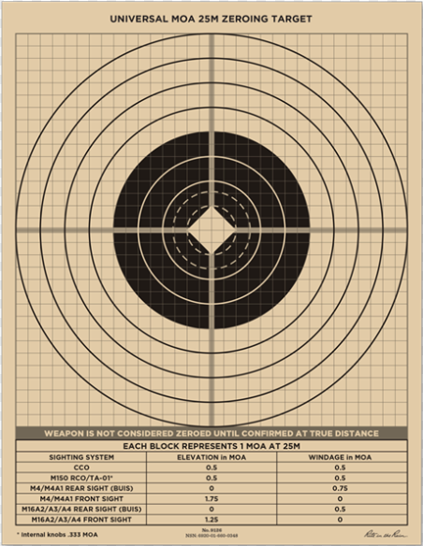
Execute and Assess

Slide 2
Action:
Develop a Unit Small Arms Marksmanship Training Plan
Conditions:
In a classroom given applicable marksmanship references, calculator, pen/pencil, and
paper.
Standards:
Student will develop a Unit Small Arms Marksmanship Training Plan IAW Command Training Guidance, and all applicable references.
Learning Domain - Level: Cognitive – Applying No JPME Learning
Areas Supported: None

Slide 3
PROGRESSIVE INTEGRATION
Tier 4- Individual, Special Purpose, and Crew Served Weapons
  Table I: PMI (up to 6 weeks prior)
  Table II: Simulations (up to 6 weeks prior)
  Table III: Drills (up to 6 weeks prior)
  Table IV: Group/Zero (up to 3 days prior)
  Table V: Practice Record Fire (up to one day prior)
  Table VI: Record Fire
What do you need to execute and Assess?
Resources
Personnel
Timelines/Throughput
Land
*= Gated event for each table
Notes:
The focus is to train and qualify Soldiers on their assigned individual or crew-served weapons.
The IWTS requires the Warrior Leader Tasks are completed at the unit level for all Soldiers. Warrior Leader Task proficiency facilitates integrated collective tasks during follow-on gates. The unit selects which warrior tasks will be trained and evaluated

Slide 4
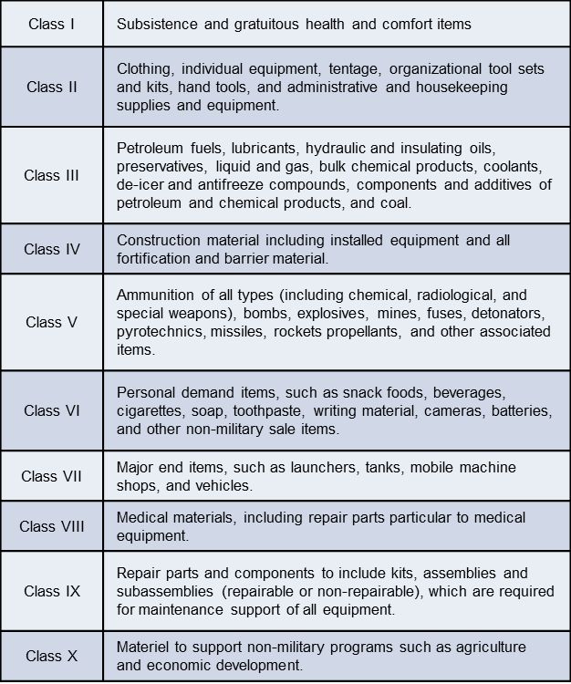
Range Resources

Slide 5
Range Resources
Targets, Panels, and Markers
Notes:
Location of Miss and Hit Operating System;
a. Location of Miss and Hit (LOMAH) is a computer controlled target system that provides
immediate feedback of each shot fired (on or off the target) by an individual shooter on a
computerized display at the individual’s firing position and the centralized tower computer system.
LOMAH enables the individual shooter, coach, or trainer to recognize and identify shooting errors. It
also allows the coach or trainer to assist in correcting shooting errors in a more defined and accurate
methodology while reducing ammunition expenditure and time required for live fire training
exercises.

Slide 6
Personnel
Student to Instructor Ratio
Assistant Instructor (AI) Selection Criteria
Certified Assistant Instructor Vs Qualified Assistant Instructor (dictated by amount of time available to certify)
Additional range personnel needed

Slide 7
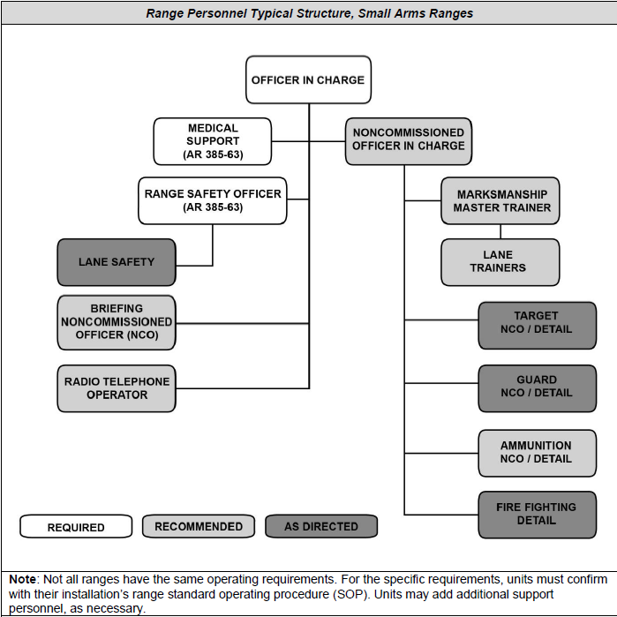
Personnel (pg. 4-12)

Slide 8
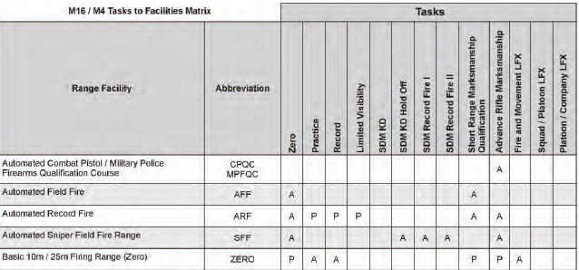
Training Ranges TC 25-8
Appendix A: M16/ M4 Range Matrix
Notes:
The following table represents the individual training requirements for the M4 and M16 series weapons and the appropriate ranges capable of meeting the training event’s specific requirements.
Primary Capability, Listed as “P” on the tables, indicates a primary capability of a range to conduct the specified STRAC resourced requirement. The range identified is specifically designed to accommodate the task.
Alternate Capability, Listed as “A” on the tables, indicates an alternate capability of the range.

Slide 9
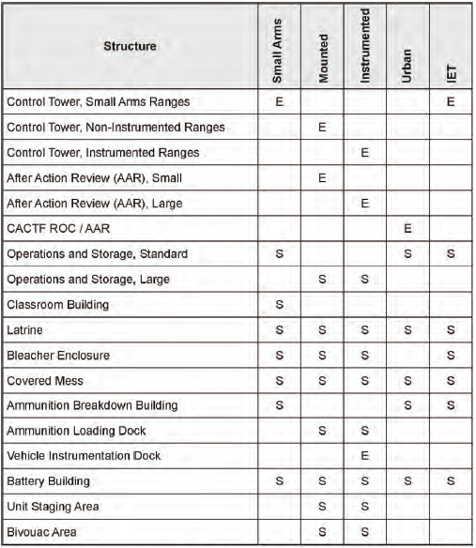
Range Operations and Control Area Facilities
Notes:
Range Operations and Control Area
The ROCA is the center for overall control and operation of the range, training exercises, administrative services, and support facilities. From the range operations and control area, downrange target and simulation equipment are operated and activities are monitored for scoring and performance data review.
There are five types of ROCA facilities: Small (Small Arms); Mounted; Instrumented; Urban; and Initial Entry Training (IET) -ROCA. Each type of ROCA provides a specific set of essential and support structures that facilitate safety, training, re-training, and after-action review on the range as well as the operation and maintenance of the range itself.

Slide 10
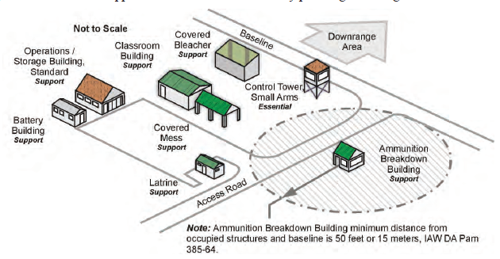
Range Operations and Control Area Facilities
SROCA
Notes:
Small ROCA (SROCA). The SROCA is tailored for small arms ranges and consists of one essential and seven (7) support structures. The following figure is an example SROCA layout that displays the essential and support structures as well as the key planning and design considerations.

Slide 11
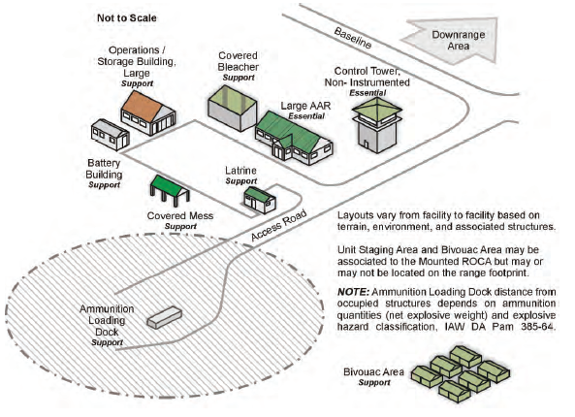
Range Operations and Control Area Facilities
MROCA
Notes:
Mounted ROCA (MROCA). The MROCA is specifically tailored to support the training requirements of mounted gunnery in the direct fire role. There are two (2) essential and eight (8) support structures/areas. The following figure shows an example MROCA layout with all essential and support structures, along with key planning and design considerations.

Slide 12
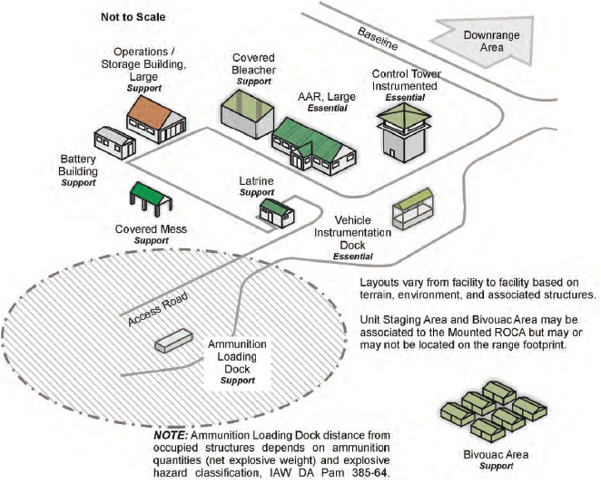
Range Operations and Control Area Facilities
IROCA
Notes:
Instrumented ROCA (IROCA). The IROCA is specifically tailored to support the training requirements of mounted and dismounted collective gunnery in the direct fire role. There are three (3) essential and eight (8) support structures/areas. The following figure shows an example IROCA layout with all essential and support structures, along with key planning and design considerations.

Slide 13
Range Operations and Control Area Facilities
Location Of Misses And Hits
LOMAH Shot Sensor
LOMAH Student Station
LOMAH Bar, Target Lifter
Notes:
Location of Miss and Hit Operating System;
a. Location of Miss and Hit (LOMAH) is a computer controlled target system that provides
immediate feedback of each shot fired (on or off the target) by an individual shooter on a
computerized display at the individual’s firing position and the centralized tower computer system.
LOMAH enables the individual shooter, coach, or trainer to recognize and identify shooting errors. It
also allows the coach or trainer to assist in correcting shooting errors in a more defined and accurate
methodology while reducing ammunition expenditure and time required for live fire training
exercises.

Slide 14
Timelines and Throughput (pg. 4-7)

Slide 15
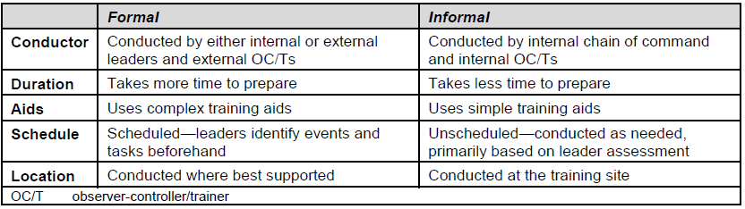
Range Operations and Control Area Facilities
After Action Reviews (AAR)
FM 7-0 Appendix D
Notes:
Leaders plan formal AARs at the same time they finalize their training plan (six to eight weeks before execution). Formal AARs require more planning and preparation than informal AARs. They require site reconnaissance and selection, coordination for training aids (such as terrain models or map blow-ups), and selection, set up, and maintenance of the AAR site.
Informal AARs require fewer training aids than formal AARs. For example, after destroying an enemy observation post during a movement to contact, the squad leader conducts an informal AAR to make corrections and reinforce strengths. Using nothing more than pinecones to represent squad members, the squad leader and squad members discuss the contact from start to finish. The squad quickly—
● Identifies what was supposed to happen.
● Establishes what happened from all levels.
● Evaluates performance against the Army standard (as stated in the task’s T&EO).
● Identifies strengths and weaknesses.
● Identifies opportunities to improve performance within the commander’s guidance when training continues.

Slide 16
QUESTIONS?

