Slide 1
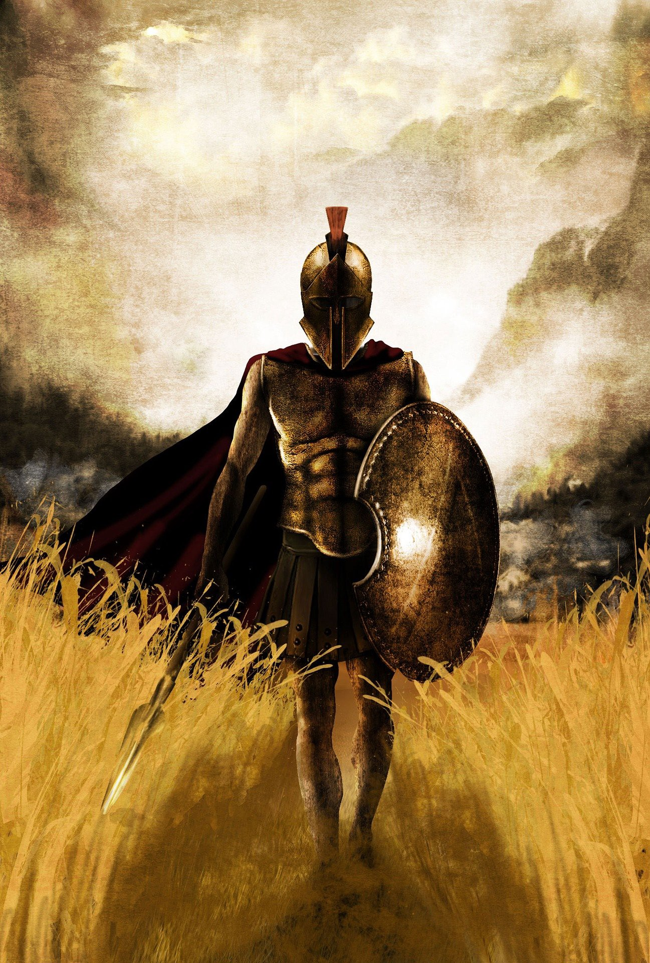
Marksmanship Master Trainer
Marksmanship Plan for Battalion
1 AUG – 18 SEP
Unit Training Plan RN#1 SSG ACKER

Slide 2
MISSION
1-13 conducts M4 qualification IAW TC 3-20.40 (Training and Qualification - Individual Weapons), TC 3-22.9 (Rifle and Carbine), and TC 3-22.0 (Integrated Weapons Training Strategy) in order to build and sustain combat readiness in support of BN LFX.

Slide 3
Commander’s Intent
Plan for the training and certification of Assistant Instructors to assist in the execution of the Battalion Marksmanship Training
Develop training to qualify 75 Soldiers on their Primary Weapon system (M4A1) with CCO during both day and night conditions in accordance with: TC 3-22.9 (Rifle and Carbine), TC 3-20.0 (Integrated Weapon Training Strategy (IWTS)), and TC 3-20.40 (Training and Qualification - Individual Weapons)
Soldiers successfully Group/Zero with Backup Iron Sights (BUIS), (CCO), and AN/PEQ-15 Aiming Laser
Soldiers successfully Qualify with Primary Optic (CCO) and Night Qualify with AN/PEQ-15 Aiming Laser (Assisted Night)

Slide 4
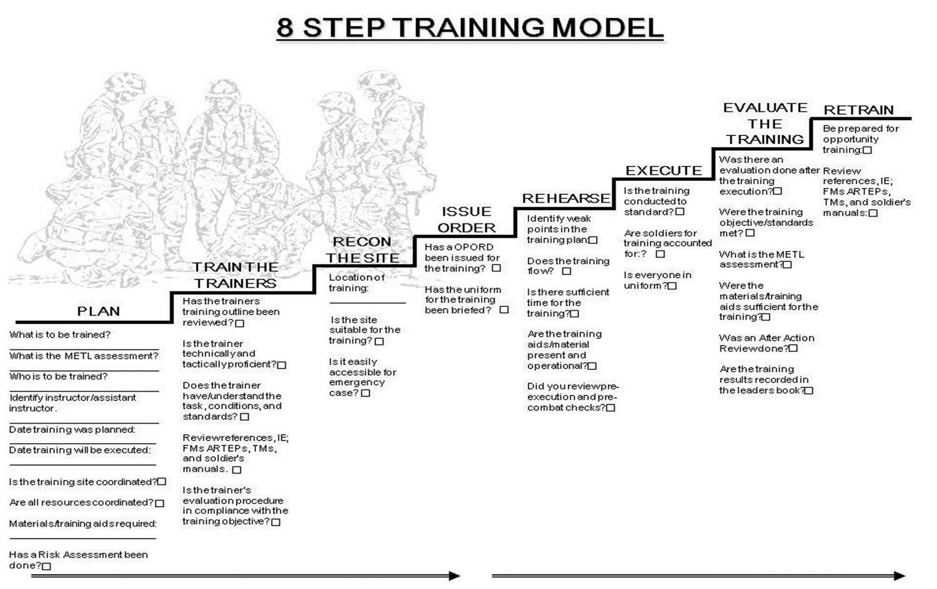
8 Step Training Model

Slide 5
4 Rules of Firearm Safety
1. Treat every weapon like its loaded.
2. Do not point at anything you do not intend to destroy.
3. Keep your finger straight and off the trigger until ready to fire.
4. Ensure positive ID of your target and its surroundings.

Slide 6
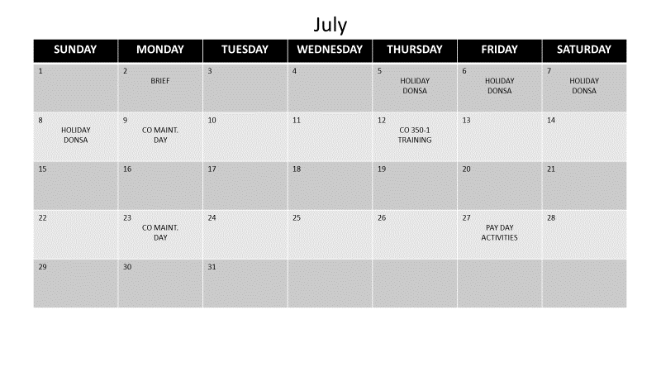
DONSA

Slide 7
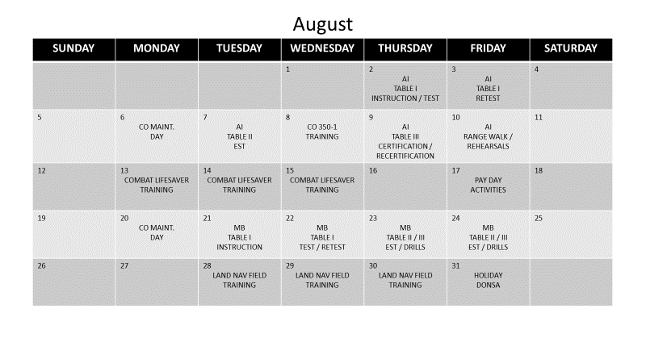

Slide 8
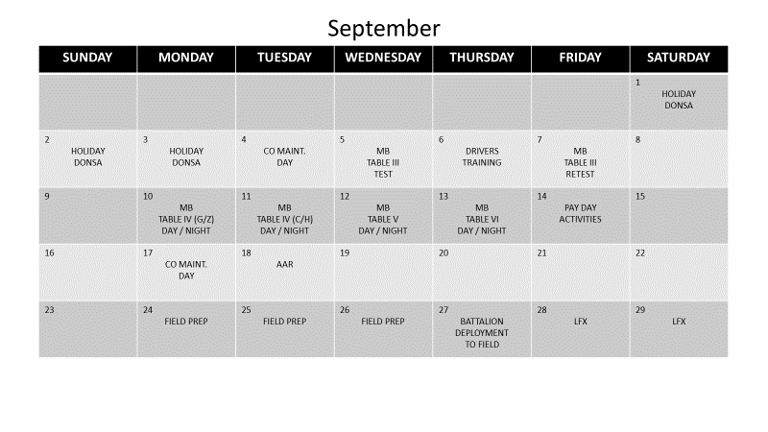
MB TABLE V & VI

Slide 9
T-WEEK TASKS
T-WEEK | TASK
T-3 | Identify firefighting details, as required. Identify target details, as required. Conduct range specific officer in charge and range safety officer briefings. Rehearse barrier guard and road closure plan.
T-2 | Draw and issue training aids, devices, simulators, and simulations. Brief external evaluators. Finalize training packets.
T-1 | Verify all firers have completed Tables I, II, and III (prerequisite tables). Draw and issue training aids, devices, simulators, and simulations, as required.
T | Provide range assistance, as required. Oversee range operations on all live facilities. Provide quality assurance and quality checks on live-fire training score sheets, roll-ups, and after-action reviews. Collect and manage firing information, engagement scores, penalties, infractions, malfunctions, and alibi information as they occur. Provide daily updates to unit performance to the commander and key leaders. Update reporting noncommissioned officer information, as appropriate. Spot-check barrier and target details. Verify targets are provided and presented according to TC 25-8 to include thermalization. (Proof range targetry). Provide recommendations to increase throughput and range management. Provide recommendations to the commander on live-fire related topics.
T+1 | AAR
T-WEEK | TASK
T-10 | TADSS training and certification. Verify class V. Verify ranges, training areas, and facilities. Confirm TSM / GUNLINE
T-9 | Confirm training aids, devices, simulators, and simulations. Verify scenario approval. Request medical support.
T-8 | Certify Table I instructors and evaluators. Conduct range walk. Confirm external evaluation support. Develop conduct of the range and range / training area layout diagrams.
T-7 | Confirm range support packages. Develop briefing packets. Coordinate barrier and road closures.
T-6 | Conduct and supervise Tables I, II, and III. Verify DA Form 581 (Request for Issue and Turn-in of Ammunition) documents. Review officer in charge and range safety officer status of unit.
T-5 | Update tower, officer in charge, and range safety officer checklists and books. Verify supplies for range support.
T-4 | Proof range scenarios. Adjust scenarios, if required. Draw class V, as required (Table III) Draw class VI, as required (Table III)
T- Week tasks outlined above per TC 3-20.0 IWTS. They are the earliest T-week that the indicated task can be completed.

Slide 10
PERSONNEL REQUIREMENTS
Assistant Instructors (AI): 15 personnel required (1:5 instructor-student ratio) from 01 August through 18 September for training, retraining, testing, retesting, and live fire events as outlined in Calendar and CONOPS.
Requirements for AIs are:
      SGT or higher (ALL)
      Qualified Sharpshooter/Expert on last M4A1 qualification within last six (6) months(ALL)
      CLS qualified (8)
      Licensed on:
        LMTV (3)
        1-Ton (3)
          Water Buffalo (3 personnel that are 1-Ton)
          Tow Pintle Qualified (3 personnel that are 1-Ton)
          Trailer Qualified (3 personnel that are 1-Ton)
      Ammo Handler Certified (3)
      RSO certified (3)

Slide 11
PERSONNEL REQUIREMENTS
Range Detail:
      OIC that are RSO/OIC certified(2LT – 1LT) (2)
      Ammo NCO (SGT-SFC):
        Must have HAZMAT on license
        Must be Ammo Handler certified
        Must be licensed on 1ton/LMTV/HMMWV
      Ammo/Range detail (8)
These 11 personnel will only be required for Tables IV – VI.

Slide 12
MODIFICATIONS FOR 75 FIRERS AMMO
BUIS GROUP 15 75 FIRERS = 1125 G2 10% (8 FIRERS): 120 EXTRA RDS REQUESTED:
BUIS ZERO 15 1125 120
CCO GROUP 15 1125 120
CCO ZERO 15 1125 120
PEQ-15 GROUP 15 1125 120
PEQ-15 ZERO 15 1125 120
CAD BUIS ------- ------- AB57 750 (10 PER)
AOH BUIS ------- ------- AB57 750 (10 PER)
CAD CCO 5 375 40 AB57 375 (5 PER)
AOH CCO 10 750 80 AB57 750 (10 PER)
CAD PEQ-15 5 375 40 AB57 375 (5 PER)
AOH PEQ-15 10 750 80 AB57 750 (10 PER)
PRE-QUAL 40 3000 Not Needed
QUAL 40 3000 320
NF PRACTICE 10B 10T 1500 Not Needed
NF CERT 10B 10T 1500 160
                ------------------------------------------------------------------------------------------------------------------------------------------------------------------------------------------------------------------------------------
                18000 1440 3750
RANGE PROOFING AMMO 400
TOTAL AMMO REQUEST FOR 120 FIRERS HW: 23590

Slide 13
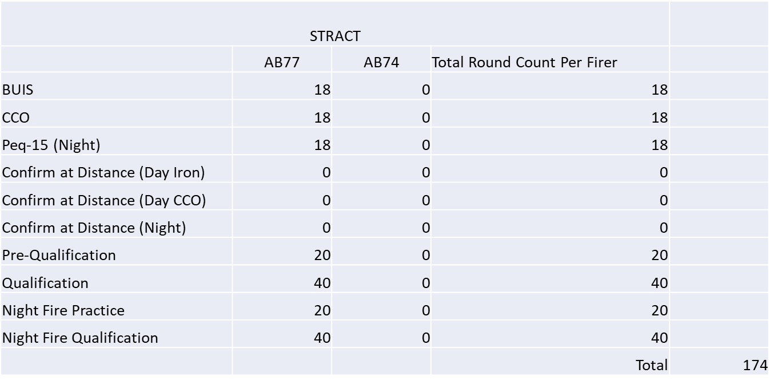
STRACT AMMO ALLOCATIONS
**Total Round Count for 75 Firers = 13,050

Slide 14
AMMO NOTES
TC 3-20.40 does not allocate round for Confirmation at distance for BUIS when a CCO is the primary sighting device.
TC 3-20.40 allocates 15 rounds for Confirmation/Application of Holds for the CCO when it is assigned as the primary sighting device. 15 rounds is not enough to get accurate feedback and data, especially for newer shooters.
Therefor I am requesting per shooter:
10 rds. for BUIS Confirm at Distance
10 rds. for BUIS Application of Holds
5 rds. for CCO Confirm at Distance
10 rds. for CCO Application of Holds
5 rds. PEQ-15 Confirm at Distance
10 rds. PEQ-15 Application of Holds
I am requesting additional ammo for retraining purposes in the event someone fails to meet the 6 MOA threshold when zeroing their sights and IR laser. There will also be extra ammo in the event someone fails to qualify.
All personnel who failed to meet any of the standards set forth by TC 3-20.40 will receive a mandatory retrain of at least 1 hour before more live ammunition is handed out .
The Soldiers are doing a Night Fire Certification, not a Qualification. Therefor, they only receive 20 rds.; 10 Ball and 10 Tracer.
STRACT allocations are do not reflect what is required by Doctrine. Therefor additional rounds have been requested to meet what is required by TC 3-20.40 and to develop a more refined, definite zero.
An Additional ammo request for proofing the ARF Range: 400 rds.

Slide 15
AMMUNITION REQUIREMENTS CONTINUED
*TC 3-20.40 uses 5 shot groups for better feedback requiring the additional 12 rounds for grouping and zeroing firers per each aiming device (BUIS, CCO, and AN/PEQ-15)
STRAC currently states 18 rounds authorized for grouping and zeroing because of the old standard for 3 shot groups, and no rounds for confirmation and holds.
**Total round counts include a 10% overage for requalification on each table. That is why allotment is for 83 firers, instead of 75 expected to attend.
***Table V is not required, however allowing Soldiers to shoot Table V historically has provided beneficial to Soldiers and Leaders about who may need additional training prior to shooting the Table VI record, reducing retrains
****The 15 rounds for Confirmation and Hold will benefit the Soldier and their confidence to engage targets effectively at distances, also reinforcing their upcoming Table VI record shoot ability****
*Table VI (Night) allocated 40 rounds for Assisted Night Qualification, per STRAC. However, given most shooter’s ability and less than favorable weather conditions, a 20-round Night “Certification” will be shot. The extra 20 rounds allocated here can be used where the STRAC is under allocation for required tasks.*

Slide 16
LAND REQUIREMENTS
Table I – Preliminary Marksmanship Instruction & Evaluation (PMI & E): Battalion Classroom
      Computer
      Projector/Screen
      Tables and Chairs for 91 personnel minimum
Table II – Simulations: EST II (15 Lanes) (Civilian Ran)
Table III – Drills: (Conducted at EST II and within Company Training Area)
Table IV – Group & Zero: Range 1 (80 Lanes)
    – Confirmation/Holds: ARF Range 14 (16 Lanes) 18 BARRIERS (1 at each firing position) 32 SANDBAGS (2 at each firing position)
Table V – Practice Qualification: ARF Range 14 (16 Lanes) 18 BARRIERS (1 at each firing position) 32 SANDBAGS (2 at each firing position)
Table VI – Record Qualification: ARF Range 14 (16 Lanes) 18 BARRIERS (1 at each firing position) 32 SANDBAGS (2 at each firing position)

Slide 17
Packing List
WORN (DAILY): WORN (EST AND RANGES):
OCPs APEL Approved Eye Protection
Patrol Cap Hearing Protection
Coyote Brown T-Shirt Body Armor w/Plates and magazine pouches and IFAK
Coyote Brown Belt Advanced Combat Helmet or Enhanced Combat Helmet
Green or Black Boot Socks Red Light
Coyote Brown Boots M4A1 (with BUIS, CCO, and AN/PEQ-15)
Pen
Notepad PACKED IN ASSAULT BAG:
Common Access Card (CAC) Wet Weather Top
Identification Tags Wet Weather Bottom
Water Source Tarp
Gloves
Magazines (4 minimum)
Spare Batteries (AAs, A123s)
*Any changes to this list will be provided to the Soldier, the day prior to the training, that requires the additional items.

Slide 18
Resources / Supply List
Borelight Set 16 (TABLES 1,2,3)
E-type Silhouette 83 (NO STANDS NEEDED)
A-8 Zero Target 763 (747 WITH 10% retrain)(16 FOR PEQ-15 Stencil)
Water Can 6
First Aid Bag 4
Magazine 38
Ear protection 2 Boxes
MRE 504
Barrier sets 18
Road Guard Vest 4 ( GATE GUARD FOR VIP)
Pens 2 boxes
Battery (AA) 240
Battery (A123) 240
Shadow Box 16
Borelight Zero Target 16
Stapler 8
Staples 2 boxes (1,000 ct)
Trash Bag 1 box (33 gal)
Engineer Tape 1 roll
BRIC Radio w/charger 2
Front Sight Post Adjustment Tools 18
Ice Sheets 16
Arm Emersion Tanks 3
Ice Bags 6
Wet Bulb 1
Markers 32
Litter 2
Glint Tape 1 roll
CLP 1 jug
Hand-held 2-way radios (For AIs) 8
Printer Paper (TRACKERS) (FIRERS PACKETS)1 pk
TMs on all equipment (CCO, NVG, M4A1) 1 ea..
Chem lights 85 (15 IR 15 red 15 blue 15 yellow 15 green 10 white)
Unit Small Arm’s Repair Tool Kit 1
Fire Extinguisher 3
Pasters (White and Black) 16 rolls ea. (INCASE NEEDED)
100 WRITTEN EXAMS (75 for MB, 15 For AI’s and 8 for MB retrain plus 2 for AI retrain)
8 SPOTTING SCOPES FOR OBSERVING FIRERS IF NEEDED

Slide 19
Meals Requested REFER TO THIS PAGE FOR SUSTAINMENT FOR CONOPS OF INDIVDUAL TABLES
DATE | MRE MEAL FOR | # OF PERSONNEL | TOTAL MRES NEEDED
7 AUG 2021 | AI TABLE II | 15 + MMT | 16
23 AUG 2021 | MB TABLE II | 75 + 15 + MMT | 91
24 AUG 2021 | MB TABLE II | 75 + 15 + MMT | 91
10 SEP 2021 | TABLE IV | 75 + 15 + 11 + MMT | 102
11 SEP 2021 | TABLE IV | 75 + 15 + 11 + MMT | 102
12 SEP 2021 | TABLE V, IV | 75 + 15 + 11 + MMT | 102
 |  |  | 504 TOTAL

Slide 20
AI CERTIFICATION
02 AUG 2021 – 10 AUG 2021

Slide 21
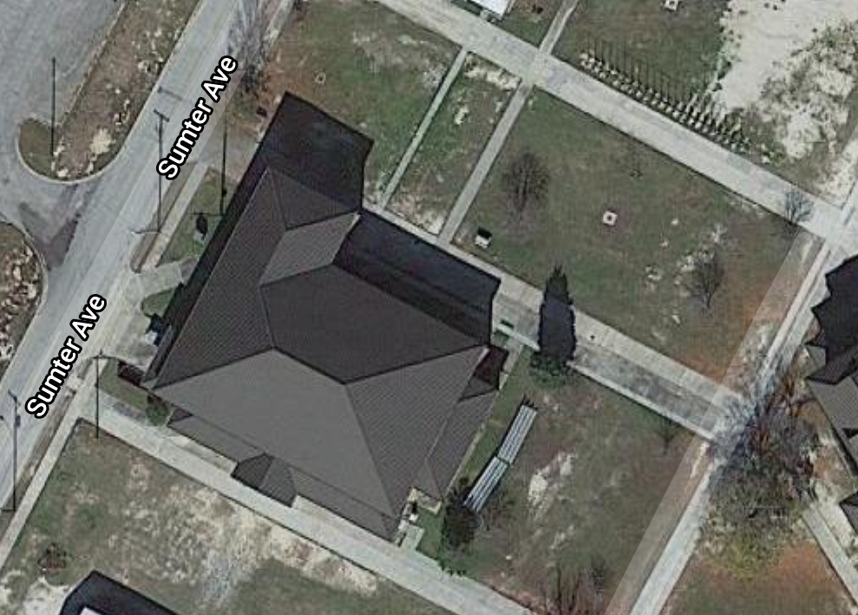
AI Table I – PMI & E
Mission: Conduct Table I (PMI & E) at Battalion Classroom NLT 180003AUG21 IOT
Train proficiency in Doctrine of marksmanship.
Uniform: Patrol cap, ACH, OCPs, ID tags, ID card, pen, notepad, and water source
Tasks: All AI will conduct PMI & E covering: TC 3.22.90
1. Appendix E of TC 3-20.40
2. Appendix I of TC 3-20.40
3. A Review
4. A 25 question test (20/25 must achieved to receive a GO)
Battalion Classroom
Port-a-Potty
Sustainment:
CL I: Water fountains are located inside the building, as well as latrine sinks, containing potable water to refill Camelbaks and water sources.
CL VIII: CLS bags will be stocked and placed inside the building.
Concept: PowerPoint presentation of PMI & E on M4A1 Carbines in accordance with TC 3-20.40. Following the PowerPoint presentation, a review of information covered, and a 25-question exam will be given to the attendees. 20/25 must be scored to receive a GO on Table I for PMI & E.
Concurrent Training/Retrain: Table I – PMI & E will have a retrain of information incorrectly answered on the exams and a retest will be administered to the Assistant Instructors that did not meet the minimum required score to receive a GO later that day (05JUL21).
Risk Assessment: Wet floors, trips/falls, dehydration, paper cuts/burns, fire, electrical shock, ceiling tiles collapsing, choking. Tsunami and Tornado as well.
Risk mitigation: Hydration, Soldiers will receive a safety brief from MMT before starting Table I presentations.

Slide 22
AI Table I – PMI & E Timeline*
02 AUG 2021 @ Battalion Classroom
0800 – 0815 | Accountability
0815 – 1200 | Ammunition Identification Rules of firearms safety Weapons safety status Weapons control status Cycle of function, rifle and carbine Conduct of fire (fire commands) Magazine change, rifle and carbine, emergency Magazine change, rifle and carbine, tactical Preliminary Marksmanship Instruction and Evaluation, rifle and carbine Maintain an M16-series rifle / M4-series carbine
1200 – 1300 | Lunch
1300 – 1700 | Perform a function check on an M-16 series rifle / M4-series carbine Mount the M68 Close Combat Optic (CCO) on a M16-series rifle or M4-series carbine Boresight a backup iron sights (BUIS) on a M16A4 rifle or M4-series carbine Zero an M16-series rifle / M4-series carbine Zero an M68 CCO to a M16-series rifle or M4-series carbine Boresight an aiming light (AN/PEQ-15) to a M16-series rifle or M4-series carbine Mount an AN/PEQ-15 aiming light to a M16-series rifle or M4-series carbine Zero an AN/PEQ-15 aiming light to a M16-series or M4-series carbine Dismount an AN/PEQ-15 aiming light to a M16-series or M4-series carbine Review
1700 | Personnel released back to organic unit
*All information covered in Table I – PMI & E is in accordance with TC 3-20.40 Appendix E, and Appendix I

Slide 23
AI Table I – PMI & E Timeline*
03 AUG 2021 @ Battalion Classroom
0800 – 0815 | Accountability
0815 – 0830 | PMI&E Test Review
0830 – 0930 | Written Exam
0930 – 1200 | Table III (Drills) Block of Instruction ( Quick show to put into mind for proficiency)
1200 – 1300 | Lunch
1300 – 1430 | Borelight Instruction Review
1430 - 1500 | Written Exam Retrain / Assistant Instructor Certification*
1500 – 1600 | Written Exam Retest
1630 – 1700 | All personnel who passed written exam released to organic unit
1630 - 1730 | Assistant Instructor Certification for Retests*
1730 | Retrained personnel released to organic unit
*All information covered in Table I – PMI & E is in accordance with TC 3-20.40 Appendix E, and Appendix I
*Certification for Assistant Instructor will be based on their overall knowledge of information learned. Specific interests in information pertinent to BUIS, CCOs, PEQ-15s, positions used during live-fire shooting, and being able to calculate MOA adjustments.

Slide 24
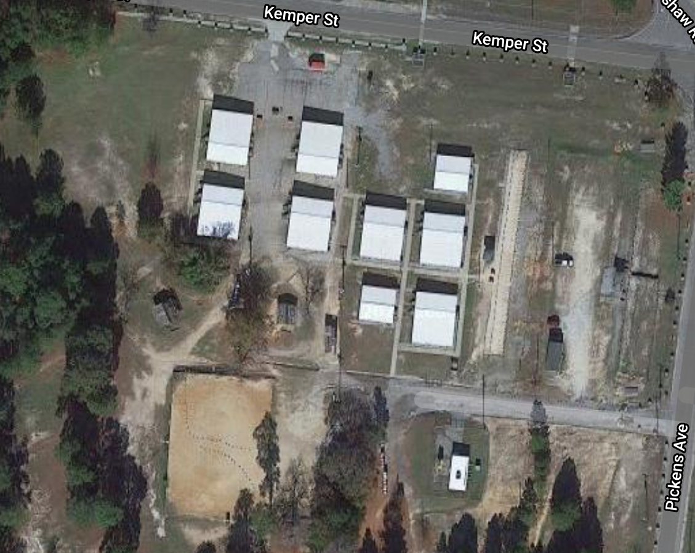
AI Table II – Simulations (EST II)
Mission: Conduct Table II (Simulations) at EST II NLT 180007AUG21 IOT
Train proficiency in fundamentals of marksmanship.
Uniform: Patrol cap, ACH, OCPs, ID tags, ID card, pen, notepad, weapons, body armor with plates, seven (7) magazines and pouches, chemical protection mask, eye protection, weapon, assault bag, and water source
Tasks: All AI will conduct simulation training with BUIS, PEQ-15, and CCO on:
1. Grouping and Zeroing
2. Confirmation and Holds
3. Table V. Practice Record Fire
4. Table VI. Record Fire (Stages 1,2,3,4) (PEQ-15 will be for Night Fire, CBRN assisted, later date)
Drills / Borelight Area
Water Buffalo
EST II
Parking Lot
EST II
LPA
LPA
Port-a-Potty
Sustainment:
CL I: Water Buffalo will be staged on site for Soldiers to fill their Camelbak or other water source
CL VIII: CLS bags will be stocked and placed inside each building and at/around the concurrent training area.
Concept: Conduct all tables in EST II and round-robin Table III and borelighting procedures. Soldiers will first group and zero, then confirm at distance and apply holds. Soldiers will then move to practice record fire, record fire, CBRN fire, night fire, unassisted, and CBRN night fire, unassisted, inside the EST II. Additionally, a Dry Fire Engagement Drill will be conducted for the PEQ-15. Soldiers must complete all tasks successfully and qualify at least Marksman before being able to move on to Table III (Drills)
Concurrent Training/Retrain: After all Assistant Instructors complete EST II they will conduct Drills and cover borelighting in the indicated area. Before leaving EST II for the day all Assistant Instructors will brief the MMT on EST II operations, specifically for commands that will be given during EST II, as well as the simulations that will be covered and minimum passing scores for ea.ch stage.
Risk Assessment: Fatigue, dehydration, heat injury, pulled muscle, fractured bones, sprained ankles, legs, or hips, inclement weather*, insect bites
Risk mitigation: Hydration, Soldiers and Instructors will receive a safety brief from EST II operators and cadre.
*In the event of inclement weather (lightning strike within 15 miles of training area) everyone will move to the nearest Lightning Protection Area (LPA) and wait for the all clear from cadre.

Slide 25
AI Table II – Simulations (EST II)
07 AUG 2021 @ EST II
0730 – 0800 | Weapons Draw at Unit Arms Room
0800 – 0815 | Accountability
0815 – 0830 | PCC / PCI
0830 – 0845 | Motor Movement to EST
0845 - 0900 | Safety Brief
0900 – 0915 | EST II Cadre Brief
0915 – 1130* | EST II (Table II,IV,VI (Stage 1-4))
1130 – 1300 | Lunch (MRE)
1300 – 1530* | EST II Retrain / Table III Round Robin / EST Operation Back Brief
1530 – 1600 | Clean up EST and Training Area
1600 – 1615 | Motor Move to CTA
1615 | Personnel released back to organic unit
*During EST II the personnel who have successfully completed Table II will receive Table III instructions and practice, as noted in CONOP

Slide 26
AI Table III – Drills
Mission: Conduct Table III (Drills) at Battalion Classroom NLT 180009AUG21 IOT
Train proficiency in fundamentals of marksmanship.
Uniform: Patrol cap, ACH, OCPs, ID tags, ID card, pen, notepad, weapons, body armor with plates, seven (7) magazines and pouches, chemical protection mask, eye protection, weapon, assault bag, and water source
Tasks: All AI will conduct Drills covering:
1. M4A1 Drills
*All Drills to be covered are in TC 3-22.9
Battalion Classroom
Port-a-Potty
Sustainment:
CL I: Water fountains are located inside the building, as well as latrine sinks, containing potable water to refill Camelbaks and water sources.
CL VIII: CLS bags will be stocked and placed inside the building.
Concept: Assistant Instructors will be evaluated on their proficiency in weapons handling and movement IOT to instruct two (2) Drills selected at random to the MMT. All pertinent information and all performance measures must be covered to receive a GO on Table III (Drills)
Concurrent Training/Retrain: Table III (Drills) can be practiced within the group of Assistant Instructors until the MMT is ready for that person and their demonstrator to be evaluated. Retrain will be allowing the Assistant Instructors additional time to cover the drills prior to being reevaluated.
Risk Assessment: Wet floors, trips/falls, dehydration, paper cuts/burns, fire, electrical shock, ceiling tiles collapsing, choking.
Risk mitigation: Hydration, Soldiers will receive a safety brief from MMT before starting Table III (Drills).

Slide 27
AI Table III – Drills
09 AUG 2021 @ Battalion Classroom
0700 – 0730 | Weapons Draw at Unit Arms Room
0730 – 0830 | Prepare Battalion Classroom (MMT)
0830 – 0845 | Accountability
0845 – 1200 | Table III (Drills) Certification*
1200 – 1300 | Lunch
1300 - 1430 | Table III (Drills) Test and Retrain
1430 - 1545 | Table III (Drills) Certification Retest*
1545 – 1615 | Reset Battalion Classroom
1615 | Personnel released back to organic unit
*During Table III evaluations each AI will be required to lead a block of instruction through two (2) drills.

Slide 28
MB QUALIFICATION
21 AUG – 18 SEP 2021

Slide 29
MB Table I – PMI & E
Mission: Conduct Table I (PMI & E) at Battalion Classroom NLT 180022AUG21 IOT
Train proficiency in fundamentals of marksmanship.
Uniform: Patrol cap, ACH, OCPs, ID tags, ID card, pen, notepad, and water source
Tasks: All soldiers will conduct PMI & E covering:
1. Appendix E of TC 3-20.40
2. Appendix I of TC 3-20.40
3. A Review
4. A 25 question test (20/25 80% must achieved to receive a GO)
Battalion Classroom
Port-a-Potty
Sustainment:
CL I: Water fountains are located inside the building, as well as latrine sinks, containing potable water to refill Camelbaks and water sources.
CL VIII: CLS bags will be stocked and placed inside the building.
Concept: PowerPoint presentation of PMI & E on M4A1 Carbines in accordance with TC 3-20.40. Following the PowerPoint presentation, a review of information covered, and a 25-question exam will be given to the attendees. 20/25 must be scored to receive a GO on Table I for PMI & E.
Concurrent Training/Retrain: Table I – PMI & E will have a retrain of information incorrectly answered on the exams and a retest will be administered to the Assistant Instructors that did not meet the minimum required score to receive a GO the following day (22AUG21).
Risk Assessment: Wet floors, trips/falls, dehydration, paper cuts/burns, fire, electrical shock, ceiling tiles collapsing, choking.
Risk mitigation: Hydration, Soldiers and AIs will receive a safety brief from MMT before starting Table I presentations.

Slide 30
MB Table I – PMI & E Timeline*
21 AUG 2021 @ Battalion Classroom
0800 – 0815 | Accountability
0815 – 1200 | Ammunition Identification Rules of fire arms safety Weapons safety status Weapons control status Cycle of function, rifle and carbine Conduct of fire (fire commands) Magazine change, rifle and carbine, emergency Magazine change, rifle and carbine, tactical Preliminary Marksmanship Instruction and Evaluation, rifle and carbine Maintain an M16-series rifle / M4-series carbine
1200 – 1300 | Lunch
1300 – 1700 | Perform a function check on an M-16 series rifle / M4-series carbine Mount the M68 Close Combat Optic (CCO) on a M16-series rifle or M4-series carbine Boresight a backup iron sights (BUIS) on a M16A4 rifle or M4-series carbine Zero an M16-series rifle / M4-series carbine Zero an M68 CCO to a M16-series rifle or M4-series carbine Boresight an aiming light (AN/PEQ-15) to a M16-series rifle or M4-series carbine Mount an AN/PEQ-15 aiming light to a M16-series rifle or M4-series carbine Zero an AN/PEQ-15 aiming light to a M16-series or M4-series carbine Dismount an AN/PEQ-15 aiming light to a M16-series or M4-series carbine Review
1700 | Personnel released back to organic unit
*All information covered in Table I – PMI & E is in accordance with TC 3-20.40 Appendix E, and Appendix I

Slide 31
MB Table I – PMI & E Timeline*
22 AUG 2021 @ Battalion Classroom
0800 – 0815 | Accountability
0815 – 0830 | PMI&E Test Review
0830 – 0930 | Written Exam
0930 – 1200 | Table III (Drills) Block of Instruction
1200 – 1300 | Lunch
1300 – 1430 | Table III (Drills) Block of Instruction
1430 – 1630 | Borelight Instruction Review
1630 | All personnel who passed written exam released to organic unit
1630 – 1700 | Written Exam Retrain
1700 – 1800 | Written Exam Retest
1800 | Retrained personnel released to organic unit
*All information covered in Table I – PMI & E is in accordance with TC 3-20.40 Appendix E, and Appendix I

Slide 32
MB Table II – Simulations (EST II)
Mission: Conduct Table II (Simulations) at EST II NLT 180024AUG21 IOT
Train proficiency in fundamentals of marksmanship
Uniform: Patrol cap, ACH, OCPs, ID tags, ID card, pen, notepad, body armor with plates, seven (7) magazines and pouches, chemical protection mask, eye protection, weapon, assault bag, and water source
Tasks: All soldiers will conduct simulation training with BUIS, PEQ-15, and CCO on:1. Grouping and Zeroing
2. Confirmation and Holds
3. Table V. Practice Record Fire
4. Table VI. Record Fire (Stages 1,2,3,4) (PEQ-15 will be for Night Fire, assisted) CBRN
Drills / Borelight Area
Water Buffalo
EST II
Parking Lot
EST II
LPA
LPA
Port-a-Potty
Sustainment:
CL I: Water Buffalo will be staged on site for Soldiers to fill their camelbak or other water source
CL VIII: CLS bags will be stocked and placed inside each building and at/around the concurrent training area.
Concept: Conduct all tables in EST II and round-robin Table III and borelight. Soldiers will first group and zero, then confirm at distance and apply holds. Soldiers will then move to practice record fire, record fire, CBRN fire, night fire, unassisted, and CBRN night fire, unassisted, inside the EST II. Soldiers will rotate through Drills and Positions prior to and after they have conducted EST II until all soldiers have completed the EST II. Additionally, a Dry Fire Engagement Drill will be conducted for the PEQ-15 . Soldiers must complete all tasks successfully and qualify at least Marksman before being able to move on to Table III (Drills)
Concurrent Training/Retrain: Table III – Drills and borelight zeroing will be conducted outside the EST II for all Soldiers who completed Table II successfully.
Risk Assessment: Fatigue, dehydration, heat injury, pulled muscle, fractured bones, sprained ankles, legs, or hips, inclement weather*, insect bites
Risk mitigation: Hydration, Soldiers and Instructors will receive a safety brief from EST II operators and cadre.
*In the event of inclement weather (lightning strike within 15 miles of training area) everyone will move to the nearest Lightning Protection Area (LPA) and wait for the all clear from cadre.

Slide 33
MB Table II – Simulations (EST II)
23 AUG 2021 @ EST II
0730 – 0800 | Weapons Draw at Unit Arms Room
0800 – 0815 | Accountability
0815 – 0830 | PCC / PCI
0830 – 0845 | Motor Movement to EST
0845 - 0900 | Safety Brief
0900 – 0915 | EST II Cadre Brief
0915 – 1230* | EST II (Table II,IV,VI (Stage 1-4) / Table III Round Robin
1230 – 1330 | Lunch (MRE)
1330 – 1530* | EST II (Table II,IV,VI (Stage 1-4) / Table III Round Robin Retrain if needed retest in an hour
1530 – 1600 | Clean up EST and Training Area
1600 – 1615 | Motor Move to CTA
1615 | Personnel released back to organic unit
*During EST II the personnel who have successfully completed Table II will receive Table III instructions and practice, as noted in CONOP

Slide 34
MB Table II – Simulations (EST II)
24 AUG 2021 @ EST II
0730 – 0800 | Weapons Draw at Unit Arms Room
0800 – 0815 | Accountability
0815 – 0830 | PCC / PCI
0830 – 0845 | Motor Movement to EST
0845 - 0900 | Safety Brief
0900 – 0915 | EST II Cadre Brief
0915 – 1230* | EST II (Table II,IV,VI (Stage 1-4) / Table III Round Robin
1230 – 1330 | Lunch (MRE)
1330 – 1530* | EST II (Table II,IV,VI (Stage 1-4) / Table III Round Robin Retrain if needed retest in an hour
1530 – 1600 | Clean up EST and Training Area
1600 – 1615 | Motor Move to CTA
1615 | Personnel released back to organic unit
*During EST II the personnel who have successfully completed Table II will receive Table III instructions and practice, as noted in CONOP

Slide 35
MB Table III – Drills
Mission: Conduct Table III (Drills) at Battalion Classroom NLT 180007SEP21 IOT
Train proficiency of Driils and marksmanship.
Uniform: Patrol cap, ACH, OCPs, ID tags, ID card, pen, notepad, weapons, body armor with plates, seven (7) magazines and pouches, chemical protection mask, eye protection, weapon, assault bag, and water source
Tasks: All soldiers will conduct D/N Drills covering:
1. M4A1 Drills
*All Drills and Positions to be covered are in TC 3-22.9
Battalion Classroom
Port-a-Potty
Sustainment:
CL I: Water fountains are located inside the building, as well as latrine sinks, containing potable water to refill Camelbaks and water sources.
CL VIII: CLS bags will be stocked and placed inside the building.
Concept: Soldiers will be evaluated on their ability to properly execute each drill associated with an M4A1 (Sling/Unsling, Load, Carry, Fight Down, Fight Up, Go-To-Prone, Reload, Clear Malfunction, Unload/Show clear) with a strong emphasis on maintain weapon orientation in a safe direction and demonstrating weapon safety (weapon on SAFE) when in the Drill.
Concurrent Training/Retrain: Table III (Drills) can be practiced within the group of soldiers until the AI is ready for that person to be evaluated. Retrain will be allowing the soldiers additional time to cover the drills/positions prior to being reevaluated.
Risk Assessment: Wet floors, trips/falls, dehydration, paper cuts/burns, fire, electrical shock, ceiling tiles collapsing, choking.
Risk mitigation: Hydration, Soldiers will receive a safety brief from MMT before starting Table III (Drills).

Slide 36
MB Table III – Drills
5 SEP 2021 @ Battalion Classroom
0700 – 0730 | Weapons Draw at Unit Arms Room
0730 – 0830 | Prepare Battalion Classroom (MMT)
0830 – 0845 | Accountability
0845 – 1130 | Table III (Drills) Practice
1130 – 1300 | Lunch
1300 – 1700 | Table III (Drills) Test*
1700-1730 | Chow, Reset Battalion Classroom
1800 | Personnel released back to organic unit
*During Table III evaluations each Soldier will be required to demonstrate proficiency executing two (2) drills.

Slide 37
MB Table III – Drills
7 SEP 2021 @ Battalion Classroom
0700 – 0730 | Weapons Draw at Unit Arms Room
0730 – 0830 | Prepare Battalion Classroom (MMT)
0830 – 0845 | Accountability
0845 – 1130 | Table III (Drills) Retrain
1130 – 1300 | Lunch
1300 – 1545 | Table III (Drills) Retest*
1545 – 1615 | Reset Battalion Classroom
1615 | Personnel released back to organic unit
*During Table III evaluations each Soldier will be required to demonstrate proficiency executing two (2) drills also Ensure Bore light was completed before Tables 4-6.

Slide 38
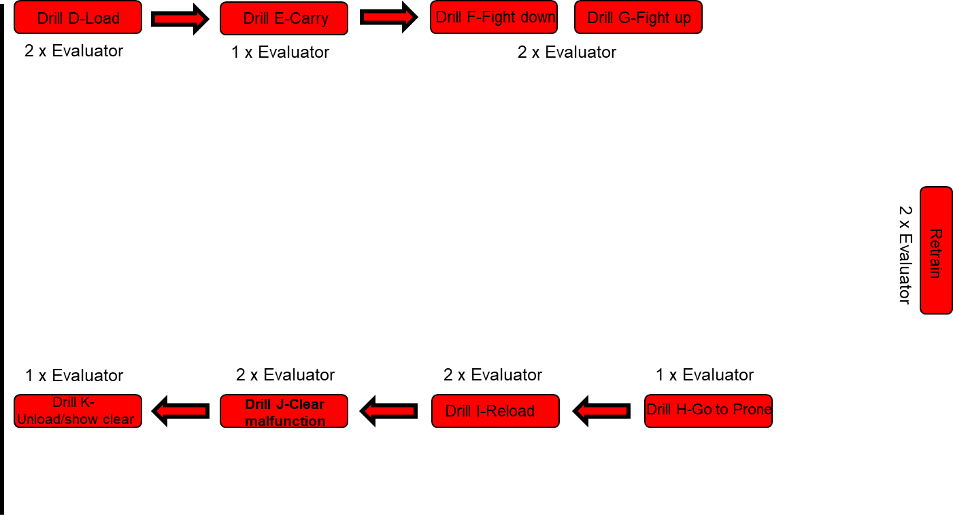
DRILLS FLOW 2 AI Per Station

Slide 39
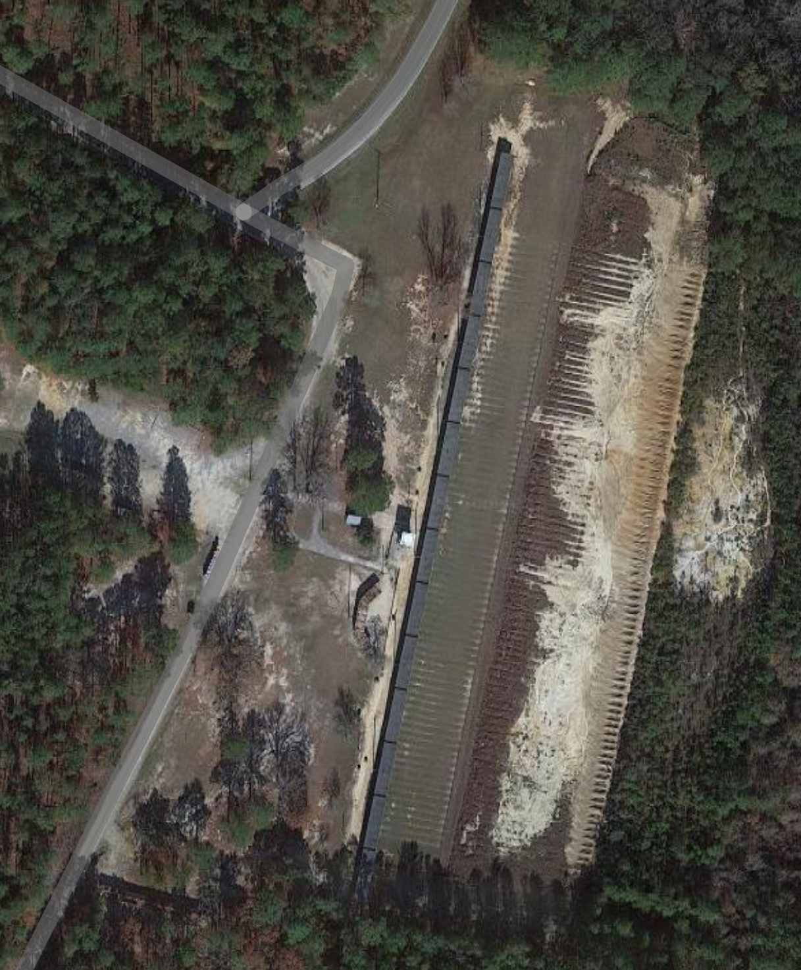
MB Table IV – Group/Zero
Mission: Conduct Table IV (Group/Zero) at Range 1 NLT 223011SEP21 in order to allow Soldiers to group and zero using their BUIS, CCO, and PEQ15.
Uniform: Patrol cap, ACH, OCPs, ID tags, ID card, pen, notepad, weapons, body armor with plates, seven (7) magazines and pouches, chemical protection mask, eye protection, weapon, assault bag, and water source
Tasks: Conduct grouping and zeroing on M4A1 carbine with their primary and back-up optic as well as group and zero with the PEQ-15 aiming laser.
Parking
Gear
Water Buffalo
Ammo Point
Sustainment:
CL I: Water Buffalo will be staged on site for Soldiers to fill up water sources as needed.
CL VIII: CLS bags will be fully stocked and staged and evenly distributed behind the firing line. One CLS Bag will be at Concurrent
Concurrent / Retrain
Port-a-Potty
LPA
Latrines
Concept: Arrive at Range 1 NLT 134510SEP21. Soldiers will ground gear at designated area, get cleared onto the range by the AIs after removing charging handle and bolt carrier group from weapons to the Lightning Protection Area (LPA). Soldiers will receive the range safety brief at the LPA and will travel in teams of two (2) onto the firing line. Soldiers will first group and zero their BUIS, then their CCO, firing 5-shot groups each iteration. After each shot group soldiers will move down range to mark/calculate their corrections on their targets. Once CCOs are grouped and zeroed then the range will be set up for limited visibility, by placing glint tape on the targets for the PEQ-15s to easily acquire. Once limited visibility is achieved then soldiers will repeat the process of zeroing and grouping their PEQ-15s in the same manner as their BUIS and CCO.
Concurrent Training/Retrain: Any Soldier unable to group or zero will be sent to the concurrent/retrain area for additional training (focused on areas of stability, aim, control, and movement) before receiving additional rounds and being sent back on the range.
Risk Assessment: Fratricide, dehydration, slip, trips, falls, burns, inclement weather, fire, animal/bug bites, and hearing loss
Risk mitigation: Water will be supplied to allow soldiers proper hydration. Safety brief will be given to all personnel at the range before going hot, as well as weapons will be cleared on and off the range.

Slide 40
MB Table IV – Group/Zero
10 SEP 2021 @ Range 1
1230-UTC | Ammo/Range Detail move to Range 1
1215-1315 | Weapons Draw at Company
1315-1330 | Accountability
1330-1345 | Motor Movement to Range 1 (4 buses)
1345-1400 | Range Safety Brief
1400-1500 | Group/Zero BUIS
1500-1530 | Retrain BUIS
1530-1600 | Group/Zero BUIS Retrains
1600-1700 | Group/Zero M68 (CCO)
1700-1730 | Retrain M68 (CCO)
1730-1800 | Group/Zero M68 Retrains
1800-1900 | Dinner (MRE)
1900-2045 | Range setup for Night Fire
2045-2100 | Range Safety Brief for Night Ops
10 SEP 2021 @ Range 1
2100-2200 | Group/Zero PEQ-15
2200-2230 | Retrain PEQ-15
2230-2300 | Group/Zero PEQ-15 Retrains
2300-2330 | Cleanup of Range
2330-2345 | Motor Movement back to Company Area
2345-UTC | Weapons Turn in at Company/ Personnel released back to organic unit

Slide 41
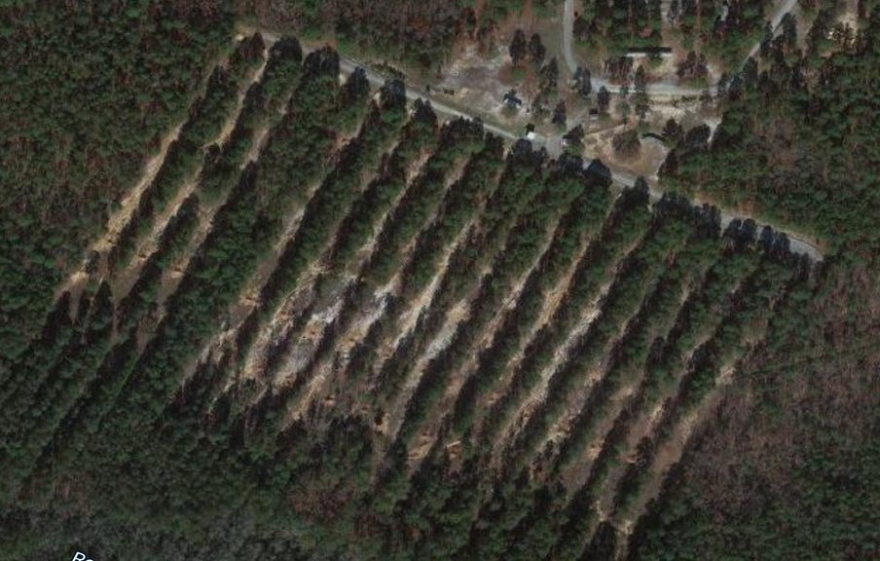
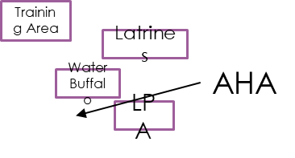
MB Table IV – Confirm/Hold
Mission: Conduct Table IV (Confirm/Hold) at Range 14 NLT 224511SEP21 in order to allow Soldiers to confirm zero and apply holds at distance using their BUIS, CCO, and PEQ15.
Uniform: Patrol cap, ACH, OCPs, ID tags, ID card, pen, notepad, weapons, body armor with plates, seven (7) magazines and pouches, chemical protection mask, eye protection, weapon, assault bag, and water source
Tasks: Conduct grouping and zeroing on M4A1 carbine with their primary and back-up optic as well as group and zero with the PEQ-15 aiming laser.
Sustainment:
CL I: Water Buffalo will be staged on site for Soldiers to fill up water sources as needed.
CL VIII: CLS bags will be fully stocked and staged and evenly distributed behind the firing line. One CLS Bag will be at Concurrent
Concept: Arrive at Range 14 NLT 160011SEP21. Soldiers will ground gear at designated area, get cleared onto the range by the AIs after removing charging handle and bolt carrier group from weapons to the Lightning Protection Area (LPA). Soldiers will receive the range safety brief at the LPA and will travel in teams of two (2) onto the firing line. Soldiers will first confirm their zero and then demonstrate application of holds at distance on their BUIS, then their CCO, firing 5-shot groups each iteration. Once CCOs are confirmed zero and application of holds have been demonstrated then the range will be set up for limited visibility, by placing glint tape on the targets for the PEQ-15s to easily acquire. Once limited visibility is achieved then soldiers will repeat the process of confirming zero and demonstrating application of holds their PEQ-15s in the same manner as their BUIS and CCO.
Concurrent Training/Retrain: Any Soldier unable to confirm zero or apply proper holds will be sent to the concurrent/retrain area for additional training (focused on areas of stability, aim, control, and movement) before receiving additional rounds and being sent back on the range.
Risk Assessment: Fratricide, dehydration, slip, trips, falls, burns, inclement weather, fire, animal/bug bites, and hearing loss
Risk mitigation: Water will be supplied to allow soldiers proper hydration. Safety brief will be given to all personnel at the range before going hot, as well as weapons will be cleared on and off the range.

Slide 42
MB Table IV – Confirm/Hold
11 SEP 2021 @ Range 14
1430-UTC | Ammo/Range Detail move to Range 14
1415-1515 | Weapons Draw at Company
1515-1545 | Accountability
1545-1600 | Motor Movement to Range 14 (4 buses)
1600-1615 | Range Safety Brief
1615-1715 | Confirm/Hold M68 (CCO)
1715-1745 | Retrain M68 (CCO)
1745-1815 | Confirm/Hold M68 Retrains
1815-1900 | Dinner (MRE)
1900-2045 | Range setup for Night Fire
2045-2100 | Range Safety Brief for Night Ops
11 SEP 2021 @ Range 14
2100-2200 | Confirm/Hold PEQ-15
2200-2230 | Retrain PEQ-15
2230-2300 | Confirm/Hold PEQ-15 Retrains
2300-2330 | Cleanup of Range
2330-2345 | Motor Movement back to Company Area
2345-UTC | Weapons Turn in at Company/ Personnel released back to organic unit

Slide 43

MB Table V – Practice Qualification
Mission: Conduct Table V (Practice Record Qualification) at Range 14 NLT 233012SEP21 in order to allow Soldiers to familiarize and gain confidence in their ability to meet the standard for the Record Fire (Table VI) on their CCO (Day) and PEQ15 (Night).
Uniform: Patrol cap, ACH, OCPs, ID tags, ID card, pen, notepad, weapons, body armor with plates, seven (7) magazines and pouches, chemical protection mask, eye protection, weapon, assault bag, and water source
Tasks: Conduct Practice Qualification during the day with CCO and Practice Qualification during the night with the PEQ-15.
Training Area
Gear
Latrines
Water Buffalo
AHA
LPA
Sustainment:
CL I: Water Buffalo will be staged on site for Soldiers to fill up water sources as needed.
CL VIII: CLS bags will be fully stocked and staged and evenly distributed behind the firing line. One CLS Bag will be at Concurrent
Port-a-Potty
Latrines
Concept: Arrive at Range 14 NLT 151512SEP21. Once soldiers arrive, they will remove their bolt carrier group and charging handles to be cleared onto the range, to the Lightning Protection Area (LPA). At the LPA soldiers will receive their safety brief. Soldiers will receive their 4 10-round magazines (1 will have a DDI round inside)(Day) or their 2 10-round magazines (night) and then they will move to their assigned firing points and begin the qualification table. After completion of their firing iteration the soldier will move to the base of the tower to receive scores and, if necessary, additional training. 28/40 70% Day and Night 14/20 Night
Concurrent Training/Retrain: Concurrent training will have a primary focus on supported firing positions from a barrier, magazine changes, dry fire drills, and immediate/remedial actions. Anything more the soldier requests will be 1:1 with an AI.
Risk Assessment: Fratricide, dehydration, slip, trips, falls, burns, inclement weather, fire, animal/bug bites, and hearing loss
Risk mitigation: Water will be supplied to allow soldiers proper hydration. Safety brief will be given to all personnel at the range before going hot, as well as weapons will be cleared on and off the range.

Slide 44
MB Table V – Practice Qualification
12 SEP 2021 @ Range 14
1315-UTC | Ammo/Range Detail move to Range 1
1330-1430 | Weapons Draw at Company
1430-1500 | Accountability
1500-1515 | Motor Movement to Range 1 (4 buses)
1515-1530 | Range Safety Brief
1530-1700 | Table V – Practice Qualification*
1700-1730 | Table V Retrains, Table VI Qualification
1730-1900 | Table V – Table VI Retrains
1900-1930 | Dinner (MRE)
1930-2045 | Range setup for Night Fire
12 SEP 2021 @ Range 14
2045-2100 | Range Safety Brief for Night Ops
2100-2230 | Table V – Night Practice Qualification*
2230-2300 | Retrain Table V, Table IV Night Qual
2300-2330 | Table IV Night Qual- Retrains
2330-0000 | Cleanup of Range
0000-0015 | Motor Movement back to Company Area
0015-UTC | Weapons Turn in at Company/ Personnel released back to organic unit
*Time estimated based on Table V, Practice, throughput time schedule (Table E-39) in TC 3-20.40 with 10-minutes of admin between iterations.

Slide 45
MB Table VI – Record Fire
Mission: Conduct Table VI (Record Qualification) at Range 14 NLT 234512SEP21 in order to assess Soldiers in their ability to meet the standard for the Record Fire (Table VI) on their CCO (Day) and PEQ15 (Night).
Uniform: Patrol cap, ACH, OCPs, ID tags, ID card, pen, notepad, weapons, body armor with plates, seven (7) magazines and pouches, chemical protection mask, eye protection, weapon, assault bag, and water source
Tasks: Conduct Record Qualification during the day with CCO and Record Qualification during the night with the PEQ-15.
Training Area
Gear
Latrines
Water Buffalo
AHA
LPA
Sustainment:
CL I: Water Buffalo will be staged on site for Soldiers to fill up water sources as needed.
CL VIII: CLS bags will be fully stocked and staged and evenly distributed behind the firing line. One CLS Bag will be at Concurrent
Port-a-Potty
Latrines
Concept: Arrive at Range 14 NLT 151512SEP21. Once soldiers arrive, they will remove their bolt carrier group and charging handles to be cleared onto the range, to the Lightning Protection Area (LPA). At the LPA soldiers will receive their safety brief. Soldiers will receive their 4 10-round magazines (Day and night) and then they will move to their assigned firing points and begin the qualification table. After completion of their firing iteration the soldier will move to the base of the tower to receive scores and, if necessary, additional training. 23/40 Day 57.5% and 14/20 70%
Concurrent Training/Retrain: Concurrent training will have a primary focus on supported firing positions from a barrier, magazine changes, dry fire drills, and immediate/remedial actions. Anything more the soldier requests will be 1:1 with an AI.
Risk Assessment: Fratricide, dehydration, slip, trips, falls, burns, inclement weather, fire, animal/bug bites, and hearing loss
Risk mitigation: Water will be supplied to allow soldiers proper hydration. Safety brief will be given to all personnel at the range before going hot, as well as weapons will be cleared on and off the range.

Slide 46
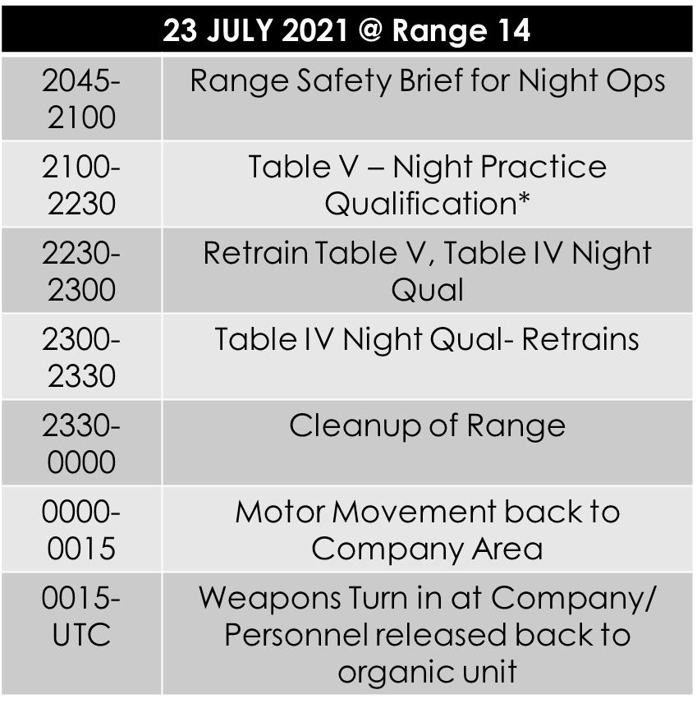

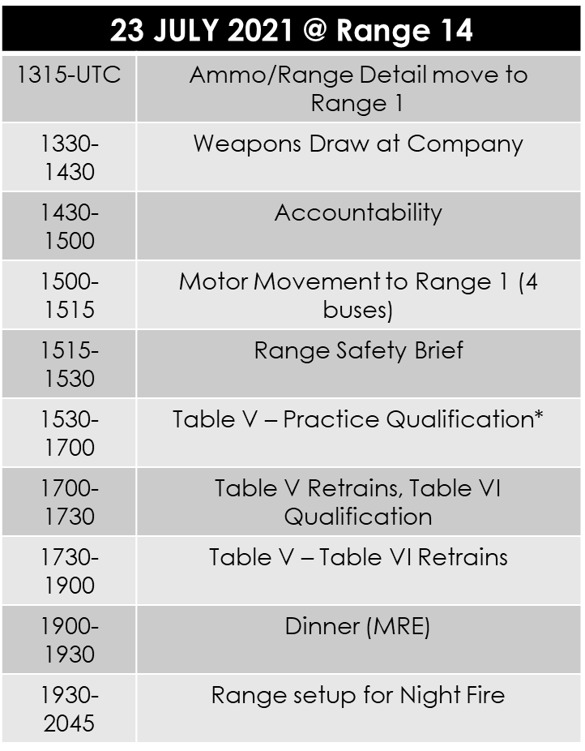
MB Table VI – Record Fire
12 SEP
*Time estimated based on Table VI, Stage 1, Day Fire, throughput time schedule (Table E-57) and Table VI, Stage 3, Night Fire, throughput time schedule (Table E-78) with 10-minutes of admin between iterations.

Slide 47
NOTES TABLES V & VI
LMTV w/detail & Buffalo; Deuce w/range gear; Chevy SP to set up range
1 AI every 2 Lanes
LTs are RSO/OIC
All remaining AI rotating as Safeties/Ushers
8 Man detail in Ammo Point at all times
During Night Prep, 8 man detail + 2 AI (Spot check) Glint tape stapled to targets
1 AI + 1 to MBP to drop off Ammo
Mouse Traps, Dime Washer and DDI Drills will be set up in C2 building near entrance of range for retrain/concurrent training.
Retrain individuals will also have the option of doing dry run(s) of the qual
Soldiers can practice laser manipulation on the barriers for concurrent training before the night Cert
For Table V, 1 DDI will be randomly inserted into each Soldiers’ load out. It will not be the first round nor will it be the last round in the magazine.
CLS Bag/Litter Locations: Lane 2, 8, 12,
FLA In Open Area in Front of Bleachers
E911 will be called in case of an emergency
5 Min Admin Time in between each firing order to collect scores
Time per iteration for Practice/Record Fire = 9 min for a total of 56 min each
Time per iteration for Night Practice/Certification Fire = 7 min for a total of 35 min

Slide 48
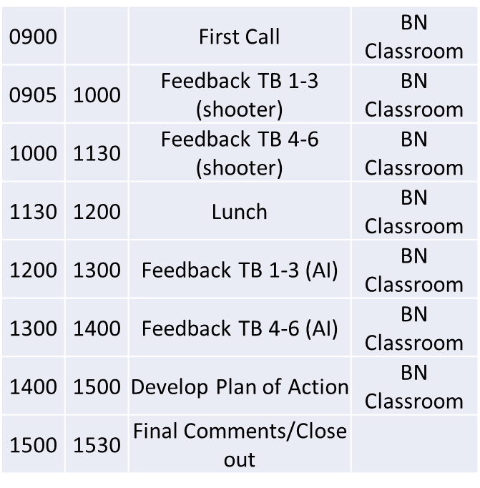
AAR 18 SEP 2021
AI and shooters will be present for the first half of the AAR.
After Lunch, only AIs will return
The plan of action is designed to take what worked and didn’t work so we can refine the plan to flow more smoothly.
Will develop an improve/sustain chart to help identify what worked and didn’t work.

Slide 49
CONCLUSION
IN CONCLUSION THE COMMANDERS INTENT WAS to Plan for the training and certification of Assistant Instructors to assist in the execution of the Battalion Marksmanship Training
Develop training to qualify 75 Soldiers on their Primary Weapon system (M4A1) with CCO during both day and night conditions in accordance with: TC 3-22.9 (Rifle and Carbine), TC 3-20.0 (Integrated Weapon Training Strategy (IWTS)), and TC 3-20.40 (Training and Qualification - Individual Weapons)
Soldiers successfully Group/Zero with Backup Iron Sights (BUIS), (CCO), and AN/PEQ-15 Aiming Laser
Soldiers successfully Qualify with Primary Optic (CCO) and Night Qualify with AN/PEQ-15 Aiming Laser (Assisted Night)
WAS THIS COMPLETED AND EXECUTED TO STANDARD?

