Slide 1
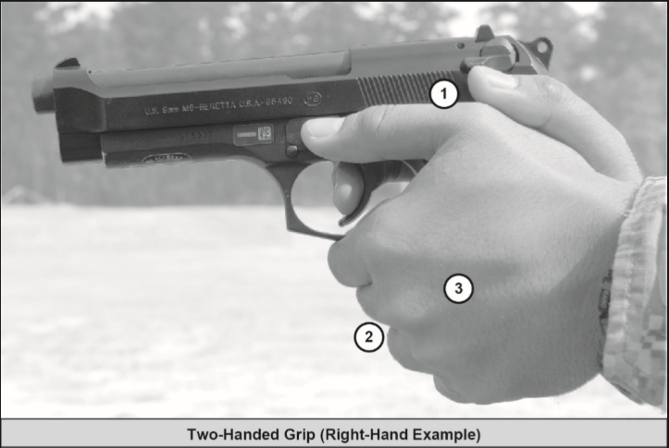
GRIP
Fill in open space with Non-Firing Hand, ensuring your hand is canted at 45 degree angle to achieve tendon lockout.
Wrap Fingers around Firing Hand.
Grip pistol with firm handshake grip.
Notes:
TWO-HANDED GRIP
6-26. The two-handed grip allows the Soldier to steady his or her firing hand and
provide maximum support while firing.

Slide 2
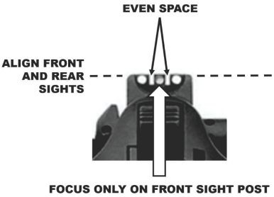
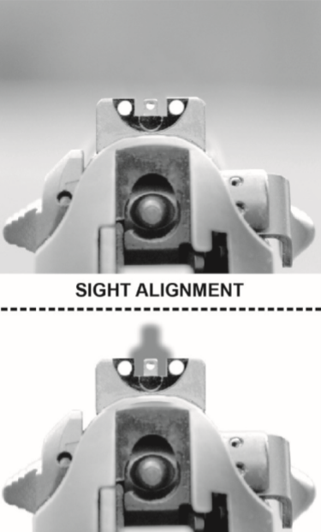
AIM
The two most important aspects of aiming the pistol correctly are:
Sight Alignment- relationship between the aiming device and the shooter’s eye.
Sight Picture- the target as viewed through the line of sight.
Common Aiming Errors:
Incorrect Sight Alignment
Incorrect Sight Picture
Non-Dominant Eye use
Notes:
Sight alignment is the relationship between the aiming device and the Shooter's eye. What process used to achieve sight alignment, depends on the type of aiming device used by the Shooter. Keep in mind, the sighting system is already set up in alignment to the weapon, when we say sight alignment, it is referring to the Shooter’s eye in relation to the sighting system.
If iron sights are used, it is the relationship between the Shooter's eye, the rear sight aperture, and the front sight post. If the aiming device is a reflex-type sight, it is the relationship with the Shooter’s eye and the red dot centered vertically and horizontally in the tube for a well-aimed shot.

Slide 3
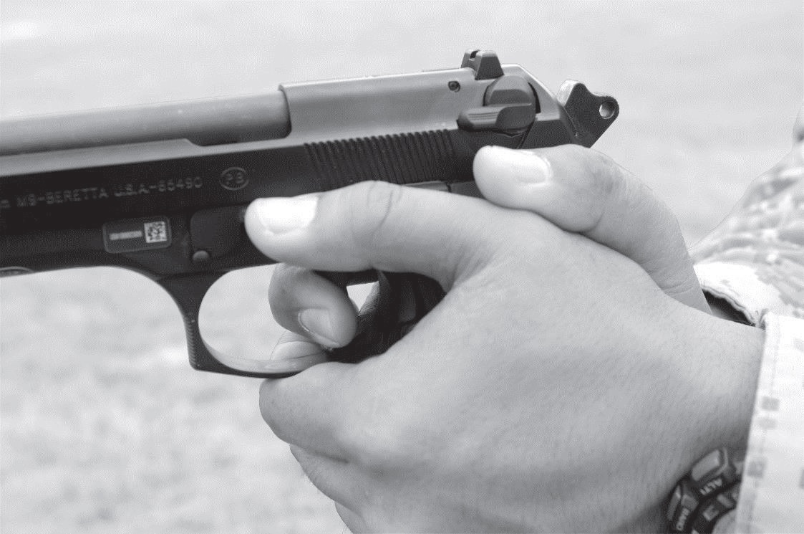
TRIGGER CONTROL
Why is good trigger control important and how do achieve it?
A smooth consistent trigger pull to the rear will allow the shooter to accurately engage the target without disturbing the sights. As the sight radius on a pistol is substantially smaller than that of a rifle.
Notes:
Stability and trigger control complement each other and are integrated during the shot process. A stable position assists in aiming and reduces unwanted movements during trigger press without inducing unnecessary movement or disturbing the sight picture. A smooth, consistent trigger squeeze, regardless of speed, allows the shot to fire at the Soldier’s moment of choosing. When both a solid position and a good trigger squeeze are achieved, any induced shooting errors can be attributed to the aiming process for refinement.
Correct placement of the trigger finger is necessary to apply pressure on the trigger with the index finger between the tip and second joint (the first bone section). Unnatural trigger finger placement can lead to an inaccurate shot.
Trigger squeeze. The Soldier pulls the trigger in a smooth consistent manner adding pressure until the weapon fires. Regardless of the speed at which the Soldier is firing the trigger control will always be smooth.
Trigger reset. Once the Soldier fires a shot, the trigger must be reset prior to firing the next shot. The trigger finger needs to move forward but should maintain contact with the trigger. This will help maintain consistent trigger finger placement. The trigger only needs to move forward far enough to reset. These actions need not be slow and must happen during the recoil of the pistol.
Notes.
1. Do not place the trigger finger on the trigger unless the sights and target are both visible.
2. Do not pin the trigger back; after firing, let the trigger reset.

Slide 4
CHECK ON LEARNING
Stability, Aim, Control
What are the Four Functions of Stability?
Support
Muscle Relaxation
Natural Point of Aim
Recoil Management
How hard should I grip the pistol?
With a firm handshake grip
What does proper sight alignment look like on a pistol?
Equal height and equal light between the front and rear sights
Notes:
Range overmatch provides a tactical engagement buffer that accommodates the Soldier’s time to engage with precision fires. For example, a Soldier that has the capability to effectively engage personnel targets at a range of 500 meters will have range overmatch of 10 to 20 percent over a threat rifleman. That 10 to 20 percent range difference is equivalent to a distance of 40 to 80 meters, which is approximately the distance a maneuvering threat can traverse in 15 to 40 seconds

Slide 5
DRAW PROCESS

Slide 6
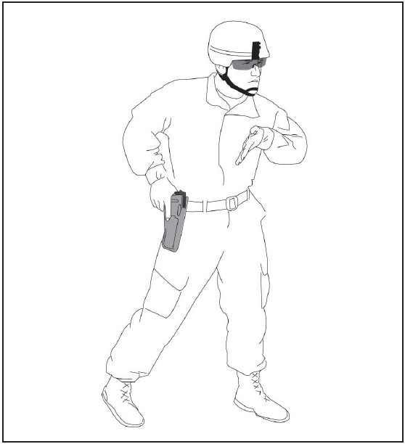
PREPARE TO DRAW
Notes:
DRAW AND PRESENT THE PISTOL
An efficient draw allows crucial seconds to refine aim. The draw is the
manipulation by which a shooter removes a pistol from its holster, and presentation
is the manipulation by which a shooter drives the pistol to the target. The transition
between these two actions is fluid and seamless; their purpose involves removing
the pistol from the holster and bringing it to bear on the target as quickly as possible.
Figures 5-1a through 5-1e (pages 5-6 through 5-10) illustrate the five steps of the draw
and presentation.
Note. Draw varies based on holster type and Soldier experience.
STEP 1: PREPARE TO DRAW
a. Move hand to pistol.
b. Establish high, firm grip.
c. Prepare to defeat holster’s retention device.
d. Anchor the nonfiring hand to body in preparation to receive the pistol.
e. Assume a correct stance.
(1) Place feet about shoulder’s width apart.
(2) Slightly bend the knees.
(3) Place weight on balls of the feet.

Slide 7
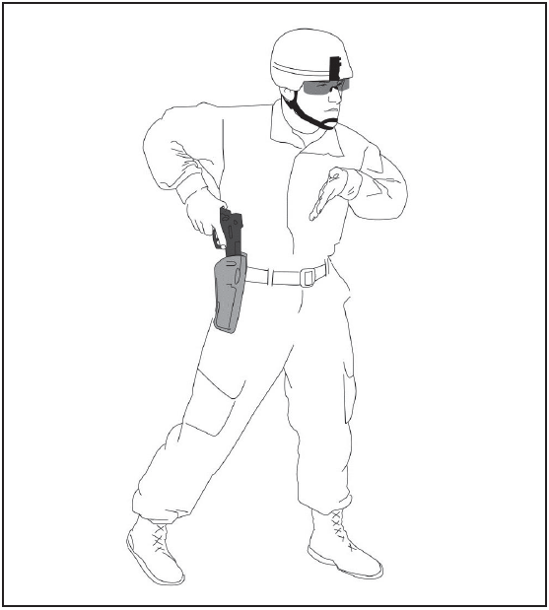
GRIP AND DEFEAT
Notes:
STEP 2: GRIP AND DEFEAT
a. After acquiring grip, defeat holster’s retention device and swiftly extract pistol from
holster in a straight upward motion.
b. Keep nonfiring hand anchored to the body in preparation to receive the pistol.

Slide 8
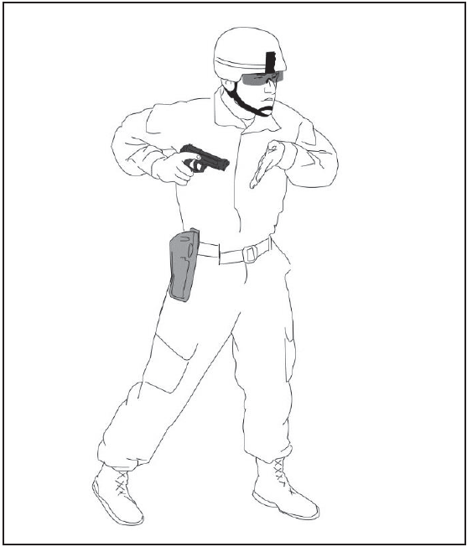
DRAW AND ROTATE
Notes:
STEP 3: DRAW AND ROTATE
a. As soon as the muzzle of the pistol clears the holster, drop the elbow of your firing
hand and rotate the pistol to orient the muzzle toward the target.
b. Move the nonfiring hand into position to support the pistol.

Slide 9
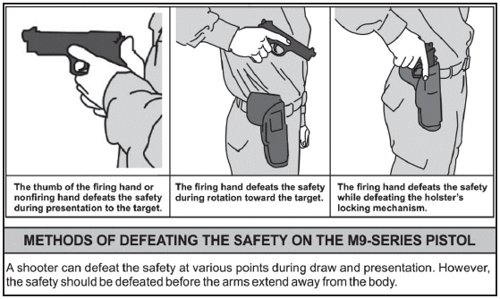
Disengage the Safety
Notes:
DISENGAGE THE SAFETY
A Soldier can disengage the safety at various points during draw and presentation.
This Figure shows methods for defeating the safety. The figure below is in no
specific order.
An important feature of the M9 service pistol is that it is safe to carry the pistol
with the safety/decocking lever in the up (off) position. The M9 service pistol is
designed so it will not fire unless the trigger is pulled. Local leadership will make the
decision for their Soldiers about the position of the safety/decocking lever while the
pistol is in the holster.

Slide 10
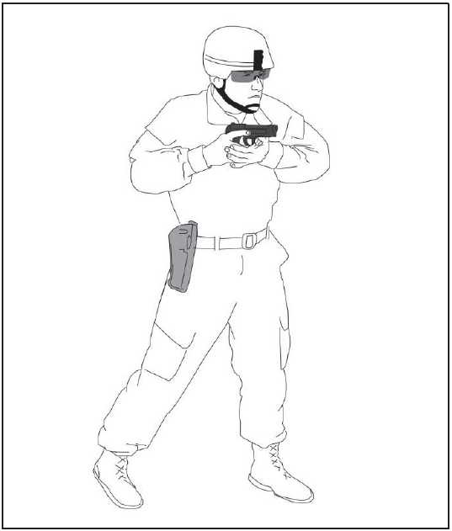
MEET AND GREET
Notes:
STEP 4:MEET AND GREET
a. Slide the fingers of the non-firing hand under and against the trigger guard.
b. Rotate the nonfiring hand so that the heel of the nonfiring hand is against the pistol
grip, resting between the space provided by the fingers and heel of the firing hand.
c. Ensure the firing hand is high on the pistol grip with the finger off the trigger.
d. Defeat the safety.

Slide 11
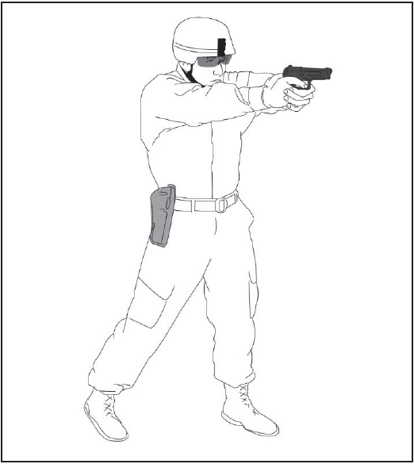
EXTEND AND PREPARE
Notes:
STEP 5: EXTEND AND PREPARE
a. Bring the pistol up to your sight line (sight line is when your sights and target
are aligned).
b. Ensure the thumb of your firing hand is on top of your other (nonfiring) thumb.
c. Lock out your nonfiring hand’s wrist.
d. As you are pushing the pistol out, prepare the trigger.
e. At full presentation, ensure you have the following:
(1) A high, firm grip.
(2) Correct sight alignment.
(3) Correct sight picture.
(4) Proper stance.

Slide 12
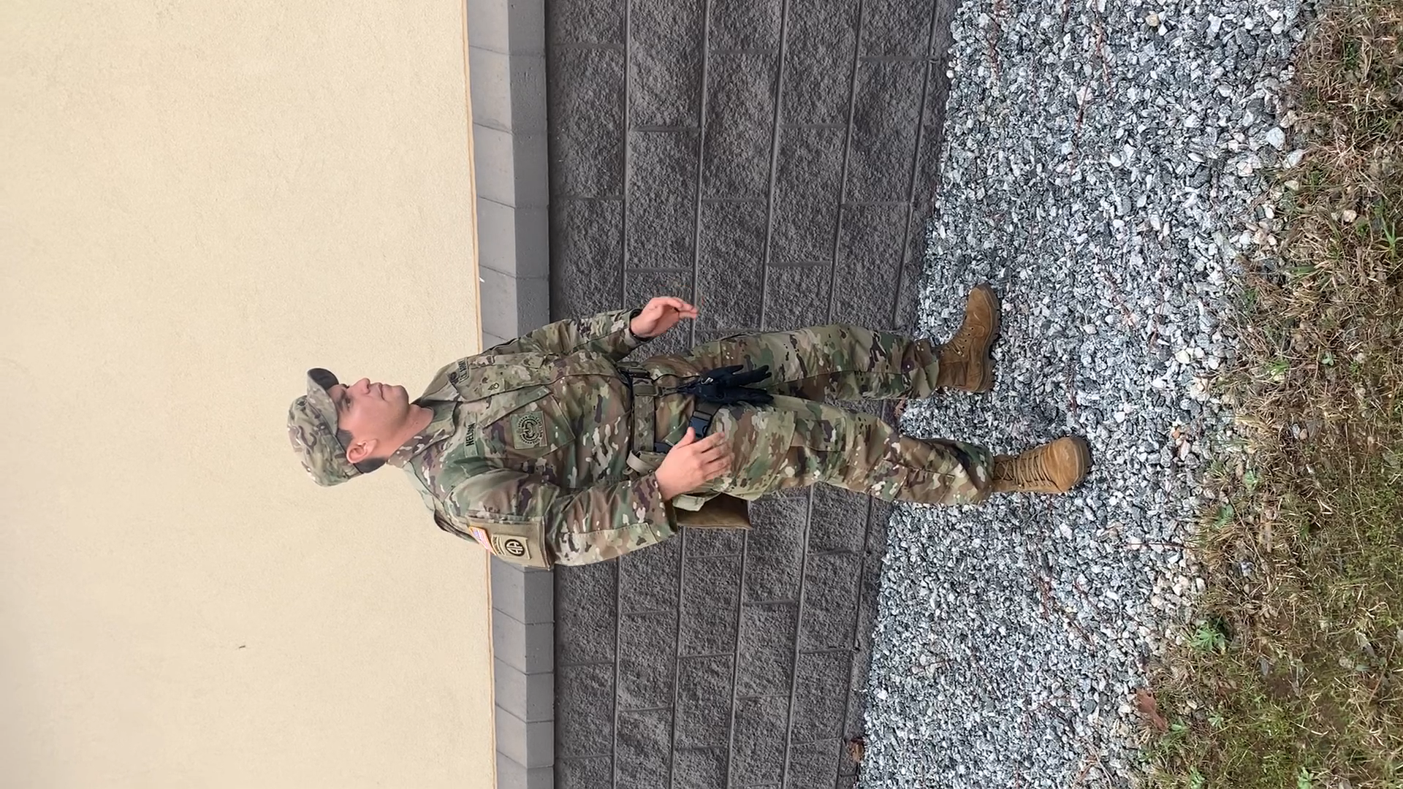
DRAW PROCESS
Prepare to Draw
Grip and Defeat
Draw and Rotate
Meet and Greet
Extend and Prep

Slide 13
CHECK ON LEARNING
DRAW PROCESS
What are the steps to the draw process?
Prepare to Draw
Grip and Defeat
Draw and Rotate
Meet and Greet
Extend and Prep
Notes:
Range overmatch provides a tactical engagement buffer that accommodates the Soldier’s time to engage with precision fires. For example, a Soldier that has the capability to effectively engage personnel targets at a range of 500 meters will have range overmatch of 10 to 20 percent over a threat rifleman. That 10 to 20 percent range difference is equivalent to a distance of 40 to 80 meters, which is approximately the distance a maneuvering threat can traverse in 15 to 40 seconds

Slide 14
FIRING POSITIONS

Slide 15
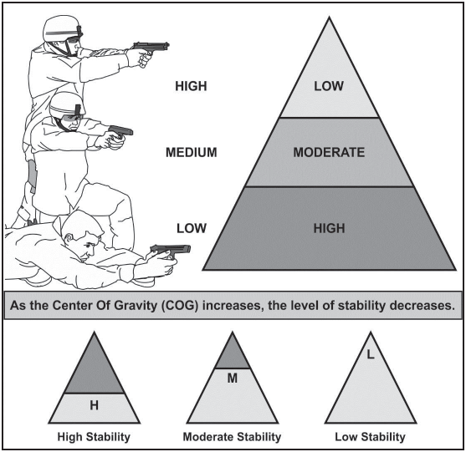
STABILIZATION
Notes:
STABILIZATION
6-32. As a rule, positions that are lower to the ground provide a higher level of stability.
When the position elevates the level of stability decreases as shown in figure 6-6. Each
firing position figure will list the stability rating using a high, moderate or low rating.

Slide 16
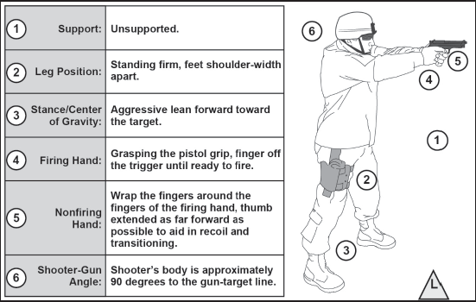
FIRING POSITIONS

Slide 17
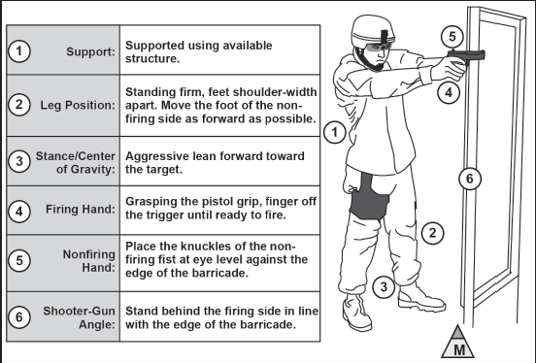
FIRING POSITIONS

Slide 18
FIRING POSITIONS

Slide 19
FIRING POSITIONS

Slide 20
FIRING POSITIONS

