Slide 1
LSA 11:
Zeroing
Notes:
Begin by asking pointed question to get concrete knowledge of the class:
Example questions
What is the primary role of a rifleman?
What two truths about firing and does it change with each weapon system?
What is DIDEA?

Slide 2
ACTION:
Demonstrate knowledge of Army service Rifle preliminary marksmanship instruction.
CONDITION:
In a classroom environment, given TC 3-22.9, Rifle and Carbine.
STANDARD:
Identify how to apply and train Rifle Marksmanship utilizing the US Army Service Rifle in accordance with applicable command guidance, TC 3-22.9 Rifle and Carbine and TC 3-20.40 Integrated Weapons Training
Strategy.

Slide 3
INTRODUCTION
Safety Considerations:
Risk Assessment:
Environmental Considerations:
Evaluation:
Notes:
Safety Considerations: Fire escape plan should be reference
Risk Assessment: Low
Environmental Considerations: Keep tops on bottles when not in use and remember to remove all trash from the classroom.
Evaluation: You will be evaluated formally on written examinations which you must achieve a minimum of 70% to continue the course.

Slide 4
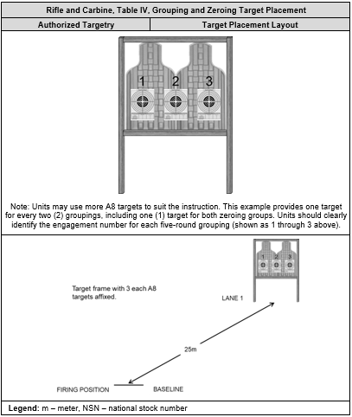
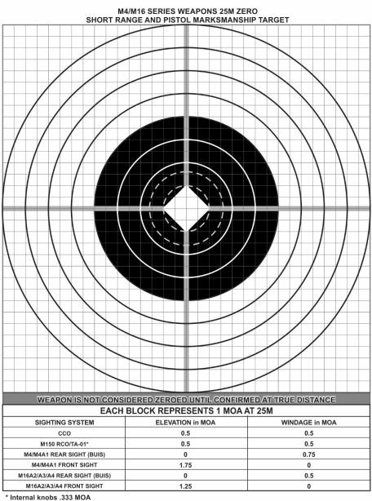
ZEROING
Notes:
Zeroing a weapon is not a training exercise, nor is it a combat skills event. Zeroing is a maintenance procedure that is accomplished to place the weapon in operation, based on the Soldier’s skill, capabilities, tactical scenario, aiming device, and ammunition. Its purpose is to achieve the desired relationship between the line of sight and the trajectory of the round at a known distance.
The zeroing process ensures the Soldier, weapon, aiming device, and ammunition are performing as expected at a specific range to target with the least amount of induced errors.
BATTLESIGHT ZERO
The term battlesight zero means the combination of sight settings and trajectory that greatly reduces or eliminates the need for precise range estimation, further eliminating sight adjustment, holdover or hold-under for the most likely engagements.
ZEROING PROCESS
A specific process should be followed when zeroing. The process is designed to be time-efficient and will produce the most accurate zero possible. The zero process includes mechanical zero, laser Bore-light, 25-m grouping and zeroing, and zero confirmation out to 300 meters.
After successfully bore-sighting the weapon, the next step is to perform grouping and zeroing exercises. Grouping and zeroing is done at 25 meters on a 25-m zero target or at known distance range.
The goal of the grouping exercise is for the shooter to fire tight shot groups and consistently place those groups in the same location. Tight, consistently placed shot groups show that the firer is applying proper aiming and smooth trigger control before starting the zeroing process. The firer should not start the zeroing process until they have demonstrated their ability to group well.
Once the firer has shown their ability to accurately group, they should begin adjusting the aiming device to move the groups to the center of the target. Depending on the aiming device used, there may be a zero offset that needs to be used at 25 meters. During the zeroing process it is important that the firer adjusts their groups as close to the offset mark as possible.

Slide 5
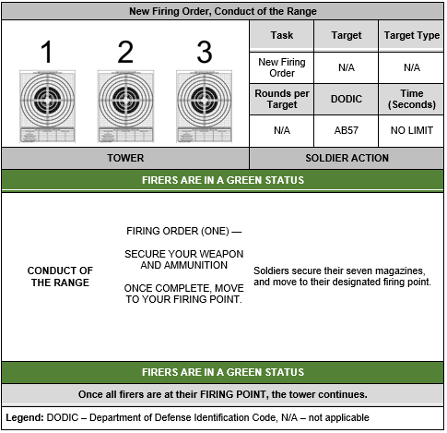
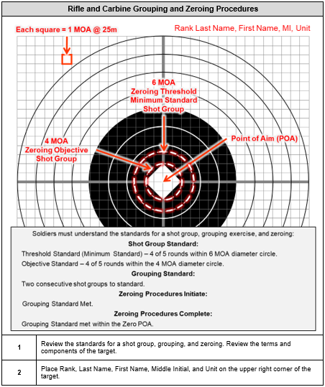
Notes:
Soldiers begin Table IV by moving into the firing position with the use of administrative commands from the tower. Administrative commands are used to control the flow of the range, movement of personnel, and other command and control purposes.
Soldiers enter the range and move to their firing points. Once at the firing point, firers assume a standing firing position with rifle and carbines in a GREEN weapons safety status. Table IV is fired from the prone supported position for each group.
To successfully complete Table IV, firers must meet the unit directed standard (threshold or objective) for their iron sight / BUIS and CCO / RCO, when assigned.
The Zero target specifies; the size of each square, the threshold and objective standard for a shot group, grouping exercise, and zeroing with dotted line or black contrast bullseye, a diamond for POA and the corrections with assigned aiming devices.

Slide 6
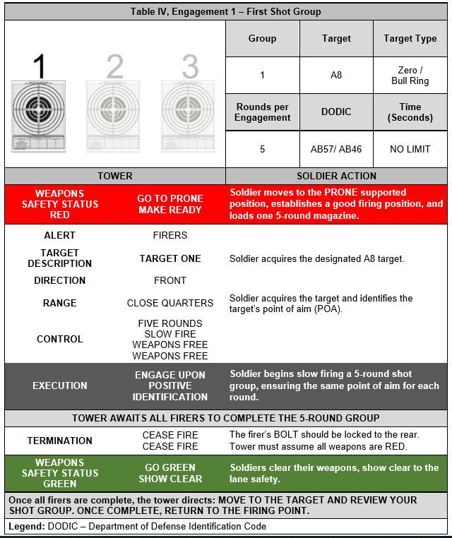
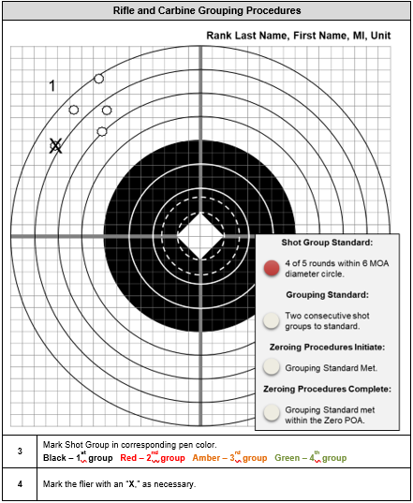
Notes:
READ RANGE CONDUCT –
During the zeroing process, the firer should attempt to center their groups as much as possible.
Shot group analysis involves the firer correlating the shots on paper with the mental image of how the shots looked when fired. An accurate analysis of the shot group cannot be made by merely looking at the holes in the paper. It is more important to observe the firer than to try and analyze the target. All firing takes place at the weapon, and the holes in the paper are only an indicator of where the barrel was pointed when the rifle was fired. When coaches are analyzing groups, they must question the firer about the group to make a determination of what caused the placement of the shots.

Slide 7
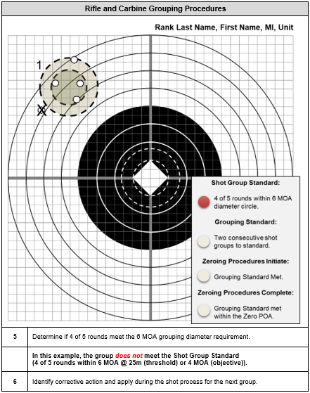
Notes:
Observing the shooter must be accomplished before analyzing the target can become effective. Coaches must learn to identify shooter errors during firing and use the bullet’s impacts on target to confirm their observations. There are often several firing errors that can be the cause of certain misplacements of impacts. The coach has to realize that bullets only go where the barrel is pointed, so he has to determine what happened that caused the barrel to be pointed in those directions, and those causes can be many.
Large groups are most commonly caused by the shooter looking at the target instead of the front sight. This causes the shooter to place the front sight in the center of
the target without regard for its location in the rear sight aperture. A small misalignment of the sights will result in a large misplacement of shots downrange.
Most likely it is not a point of aim issue; most shooters will not fire when their properly aligned sights are pointed all over the target.
Target Marking Best Practices:
Determine Quadrant (POA vs. POI)
Determine shot group size
Mark shot group holes
Determine MPI

Slide 8
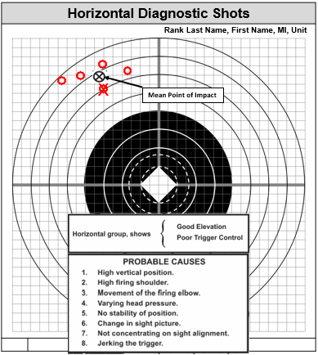
Notes:
All sight adjustments are from the center of the group, called the mean point of impact (MPI), and not from the location of a single shot. When using five-shot group, a single shot that is outside of the rest of the group should not be counted in the group for sight adjustment purposes.
Bullets displaced in this manner could be caused by a lateral movement of the barrel due to an unnatural placement of the trigger finger on the trigger. Reasons for this could include—
● The shooter may be slightly misaligning the sights to the left and right.
● The shooter may have the sights aligned properly but may have trouble keeping the target itself perfectly centered on the tip of the front sight.
● Shooter may be closing eyes at the moment of firing or flinching.

Slide 9
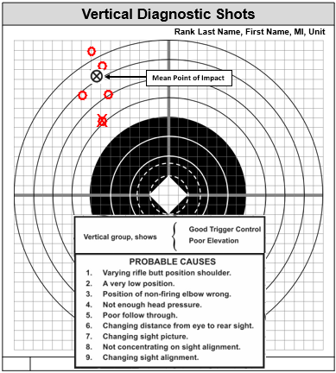
Notes:
Bullets displaced in a vertical manner could be caused by the following:
● Shooter may be misaligning the front sight in the rear sight aperture vertically. May be caused by the shooter watching the target instead of the front sight. Happens more frequently from less stable positions (kneeling, unsupported positions) due to the natural movement of the weapon.
● Shooter may have trouble seeing the target and keeping the tip of the front sight exactly centered vertically on the target. Coach may consider using a larger target or a non-standard aiming point such as a 5-inch circle. Many shooters find it easier to find the center of a circle than a man shaped target.
● Shooter may not have good support, which causes him to readjust their position every shot and settle with the sights slightly misaligned.
● Shooter may be flinching or closing eyes at the moment of firing.
● Shooter may be breathing while firing the rifle. (This is not normally the case, most shooters instinctively hold their breath just before the moment of firing).

Slide 10
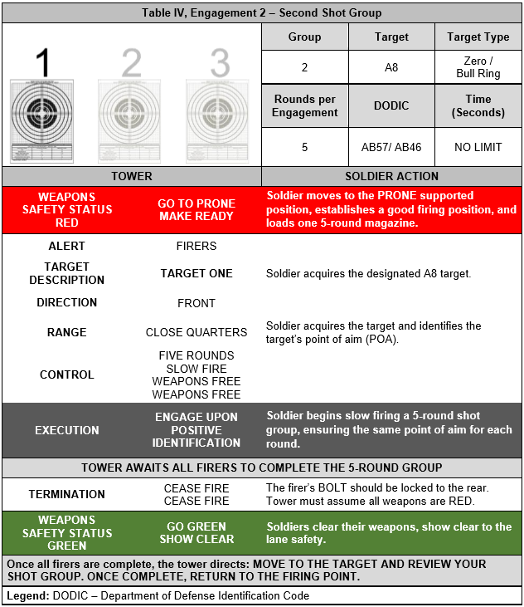
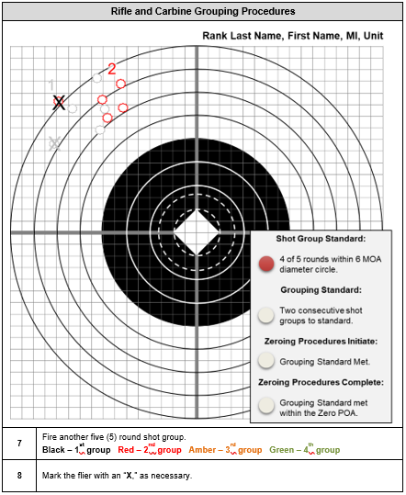
Notes:
Ensure that Coach and Firer mark MPI on first Group. This will allow the Shooter and Coach to see shift in POA/POI. It may also allow for more accurate corrections.

Slide 11
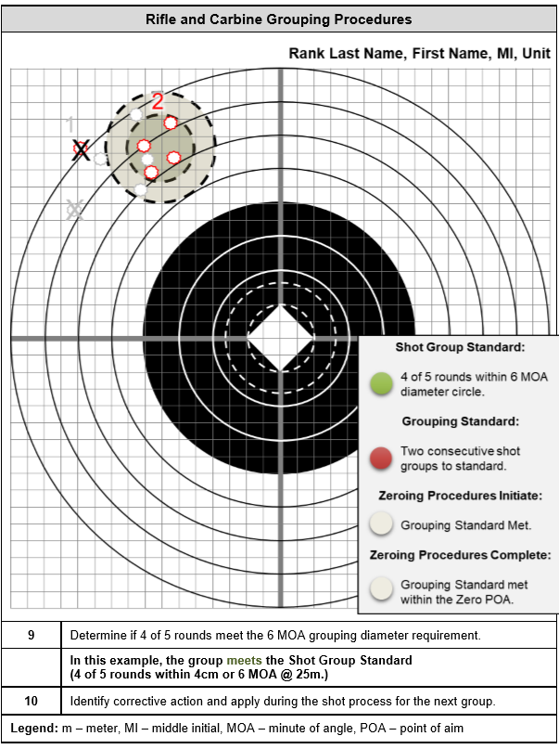
Notes:
READ ACTIONS FOR SECOND SHOT GROUP.
RE-EMPHESIZE MARKING TARGET PROCEDURES
When the shooter has good groups but they are located at different positions on the target, there can be a number of reasons. These include the following:
● May be caused by the shooter properly aligning sights during shooting but picking up a different point of aim on the target each time.
● May be caused by the shooter settling into a position with the front sight on target but the sights misaligned. The shooter maintains the incorrect sight picture throughout the group but aligns the sights incorrectly and in a different manner during the next group. Tell the firer to focus on the front sight and have them check natural point of aim before each group.

Slide 12
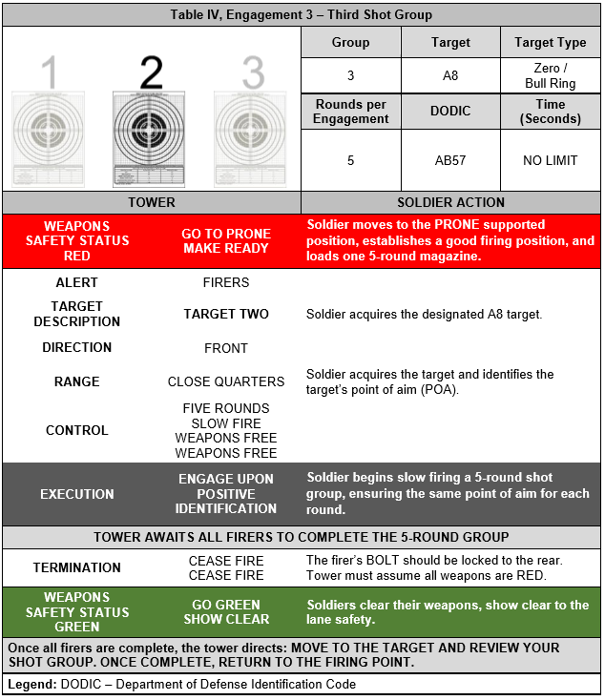
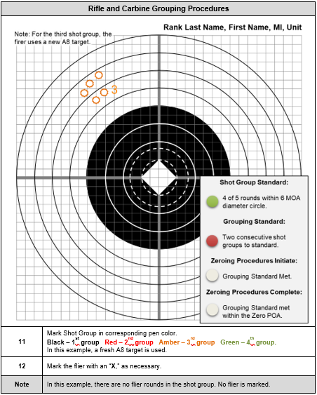
Notes:
READ CONDUCT OF FIRE AND STEPS ON ZERO TARGET

Slide 13
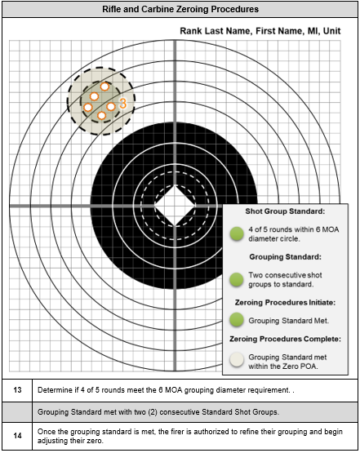
Notes:
SUMMERIZE STEPS

Slide 14
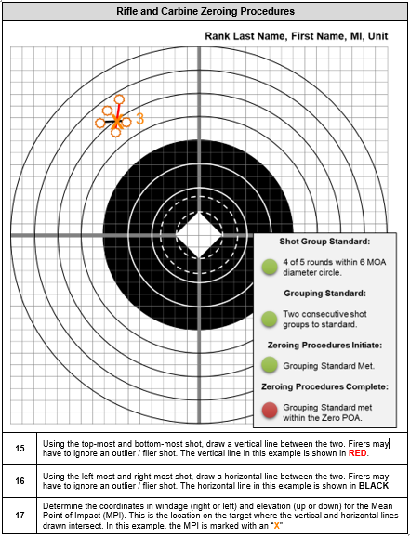

Slide 15
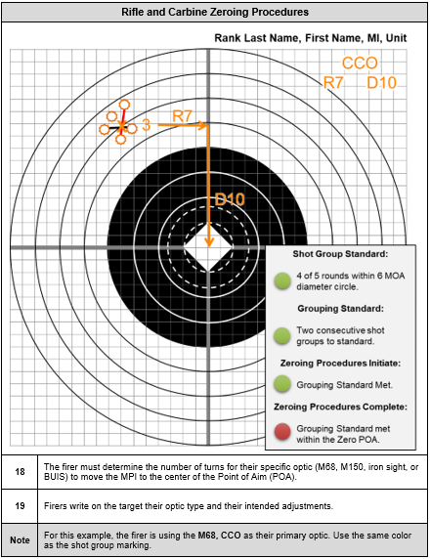

Slide 16
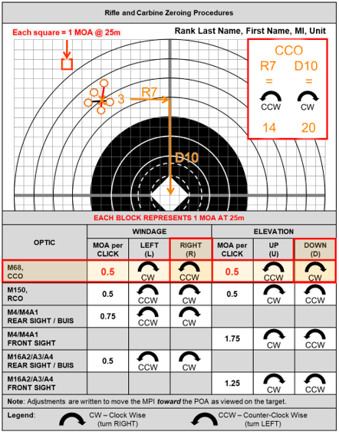

Slide 17
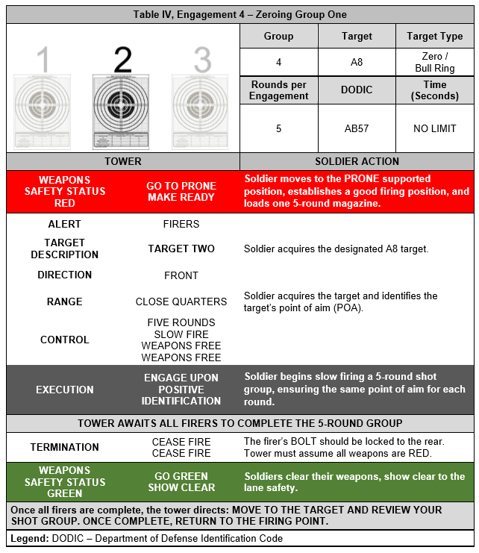
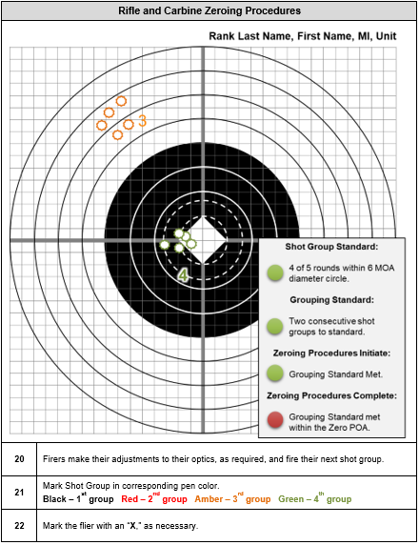

Slide 18
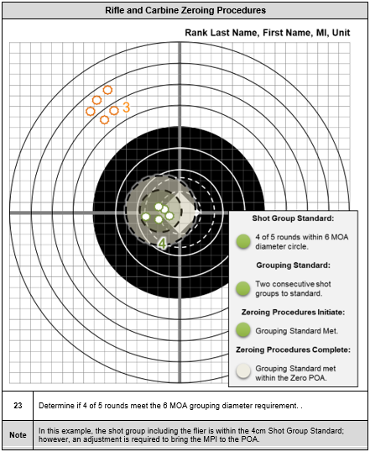

Slide 19
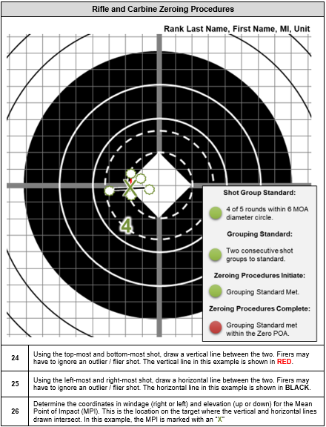

Slide 20
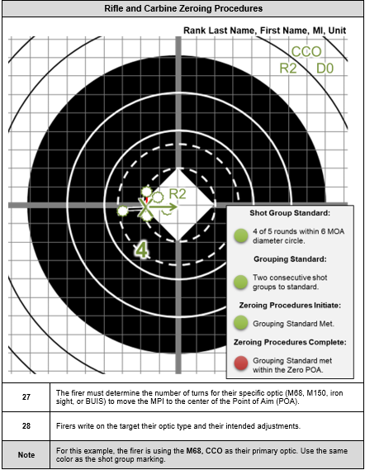

Slide 21
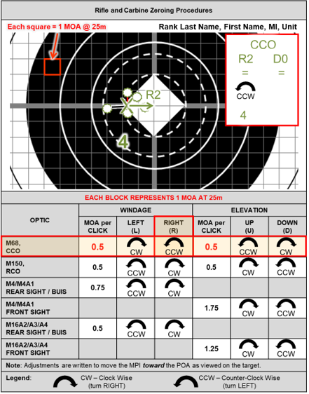

Slide 22
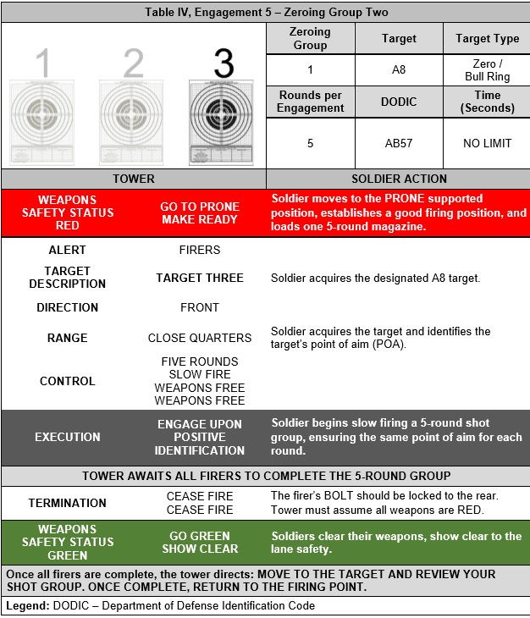
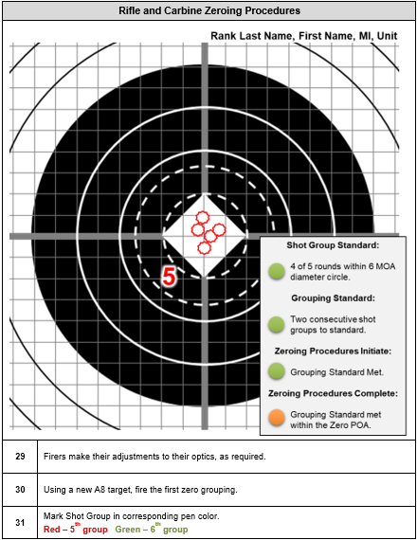

Slide 23
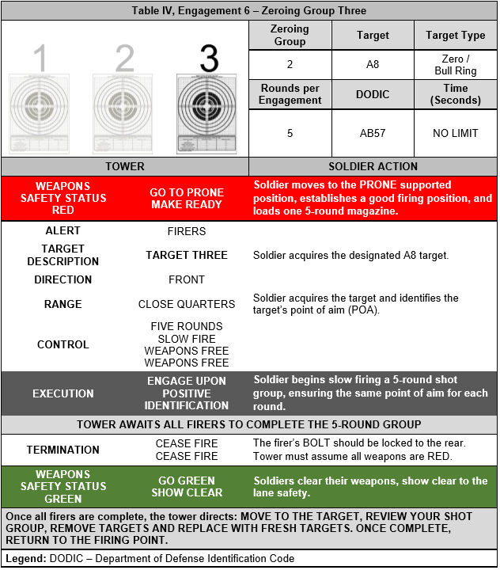
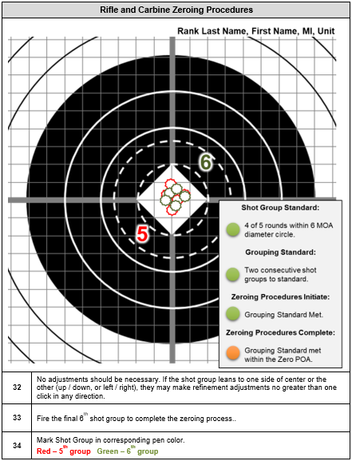

Slide 24
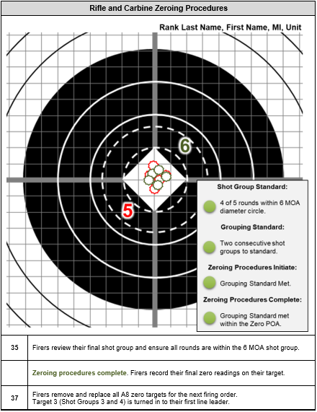

Slide 25
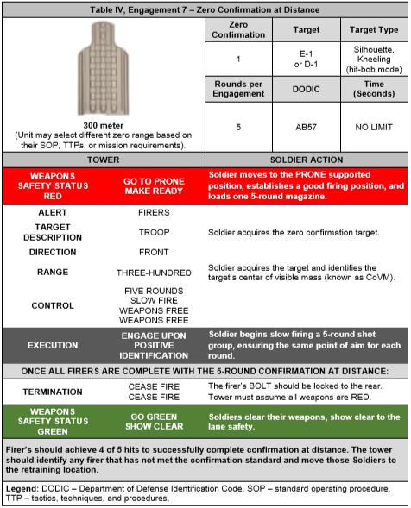
Notes:
There are multitudes of factors that can affect a zero, and the only sure way to know where the rounds are going, is to fire the rifle to confirm.
The most important step in the zeroing process is zero confirmation out to 300 meters. Having a 25 m zero does not guarantee a center hit at 300 meters. The only way to rely on a 300-m hit, is to confirm a 300-m zero.
Confirmation can be done on any range where Soldiers can see the impacts of their rounds. Groups should be fired and aiming devices should be adjusted. At a minimum, the confirmation should be done at 300 meters.
When confirming zero at ranges past 100 meters, the effects of the wind needs to be considered and acted upon, if necessary. If a zero is confirmed at 300 meters on a windy day, and then the weapon is fired at a later date in different wind conditions or no wind at all, the impact will change.

Slide 26
Questions?
Notes:
Begin by asking pointed question to get concrete knowledge of the class:
Example questions
What is the primary role of a rifleman?
What two truths about firing and does it change with each weapon system?
What is DIDEA?

