Slide 1
LSA 6:
Shot process Cont.
Control

Slide 2
ACTION:
Demonstrate knowledge of Army service Rifle preliminary marksmanship instruction.
CONDITION:
In a classroom environment, given TC 3-22.9, Rifle and Carbine.
STANDARD:
Identify how to apply and train Rifle Marksmanship utilizing the US Army Service Rifle in accordance with applicable command guidance, TC 3-22.9 Rifle and Carbine and TC 3-20.0 Integrated Weapons Training
Strategy.

Slide 3
INTRODUCTION
Safety Considerations:
Risk Assessment:
Environmental Considerations:
Evaluation:
Notes:
Safety Considerations: Fire escape plan should be reference
Risk Assessment: Low
Environmental Considerations: Keep tops on bottles when not in use and remember to remove all trash from the classroom.
Evaluation: You will be evaluated formally on written examinations which you must achieve a minimum of 70% to continue the course.

Slide 4
FUNCTIONAL ELEMENTS
CONTROL
SUPPORTING SOLDIER FUNCTIONS
Trigger Control | Breath Control | Work Space Management
Calling the Shot |  | Follow-Through
FOLLOW-THROUGH SEQUENCE
1. Recoil Management | 2. Recoil Recovery | 3. Trigger/ Sear Re-set
4. Sight Adjustments |  | 5. Engagement Assessment
Notes:
Take Away:
Introduction to the Supporting solider functions do not spend a lot of time discussing each.
Explain Breathing as being an interruption of the NPA or a bodily function that will can interrupt fine mechanical movements.

Slide 5
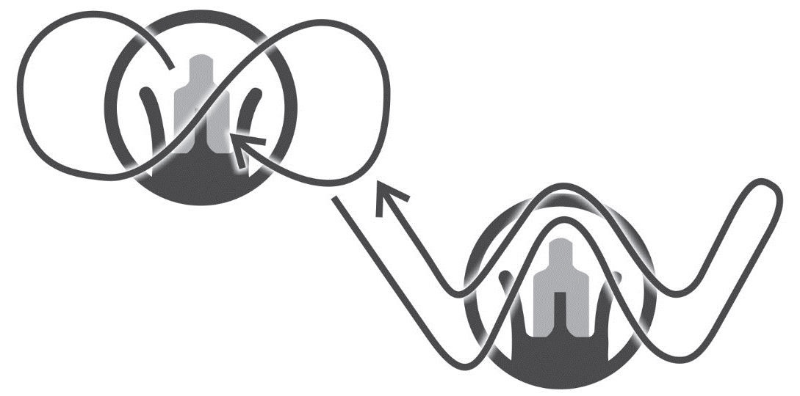
EMPLOYMENT
ARC OF MOVEMENT
(WOBBLE ZONE)
Notes:
Take away:
Wobble zone always exists, will increase with less stability or at higher positions.
Counter random movement of the weapon by inducing predictable movement in a infinity pattern or W as in the example. This can be done by approaching target from the bottom or side.
Can change based on optic and distance of shot.

Slide 6
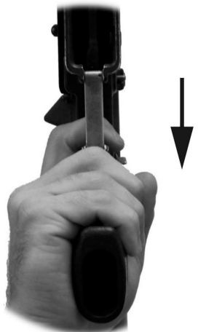
EMPLOYMENT
TRIGGER CONTROL
Notes:
Take away:
Trigger Control is the most important aspect of Control to learn, and the most difficult to master.
The key to Trigger Control is a smooth consistent squeeze, regardless of the speed at which it is pulled.
When the Soldier has a solid position, and a good trigger squeeze, then any induced shooting errors are attributed to the Soldier's aiming process. (Good talking point when relating to coaching)
In order to get a smooth trigger squeeze, the Soldier places their finger where it lays naturally on the trigger.
This will allow for maximum mechanical advantage when applying rearward pressure on the trigger.
One other thing to keep in mind is trigger reset, to allow for efficiently transition to follow on shots without having to apply more pressure to the trigger than necessary.
It is important that they keep their eyes on their sighting system (iron sights, optic, laser, etc.) to ensure that they are ready for follow up shots if needed and to calling the shot. (Good talking point when relating to coaching)

Slide 7
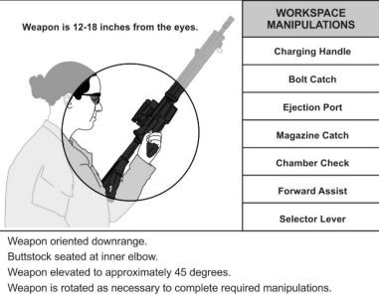
EMPLOYMENT
WORK SPACE
Notes:
Take away:
The workspace is a spherical area, 12 to 18 inches in diameter centered on the Soldier’s chin and approximately 12 inches in front of their chin.
The workspace is where the majority of weapons manipulations take place.
Conducting manipulations in the workspace allows the Soldier to keep his eyes oriented towards a threat or his individual sector of fire while conducting critical weapons tasks that require hand and eye coordination.
Location of the workspace will change slightly in different firing positions.
Examples are leaving the butt stock in the shoulder, tucking the butt stock under the armpit for added control of the weapon, or placing the butt stock in the crook of the elbow.

Slide 8
Notes:
Take away:
Primary (Switch): The key placement of all shots. This is identified as a 10” X 10” square at COVM. This shot leads to incapacitation of the neural pathway from the brain to the body.
Good lead in to understanding “what is COVM on a E type target?”
Secondary (timer): Is the poor shot placement of COVM. This is the slower incapacitation of the body, IE. Hemorrhaging/ bleeding out.

Slide 9
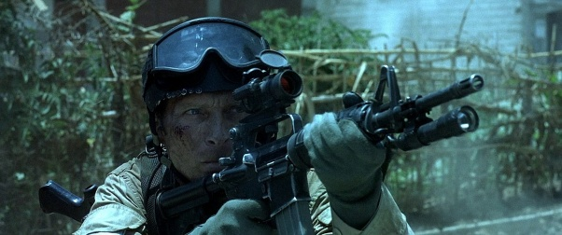
EMPLOYMENT
FOLLOW-THROUGH ACTION SEQUENCE
4. Sight picture adjustment
1. Recoil management
2. Recoil Recovery
5. Engagement Assessment
3. Trigger/ Sear Reset
Notes:
Take away:
Follow-through consists of all actions controlled by the shooter after the bullet leaves the muzzle. It is required to complete the shot process. These actions are executed in a general sequence:
● Recoil management. This includes the bolt carrier group recoiling completely and returning to battery.
● Recoil recovery. Returning to the same pre-shot position and reacquiring the sight picture.
● Trigger/Sear reset. Reference back to a good trigger placement and trigger squeeze. This will allow for faster follow up shots and CALLING THE SHOT.
● Sight picture adjustment. Counteracting the physical changes in the sight picture caused by recoil impulses and returning the sight picture onto the target aiming point.
● Engagement assessment. Is a follow on shot necessary. The shooter can only shoot as fast it takes to get the sights back on target.

Slide 10
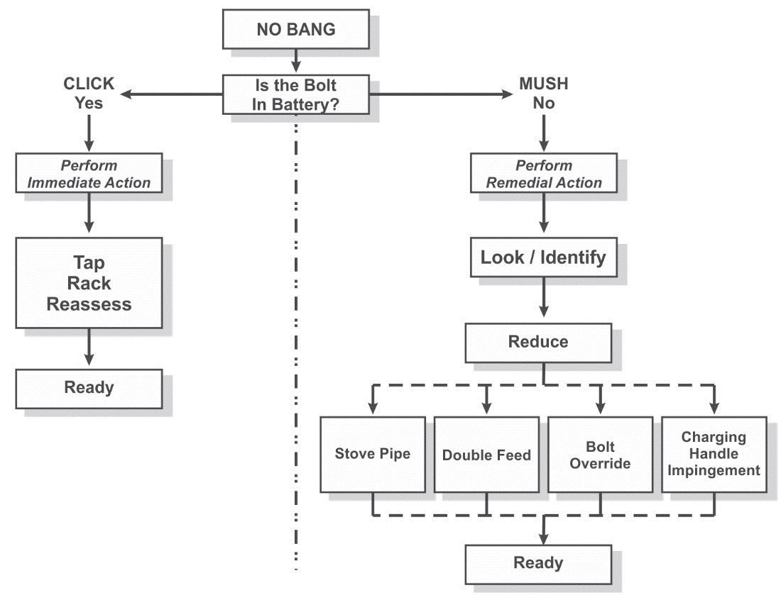
EMPLOYMENT
MALFUNCTION FLOW CHART
Notes:
Take away;
Hear a click, conduct immediate action (tap, rack, reassess)
Hear a mush, start with immediate action, stop when observing an interruption of the 8 cycles of function, correct malfunction/ stoppage, reinsert a source of feed and reassess.

Slide 11
CHECK ON LEARNING
CONTROL
What is Arc of Movement or the wobble zone?
The extent of lateral horizontal and front-to-back variance in the movement that occurs in the sight picture.
What is the key to trigger control?
A smooth, consistent trigger squeeze, regardless of speed, allows the shot to fire at the Soldier’s moment of choosing.
What is the sequence of action for follow-through?
● Recoil management.
● Recoil recovery.
● Trigger/Sear reset.
● Sight picture adjustment.
● Engagement assessment

