Slide 1
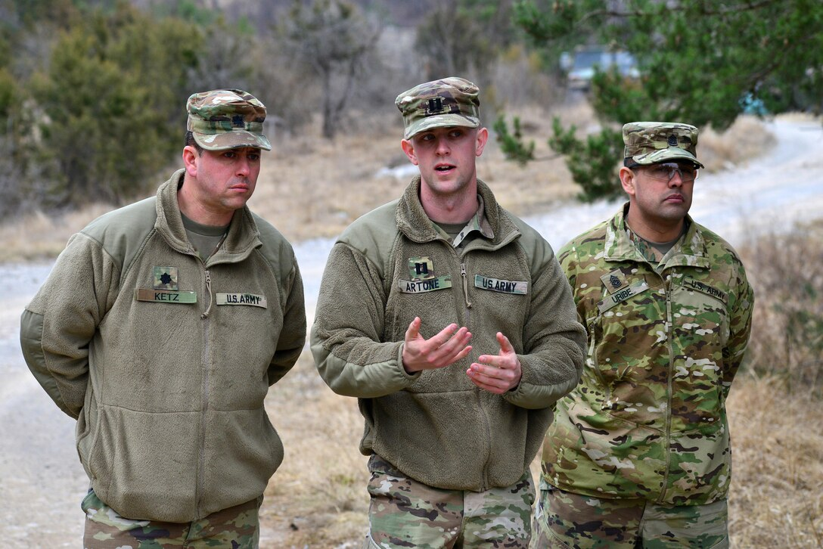
Command Climate
158-CCFSC
Company Commander/First Sergeant Pre- Command Course

Slide 2
Terminal Learning Objective (TLO)
Action: Examine command climate.
Conditions: As an incoming company commander or first sergeant attending the pre-command course (PCC); given classroom instruction, peer-to-peer discussion, instructor feedback, reflection time, and references AR 600-20, ADP 6-22, and FM 6-22 and the Building and Maintaining a Positive Climate handbook.
Standard:
Distinguish at least three elements between command climate and organizational culture.
Identify at least three ways that command climate may affect unit performance.
Explain at least three individual Soldier behaviors that may affect command climate.
Review the Army requirement for the Defense Organizational Climate Survey (DEOCS) in a clear and concise manner.
Learning Domain: Cognitive
Level of Learning: Analysis

Slide 3
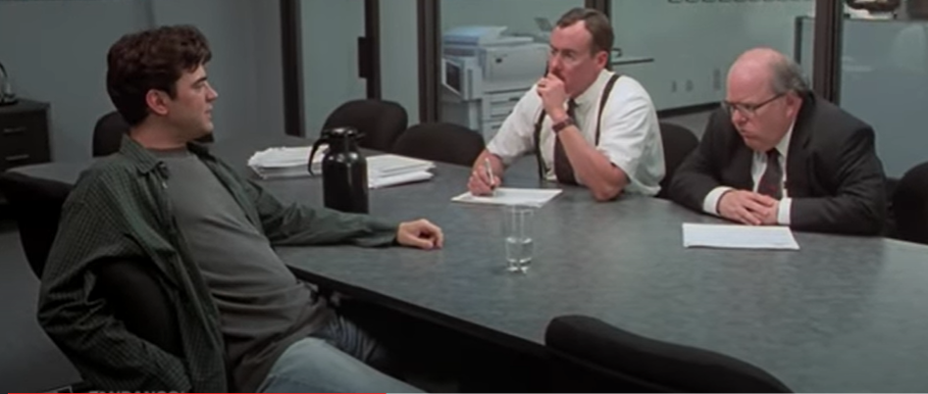
Introduction - Video
Office Space Movie CLIP - YouTube

Slide 4
Climate and Culture
Climate
How members think or feel about the unit
Can change quickly (as people come and go with personnel cycles)
Usually a short-term experience
Shared perceptions and attitudes
The environment of the unit
Shaped by organizational and direct leaders
Culture
How members do things (includes how things were done in the past)
Hard to change (may be associated with a particular Branch or Service)
Long lasting (may last for generations)
Deeply embedded and enduring beliefs, customs, and traditions
The environment of the Army as a profession/whole
Shaped by strategic leaders
ADP 6-22 and FM 6-22

Slide 5
What is Command Climate?
A state or condition existing from shared feelings and perceptions among Soldiers about their unit, their leaders, and their unit’s programs and policies.
Positive command climate
Drives unit performance
Results in mission accomplishment
Drives unit readiness
Why is command climate a reflection of leader effectiveness?
"By the work one knows the workman."
Jean de La Fontaine

Slide 6
Leader Effectiveness
Positive Impact on
Command Climate
Negative Impact on
Command Climate
Leader
Effectiveness
Less Prepared
More Prepared
Level of Organizational
Preparedness
Fairness
Communication
Cohesion
Leadership
Respect
Trust

Slide 7
Individual Soldier Behavior and Command Climate
Positive Command Climate
An environment free from personal, social, or institutional barriers.
Unlawful discrimination creates barriers.
Hazing & Bullying
Harassment & Intimidation
Insults
Humiliation
Disparagement
Be vigilant for those treated less favorably.
Race
Color
Sex/Gender/Sexual orientation
National origin
Religion
(Not all inclusive)
What does negative command climate look like?
Building and Maintaining a Positive Climate Handbook (July 2020)

Slide 8
Determine the Health of the Unit
Step 1: Evaluate your organization on climate factors.
Step 2: Identify strengths and areas to improve.
Step 3: Diagnose problems as they arise.
Step 4: Share results.
Building and Maintaining a Positive Climate Handbook (July 2020)

Slide 9
Assessment Methods
Staff Assistance Visits (SAVs)
Personal Interactions (Battlefield circulation, open door policy)
Observations (Yours and others)
Focus groups (Sensing/listening sessions)
Data/Trends
AR 600-20, Army Command Policy (July 2020)

Slide 10
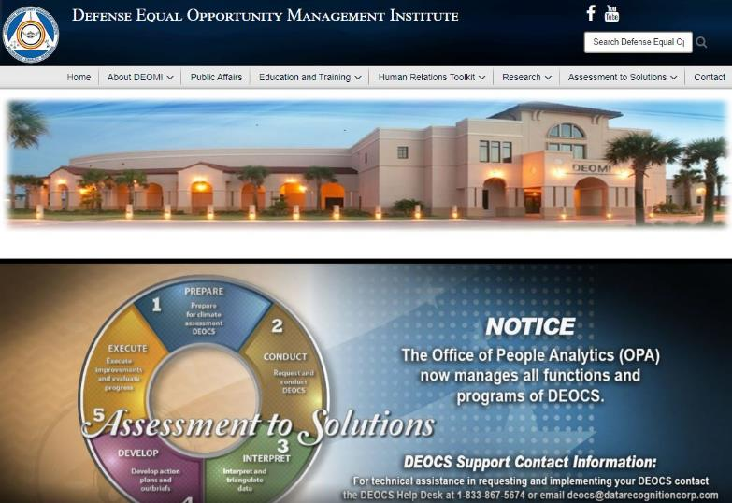
DEOCS and the DEOMI Website
https://www.defenseculture.mil/Assessment-to-Solutions/A2S-Home/

Slide 11
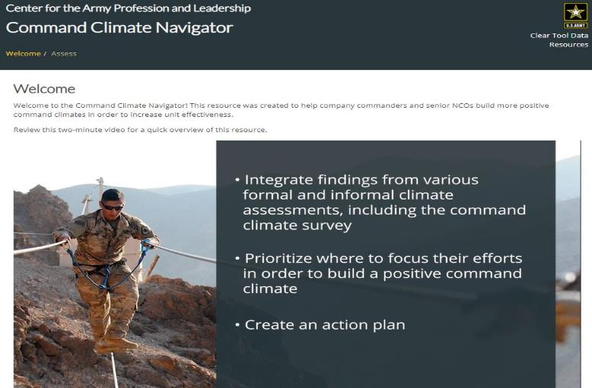
Command Climate Navigator
Reference: https://capl.army.mil/command-climate-navigator/

Slide 12
Influencing Positive Command Climate
Leadership
Communication
Respect/Values
Team Cohesion
Growth
Innovation
Empowerment
Recognition
Order/Discipline
Fairness
Building and Maintaining a Positive Climate Handbook (July 2020)

Slide 13
Practical Exercise / Discussion Questions
How do you maintain/nurture a constructive a positive command climate within your organization, when faced with difficult situations?
As a new CDR/1SG, how will you communicate your leadership philosophy to your troops?
What types of settings/activities would be most suitable in triggering candid responses from your Soldiers, when trying to gauge the command climate of your unit?
As a CDR/1SG, should you assume that minorities will be marginalized?
How confident are you in your ability to recognize disparaged populations within your unit?

Slide 14
Practical Exercise / Discussion Questions
Cont.
As a new CDR/1SG in charge of a training company, what strategies would you use to deal with assigned civilian populations?
As a new CDR/1SG, how do you lead by example?
What percent of your efforts should focus on maintaining a positive command climate?
How will you address results from your command climate survey?
How important is praise within your command? Explain
How would you deal with rumors in your organization?

Slide 15
Company Commander and 1SG Relationship
In my opinion, the most imperative requirement for a CDR/1SG relationship is a brutally honest understanding that everything that is decided, planned, executed or resourced is done for the good of the unit and its Soldiers.
This common-ground agreement sets the bar for the relationship between the CDR and the 1SG and ultimately facilitates the success of the command-team relationship.
In ‘the good of the unit and its Soldiers,’ I include all aspects of the unit’s mission, training, administration and equipping, as well as the care of Soldiers’ families.
There are times when you and your 1SG will disagree on an issue. However, as in all military organizations, decisions must be made, and the CDR is the individual charged with this responsibility.
1SGs are professionals and understand this concept, and as long as their council, recommendations and experience were considered in the decision-making process, they will typically support your decision and expend every ounce of energy to execute your intent.
Our basic output from this was that the 1SG ran the company so that I could command it.

Slide 16
Back Up / Additional Slides

Slide 17
Diversity - Equity - Inclusion
All attributes, experiences, cultures, characteristics, and backgrounds of the total force which are reflective of the Nation we serve and enable the Army to deploy, fight, and win.
The fair treatment, access, opportunity, choice, and advancement for all Soldiers and Civilians while striving to identify and encourage drivers and identify and eliminate barriers that have prevented the full participation of the total force.
.
The process of valuing and integrating each individual's perspectives, ideas, and contributions into the way an organization functions and makes decisions; enabling workforce members to achieve their full potential in focused pursuit of organizational objectives.
DIVERSITY
EQUITY
INCLUSION
Army People Strategy - Diversity, Equity, and Inclusion Annex

Slide 18
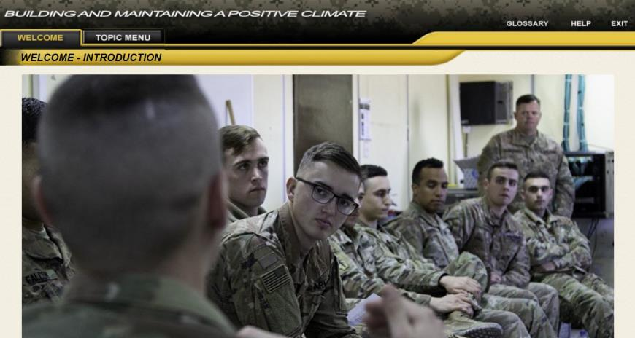
Building and Maintaining a Positive Climate
Reference: https://capl.army.mil/imi/

Slide 19
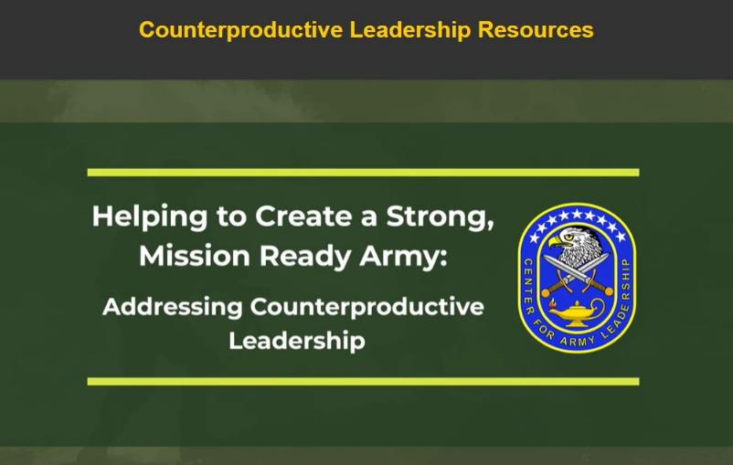
Counterproductive Leadership
Reference: https://capl.army.mil/counterproductive-leadership/

Slide 20
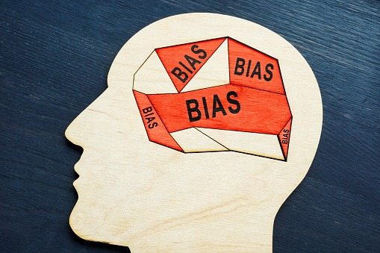
Unconscious or Implicit Biases
“Science tells us, if you have a brain, you have a bias. Bias is a way of sorting out information that comes into our brain. It’s based on stereotypes about a person or group and it’s automatic.”
However there’s nothing wrong with having bias depending on how you choose to use it. “It is a choice to let bias control your behavior,”
Dr. David Allen Parker, University of Utah
Affinity Bias
Halo Effect
Perception Bias
Confirmation Bias
Group Think
Source: US Army Soldier Support Institute (SSI) Equal Opportunity Training Proponent (EOTP)

Slide 21
Summary
Analyze command climate
Command climate vs organizational culture
Command climate and unit performance
Individual Soldier behavior and command climate
Unit assessment methods
Army requirement for the DEOCS survey

Slide 22
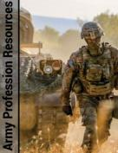

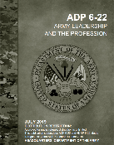
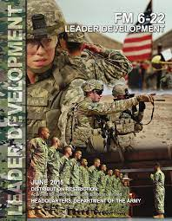
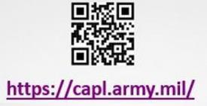

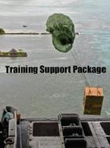

CAPL Training and Education Resources
Army Profession Resources
Doctrine
Leader Development Resources
Project Athena
Training Support Packages

