Slide 1

2-327 HHC
SQD LFX OPORD
17 AUG 2021
CPT Batley, CPT Rodriguez, CPT Dipasquale, CPT Nam, CPT Robinson

Slide 2
METL/Battle Tasks
Mission & Commander’s Intent
8 Step Training Model
SQD LFX CONOP
  Sync Matrix
Annexes
  A: Task Org
  B: Intelligence
  C: T&EO Tasks + Evaluation Plan
  C: Leader Development Plan
  C: Observer/Controller Plan
  F: Ammunition
Final CDR Guidance

Slide 3
Mission Essential Tasks
COMPANY MISSION ESSENTIAL TASK LIST
TASK | STRATEGY (Next 2 Months)
Conduct a Movement to Contact 07-2-1090 | TM Level Training, SQD STX, SQD LFX
React to Contact 07-3-D9103 | TM Level Training, SQD STX, SQD LFX
Conduct Squad Attack 07-SQD-1092 | TM Level Training, SQD STX, SQD LFX
COMPANY PAYOFF TASK LIST
INDIVIDUAL TASKS | COLLECTIVE TASKS | LEADER TASKS
Move as a Member of a Fire Team 071-326-0501 | Conduct a Movement to Contact 07-2-1090 | Develop an Effective Team 158-100-7015
Land Navigation 071-329-1006 | React to Contact 07-3-D9103 | Conduct TLPs 71-1-5100
Engage Targets with an M4 or M4A1 Carbine 071-100-0003 |  | Control Movement 071-326-5605
Engage Targets with an M249 Machine Gun 071-010-0006
Training Objectives
100% Teams are trained in the following
  Movement tactically day and night
  Squads are able to conduct actions on contact
  Squad Leaders effectively employ Troop Leading Procedures and Fire Control Principles.

Slide 4
MISSION & COMMANDERS INTENT
Mission
C /2-327 conducts Squad Live Fire Exercises on Range 77 11-15SEPT17 IOT integrate collective marksmanship with movement techniques for a dismounted Infantry Squad in preparation for Platoon LFXs.
Commander’s Intent
C Co Squads certified on collective Battle Tasks in preparation for Platoon LFXs. Challenge Squad members and Squad Leaders in a dilemma where they must make timely decisions on how to best maneuver their element.
Purpose
Evaluate and certify all C Co Squads, in preparation for Platoon LFXs.
Key Tasks
  Request and Reserve Resources
  Train and Certify Leaders
  Select Training Objectives
  Develop Range Concept
  Terrain Walk
  All SQDs conduct LFX
End State
All C Co Squads are certified and proficient at Company Battle Tasks and prepared to execute Squad and Platoon LFXs.

Slide 5

RETRAIN
- 16 SEP
EVALUATE
THE TRAINING
- 15 SEP
8 STEP TRAINING MODEL
Be prepared for opportunity training
Review references, IE; FMs, ARTEPs, TMs, and soldier's manuals
EXECUTE
- 13-15 SEP
Was there an evaluation done after the training execution?
Were the training objective/standards met?
What is the METL assessment?
Were the materials/training aids sufficient for the training?
Was an After Action Review done?
Are the training results recorded in the leaders book/DTMS?
REHEARSE
- 4 SEP
Is the training conducted to standard?
Are soldiers for training accounted for?
Is everyone in uniform?
ISSUE ORDER
- 28 AUG
Identify weak points in the training plan?
Does the training flow?
Is there sufficient time for the training?
Are the training aids/material present and operational?
Did you review pre-execution and pre-combat checks?
RECON THE SITE
- 21 AUG
Has a OPORD been issued for the training?
Has the uniform for the training been briefed?
TRAIN THE TRAINERS
- 4 AUG
Location of training:
Is the site suitable for the training?
Is it easily accessible for emergency case?
PLAN
- 27 JUL
Have the training outline been reviewed?
Is the trainer technically and tactically proficient?
Does the trainer understand the task, conditions, and standards?
Review references (FMs, TMs, and Soldier’s manuals)
Is the trainer’s evaluation procedure in compliance with the training objective?
What is to be trained?
What is the METL assessment?
Who is to be trained?
ID Instructor/Assistant
Date training was planned:
Date training will be executed:
Is the training site coordinated?
Are all the resources coordinated?
Materials/training aids required:
Has a risk assessment be done?
Levels of Training:
Constructive: Table I – PMI @ 4-21 AUG
Virtual: Table II-lll – EST 2000 @ 3-5 SEP
Live Fires: IV-VI – LFX @ 13-15 SEP
IAW IWTS TC 3-20.0 PG 3-3

Slide 6
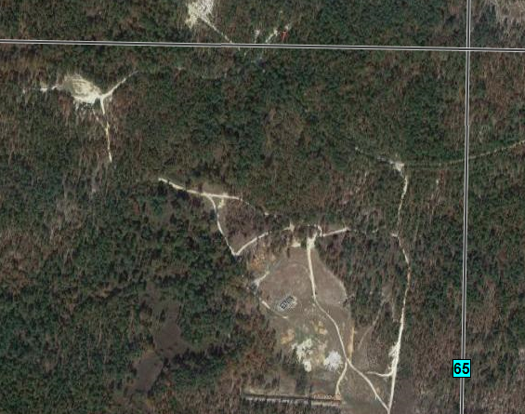
Mission: C / 2-327 conducts a Squad Live Fire Exercise on Range 77 11-15 SEP IOT integrate collective marksmanship with collective movement techniques for dismounted movement.
Commander’s Intent: All C Co Squad Squads are proficient in collective marksmanship and movement during LFX conditions IOT prepare for PLT level LFX
Key Tasks
Request and reserve resources
Train and certify leaders
Select training objectives
Develop range concept
Terrain walk and refine concept
  Endstate:
  Squads effectively plan and rehearse
  Squads move tactically
  Squads conduct actions on contact
  Squad leaders employ fire control and distribution of fire principles
  Concept:
  The purpose of this event is to certify all Squads during LFX conditions. Decisive to this event is the completion of dry and blank fire. This is decisive because it will ensure Squads are prepared to advance to the live fire iteration. We assume tactical risk by using live ammunition. We will mitigate this risk through the use of planning, rehearsals, range safeties, and proper wear of PPE.
  Phase I: Planning/Preparation
  Starts: ADVON SPs for leader’s recon
  Ends: PLT SP from Company
  Critical: Leaders certified, PMI conducted, and resources secured.
  Phase II: Execution
  Starts: PLTs SP from Company to Range
  Ends: Last iteration is complete.
  Critical: Control of the flow of Squads, concurrent training
  Phase III: Recovery
  Starts: Completion of Final Iteration
  Ends: 100% MWE at company
  Critical: Leaders secure MWE and Range cleaned and handed to Range Control
TIMELINE:
11SEP2017
0900: ADVON SP
1500: Company SP
12-14SEP2017
0600: Wake Up
0700: Lane 1
0000: Lanes complete
15SEP2017
0600: Wake up
0700: Police call
1200: RTB
C Co
2-327
N
Co CP
LD
Stage Area
ASP
1/1
C
TGT 1
  Key Personnel:
  OIC – 2LT Baumeister
  NCOIC – SSG Gonzalez
  RSO – SSG Romero
  Ammo Handler – SGT Mehmel
  Safety – Command Squad(CO/1SG)
  Concurrent Training – PLT Internal
  RTO – SPC Phinney
  Lane Medic – FLA, 2x Medics
Signal:
Range Control Phone: 432-2170/2900/1161
Range Control FREQ: 38.90 (PRIMARY); 46.75 (ALT)
MEDEVAC: FLA Vehicle
P: FM
A: Hardline
C: Cell Phone
E: Runner
RESOURCE STATUS
LAND | Range 77
CL I | MRE
CL IV | N/A
CLV | Request Sent
CL VIII | N/A
TNG AIDS | TAS-C
Training Management (8-STEP Training Model)
Plan the Training | Recon the Site | Train/Certify Leaders | Issue the Plan | Rehearse the TNG | Execute Training | Evaluate TNG | Retraining
27 JUL | 21 AUG | 04 SEP | 28 AUG | 4 SEP | 11-15 SEP | 15 SEP | TBD

Slide 7
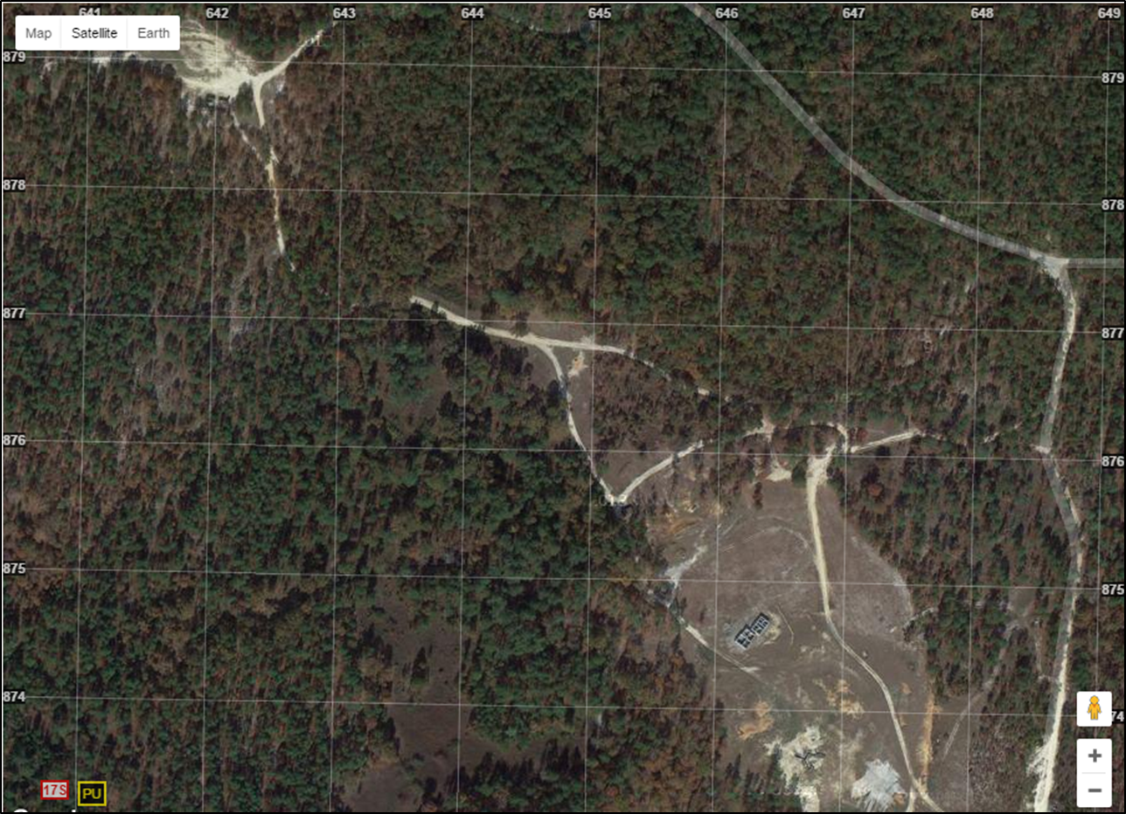
Phase I
MISSION:
C / 2-327 conducts a Squad Live Fire Exercise on Range 77 11-15 SEP IOT integrate collective marksmanship with collective movement techniques for dismounted movement.
TIMELINE:
13 JULY2017
0730: Range party departs for range set up.
0800: Range Setup
0900: Shooters staged for trans to RG 32/ RANGE HOT
0930: TCS Briefed, RG Safety Brief
TBD-NLT 1700: Range cold/ Cleared/ Exfil back to CoF
UNIFORM:
ACU
Plate carrier/TAPS (no plates)
ACH
PPE
Camelbak
M4
Chow Area
Terrain Model
ATK POS CHAOS
A/1
C
Lane 1
Phase I: Planning
Starts: Receipt of OPORD
Ends: LD ATK POS CHAOS
Key Tasks Trained:
Issue a FRAGO (071-326-5502)
Route Selection & Movement Tech/Form.
Alter Soldier Load based on Mission
Endstate:
All Squad members understand and have rehearsed plan. PCC/PCIs complete, Squad postured in Attack Position and ready to cross the LD.
Scheme of Maneuver:
Squad Leader receives Mission to Conduct SQD Attack to the South of the OBJ.
Squad conduct TLPs
Squad LDR issues FRAGO / Conducts RXLs
Squad LD ATK POS CHAOS
N
TASK ORG:
Range OIC- 1LT Gongora
Range RSO- SFC Negron
Safeties: SSG Miles, SGT Chacon, SGT Cotton
O/C Personnel:
Target Sets controlled from the O/C (CDR/1SG will advise when to activate). Target Set will come up.
Weapon Systems to engage: M4s, M249s, M320
.
.
SUSTAINMENT:
Class I: 10x Box MRE, 6x 5 Gallon Water Cans
Class II: West of Gruber Uniform with plates
Class III: 1G CLP; Vehicles Pre-Fueled
Class V: See Ammunition Attachment
Class VII:2x LMTVs, 1x HMMWV
Class VIII: 1x CLS Bags, 1x FLA
Class X: 1x Box Earpro, 1x Roll Engineer Tape, 1x Box Large Trash Bags
RESOURCE STATUS
LAND | T - 6
CL I | N/A
CL IV | N/A
CLV | T - 12
CL VIII | T - 1
TNG AIDS
Commo:
P: FM A: Cell Phone
C: BFT E: Runner
Training Management (8-STEP Training Model)
Plan the Training | Recon the Site | Train/Certify Leaders | Issue the Plan | Rehearse the TNG | Execute Training | Evaluate TNG | Retraining
27 JUL | 21 AUG | 04 SEP | 28 AUG | 4 SEP | 11-15 SEP | 15 SEP | TBD

Slide 8
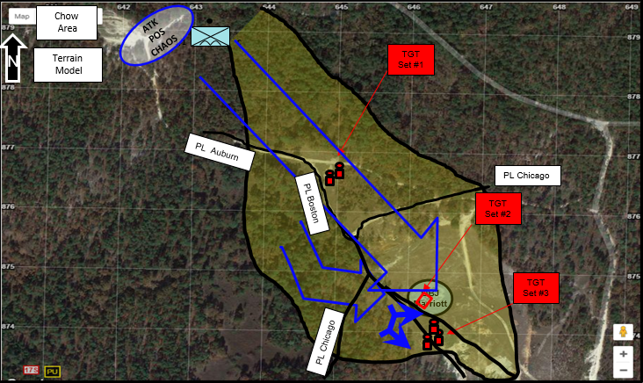
Phase II
MISSION:
C / 2-327 conducts a Squad Live Fire Exercise on Range 77 11-15 SEP IOT integrate collective marksmanship with collective movement techniques for dismounted movement.
TIMELINE:
13 JULY2017
0730: Range party departs for range set up.
0800: Range Setup
0900: Shooters staged for trans to RG 32/ RANGE HOT
0930: TCS Briefed, RG Safety Brief
TBD-NLT 1700: Range cold/ Cleared/ Exfil back to CoF
UNIFORM:
ACU
Plate carrier/TAPS (no plates)
ACH
PPE
Camelbak
M4
Phase II: React to Ambush
Starts: LD ATK POS CHAOS
Ends: Continue movement to Attack POS
Key Tasks Trained:
Conduct Tactical Movement (07-2-1342)
React to Near Ambush (171337-1018)
Conduct C&R (07-2-5027)
Send a SALUTE Report (071-121-4080)
Endstate:
Enemy LP/OP Destroyed, SALUTE Report sent up and ready to continue movement.
Scheme of Maneuver:
Squad begins movement and receives FRAGO to move along 145 degree azimuth to inspect a possible cache site at intersection (17S PU 64465 87682).
When lead Squad enters clearing (vic 17S PU 64454 87698), this triggers ambush from enemy LP/OP to Squad Front (TGT 1 and 2 w/ pneumatic gun). Squad reacts to near ambush, engages enemy target, clears through kill zone and enemy LP/OP position.
Squad LDR conducts C&R; sends SALUTE Report. Receives order to continue movement.
Squad Leader has one fire team move to SBF1 and begin suppressing TGT Set #3
2nd Fire team enters and clears building
TASK ORG:
Range OIC- 1LT Gongora
Range RSO- SFC Negron
Safeties: SSG Miles, SGT Chacon, SGT Cotton
Key Personnel:
Target Sets controlled from the O/C (CDR/1SG will advise when to activate). Target Set will come up.
Weapon Systems to engage: M4s, M249s, M320
.
.
SUSTAINMENT:
Class I: 10x Box MRE, 6x 5 Gallon Water Cans
Class II: West of Gruber Uniform with plates
Class III: 1G CLP; Vehicles Pre-Fueled
Class V: See Ammunition Attachment
Class VII:2x LMTVs, 1x HMMWV
Class VIII: 1x CLS Bags, 1x FLA
Class X: 1x Box Earpro, 1x Roll Engineer Tape, 1x Box Large Trash Bags
RESOURCE STATUS
LAND | T - 6
CL I | N/A
CL IV | N/A
CLV | T - 12
CL VIII | T - 1
TNG AIDS
Commo:
P: FM A: Cell Phone
C: BFT E: Runner
Training Management (8-STEP Training Model)
Plan the Training | Recon the Site | Train/Certify Leaders | Issue the Plan | Rehearse the TNG | Execute Training | Evaluate TNG | Retraining
27 JUL | 21 AUG | 04 SEP | 28 AUG | 4 SEP | 11-15 SEP | 15 SEP | TBD

Slide 9


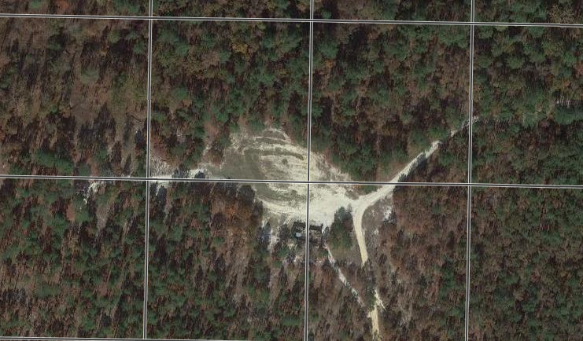

Staging Area Concept
Concept of Staging
Staging area is located North West of main RG 77 building near Morganton Road (17S PU 64211 87898)
Chaos Paratroopers will arrive on the North Entrance of the Staging area from Morganton Road
Safeties will send all Paratroopers immediately to the OIC/RSO
Paratroopers will receive the Range/Safety Brief then move to their respective areas.
Platoon Conducting the Lane
Squads training the lane that day will rehearse, brief their FRAGO, draw ammunition, check in at the Co CP move to the staging area, conduct the lane, then conduct an AAR.
Platoon Rehearsing
The day prior to conducting the range, Squads will be rehearsing in the wood line.
Platoon Running Range
Squads not on the lane or scheduled to go the next day will be assisting in running the range and conducting Platoon internal concurrent training.
N
P2
PL Bronze
X2
C
P1
1/1
C
P3
Direction of Travel
(145 Degrees)
X1
C
Final
Rehearsal Area
17S PU 64156 87910
Co CP
Trans
Roadguards
(Entry Point)
C Co
2-327
LD
AAR
FRAGO
(GPM)
Live Ammo ASP
17S PU 64199 87867
On-Deck Staging
On-Deck Staging Area:
Squad Leaders will arrange their Squads in the formation depicted below
RSO will repeat instructions, answer any additional questions, and inspect each Paratrooper for serviceable and proper wear of all PPE.
MEDEVAC
Blank Ammo ASP
PL BUD
PL AMSTEL
5º
5º
5º
5º
RL 165 DEG (MAG)
5º
5º
5º
5º
LL 120 DEG (MAG)
5º
5º
5º
5º
Notes:
Firing Box (TGT Set 2)
Center: 17S PU 59087 84838
L/U: 17S PU 59067 84846
R/U: 17S PU 59100 84853
L/L: 17S PU 59075 84824
R/L: 17S PU 59100 84830
Target: 17S PU 59068 84877 / 59080 84871

Slide 10
Concurrent Training Plan
Rehearsal Lane
1st PLT will set up a small scale mock lane to include targetry starting IVO 17S PU 64156 87910 and ending IVO 17S PU 64211 87898.
Squads not conducting an iteration, on deck for an iteration, or working the range, will conduct rehearsals on the mock lane
Platoon Leaders and Platoon Sergeants will walk through the mock lane with their Squads IOT evaluate and improve the execution
Platoons will use Paratroopers from their formation to serve as OPFOR during the rehearsals
N
N
PB
PB
PB
Patrol Base Locations
Following day and night iterations on the rehearsal line, PLTs will establish patrol bases NW of the LFX Lane
PLTs will practice patrol base operations each night, to include reconnaissance, occupation, establishment, and priorities of work.
Patrol Bases will be established IVO grid 17S PU 64183 87954, 50 m North of the mock lane.
Rehearsal Area
Co CP
C Co
2-327
ASP
MEDEVAC
PL BUD
PL AMSTEL
5º
5º
5º
5º
RL 165 DEG (MAG)
5º
5º
5º
5º
LL 120 DEG (MAG)
5º
5º
5º
5º
Notes:
Firing Box (TGT Set 2)
Center: 17S PU 59087 84838
L/U: 17S PU 59067 84846
R/U: 17S PU 59100 84853
L/L: 17S PU 59075 84824
R/L: 17S PU 59100 84830
Target: 17S PU 59068 84877 / 59080 84871

Slide 11
SYNC MAT 13 SEP: Blank Fire
TIMELINE | 1st PLT | 2nd PLT | 3rd PLT | HQ PLT
0600-0900 | SP, establish/validate lane, MEDEVAC RXL, open range with range control, establish ammo distribution point, distribute ammo, and conduct safety brief
0930-1230 | 1st PLT Prep | 2nd PLT Execution D Blank | 3rd PLT Range Detail | CP OPS
1230-1530 | 1st PLT Execution D Blank | 2nd PLT Range Detail | 3rd PLT Prep | CP OPS
1530-1830 | 1st PLT Range Detail | 3rd PLT Prep | 3rd PLT Execution D Blank | CP OPS
1830-1930 | Dinner chow/ transition to Night Fire |  |  | CP OPS Dinner Chow
1930-2130 | 1st PLT Prep | 2nd PLT Execution N Blank | 3rd PLT Range Detail | CP OPS
2130-2330 | 1st PLT Execution N Blank | 2nd PLT Range Detail | 3rd PLT Prep | CP OPS
2330-0130 | 1st PLT Range Detail | 3rd PLT Prep | 3rd PLT Execution N Blank | CP OPS

Slide 12
SYNC MAT 14 SEP: Blank Fire
TIMELINE | 1st PLT | 2nd PLT | 3rd PLT | HQ PLT
0600-0900 | MEDEVAC RXL, open range with range control, distribute ammo, breakfast chow, and conduct safety brief
0930-1230 | 1st PLT Prep | 2nd PLT Execution D Live | 3rd PLT Range Detail | CP OPS
1230-1530 | 1st PLT Execution D Live | 2nd PLT Range Detail | 3rd PLT Prep | CP OPS
1530-1830 | 1st PLT Range Detail | 3rd PLT Prep | 3rd PLT Execution D Live | CP OPS
1830-1930 | Dinner chow/ transition to Night Fire |  |  | CP OPS Dinner Chow
1930-2130 | 1st PLT Prep | 2nd PLT Execution N Live | 3rd PLT Range Detail | CP OPS
2130-2330 | 1st PLT Execution N Live | 2nd PLT Range Detail | 3rd PLT Prep | CP OPS
2330-0130 | 1st PLT Range Detail | 3rd PLT Prep | 3rd PLT Execution N Live | CP OPS

Slide 13
SYNC MAT 15 SEP: Alibi/Retrain
TIMELINE | 1st PLT | 2nd PLT | 3rd PLT | HQ PLT
0600-0900 | MEDEVAC RXL, open range with range control, distribute ammo, breakfast chow, and conduct safety brief
0930-1430 | RETRAIN WINDOW |  |  | CP OPS
 |  |  |  | CP OPS
 |  |  |  | CP OPS
1430-1700 | Range final brass sweep, range closure, movement back to COF

Slide 14







Annex A: Task Organization
I
C
2-327
92 x PAX
1st ITERATION
2nd ITERATION
3rd ITERATION
AVG SQD Break Down
1/C
2/C
3/C
*Average squad break down will consist of 7 personnel in a SQD.
1
1
8 PAX TOT
2
1
7 PAX TOT
3
1
9 PAX TOT
1
2
7 PAX TOT
2
2
7 PAX TOT
3
2
7 PAX TOT
1
3
8 PAX TOT
2
8 PAX TOT
9 PAX TOT
*WPNs SQDs will move in similar formation only will transition there AG’s to M4 TL’s, and AB’s will be M4 Riflemen.
*Platoons will designate SAW gunners to run an additional live fire as SAW gunners for the WPN’s SQD’s.
3
3
3
-2x Gun TMs-
0 PAX TOT
-2x Gun TMs-
0 PAX TOT
-2x Gun TMs-
0 PAX TOT
1
4
2
4
3
4
Total Combat Strength- 31
Total Combat Strength- 31
Total Combat Strength-31

Slide 15
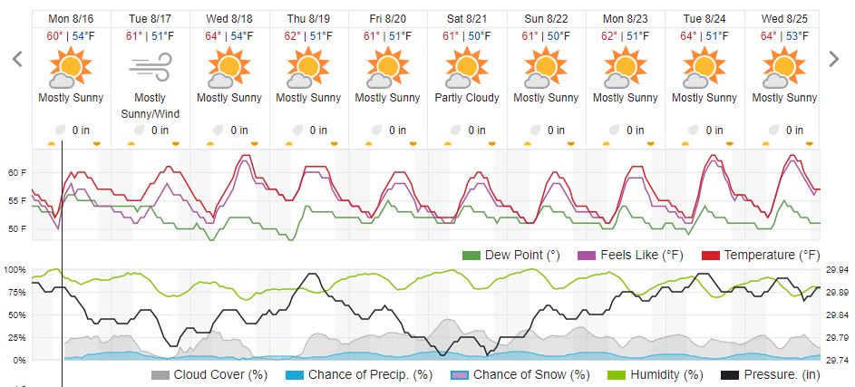
Annex B: Weather

Slide 16
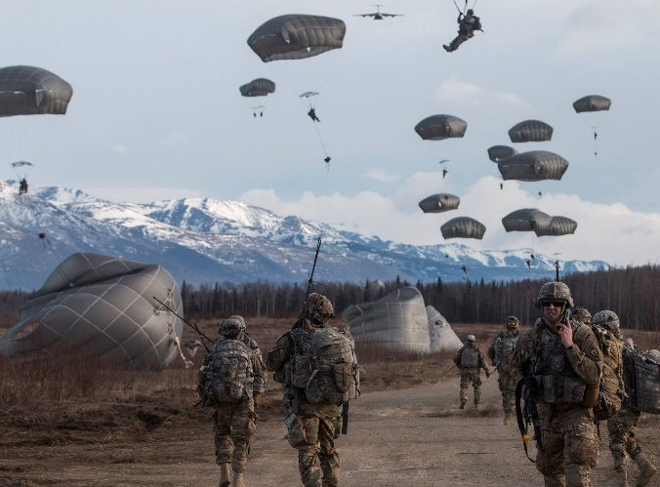
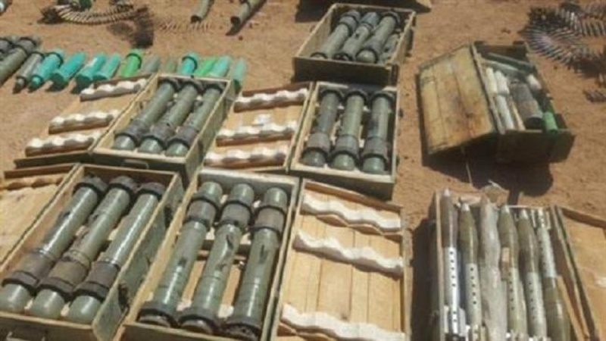
Annex B: Tactical Scenario
IAW with FY 2021 2-237 IN Training glide path “Road to War” we are currently 24 hours past the seizure of OBJ Devils (Arianan Int Airport) in the eastern mountain region of Ariana. Companies are staged for follow on operations.
_/ _ / C/ 2-327 IN is postured to clear OBJ Marriott, a suspected SAPA IED cache protected by a SAPA team IOT to enable freedom of maneuver for follow on mechanized forces.

Slide 17
Annex C: T&EO

Slide 18
Annex C: T&EO

Slide 19
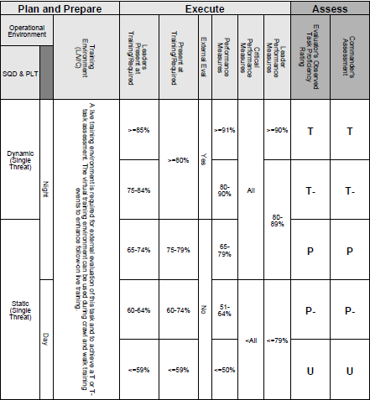
Annex C: Evaluation

Slide 20
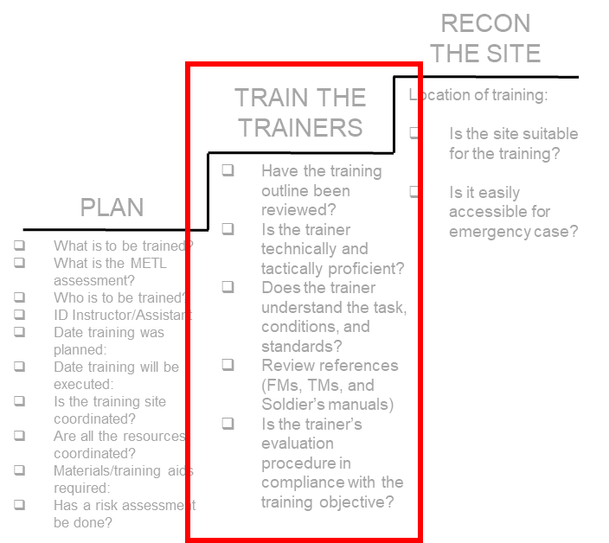
Annex C: Leader Development Plan
Leader Development:
Primary Trainers = Platoon Leaders
“Train the Trainer” training will be led by CO/1SGs between 4 SEP
  CO/1SG will develop “train the trainer” training plan
  All PLs/PSGs will be RSO certified
Train the Trainer Checklist:
  Have the training outline been reviewed?
  Is the trainer technically and tactically proficient?
  Does the trainer understand the task, conditions, and standards?
  Review references (FMs, TMs, and Soldier’s manuals)
  Is the trainer’s evaluation procedure in compliance with the training objective?

Slide 21
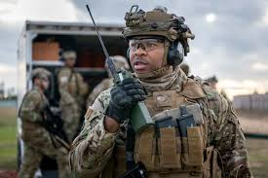
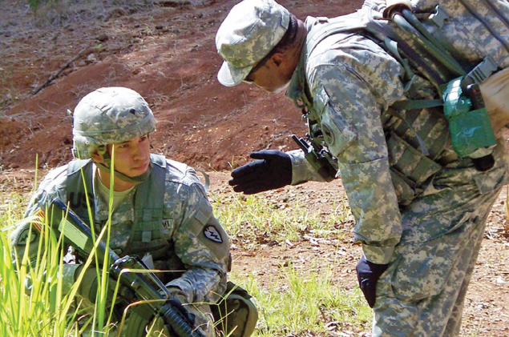
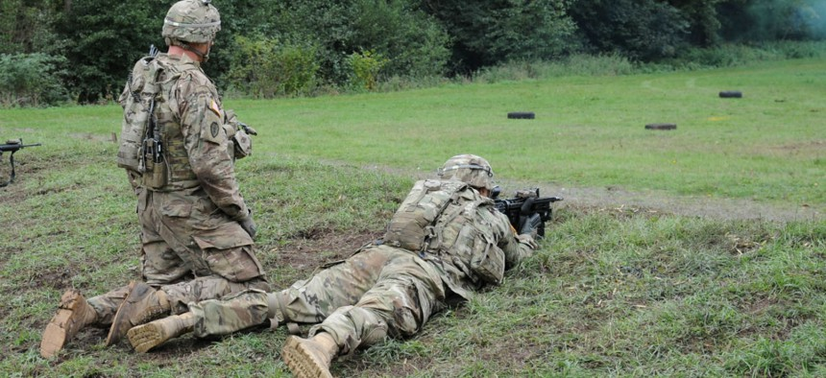
Annex C: OC/ T Plan
Audience: 1SG, PLs, PSGs, and WSLs working per SYNC MAT
TACSOP/CONOP Review: 04 1300 AUG 2021
Lane Validation/MEDEVAC RXL: Conducted two hours prior to start of first iteration.
Lane OC/ T Uniform: ACH, IOTV, Eye Pro, Gloves, NODs, IR Strobe (OC/ T marker per TACSOP)

Slide 22
Annex F: Sustainment (AMMUNITION)
DODIC | Description | By Request | Actual Allotment
A080 | 5.56 Blank | 12,000 | XXX
A075 | 5.56 Link Blank | 7,000 | XXX
A059/AB57 | 5.56 Ball | 14,500 | XXX
A064 | 5.56 Link 4 Ball/1 TRCR | 10,000 | XXX
A111 | 7.62 Blank Link | 10,000 | XXX
A131 | 7.62 Link Ball/1 TRCR | 11,000 | XXX
DODIC | Description | Allotment
G950 | HG, SMK RED | 13
G955 | HG, SMK VIOL | 16
G982 | HG, SMK TNG M83 | 24
L305 | SIG, ILLUM GS PARA M195 | 10
L307 | SIG ILLUM WS CLUSTER M1 | 10
L311 | SIG ILLUM RED PARA M126 | 10
L594 | SIM, PROJ GRND BURST M11 | 30

Slide 23
D6/CSM Guidance

