Slide 1
LSA 7:
Ballistics and Ammunition
Notes:
Begin by asking pointed question to get concrete knowledge of the class:
Example questions
What are the three stages of Ballistics?
What are the lethal zones?

Slide 2
ACTION:
Demonstrate knowledge of Army service Rifle preliminary marksmanship instruction.
CONDITION:
In a classroom environment, given TC 3-22.9, Rifle and Carbine.
STANDARD:
Identify how to apply and train Rifle Marksmanship utilizing the US Army Service Rifle in accordance with applicable command guidance, TC 3-22.9 Rifle and Carbine and TC 3-20.0 Integrated Weapons Training
Strategy.

Slide 3
INTRODUCTION
Safety Considerations:
Risk Assessment:
Environmental Considerations:
Evaluation:
Notes:
Safety Considerations: Fire escape plan should be reference
Risk Assessment: Low
Environmental Considerations: Keep tops on bottles when not in use and remember to remove all trash from the classroom.
Evaluation: You will be evaluated formally on written examinations which you must achieve a minimum of 70% to continue the course.

Slide 4
Ballistics is the science of the processes that occur from the time a firearm is fired to when the bullet comes to terminal rest.
BALLISTICS
The flight path of a bullet includes three stages: the travel down the barrel, the path through the air to the target, and the actions the bullet takes upon impact with the target until terminal rest.
These stages are defined in separate categories of ballistics; internal, external, and terminal ballistics.
2

Slide 5
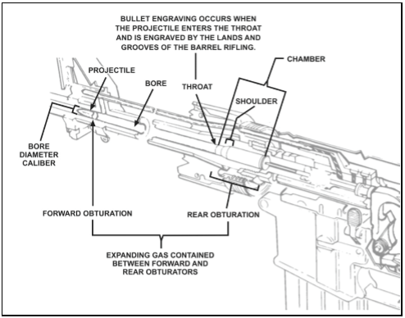
INTERNAL BALLISTICS
Notes:
Internal ballistics – is the study of the propulsion of a projectile. Internal ballistics begin from the time the firing pin strikes the primer to the time the bullet leaves the muzzle. Once the primer is struck the priming charge ignites the propellant. The expanding gases caused by the burning propellant create pressures which push the bullet down the barrel. The bullet engages the lands and grooves (rifling) imparting a spin on the bullet that facilitates stabilization of the projectile during flight. Internal ballistics ends at shot exit, where the bullet leaves the muzzle.
key terms are used when discussing the physical actions of internal ballistics —
● Bore – the interior portion of the barrel forward of the chamber.
● Chamber – the part of the barrel that accepts the ammunition for firing.
● Grain (gr) – a unit of measurement of either a bullet or a projectile. There are 7000 grains in a pound, or 437.5 grains per ounce.
● Pressure – the force developed by the expanding gasses generated by the combustion (burning) of the propellant. Pressure is measure in pounds per square inch (psi).
● Shoulder – the area of the chamber that contains the shoulder, forcing the cartridge and projectile into the entrance of the bore at the throat of the barrel.
● Muzzle – the end of the barrel.
● Throat – the entrance to the barrel from the chamber. Where the projectile is introduced to the lands and grooves within the barrel.

Slide 6

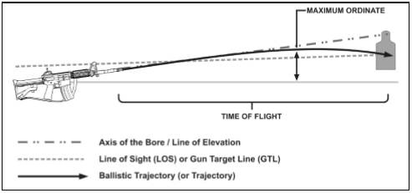
EXTERNAL BALLISTICS
5
Notes:
External ballistics is the study of the physical actions and effects of gravity, drag, and wind along the projectile’s flight to the target.
These key terms and definitions are used to describe the actions or reactions of the projectile during flight-
● Axis of the bore (Line of Bore) – the line passing through the center of the bore or barrel.
● Line of sight (LOS) or gun target line (GTL) – a straight line between the sights or optics and the target. This is never the same as the axis of the bore. The LOS is what the Soldier sees through the sights and can be illustrated by drawing an imaginary line from the firer’s eye through the rear and front sights out to infinity. The LOS is synonymous with the GTL when viewing the relationship of the sights to a target.
● Line of elevation (LE) – the angle represented from the ground to the axis of the bore.
● Ballistic trajectory – the path of a projectile when influenced only by external forces, such as gravity and atmospheric friction.
● Maximum ordinate – the maximum height the projectile will travel above the line of sight on its path to the point of impact.
● Time of flight – the time taken for a specific projectile to reach a given distance after firing.
● Jump – vertical jump in an upward and rearward direction caused by recoil. Typically, it is the angle, measured in mils, between the line of departure and the line of elevation.
● Line of departure (LD) – the line the projectile is on at shot exit.
● Muzzle – the end of the barrel.
● Muzzle velocity or velocity – the velocity of the projectile measured at shot exit. Muzzle velocity decreases over time due to air resistance. For small arms ammunition, velocity (V) is represented in feet per second (f/s).
● Twist rate – the rotation of the projectile within the barrel of a rifled weapon based on the distance to complete one revolution. The twist rate relates to the ability to gyroscopically spin-stabilize a projectile on rifled barrels, improving its aerodynamic stability and accuracy. The twist rate of the M4- or M16-series weapon is a right hand, one revolution in every seven inches of barrel length (or R 1:7 inches).
● Shot exit – the moment the projectile clears the muzzle of the barrel, where the bullet is not supported by the barrel.
● Oscillation – the movement of the projectile in a circular pattern around its axis during flight.
● Drift – the lateral movement of a projectile during its flight caused by its rotation or spin.
● Yaw – a deviation from stable flight by oscillation. This can be caused by cross wind or destabilization when the projectile enters or exits a transonic stage.
● Grain (gr) – a unit of measurement of either a bullet or a propellant charge. There are 7000 grains in a pound, or 437.5 grains per ounce.
● Pressure – the force developed by the expanding gases generated by the combustion (burning) of the propellant. For small arms, pressure is measured in pounds per square inch (psi).
● Gravity – the constant pressure of the earth on a projectile at a rate of about 9.8 meters per second squared, regardless of the projectile’s weight, shape or velocity. Commonly referred to as bullet drop, gravity causes the projectile to drop from the line of departure. Soldiers must understand the effects of gravity on the projectile when zeroing as well as how it applies to determining the appropriate hold-off at ranges beyond the zero distance.
● Drag (air resistance) – the friction that slows the projectile down while moving through the air. Drag begins immediately upon the projectile exiting the barrel (shot exit). It slows the projectile’s velocity over time, and is most pronounced at extended ranges. Each round has a ballistic coefficient (BC) that is a measurement of the projectile’s ability to minimize the effects of air resistance (drag) during flight.
● Trajectory – the path of flight that the projectile takes upon shot exit over time. For the purposes of this manual, the trajectory ends at the point of impact.
● Wind – has the greatest variable effect on ballistic trajectories. The effects of wind on a projectile are most noticeable in three key areas between half and two-thirds the distance to the target:
■ Time (T) – the amount of time the projectile is exposed to the wind along the trajectory. The greater the range to target, the greater time the projectile is exposed to the wind’s effects.
■ Direction – the direction of the wind in relation to the axis of the bore. This determines the direction of drift of the projectile that should be compensated.
■ Velocity (V) – the speed of the wind during the projectile’s trajectory to the target. Variables in the overall wind velocity affecting a change to the ballistic trajectory include sustained rate of the wind and gust spikes in velocity.

Slide 7
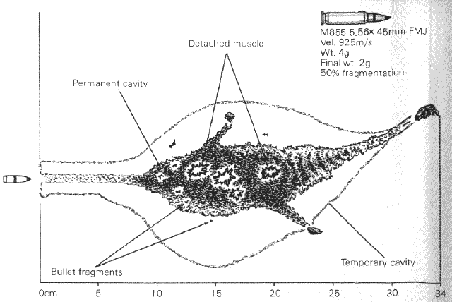
TERMINAL BALLISTICS
Notes:
Terminal ballistics is the science of the actions of a projectile from the time it strikes an object until it comes to rest (called terminal rest). This includes the terminal effects that take place against the target.
● Kinetic Energy (EK) – a unit of measurement of the delivered force of a projectile. Kinetic energy is the delivered energy that a projectile possesses due to its mass and velocity at the time of impact. Kinetic energy is directly related to the penetration capability of a projectile against the target.
● Penetration – the ability or act of a projectile to enter a target’s mass based on its delivered kinetic energy. When a projectile strikes a target, the level of penetration into the target is termed the impact depth. The impact depth is the distance from the point of impact to the moment the projectile stops at its terminal resting place. Ultimately, the projectile stops when it has transferred its momentum to an equal mass of the medium (or arresting medium).

Slide 8
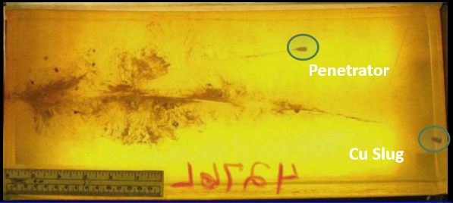
TERMINAL BALLISTICS
M855 is designed to tumble and fragment. This action is dependent on its velocity (after 2250 FPS or approximately 185m). At close ranges the round must travel through 6” of flesh in order to have maximum effects.
M855A1 is much less sensitive to velocity to achieve maximum results. It begins to tumble as soon as it penetrates and remains effective out to 415m or falls below 1750 FPS.
Permanent Cavity
Temporary Cavity

Slide 9
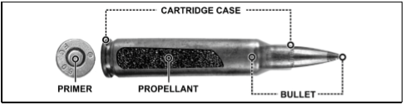
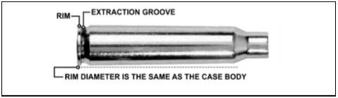
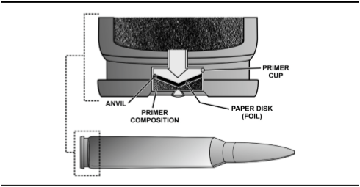
AMMUNITION COMPONENTS
Notes:
Ammunition for use in rifles and carbines is described as a cartridge. A small arms cartridge is an assembly consisting of a cartridge case, a primer, a quantity of propellant, and a bullet. The following terminology describe the general components of all small arms ammunition (SAA) cartridges:
● Cartridge case. The cartridge case is a brass, rimless, center-fire case that provides a means to hold the other components of the cartridge.
● Propellant. The propellant (or powder) provides the energy to propel the projectile through the barrel and downrange towards a target through combustion.
● Primer. The primer is a small explosive charge that provides an ignition source for the propellant.
● Bullet. The bullet or projectile is the only component that travels to the target.
Note. Dummy cartridges are composed of a cartridge case and bullet, with no primer or propellant. Some dummy cartridges contain inert granular materials to simulate the weight and balance of live cartridges.
The cartridge case is made of steel, aluminum, or a brass combination (70 percent copper and 30 percent zinc) for military use. The M4- and M16-series weapons is a rimless cartridge case that provides an extraction groove. These cartridge cases are designed to support center-fire operation.
Center-fire small arms cartridges contain a percussion primer assembly. The assembly consists of a brass or gilding metal cup. The cup contains a pellet of sensitive explosive material secured by a paper disk and a brass anvil.

Slide 10
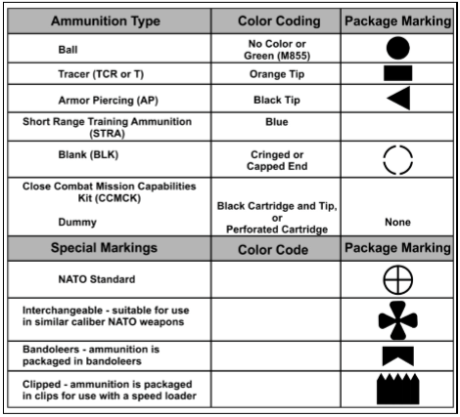
AMMUNITION MARKINGS
Notes:
Small arms ammunition is identifiable by color coding specification per type and intended use.
Markings stenciled or stamped on munitions or their containers include all information needed for complete identification.
Packaging and containers for small arms ammunition are clearly marked with standard NATO symbols identifying the contents of the package by type of ammunition, primary use, and packaging information.

Slide 11
What are the three stages of ballistics?
Internal, external, and terminal

