Slide 1
LSA 5:
Employment
Notes:
Begin by asking pointed question to get concrete knowledge of the class:
Example questions
What is the primary role of a rifleman?
What two truths about firing and does it change with each weapon system?
What is DIDEA?

Slide 2
ACTION:
Demonstrate knowledge of Army service Rifle preliminary marksmanship instruction.
CONDITION:
In a classroom environment, given TC 3-22.9, Rifle and Carbine.
STANDARD:
Identify how to apply and train Rifle Marksmanship utilizing the US Army Service Rifle in accordance with applicable command guidance, TC 3-22.9 Rifle and Carbine and TC 3-20.0 Integrated Weapons Training
Strategy.

Slide 3
INTRODUCTION
Safety Considerations:
Risk Assessment:
Environmental Considerations:
Evaluation:
Notes:
Safety Considerations: Fire escape plan should be reference
Risk Assessment: Low
Environmental Considerations: Keep tops on bottles when not in use and remember to remove all trash from the classroom.
Evaluation: You will be evaluated formally on written examinations which you must achieve a minimum of 80% to continue the course.

Slide 4
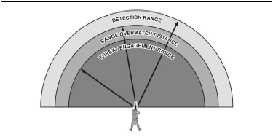
Employment
OVERMATCH
Notes:
Range overmatch provides a tactical engagement buffer that accommodates the Soldier’s time to engage with precision fires. For example, a Soldier that has the capability to effectively engage personnel targets at a range of 500 meters will have range overmatch of 10 to 20 percent over a threat rifleman. That 10 to 20 percent range difference is equivalent to a distance of 40 to 80 meters, which is approximately the distance a maneuvering threat can traverse in 15 to 40 seconds

Slide 5
Employment
OVERMATCH
The Soldier applying their learned skills, employing their equipment, leveraging technology, and applying the proper force to create an unfair fight in favor of the Soldier.
ATTRIBUTES
Smart | Fast | Lethal | Precise
COMPONENTS
Target Detection | Target acquisition | Target Identification | Engagement Range
Limited Visibility | Precision | Speed | Terminal Performance
Notes:
To achieve and maintain overmatch against any threat, this publication focuses on providing information that develops the Soldier’s direct fire engagement skills using the following attributes:
● Smart – the ability to routinely generate understanding through changing conditions.
● Fast – the ability to physically and cognitively outmaneuver adversaries.
● Lethal – deadly in the application of force.
● Precise – consistently accurate in the application of power to ensure deliver of the right effects in time, space, and purpose.
The components of overmatch are:
● Target detection, acquisition, and identification – the ability of the Soldier to detect and positively identify any suspected target as hostile at greater distances than their adversary. This relies upon Soldier training and their ability to leverage the capabilities of their optics, thermals, and sensors.
● Engagement range – provide the Soldier with weapons, aiming devices, and ammunition capable of striking and defeating a threat at a greater range than the adversary can detect or engage the friendly force with effective fires.
● Limited visibility – provide the Soldier to make operations during limited visibility an advantage through technology and techniques, and compound their adversary’s disadvantages during those conditions.
● Precision – provide a weapon and ammunition package that enhances the Soldier’s consistent application of shots with a level of precision greater than the adversary’s.
● Speed – the weapon, aiming devices, and accessories a Soldier employs must seamlessly work in unison, be intuitive to use, and leverage natural motion and manipulations to facilitate rapid initial and subsequent shots during an engagement at close quarters, mid-, and extended ranges.
● Terminal performance – ensures that precise shots delivered at extended ranges provide the highest probability to defeat the threat through exceptional ballistic performance.

Slide 6
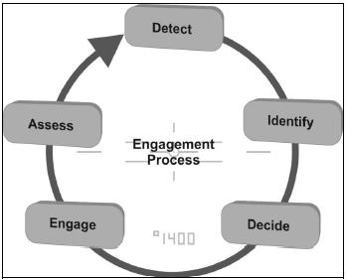
EMPLOYMENT
DIDEA
Notes:
The goal of the direct fire engagement process is to provide a standardized method of engagement for weapons and platforms on the battlefield. This method allows Soldiers and leaders to maximize the effects of lethal fires against the enemy while at the same time reducing or eliminating the effects of fires on friendly or neutral personnel, equipment, or facilities.
The following figure represents this process.
Direct fire weapons, platforms, squads, and small units incorporate the principles of combat identification into the direct fire engagement process.
The DIDEA process provides an iterative, standardized, and systematic approach to target engagement activities with direct fire.
Detect. The target detection process takes practice and skill to acquire potential threats successfully in various environments and visibility conditions. This process includes all actions to actively search, acquire, and locate potential targets.
Identify. Once a potential threat is detected and acquired, the firer accurately identifies the range to target, and effectively establishes the threat as friend, foe, or neutral. Target identification is a systematic process supporting the characterization of detected objects. Once identified as a hostile threat, crews classify the threat as most dangerous, dangerous, or least dangerous from their perspective.
Decide. The determination is made by the crew to engage or not. Soldiers and leaders use all the situational information at their disposal to ensure an appropriate level of response to the threat.
Engage. Engage is the specific application of military options or weapons to defeat, neutralize, or destroy the threat. Successful implementation of the weapons or military options at the disposal of the firer efficiently and effectively alters, disrupts, or halts the threat’s DIDEA process, and ultimately eliminates the threat to friendly forces.
Assess. This step evaluates the weapons or options employed to defeat the threat or threats. It is the process the crew uses to determine if the applied weapons or options deliver the desired effect.

Slide 7
EMPLOYMENT
APPLYING THE SHOT PROCESS
The shot process has three distinct phases:
Pre-shot
Shot
Post-shot
Notes:
The shot process is the basic outline of an individual engagement sequence all firers consider during an engagement, regardless of the weapon employed. The shot process formulates all decisions, calculations, and actions that lead to taking the shot. The shot process may be interrupted at any point before the sear disengaging and firing the weapon should the situation change.
The shot process allows the Soldier to focus on one cognitive task at a time. The Soldier must maintain the ability to mentally organize the shot process’s tasks and actions into a disciplined mental checklist, and focus their attention on activities which produce the desired outcome; a well-aimed shot.

Slide 8
EMPLOYMENT
THE SHOT PROCESS
STABILITY
THE SHOT PROCESS
MOVEMENT
AIM
CONTROL
Notes:
The functional elements, which we will refer to as SACM, are interrelated and interdependent. SACM is a truly holistic approach to the entire system of weapons employment. It includes not only the shot, or “marksmanship”, but also pays attention to the aspects of Gunfighting that have been forgotten in “marksmanship” training, i.e. weapons manipulations that keep the weapon in the fight and allow for the shot.

Slide 9
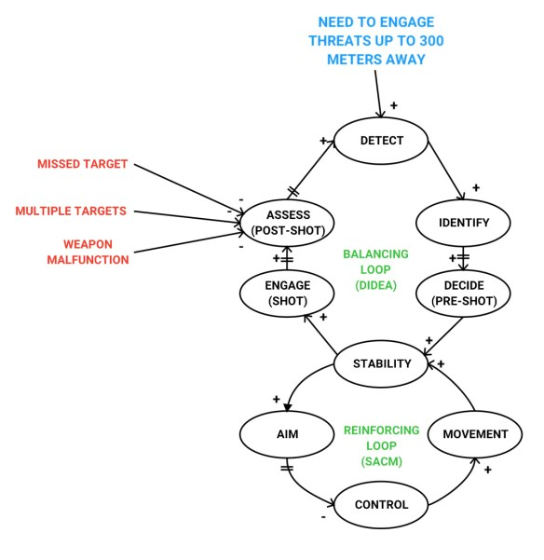
Notes:
This Slide shows the correlation between DIDEA and the Functional Elements of the Shot Process. During the Direct Fire Engagement Process the soldier reaches a Decision Point, once they have made the determination to engage the threat (Pre-Shot) they begin to employ the Shot Process ensuring success of the Shot (Engage portion of DIDEA). During the Assessment of DIDEA or Post-Shot the soldier will determine if a follow on shot is required. If so, they will reemploy the shot process and engage.

Slide 10
CHECK ON LEARNING
EMPLOYMENT
What are the elements of the Direct Fire Engagement Process?
● Detect  Identify  Decide  Engage  Assess
What is the shot process?
The basic outline of an individual engagement sequence all firers consider during an engagement, regardless of the weapon employed.
What are the functional elements of the shot process?
● Stablility  Aiming  Movement  Control
What is overmatch?
Overmatch is the Soldier applying their learned skills, employing their equipment, leveraging technology, and applying the proper force to create an unfair fight
in favor of the Soldier.

