Slide 1
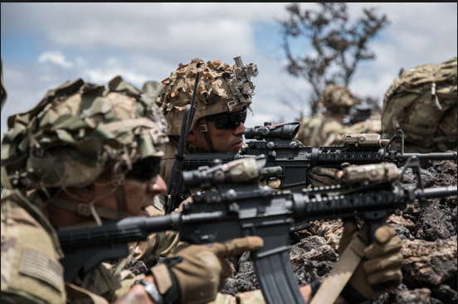

Slide 2
ACTION:
Conduct an Introduction to Complex Engagements
CONDITION:
In a classroom and field environment, given a M4-Series rifle, M4 Rifle magazine, M150 RCO and small arms maintenance equipment.
STANDARD:
Apply the Shot Process to Mid Range Marksmanship training with an M4 Rifle and M150 RCO IAW TC 3-22.9 Rifle and Carbine to engage targets at ranges from100-600 meters. Achieve a 80% or greater on the written test.

Slide 3
INTRODUCTION
Safety Considerations:
Risk Assessment:
Environmental Considerations:
Evaluation:
Notes:
Safety Considerations: Fire escape plan should be reference
Risk Assessment: Low
Environmental Considerations: Keep tops on bottles when not in use and remember to remove all trash from the classroom.
Evaluation: You will be evaluated formally on written examinations which you must achieve a minimum of 70% to continue the course.

Slide 4
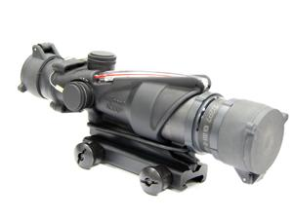
INTRODUCTION TO THE RCO
Notes:
The M150 Sight, Rifle Combat Optic (RCO) is) designed for the M4, M4A1, M16A2, M16A4 Rifle/Carbine, and M249 Squad Automatic Weapon (SAW) Machine Gun in automatic rifle role. The M150 Sight, RCO provides the shooter with quick target acquisition at close combat ranges while providing enhanced target identification and hit probability out to 800 m (875 yd) utilizing the Bullet Drop Compensator (BDC). The M150 Sight, RCO incorporates dual-illumination technology using a combination of fiber optics and self-luminous tritium. This allows the aiming point to be always illuminated without the use of batteries. The tritium illuminates the aiming point in total darkness, and the fiber-optic self-adjusts reticle brightness during daylight according to ambient light conditions. This allows the operator to keep both eyes open while engaging targets and maintaining maximum situational awareness.

Slide 5
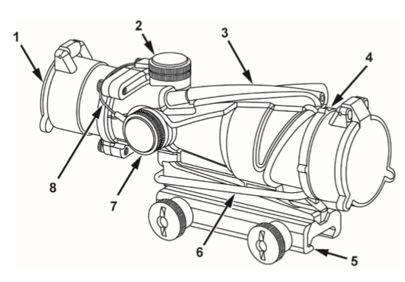
MAJOR COMPONENTS
Notes:
KEY CONTROL/ INDICATOR FUNCTION
1 Flip-Up Cover -Protects the eyepiece lens when not using sight.
2 Elevation Adjuster Cap- Protects the elevation adjuster.
3 Fiber Optic Light Collector- Provides additional light for improved viewing of the reticle in low-light conditions.
4 Laser Filter Unit (LFU)/ Anti-Reflection Device (ARD) Flip-up Cover- Protects the LFU/ARD when not using sight.
5 TA51 Thumbscrew Mount, Sight- Attaches the sight to MIL-STD 1913 Picatinny Rail.
6 LFU/ARD Retaining Band (O-Ring)- Secures LFU/ARD to sight.
7 Windage Adjuster Cap- Protects the windage adjuster.
8 Adjuster Cap Retention Lanyard- Secures adjuster caps to sight.

Slide 6
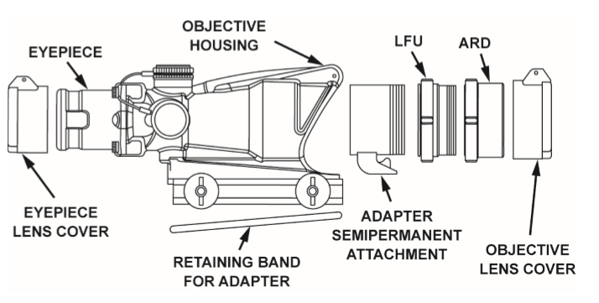
MAJOR COMPONENTS
Notes:
Laser Filter Unit (LFU) and Anti-Reflection Device (ARD).
DO NOT use a tool to tighten the LFU/ARD components. Overtightening will damage the LFU/ARD components.
DO NOT use thread locking compounds on threads of LFU/ARD components. Failure to comply may result in damage to equipment.

Slide 7
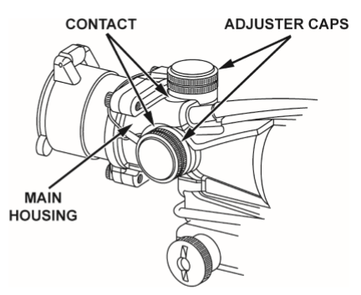
ADJUSTMENTS
Notes:
Damage may occur to the cap or the threads of the adjuster housing if the cap does not make contact with the main housing when the cap is exposed to impact. Take care to secure the cap properly. Failure to comply may result in damage to equipment

Slide 8
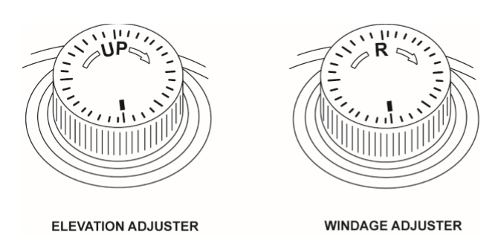
WINDAGE/ ELEVATION ADJUSTMENTS
Notes:
Elevation Adjustment
NOTE: Tap the adjusters after each adjustment to ensure the internal mechanism is fully seated.
Remove the top adjuster cap to expose the Elevation Adjuster. Moving the Elevation Adjuster in the direction of the arrow (clockwise) will move the strike of the bullet UP as indicated on the adjuster. The amount of clicks can be detected through audible and tactile feedback.
Windage Adjustment
Remove the side adjuster cap to expose the Windage Adjuster. Moving the Windage Adjuster in the direction of the arrow (clockwise) will move the strike of the bullet RIGHT as indicated on the adjuster. The amount of clicks can be detected through audible and physical feedback.

Slide 9
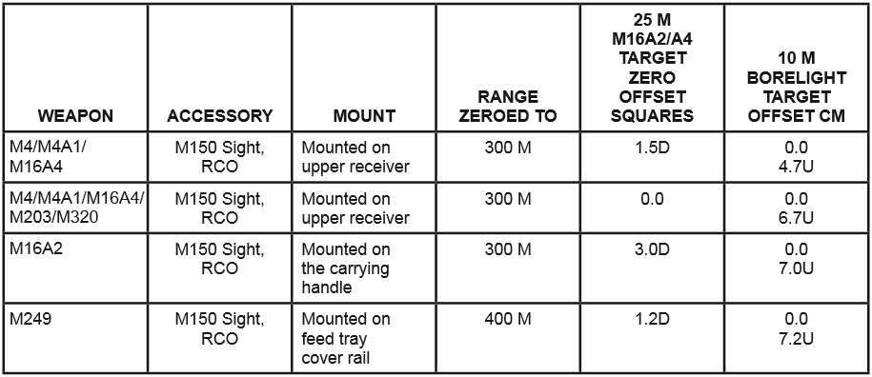
RCO OFFSET
Notes:
For M4/M4A1/M16A4 the M150 Sight, RCO is zeroed after the installation and zeroing of the Backup Iron Sight (BUIS). The M150 CANNOT be zeroed through the BUIS, and the BUIS CANNOT be employed through the sight.
For M4/M4A1/M16A4 an offset is used on the M16 zero target of 1.5 blocks lower offset point with a 4-cm (1.57-in.) box outlined around that point and shaded for a designated strike zone.
For an M16A2, an offset is used on the M16 zero target of 4.0 blocks lower offset point with a 4-cm (1.57-in.) box outlined around that point and shaded for a designated strike zone.
The Laser Borelight System TM 9-5860-226-13&P (WP 0021) may be used to transfer zero to the weapon/sight combinations identically configured to a master weapon.

Slide 10
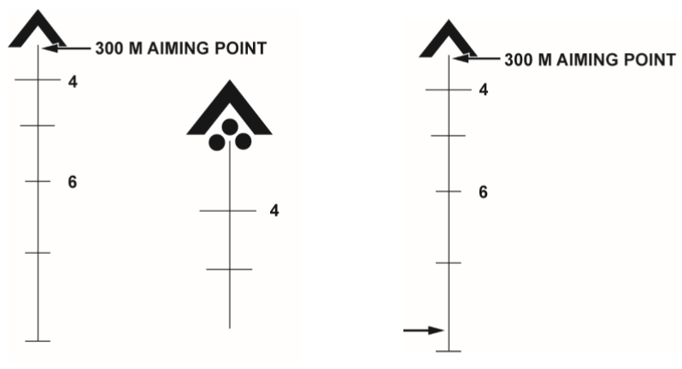
RCO ZERO
Notes:
The M150 Sight, RCO, when installed on a M4/M4A1/M16A4/M16A2, is zeroed on a standard M16 zero target with alternate strike points (see NOTE above) using established procedures in FM 3-22.9 (WP 0014).
NOTE At 25 m, three clicks move the bullet impact approximately one square on the M16 zero target.
2. In the zeroing process, groups of three single shot rounds are fired at a standard M16 zero target. After each three rounds, the center of the group is determined and adjustments to windage and elevation are made until center of the group is within the designated strike zone.
3. Aiming Point. At 25 m, the point of the aim using the tip of the 300-meter aiming point is center mass.

Slide 11
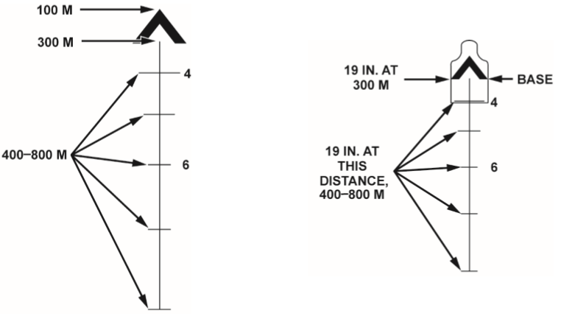
BULLET DROP COMPENSATOR (BDC)
RANGING FEATURE
Notes:
The Bullet Drop Compensator (BDC) The entire reticle pattern is a BDC, designed to compensate for the trajectory of the 5.56 mm round from 100 to 800 m without making mechanical adjustments to the sight. When zeroed properly, the Point of Aim (POA)/POI at the designated distance.
Ranging Feature
The Base of the chevron and the horizontal stadia lines below the chevron represent 19 in. (48.3 cm) at the indicated range (19 in. is the average width of a man’s shoulders). Range your target, using the Base of the chevron for 300 m and the width of the horizontal stadia lines for 400 to 800 m.

Slide 12
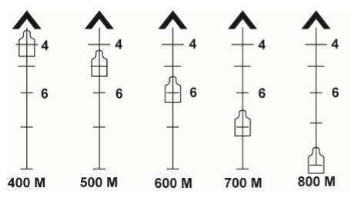
RANGING FEATURE BEYOND 300M
Notes:
Beyond 300 m, determine which stadia line best fits the target’s shoulders and use that crosshair as your point of aim (Figure 16). Because the BDC is calibrated for the correct trajectory, your POA is your POI at each distance. Figure 16 illustrates proper sight picture at each distance

Slide 13
HORIZONTAL MIL-SCALE
Notes:
The right side of the horizontal mil-scale will appear out of focus. This is normal. The M150 Sight, RCO reticle includes a horizontal mil-scale graduated in 5-mil increments (Figure 17). The distance from the center post to the first mil-bar is 10 mils on left side and 10 mils on right side. Due to the design of the optic, the right side of the mil-scale will become blurry. This is normal. The horizontal mil-scale is primarily used for communicating target positions and other relationships to team members within the small unit.

Slide 14
THE BINDON AIMING CONCEPT (BAC)
Notes:
The BAC feature allows the shooter to track and engage moving targets quickly. Utilizing the Both Eyes Open aiming method, when the weapon is being moved, the image, as seen through the M150 Sight, RCO with your shooting eye, blurs much quicker than the view from your non-shooting eye (because it is magnified 4x). The brain chooses the non-blurry view from the non-shooting eye automatically (switches focus). As soon as you are close to the proper aim on target, weapon movement slows, the blur ceases, and your brain instantly selects the greater detail of the magnified view. This means when the weapon is moving to the target you will not notice any magnification. All you will see is the illuminated chevron in the target area, like a reflexive sight. Once you slow the weapon on the target, the target will zoom in at 4x, allowing you to identify and engage more accurately if necessary. This aiming concept happens naturally (without conscious thought) for those with equal or close to equal vision in both eyes. It takes practice keeping BOTH eyes OPEN and FOCUSING ON YOUR TARGET.

Slide 15
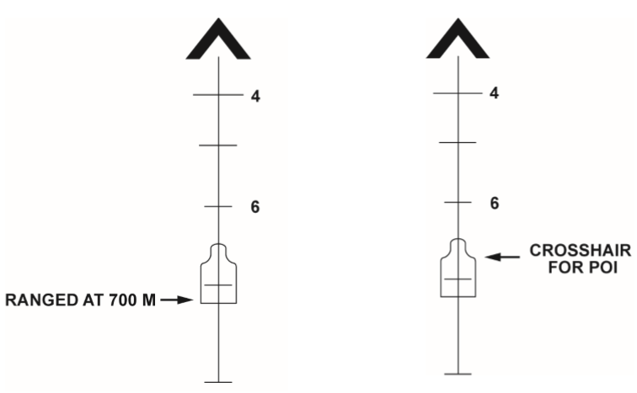
SHOOTING 400 TO 800M
Notes:
NOTE:
To engage targets from 400 to 800 m: seek a supported position (if possible), close your nonshooting eye, and raise the ranging reticle until one of the horizontal lines fits the shoulders of the intended target.
Beyond 300 m (328 yd), the M150 Sight, RCO provides a ranging reticle that will allow the shooter to place well-aimed accurate hits on target using traditional marksmanship skills. Use that crosshair reticle pattern to identify your POA. This also becomes your POI.

Slide 16
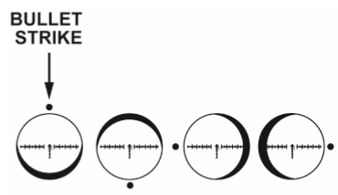
SIGHT ALIGNMENT
Notes:
Ensure you have a FULL Field of View (FOV) and proper Sight Alignment (no shadow). Improper FOV or Sight Alignment (shadow) will result in improper shot placement. To acquire the proper FOV, move your shooting eye closer or further from the eyepiece until you have no shadow on the outer most portion of the optic’s view. To acquire proper Sight Alignment, move your shooting eye vertically and horizontally until no shadow exists. Figure 20 illustrates incorrect bullet strikes based on existing shadow.
Focus on the reticle to acquire the necessary precision aim.
Apply a smooth trigger squeeze so as to not disturb your sight alignment and/or aiming point.
Follow through. Do not release the trigger, move your eye from your aiming point, or otherwise disturb your position. Identify your impact by maintaining a visual on your target. If the round struck your target, determine if another follow-up shot is required. If the round did not strike your target, adjust your POA and repeat.

Slide 17
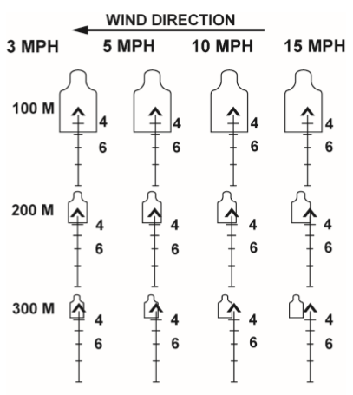
COMPENSATING FOR WIND
Notes:
Wind will have a significant effect on the 5.56 mm round’s POI beyond 100 m (109.4 yd). Aim to the opposite direction of the wind and watch for impacts. Adjust accordingly. This figure shows the proper reticle position to acquire a torso hit at various distances and wind strengths.

Slide 18
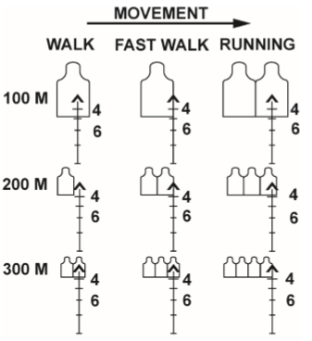
COMPENSATING FOR MOVING TARGETS
Notes:
Shooting a moving target at close range (approximately 50 m (54.7 yd) and closer) requires the shooter to keep BOTH eyes open, use BAC, and track the target from behind until the chevron is at the leading edge of the torso (Figure 22). Continue to maintain that lead as you squeeze the trigger. Repeat if necessary. Shooting at moving targets beyond 50 m (54.7 yd) utilizes the same lead concept as iron sights. At longer distances, the shooter must take into consideration the speed of the target, angle of the target’s movement, range to target, and wind. Figure 23 illustrates leads based on a target at a known distance and speed moving 90 degrees to the shooter. Watch for bullet impact and adjust accordingly.

Slide 19
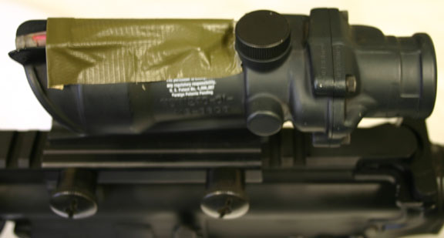
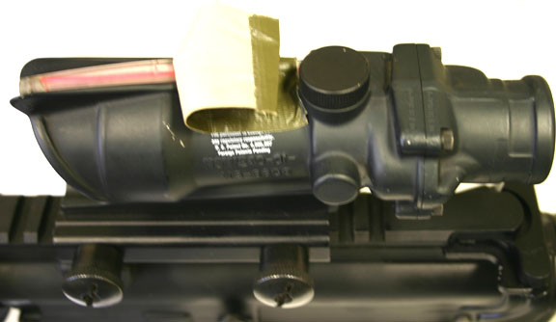
FIELD CRAFT
IMPROVISED ADJUSTABLE RETICLE ILLUMINATION.
Notes:
The chevron and front sight post can and will completely obscure and or overwhelm the target if you do not do something like this to counteract the effect of the flashburned image on the back of your retina.

Slide 20
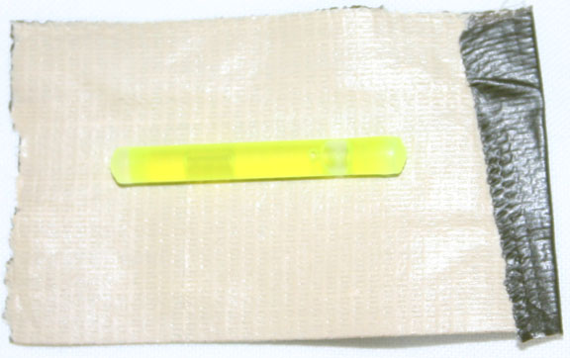
FIELD CRAFT
IMPROVISED ADJUSTABLE RETICLE ILLUMINATION.
Transitional light periods

Slide 21
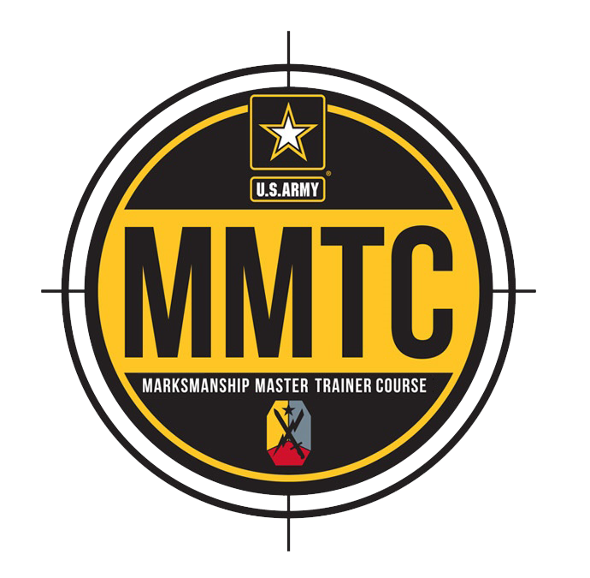
QUESTIONS?

