Slide 1
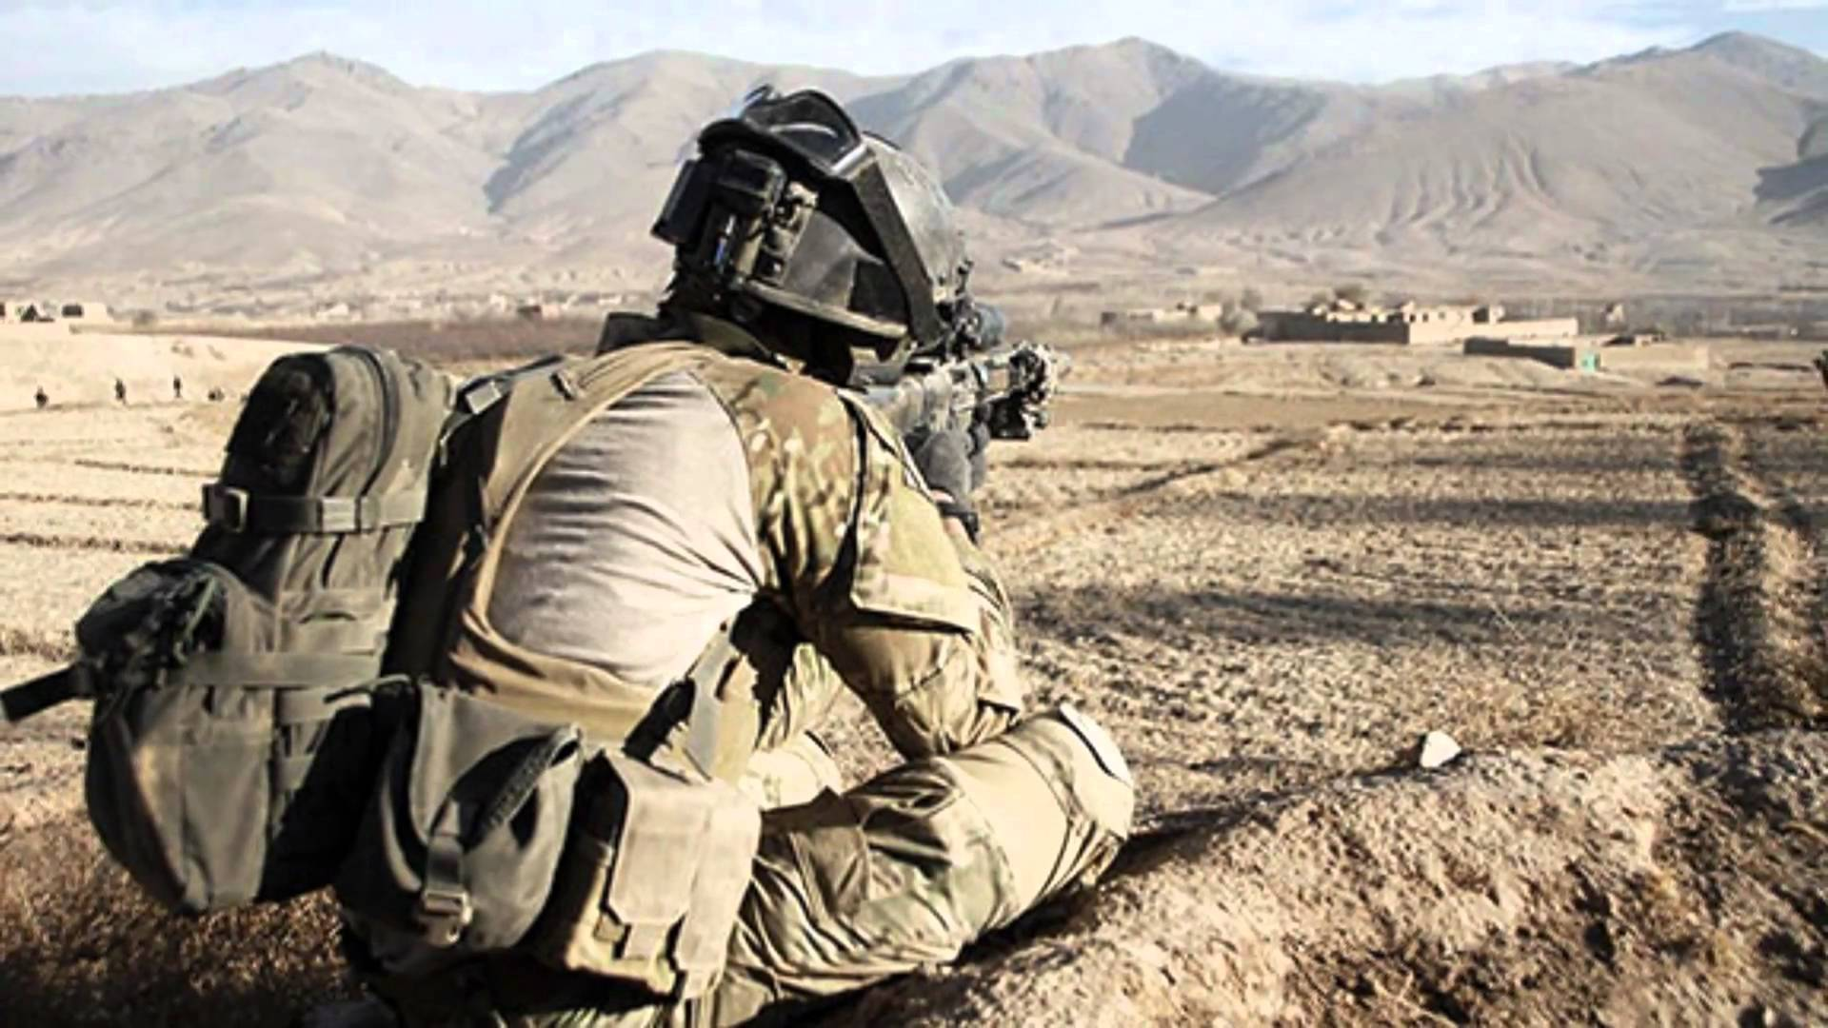

Slide 2
TSA 2
Safe Weapons Handeling
ACTION:
Demonstrate knowledge of Army service Rifle preliminary marksmanship instruction.
CONDITION:
In a classroom environment, given TC 3-22.9, Rifle and Carbine.
STANDARD:
Identify how to apply and train Rifle Marksmanship utilizing the US Army Service Rifle in accordance with applicable command guidance, TC 3-22.9 Rifle and Carbine and TC 3-20.0 Integrated Weapons Training
Strategy.

Slide 3
INTRODUCTION
Safety Considerations:
Risk Assessment:
Environmental Considerations:
Evaluation:
Notes:
Safety Considerations: Fire escape plan should be reference
Risk Assessment: Low
Environmental Considerations: Keep tops on bottles when not in use and remember to remove all trash from the classroom.
Evaluation: You will be evaluated formally on written examinations which you must achieve a minimum of 70% to continue the course.

Slide 4
Weapons Handling is built on three Components
The Soldier
The Weapon
The Environment
Notes:
● The Soldier is the primary safety mechanism They must have situational understanding of friendly forces, the
status of the weapon, and the ability to evaluate the environment to properly
handle any weapon.
● The weapon is the primary tool of the Soldier. The Soldier must know of and how to operate the mechanical safeties built into the weapons they employ, as well as the principles of operation for those weapons.
● What is Environment? In what way does the soldier maintain awareness of the environment?
The environment is the Soldier’s surroundings. The Soldier must be aware of muzzle discipline, the nature of the target, and what is behind it.

Slide 5
SAFE WEAPONS HANDLING
RULES OF FIREARMS SAFETY
Rule 1: Treat every weapon as if it is loaded
Rule 2: Never point the weapon at anything you do not intend to destroy
Rule 3: Keep finger straight and off the trigger until ready to fire
Rule 4: Ensure positive identification of the target and its surroundings
Notes:
Rule 1: Any weapon handled by a Soldier must be treated as if it is loaded and prepared
to fire. Whether or not a weapon is loaded should not affect how a Soldier handles the
weapon in any instance. Soldiers must take the appropriate actions to ensure the proper weapon status is
applied during operations, whether in combat or training.
Rule 2: Soldiers must be aware of the orientation of their weapon’s muzzle and what is
in the path of the projectile if the weapon fires. Soldiers must ensure the path between
the muzzle and target is clear of friendly forces, noncombatants, or anything the Soldier
does not want to strike. When this is unavoidable, the Soldier must minimize the amount of time the
muzzle is oriented toward people or objects they do not intend to shoot, while
simultaneously applying the other three rules of fire arms safety.
Rule 3: Soldiers must not place their finger on the trigger unless they intend to fire the
weapon. The Soldier is the most important safety feature on any weapon. Mechanical
safety devices are not available on all types of weapons. When mechanical safeties are
present, Soldiers must not solely rely upon them for safe operation knowing that
mechanical measures may fail. Whenever possible, Soldiers should move the weapon to mechanical safe when a
target is not present. If the weapon does not have a traditional mechanical safe, the
trigger finger acts as the primary safety.
Rule 4: The disciplined Soldier can positively identify the target and knows what is in
front of and what is beyond it. The Soldier is responsible for all bullets fired from their
weapon, including the projectile’s final destination. Application of this rule minimizes the possibility of fratricide, collateral damage,
or damage to infrastructure or equipment. It also prepares the Soldier for any follow-on
shots that may be required.

Slide 6
SAFE WEAPONS HANDLING
WEAPONS SAFETY STATUS
Notes:
The readiness of a Soldier’s weapon as it described as its weapon safety status (WSS).
Common colors (green, amber, and red) are used to represent the level of readiness for a given weapon.
Each color represents a specific series of actions that are applied to a weapon.
Each has a command that applies to each color. Clear, Load Magazine and Make Ready
They are used in training and combat to place or maintain a level of safety relevant to the current task or action of a Soldier, small unit, or group.

Slide 7
SAFE WEAPONS HANDLING
WEAPONS CONTROL STATUS
WEAPONS CONTROL STATUS | DESCRIPTION
WEAPONS HOLD | Engage only if engaged or ordered to engage.
WEAPONS TIGHT | Engage only if target is positively identified as enemy.
WEAPONS FREE | Engage targets not positively identified as friendly.
Notes:
A weapons control status (WCS) are fire controls given by a leader that incorporates the environment that the soldier is operating in.
It can be derived by the Tactical situation, rules of engagement for the area of operations, and expected or anticipated enemy contact.
This applies to DIDEA for the solider.
* Weapon control status and a weapons safety status are both implemented and available to leaders to prevent fratricide and limit collateral damage.

Slide 8
CHECK ON LEARNING
SAFETY
What are the 4 rules of firearms safety?
Rule 1: Treat every weapon as if it is loaded
Rule 2: Never point the weapon at anything you do not intend to destroy
Rule 3: Keep finger straight and off the trigger until ready to fire
Rule 4: Ensure positive identification of the target and its surroundings
What are the weapon safety status (WSS)?
Green- The weapon’s magazine is removed, its chamber is empty, its bolt is locked open or forward, and the selector is set to SAFE
Amber- A magazine is locked into the magazine well of the weapon, the bolt is forward on an EMPTY chamber, the ejection port cover should be CLOSED, and the selector should be set to SAFE
Red-The weapon’s magazine is inserted, a round is in the chamber, the bolt is forward and locked, the ejection port cover is closed, and the selector is set to SAFE.
Black-A magazine is locked in the magazine well, the bolt is forward with a Round chambered, the ejection port cover is CLOSED or OPEN, Selector is on Fire and the Shooter’s Finger is on the Trigger because they have initiated their Shot Process
What are the Weapons Control Status?
Weapons Hold, Weapons Tight, and Weapons Free

