Slide 1
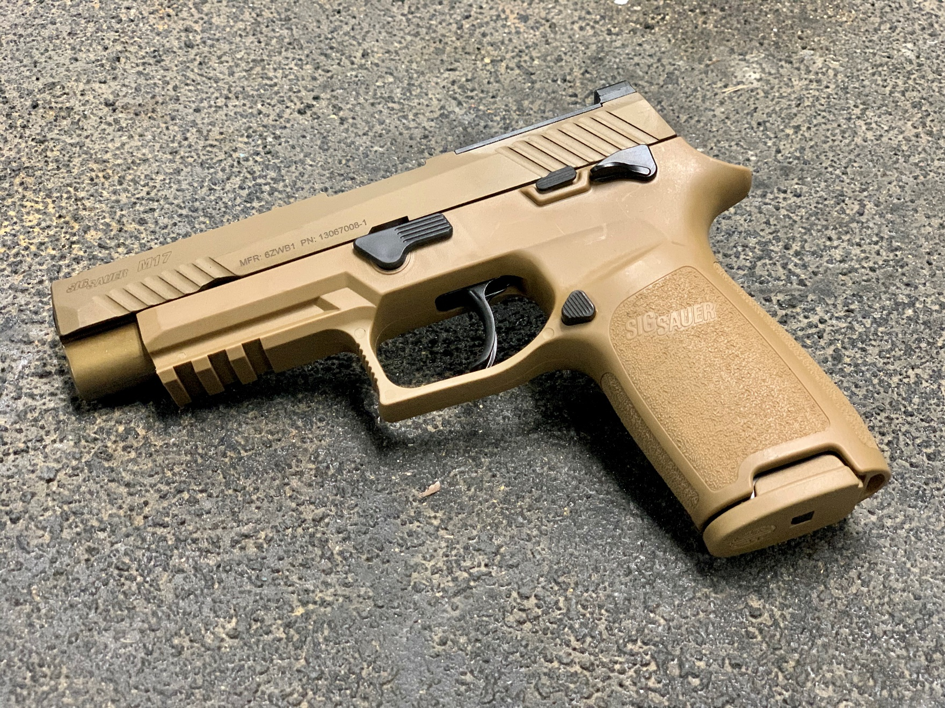

Slide 2
ACTION:
Demonstrate knowledge of Army service Pistol preliminary marksmanship instruction.
CONDITION:
In a classroom environment, given TC 3-23.35, Pistol.
STANDARD:
Soldiers must demonstrate knowledge and proficiency covering topics discussed in TC 3-23.35 through a drills and positions exam.

Slide 3
INTRODUCTION
Safety Considerations:
Risk Assessment:
Environmental Considerations:
Evaluation:
Notes:
Safety Considerations: Fire escape plan should be reference
Risk Assessment: Low
Environmental Considerations: Keep tops on bottles when not in use and remember to remove all trash from the classroom.
Evaluation: You will be evaluated formally on written examinations which you must achieve a minimum of 70% to continue the course.

Slide 4
Agenda
Safety
Principles of Operations & Maintenance Procedures
Holster Requirements and Placement
Stability, Aim, Control
Draw Process
Positions
Malfunctions
Reloads
Shot Process
Notes:
Begin by asking pointed question to get concrete knowledge of the class:
Example questions
What is Stability?
What is support?

Slide 5
SAFETY
Notes:
Begin by asking pointed question to get concrete knowledge of the class:
Example questions
What is Stability?
What is support?

Slide 6
SAFETY
FOUR RULES OF FIREARM SAFETY
Rule 1: Treat every weapon as if it is loaded
Rule 2: Never point the weapon at anything you do not intend to destroy
Rule 3: Keep finger straight and off the trigger until ready to fire
Rule 4: Ensure positive identification of the target and its surroundings

Slide 7
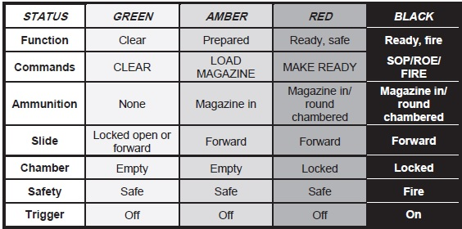
WEAPON SAFETY STATUS

Slide 8
Principles of Operations & Maintenance Procedures
Notes:
Begin by asking pointed question to get concrete knowledge of the class:
Example questions
What is Stability?
What is support?

Slide 9
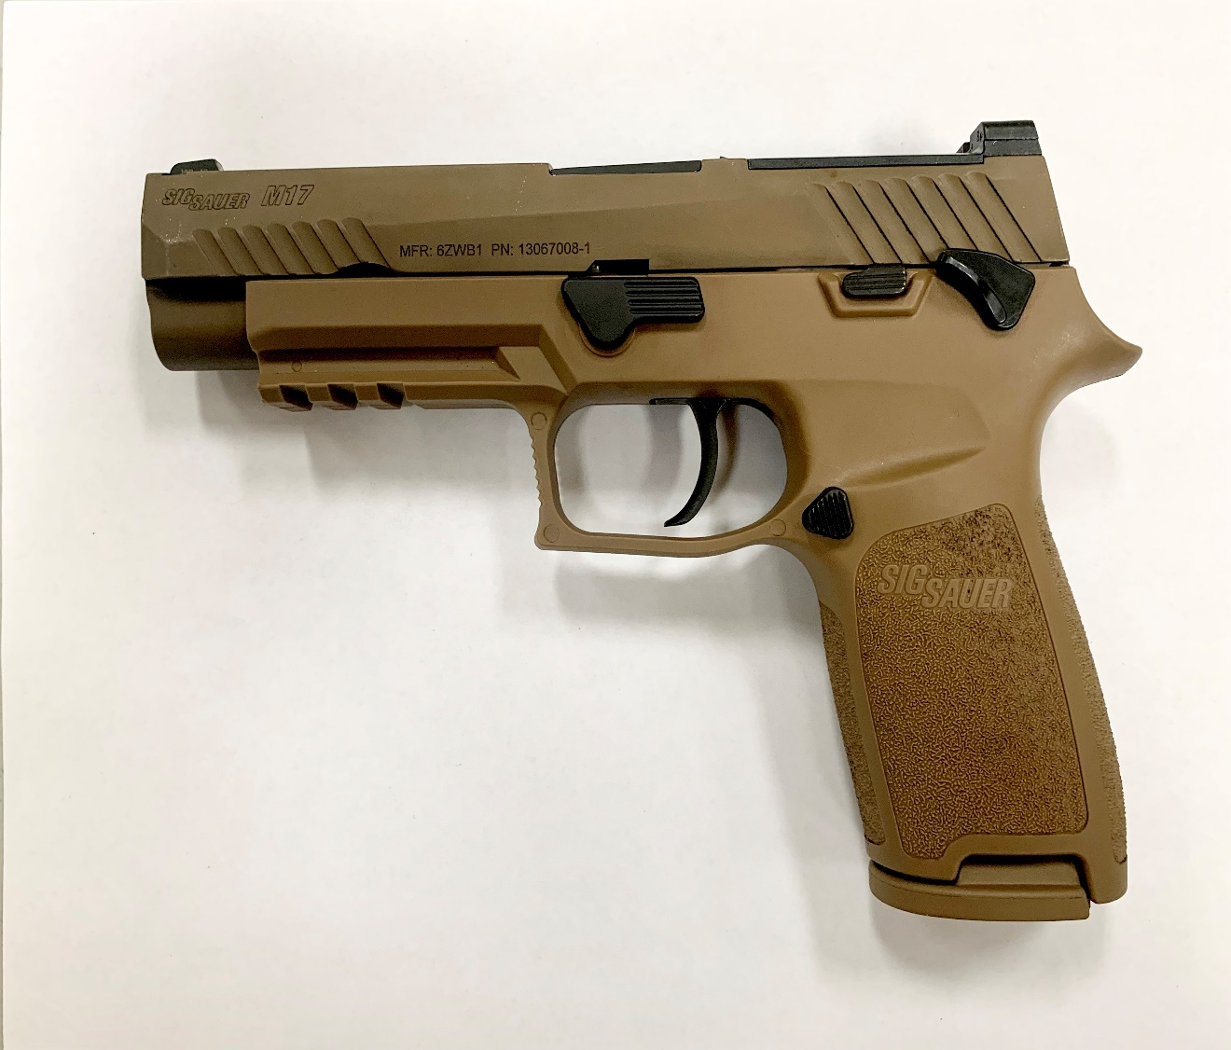
Parts Diagram
1
2
3
4
5
6
7
12
13
Front Sight
Slide
Barrel
Loaded Chamber Indicator (LCI)
Ambidextrous Slide Catch Lever
Rear Sight Plate
Ambidextrous Manual Safety
Lanyard Loop
Magazine (17 Rd Pictured)
Magazine Catch
Trigger
Takedown Lever
MIL-STD 1913 Rail
11
10
8
9

Slide 10
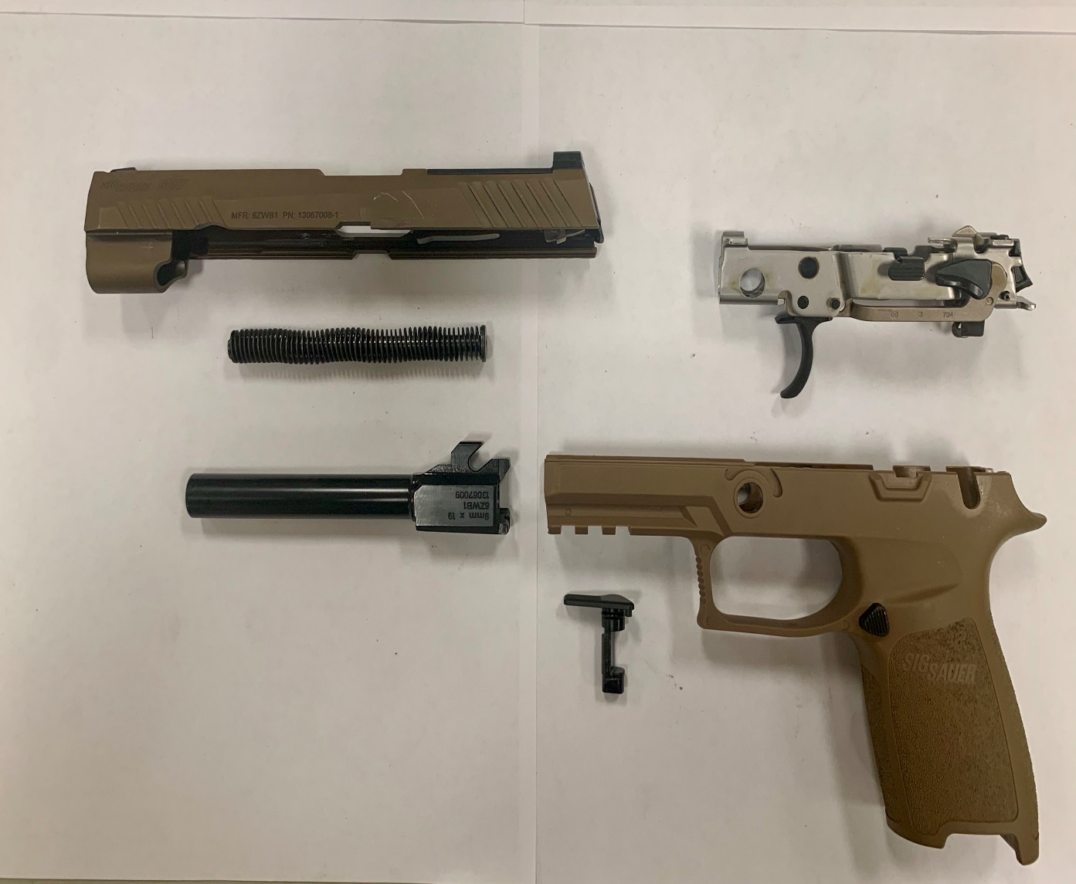
Parts Diagram Cont.
1
2
3
4
Slide Assembly
Trigger Assembly
Recoil Spring Guide Assembly
Barrel
Takedown Lever
Frame/Grip Module Assembly
5
6

Slide 11
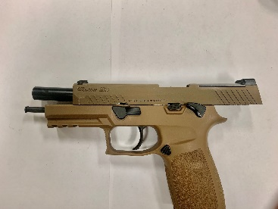
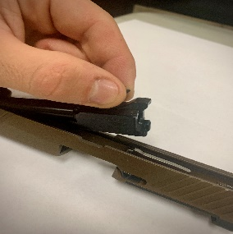
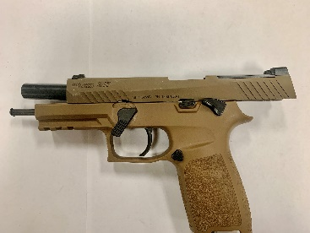
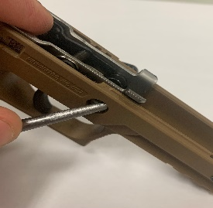
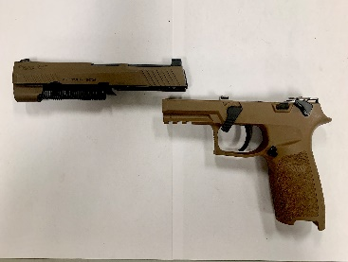
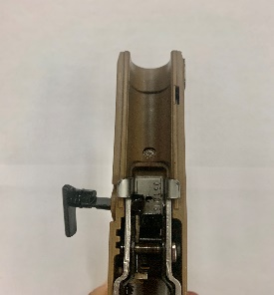
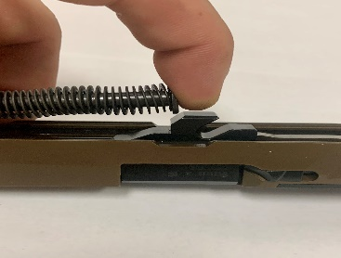
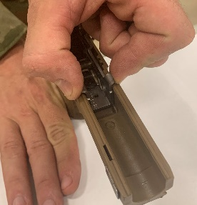
Assembly / Disassembly
* Ensure you clear the Weapon Prior to Disassembly*
Step 1: Lock slide
to the rear
Step 5: Remove Barrel
from slide
Step 2: Push down on
the takedown lever
Step 6: Push takedown
lever through frame
Step 3: Remove slide
from frame
Step 7: Remove takedown
lever from frame, may require
finesse
Step 4: Remove recoil spring
guide assembly
Step 8:Pinch Trigger Assembly
and Remove from frame

Slide 12
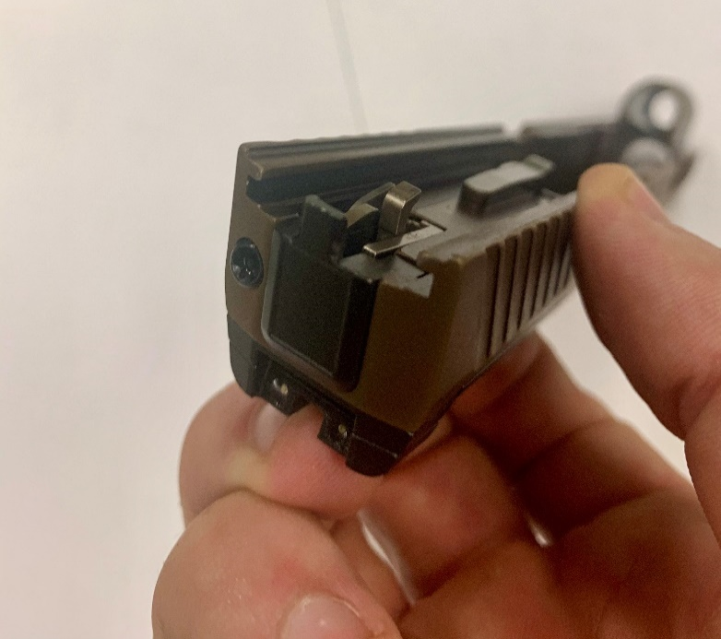
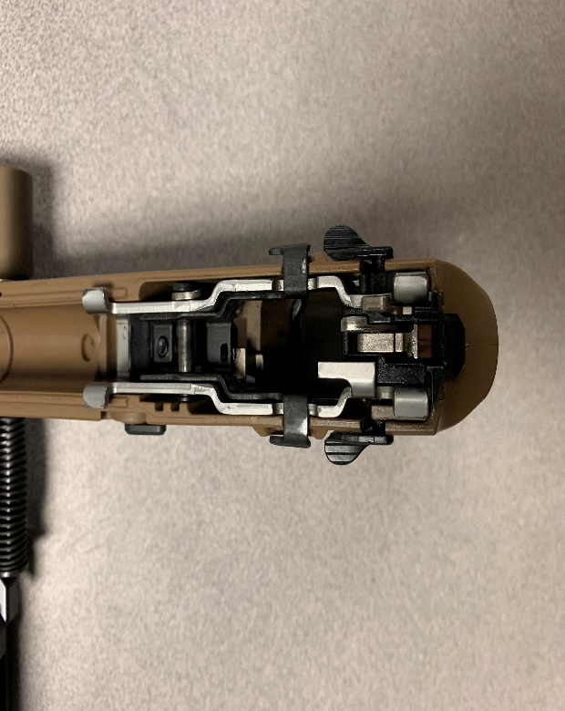
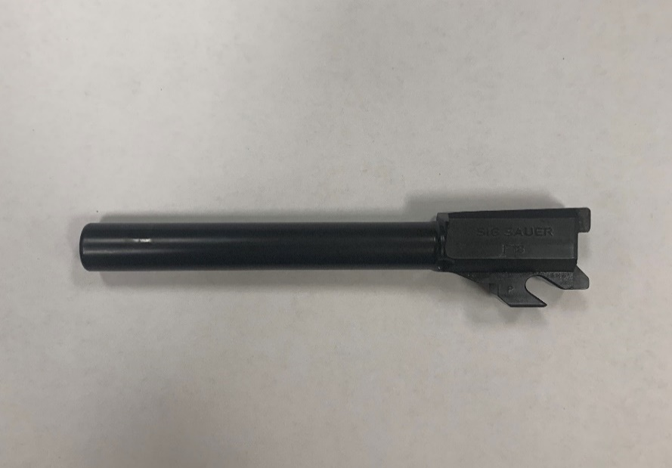
LUBRICATION GUIDE
Apply lubricant where indicated by arrows with a light coat of CLP or other authorized lubricants.

Slide 13
CYCLE OF FUNCTION
The cycle of function is the mechanical process a weapon
follows during operation.
What are the 8 Cycles of Function?
FEEDING
CHAMBERING
LOCKING
FIRING
UNLOCKING
EXTRACTING
EJECTING
COCKING

Slide 14
FEEDING
Slide is released by pressing down slide stop or retracting the slide.
Recoil spring assembly forces the slide forward.
Bottom of slide contacts top cartridge and strips it from the magazine.
Cartridge is guided to the feed ramp and starts its travel into the chamber.

Slide 15
CHAMBERING
Slide continues forward movement guiding cartridge up the feed ramp.
Cartridge enters the chamber.
Chambering of cartridge is complete when forward movement of cartridge case is stopped by machined surface of chamber.
Striker pin is energized (See Cocking).

Slide 16
LOCKING
Recoil spring guide assembly pushes the slide forward.
The barrel cams up into the breech of the slide and locks in place.

Slide 17
FIRING
2
3
1
6
4
5
Manual safety is disengaged allowing trigger movement.
As trigger (4) is pressed, trigger bar (5) moves forward pulling safety lever (1) which rotates upward pushing safety lock (2) upward and simultaneously dropping sear (6) from engagement with hook of striker pin (3).
Sear releases striker pin to impact primer of chambered cartridge.
Expanding gases propel projectile down the bore of barrel.

Slide 18
UNLOCKING
Barrel Lug
Upon firing, barrel and slide begin rearward movement.
Barrel lug cams down against slide stop pivot pin causing the barrel to unlock from slide.

Slide 19
EXTRACTING
1
The extractor (1) grips the cartridge case head on the right side.
As the slide moves rearward under recoil, the extractor pulls the expended case from chamber of the barrel.

Slide 20
EJECTING
1
Slide continues rearward movement.
Expended case is pulled rearward by extractor until the left side of the case strikes the fixed ejector (1).
Upon striking the fixed ejector, the spent case is rotated out from under the spring-loaded extractor and through the ejection port of the slide.
Note: The fixed ejector is part of the MHS receiver. The slide is deleted for clarity.

