Slide 1
LSA 6:
Shot Process Cont.
Stability
Notes:
Begin by asking pointed question to get concrete knowledge of the class:
Example questions
What is Stability?
What is support?

Slide 2
ACTION:
Demonstrate knowledge of Army service Rifle preliminary marksmanship instruction.
CONDITION:
In a classroom environment, given TC 3-22.9, Rifle and Carbine.
STANDARD:
Identify how to apply and train Rifle Marksmanship utilizing the US Army Service Rifle in accordance with applicable command guidance, TC 3-22.9 Rifle and Carbine and TC 3-20.0 Integrated Weapons Training
Strategy.

Slide 3
INTRODUCTION
Safety Considerations:
Risk Assessment:
Environmental Considerations:
Evaluation:
Notes:
Safety Considerations: Fire escape plan should be reference
Risk Assessment: Low
Environmental Considerations: Keep tops on bottles when not in use and remember to remove all trash from the classroom.
Evaluation: You will be evaluated formally on written examinations which you must achieve a minimum of 70% to continue the course.

Slide 4
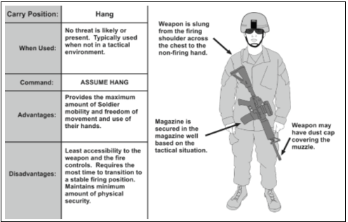
CARRY POSITIONS
HANG
Notes:
There are six primary carry positions. These positions may be directed by the
leader, or assumed by the Soldier based on the tactical situation. The primary positions
are—
● Hang.
● Safe hang.
● Collapsed low ready.
● Low ready.
● High ready.
● Ready (or ready-up).
The safe hang is used when no immediate threat is present and the hands are not necessary. In the safe hang carry, the weapon is slung, the safety is engaged, and the Soldier has gripped the rifle’s pistol grip. The Soldier sustains Rule 3, keeping the finger off the trigger until ready to engage when transitioning to the ready or ready up position.
The low ready provides the highest level of readiness and with the maximum amount of observable area for target acquisition purposes. In the low ready position, the weapon is slung, the butt stock is in the Soldier’s shoulder, and the muzzle is angled down at a 30- to 45-degree angle and oriented towards the Soldier’s sector of fire.
The ready is used when enemy contact is imminent. This carry is used when the Soldier is preparing or prepared to engage a threat. In the ready, the weapon is slung, the toe of the butt stock is in the Soldier’s shoulder, and muzzle is oriented toward a threat or most likely direction of enemy contact. The Soldier is looking through his optics or sights. His non-firing side hand remains on the hand guards or the vertical foregrip.

Slide 5
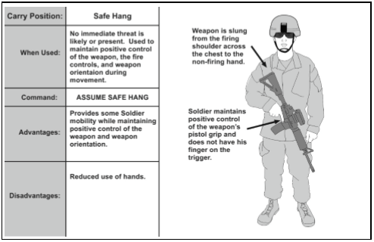
CARRY POSITIONS
SAFE HANG
Notes:
There are six primary carry positions. These positions may be directed by the
leader, or assumed by the Soldier based on the tactical situation. The primary positions
are—
● Hang.
● Safe hang.
● Collapsed low ready.
● Low ready.
● High ready.
● Ready (or ready-up).
The safe hang is used when no immediate threat is present and the hands are not necessary. In the safe hang carry, the weapon is slung, the safety is engaged, and the Soldier has gripped the rifle’s pistol grip. The Soldier sustains Rule 3, keeping the finger off the trigger until ready to engage when transitioning to the ready or ready up position.
The low ready provides the highest level of readiness and with the maximum amount of observable area for target acquisition purposes. In the low ready position, the weapon is slung, the butt stock is in the Soldier’s shoulder, and the muzzle is angled down at a 30- to 45-degree angle and oriented towards the Soldier’s sector of fire.
The ready is used when enemy contact is imminent. This carry is used when the Soldier is preparing or prepared to engage a threat. In the ready, the weapon is slung, the toe of the butt stock is in the Soldier’s shoulder, and muzzle is oriented toward a threat or most likely direction of enemy contact. The Soldier is looking through his optics or sights. His non-firing side hand remains on the hand guards or the vertical foregrip.

Slide 6
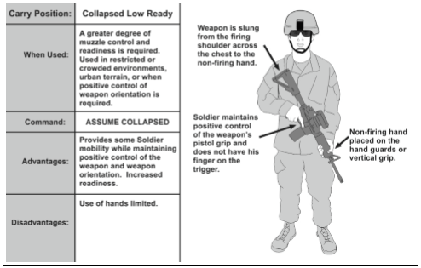
CARRY POSITIONS
COLLAPSED LOW READY
Notes:
There are six primary carry positions. These positions may be directed by the
leader, or assumed by the Soldier based on the tactical situation. The primary positions
are—
● Hang.
● Safe hang.
● Collapsed low ready.
● Low ready.
● High ready.
● Ready (or ready-up).
The safe hang is used when no immediate threat is present and the hands are not necessary. In the safe hang carry, the weapon is slung, the safety is engaged, and the Soldier has gripped the rifle’s pistol grip. The Soldier sustains Rule 3, keeping the finger off the trigger until ready to engage when transitioning to the ready or ready up position.
The low ready provides the highest level of readiness and with the maximum amount of observable area for target acquisition purposes. In the low ready position, the weapon is slung, the butt stock is in the Soldier’s shoulder, and the muzzle is angled down at a 30- to 45-degree angle and oriented towards the Soldier’s sector of fire.
The ready is used when enemy contact is imminent. This carry is used when the Soldier is preparing or prepared to engage a threat. In the ready, the weapon is slung, the toe of the butt stock is in the Soldier’s shoulder, and muzzle is oriented toward a threat or most likely direction of enemy contact. The Soldier is looking through his optics or sights. His non-firing side hand remains on the hand guards or the vertical foregrip.

Slide 7
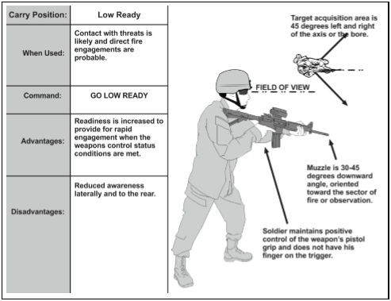
CARRY POSITIONS
LOW READY
Notes:
There are six primary carry positions. These positions may be directed by the
leader, or assumed by the Soldier based on the tactical situation. The primary positions
are—
● Hang.
● Safe hang.
● Collapsed low ready.
● Low ready.
● High ready.
● Ready (or ready-up).
The safe hang is used when no immediate threat is present and the hands are not necessary. In the safe hang carry, the weapon is slung, the safety is engaged, and the Soldier has gripped the rifle’s pistol grip. The Soldier sustains Rule 3, keeping the finger off the trigger until ready to engage when transitioning to the ready or ready up position.
The low ready provides the highest level of readiness and with the maximum amount of observable area for target acquisition purposes. In the low ready position, the weapon is slung, the butt stock is in the Soldier’s shoulder, and the muzzle is angled down at a 30- to 45-degree angle and oriented towards the Soldier’s sector of fire.
The ready is used when enemy contact is imminent. This carry is used when the Soldier is preparing or prepared to engage a threat. In the ready, the weapon is slung, the toe of the butt stock is in the Soldier’s shoulder, and muzzle is oriented toward a threat or most likely direction of enemy contact. The Soldier is looking through his optics or sights. His non-firing side hand remains on the hand guards or the vertical foregrip.

Slide 8
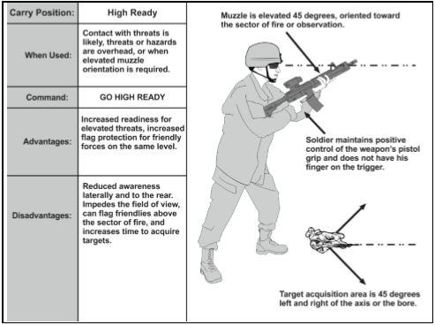
CARRY POSITIONS
HIGH READY
Notes:
There are six primary carry positions. These positions may be directed by the
leader, or assumed by the Soldier based on the tactical situation. The primary positions
are—
● Hang.
● Safe hang.
● Collapsed low ready.
● Low ready.
● High ready.
● Ready (or ready-up).
The safe hang is used when no immediate threat is present and the hands are not necessary. In the safe hang carry, the weapon is slung, the safety is engaged, and the Soldier has gripped the rifle’s pistol grip. The Soldier sustains Rule 3, keeping the finger off the trigger until ready to engage when transitioning to the ready or ready up position.
The low ready provides the highest level of readiness and with the maximum amount of observable area for target acquisition purposes. In the low ready position, the weapon is slung, the butt stock is in the Soldier’s shoulder, and the muzzle is angled down at a 30- to 45-degree angle and oriented towards the Soldier’s sector of fire.
The ready is used when enemy contact is imminent. This carry is used when the Soldier is preparing or prepared to engage a threat. In the ready, the weapon is slung, the toe of the butt stock is in the Soldier’s shoulder, and muzzle is oriented toward a threat or most likely direction of enemy contact. The Soldier is looking through his optics or sights. His non-firing side hand remains on the hand guards or the vertical foregrip.

Slide 9
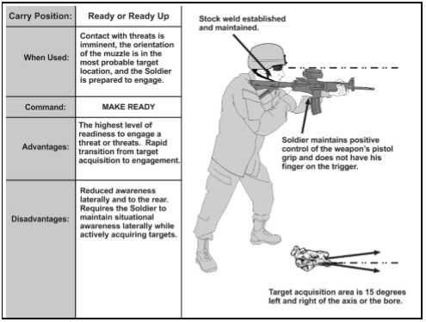
CARRY POSITIONS
READY OR READY UP
Notes:
There are six primary carry positions. These positions may be directed by the
leader, or assumed by the Soldier based on the tactical situation. The primary positions
are—
● Hang.
● Safe hang.
● Collapsed low ready.
● Low ready.
● High ready.
● Ready (or ready-up).
The safe hang is used when no immediate threat is present and the hands are not necessary. In the safe hang carry, the weapon is slung, the safety is engaged, and the Soldier has gripped the rifle’s pistol grip. The Soldier sustains Rule 3, keeping the finger off the trigger until ready to engage when transitioning to the ready or ready up position.
The low ready provides the highest level of readiness and with the maximum amount of observable area for target acquisition purposes. In the low ready position, the weapon is slung, the butt stock is in the Soldier’s shoulder, and the muzzle is angled down at a 30- to 45-degree angle and oriented towards the Soldier’s sector of fire.
The ready is used when enemy contact is imminent. This carry is used when the Soldier is preparing or prepared to engage a threat. In the ready, the weapon is slung, the toe of the butt stock is in the Soldier’s shoulder, and muzzle is oriented toward a threat or most likely direction of enemy contact. The Soldier is looking through his optics or sights. His non-firing side hand remains on the hand guards or the vertical foregrip.

Slide 10
FUNCTIONAL ELEMENTS
STABILITY
FUNCTIONS OF STABILITY
Support | Muscle Relaxation
Natural Point of Aim | Recoil Management
COMBINATIONS OF SUPPORT
Leg Position | Stance/CoG | Firing Elbow
Non-firing Elbow | Firing Hand | Non-Firing Hand
Buttstock |  | Stock weld
Notes:
The Soldier stabilizes the weapon to provide a consistent base to fire from and maintain through the shot process until the recoil pulse has ceased. This process includes how the Soldier holds the weapon, uses structures or objects to provide stability, and the Soldier’s posture on the ground during the engagement process.
Support can be natural or artificial or a combination of both. Natural support comes from a combination of the shooter’s bones and muscles. Artificial support comes from objects outside the shooter’s body. The more support a particular position provides, the more stable the weapon.
Muscle relaxation is the ability of the Soldier to maintain orientation of the weapon appropriately during the shot process while keeping the major muscle groups from straining to maintain the weapon system’s position. Relaxed muscles contribute to stability provided by support.
The natural point of aim is the point where the barrel naturally orients when the shooter’s muscles are relaxed and support is achieved. When a Soldier aims at a target, the lack of stability creates a wobble area, where the sights oscillate slightly around and through the point of aim.
Recoil management is the result of a Soldier assuming and maintaining a stable firing position which mitigates the disturbance of one's sight picture during the cycle of function of the weapon.
To create a stabilized platform, Soldiers must understand the physical relationship between the weapon system, the shooter’s body, the ground, and any other objects touching the weapon or shooter’s body. When a shooter assumes a stable firing position, movement from muscle tension, breathing, and other natural activities within the body will be transferred to the weapon and must be compensated for by the shooter. Failing to create an effective platform to fire from is termed a stabilization failure. These failures compound the firing occasion’s errors, which directly correlate to the accuracy of the shot taken. As a rule, positions that are lower to the ground provide a higher level of stability.

Slide 11
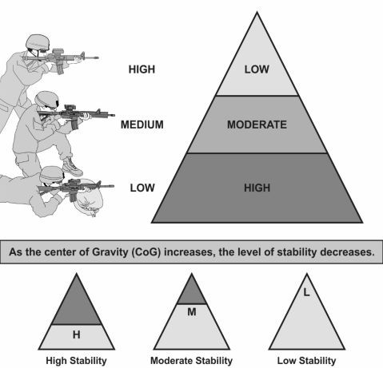
EMPLOYMENT
PRINCIPLES OF STABILIZATION
Notes:
The Soldier focuses on getting as stable a position as is possible throughout the pre-shot, shot, and post-shot process. A good rule of thumb for Soldiers to remember is the more contact their body has with the ground, the more stable their position will be. The amount of contact they have with the ground is driven by the situation they are in and tactics required to win the fight.
The most important thing for Soldiers to remember is that they have to practice these positions frequently in order to know where their natural point of aim is for any specific position. Dry fire should be done in the kit that the Soldier normally wears on a regular basis, so that they get an idea of the restrictive nature of their equipment. This also leads to the Soldier being able to efficiently transfer between positions and master stability under optimal conditions, so that when the variables of battlefield calculus are introduced, the Soldier can rely on the 'muscle memory' they have built through multiple repetitions of building a stable position
There is a misleading statement in the words ‘comfortable position.’ To most, it implies that there should be no discomfort at all. In truth, it means that the Soldier may be losing feeling in their non-firing arm due to the tension of a sling-wrap, or their foot is falling asleep from sitting on it. A stable, comfortable position means that I can hold that position for long periods of time without having to rely on any (or minimal) muscle usage to do so.

Slide 12
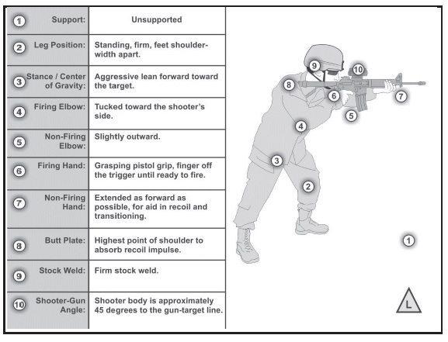
STANDING UNSUPPORTED
Notes:
The standing position is the most rapidly achieved position. It has to be practiced as a part of Table III, so that there is a solid understanding of what their natural point of aim is, and how to get a steady position with all their kit.
To achieve a standing unsupported position, the Soldier starts with the feet, spread shoulder width apart in a fighter’s stance. Weight should be on the balls of the feet, providing the Soldier with a aggressively leaning stance. The non-firing foot should be approximately a half-step forward from the firing foot. The knees are slightly flexed to help absorb recoil.
The Soldier’s hips are squared as much as possible with the target. This is not to ensure that the plates are in-line with the target, but to ensure that the maximum amount of body is behind the weapon for recoil management. Transitions to multiple threat targets are conducted by moving from the hips.
The buttstock is mid to high in the Soldier’s shoulder, the weapon is brought to the head, not the other way around. The firing arm is located in close to the Soldier, with the firing hand high on the pistol grip, allowing for maximum mechanical advantage on the trigger.
The non-firing hand is located as far forward as comfortable for the Soldier to be able to transition rapidly and efficiently between threats. The Non-firing hand should not be on the magazine well, as putting it there while transitioning between threats from the standing will cause over-correction of the threat, increasing the engagement time.
The analogy used is if I place my hand at the back end of a pen, I can write my name. It may look like a five-year-old has done it, but I can write my name. I get much more precise when I choke up on the business end of the pen, I can write my name with economy of motion, and do it much more rapidly.
It is the same way with our rifle. The non-firing hand should be out as far as is comfortable for the shooter so that rapid, efficient transitions are possible.
The benefit to this position is a Soldier with practice can get a shot off to approximately 50 meters with a reasonable expectation of hitting in the lethal zone. The drawback is, without that training, Soldiers do not have enough practical experience to feel confident engaging targets at this distance. Incorporation of a good two-point sling can make this position much more stable.

Slide 13
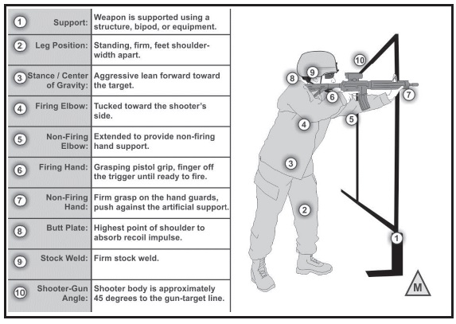
STANDING SUPPORTED
Notes:
Standing supported is the same as the Standing Unsupported. The only difference being the integration of some form of support. The Soldier places their non-firing hand up against the support and makes either an ‘L’ or ‘C’ grip of the weapon with their palm placed flat against the support. . It has to be practiced as a part of Table III, so that there is a solid understanding of what their natural point of aim is, and how to get a steady position with all their kit.
The Firing leg should be applying forward pressure into the support. This will help to stabilize the Soldier’s firing position. The benefit over the standing unsupported is Soldiers can get a shot off more efficiently at longer distances. The drawback to using this position is that it makes it more challenging for Soldiers to determine where threats are due to the reduction of their field of view. It also has to be trained prior to coming out to the range as a part of table III so that Paratroopers have a solid understanding of transitioning between targets.

Slide 14
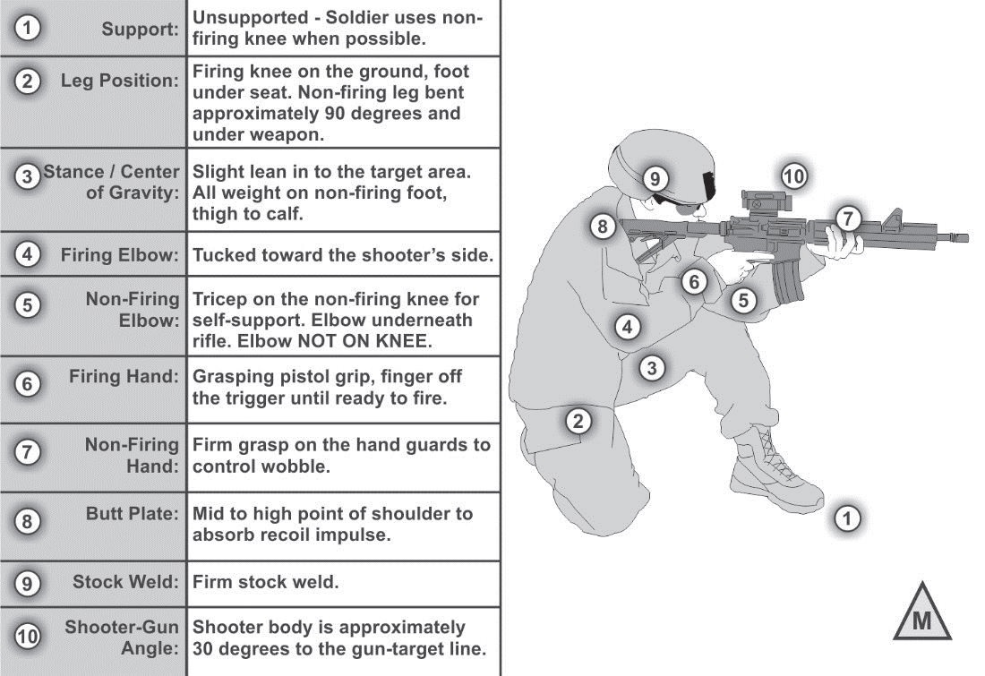
KNEELING UNSUPPORTED
Notes:
The Kneeling unsupported position is one of the most commonly used positions in combat, and also one of the positions that causes Soldiers issues during Table VI (qualification). . It has to be practiced as a part of Table III, so that there is a solid understanding of what their natural point of aim is, and how to get a steady position with all their kit.
The position is assumed from the standing by taking a half-step forward with the non firing leg. The firing leg goes perpendicular to the target or sector. The Soldier’s legs should be in an ‘L’ shape, providing as stable a platform as possible.
The Soldier needs to get as low to the ground as possible, remembering that the lower the center of gravity, the more stable they become. The Soldier can sit on the firing foot, or point the toe. The non-firing foot should be up with the non-firing tricep planted into it. The Non-firing arm will be under the weapon as much as possible. Ideally, the magazine will be placed into the non-firing forearm. This ensures that the Soldier’s Non-firing arm is using Bone support to stabilize the weapon.
If available, two-point sling should be used to provide support. This will make the Soldier much more stable from the kneeling unsupported, and will ensure that their wobble area has been reduced as much as possible.
All transitions from this position are done from the non-firing foot. This ensures that the Soldier keeps as stable a platform as possible.
The benefit to this position is that it is much more stable than the standing unsupported, it reduces the Soldier’s center of gravity, and silhouette. The drawback to this position is it takes time to achieve a solid position, and the wobble area may be increased by external factors (e.g. being blown about by the wind).

Slide 15
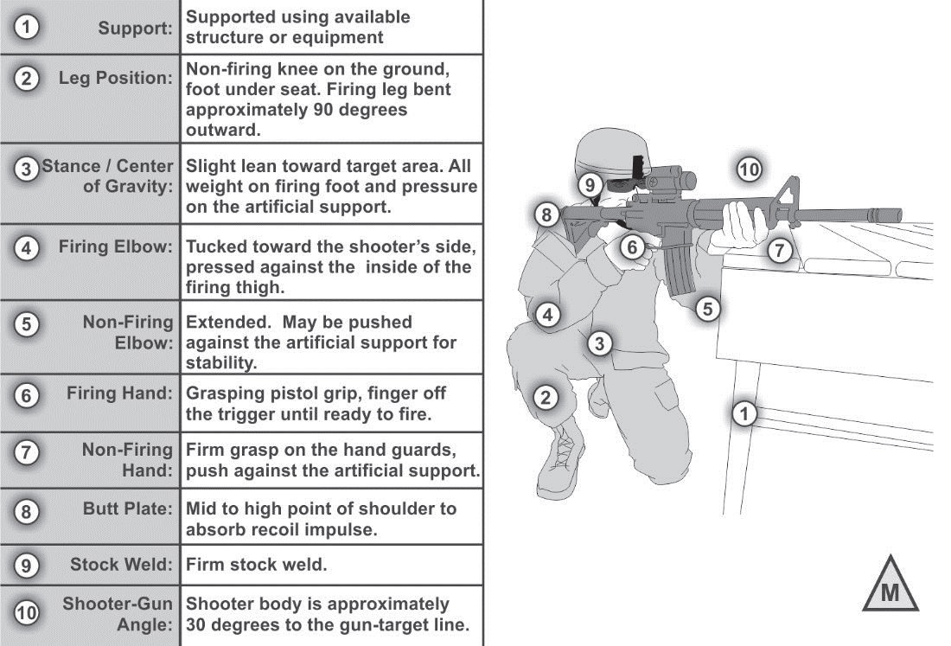
KNEELING SUPPORTED
Notes:
The Kneeling supported position is one of the most commonly used positions in combat. It has to be practiced as a part of Table III, so that there is a solid understanding of what their natural point of aim is, and how to get a steady position with all their kit.
The position is assumed from the standing by taking a half-step forward with the non firing leg. The firing leg goes perpendicular to the target or sector. The Soldier’s legs should be in an ‘L’ shape, providing as stable a platform as possible.
The Soldier needs to get as low to the ground as possible, remembering that the lower the center of gravity, the more stable they become. The Soldier can sit on the firing foot, or point the toe. The non-firing foot should be up with the non-firing tricep planted into it. The Non-firing arm will be under the weapon as much as possible. Ideally, the magazine will be placed into the non-firing forearm. This ensures that the Soldier’s Non-firing arm is using Bone support to stabilize the weapon.
If available, two-point sling should be used to provide support. This will make the Soldier much more stable from the kneeling unsupported, and will ensure that their wobble area has been reduced as much as possible.
All transitions from this position are done from the non-firing foot. This ensures that the Paratrooper keeps as stable a platform as possible.
The benefit to this position is that it is much more stable than the standing unsupported, it reduces the Soldier’s center of gravity, and silhouette. The drawback to this position is it takes time to achieve a solid position, and the wobble area may be increased by external factors (e.g. being blown about by the wind).

Slide 16
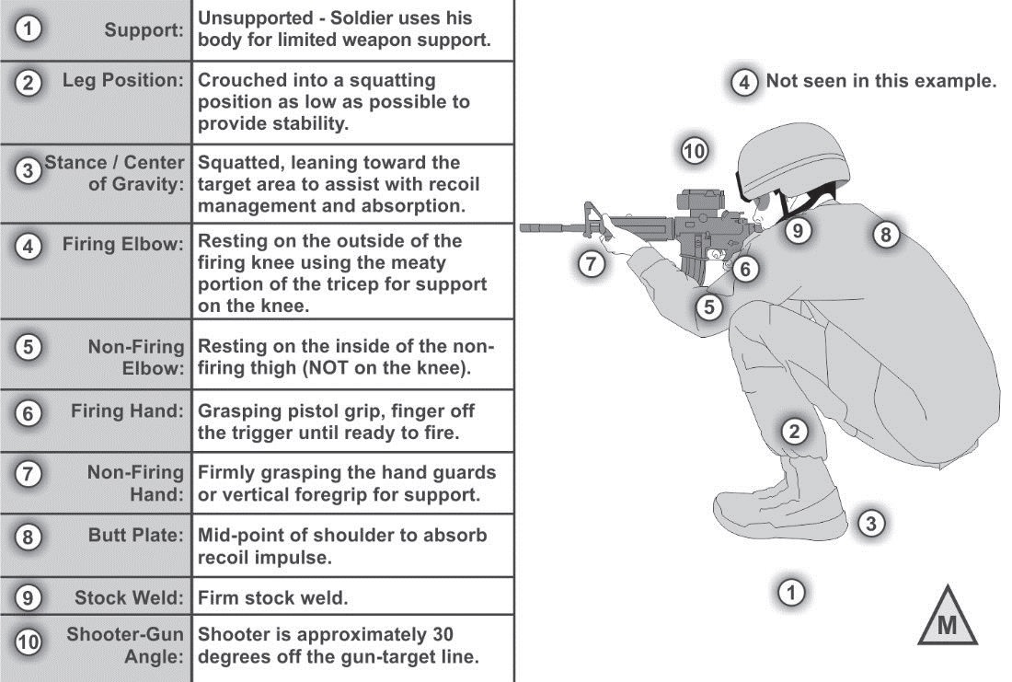
SQUATTING
Notes:
The squatting position is not a position commonly encountered in combat, but may be used if there is cover that is too short for a kneeling supported, but too tall, for a prone supported. It can also be used as an unsupported position to reduce the Soldier’s overall silhouette. . It has to be practiced as a part of Table III, so that there is a solid understanding of what their natural point of aim is, and how to get a steady position with all their kit.
The major component of this is the elbows are planted into the meaty parts of the thighs, or resting the tricep muscle into the knee. The Soldier assumes a leaning-forward center-of-gravity to assist in recoil management.

Slide 17
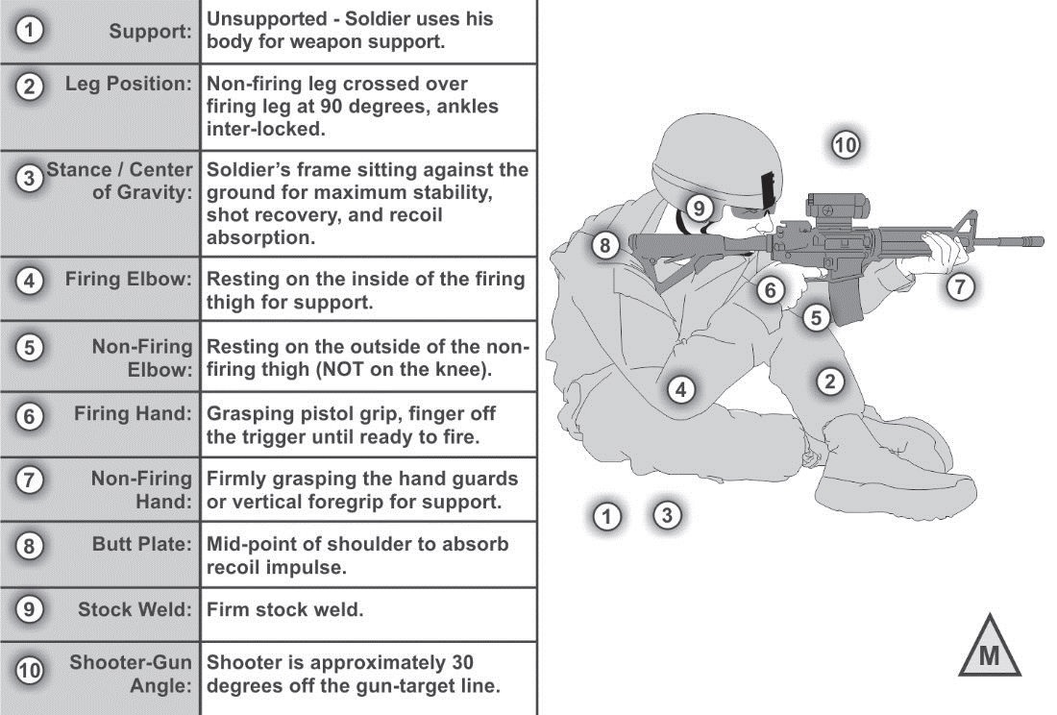
SITTING, CROSS-ANKLE
Notes:
The cross-legged sitting position will be used when the Soldier needs to either take a well-aimed shot from low cover, or as an attempt to reduce their overall silhouette rapidly. . It has to be practiced as a part of Table III, so that there is a solid understanding of what their natural point of aim is, and how to get a steady position with all their kit.
The Soldier assumes this by assuming a 30-degree off angle to the target and sitting down, placing their non-firing hand down to break their fall.
Once on the ground, the Soldier will then place either their elbows into the meaty portion of their thighs, or their triceps into the knees. The legs are crossed, with the non-firing leg on top. The Soldier’s torso is leaning forward so as to achieve a good recoil management for the weapon.
The benefit to this position is it provides more stability than the kneeling while reducing the overall silhouette. The drawback is it takes longer to achieve this position, and the Soldier cannot move rapidly once this position is achieved.

Slide 18
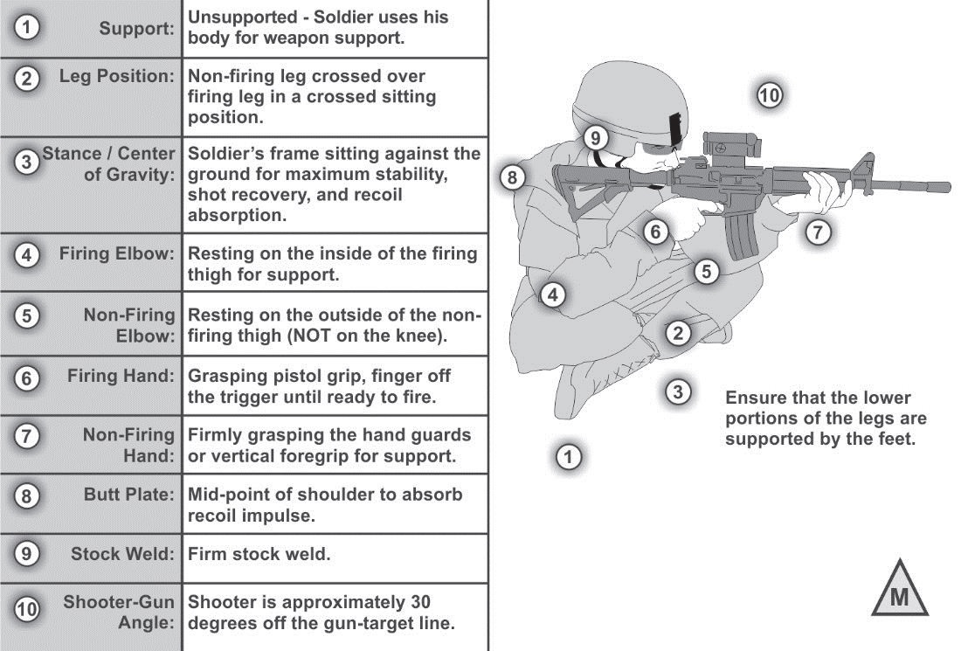
SITTING, CROSS-LEGGED
Notes:
The Cross-legged sitting position is one of the most stable positions achievable for the Soldier outside of the prone. It has to be practiced as a part of Table III, so that there is a solid understanding of what their natural point of aim is, and how to get a steady position with all their kit.
The Soldier assumes this by assuming a 30-degree off angle to the target and sitting down, placing their non-firing hand down to break their fall.
Once on the ground, the Soldier will then place either their elbows into the meaty portion of their thighs, or their triceps into the knees. The legs are crossed, with the non-firing leg on top. The Soldier’s torso is leaning forward so as to achieve a good recoil management for the weapon.
The benefit of this position is that the Soldier has a low silhouette and is stable. The drawback is the length of time it takes to achieve this position, and get out of it.

Slide 19
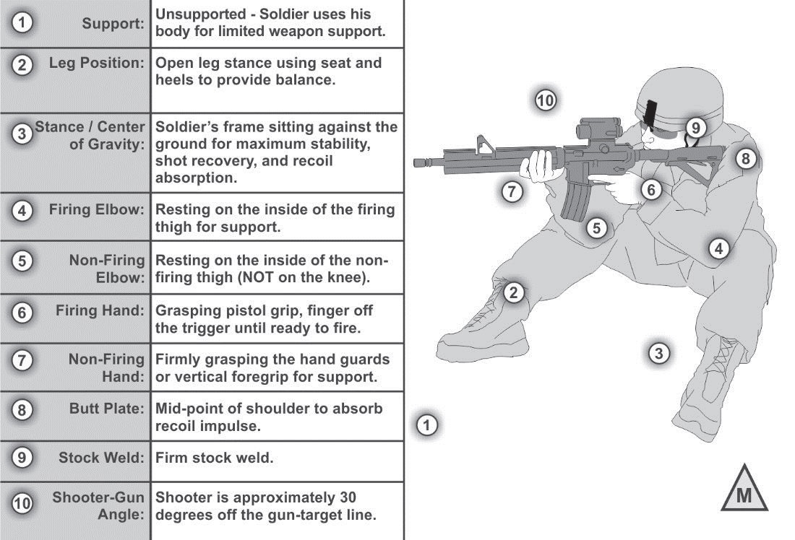
SITTING, OPEN-LEGGED
Notes:
The Open-legged sitting position allows the Soldier the ability to assume a stable position with some tradeoffs for the other sitting positions. It has to be practiced as a part of Table III, so that there is a solid understanding of what their natural point of aim is, and how to get a steady position with all their kit.
The Soldier assumes this position by taking a seat at a thirty-degree angle off the gun-target-line. They will then place their feet flat on the ground, with their elbows going into either the meaty portions of the thigh, or the tricep into the knee.
The benefit to this position is it can be assumed and gotten out of (compared to the other sitting positions) rapidly. The drawback is, it is not as stable as the other sitting positions.

Slide 20
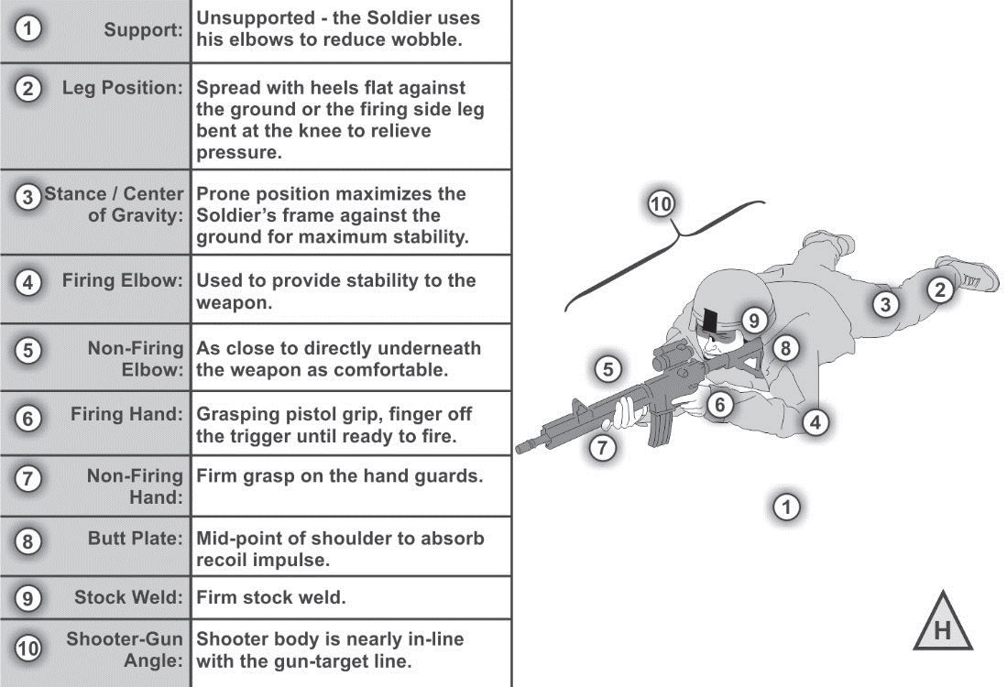
PRONE UNSUPPORTED
Notes:
The prone unsupported position is the basic position for any Soldier to assume. It is the most stable outside of the prone supported position. The Soldier can incorporate a sling-wrap and rest their magazine on the ground in this position to provide stability on par with a prone supported position. It has to be practiced as a part of Table III, so that there is a solid understanding of what their natural point of aim is, and how to get a steady position with all their kit.
The Soldier assumes this position by placing their non-firing hand under the weapon. If a high-prone supported position is assumed, the Soldier will place their non-firing elbow as close as possible to the magazine of the weapon, providing bone support as opposed to muscle support. If the magazine is resting on the ground, the Soldier plants his non-firing elbow as far out as is comfortably possible to keep the weapon level and providing a tripod-like effect on the weapon (when the firing elbow is added into the equation).
The buttstock is placed low to mid level in the pocket of the shoulder. The Soldier should be placing the weapon in line with their body, not off at an angle. This ensures that the weapon recoils back into the Soldier’s body, providing maximum recoil management for the Soldier.
The feet and legs are placed flat on the ground so as to provide the Soldier as stable a platform as possible. The alternate position is the firing leg brought up towards the Soldier’s torso, and the non-firing leg rotated inwards. This provides additional space between the Soldier’s torso to accommodate their kit.
The benefit to this position is the stability it offers the Soldier. The Drawback is the time it can potentially take the Soldier to achieve this position.

Slide 21
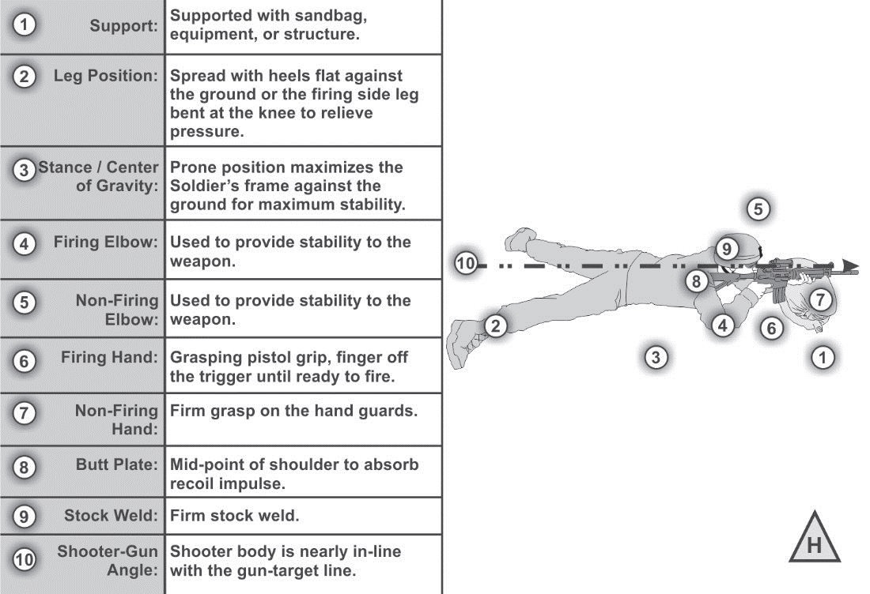
PRONE SUPPORTED
Notes:
The prone supported position is generally the most stable position to fire from. The Soldier can incorporate a sling-wrap and rest their magazine on the ground in this position to provide additional stability. It has to be practiced as a part of Table III, so that there is a solid understanding of what their natural point of aim is, and how to get a steady position with all their kit.
The Soldier assumes this position by placing their non-firing hand under the weapon. If a high-prone supported position is assumed, the Soldier will place their non-firing elbow as close as possible to the magazine of the weapon, providing bone support as opposed to muscle support. If the magazine is resting on the ground, the Soldier plants his non-firing elbow as far out as is comfortably possible to keep the weapon level and providing a tripod-like effect on the weapon (when the firing elbow is added into the equation).
The buttstock is placed low to mid level in the pocket of the shoulder. The Soldier should be placing the weapon in line with their body, not off at an angle. This ensures that the weapon recoils back into the Soldier’s body, providing maximum recoil management for the Soldier.
The feet and legs are placed flat on the ground so as to provide the Soldier as stable a platform as possible. The alternate position is the firing leg brought up towards the Soldier’s torso, and the non-firing leg rotated inwards. This provides additional space between the Soldier’s torso to accommodate their kit.
The benefit to this position is the stability it offers the Soldier. The Drawback is the time it can potentially take the Soldier to achieve this position.

Slide 22
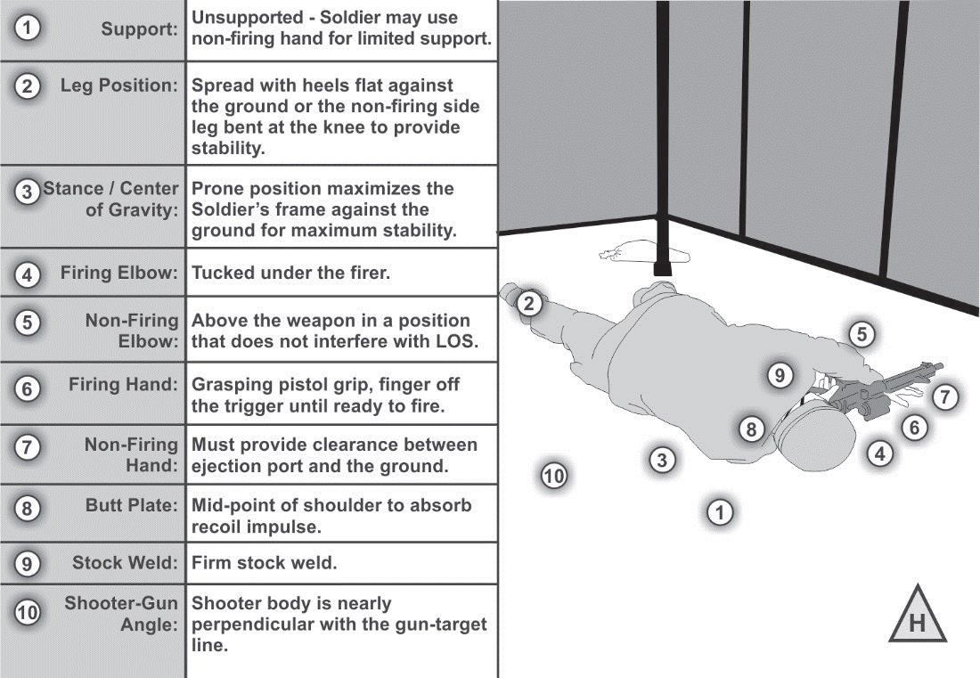
ROLLOVER PRONE
Notes:
The rollover prone is one of the lowest positions possible for the Soldier to achieve. It is used when attempting to fire out of low loopholes, or under a fence. It has to be practiced as a part of Table III, so that there is a solid understanding of what their natural point of aim is, and how to get a steady position with all their kit.
The Soldier lays on their Firing side, with their non-firing hand under the weapon. This provides stability for the weapon at the lowest possible silhouette.
The Soldier needs to be aware with this position, that since the weapon is canted, they will have to aim in the direction of the magazine and up, to compensate for the offset of the sights.
The benefit of this position is the low silhouette it provides the Soldier. The Drawback is the offset point of aim that only comes with practice.

Slide 23
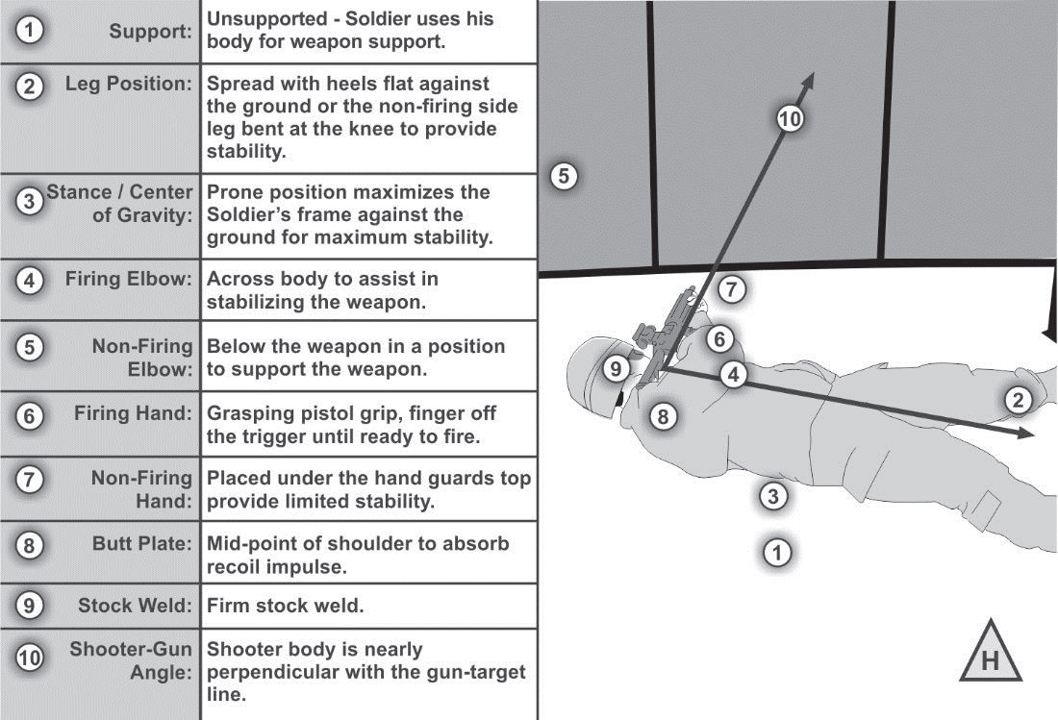
REVERSE ROLLOVER PRONE
Notes:
The reverse rollover prone is one of the lowest positions possible for the Soldier to achieve. It is used when attempting to fire out of low loopholes, or under a fence. It has to be practiced as a part of Table III, so that there is a solid understanding of what their natural point of aim is, and how to get a steady position with all their kit.
The Soldier lays on their non-firing side, with their non-firing hand under the weapon. This provides stability for the weapon at the low silhouette.
The Soldier needs to be aware with this position, that since the weapon is canted, they will have to aim in the direction of the magazine and up, to compensate for the offset of the sights.
The benefit of this position is the low silhouette it provides the Soldier. The Drawback is the offset point of aim that only comes with practice.

Slide 24
CHECK ON LEARNING
STABILITY
What are the carry positions?
● Hang.  Safe hang.  Collapsed low ready.  Low ready.  High ready.  Ready (or ready-up).
What are the primary positions?
● Standing  Squatting  Kneeling  Sitting  Prone
What are the 8 components of natural support?
● Leg Position  Stance/ center of gravity  Firing elbow.  Non-firing Elbow.  Firing Hand.  Non-firing Hand  Buttstock  Stockweld
What are the four functions of stability?
● Support   Muscle Relaxation  Natural Point of Aim  Recoil Management

