Slide 1

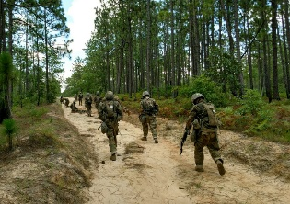
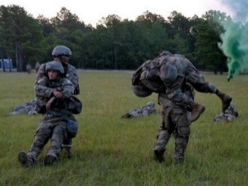
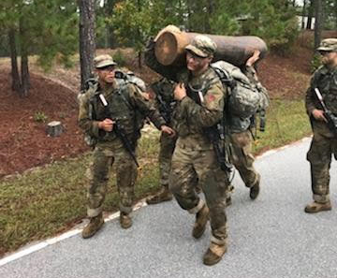
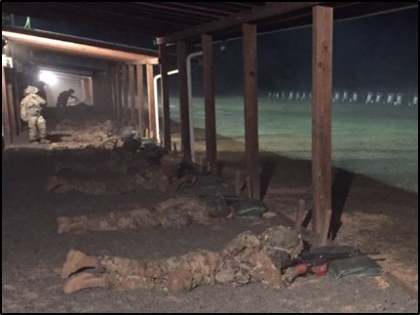
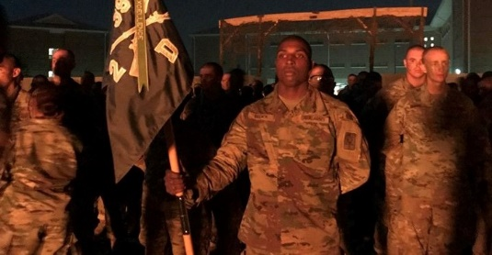
THE FORGE
The Final Transformation to Soldier
071-BT071012 v 5.2 (CIMT approved)
The Soldier’s Ceremony
Black Beret
US Army Patch
Trainee’s have earned the right to be called “Soldier”
Day 1
Day 2
Day 3
Continuous Operations in a Tactical Field Environment
10 Mile Approach march (out or in)
Resupply Mission
Tactical Operations in TAA
~ 10 mile movement
Fire & Movement Crs
Medical Skills Lane
Assault Course
Night Infiltration Course
~ 10 mile movement
Mass Casualty Exercise
Equipment Movement
Battle, March, and Shoot
Soldiers Ceremony
A personal and team gut check- a defining moment, ready for close combat
72 hour grueling and continuous field training exercise
Accumulate no less than 30 miles foot movement with the majority of the movement occurring at night
Continually increasing emotional, physical, and mental stress
Revolving peer leadership – agile and adaptive mindset
Perform critical basic combat tasks in a challenging, complex environment
Every challenge is linked to the Army story, Soldier’s Creed, and Army Values
Commanders will conduct the events of THE FORGE in the order that works for their local operational environment
6
4
Notes:
Goal is a demanding, capstone training event that builds confidence and strengthens the trainee’s bond to the Army
The sequence of events associated with this power point are not intended to be prescriptive. Please refer to the Forge Lesson Plan “Instructor Lead-In” for further guidance.
72 hours, no less than 30 miles of foot movement, variety of tasks, high physical demands
Interwoven with Army history
Culminates with a Soldiers ceremony
Wear Black Beret
Wear US Army Patch
Trainees have earned the right to be called “Soldier” for the first time

