Slide 1
LSA 6:
Shot process cont.
Aim
Notes:
Begin by asking pointed question to get concrete knowledge of the class:
Example questions
What is a common engagment?
Is aiming something that a coach can effect?

Slide 2
ACTION:
Demonstrate knowledge of Army service Rifle preliminary marksmanship instruction.
CONDITION:
In a classroom environment, given TC 3-22.9, Rifle and Carbine.
STANDARD:
Identify how to apply and train Rifle Marksmanship utilizing the US Army Service Rifle in accordance with applicable command guidance, TC 3-22.9 Rifle and Carbine and TC 3-20.0 Integrated Weapons Training
Strategy.

Slide 3
INTRODUCTION
Safety Considerations:
Risk Assessment:
Environmental Considerations:
Evaluation:
Notes:
Safety Considerations: Fire escape plan should be reference
Risk Assessment: Low
Environmental Considerations: Keep tops on bottles when not in use and remember to remove all trash from the classroom.
Evaluation: You will be evaluated formally on written examinations which you must achieve a minimum of 70% to continue the course.

Slide 4
FUNCTIONAL ELEMENTS
AIM
COMMON ENGAGEMENT ACTIONS
1. Weapon Orientation | 2. Sight Alignment | 3. Sight Picture
4. Point of Aim (POA) |  | 5. Desired Point of Impact (POI)
COMMON AIMING ERRORS
Non Dominant Eye Use | Incorrect Zero | Light Conditions
Battle Field Obscurants | Incorrect Sight Alignment | Incorrect Sight Picture
 | Improper Range Determination
Notes:
The aim element of employment is the continuous process of orienting the weapon correctly, aligning the sights, aligning on the target, and the application of the appropriate lead and elevation (hold-off or aim-off) during a target engagement. Aiming is a continuous process conducted through pre-shot, shot, and post-shot, to effectively apply lethal fires in a responsible manner with accuracy and precision.
The aiming process for engaging stationary targets consist of the following Soldier actions, regardless of the optic, sight, or magnification used by the aiming device:
● Weapon orientation – the direction of the weapon as it is held in a stabilized manner.
● Sight alignment – the physical alignment of the aiming device:
■ Iron sight/back-up iron sight and the front sight post.
■ Optic reticle.
■ Ballistic reticle (day or thermal).
● Sight picture – the target as viewed through the line of sight.
● Point of aim (POA) – the specific location where the line of sight intersects the target.
● Desired point of impact (POI)–the desired location of the strike of the round to achieve the desired outcome (incapacitation or lethal strike)

Slide 5
AIM
SIGHT ALIGNMENT/ SIGHT PICTURE
Notes:
Sight alignment is the relationship between the aiming device and the Soldier's eye. What process used to achieve sight alignment, depends on the type of aiming device used by the Soldier. Keep in mind, the sighting system is already set up in alignment to the weapon, when we say sight alignment, it is referring to the Paratrooper’s eye in relation to the sighting system.
If iron sights are used, it is the relationship between the Soldier's eye, the rear sight aperture, and the front sight post. If the aiming device is a reflex-type sight, it is the relationship with the Soldier’s eye and the red dot centered vertically and horizontally in the tube for a well-aimed shot. For a magnifying optic to achieve sight alignment, the Soldier will achieve the appropriate eye relief (distance from the eye to the optic) so that a full field of view is achieved and there is minimal scope shadow. Thermals are a little different, it is the relationship between the Soldier's eye, the eyepiece on the thermal, and the reticle. For Night Vision Devices (NVD's), sight alignment is achieved with the Soldier looking through a properly focused NVD, and placing the laser aiming point on the threat.
Sight picture is achieved when you take those aligned sights and place them Center of Visible Mass on the target. The only difference from sight alignment is the incorporation of the target.
For all of these things, the Soldier needs to keep in mind that the most important place to be focused when the slack is coming out of the trigger is not on the target, but on the aiming point. The Iron Sight/Reticle/Laser is where the projectile is going to be going, so that is where our Soldiers need to be focused to ensure shot placement is where they intended.

Slide 6
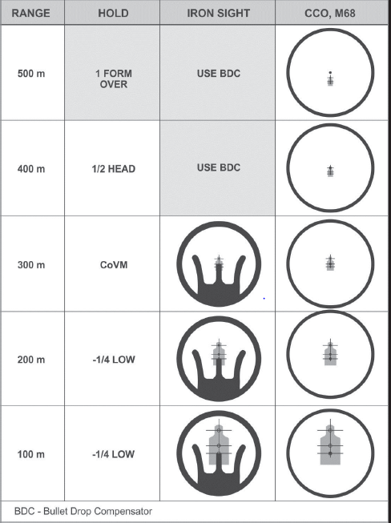
AIM
IMMEDIATE HOLDS ELEVATION
Notes:
Immediate range determination holds are based on the zero applied to the weapon. The 300 meter zero is the Army standard and works in all tactical situations, including close quarters combat. The figure shows the appropriate immediate holds for range to target based on the weapon’s respective zero.

Slide 7
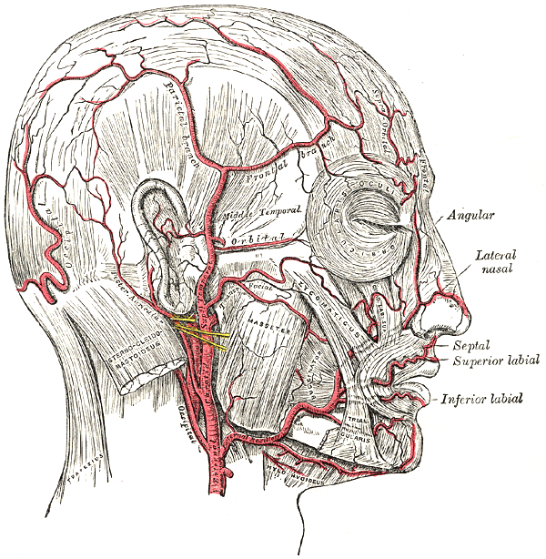
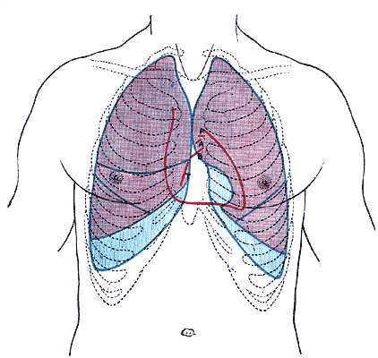
AIM
CIRCUITRY SHOTS (SWITCHES)
POA
Round passes thru and severs
Notes:
7
Read and point out vital areas in the head region.
Show next slide

Slide 8
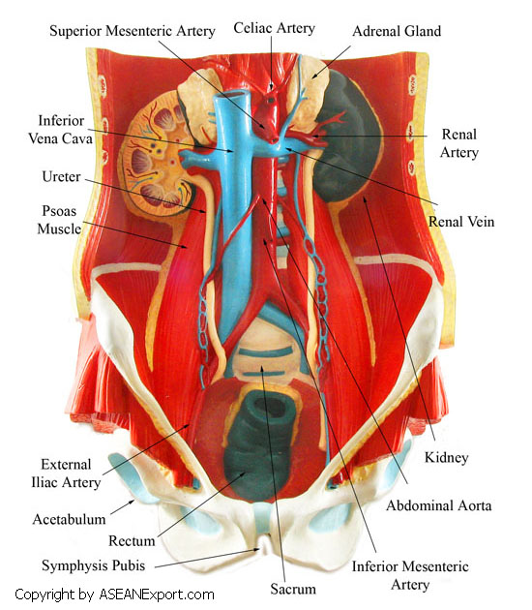
AIM
HYDRAULIC SHOTS (TIMERS)
Notes:
8
Read bullet and point out vital areas in the pelvic region
This area is rich in large blood vessels and a shot here has a good possibility of hitting the lower spine.

Slide 9
CHECK ON LEARNING
EMPLOYMENT
What are two components of Aiming ?
● Sight Alignment  Sight Picture
What is the aiming process actions for common engagements?
● Weapon Orientation  Sight Alignment  Sight Picture  Point of Aim (POA)  Desired Point of Impact (POI)

