Slide 2
Administrative Notes
Click on the Normal View icon located in the lower left hand corner of your screen to read the detailed notes on the M320 Grenade Launcher
Click on the Slide View icon to get a detailed look at the slides on the M320 Grenade Launcher
Click on the Slide Show icon to rehearse the presentation with animation and present your class
Click on the Slide Sorter View icon to look at all the slides at once and hide the slides that will not be taught by RIGHT clicking on it and then LEFT clicking on HIDE SLIDE
Hide this slide during your presentation
Notes:
TRAINING SUPPORT PACKAGE (TSP)
TSP Number: NEED TSP NUMBER FOR THE COURSE
Title:Qualify with the M320
Task Number(s) /Title(s): task number task title
Effective Date: ??????
Supersedes TSP(s): N/A
TSP User: Use this TSP in Unit Sustainment Training.
Proponent: The proponent for this document is the Advanced Infantry Marksmanship Strategies and Standards Committee, C Company 2/29th IN Regt, Ft. Benning GA. 31905.
Comments/ Recommendations: Send comments and recommendations directly to C 2/29th IN Regt, Ft. Benning GA. 31905
Foreign Disclosure Restrictions: The material contained in this course has been reviewed by course instructors. This is releasable to military students from all requesting foreign countries without restriction.
(NEXT SLIDE)

Slide 3
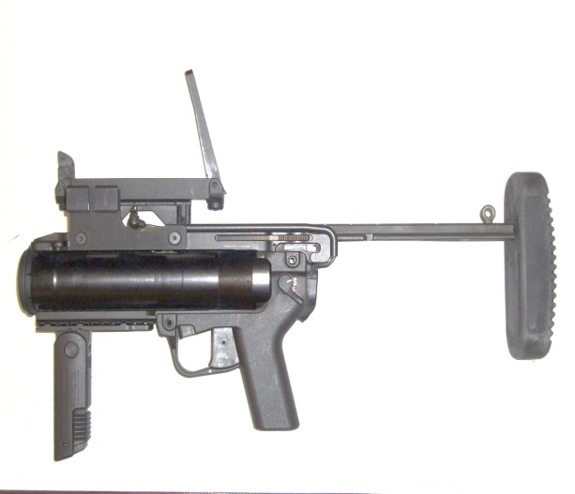
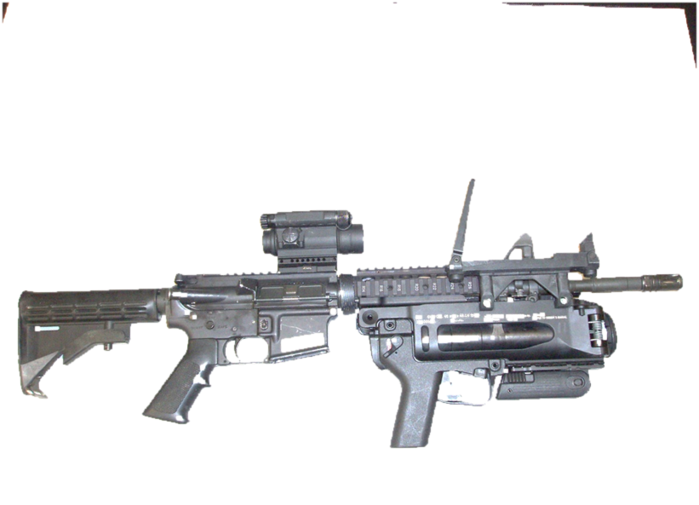
M320/M320A1 Grenade Launcher
M320 M320A1
FOR TRAINING USE ONLY
Notes:
3

Slide 4
Safety Requirements: Classroom Environment
Risk Assessment: Low
Environmental Considerations: None
Evaluation: Instruction is testable and will be included on the General Subjects Examination to include the written exam and the performance evaluation
Notes:
Environmental Considerations: Make sure if you brought anything with you into the classroom you take it with you when you leave. (e.g. box for doughnuts; soda can) Police up your trash!!
Evaluation: You will be given a written examination at the end of this class on which you must score a 14 out of 20 to pass.
(NEXT SLIDE)

Slide 5
Classroom Safety
Keep weapon pointed in a safe direction
Handle weapon only when instructed
No HORSEPLAY will be tolerated!
Don’t anticipate instructions
If, at any time you don’t understand the instructions or have problems during class, ASK questions.
Notes:
(NEXT SLIDE)
5

Slide 6
Terminal Learning Objective
Action: Qualify with the M320/M320A1 Grenade Launcher..
Conditions: On a record fire range, given a weapon, 9 timed target exposures at ranges from 100 to 400 meters and 18 rounds of 40 mm TPT ammunition..
Standards: Answer 14 of 20 questions on a written test. Obtain 6 out of 9 target hits out of 9 timed targets.
Notes:
6
Read Slide,
Terminal Learning Objective:
Action: Qualify with the M320 Grenade Launcher.
Conditions: Daylight, on a record fire range, given a weapon, 9 timed target exposures at ranges from 100 to 400 meters and 18 rounds of 40 mm TPT ammunition..
Standards: Answer 14 of 20 questions on a written test. Obtain 6 out of 9 target hits out of 9 timed targets.
A nighttime Familiarization is also suggested.
INSTRUCTIONAL LEAD-IN: Now that we have gotten the administrative notes out of the way, we will proceed into our agenda
(NEXT SLIDE)

Slide 7
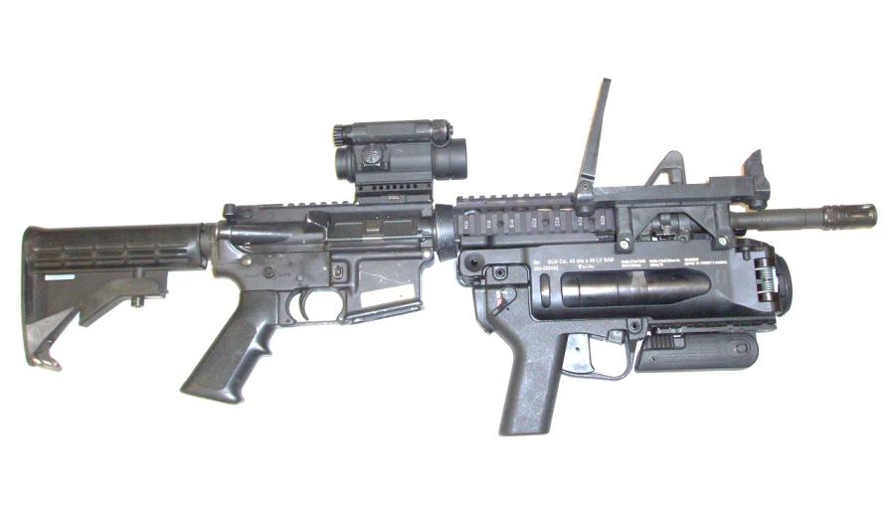
M320 AGENDA
Identify Characteristics of the M320/M320A1
Perform PMCS on the M320/M320A1
Put M320/M320A1 into operation in stand-alone/host weapon configuration
Methods of zeroing M320 (Leaf Sight)
Practical exercise
Qualify with M320/M320A1
Notes:
Purpose: This training support package provides the instructor with a standardized lesson plan for presenting instruction for:
Task number: NEED TASK NUMBER FOR COURSE
Action: Qualify with the M320 Grenade Launcher
Conditions: Daylight, on a record fire range, given a weapon, 8 timed target exposures at ranges from 100 to 400 meters and 18 rounds of 40 mm TPT ammunition..
Standards: Answer 14 of 20 questions on a written test. Obtain 6 out of 9 target hits out of 9 timed targets.
This TSP contains: TABLE OF CONTENTS Slide
Preface
Lesson 1 Section I. - Administrative Data 2-3
Section II. - Introduction
Terminal Learning Objective
Section III. - Presentation
A - Identify Characteristics of the M320
B - Perform PMCS on the M320
C - Put the M320 into Operation in Stand-Alone/Host Weapon configuration
D - Methods of zeroing the M320
E - Written Test
F - Qualify with the M320
Qualify with the M320
Effective Date: ????????
SECTION I. ADMINISTRATIVE DATA
All Courses Including This Lesson: course number course title
Task(s) Taught or Supported task number task title
Identify Characteristics of the M320
Perform PMCS on the M320
Put the M320 into Operation
Zero the M320
Qualify with the M320
Marksmanship
Task(s) Reinforced: task number task title
Academic Hours: The academic hours required to teach this course are as follows:
Peacetime Mobilization
hours/ methods hours/methods
Characteristics 30 min / L 30 min / L
PMCS 30 min / L 30 min / L
Operation/Test 1 hr / PE1 1 hr / PE1
Zero the M320 3hr / PE2 3 hr / PE2
Qualification 4 hr / E1 4 hr / E1
*Total Hours 9 hrs Total 9 hrs Total Test Lesson Number:
Prerequisite Lesson(s): Laser borelight class lesson number
Clearance and Access: There are no clearance or access requirements for this lesson.
References:
Number title date paragraph # additional information
FM 3.22-31C1 40 MM Grenade LauncherM203/M320 3 March, 2007
TM TM 9-1010-232-10 M320 Operator’s and Unit Maintenance Manual All
Student Study Assignments: N/A
Instructor Requirements: : 1 instructor certified to teach the M320, 4-Assistant instructors (AI’s must be Familiar with the M320)
Additional Personnel Requirements: 5-personnel for ammo point and Necessary Range Personnel
Equipment Required: 1 M320 per student, 1 Digital Projector and screen, 1 weapon per student,
1 Borelight Device w/Battery per 10 students , 1 battery per DNS (123), 1 Offset per 9 students Materials Required: (instructor materials): 4, 40 mm Mandrels 2 Cleaning Rods, Slides, 1 Boresighting Box, 1 Staple Gun, 1 Box of Staples, and 1 Range Flag.
Materials Required: (student materials): 1 Hearing Protection per student, and 1 Cleaning kit per student.
Classroom, Training Area, and Range Requirements: One classroom for 40 students, and a 400 meter, 40mm qualification/zero range.
Ammunition Requirements: 46 rounds per person; XM1110 or M781 TPT, 10 rounds to zero, 18 for practice qualification and 18 for qualification
Instructional Guidance: Before presenting this lesson, thoroughly prepare by studying this lesson and identified reference material to include prerequisite classes. The day prior to training, the primary instructor will brief the chief instructor.
Proponent Lesson Plan Approvals NAME Rank Position Date
Heisel, Matthew SGT Instructor ?????????
Miller, Raymond SSG ___Instructor__ ????????
Safety Requirements Range OIC will give a safety briefing. Range safety NCO will clear and inspect weapons when soldiers enter and exit the firing line. Range OIC will ensure that all range requirements are met, and all safety warnings stated in the technical manual are enforced.
Risk Assessment Level: MEDIUM (with live ammunition) LOW (with no ammunition)
Environmental Considerations: NONE
Evaluation: At the completion of the classroom instruction, you will receive a twenty question written test during which you must score a minimum of at least 14 out of 20 questions in order to pass. At the completion of the range instruction, you will qualify with the M320 on the selected weapon during a LFX; in order for you to qualify, you must achieve at least 6 target hits out of 9 target exposures.
(NEXT SLIDE)
7

Slide 8
Enabling Learning Objective A
Action: Identify Characteristics of the M320
Conditions: Given an M320
Standards: Become familiarized with the characteristics and identify all 20 components of the M320
Notes:
A ENABLING LEARNING OBJECTIVE A
TRANSITION: In order to effectively engage targets with the M320, you must first be familiar with the M320 and its characteristics. So let’s take a look at the M320.
Action: Identify Characteristics of the M320
Conditions: Given a M320
Standards: Familiarize with the characteristics and identify all 20 M320 components IAW TM.
1. Learning Step/Activity: Characteristics of the M320
Method of instruction: LECTURE
Instructor to student ratio is: 1:10
Time of instruction: 2 hr
Media: Digital Projector, screen and Actual equipment
(NEXT SLIDE)

Slide 9
Technical Data
CHARACTERISTICS
Caliber – 40 x 46mm( same as 203)
Weight – weapon only – 3.42 lbs (1.55 kg)
Weight (W/M4 Host weapon) –10.92 lbs
Barrel length – 8.46 in (21.48 cm)
Rifling – 6 lands/grooves
Muzzle velocity (average) – 74 mps (243 fps/HEDP)
Trigger Pull – 11.25 – 15.75 lb
Max Range – 400 meters
Effective Range--Point Target – 150 meters
– Effective Range--Area Target – 350 meters
Notes:
Equipment Data:
Description: 40 X 46 MM Grenade Launcher; same caliber as the M203
Length (Barrel): 8.46 in (21.48 cm)
Length (w/o Mount w/ Mount): 5.1 in/ 10.24 in (260mm)
Weight (Weapon Only): 3.42 Lbs (1.55 kg)
Weight (M4 Host Weapon Config.): 10.92 Lbs (M4) In this configuration, the M320 weighs slightly more than the M203, it is also a little more barrel heavy than the M203 when mounted to a Host Weapon.
Max Range – 400 Meters: this is the maximum range this round can reach under optimal conditions. The actual maximum engagement ranges are listed below:
-Effective Range– Point Target - 150 Meters
-Effective Range– Area Target – 350 Meters
(NEXT SLIDE)
9

Slide 10
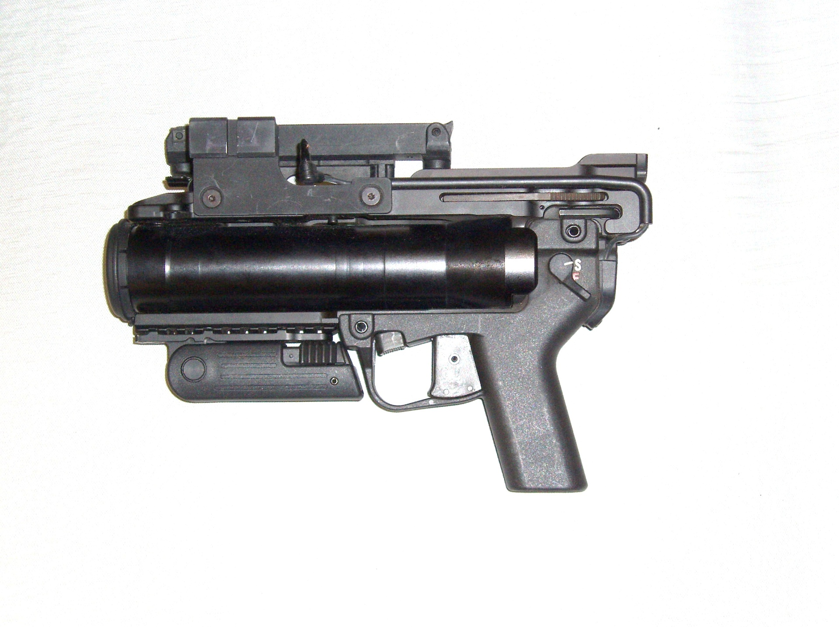
Characteristics
Clearing Procedures
Safety Lever (Ambidextrous)
Barrel Release Lever
Notes:
In order to clear the M230, first point the weapon In a safe direction, then check the safety lever to ensure the weapon is on safe. Once the weapon has been placed on safe, depress the barrel release lever, the barrel should open from right to left. Visually inspect the chamber to make sure that there is no rounds lodged in the barrel.
CHECK ON LEARNING:
What is the maximum effective range of the M320?
What is the weight of the M320 in Stand-Alone Configuration?
(NEXT SLIDE)

Slide 11
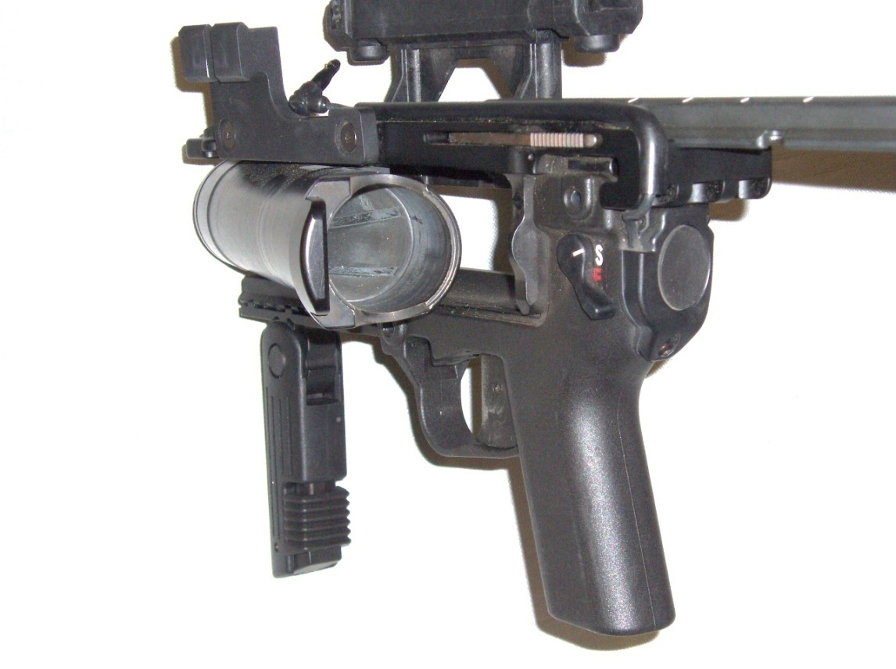
Characteristics Clearing Procedures
1 - Point the muzzle of the M320 in a safe direction, with the trigger finger outside the trigger guard.
2 - Put the selector lever in the “S“ (Safe) position .
3 - Push the barrel release button up, allowing the barrel to swing out to the left side of the receiver.
4 - Physically and visually inspect the chamber for obstructions, ammunition or empty cartridge case.
Notes:
1 - Point the muzzle of the XM320 in a safe direction, with the trigger finger outside the trigger guard.
2 - Put the selector lever in the “S“ (Safe) position . Point out.
3 - Push the barrel release button up, allowing the barrel to swing out to the left side of the receiver. Point out.
4 - Physically and visually inspect the chamber for ammunition or empty cartridge case. Point out.
(NEXT SLIDE)

Slide 12
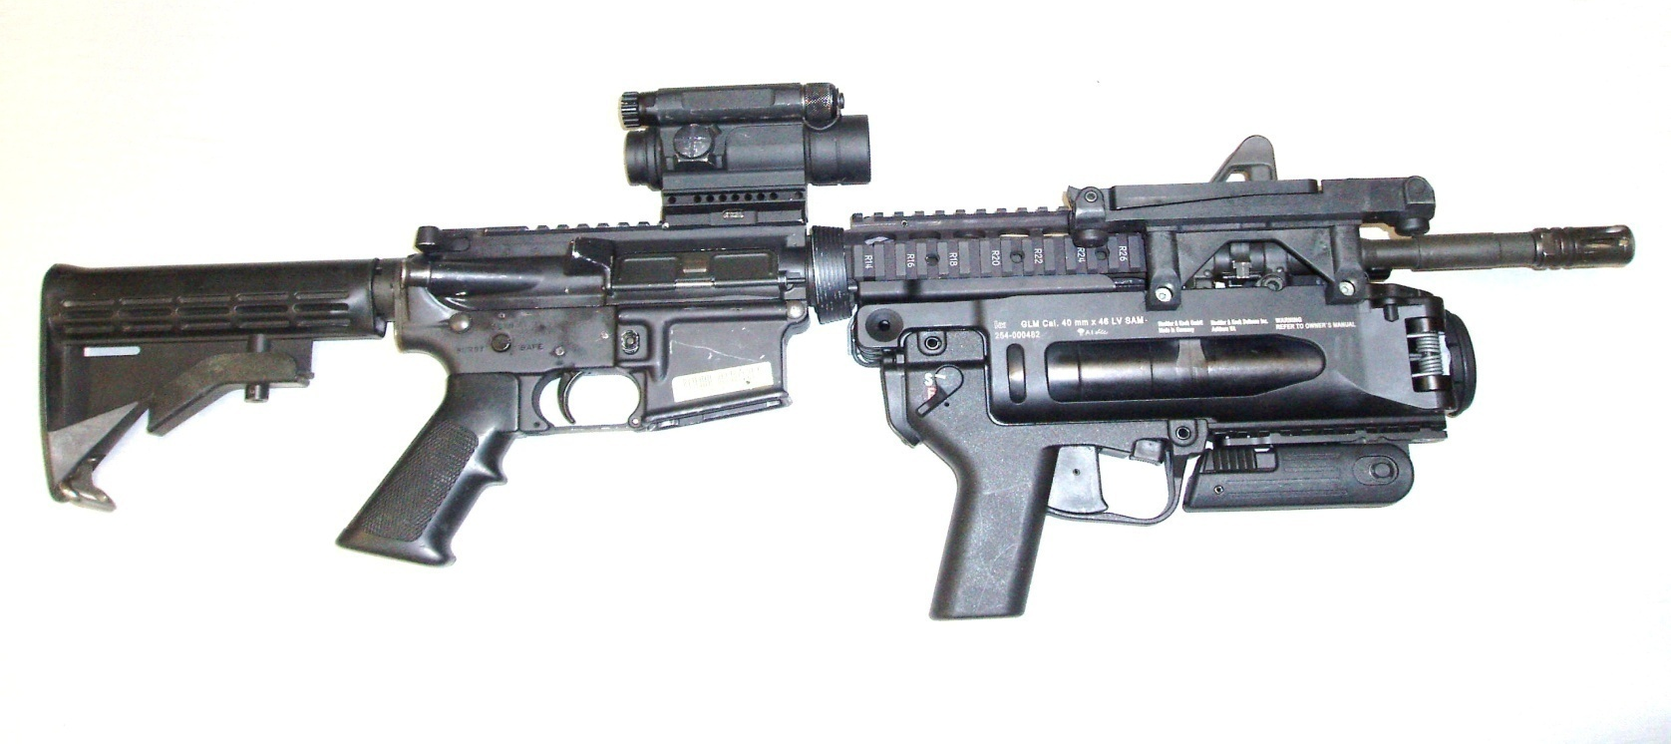
CHARACTERISTICS
Ambidextrous Safety
Mechanical Leaf Sight
Double Action Trigger
Various Mounting Options
Barrel – Forged Aluminum
Notes:
Major Characteristics of the M320 are:
Ambidextrous Safety: The M320 can be fired Ambidextrously. However for Left-Handed Firers, there is the issue of loading the weapon with the firing hand, since it opens only on the right-hand side.
Mechanical Sights: The M320 can be fired with either the Leaf sight mounted or with the Day/Night Sight
Double Action Trigger: This means that each time the trigger depressed, it will charge the weapon
Various Mounting Options: the M320 can be used in either a stand-alone configuration, Or mounted to a variety of host weapons. The M320 can be tailored to fit mission needs.
Barrel- Forged Aluminum: The barrel is much more durable than the M203, and is undergoing feasibility studies for Medium-Velocity Rounds to increase the range of the weapon.
DIFFRENCES FROM THE M203:
M320 has the capability of being removed from the weapon by the individual soldier. The M320 has an integral 3X5 mm Allen Wrench which allows the soldier to remove the host weapon adapters on their own.
The M320 is a side-opening breech. This feature was chosen to allow for the design of longer 40mm rounds.
The M320 does not have a round ejection feature like the M203. the student must take this into account and realize that he will have to strip the empty cartridge by hand.
(NEXT SLIDE)
12

Slide 13
CHARACTERISTICS
Left Side
M4 Rear Adapter (installed)
DNS Mounting Bracket
Muzzle
cap
Buttstock Locking Lever
Safety Lever (Ambidextrous)
Vertical Grip
Barrel release lever
Notes:
Major Characteristics of the M320 on the left side are:
DNS Mounting Bracket: Bracket is set up for mounting the integrated Day/Night Sight (DNS). There is also an integral plug for the DNS Remote Switch
Muzzle cap: Keeps dirt and debris out of the barrel
Finger Guard: This ensures that the firer does not place their fingers in front of the muzzle while firing and prevents any debris from the round from hitting the firer.
Forward Pistol Grip: The forward pistol grip can be used in either it’s stowed configuration or deployed as a pistol grip.
Barrel Release Lever: This Lever is how the barrel is deployed. Pushing up on it with the trigger fingerwill open the breech.
Safety Lever: This lever is ambidextrous and has 2 modes, safe and fire.
Buttstock Locking Lever: This lever is used to adjust the buttstock in the stand-alone configuration.
M4 Rear Adapter: This shows what the adapter to mount the M320 to the Host weapon looks like. In this case it is for the M4 MWS.
(NEXT SLIDE)

Slide 14
CHARACTERISTICS
Left Side
DNS Cable Channel Guide
5x3mm Allen Wrench in Storage Location
DNS Remote Switch
Notes:
Major Components of the M320 on the Left Side (cont.):
DNS Remote switch: This switch is what activates the Day/Night Sight. It works in a similar function to the pressure switches on the PEQ-2A or PEQ-15. Holding down on the switch will turn on the DNS momentarily. Double tapping the switch will activate the DNS continuously.
5x3mm Allen Wrench: This is the storage location for the 5x3mm Allen Wrench. This Allen wrench is used for attaching the rear adapter for the M4/M16A4, the Quick Attach Bayonet Adapter, and also to make adjustments to the Mechanical Leaf Sight.
DNS Cable Channel Guide: This channel keeps the DNS Pressure switch cable tight to the weapon, and prevents it from snagging on items (e.g door to HMMWV when exiting vehicle, etc.)
(NEXT SLIDE)

Slide 15
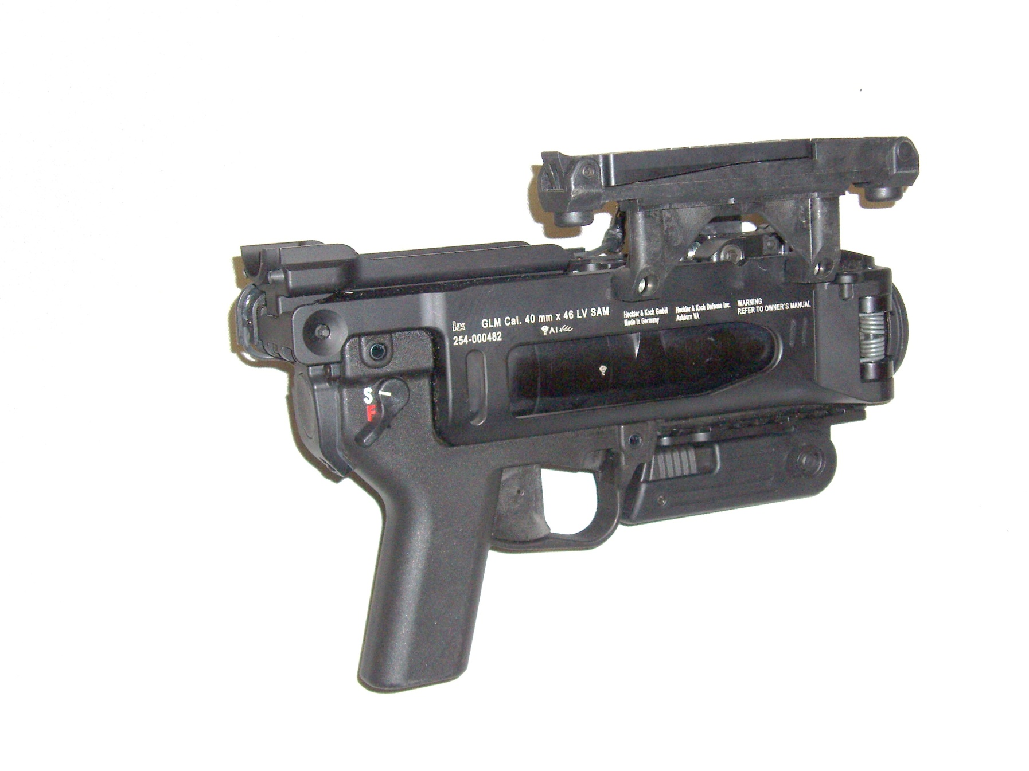
Right Side
CHARACTERISTICS
Mechanical leaf
sight
Manufacturer, Model, Serial #
Trigger
Notes:
Major Components of the M320 on the Right Side:
Mechanical Leaf Sight: This sight can be used in place of the DNS. It can be mounted on either side of the M320.
Manufacturer, Model, Serial #, etc: This is where the serial number of the weapon is located.
Trigger: This is how the weapon is fired. Trigger squeeze is approximately 12-15 Lbs. Notify the students to be aware of this as it can affect the trajectory of the round if they jerk the trigger.
(NEXT SLIDE)

Slide 16
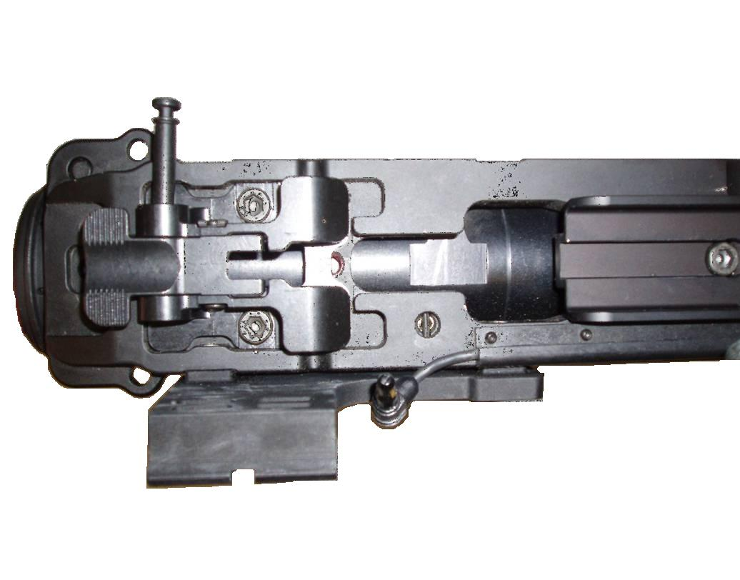
Top View
CHARACTERISTICS
Quick Attach Bayonet Adapter w/push–pull pin
Sling Attachment Points (Ambidextrous)
DNS Mounting Bracket
DNS Remote Cable Plug
DNS Cable Channel Guide
Notes:
Major Components of the M320 in the top view:
1. Quick Attach/ Detach Bayonet Adaptor: This is where the front adapter for the M320 is placed In the picture you see the M4 mount. The M16 Quick Attach/ DetachBayonet Adaptor mounts to the 2 screw holes in front of the current adapter.
2. Sling Attachment Points (Ambidextrous): This is where the M320 Can have a sling mounted In either the stand-alone configuration or when mounted to the host weapon.
3. DNS Mounting Bracket: This gives you another view of the DNS mounting bracket. Also it lets you get another view of the DNS remote cable plug, and the DNS Cable Channel Guide.
(NEXT SLIDE)

Slide 17
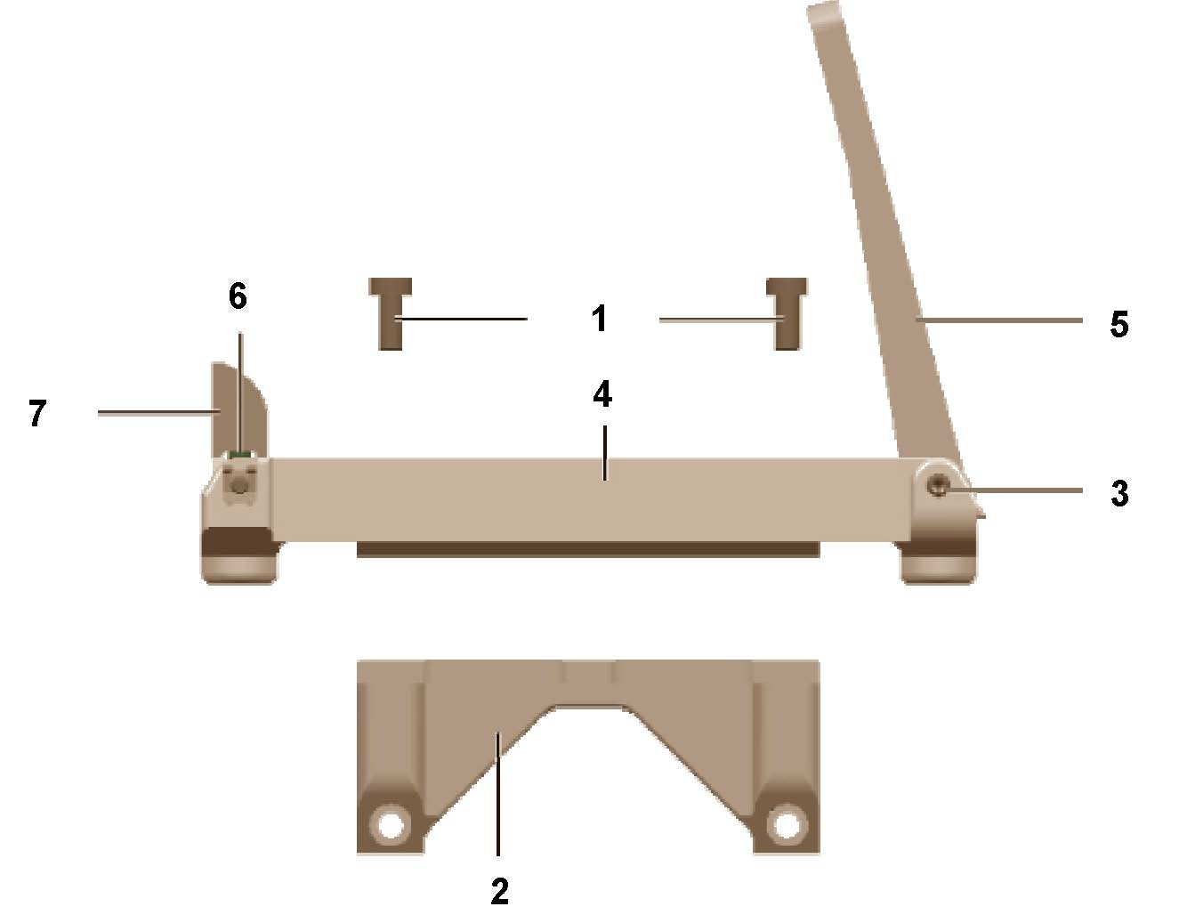
CHARACTERISTICS
Mechanical Leaf Sight
Mounted left or right side
50-350 meter range marks
50 meter increments
Rear sight – moves left/right impact
Front sight – moves up/down impact
1 twist in 47.25 inches (1200mm)
Sight fastening screws
Leaf rear sight
Sight base
Front sight post
Elevation adjustment screw
Threaded rear sight axis
Sight support
Notes:
This gives you an example of how the Mechanical Leaf Sight can be set up on your weapon. The sight support allows you to mount the Mechanical Leaf Sight to the right side, or in the location of the DNS mounting bracket on the left side. The student is not authorized to remove the DNS Bracket in garrison. In a combat environment, if necessary, it can be removed and replaced by the Mechanical Leaf Sight.
Installation procedures:
Align the sight base to the sight support.
Emplace the sight fastening screws. Align the threads properly to avoid cross threading and turn clockwise.
Hand tighten the screws and then tool tighten ½ turn extra.
NOTE: Tool tighten the sight only.
(NEXT SLIDE)

Slide 18
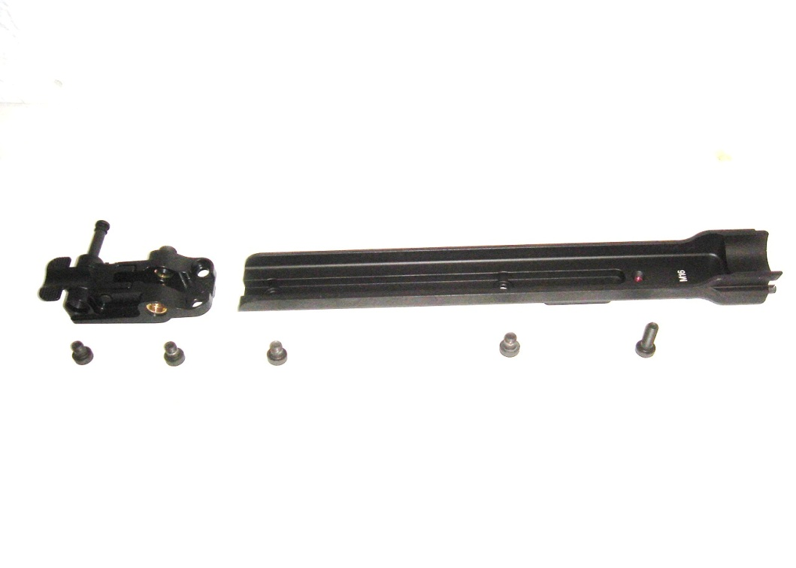
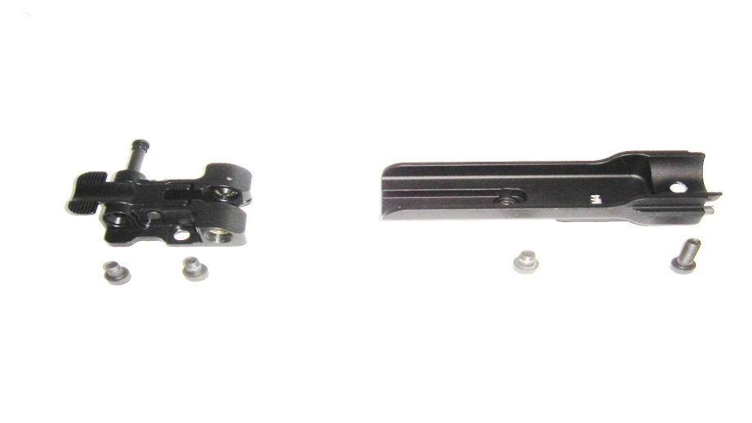
M320/M320A1 Mounting Adapters
CHARACTERISTICS
Quick Attach/Detach
Bayonet Adaptor
Socket Head Capscrew X3
Rear Mounting Adapter
M16 Series
Quick Attach/Detach
Bayonet Adaptor
Rear Mounting Adapter
Socket Head Capscrew X2
M4 Series
Notes:
These are the initial Host Weapon Mounting Adapters for the M320. The production M320 adapters have a Push/Pull retainer pin that is pushed through the Quick Attach/Detach Bayonet Adaptor to ensure weapon retention. Also not that only units that specifically request the mounting adapters for the M16 series will receive it. The M320 will not come with them as a standard issue item.
(NEXT SLIDE)
18

Slide 19
CHARACTERISTICS Muzzle Cap
Detachable cap limits debris into barrel of M320
Shoot-through accessory
Allows operator to fire a grenade with cap in place
Lanyard loop provided for attachment to launcher
*NOTE: Never attach cap to muzzle of M320 using adhesive tape!
Notes:
Notes
Detachable cap limits debris into barrel of M320
Shoot-through accessor
Allows operator to fire a grenade with cap in place
Lanyard loop provided for attachment to launcher
Pressure will blow cap off when fired.
(NEXT SLIDE)
19

Slide 20
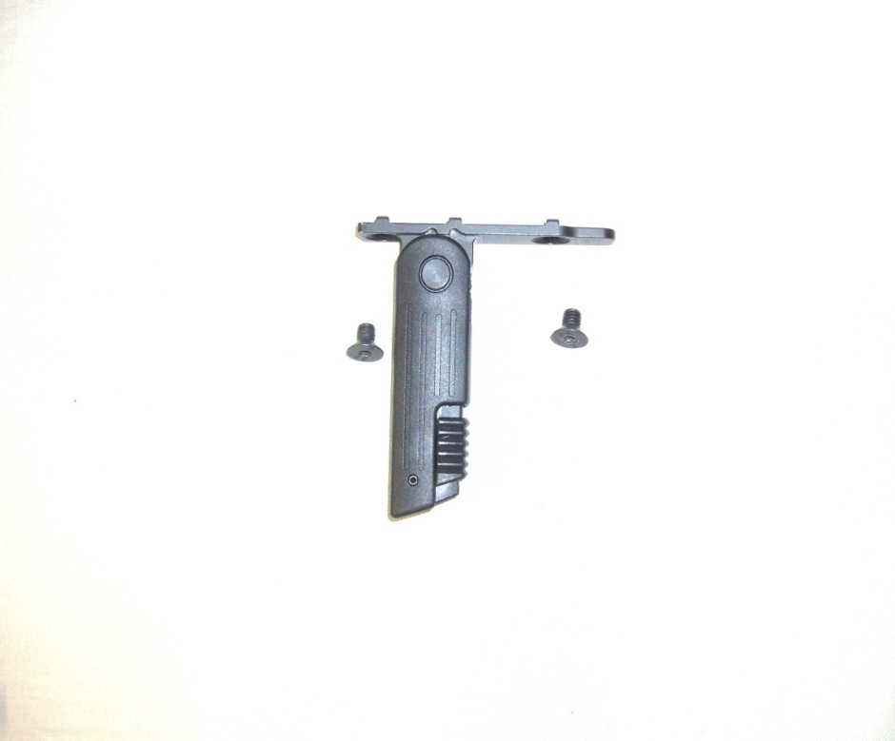
CHARACTERISTICS Vertical grip
Lower by pulling down
To collapse, pull serrated release lever down and fold up
*NOTE: Do NOT attempt to fold grip without first actuating the release lever or damage may occur
Notes:
The folding pistol grip mounts to the lower Picatinny rail on the M320. To Mount it, there are 2 screws that thread into the Picatinny Rail Adapter.
Only the pistol grip should be mounted on rail on Grenade launcher, no other device is authorized.
CHECK ON LEARNING:
1.How many pounds of pressure does it take to fire the M320? (12-15lbs trigger squeeze)
2. How many configurations can the M320 be fired in? (2 Host Weapon and Stand-Alone)
3. Can you fire the M320 with the muzzle cap on? (yes)
(NEXT SLIDE)

Slide 21
Enabling Learning Objective B
Action: Perform PMCS on the M320/M320A1.
Conditions: Given a M320/M320A1, DA 2404, Pencil, lens paper, and 5x3mm Allen Wrench.
Standards: Perform PMCS IAW TM 9-1010-232-10.
Notes:
B. ENABLING LEARNING OBJECTIVE B
TRANSITION: Now that you can identify the major components of the M320, We can discuss how to perform maintenance on the M320.
Action: Perform PMCS on the M320
Conditions: Given a M320, DA 2404, Pencil, Lens Paper, 5x3mm Allen Wrench, DNS battery
Standards: Perform PMCS IAW TM ???
Method of instruction: Lecture
Instructor to student ratio is: 1:10
Time of instruction: .5 hr
Media: Actual equipment
Learning Step/Activity: Perform Preventive Maintenance on the M320:
NOTE: Always use the appropriate TM (TM?????) when performing PMCS
A. Inspect Barrel and Barrel cap and ensure the:
Securely mounted to receiver with barrel axle and elbow spring
Inspect barrel and muzzle for dents, burrs, signs of corrosion and excessive fouling
Engage barrel locking lever by pushing up
a.Barrel should swing out from right to left
Push barrel back into receiver
a.Once seated, barrel should remain locked in place
B. Inspect Mechanical Leaf Sight For:
Inspect front and rear sights for proper attachment and signs of damage
Ensure sight base is securely attached
Ensure sight support is securely attached to receiver
Inspect front and rear sight to ensure they are safely clamped in both extended and retracted positions
C. Inspect Ambidextrous Safety Lever:
1.Rotate safety lever to “S” (safe) to “F” (fire and back to “S”
a. In each of the two positions the safety lever must seat firmly into place, accompanied by an audible click
2.Place weapon on “S” and attempt to pull trigger
a. Trigger must remain in forward position and must not be able to travel rearward
3.Push up on barrel locking lever, allowing barrel to swing out, rotate “S” to “F”.
a. The hammer tip (firing pin) must not protrude from bolt face into chamber
D. Inspect Trigger Mechanism:
1.With barrel swung out, place safety lever on “F”, press up on barrel locking lever while attempting to pull trigger
a.Trigger must not be able to pull to rear
2.With barrel swung out, place safety lever on “F”, attempt to pull trigger
a.Trigger will now to be able to pull to the rear
E. Inspect Receiver and Host Weapon Adapters
Inspect receiver for cracks, dents, burrs, and signs of corrosion
Inspect buttstock locking lever
Push down on rear serrated edge, locking lever should pivot in and out of receiver
Inspect Host Weapon Adapters
Ensure all mounting screws, adapters, accessories, forward pistol grip and sights are present and tight
Ensure 3x5mm combination hex wrench is stowed
F. Functions Check:
1.Clear Host weapon (if applicable)
2.Clear the GL
3.Ensure selector lever rotates from “S” (Safe) to “F” (Fire) and back to “S” with an audible click
4.With weapon unloaded, pointed in safe direction, and selector lever in “S” position, attempt to pull trigger rearward
5.Trigger must remain in forward position with no rearward travel
6.Press barrel release allowing barrel to pivot outward
7.Place selector lever in “S” position
8.Firing pin ,located on hammer, must not protrude from bolt face into chamber
9.Place selector lever in “F” position
10.Press barrel release while attempting to pull trigger
11.It must not be possible to pull trigger enough to raise and release hammer
12.With barrel pivoted outward and selector lever in “F” position pull trigger and detect firing pin protrusion with Light finger pressure on breech face
13.End of functions check
3. At this time have students check the M320 for deficiencies, have them look in the TM and find what page the PMCS table is on.
Ensure that:
Soldiers tell you if their M320 has any deficiencies that will restrict their training
(NEXT SLIDE)

Slide 22
PMCS: (initial)
Clear the M320/M320A1
Remove Preservatives
Remove long-term preservatives
Normally applied at factory prior to shipping
Also applied if M320/M320A1 are placed in long-term storage
Notes:
Make sure when performing the initial PMCS of the M320 that all packing grease (preservatives) are removed from the weapon. The preservatives are in the form of a grease and need to be removed to prevent the M320 from attracting too much dirt and mud.
(NEXT SLIDE)

Slide 23
PMCS Inspect Barrel
Barrel
Securely mounted to receiver with barrel axle and elbow spring
Inspect barrel and muzzle for dents, burrs, signs of corrosion and excessive fouling
Engage barrel locking lever by pushing up
Barrel should swing out from right to left
Push barrel back into receiver
Once seated, barrel should remain locked in place
Notes:
The barrel is not designed to be removed from the M320. To inspect it, simply open the barrel and look for deficiencies. If any signs of corrosion, excessive fouling from TPT rounds, any Burrs on the inside of the barrel, and any dents or bulges in the barrel.
(NEXT SLIDE)

Slide 24
PMCS Inspect Sights
Inspect front and rear sights for proper attachment and signs of damage
Ensure sight base is securely attached
Ensure sight support is securely attached to receiver
Inspect front and rear sight to ensure they are safely clamped in both extended and retracted positions
Notes:
Inspect the Mechanical Leaf sight to ensure that there is no damage. Make sure that the sight base is securely attached to the weapon, and make sure that the sights work in both the extended and retracted positions.
(NEXT SLIDE)

Slide 25
PMCS Inspect Ambidextrous Safety Lever
Rotate safety lever to “S” (safe) to “F” (fire and back to “S”
In each of the two positions the safety lever must seat firmly into place, accompanied by an audible click
Notes:
If no audible click is heard while moving the safety back and forth between safe and fire, it is deadlined.
(NEXT SLIDE)

Slide 26
PMCS Inspect Ambidextrous Safety Lever
Place weapon on “S” and attempt to pull trigger
Trigger must remain in forward position and must not be able to travel rearward
Push up on barrel locking lever, allowing barrel to swing out, rotate “S” to “F”.
The hammer tip (firing pin) must not protrude from bolt face into chamber
Notes:
These are the faults to look for when inspecting the safety lever:
Trigger depresses while weapon is on safe.
With the breach open, inspect the firing pin hole. If the firing pin protrudes out of the hole, it is deadlined.
Push up on the barrel release lever and hold, squeeze the trigger, if the weapon fires, it is deadlined.
CHECK ON LEARNING:
What should be removed completely upon initially receiving the M320? (Packing grease)
What are you looking for on the inside of the barrel? (Dents, Bulges, Excessive Fouling, signs of corrosion) \
(NEXT SLIDE)

Slide 27
PMCS Inspect Trigger Mechanism
With barrel swung out, place safety lever on “F”, press up on barrel locking lever while attempting to pull trigger
Trigger must not be able to pull to rear
With barrel swung out, place safety lever on “F”, attempt to pull trigger
Trigger will now pull to the rear
Notes:
With barrel swung out, place safety lever on “F”, press up on barrel locking lever while attempting to pull trigger
Trigger must not be able to pull to rear
With barrel swung out, place safety lever on “F”, attempt to pull trigger
Trigger will now to be able to pull to the rear
(NEXT SLIDE)

Slide 28
PMCS Inspect Receiver and Host Weapon Adapters
Inspect receiver for cracks, dents, burrs, and signs of corrosion
Inspect buttstock locking lever
Push down on rear serrated edge, locking lever should pivot in and out of receiver
Inspect Host Weapon Adapters
Ensure all mounting screws, adapters, accessories, forward pistol grip and sights are present and tight
Ensure 3x5mm combination hex wrench is stowed
Notes:
While checking the Receiver, make sure that you check the barrel spring for signs of rust. Check the buttstock to make sure that all the detents are not damaged or have any burrs or dents. Make sure there is no deformation of the buttstock either. And make sure the sling eye is still in place on the buttstock.
Also check the host weapon adapters to make sure there is no rust, burrs or deformation present. In addition to that, make sure that the Allen Key is stowed properly. Over time, the 3x5mm Allen key retention spring has a habit of working it’s way loose. If that is the case, make sure to stow the Allen wrench in another location (e.g. weapon cleaning kit.)
CHECK ON LEARNING:
If no audible click is heard while rotating safety lever, is the weapon deadlined? (Yes)
If lifting up on the Barrel Release Lever and squeezing the trigger and the weapon does not fire, is it deadlined? (No)
(NEXT SLIDE)

Slide 29
PMCS FUNCTIONS CHECK
Clear Host weapon (if applicable)
Clear the M320/M320A1
Ensure selector lever rotates from “S” (Safe) to “F” (Fire) and back to “S” with an audible click
With weapon unloaded, pointed in safe direction, and selector lever in “S” position, attempt to pull trigger rearward
Trigger must remain in forward position with no rearward travel
Notes:
FUNCTIONS CHECKS ARE DONE EVERY TIME AFTER THE WEAPON IS PMCS OR AFTER THE WEAPON IS CLEANED:
To start with, make sure that the weapon is clear.
Once the weapon is clear, make sure that the selector lever travels freely from safe to fire. Listen for an audible click.
Place the weapon back on safe, Point the weapon in a safe direction and attempt to fire.
The trigger should not move back.
(NEXT SLIDE)

Slide 30
PMCS FUNCTIONS CHECK (cont)
Press barrel release allowing barrel to pivot outward
Place selector lever in “S” position
Firing pin ,located on hammer, must not protrude from bolt face into chamber
Place selector lever in “F” position
Press barrel release while attempting to pull trigger
It must not be possible to pull trigger enough to raise and release hammer
Notes:
FUNCTIONS CHECK: DONE EVERY TIME AFTER A WEAPON IS CLEANED OR PMCS’D.
Ensure the firing pin does not protrude from bolt face.
Hold up on barrel release lever, and squeeze the trigger with the safety on fire. Make sure that the hammer does not fall. If it does it is a deadlined weapon.
(NEXT SLIDE)

Slide 31
PMCS FUNCTIONS CHECK (cont)
With barrel pivoted outward and selector lever in “F” position pull trigger and detect firing pin protrusion with Light finger pressure on breech face
End of functions check
Notes:
With the barrel open, squeeze the trigger with a finger over the firing pin hole. If the pin does not come in contact with your finger, the weapon is deadlined.
(NEXT SLIDE)

Slide 32
PMCS Cleaning Intervals
Normal
Performed after each live-fire
Performed after firing at least 50 rounds
Performed every 6 months
Major Cleaning
Detailed cleaning
*NOTE: The cleaning frequency listed above are recommended intervals only.
Notes:
In a combat environment, students and leaders should ensure that their soldiers are cleaning and inspecting their weapons on a daily basis, especially if the weapon is being fired a lot.

Slide 33
PMCS Cleaning Intervals
Your intervals between cleaning will vary and will depend on many factors:
Type of ammo used
Quantity of ammo used
Quality of ammo used
Environment weapon is operated
Thoroughness of your cleaning
Notes:
All of these factors come into play when cleaning the weapon, Especially ammunition. If soldiers are firing large volumes of straight TPT, they will have to clean their weapons more often than if they were firing Live HEDP. The Poly-sulfide rubber used to mount the shell to the Round itself melts and sticks to the inside of the barrel. And because of that, takes longer to clean than a weapon that had fired strictly HEDP.
(NEXT SLIDE)

Slide 34
PMCS Normal Cleaning
CAUTION
Never clean bore from MUZZLE end of barrel
DAMAGE may occur to bore and/or muzzle
May have an effect on accuracy
Never stop or attempt to reverse direction when pushing bore brush or cleaning patch through bore
These items may become permanently lodged in barrel
Notes:
Ensure the students understand that they can cause serious damage to the barrel’s rifling if they attempt to force a patch or cleaning brush through from the muzzle end. Also they should never attempt to push a brush back the way it came, as this will cause more damage to barrel than just continuing to push it through towards the muzzle.
(NEXT SLIDE)

Slide 35
PMCS CAUTION
Do NOT clean with:
Metallic objects
Chemicals such as trichloroethylene
Synthetics
When weapon is at hot temperatures
Water
Notes:
Make sure the students realize they should not clean a weapon immediately after firing, as they could be injured from the hot barrel. Any normal gun oil or lubricant such as CLP will work effectively at cleaning the barrel.
(NEXT SLIDE)

Slide 36
PMCS Function Check
A function check should be conducted on the M320/M320A1 after:
Cleaning
PMCS
Notes:
ALWAYS PEFORM A FUNCTION CHECK AFTER PERFORMING ANY MAINTENANCE ON ANY WEAPON OR A PMCS!!!
(NEXT SLIDE)

Slide 37
PMCS Lubrication Instructions
Absence of lubrication may impede operation of M320/M320A1, especially:
Load-bearing areas
Friction contact areas
Excessive lubrication may also cause function problems by acting as a magnet for:
Dirt
Grit
Sand
Fouling
Notes:
Ensure that the M320 does not have excessive lubrication, especially in a desert environment. As it will attract dust to the oil. Light lubrication on the wear points (e.g. Barrel Spring, Barrel Release Lever portion that retains the barrel, and the inside of the barrel will work well. A light coating of CLP every week to month will work for the weapon’s exterior, depending on the operational environment. Ensure leaders understand to check that in their PCC’s And PCI’s.
(NEXT SLIDE)

Slide 38
PMCS Lubrication Instructions
Do NOT use lubricants that boast their ability to penetrate metals (mil tec)
These substances may deaden cartridge primers
Notes:
This is referring to lubricants such as Mil-Tech which are known for their properties of penetrating metal and staying in the weapon until the parts start moving. This can penetrate the actual cartridge and prevent your primer from firing.
(NEXT SLIDE)

Slide 39
PMCS POST OPERATION PMCS
During or immediately after cleaning the operator should inspect the M320/M320A1
Check the following:
Improper function- FUNCTIONS CHECK!
Missing parts
Cosmetic flaws
Improper assembly
Loss of spring tension
Notes:
After Firing the weapon, ensure that a Functions check is conducted. Any missing parts, or cosmetic flaws should be noted on the 2404. If the student feels there is a noticeable drop-off of spring tension in the trigger, the weapon should be turned in to the armorer to get fixed.
(NEXT SLIDE)

Slide 40
PMCS Inspection Checklist
Receiver
Inspect for cracks, dents bulges and excessive wear
Trigger
Inspect for cracks and excessive wear
Inspect trigger spring for excessive wear fouling
Notes:
The inspections listed are more for the armorer and Depot Level checks, especially the trigger spring, which the student is not authorized to check.
(NEXT SLIDE)

Slide 41
Enabling Learning Objective C
Action: Place the M320/M320A1 Grenade Launcher into Operation.
Conditions: Given a M320/M320A1 with 3x5mm combination wrench, borelight with battery, stable platform and offset for the DNS in appropriate weapon configuration.
Standards: Put the M320/M320A1 into Operation IAW
TM 9-1010-232-10..
Notes:
NOTE: If this is not a mounting option for your unit, hide this slide during the presentation.
C. ENABLING LEARNING OBJECTIVE C
TRANSITION: Now that you are familiar with the major components and how to maintain the M320 we will discuss how to place the M320 into operation.
Action: Place the M320 Into Operation
Conditions: Given a M320 with 3x5mm combination wrench, borelight with battery, stable platform and offset for the DNS in appropriate weapon configuration.
Standards: Put the M320 into operation IAW TM
Method of instruction: PE-1
Instructor to student ratio is: 1:10
Time of instruction: 1 hrs
Media: Actual equipment
Learning Step/Activity 1: Put the M320 into Operation in the stand-alone configuration
Remove the M320 from the host weapon (if applicable) after clearing both M320 and host weapon.
Remove host weapon adapters with the 3x5mm Allen Wrench (if applicable).
Insert the buttstock sling-eye side up into the back of the receiver. Make sure that you are depressing the buttstock locking lever at the same time.
.
At this time have students mount the M320 in stand-alone configuration.
Ensure that:
The students lift up on the flange on the front of the buttstock.
The adapter bracket is removed properly and the 3x5 Allen Wrench is stowed properly.
The students know how to insert and adjust the buttstock properly..
(NEXT SLIDE)

Slide 42
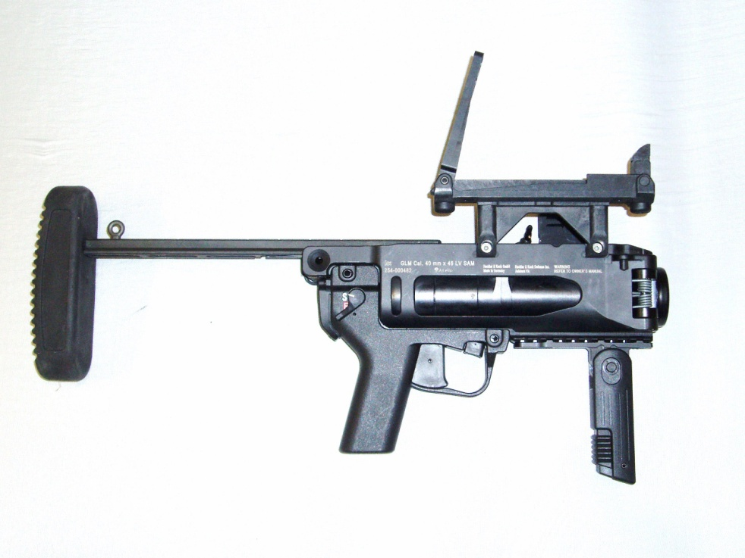
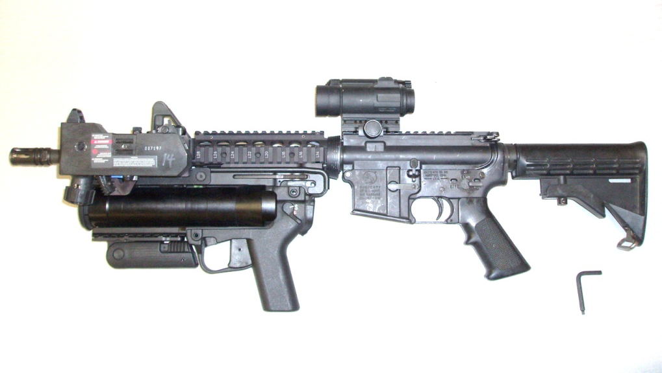
PLACE INTO OPERATION CONFIGURATIONS
STAND-ALONE HOST MOUNTED MODES
M320
M320A1
Notes:
Make sure the students and leaders understand the reason the army decided to add the Modular requirement to the M320. This allows small units the flexibility to tailor their weapons to projected OPORDS. If a squad is having to do cordon and search operations in an urban environment, the M320 offers the squad leader the flexibility to have his soldier’s weapons primarily set up for Close Quarters Marksmanship. Or ranged weapons fire. The M320 gunner can carry the weapon in the stand-alone configuration if necessary, or pack it in their assault pack.
(NEXT SLIDE)

Slide 43
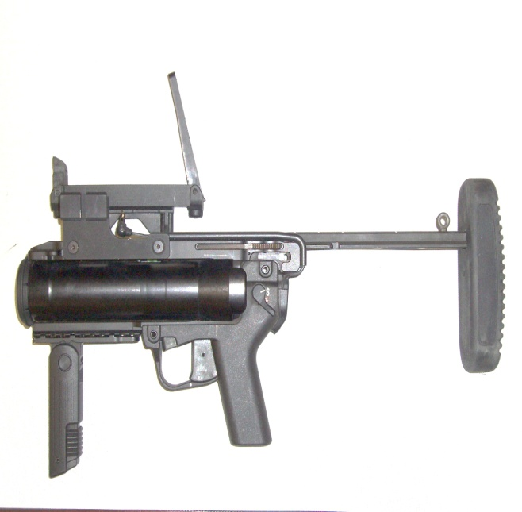
PLACE INTO OPERATION CONFIGURATIONS Installing M320 Buttstock for Stand-Alone Mode (SAM)
Tool needed: On-board 3x5mm Allen Wrench
Clear Host Weapon
Clear M320
Detach M320/M320A1 from Host Weapon (if applicable)
Remove rear host adapter (if applicable)
Notes:
Once again, reiterate that the M320 needs to be treated just like any other weapon, and handle it as if it were loaded at ALL TIMES. And that it is vital that the weapon is cleared immediately after receiving it.
(NEXT SLIDE)

Slide 44
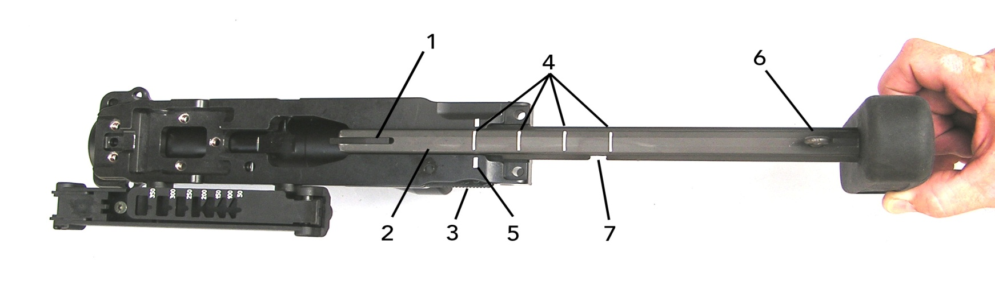
PLACE INTO OPERATION Installing M320 Buttstock
Buttstock
Ensure index marks (4/5) and sling eyelet (6) are facing up before attempting installation
Buttstock locking lever
Depress serrated edge (3) of lever, while inserting front of buttstock into M320 receiver
Raise the vertical locking lever (1) while pushing forward until it locks
Notes:
The installation of the buttstock: ensure that the Vertical Locking Lever is raised before placing the buttstock onto the Receiver.
(NEXT SLIDE)

Slide 45
PLACE INTO OPERATION Buttstock
Adjustment
Adjust the length to one of five positions (4) by depressing serrated edge of buttstock locking lever(2), and lock in place
Notes:
The Buttstock can be adjusted close for when the M320 is carried in Stand-Alone configuration. While the M320 can be fired from the furthest forward position. If time allows, extend the buttstock so that the firer can have a more stable firing platform. Explain to the students that Buttstock length is driven by shooter preference, however.
(NEXT SLIDE)

Slide 46
PLACE INTO OPERATION Remove the M320 Buttstock
Clear the M320
Simultaneously depress receiver locking lever (1) and lift up on buttstock locking lever (2), while withdrawing buttstock from M320
Notes:
When removing the buttstock, make sure that you lift up on the reciever locking lever before depressing the buttstock locking lever and removing the buttstock. Failure to do so will have the buttstock stop at it’s maximum extended range and the student will have to push the buttstock back forward to remove it. The Receiver Locking Lever is steel, and the M320 Receiver is Aluminum. Repeatedly pulling out on the Buttstock without raising the Receiver Locking Lever can wear out the frame of the receiver.
(NEXT SLIDE)

Slide 47
PLACE INTO OPERATION Attaching & Detaching the M320/M320A1 to and from M16/M4 Series Weapons
Notes:
3. Learning Step/Activity 3: Attaching & Detaching the M320 to and from the M16/M4 Series Weapons:
MAKE SURE THE M320 AND HOST WEAPON ARE CLEAR:
a. Ensure that M320 has appropriate mounting adapters for student’s Host Weapon.
Emplace the rear mounting adapter and screw in the socket head capscrew. Make sure you tighten from BOTTOM TO TOP!
Emplace the front mounting adapter in the front most position for the M16A4 series weapons.
Hand tighten socket head capscrew and then tool tighten ½ to 1 turn past hand tight. DO NOT OVERTIGHTEN!!
For the M4 Series weapons, ensure that the Front Mounting adapter is in the rear position on the M320 Reciever.
Make sure that the socket head capscrews do not cross-thread.
(NEXT SLIDE)

Slide 48
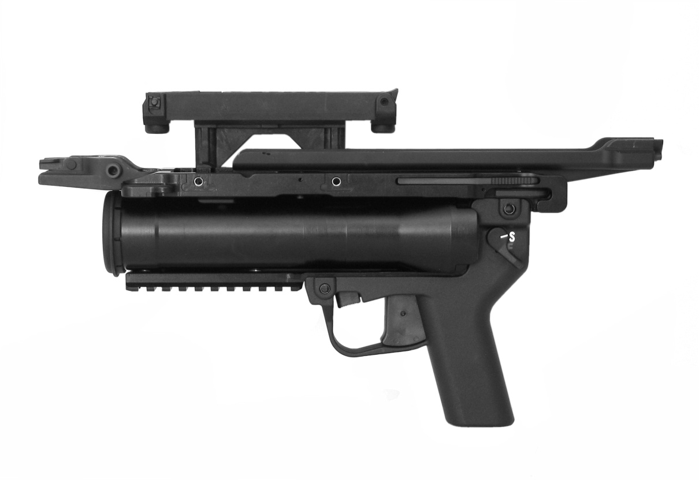
PLACE INTO OPERATION M16 Series Adapter Installation
M16 Series M320 Adapters/
Brackets Installed
Notes:
(NEXT SLIDE)

Slide 49
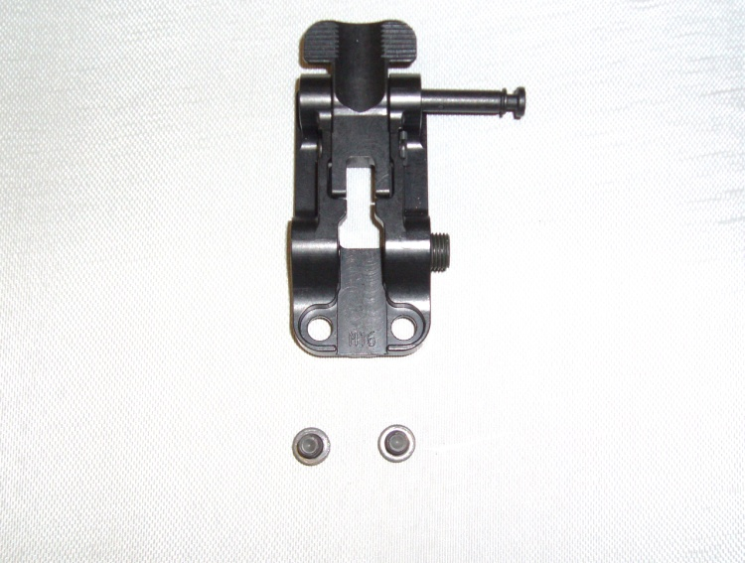
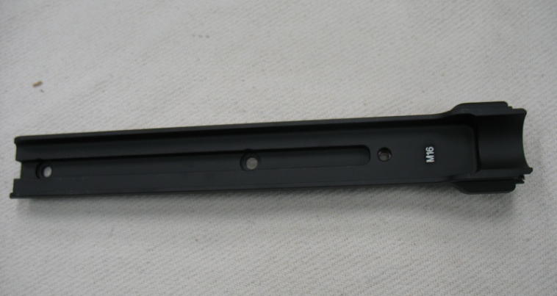
PLACE INTO OPERATION M16 Series Mounting Adapters
M16 series Quick Attach/Detach
Bayonet Adapter
M16 series Rear Mounting Bracket
Notes:
Notice that the M16A4 Series Quick Attach/Detach Bayonet Adapter is narrow compared to the M4 series Quick Attach/Detach Bayonet Adapter. And that the M16A4 Rear Mounting Bracket is longer than the M4 Series Rear Mounting Bracket.
(NEXT SLIDE)

Slide 50
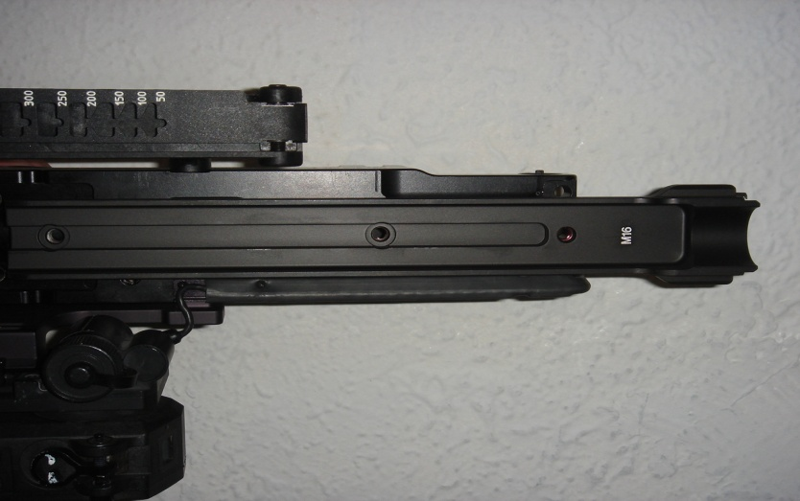
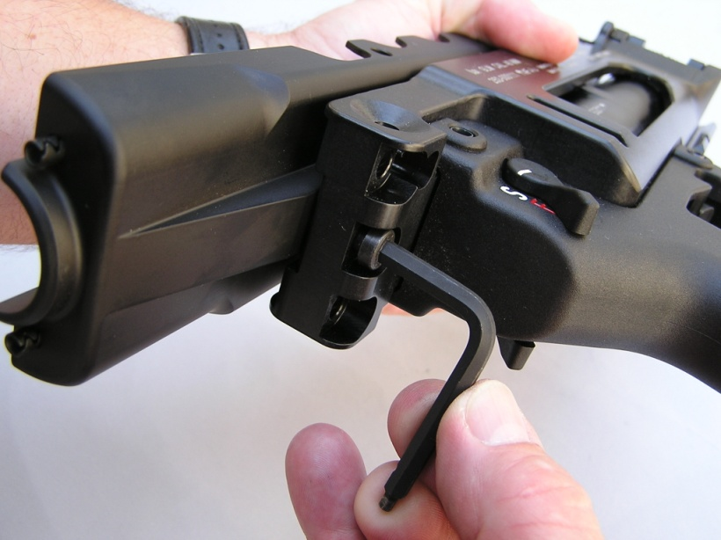
PLACE INTO OPERATION Attaching to M16 Series
1
1
CLEAR THE M16. (See appropriate operators manual).
REMEMBER to remove the M16 series lower hand guard
CLEAR THE M320
Remove M320 Buttstock (if installed)
Depress buttstock locking lever and seat HOST weapon adapter in the mounting interface
Install top screws (1) into bracket using provided combination wrench, until snug.
Install rear screw (2) using the provided combination wrench (3) tighten from
BOTTOM to TOP
2
3
Notes:
Hand tighten the top screw after mounting the rear adapter plate. Once that is completed, install the rear socket head capscrews and hand tighten. Once both sets of screws are tightened, Tighten with the 3x5mm Allen Wrench. Tighten them evenly from BOTTOM TO TOP!!
(NEXT SLIDE)

Slide 51
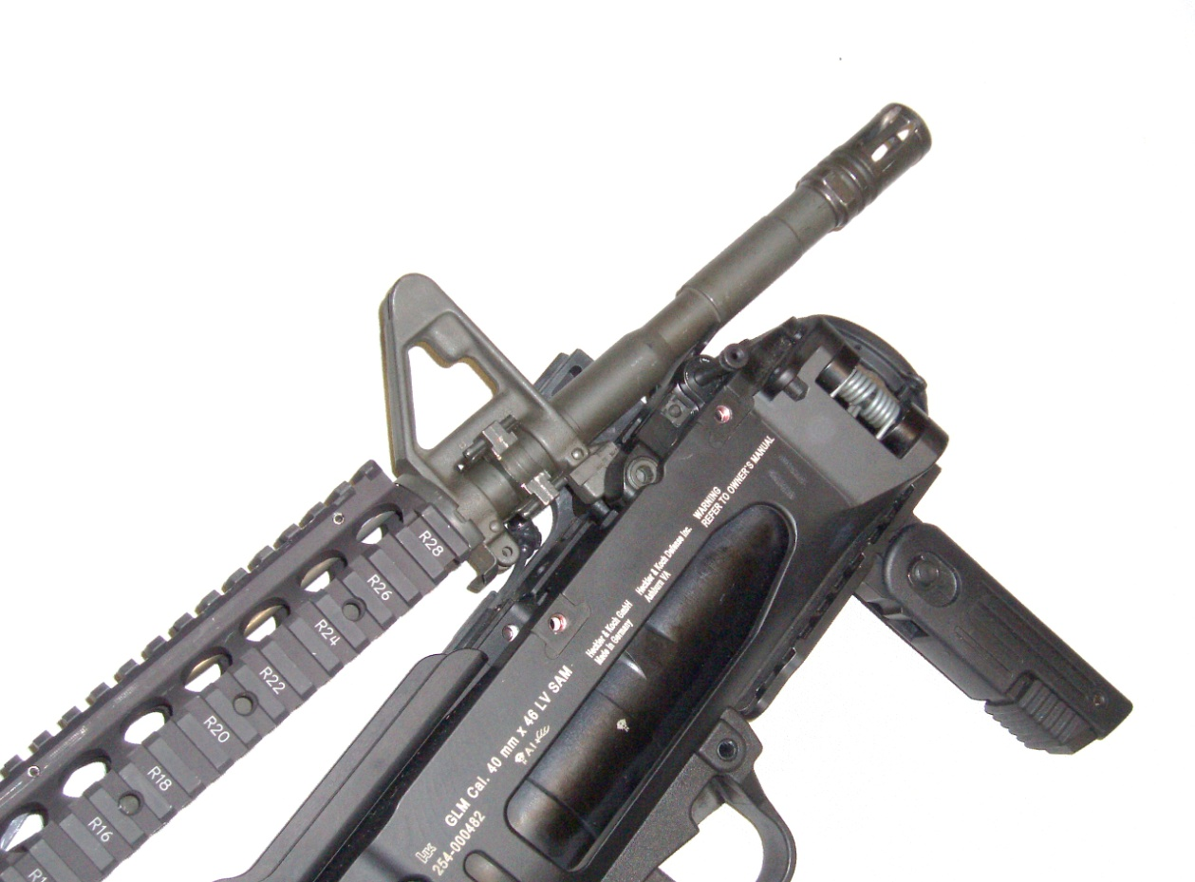
PLACE INTO OPERATION M320 Mounting
Place quick attach bayonet adapter on to front of bayonet lug (1) with M320 (2) slightly angled
1
2
Notes:
Emplace the M320 Quick Attach Bayonet Adapter on the front of the bayonet lug. Then Rotate the M320 towards the barrel of the Host Weapon. Make sure that the Rear Mounting Adapter has clearance to fit over the rear of the barrel as it flares out towards the Barrel nut. Ensure the student checks the M16 sling swivel to ensure it is out of the way of the M320.
(NOTE: Leaf sight assembly is removed for better viewing)
(NEXT SLIDE)

Slide 52
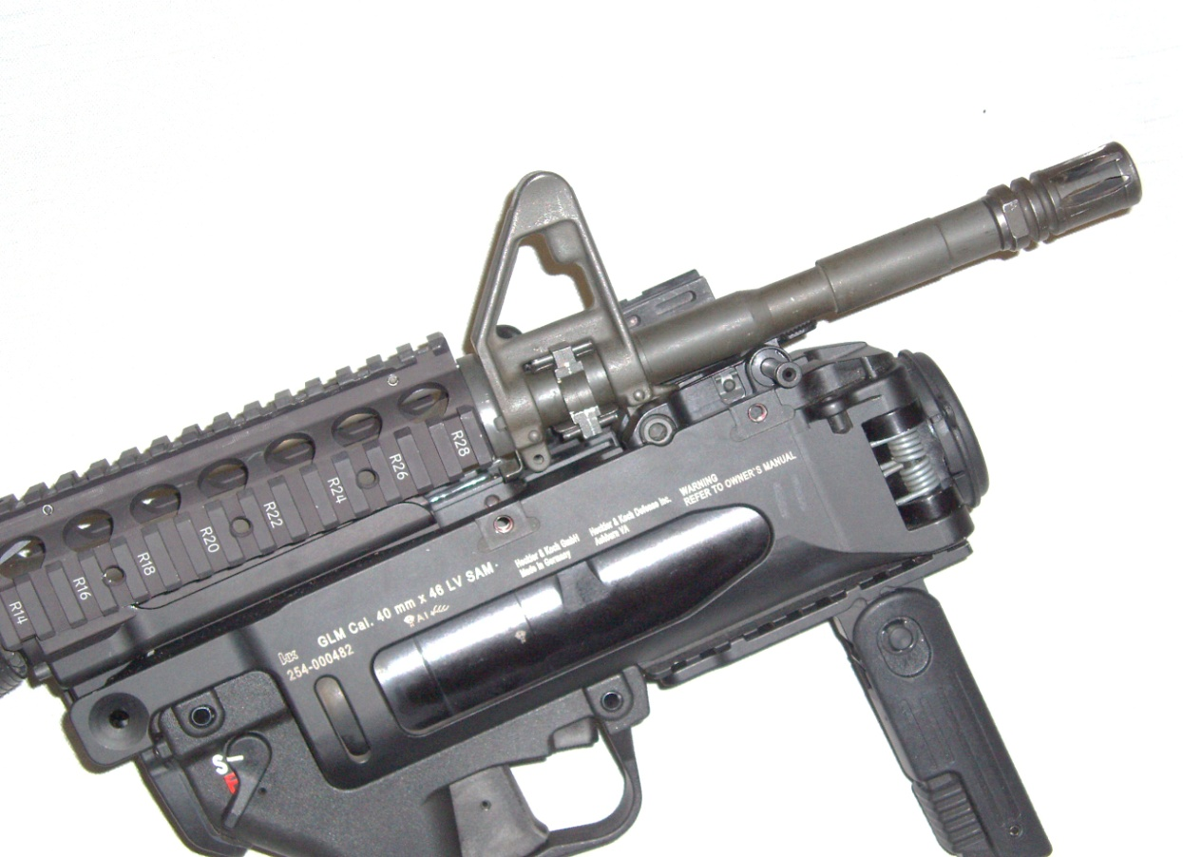
PLACE INTO OPERATION M320 Mounting
Tilt M320 (3) toward host weapon and pull down till an audible click is heard and resistance is felt ensuring positive retention.
Pull the M320 back and forth to test positive retention to the host weapon.
3
Notes:
Once you have the Rear Mounting Adapter over the barrel, and the Quick Attach/Detach Bayonet Adapter is still on the Bayonet lug, pull downwards on the M320. Pulling the M320 in the direction of the Lower Receiver of the Host Weapon. When Checking the M320 for proper mounting, ensure that the Rear Mounting Bracket is seated firmly in the barrel nut. And then inspect the Quick Attach/Detach Bayonet Adapter to ensure the Bayonet Lug is firmly seated. Once completed, push in on the Push/Pull pin to lock the M320 in place.
(NOTE: Leaf sight assembly is removed for better viewing)
(NEXT SLIDE)

Slide 53
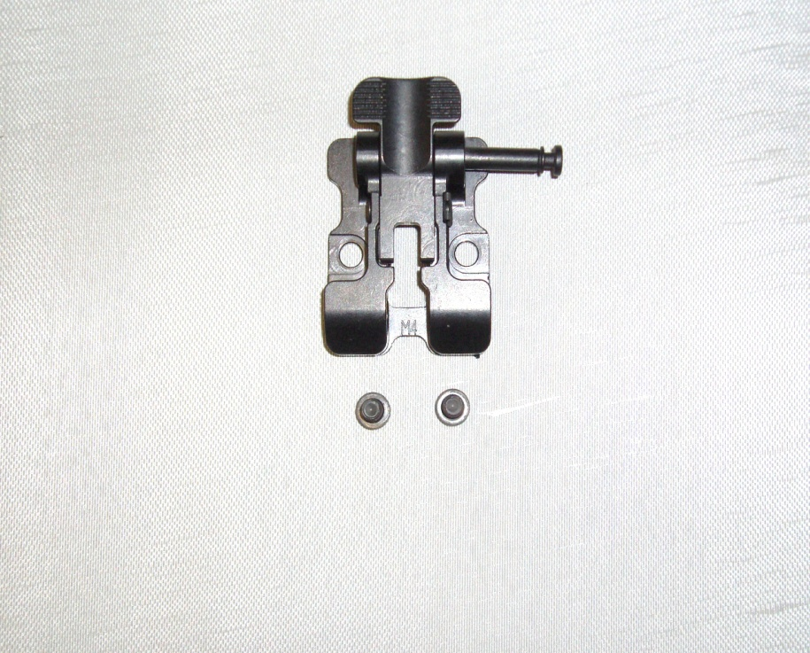
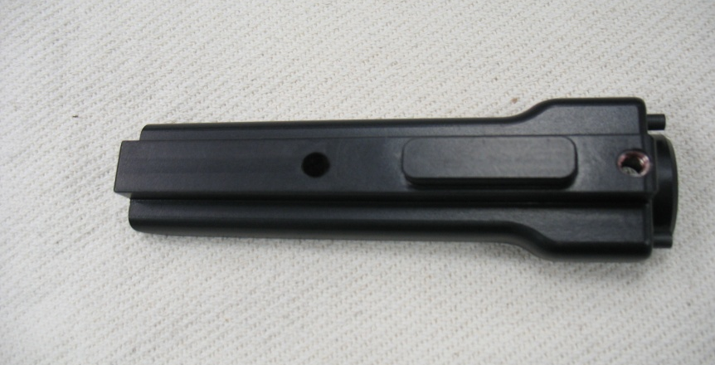
PLACE IN TO OPERATION M4 Series M320A1 Adapters
M4 series Quick Attach/Detach
Bayonet Adapter
M4 series Rear Mounting Bracket
Notes:
Notice that the M4 Quick Attach/Detach Bayonet Adapter is larger than the M16A4 series Quick Attach/Detach Bayonet Adapter. And the M4 series Rear Mounting Bracket is shorter than the M16A4 series.
(NEXT SLIDE)

Slide 54
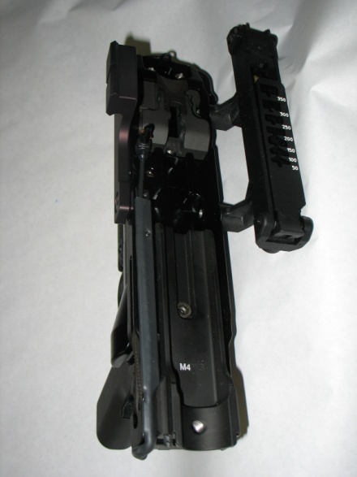
PLACE INTO OPERATION Attaching to M4 Series
CLEAR THE M4. (See appropriate operators manual).
Remove the M4 lower handguard.
CLEAR THE M320A1
Remove M320A1 Buttstock (if installed)
Depress buttstock locking lever and seat HOST weapon adapter in the mounting interface
Install top screw (1) into bracket using provided combination wrench, until snug.
Install rear screw (3) using the provided combination wrench (4) from BOTTOM to TOP
1
2
3
Notes:
The M4 is different from the M16A4 in that it only takes 2 Socket Head Capscrews to mount the Rear Mounting Bracket to the M320. once again, emplace the central screw in the center of the bracket first. And then hand-tighten the bottom Socket Head Capscrew. And then tighten from BOTTOM TO TOP!!
(NEXT SLIDE)

Slide 55
PLACE INTO OPERATION M320A1 Mounting
Place quick attach bayonet adapter on to front of bayonet lug (1) with M320A1 (2) slightly angled
1
2
Notes:
Emplace the M320 Quick Attach Bayonet Adapter on the front of the bayonet lug. Then Rotate the M320 towards the barrel of the Host Weapon. Make sure that the Rear Mounting Adapter has clearance to fit over the rear of the barrel as it flares out towards the Barrel nut. Ensure the student checks the M16 sling swivel to ensure it is out of the way of the M320.
(NOTE: Leaf sight assembly is removed for better viewing)
(NEXT SLIDE)

Slide 56
PLACE INTO OPERATION M320A1 Mounting
Tilt M320A1 toward (3) host weapon and pull down till an audible click is heard and resistance is felt ensuring positive retention.
Pull the M320A1 back and forth to test positive retention to the host weapon.
3
Notes:
Once you have the Rear Mounting Adapter over the barrel, and the Quick Attach/Detach Bayonet Adapter is still on the Bayonet lug, pull downwards on the M320. Pulling the M320 in the direction of the Lower Receiver of the Host Weapon. When Checking the M320 for proper mounting, ensure that the Rear Mounting Bracket is seated firmly in the barrel nut. And then inspect the Quick Attach/Detach Bayonet Adapter to ensure the Bayonet Lug is firmly seated. Once completed, push in on the Push/Pull pin to lock the M320 in place.
(NOTE: Leaf sight assembly is removed for better viewing)
(NEXT SLIDE)

Slide 57
PLACE INTO OPERATION Disassembly/Assembly
Operator disassembly is not authorized or required with the M320!!
Only unit armorers are authorized to perform detailed disassembly and maintenance when repair is required
Notes:
The Only authorized Disassembly that the Operator is allowed to do is to remove the Buttstock , the Host Weaon Mounting Adapters, or the Mechanical Leaf Sight. THE M320 BARREL DOES NOT REMOVE FROM THE RECIEVER AT OPERATOR LEVEL MAINTENANCE!!!
CHECK ON LEARNING:
In what order should the Socket Head Capscrews be tightened? (bottom to top)
What are the only items the operator is authorized to remove? (Buttstock, Host Weapon Mounting Adapters, Mechanical Leaf Sight)
(NEXT SLIDE)

Slide 58
PLACE INTO OPERATION Loading the M320/M320A1
Ensure Safety Lever is set on “S” (Safe), (1)
Press Barrel Release Lever up (2), allow Barrel (3) to swing out
3
1
2
Notes:
NOTE:.
4. Learning Step/Activity 4: Loading Procedures.
Method of instruction: Demonstration
Instructor to student ratio is: 1:10
Time of instruction: 15 min
Media: Actual equipment
TRANSITION: Now that you are familiar with the how to mount and dismount the M320, we will discuss how to place the M320 into operation.
Action: Place the M320 into operation.
Conditions: Given a M320 with Mechanical Leaf Sight, 10 rounds, 40 mm M781 TPT, And a 40 mm target range.
Standards: Zero the M320 3 rounds or less, Day and Night.
Method of instruction: PE-1
Instructor to student ratio is: 1:10
Time of instruction: 1 hrs
Media: Actual equipment
Learning Step/Activity 1: Loading the M320:
Ensure the M320 is on Safe
Press the Barrel release lever up and allow the barrel to swing out.
Insert the first 40 mm cartridge into the chamber, make sure that it is fully seated.
Close the barrel, make sure that the barrel locks into place.
At this time have students assume a good standing or kneeling firing position.
Ensure that:
The students assume a good firing platform using the 4 fundamentals of marksmanship. .
Ensure that the weapon is on safe until the student acquires a target.
Make sure the student acquires a good sight picture in order to zero the M320.
After firing the round ensure the students:
Place the weapon back on safe.
Press the barrel release lever up.
Remove the spent cartridge.
Load a fresh cartridge if required.
(NEXT SLIDE)

Slide 59
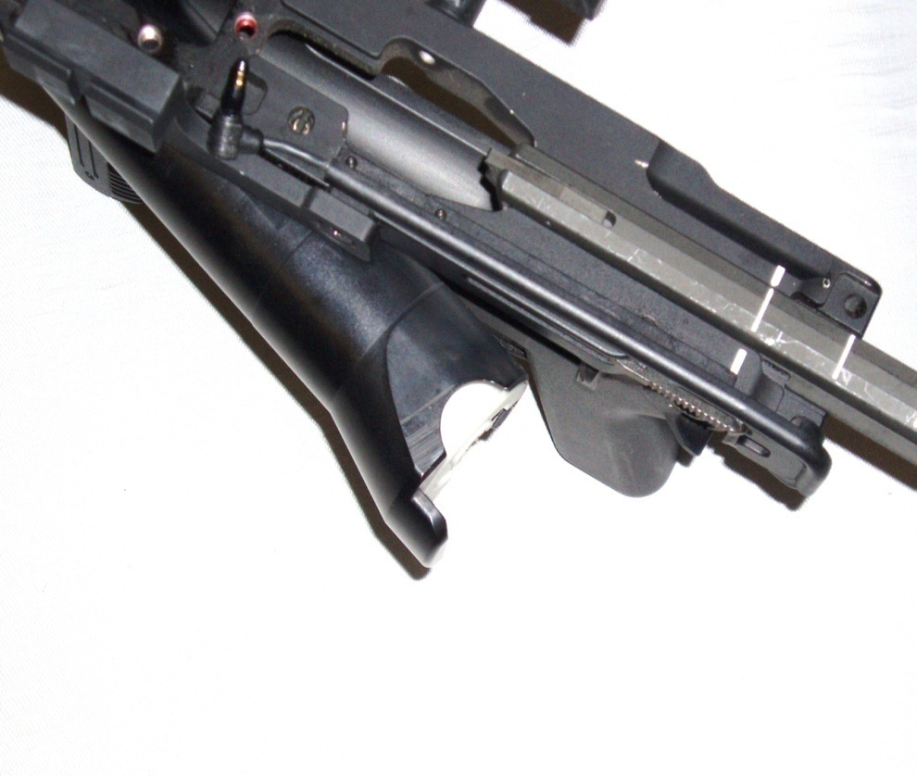
PLACE IN TO OPERATION Loading the M320/M320A1
Insert Cartridge (4), ensure its fully seated in chamber
Return barrel to closed position
Make sure it’s LOCKED!
4
Notes:
Ensure that the barrel locks fully in the closed position, as it can be held by the Barrel Locking Lever with minimal tension.
(NEXT SLIDE)

Slide 60
PLACE INTO OPERATION Unloading the M320/M320A1
Ensure safety lever is set on “S” (Safe)
Press barrel release button up, allow barrel to swing out
Remove cartridge or case by hand
Grasp rim using (cutouts in barrel) by hand and pull to rear
Discard live ammo IAW local procedures
Return barrel to closed position
Notes:
(NEXT SLIDE)

Slide 61
PLACE IN TO OPERATION Immediate Action Steps
Failure to Fire
Place safety lever to “S” (Safe)
Wait for 30 seconds, with weapon pointed down range
Pull trigger again
If round still fails, wait 30 seconds
Unlock and open barrel
Remove faulty cartridge, Inspect Primer, rotate ¼ turn
Reinsert round, attempt to fire again.
If round still does not fire Dispose of cartridge IAW applicable procedures
Notes:
If round still fails, wait 1 min and atempt to fire the round again. If round still fails to fire check primer for primer strike, if primer strike hasn’t accoured remove rond and fire from different weapon. If primer strike has accoured, close breach and contact EOD.
If round still does not fire Dispose of cartridge IAW applicable procedures
Immediate action times are for peacetime application. In combat the important issue is muzzle awareness with Live HEDP, if the round does not fire after initial squeeze, immediately pull the trigger. If the round fails after immediate action, apply the remedial action listed. This allows the firing pin to strike a clear portion of the primer. In a pecetime range environment, if the round still does not fire after remedial action, and another M320 is available, attempt to fire the round through it. 90% of the time the round will fire. If the round will not fire in combat, secure the round in an ammunition pouch and get to a vehicle, secure the round in a vehicle under sand bags or kevlar blankets to ensure the round does not roll around or go off and cause damage. The M433 HEDP has a fuze with a safety that is set after approximately 3-5 full rotations. Which puts you at 14-28 Meters out the end of the barrel. Or a meter and a half to 2 meters if rolled on it’s side. DO NOT ROLL OR SPIN LIVE 40 MM ROUNDS AS THIS MAY ARM THEM!!
CHECK ON LEARNING:
How long should you wait after a misfire before attempting to fire again? (30 Seconds)
What should you do if the round does not fire after a second trigger squeeze? ( remove, Inspect Primer, Rotate ¼ turn and reinsert.)
(NEXT SLIDE)

Slide 62
PLACE IN TO OPERATION Immediate Action Steps
Failure to Extract/Eject
Place safety lever to “S” (Safe)
Place cleaning rod into barrel from muzzle end, until contact with spent case is made
Carefully tap top of rod with applicable tool until round disengages from chamber
Inspect bore and chamber for signs of damage
Notes:
If the cartridge fails to extract even with the student placing their hand on the round and attempting to pull the round, immediately secure a cleaning rod and attempt to remove the cartridge only if a round has exited the barrel. If no round has exited the barrel, perform misfire procedures before doing any immediate action steps for extraction.
(NEXT SLIDE)

Slide 63
Enabling Learning Objective D
Action: Discuss M320 marksmanship procedures
Conditions: Given a M320 with Mechanical Leaf Sight, simulated target, classroom block of instruction.
Standards: Identify characteristics of M320 Marksmanship
Notes:
Enabling Learning Objective D
Action: Discuss M320 marksmanship procedures
Conditions: Given a M320 with Mechanical Leaf Sight, simulated target, classroom block of instruction.
Standards: Identify characteristics of M320 Marksmanship
INSTRUCTOR LEAD-IN: Now that we have covered how to load, fire and perform misfire procedures, we will cover how to apply the 4 Marksmanship fundamentals to the M320.
(NEXT SLIDE)

Slide 64
M320/M320A1 Marksmanship
Trigger Control
Finger placement
Apply direct rearward pressure
Avoid jerking trigger
Practice and technique are required to master proper trigger manipulation of the M320/M320A1
Notes:
Trigger squeeze is vital with the M320 as it has a much heavier trigger squeeze than the M203. Follow through is vital with the trigger squeeze when applying the four fundamentals. Continue to squeeze the trigger until after the round has exited the barrel, if not you will jerk the trigger and the round will fall off target. In addition to this, make sure you still apply the remaining 4 fundamentals of marksmanship to make sure you will hit your target.
(NEXT SLIDE)

Slide 65
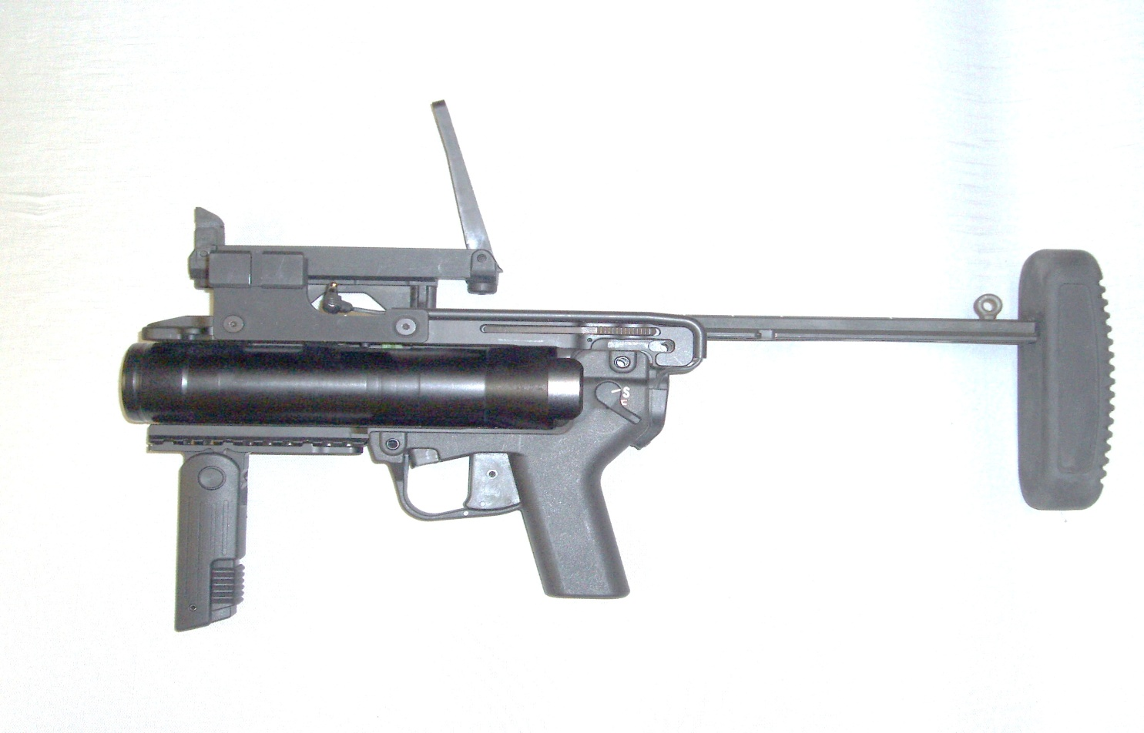
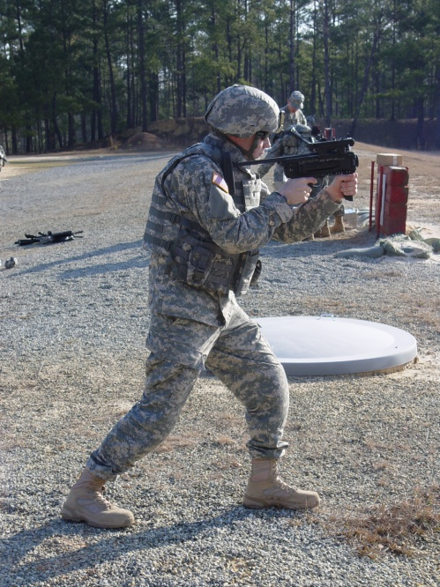
M320 Marksmanship Stand-Alone
3
1
2
Deploy the vertical grip, place non firing hand on grip
Place firing hand on pistol grip
Adjust butt-stock to desired length
Notes:
When firing the M320 in the Stand-Alone position as illustrated in the picture, the four fundamentals are key:
A. Steady Position:
make sure that student is using good bone-to-muscle contact.
Ensure the student’s chest is square to the target, one foot back as if the student is doing the calf stretch,
feet pointing towards the target. Ensure the student is also leaning forward with the weight on the front leg.
B. Trigger Squeeze:
Ensure the student does not jerk the trigger, with the heavier trigger pull, it is easier for the student to jerk the trigger and affect the trajectory of the round. A smooth trigger squeeze to the rear and follow-through on the trigger after the round has exited the barrel is vital.
C. Aiming:
When using the Mechanical Leaf Sight, it is vital that the Student keep their head upright, This allows the student to keep the same sight picture which they would be unable to do if they have their head bent over the sight.
D. Breathing:
The student should attempt to fire the M320 on the natural pause between breaths, the same as if they were firing the M4 or M16.
Inform the students that the M320 in this configuration has less mass to absorb the recoil of the round being fired. So there is a more perceptible recoil to the weapon in this configuration. Also ensure that the students understand that if they remove the M320 from the host weapon, there will be a noticeable shift of their point of aim on the host weapon. Students should re-zero host weapon if possible.
(NEXT SLIDE)

Slide 66
M320/M320A1 Marksmanship Host-Weapon mounted
Grip
Mounted on weapon
Retract vertical grip
Place non-firing hand (1)on host weapon pistol grip
Place firing hand (2) on M320/M320A1 pistol grip
1
2
Notes:
Ensure the students understand that the Firing hand will be on the M320 Pistol Grip and the Non-Firing hand goes on the host weapon pistol grip if applicable.
When they are firing from the Kneeling position, ensure the students understand that they will need to do the following:
Steady Position:
1. Kneeling:
Make sure the student is using good bone-to-muscle contact. If a barricade is present, they can use the barricade to press their forearm against to give a more stable firing platform.
Ensure that The student avoids placing their elbows into the meaty portion of their thighs. The back of the upper arms where their triceps are located should come into contact with their knees.
In addition to the Kneeling, the M320 can be fired from the Prone.
2. Prone:
Ensure the student clears their muzzle before they fire. Any obstacle in front of the weapon can affect the ballistics of the round.
The student will be laying on the ground in the direction of the target, feet flat on the ground, buttstock in the ground, any elevation corrections to be made will be made by raising the barrel.
Prone can only be used effectively out to 200 meters. Inform the students if they need to take a shot past that they will need to take a knee and then take their shot.
B. Trigger Squeeze:
Ensure the student does not jerk the trigger, with the heavier trigger pull, it is easier for the student to jerk the trigger and affect the trajectory of the round. A smooth trigger squeeze to the rear and follow-through on the trigger after the round has exited the barrel is vital.
C. Aiming:
When using the Mechanical Leaf Sight, it is vital that the Student keep their head consistent and keeps the same sight picture.
D. Breathing:
The student should attempt to fire the M320 on the natural pause between breaths, the same as if they were firing the M4 or M16.
(NEXT SLIDE)

Slide 67
M320/M320A1 Marksmanship Sight Alignment
M320 Front Sight
M320 Leaf
Sight
Notes:
Proper sight picture is demonstrated above, align the front sight post with the rear leaf sight at the appropriate range.
(NEXT SLIDE)

Slide 68
M320 Marksmanship Sight Picture
Top of Front
Sight
100 Meter
Notes:
In the example above, place the front sight post center mass on the window. Then assure that you estimate range and use the rear leaf sight at the appropriate range for the target.
(NEXT SLIDE)

Slide 69
M320 Marksmanship Firing the M320 (using the leaf sight)
Ensure safety is on “S” (Safe)
Ensure both front and rear sights are extended in up position
Estimate range to target
Select range on scale (1)
Align front sight post with applicable
range setting on the rear leaf sight
Sight in on target
Notes:
CHECK ON LEARNING:
Where is the firing hand located at when the M320 is in Host Weapon configuration? ( M320 Pistol Grip)
What is important when squeezing the trigger of the M320 (followthrough)
(NEXT SLIDE)

Slide 70
M320 Marksmanship Firing the M320 (using the leaf sight)
Align and center front sight post (1)in the aperture window (2) on the leaf sight
2
1
Notes:
Align and center front sight post (1)in the aperture window (2) on the leaf sight
(NEXT SLIDE)

Slide 71
Enabling Learning Objective E
Action: Zero the M320/M320A1
Conditions: Given a M320/M320A1 with Mechanical Leaf Sight,
200m zero target, 10 rounds, 40 mm M781 TPT, And a 40 mm target range
Standards: Zero the M320/M320A1 3 rounds or less, Day and Night.
Notes:
Enabling Learning Objective E
Action: Zero the M320
Conditions: Given a M320 with Mechanical Leaf Sight,
200m zero target, 10 rounds, 40 mm M781 TPT, And a 40 mm target range
Standards: Zero the M320 3 rounds or less, Day and Night.
INSTRUCTOR LEAD-IN: Now that we have covered how to load, fire and perform misfire procedures, we will cover how to apply the 4 Marksmanship fundamentals to the M320.
(NEXT SLIDE)

Slide 72
Zero the M320/M320A1
Setup target at 200 meters
Extend both front and rear sights
Attain proper sight alignment and sight picture (4 Fundamentals)
Fire at least 2-3 rounds at target
If round does not impact at POA make necessary sight adjustments (windage and elevation)
Continue to shoot/adjust until the POI = POA
Notes:
When Zeroing at 200 meters, remind the students that they need to get within 5 meters of their target in order to be considered zeroed. If their round hits 1-2 meters past their intended target, they should consider themselves zeroed. The M433 HEDP and M441 HE bury themselves somewhat upon impact, and throw their shrapnel pattern in a cone back in the direction of the firer and up. So if they are hitting just past their target, they are good.
(NEXT SLIDE)

Slide 73
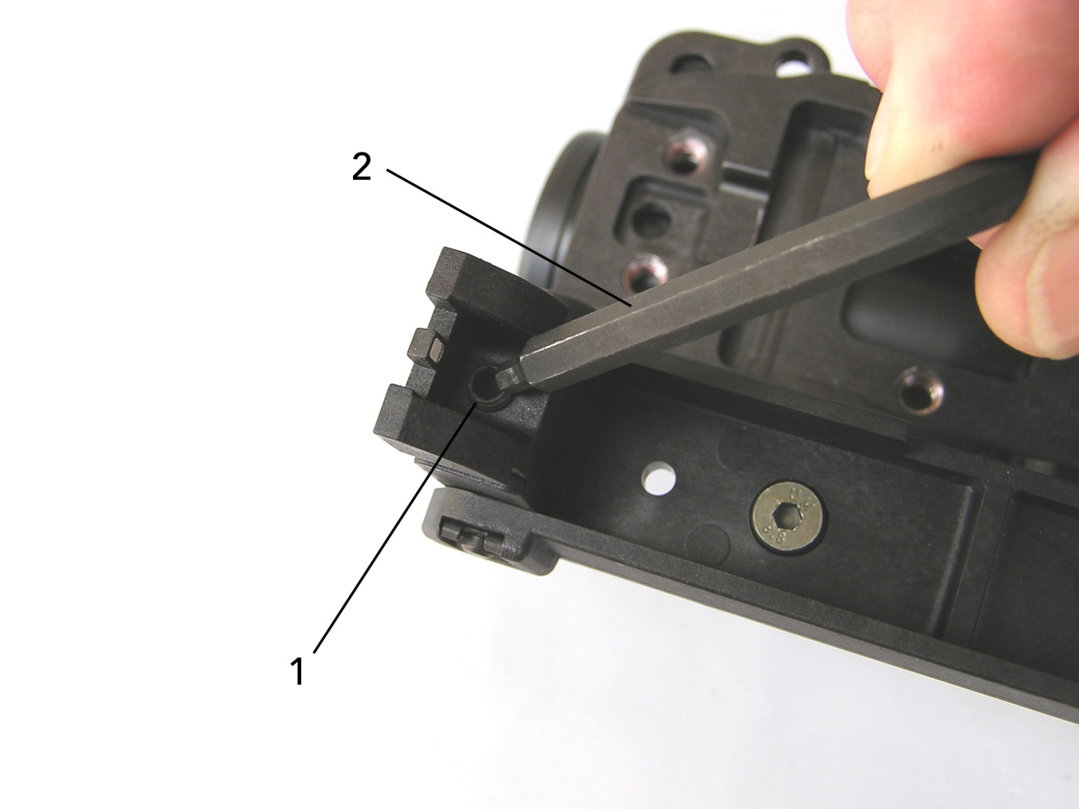
Zero the M320/M320A1 Elevation Adjustments
Tool needed: 3mm Allen wrench
Point of Impact (POI)
1 complete rotation moves impact 13.4 in/35 cm @100 meters
To lower POI-turn screw clockwise
To Raise POI-turn screw counter-clockwise
Notes:
Ensure the students understand when they say low, they are referring to POI. So if they hit in front of their intended target, their POI would be low. If their round impacted behind their target, their POI would be High.
(NEXT SLIDE)

Slide 74
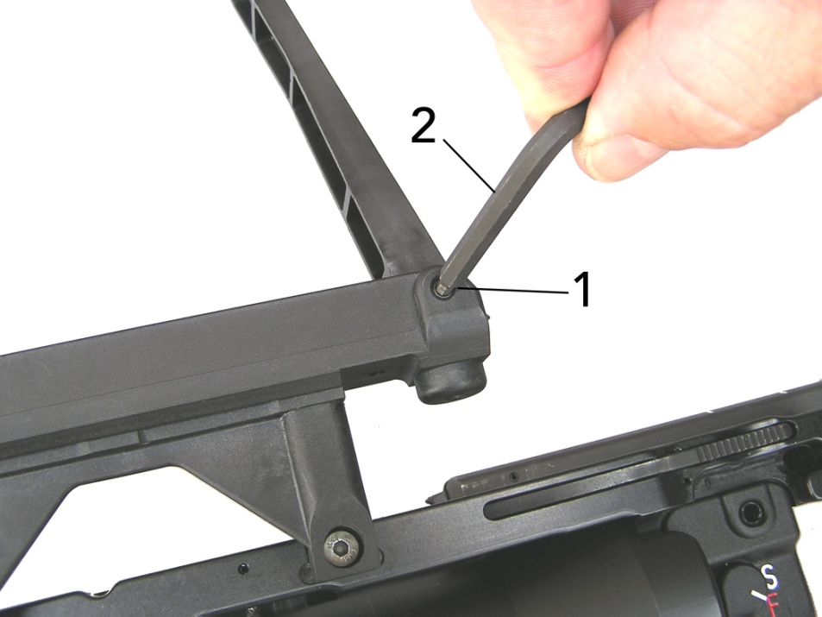
Zero the M320/M320A1 Windage Adjustments
Tool needed: 3mm Allen wrench
1 complete rotation moves impact 13.4 in/35 cm @100 meters
To adjust POI left- turn screw clockwise
To adjust POI right-turn screw counter-clockwise
Notes:
These adjustments move the strike of the round, not the actual direction listed. Ensure the students understand that.
(NEXT SLIDE)

Slide 75
Zero the M320/M320A1
M320/M320A1 Sight Adjustment Table
Distance | Impact | Rotation on Sights
100m | 13.4 in/35 cm | 1 complete
200m | 26.8 in/70 cm | 1 complete
300m 400m | 40.2 in/105 cm 53.6in/136 cm | 1 complete 1 complete
Notes:
Explain : Table shows distance of adjustment for POI @ each range for elevation and widage
(NEXT SLIDE)

Slide 76
Zero the M320/M320A1 To make Adjustments
An acronym to help remember how to adjust is-
L ow or
R ight turn
C lockwise
Notes:
In summary: this is an easy way to remember how to adjust the elevation/windage on the Mechanical Leaf Sight. If you need to lower or adjust POI right, rotate the sight adjustments clockwise. The sight will move the dimensions listed in the previous table.
CHECK ON LEARNING:
How much does 1 complete turn of the sight adjustment screw move the POI in any direction(Left, Right, Up, Down) at 200 meters? (26.8 Inches/70Cm)
How Many rounds should it take to zero at 200 Meters? (3)
(NEXT SLIDE)

Slide 77
Perform Cleaning and Lubrication
Now is your time to properly clean and lubricate your weapon system IAW TM 9-1010-232-10 and ask any questions that you may have.
Notes:
NOTE: After firing weapon, make sure to clear before performing any cleaning operations.
Learning Step/Activity 5:Operator Cleaning and Lubrication
Method of instruction: Demonstration
Instructor to student ratio is: 1:10
Time of instruction: 15 min
Media: Actual equipment
Cleaning intervals:
The M320 Should be cleaned after every live-fire, or after 50 rounds fired, whichever comes first.
If the weapon is in a Desert environment, make sure that the weapon is cleaned on a daily basis if possible, or at the least a weekly basis.
Do not apply a heavy coat of CLP or Weapon Lubricant to the bolt face. Or place large amounts of lubricant down the firing-pin hole, as this will cause dust to build up in the firing pin and the weapon will be deadlined until seen by depot-level maintenance.
2.Cleaning the Barrel:
1. Always place patches or brushes in from the breech end. DO NOT ATTEMPT TO FEED A CLEANING BRUSH IN THROUGH THE MUZZLE-END OR REVERSE DIRECTION. THIS CAN CAUSE THE ITEM TO BE PERMANENTLY LODGED IN THE BARREL.
While Cleaning the weapon, make sure to NOT use:
Metallic objects
Chemicals such as trichloroethylene
Synthetics
Clean When weapon is at hot (fired) temperatures
Water
(NEXT SLIDE)

Slide 78
Summary
Safety
Technical Data
Nomenclature
Mechanical Operation
Stand-Alone Mode
Maintenance/Cleaning/Lubrication
Troubleshooting
Zeroing procedures
Notes:
Instructor Lead-in: In conclusion, these are the areas we have covered today on the M320. If there are any questions, you may ask them at this time.
CHECK ON LEARNING:
What should be conducted during the before, during, and after phases of the PMCS? (functions check.)
What three things are the students authorized to remove from the M320? (Mechanical Leaf Sight, Buttstock, Host Weapon Mounting Adapters)
(NEXT SLIDE)

Slide 79
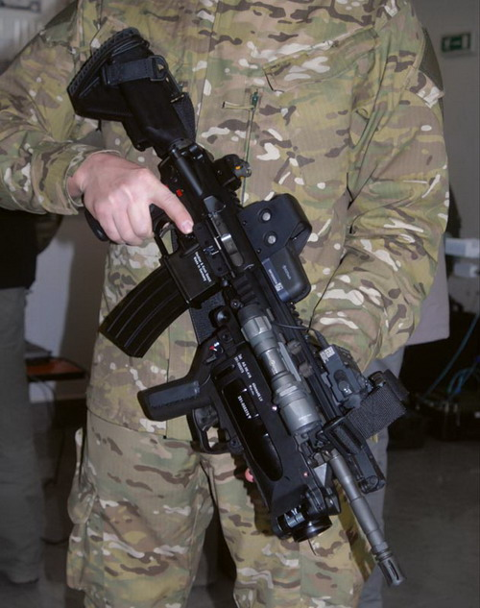
Test/Practical Exercise
Notes:
Instructor Lead In: At this time you will be given a 20 question written examination and perform a practical exercise. You must score a minimum of 14 out of 20 answered correctly to pass and get all go’s on the PE. You may begin when you receive the test. Are there Any Questions?

