Slide 1
LSA 3:
Rifle and Carbine principles of Operations
Notes:
Begin by asking pointed question to get concrete knowledge of the class:
Example questions
What are the 8 Cycle?
Why is it so important to know the 8 cycles of function?

Slide 2
ACTION:
Demonstrate knowledge of Army service Rifle preliminary marksmanship instruction.
CONDITION:
In a classroom environment, given TC 3-22.9, Rifle and Carbine.
STANDARD:
Identify how to apply and train Rifle Marksmanship utilizing the US Army Service Rifle in accordance with applicable command guidance, TC 3-22.9 Rifle and Carbine

Slide 3
INTRODUCTION
Safety Considerations:
Risk Assessment:
Environmental Considerations:
Evaluation:
Notes:
Safety Considerations: Fire escape plan should be reference
Risk Assessment: Low
Environmental Considerations: Keep tops on bottles when not in use and remember to remove all trash from the classroom.
Evaluation: You will be evaluated formally on written examinations which you must achieve a minimum of 70% to continue the course.

Slide 4
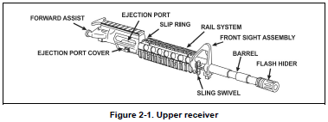
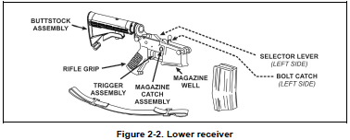
PRINCIPLES OF OPERATION
MAJOR COMPONENTS
Notes:
The Army Standard Service Rifle
A 5.56-mm, magazine-fed, gas-operated, air-cooled, shoulder-fired rifle/carbine Semiautomatic (single-shot) or three-round burst/automatic mode
Components: Uniquely identifiable group of fitted parts, pieces, assemblies or subassemblies required to perform a distinctive function. Usually removable in one piece.
Assemblies: Group of subassemblies and parts that are fitted to perform specific set of functions during operation. Cannot be used independently for any other purpose.
Subassemblies: Group of parts fitted to perform a specific set of functions during operation. Compartmentalized to complete a single specific task. May be grouped with other assemblies, subassemblies, and parts to create a component.
Parts: Individual items that perform a function when attached to a subassembly, assembly, or component that serves a specific purpose.

Slide 5
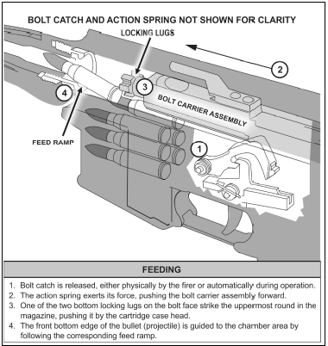
PRINCIPLES OF OPERATION
Notes:
The cycle of function is the mechanical process a weapon follows during operation. The phases of the cycle of function in order are—
● Feeding.
● Chambering.
● Locking.
● Firing.
● Unlocking.
● Extracting.
● Ejecting.
● Cocking.
The M4- and M16-series weapons use a direct impingement gas operating system. This system uses a portion of the high pressure gas from the cartridge being fired to physically move the assemblies and subassemblies in order to complete the cycle of function.
Feeding is the process of mechanically providing a cartridge of ammunition to the entrance of the chamber

Slide 6
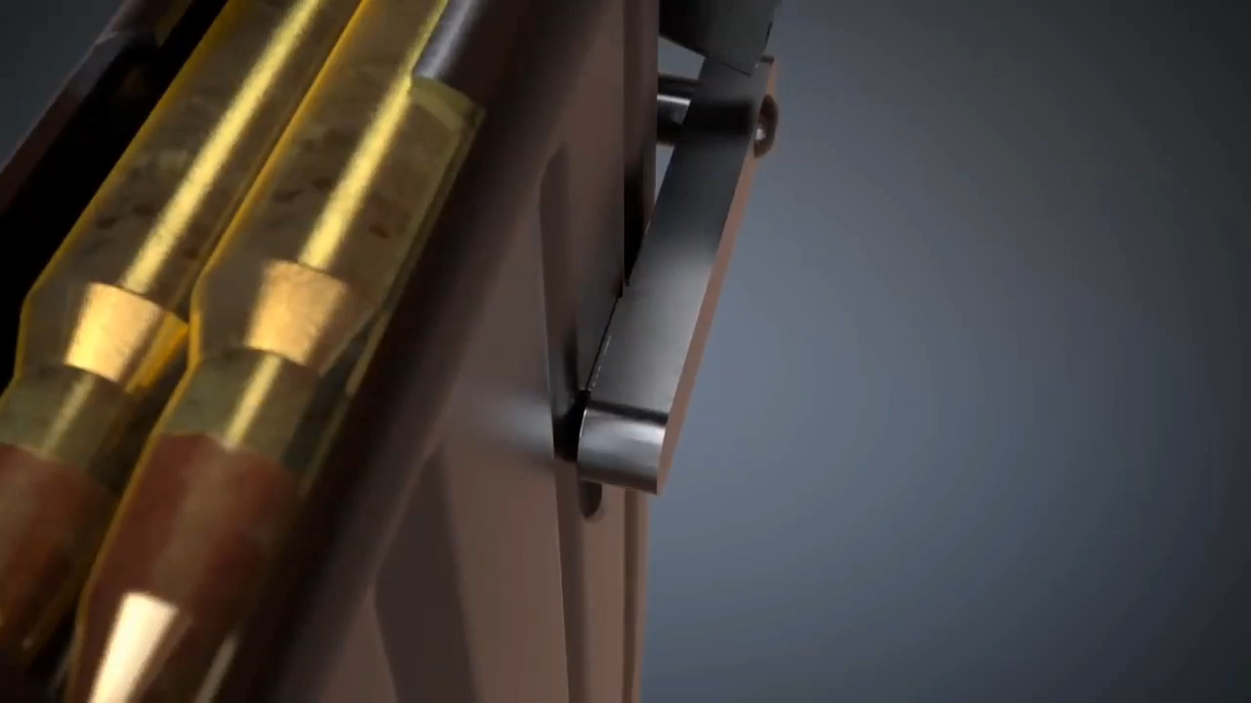
Feeding

Slide 7
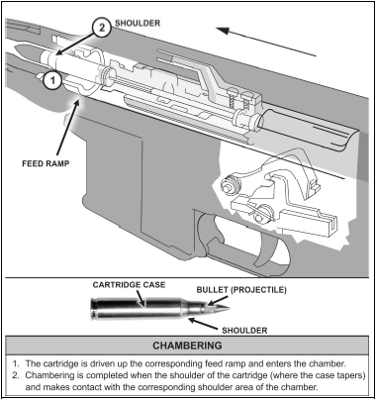
PRINCIPLES OF OPERATION
Notes:
Chambering is the continuing action of the feeding round into the chamber of the
weapon

Slide 8
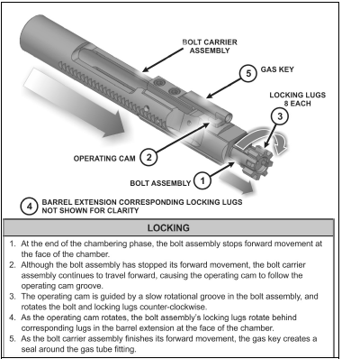
PRINCIPLES OF OPERATION
Notes:
Locking is the process of creating a mechanical grip between the bolt assembly and chamber with the appropriate amount of headspace (clearance) for safe firing (see figure 2-5). With the M4- and M16-series weapons, locking takes place simultaneously with the final actions of chambering.

Slide 9
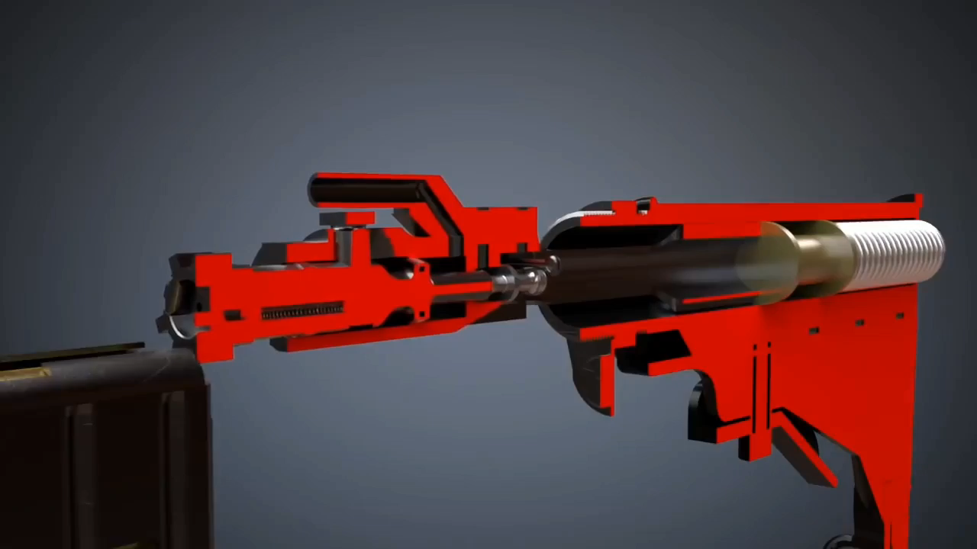
Chambering and Locking

Slide 10
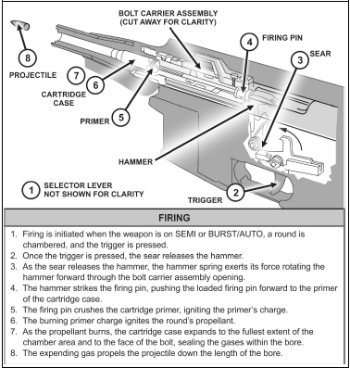
PRINCIPLES OF OPERATION
Notes:
Firing is the finite process of initiating the primer detonation of the cartridge and
continues through shot-exit of the projectile from the muzzle

Slide 11
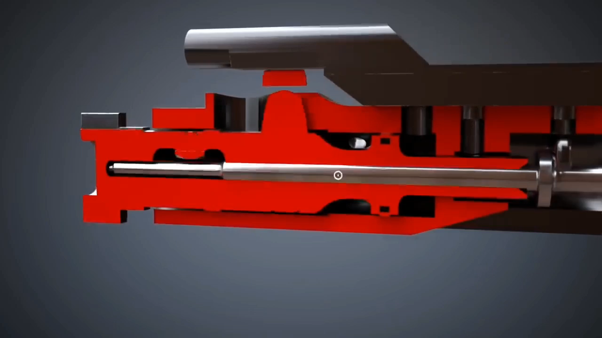
Firing

Slide 12
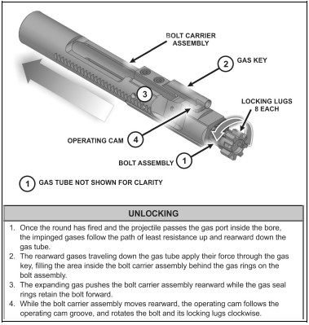
PRINCIPLES OF OPERATION
Notes:
Unlocking is the process of releasing the locking lugs on the bolt face from the
corresponding recesses on the barrel extension surrounding the chamber area

Slide 13
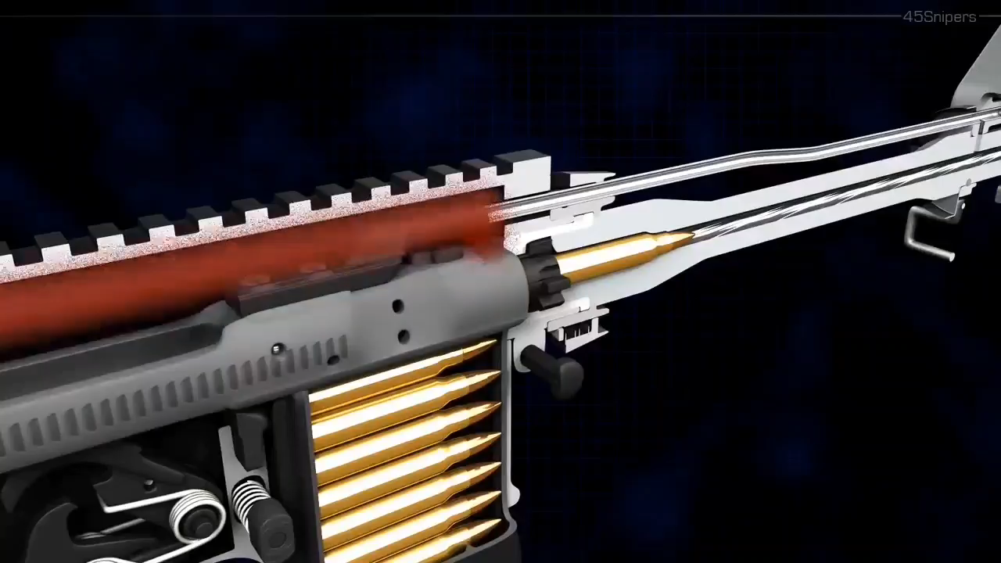
Unlocking

