Slide 1
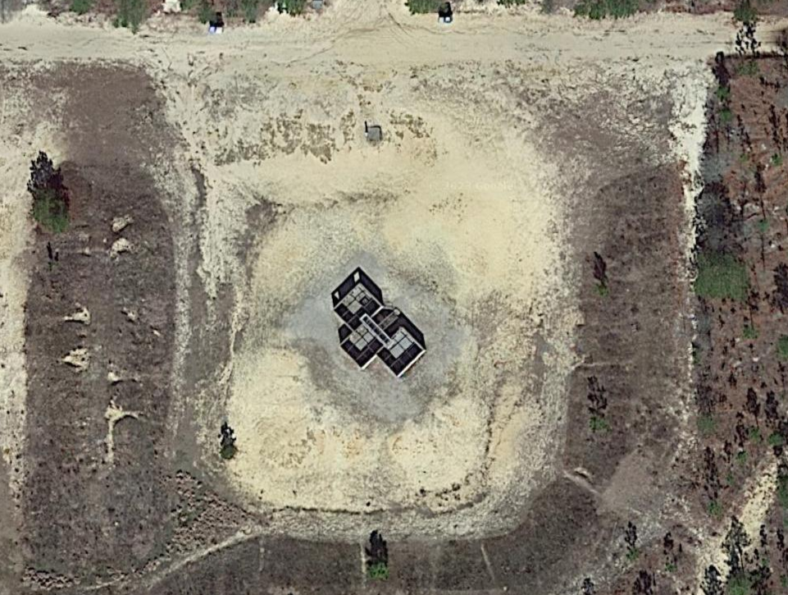
C CO – FORGE Company Training
Mission: C/1-13 IN conducts Company Training 251300JAN2023 IVO Urban Assault Course IOT train and evaluate Battle Drill 6 in a field environment, laying the foundation of Urban Operations and preparing Trainees for future training.
N
Concept of Operations:​
Phase I (Preparation): will be executed from 08JAN-24JAN23, beginning with prerequisite training on Urban Operations tasks and ending with final PCC/PCI prior to movement.
Phase IIa (Movement): Will begin at completion of all PCC/PCI NLT 251300JAN23 and end upon arrival of UAC. At 1300 FM will begin from CHIP at a 20 min/mile pace for 1.4 miles to UAC.
Phase IIb (Occupation): Begins upon arrival at UAC and ends once UAC is occupied. PLTs get 100% accountability of personnel and equipment and stage equipment to prepare for training.
Phase IIIa (Execution): Begins once Equipment is staged and teams are set NLT 251400JAN23 and ends NLT 251730JAN23. Platoons conduct Battle Drill 6 in Fire team elements.
Phase IV (Preparation for follow on mission): Begins NLT 251730JAN23 with platoons conducting AAR of the training, establish patrol bases and conducting priorities of work in preparation for FM4 and ends with the company staged and ready to conduct FM4 NLT 252330JAN23.
2nd
AO CRUSADER
3rd
4th
Sustainment:
CL I: M-A (10 Boxes), MORE meal prior to SP
CL III: Resupply POL at designated fuel points when vehicles are at 50% threshold
Class V: 2000 x 5.56 blank
Class VII: 4x BRICs, 4 Rescue Randy's
1x LMTV, 1x 1-Ton Water Buffalo, GSA Van, 1x HMMWV
Class VIII: 4x Litters, 4x CLS bags, 4x Foot Care Kit
Timeline:
25 JAN
1230-1300: Lunch MRE, PCC/PCIs for FM 1745-1830: Dinner Chow
1300-1330: FM from CHIP to UAC 1830-1900: Establish Patrol bases
1330-1400: Stage equipment, prepare for training 1900-2230: Priorities of work
1400-1730: Platoons conduct Battle Drill 6 2230-2300: Stage at UAC for FM4
1730-1745: Training AAR 2300-2330: Final FM4 PCC/PCIs
P: Radio | A: Cell Phones | C: BRIC | E: Runner | EMS: 751-91111
PLAN​ | OPORD​ | RECON​ | CERT LEADERS​ | REHEARSE​ | EXECUTE​ | AAR​ | RETRAIN​
10JAN23 | 12JAN23 | 14JAN23 | 14JAN23 | 14-16JAN23, 21JAN23 | 25JAN23 | 25JAN23 | 25JAN23

