Slide 1
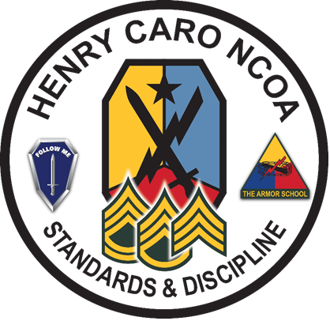
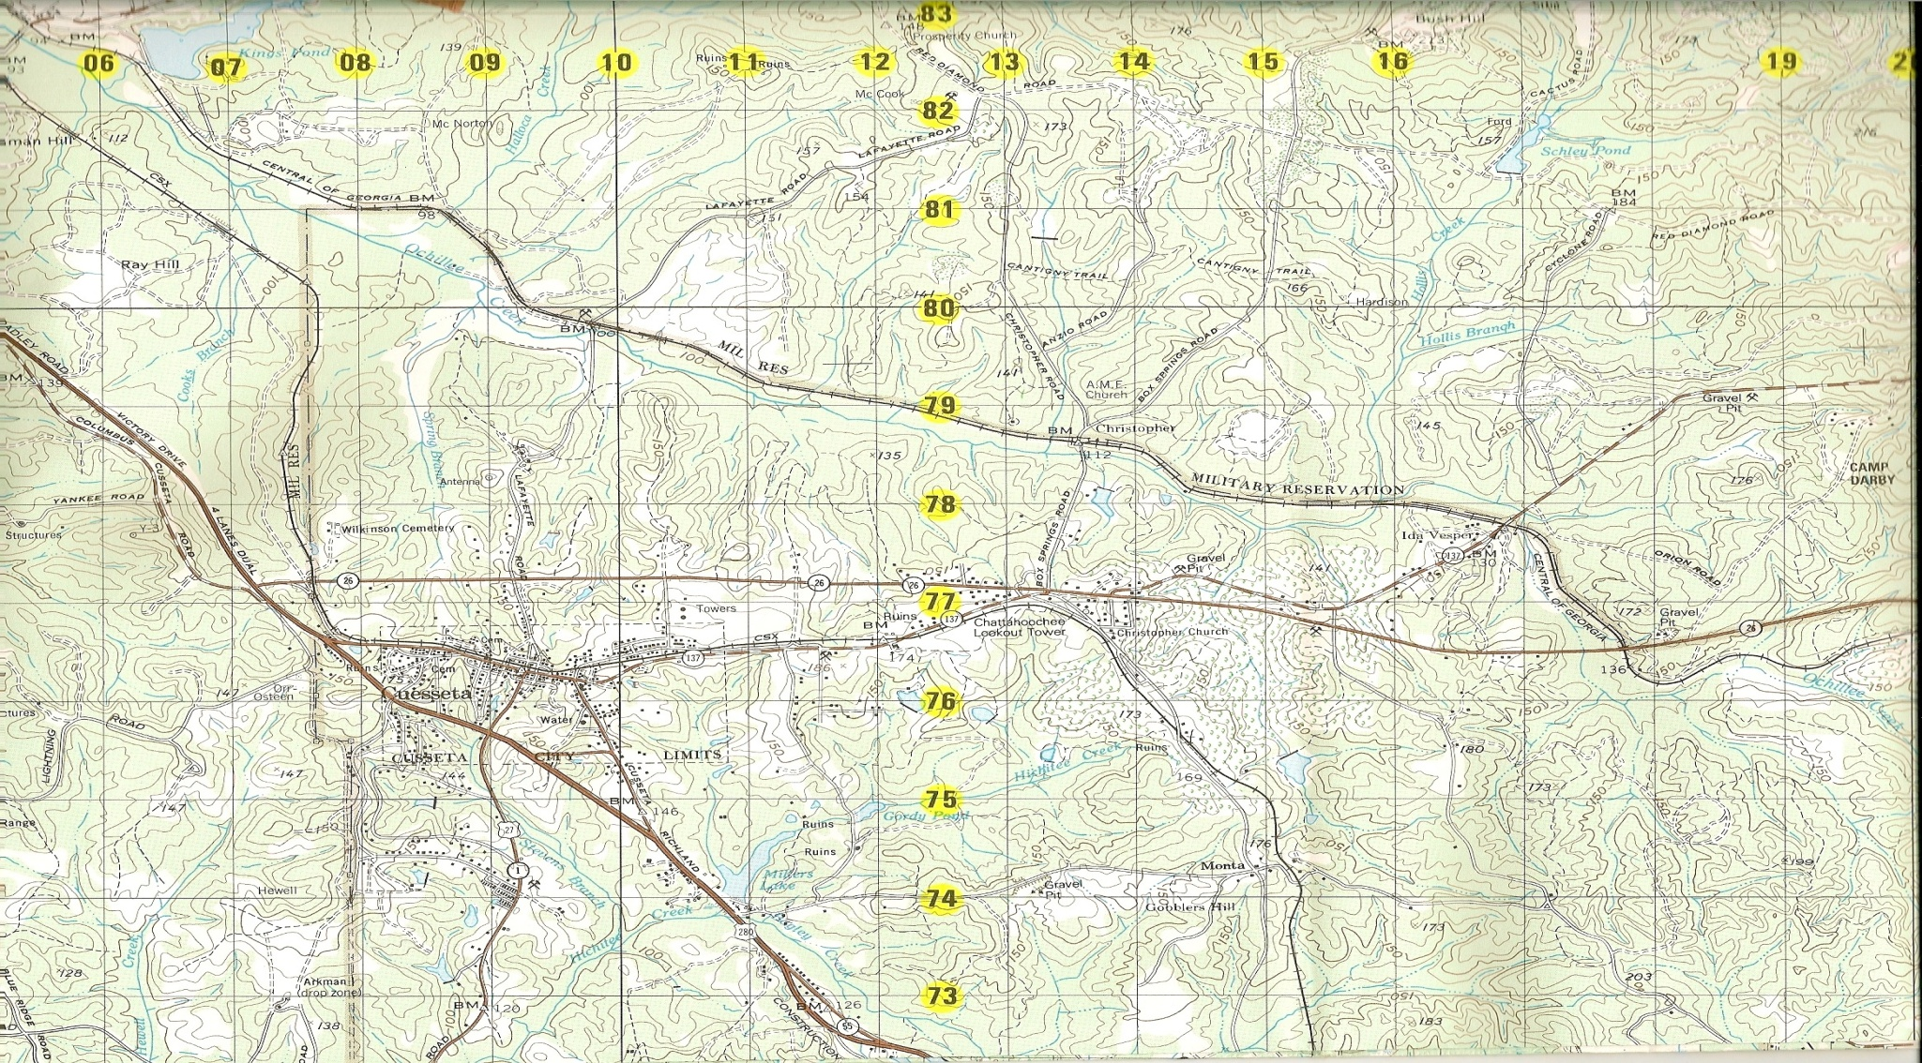
Introduction to Operational
Graphics
071-NRRAD072
MAP FORT BENNING 1:50 000
EDITION 1-DMA SERIES V745S
UNCLASSIFIED
OP CRUSADE
06
81
3 (AS)
II
3
X
II
3 (AS)
FEBA
X
XX
II
3
I
(NZ)
108
M
227
II
T
1
7
X
II
II
6018
1
S
II
II
II
2
II
S
(CA)
II
2
7
3
3
19
X
UNCLASSIFIED
X
CPT I.M.GOOD
173
173
FEBA
211905Z AUG 09
Developed by:​
Maneuver COE, DOTD, TEDD​
for Infantryman ALC
Last Revised: 15 JUNE 2023

Slide 2
VL Classroom Rules
MS Teams
Conduct a microphone and webcam check.
Identify yourself before contributing to the discussion or asking a question.
Use the A365 MS Teams raised hand function to ask questions.
Use the chat section to ask questions that are complex or require an extended time to answer. The host/presenter will introduce your question and then allow the group to further discuss it. If your question does not get presented to the group due to time constraints, then the host will answer it before the next meeting.
Classroom introductions (name/location/unit).

Slide 3
Terminal Learning Objective
Action: Prepare an Operational Overlay.
Condition: As a small unit leader in a virtual (digital) or face-to-face classroom environment, given a 1:50,000 scale military map, clear map acetate (non-adhesive), tape, colored markers/pencils, a No. 2 pencil, GTA 05-02-012 Coordinate Scale and Protractor, FM 1-02.2 Military Symbols, and a requirement to prepare an operational overlay.
Standard: Prepare an operational overlay using standard symbols that depicts orientation, plotting, symbolizing, and required marginal information accurately by applying 28 out of 40 overlay requirements, within 1 hour.

Slide 4
Pre-Assessment
1
2
3
4
L
6
R
5
7
8
9
10
11
12
Notes:
Instructor Note: See IH 1 for answers to Pre-assessment

Slide 5
Pre-Assessment
E
13
14
15
16
17
18
19
20
21
RP
22
PLD
23
24
PLD
NAME
25
A
A
26
B
B

Slide 6
What are Military Symbols?
Graphic Representation of:
  -Units
  - Equipment
  - Installations
  - Control Measures
  - Tactical Tasks
  - Other Elements relevant to military operations
Common Operating Picture
Notes:
NOTE: Ask students “In your own words, what are military symbols?”
Military symbols are logograms that represent words or phrases that are used to depict abstract graphic representations of a unit, equipment, installation, activity, control measure, or tactical mission task relevant to military operations. They are used for course of action sketches, visualizing operations orders, planning, or to represent a current common operational picture on a map, display, or overlay.
REF: FM 1-02.2 Chapter 1 Introduction, page 1-1 (PDF page 13)

Slide 7
Purpose of Military Symbols?
To allow Commanders and Staffs to display certain elements of the Operational Picture.
Used on
  Situational Maps
  Overlays
  Annotated Aerial Photographs
Used to Express
  Operational Plan or Order
  Concept
  Friendly or Hostile Situation (SIT TEMP)
Notes:
To allow Commanders and Staffs to display certain elements of the Operational picture. They are used on situational maps, overlays, and aerial photographs. They are used to express an Operational Plan, Concept or a Friendly or Hostile Situation.

Slide 8
Basic Rules for Building
Symbols
Use existing Symbols
Hand-Drawn or Computer Generated
Easily Distinguishable
Friendly and Enemy Symbols
Distinguishable without Color
Use of Amplifier and Modifier tables
Lettering
Notes:
LSA 3: Basic Rules for Building Military Symbols:
Use existing Symbols, do not make up your own.
They can be hand drawn or computer generated.
They must be easily distinguishable.
Distinguish friendly from enemy.
Distinguishable with or without color.
Use the Amplifier and Modifiers to better describe the Symbol being represented.
Ensure you are using the proper abbreviations as well as ensuring all letters are capitalized.
Check on Learning:
Q: Where can you find military symbols for reference? A: FM 1-02.2
Q: What are some examples of where you would see computer generated symbols? A: FBCB2/JCR/JCB-P Tactical Applique Displays.
Q: How can you distinguish a friendly symbol from an enemy symbol without color? A: By the shape of the symbol.

Slide 9
Composition of Military Symbols
Composed of:
  Frame/Unframed (Standard Identity, Physical Domain)
  Status
  Color (Fill)
  Icon
  Modifiers
  Amplifiers
Notes:
Military Symbols can be either Framed or Unframed.
Framed symbols are used to depict units, equipment, installations, and activities by using a combination of main icon, modifiers, amplifiers, and color (optional) to complete the military symbol construct. REF: FM 1-02.2, para 1-1, page 1-1 (PDF page 13)
Equipment symbols may be depicted with frame or unframed. Control measure symbols and mission task symbols are unframed symbols that conform to special rules for their own elements. REF: FM 1-02.2, para 1-12, page 1-6 (PDF page 18)
For the purpose of this learning activity we will focus on Framed Symbols used to depict units.
The framed symbol standard identity is identified by the design of the frame, and the categories are unknown, pending, assumed friend, friend, neutral, suspect, and hostile. REF: FM 1-02.2, para 1-2, page 1-1 (PDF page 13)
The physical domain defines the primary mission area above the earth’s surface (in the air or space domains), on the earth’s surface (land or maritime domains), or below the earth’s surface (subsurface domain). Frame shapes differ by surface (land and sea), sea subsurface, air, and space physical domains. REF: FM 1-02.2, para 1-3, page 1-1 (PDF page 13)
Frame shape symbol use is dependent on the object’s current physical domain. An aircraft, regardless of Service ownership, can be depicted in either the air domain (in flight) or land domain (on the ground),while aviation units are depicted as land units and facilities as a land installations. The exception is surface equipment (land and sea) frames that do not change between land and maritime physical domains. An example is an amphibious vehicle that uses the same frame shape regardless of current physical domain because it can operate in both land and maritime domains. REF FM 1-02.2, para 1-4, page 1-1 (PDF page 13)

Slide 10
Basic Symbol Color
In framed symbols, color provides a redundant clue with regard to standard identity.
The fill is the interior area within a symbol.
If color is not used, the fill is transparent.
In unframed symbols (equipment), color is the sole indicator of standard identity, excluding text amplifiers.
Blue for friendly or assumed friend, red for hostile or suspect, green for neutral, and yellow for unknown or pending are the default colors used to designate standard identity.
Affiliation color without the fill may also be used for the frame, main icon, and modifiers.
Notes:
Refer students to FM 1-02.2, Table 1-4 on page 1-5 (PDF page 17)
RECAP:
Blue is used for Friendly Symbols.
Red is used for Hostile Symbols (Enemy)
Green is used for Neutral symbols.
Yellow is used for Unknown symbols.
Computer Generated Symbols will either use color for the Frame, Icon, Modifiers, and Amplifiers, or will these will be drawn in black and a color fill will be used in the Frame.
Hand Drawn symbols do not use a fill. The Frame, Icon, Modifiers, and Amplifiers will either be drawn in color, or in black if color is not available.
White may be used instead of black if drawn on a dark surface.
Q: If you are using color, what color would you use to draw a symbol for a minefield?
A: Green (because obstacles are neutral regardless of who emplaced them, as the impede movement of all forces on the battlefield)

Slide 11
Composition of Unit Symbols
2/A/1-21
L
2/25ID
Notes:
LSA 3: Composition of Military Symbols
This is an example of a complete Framed Unit Symbol.
A symbol is considered complete when all information needed to accurately depict the unit graphically is combined into a single symbolic form. Generally, you want to build the symbol using as little information as possible for the sake of simplicity, but include enough information to make an accurate representation of the unit and its capabilities.
A complete unit symbol will consist of a minimum of a frame, 1 icon, up to 2 modifiers, and at least 3 modifiers.

Slide 12
Composition of Unit Symbols
Composed of:
  -A Frame (Standard Identity, Physical Domain
  -Status
  -Color (Fill)
  -Icon
  -Amplifiers
  -Modifiers
Echelon Modifier
Frame
Full Frame
Icon (Branch
or Functional
Symbol)
UNIQUE DESIGNATION
2
A/1-1
Higher Formation
Color
Notes:
The frame is the border of the symbol, and it serves as the base to which other symbol components are added, and indicates the standard identity, physical domain, and status of the object being represented. Framed symbols may use standard identity colors to enhance depiction or can be black and white depending on display. REF: FM 1-02.2, para 1-1, page 1-1 (PDF page 13)
Status depicts whether an object exists at the location identified (status is “present” or “confirmed”),will in the future reside at that location (status is “planned” or “anticipated”), or is thought to reside at that location (“suspected”). REF: FM 1-02.2, para 1-5, page 1-3 (PDF page 15)
Standard identity colors are used as the fill areas for framed military symbols, and line colors for unframed and framed military symbols.
Fill and line color are optional for framed symbols because the frame design provides the standard identity, and color is only a redundant identity indicator used to enhance the framed symbol. REF: FM 1-02.2, para 1-9, page 1-5 (PDF page 17)
The colors used for hand drawn symbols are:
Blue for Friend or Assumed Friend
Yellow for Unknown or Pending
Green for Neutral
Red for Hostile, Suspect, Joker, or Faker
Black is used for all symbols when standard identity colors are not available.
White may be used instead of black for symbols drawn on a dark surface.
REF: FM 1-02.2, Table 1-4 (PDF page 17)
The main icon for units, equipment, installations, or activities provides the main function of the military symbol construct. It is placed in the innermost part of the symbol construct. REF: FM 1-02.2, para 1-7, page 1-4 (PDF page 16)
A modifier provides additional capability information when portraying a symbol. REF: FM 1-02.2, para 1-8, page 1-5 (PDF page 17)
Amplifiers are optional fields that provide the capability to include additional information about the symbol being portrayed. Not all military symbols use amplifiers, and each symbol construct has its own unique amplifier applicability or placement location that is displayed in accordance with the appropriate military symbol construct standard. REF: FM 1-02.2, para 1-10, page 1-6 (PDF page 18)
The lettering for all military symbols will always be upper case, sans serif font, right aligned on the left side, left aligned on the right, and centered on top. In some cases, the lettering may be tilted slightly to follow the contour of a line but must be oriented for left-to-right legibility and avoid tilting so much that readers must tilt their heads to read it. REF: FM 1-02.2, para 1-11, page 1-6 (PDF page 18)

Slide 13
Basic Symbol Frames and Status
Notes:
Refer students to FM 1-02.2, Table 2-1 on page 2-1 (PDF page 23) and discuss.

Slide 14
Building of a Unit Symbol
Step 1
Choose the frame that matches the affiliation of the unit. Then choose branch or functional symbol.
Step 2
If required, choose the second branch symbol modifier that further explains the capability of the unit.
Step 3
Again, if required choose the third branch symbol modifier for the next capability.
Step 4
Choose a fourth branch symbol modifier for any other capability.
Step 5
Choose the text or graphic modifiers as necessary to provide further amplifying information.
Notes:
Table 1-5 on page 1-8 provides a step-by-step framed symbol building process example for an infantry unit with armored high mobility vehicle capability, echelon of command level, and its unit designation.

Slide 15
Echelon Amplifiers for Unit Symbols (Field B)
Squad
Section
Platoon
Company, Battery or Troop
Battalion or
Squadron
Regiment or
Group
Notes:
An echelon is a separate level of command. In addition, there is also a separate echelon known as a non-echelon command. A non-echelon command is a unit or units, an organization, or an area under the command of one individual. It does not correspond to any of the other echelons. REF: FM 1-02.2, para 2-4, PDF page 27
Figure 2-2 (PDF page 27) shows the template for an echelon amplifier. The height of the echelon amplifier is one-fourth of the size of the height of the frame.
Table 2-3, on page 2-6 (PDF page 28), shows the Field B amplifiers for Army echelons and non-echelon commands.
Have the students identify the echelon of each symbol on the slide and find it in the table.

Slide 16
Echelon Amplifiers for Unit Symbols (Field B)
Squad
Section
Platoon
Company, Battery or Troop
Battalion or
Squadron
Regiment or
Group

Slide 17
Branch and Functional Icons
E
Infantry
Armor
Artillery
RECON
Engineer
E
MP
Anti Armor
Supply
Medical
Military
Police
Notes:
Instructor Note: Ask students to identify each branch and functional icons.
Instructor Note: Show Enemy Icons.

Slide 18
Team & Task Force
Amplifiers (Field D)
Battalion Task
Force
Company Team
L
Notes:
This amplifier is used with a battalion task force, or company team. REF: FM 1-02.2, para 2-6, PDF page 31
A battalion task force is a maneuver battalion-size unit consisting of a battalion headquarters, at least one assigned company size-element, and at least one attached company-size element from another maneuver or support unit (functional or multifunctional).
A company team is a combined arms organization formed by attaching one or more nonorganic armor, mechanized infantry, Stryker infantry, or infantry platoons to a tank, mechanized infantry, Stryker, or infantry company, either in exchange for, or in addition to, its organic platoons.
Figure 2-5 (PDF page 31) provides the template for a task organization amplifier, and table 2-4, on page 2-10 (PDF page 32), shows the task organization amplifier and construct examples.

Slide 19
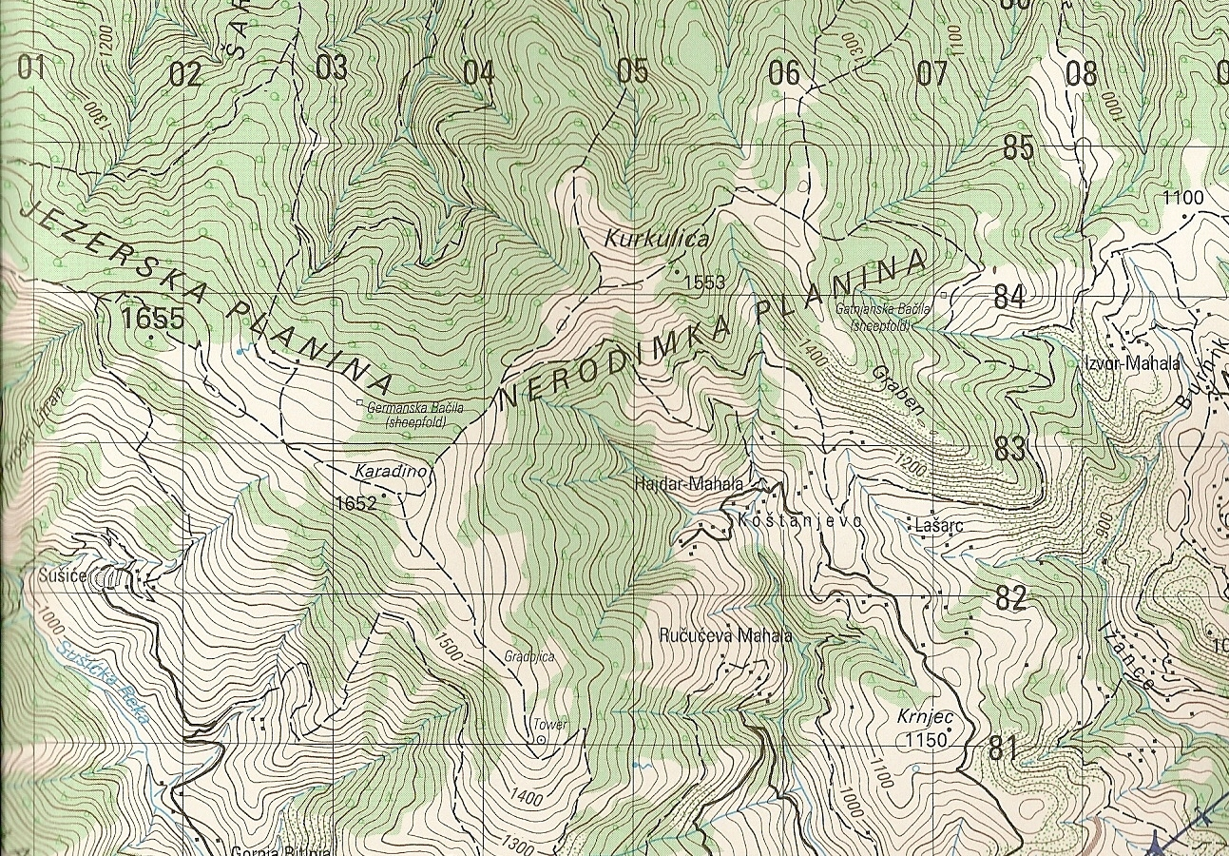

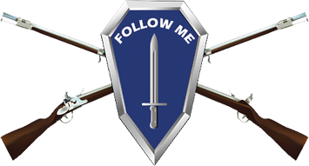
Overlay Graphic Examples
B
1-77
1-77
X
II
A
1-77
Notes:
Typically, a unit symbol is drawn centered over the unit's location, such that the center of the frame is directly over the exact location of the unit on the map or graphic. When this is not possible, the symbol is drawn with the entire frame above the actual location and a straight vertical line is drawn from the bottom of the frame, centered, down to the location of the unit. If a bent line is needed to show the unit location because the symbol had to be drawn offset, a straight vertical line will be drawn from the bottom of the frame, centered, extending ¼ of the height of the frame, then the line may be bent in the direction needed to show the precise location of the unit.
Headquarters units follow special rules:
Headquarters Staff Location Indicator Amplifier (Field S). To indicate a precise location or reduce the clutter of headquarters unit symbols, a staff extends from the bottom left-hand corner to the headquarters location displayed as Field S. If several headquarters are at one location, more than one headquarters can be on a single staff. The highest echelon headquarters is placed on top, followed by the next echelons in descending order. Figure 2-18 on PDF page 39 shows examples of how the headquarters locator indicator is used.
REF: FM 1-02.2, para 2-16, PDF pg 39
Offset Location Indicator Amplifier (Field S2). Field S2 is a bent line that extends from the end of the headquarters staff location indicator amplifier (Field S) to the desired location. The offset location indicator amplifier field is used to indicate precise location or reduce clutter in an area with multiple units. Figure 2-19, PDF page 40, shows examples of how to use the offset locator indicator.
REF: FM 1-02.2, para 2-17, PDF pg 39
For multiple units occupying a single location, such as occupying an assembly area, the unit symbols can be drawn offset from the location and stacked vertically, ordered by highest echelon to lowest. Then the symbols are enclosed in a bracket and a line is drawn from the center of the bracket to the exact location on the map or graphic.
If several headquarters are at one location, more than one headquarters can be on a single staff. The highest echelon headquarters is placed on top, followed by the next echelons in descending order. A bent line (without an arrow) that extends from the end of the headquarters staff location indicator amplifier (Field S) to the desired location.
REF: FM 1-02.2, para 2-16 and 2-17, PDF pg 39

Slide 20
Composition of Unit Symbols
Role Indicator
R
L
INFANTRY
LIGHT INFANTRY
RANGER
AIRBORNE
INFANTRY
AIRBORNE
INFANTRY
ANTIARMOR
MECHANIZED
INFANTRY
MECHANIZED INFANTRY
W/GUN SYSTEM
Notes:
Have students identify each symbol.

Slide 21
Composition of Unit Symbols
Fields
SIZE
Unit
1
A/1-1
Higher
Formation

Slide 22
Other Possible Modifiers
Reinforced / reduced
Country indicator
(+)
(US)
1/3
172115ZAUG07
Direction of
movement
FREE TEXT

Slide 23
Composition Equipment
Symbols
Rules
Icon
Orientation
Modifiers
Mobility Indicator Amplifier (Field R)
Frames
Size and Range Indicators
Notes:
Equipment is nonexpendable items needed to outfit or equip an individual or organization. Our focus will be on land equipment symbols. Equipment symbols are discussed in Chapter 4 of FM 1-02.2.
The equipment symbol construct standard permits the option to depict the symbol with frame or unframed. As discussed earlier during our discussion on unit symbols, the frame shape is what indicates the standard identity of a symbol. The unframed equipment symbol constructs must use colors (including blue, red, green, and yellow) in order to indicate the standard identity depiction of friendly, enemy, neutral, or unknown items. REF: FM 1-02.2, para 4-1, PDF pg 129
If frames are used, this symbol frame shape is used to identify friendly, enemy, neutral, and unknown equipment affiliation in or supporting an area of interest or operations. Table 4-1, on page 4-2 (PDF pg 130), provides the standard identity frame shapes for equipment.
The frame shape construct guidelines for main and modifier icons, and amplifier placement locations, are provided in paragraph 4-4 (PDF page 134).
Every equipment symbol, framed or unframed, must include an equipment icon. Depending on the equipment being shown, you may have modifiers to indicate things such as size, range, or weapon system caliber and mobility modifiers for self-propelled or towed equipment.
Equipment is oriented with the top of the symbol oriented in the same direction on the map that the equipment is oriented on the ground. For example, a mortar tube oriented on a hill to the northeast would be drawn so that the symbol is turned towards the hill to the northeast on the map.

Slide 24
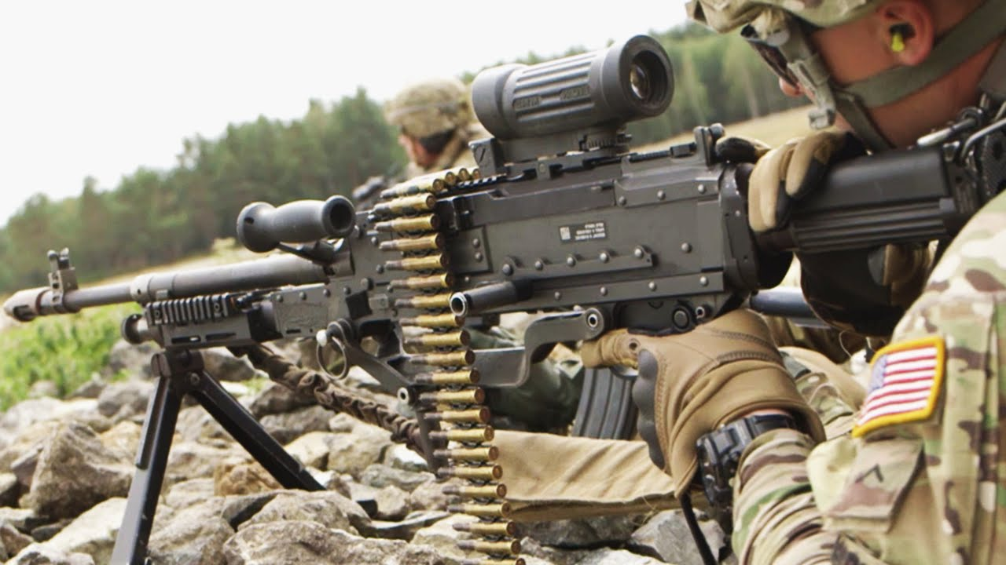
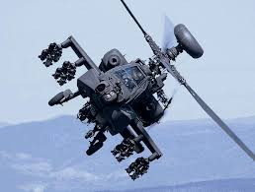
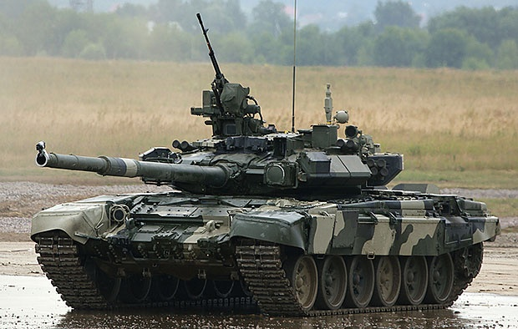
Equipment/Vehicle Symbols
A
M
Notes:
Tank (generic), FM 1-02.2, Pg 4-26
Medium Machine Gun, FM 1-02.2, Pg 4-18
Attack Helicopter, FM 1-02.2, Pg 4-30
Modifier Pg 4-34 & 4-39

Slide 25
Building of an equipment Symbol
Step 1
Choose the main Icon of the weapon/piece of equipment.
Step 2
If required/known, choose the appropriate size, range, or altitude indicator.
Choose the text or graphic modifiers as necessary to provide further amplifying information (in this example none).
Step 3
Step 4
If required/known annotate the proper Mobility Amplifier.
Step 5
Frame or leave unframed.
Framed
Unframed
What piece of equipment is shown?
Friendly light towed howitzer.
Notes:
Step 1: Table 4-6, beginning on PDF page 140, contains all the main icons for equipment symbols.
Step 2: These are in Table 4-6. When you find your equipment icon (in this example, a howitzer, you will see there are modifications in the table for different sizes of howitzer (light, medium, heavy, etc.)
Step 3: Table 4-2, starting on PDF page 132, contains descriptions of all amplifier fields. For hand-drawn symbols, usually none are used.
Step 4: The mobility (transportation) mode indicator is only used to depict the mode of transport of equipment. For example, a symbol for an armored self-propelled howitzer transported by train would include a railway mobility mode indicator in Field R (See figure 4-4 on PDF page 136.) REF: FM 1-02.2, para 4-4, PDF page 136.
Table 4-4, beginning on PDF page 137, provides a list of mobility (transportation) mode indicators with construct examples of the transporting of a howitzer.
Step 5: Decide if you will leave the symbol unframed, or use a frame. Table 4-1, on page 4-2 (PDF pg 130), provides the standard identity frame shapes for equipment.

Slide 26
Equipment Symbol
Components
Weapon
System
Rocket Launcher
Anti-Tank
Missile
Direct Fire
Gun
Indirect
Fire
Air
Defense
Rifle/
Automatic
Weapon
Light MG
Medium MG
Heavy MG
Light
Mortar
Medium
Mortar
Heavy
Mortar
Tank
Armored Personnel Carrier
Armored Fighting Vehicle
(Infantry Fighting Vehicle)
Notes:
FM 1-02.2, Pgs 4-11 thru 4-33 , Table 4-6 Main Icons for Equipment
Review weapons symbols on slide with students.
Equipment symbols can be used with or without frames.
When frames are not used, then standard identity color must be used.

Slide 27
Equipment Symbol Modifiers
3
2
2 x Enemy
Heavy Self-Propelled Howitzers
Oriented West
Heavy Mortar
Oriented North
Question: Why are control measures used when developing operational graphics?
Answer: To regulate forces and warfighting functions.
Notes:
There are numerous text and graphic modifiers which can be added to equipment symbols.
Instead of a unit size indicator graphic above the symbol, a number is placed denoting the actual number of pieces of equipment.
Additional information can be found in FM 1-02.2, page 4-1.

Slide 28
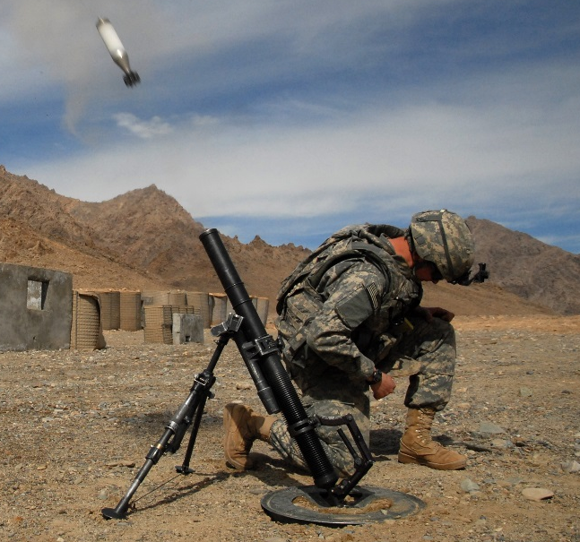
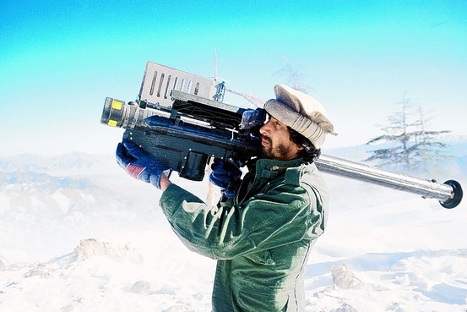
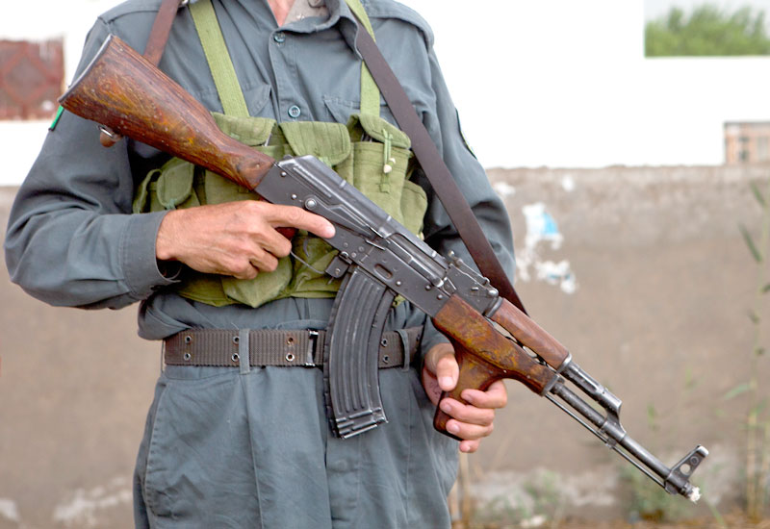

Draw the Pieces of Equipment
Notes:
Mortar (60mm or less), FM 1-02.2, Pg 4-15
Rifle Automatic, FM 1-02.2, Pg 4-18
Short range (Air defense), FM 1-02.2, Pg 4-20

Slide 29
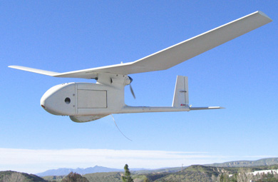


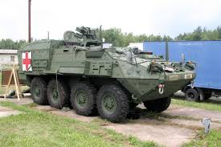
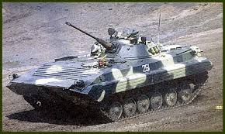
Draw the Vehicles
Notes:
Medical evacuation armored wheeled high mobility, FM 1-02.2, Pg 4-36
Unmanned aircraft system, FM 1-02.2, Pg 2-57
Armored fighting vehicle, FM 1-02.2, Pg 4-25

Slide 30
Control Measures
Graphic control measures are graphic directives given by
a Commander to subordinate Commanders / Leaders to
assign responsibilities, coordinate fire and maneuver and
control combat operations.
They include:
  - Boundaries
  - Lines
  - Areas
  - Points
  - Targets
  NBC Attacks and events
Land
  Maneuver
  Fire support
  Mission Command
  Mobility Operations
  Sustainment
Notes:
FM 1-02.2, Chapter 5
Control measure symbols generally fall into one of three categories: points, lines, or areas.
- Land graphic control measures are classified as maneuver, fire support, mission command, mobility
operations, and sustainment.
The coloring and labeling of control measure symbols is almost identical to framed symbols.
Friendly graphic control measures are shown in black or blue.
- Hostile graphic control measures are shown in red. If red is not available, they are shown in black with
the abbreviation “ENY” placed on the graphic in amplifier field 15.
- If a special requirement arises to show neutral or unknown graphic control measures, they are shown in
black, and the abbreviations of “NEU” for neutral or “UNK” for unknown are used in amplifier field 15.
- All obstacles, regardless of standard identity, are shown in green. If green is not available, obstacles
should be shown using black.
- Yellow is used for the cross-hatching of areas with chemical, biological, radiological, or nuclear (CBRN)
contamination.

Slide 31
OPERATIONAL OVERLAY LABELING REQUIREMENTS
OVERLAY / OP NAME
CLASSIFICATION
MAP 1:50 000
KOSOVO
UNCLASSIFIED
OP CRAYON
MAP
REFERENCE
02
GRID REFERENCE
POINT
84
GRID REFERENCE
POINT
NORTH
POINT
82
N
08
AUTHOR
LT I.M.GOOD
UNCLASSIFIED
230900ZAUG07
DTG
CLASSIFICATION
Notes:
Overlays are graphics drawn on top of a map, sketch, or photograph.
To ensure accurate alignment, the overlay must have at least two grid reference points at opposite locations.
Point out other labeling requirements.
Make all text labeling upper case letters.
All lettering should be oriented horizontally, from left to right, so that readers can see it easily without having to tilt their head.
Abbreviations must be used for Army control measure symbols.

Slide 32
Boundaries
A boundary is a line that delineates surface areas for the purpose of facilitating coordination and deconfliction of operations between adjacent units, formations, or areas (JP 3-0). There are three types of boundary lines: lateral, rear, and forward. Amplifiers are displayed perpendicular to the boundary line.
Notes:
A boundary is a line that delineates surface areas for the purpose of facilitating coordination and deconfliction of operations between adjacent units, formations, or areas (JP 3-0). Figure 5-6 on PDF page 175 provides a boundary composition template that includes orientation of optional amplifier field labels for horizontal (east—west) and vertical (north—south) boundaries.
(See table 5-3 on PDF pages 176 through 177 for depictions of boundary control measures.)
The following are the optional amplifiers that may be used with this control measure construct:
Country code Field “AS” to identify the units’ three-letter geographical entity country code.
Echelon indication Field “B” to identify the boundary echelon.
Hostile (enemy) Field “N” to identify enemy boundaries.
Unique identifier Field “T” to identify designations of adjacent units.
Table 5-4 on PDF page 178 shows examples of complete boundary lines.

Slide 33
Boundaries
Friendly Planned or On Order
Friendly Present
A
A
B
B
1-11
1-11
2-502
2-502
1
1
2
2
Notes:
Instructor Note: Ask students how boundaries are placed on a map overlay.
Guide discussion to get at the following:
Within their boundaries, units may maneuver within the overall plan without close coordination with neighboring units unless otherwise restricted.
Direct fire may be placed across boundaries on clearly identified enemy targets without prior coordination, provided
friendly forces are not endangered. Indirect fire may also be used after prior coordination.
Boundaries in the offense establish zones of action and in the defense, they establish sectors of responsibility.
Boundaries are indicated by a line with the size of the unit shown at convenient intervals.
Designations of units are placed on either side of the size indication.
The highest echelon of adjacent units shares the boundary.
When boundaries separate units of unequal size, the size symbol of the larger unit is placed on the boundary.
The designation of the smaller unit is spelled out to include its size.

Slide 34
Areas
An area is a control measure symbol with multiple sets of coordinates that start and finish at the same point. Areas normally are marked with the abbreviation for the type of area in the icon field, followed by a name in field 3. This labeling should be in the center of the area unless the area is too small, or the labeling would interfere with locating units. The type of area determines the number of fields being used. Not all fields are required for each area. Some areas may use only one field, while other areas will use several.
Notes:
An area is a specified geographic surface included within a delineated set of lines (boundaries) used for the purpose of facilitating coordination and deconfliction between adjacent units, formations, or other specific geographical surfaces. Figure 5-7 on PDF page 179 provides the dynamic figure template for areas that provides the option to use 7 amplifier fields with the operations area main icon symbols listed in table 5-5 and 5-6, on PDF pages 180 through 187. lists battle positions and operations area templates with unique drawing constructs.

Slide 35
Areas
TAI ATLANTA
AA EAGLE
EA DESTROYER
ATK TEXAS
(P) SNAKE
C
A/1-8
Notes:
Have the students use Tables 5-5 and 5-6 to identify the areas on the slide.
Answers:
Target area of interest: The geographical area where high-value targets can be acquired and engaged by friendly forces. (JP 2-01.3)
Assembly area: An area a unit occupies to prepare for an operation. (FM 3-90-1)
Engagement area: An area where the commander intends to contain and destroy an enemy force with the massed effects of all available weapons and supporting systems. (ADP 3-90)
Battle position prepared but not occupied
Attack position: The last position an attacking force occupies or passes through before crossing the line of departure. (ADP 3-90)
**Contaminated Area: Remember when we discussed colors that yellow is used for the cross-hatching of CBRN contaminated areas?
** Students will not find this symbol. Have them read para 5-44 on PDF page 266 then use Table 5-27 on PDF page 269.

Slide 36
Points
A point is a control measure symbol that has only one set of coordinates. Most Army point symbols follow a standard format.
Notes:
Figure 5-8 on PDF page 189 provides the templates used for point control measure main icon symbols listed in table 5-7, starting on PDF page 190, that include contact, coordination, decision, targets, sustainment, special supply distribution, and CBRN decontamination points.
Distinctive action points have unique formats (including square, circular, star, and cross) that do not follow a specific template and are unique symbols that represent specific actions (including contact, coordination, decision, targets, communication, and air). Distinctive action points are listed in Table 5-8, on PDF pages 203 through 208.
The point templates in figure 5-8 also includes amplifier fields (see table 5-2 on PDF page 172) that can be used for additional information.
As a minimum a point shall include the function (Field A) information, and all other fields are optional information. Point symbols cannot be rotated and therefore text will not be written on an angle. Point symbol fields include:
Field A (required): can use acronyms or graphics in to identify the point name or function.
Field H (optional): used for additional information (content is implementation specific).
Field N (optional): used to identify an enemy point using “ENY”.
Field T, T1 (optional): for text amplifiers used to differentiate a symbol by numbering, lettering or a combination of both, and or unit designations.
Field S2 (optional): used to indicate the offset or precise location of a single point symbol.
Field W, W1 (optional): used to identify the date-time group associated with point.

Slide 37
Control Measures
(Points)
SP
RLY
CKP
8
PP
3
Contact
Point
Check
Point
Passage
Point
Start
Point
Rally
Point
RP
ACP
#
Coordinating
Point
Air
Control
Point
Decision
Point
Release
Point
Notes:
Have the Students find the points on the slide in Table 5-7 and 5-8 in FM 1-02.2

Slide 38
Lines
A line is a control measure symbol with multiple sets of coordinates. Most lines are also labelled as phase lines for easy reference in orders and during transmissions. A phase line is marked as PL, with the line’s name in field T. When lines representing other purposes are marked as phase lines, they should show their primary purpose in the icon field (such as NFL for no fire line). The purpose of the line is labelled on top of the line at both ends inside the lateral boundaries in field T1 or as often as necessary for clarity. Field T2 is used for fire support coordination measures, to show the designation of the controlling headquarters. The use of phase lines to mark line control measure symbols is not mandatory.
Notes:
In table 5-9, on PDF pages 208 through 213, there are line control measure symbols that follow a specific template format as shown in figure 5-9 on PDF Page 205:
Most lines are also named as a phase line for ease of reference in orders and during transmissions.
Lines that have a specific purpose and are also named as phase lines (such as a restrictive fire line)should have the primary purpose in the Field T1 labeled on top of the line at both ends of the line inside the lateral boundaries or as often as necessary for clarity.
The designation of the controlling headquarters for fire support coordination measures is depicted in Field T2.
The use of phase lines to mark line control measure symbols is not mandatory.

Slide 39
Lines
Limit of Advance
LOA
LOA
Line of Contact
LC
LC
Line of Departure
LD
LD
Phase Line
PL
DOG
PL
DOG
Probable Line of Deployment
PLD
PLD
Notes:
In table 5-9, on pages 5-36 through 5-41, there are line control measure symbols that follow a specific
template format as shown in figure 5-9.
- Most lines are also names as a phase line for ease of reference in orders and during transmissions.
- Lines that have a specific purpose and are also named as phase lines (such as a restrictive fire line)
should have the primary purpose in the Field T1 labeled on top of the line at both ends of the line
inside the lateral boundaries or as often as necessary for clarity.
-The designation of the controlling headquarters for fire support coordination measures is depicted
in Field T2.
The use of phase lines to mark line control measure symbols is not mandatory.

Slide 40
Movement and Maneuver
Notes:
Movement is the positioning of combat power to establish the conditions for maneuver (ADP 3-90) ,and maneuver is the employment of forces in the operational area, through movement in combination with fires and information, to achieve a position of advantage in respect to the enemy (JP 3-0). (See FM 3-90-1and FM 3-90-2 for additional information on movement and maneuver.)
REF FM 1-02.2, para 5-26, PDF page 211.
Table 5-10, on PDF pages 212 through 215, includes forms of maneuver control measures. Forms of maneuver are distinct tactical combinations of fire and movement with a unique set of doctrinal characteristics that differ primarily in the relationship between the maneuvering force and the enemy (ADP 3-90).
Table 5-11 on PDF page 215 includes movement to contact control measures. Movement to contact is a type of offensive operation designed to develop the situation and to establish or regain contact (ADP 3-90).
Table 5-12, on PDF page 216, includes attack control measures. An attack is a type of offensive operation that destroys or defeats enemy forces, seizes and secures terrain, or both (ADP 3-90). Demonstrations and feints, while forms of attack, are also associated with the conduct of military deception operations. (See JP3-13 for more information on attacks.)
Table 5-13, on PDF pages 217 through 218 includes enabling control measures. Enabling operations apply to all elements of decisive action, and related military symbols usage is described in ADP 3-90. Enabling operations include security, reconnaissance, relief in place, and passage of lines.
Table 5-14, on PDF page 219, includes retrograde control measures. Retrograde applies to the elements of decisive action under defensive operations. Retrograde-related military symbols usage is described in ADP 3-90. Retrograde includes delay, withdraw, and retirement.
Table 5-15, on page 220, lists the observation post control measures.

Slide 41
Routes
Friendly Ground Axis of Supporting Attack
Friendly Direction of Supporting
Attack or Shaping Operation
Friendly Ground Axis of Main Attack
L
A/2-1
Friendly Direction of Main Attack
or Decisive Operation
L
A/2-1
Notes:
Main axis of advance – FM 1-02.2, Pg 5-43, Table 5-10
Direction of main attack – FM 1-02.2, Pg 5-44, Table 5-10

Slide 42
Fires Planning
#
PAA
PAA
PAA
PAA
Notes:
Have the students identify the symbols on the slide using Table 5-19.
Answers:
Target reference point: A predetermined point of reference, normally a permanent structure or terrain feature that can be used when describing a target location. (JP 3-09.3)
Linear target
Position area for artillery—rectangular.
Fire support coordination measures are employed by land or amphibious commanders to facilitate the
rapid engagement of targets and simultaneously provide safeguards for friendly forces.
Fire support coordination control measures should be labeled with the abbreviation of the control measures, the controlling headquarters (Field T), and the effective times (Fields W and W1).
Lines should have this labeling on both ends of the line and repeated as often as necessary for clarity along any line that passes through boundaries.

Slide 43
Mobility / Countermobility
S
AP
AT
Unspecified
Directional
101200Z
Scatterable Minefield (AT) with Self Destruct Date/Time Group
Completed Minefield (Unspecified Mines)
Planned Minefield (AT Mines)
Mixed Minefield AP & AT
Wire
(Double Apron Fence)
Anti-Tank under Construction
Anti-Tank Completed
Notes:
FM 1-02.2, Chapter 5, Pg 5-76
MOBILITY AND COUNTERMOBILITY CONTROL MEASURES
5-39. Mobility and countermobility are subordinate tasks within the movement and maneuver warfighting
function. Mobility and countermobility are complementary opposites. Mobility is focused on friendly force
movement and maneuver, and countermobility is focused on affecting or thwarting enemy mobility. (See
ADP 3-90 and FM 3-90-1 for additional information on mobility and countermobility control measures.)
MOBILITY
5-40. Mobility is a quality or capability of military forces which permits them to move from place to place
while retaining the ability to fulfill their primary mission (JP 3-36). Table 5-21 on pages 5-77 through 5-79
lists mobility related control measure symbols. (See ATP 3-90.4 for additional information on mobility and
associated military symbol doctrine.)
COUNTERMOBILITY
5-41. Countermobility operations are those combined arms activities that use or enhance the effects of natural
and man-made obstacles to deny enemy freedom of movement and maneuver, and they include proper
obstacle integration with the maneuver plan, adherence to obstacle emplacement authority, and positive
obstacle control. An obstacle is any natural or man-made obstruction designed or employed to disrupt, fix,
turn, or block the movement of an opposing force, and to impose additional losses in personnel, time, and
equipment on the opposing force (JP 3-15). Table 5-22 on pages 5-80 through 5-85 lists countermobility
symbols and control

Slide 44
Other Control Measures
Attack by Fire
Position
Support by Fire
Position
NAME
NAME
Observation
Post
Forward
Observer
Position
Notes:
Attack by Fire – FM 1-02.2, Pg 6-2
Support by Fire -FM 1-02.2, Pg 6-4
Observation Post -FM 1-02.2, Pg 5-50
Forward Observer Position - FM 1-02.2, Pg 5-50

Slide 45
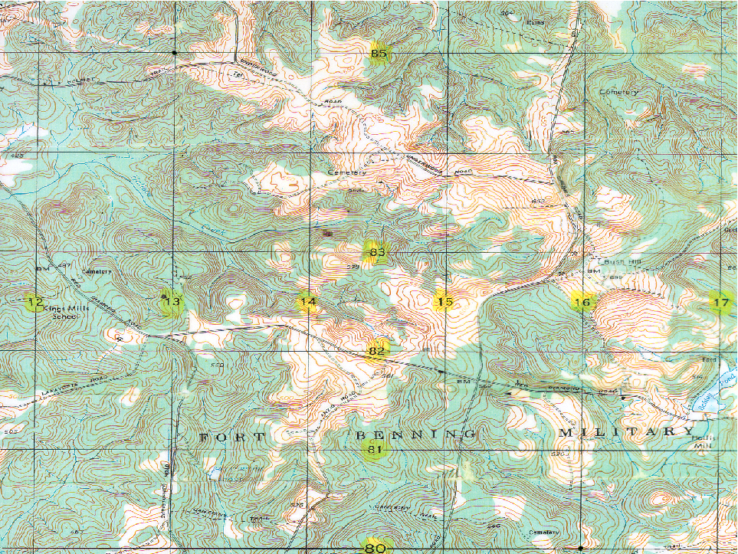
13
85
3
BP3
BP2
FG2301
ENY
3
BP1
C
L
C/5-87
C/5-87
5/87
FEBA
81
16
Notes:
Instructor Note: Briefly explain the graphics and control measures on the overlay.

Slide 46
Graphics & Control Measures
Overlays
  Graphics drawn on top of a map, sketch, or photograph
  Overlay must have at least two reference points
  Automated displays
Orientation
  Most in FM 1-02.2 have a 360-degree orientation capability
  Control measures are oriented to reflect positions on the ground

Slide 47
Operational Graphics
071-NRRAD072
Practical Exercise

Slide 48
Terminal Learning Objective
Action: Prepare an Operational Overlay.
Condition: As a small unit leader in a virtual (digital) or face-to-face classroom environment, given a 1:50,000 scale military map, clear map acetate (non-adhesive), tape, colored markers/pencils, a No. 2 pencil, GTA 05-02-012 Coordinate Scale and Protractor, FM 1-02.2 Military Symbols, and a requirement to prepare an operational overlay.
Standard: Prepare an operational overlay using standard symbols that depicts orientation, plotting, symbolizing, and required marginal information accurately by applying 28 out of 40 overlay requirements, within 1 hour.

Slide 49
Questions?

