Slide 1


Review Army Training Management at the Troop-Company-Battery Level
Commander and First Sergeant
Pre-Command Course
150T L70PCC v2.0
Notes:
REFERENCE: FM 7-0, Training, June 2021.
INSTRUCTOR NOTES:
The instructor must be familiar with FM 7-0, Training and be able to describe leader roles and responsibilities for Army Training at all echelons, particularly those at echelons below the Company Level.
Instructor must conduct a familiarization walk-through using all hyperlinks to ensure that they function properly with the computer system used to conduct the class.
Use real-world examples to demonstrate leader roles in Army Training.
In informing the class of the administrative notes the instructor will clarify the details based on local SOP, policy, and building design.
SCRIPT -
Training management is a capability required of all Army leaders as part of their leader roles and as mission-essential training is planned and developed and executed to published Army standards.
Training management skills are applied at every echelon within the Army, from teams and small units to brigades and beyond.
This Professional Military Education lesson is a company grade lesson to the previous US Army Training Management lesson and will aid you as you seek to increase your skills for fulfilling your duties in developing realistic and challenging training in your assignment as a Troop-Company-Battery Command leader.
It is imperative that you understand that this lesson builds on previous training concerning how you can develop training programs to prepare you and your subordinates for their mission requirements.
It is also an objective of this course that you will develop confidence in the application of FM 7-0, Training, and the US Army training management governing concepts it provides you to train your units, whether in traditional and non-traditional training environments.
This lesson will review for you on training management and how you will utilize these skills in a manner to improve the training proficiency ratings of your units as it supports higher echelon mission requirements and simultaneously aligns your training mission objectives and goals with higher echelon priorities and objectives.
Successful application of this material will aid you as Commander and First Sergeant as you improve the capabilities, competency, and confidence of you unit for the tasks it must perform to fight and win the nations wars ethically, justly, and proficiently.
Furthermore, this less will help you as you improve you and your subordinate leaders understanding and awareness on how to prioritize, plan and prepare, execute, and evaluate/assessment troop-company-battery, and small unit training.
This lesson is designed to reinforce your leadership capabilities in a manner that supports, develops, and fields a fighting force capable of deterring America’s enemies, and when deterrence fails, to fight and decisively defeat that enemy on the fields of battle.
Let us begin with a few administrative notes --
Administration Management:
As an adult and a leader, you are expected to comport yourself professionally.
Here are some basic administrative issues you need to know:
Turn off all electronic devices: cell/smart phones, etc. since they serve to distract class dynamics.
Restroom locations.
Breaks.
Breakroom/area: Food, drinks (coffee, water fountain).
Rules for food/drink in classroom.
Emergency situations: Location of exits, accountability, tornado, hurricane.
Restricted areas (if applicable).
Network outage (contingency plan).
Power outage.
Are there any questions?
Next slide.

Slide 2
Terminal Learning Objective
Action: Review Army Training Management at the Troop-Company-Battery Level
Conditions: In a classroom environment, given a network with internet access, a computer workstation with CAC card access, access to the Army Training Network (ATN), the company’s annual training guidance (ATG), training management doctrinal references and resources.
Standards: Review Army Training Management at the T-C-B Level in a clear and concise manner with 100% accuracy, this will include the following: Review Army Training Management, Review Prioritizing Training Tasks, Review Planning for Training, and Review the Communication of Training Priorities.
Notes:
REFERENCE: FM 7-0, Training, June 2021.
INSTRUCTOR NOTES:
Pause to allow Soldiers time to read and process the Terminal Learning Objective (TLO) Action, Condition, and Standard.
SCRIPT -
The terminal learning objective with the task, conditions, and standards for today’s instruction is shown. This lesson is based on FM 7-0; students may download an electronic copy of FM 7-0 at https://armypubs.army.mil.
Our overall lesson will review how you, as Commanders and First Sergeants, will apply US Army training management principles at the organizational level and your obligations to do so by emphasizing the follow lesson topics, supporting lesson objectives, and accompanying practical exercise.
We will accomplish this by:
Reviewing unit training management principles.
Reviewing how to use a task crosswalk to prioritize tasks for training.
Reviewing how to identify and utilize the digital training tools provided for Army training management.
Reviewing the methods and means for planning training.
Reviewing the methods and means for communicating your training plan through all echelons of Army leadership.
Are there any questions?
Next slide.

Slide 3
Motivator
“The relationship between officers and men should . . . be that of . . . teacher and scholar . . . to the extent that . . . commanding officers, are responsible for the physical, mental, and moral welfare, as well as the discipline and military training of the young men under their command”
General John A. Lejeune
Notes:
REFERENCE: FM 7-0, Training, June 2021.
INSTRUCTOR NOTES:
If time permits have the students reflect for a moment on the quote by Lejeune, then share stories and experiences from productive and counter-productive training.
Manage the discussion and the time to stay on track for course instruction.
SCRIPT -
Though reflecting on the role that officers play in the leadership and training process, General Lejeune’s comment is directly applicable to the Leading T-C-B NCO, the First Sergeant as well. General Lejeune reminds you of your critical role as a Command Team in preparing your units to deter our nations enemies and when deterrence fails, to decisively defeat them on the fields of battle.
ASK:
In what way does General Lejeune’s statement apply to training and mission success? Explain.
In what ways will the Commander and First Sergeant relationship impact training plan development and success? Explain.
Answer: Student response will vary, encourage productive dialogue, guide discussions, correct misconceptions about training, the planning process, and subsequent actions that lead to successful execution of training.
Army units spend a lot of time training. The students should realize the importance of correctly planned and executed training. Guide the discussion so students understand the importance of training.
Are there any questions?
Next slide.

Slide 4
LSA 1
Review Army Training Management
at the T-C-B Level
Notes:
REFERENCE: FM 7-0, Training, June 2021.
INSTRUCTOR NOTES:
The Instructor must read and be familiar with FM 7-0, the focus of the lesson plan is: constructing training at the organizational level by understanding the importance of training proficiencies, training proficiency rating assessments, and the importance of the principles of training as a key feature of employing training management at the organizational level.
Use this time to transition to the first lesson: LSA 1- Review Army Training Management at the T-C-B Level
SCRIPT -
As noted in other discussion about unit training management, training at the organization level progresses on the previous concepts of achieving proficiency in battle tasks. However, at the organizational level you will own a greater responsibility for UTM as you directly lead your organizational and small unit leaders by providing critical training guidance while simultaneously supervising training down to the lowest organizational echelons where individual Soldier are trained.
You accomplish this by developing critical organizational training plans, conducting organizational training events and through the process of evaluating and recording organizational training with the underlying end-state being your assessment of training proficiencies geared towards meeting the designed and/or assigned mission you and your higher echelon units own.
In this lesson we will discuss how you as the leader construct and manage organizational level training in support of higher echelon Commander training objectives and goals published formally through Training Guidance, and informally through continuous dialogue with Commanders at echelon to ensure that goals and objectives set out in the training guidance is faithfully applied throughout the organizational level, your area of responsibility.
By way of reminder, the US Army is the premier ground fighting force for the American people. As such, we are often called to fight and win our nations wars, to establish and sustain peace, and decisively defeat our enemies in various operational environments. The success of the Army is directly related to its ability to prepare for every contingency by training on the tasks necessary for mission success. Army training is a methodical process by which leaders develop their units through tough realistic training performed to the highest standards of excellence.
One of our ultimate aims is task mastery, both individual and collective. As an Army force, we exist to deter our enemies; when deterrence fails, we decisively defeat our enemies on the battlefield.
Leaders train, and in training identify gaps which exist between a unit's proficiency level and its mission. Identified gaps shape leader training efforts to close identified gaps in a manner that enables the organization to operate at a high level of proficiency in its tasks and is ready to deploy at a moments notice.
We will review some fundamentals of training that are crucial for preparing the Army to fight and win the right way. These fundamentals center on the key principles of shoot, move, communicate, and survive. These serve as the basis for how leaders at all echelons prioritize their training plans.
As you continue to prepare for further positions of leadership in times of change and chaos your ability to lead the training planning processes at all stages is critical to your success as a leader, and for the Army to meet its mission of engaging the enemy on the fields of battle when deterrence fails.
As current and future organizational leaders it is imperative that you understand the importance of Army training to mission success at all levels, the underlying principles for Army Training and the framework the Training Management Cycle (TMC) for applying those principles.
You will recognize that not all principles and not all parts of the framework may be applicable at the same time, but each principle is necessary as a critical feature of training management and establishing the fundamentals of Army training at your echelon of leadership. This lesson will attempt to identify some of the most important principles and the most applicable portions of training management so that your next phase of leadership is successful.
Are there any questions?
Next slide.

Slide 5
What do you think are the challenges you will encounter in managing your unit training?
Notes:
REFERENCE: FM 7-0, Training, June 2021.
INSTRUCTOR NOTES:
Allow the participants time to read the question.
Allow time for discussion but manage time accordingly.
Identify trends in the answers provided, if time allows try to tie them into the discussion.
SCRIPT -
Are there any other ideas or questions?
Next Slide

Slide 6
The Big Picture
Understand the links between what your unit is designed to do (capabilities) and the TASKS on which it needs to train
METL
Battle Tasks
Prioritized Training
Training Guidance
Capabilities
TOE/MTOE/TDA
Required Capabilities
How your unit is designed:
missions, functions, capabilities, people & equipment
The range of tasks that delivers your unit’s capability
Recognize that units can’t fully train every task. Prioritize based on:
Mission-Resources-Time
Unit
Training
Notes:
REFERENCE: FM 7-0, Training, June 2021.
INSTRUCTOR NOTES:
SCRIPT -
We have already noted this, but I must emphasize that unit training programs acknowledge the principle that units cannot achieve or sustain fully trained proficiency on every task simultaneously. Therefore, organizational leaders must focus training efforts on their unit’s prioritized METs to optimize limited training time and resources.
Every unit in the Army is designed, or assigned missions, in a specific manner and order that affects how they fight and win the nations wars. If this is true, then as T-C-B Command Teams you will shape and manage training programs that optimize training proficiency requirements whether for missions.
In order to provide this capability your organization is assigned a Table of Organization and Equipment (TOE) or Table of Distribution and Allowances (TDA). These tables are authorizations documents that establish how an organization is equipped, staffed, organized, and afforded mission capabilities which ultimately governs how it trains to meet its mission.
It goes unspoken, but we can't train to the TOE or TDA, so what is it that we use to train? Organizations at all echelons train to accomplish their Mission Essential Task (MET) proficiencies and attain their MET proficiency ratings.
Time and resource constraints not withstanding, as leaders, you will need to be creative to train all MET tasks at one point or another. It is in this time of constraint that organizational leaders prioritize training tasks by aligning your training goals and objectives to higher echelon Commander guidance, goals, and objectives.
The end-state is a fully trained organization that accomplishes those necessary tasks, individual and collective, that allows it to contribute to the Army goal of deterrence, and when necessary, victory on the battlefield.
Are there any questions?
Next Slide

Slide 7
The Nine Principles of Training
  Commanders are the primary trainers.
  NCOs train individuals, crews, and small teams; advise commanders on all aspects of training.
  Train using multiechelon techniques to maximize time and resource efficiency.
  Train as a combined arms team.
  Train to standard using appropriate doctrine.
  Train as you fight.
  Sustain levels of training proficiency over time.
  Train to maintain.
  Fight to train.
Notes:
REFERENCE: FM 7-0, Training, June 2021.
INSTRUCTOR NOTES:
SCRIPT -
The Army fights as a team, and whenever possible, trains at echelon as a team. Additionally, the simultaneous training of multiple echelons on complementary tasks is the most efficient and effective way to train because it optimizes the use of time and resources.
As a one-team, one-fight approach National Guard and Reserve elements, as well as allied nations can operate directly with and in support of their US and active counterparts, and in doing so training will need to be planned in a manner which will foster this capability. These principles of training aid in developing training with this end-state in mind.
When engaging with the Nine Principles of Training there are unifying themes that undergird how and why these principles are critical for managing training at the platoon level.
These unifying themes include but are not limited to the following:
1. The principles of training provide foundational direction and influence for training planning, preparation, and execution at all echelons.
2. The principles of training are complimentary. The leader must understand that these principles rely on each other.
3. The principles of training focus the leader on the task and purpose of Army training at all echelons.
4. The Army is designed as and fights as a team at all echelons. This includes not only Joint operations, but in a multi-echelon and multi-compo setting.
5. The Army fights as a combined arms team. To win, units must regularly train with the organizations in which they operate, and with the capabilities with which they intend to fight. Leaders must proactively plan and coordinate training to account for as many elements and domains as possible with which they will operate.
The Nine Principles of Training provide Army leaders with the foundational direction for guiding and influencing training at all echelons. These principles complement one another and provide task and purpose to all aspects of training management. Today we will focus on Principle’s 1 and 2 since they are directed at you- the Commander and First Sergeant:
1. COMMANDERS ARE THE PRIMARY TRAINERS
Commanders and leaders at echelon are responsible and accountable for the training and performance of their units. Commanders train and resource training one echelon down, and they evaluate to two echelons down. They are responsible for assessing unit training proficiency and prioritizing unit training. Subordinate unit leaders are the primary trainers of their elements. For example, a platoon leader is responsible for the training and performance of the platoon.
2. NONCOMMISSIONED OFFICERS TRAIN INDIVIDUALS, CREWS, AND SMALL TEAMS; ADVISE COMMANDERS ON ALL ASPECTS OF TRAINING
Noncommissioned officers set the foundation for Army training. They train Soldiers, crews, and small teams to be battle-ready. They provide crucial input and advice to the commander on what is trained and how it is trained. This ensures the organization trains on its most important tasks down to the individual Soldier. Noncommissioned officers—
Maintain responsibility for Soldier and small-unit training proficiency.
Identify and train Soldier, crew, and small-team tasks.
Help identify and prioritize unit collective tasks that support unit mission-essential tasks.
Train and enforce task standards.
Continually focus training on sustaining strengths and improving weaknesses.
Develop junior noncommissioned officers and help officers develop junior officers.
Provide timely and objective training advice to their officers.
Assist in planning, resource coordination, support, risk mitigation, supervision, and evaluation of training.
We will discuss these two principles a little further on the next two slides.
Are there any questions?
Next slide.

Slide 8
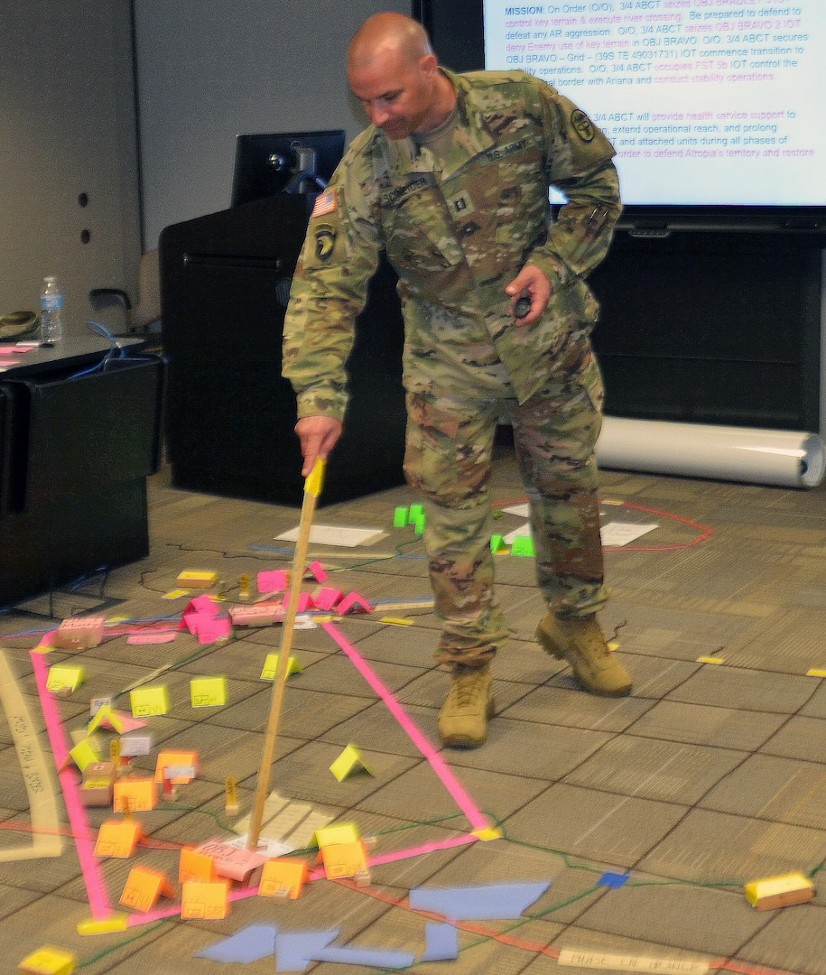
Commanders Are the Primary Trainers
Responsible and accountable for the unit training and performance
Train and resource training one echelon down
Evaluate to two echelons down
Prioritize unit training
Subordinate unit leaders are the primary trainers of their elements
Notes:
REFERENCE: FM 7-0, Training, June 2021.
INSTRUCTOR NOTES:
The question noted below should be a rhetorical one that allows the participants to think about their responsibilities to address identified challenges.
SCRIPT –
Commanders and first sergeants are responsible and accountable for the training and performance of their units. 1SGs ensure that training is designed and executed according to Army standards. Commanders train and resource training one echelon down, and they evaluate to two echelons down.
They are responsible for assessing unit training proficiency and prioritizing unit training. Subordinate unit leaders are the primary trainers of their elements.
For example, a platoon leader is responsible for the training and performance of his/her platoon and the platoon sergeant is responsible for ensuring that training is to standard.
ASK:
As a Commander should you respond to the challenges you identified earlier?
Suggested Answer: Advise the participants to write the question down and dialog with their First Sergeant on the class break or other identified time to allow them to wrestle with the implications of this question.
Are there any questions?
Next slide.

Slide 9
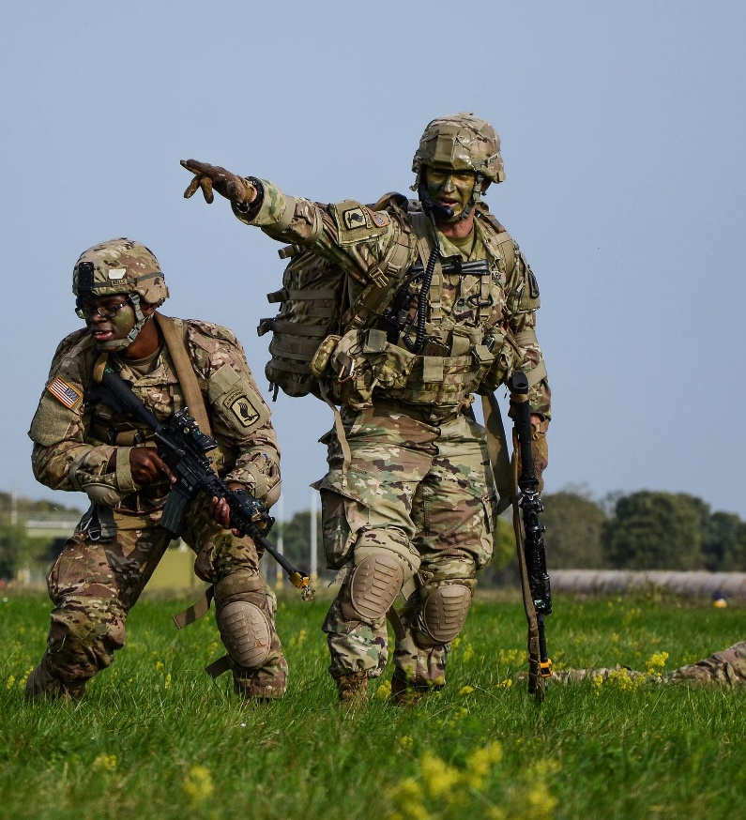
NCOs Train Individuals, Crews, and Teams
  Responsible for Soldier/small-unit training proficiency
  Identify and train Soldier, crew, and small-team tasks
  Help identify and prioritize unit collective tasks that support unit METs
  Train to and enforce task standards
  Sustain strengths and improve
  weaknesses
  Develop junior NCOs and help
  develop junior officers
  Provide timely and objective training
  advice
  Assist in planning, resourcing, risk
  mitigation, certification, supervision,
  and evaluation of training
Notes:
REFERENCE: FM 7-0, Training, June 2021; the Army Training Network at https://atn.army.mil, and the Digital Job Book and Small Unit Leaders Tool, also the DTMS Knowledge Base tutorials.
INSTRUCTOR NOTES:
The question noted below should be a rhetorical one that allows the participants to think about their responsibilities to address identified challenges.
SCRIPT –
The First Sergeant, alongside the Commander, and in collaboration with the noncommissioned officers of the unit set the foundation for Army training. They train Soldiers, crews, and small teams to be battle-ready.
They provide crucial input and advice to the commander on what is trained and how it is trained. This ensures the organization trains on its most important tasks down to the individual Soldier.
The First Sergeant and the NCOs of the unit will—
Maintain responsibility for Soldier and small-unit training proficiency.
Identify and train Soldier, crew, and small-team tasks.
Help identify and prioritize unit collective tasks that support unit mission-essential tasks.
Train and enforce task standards.
Continually focus training on sustaining strengths and improving weaknesses.
Develop junior noncommissioned officers and help officers develop junior officers.
Provide timely and objective training advice to their officers.
Assist in planning, resource coordination, support, risk mitigation, supervision, and evaluation of training.
The Army provides leaders at echelon, officer and enlisted, with tools to help manage and record training. Two tools are the Digital Job Book (DJB) and Small Unit Leaders Tool (SULT). Each tool is unique and provides users with access to view and review notifications for Army course registrations.
These tools will also provide leaders with the capabilities to view, assign, update, and record Soldier training and qualification information such as ACFT scores, height / weight, weapon assignments/qualifications, and training tasks.
Users can also manage Expert Badges and assign training to their Soldiers without the need for a system account or specialized training.
Once locally authorized / enabled by the unit commander / first sergeant, junior leaders can access the DJB and SULT from any device without the need for a system account or training using their ICAM Username / Password.
Are there any questions?
Next slide.

Slide 10
Training as Leader Development
Commanders and First Sergeants:
Must establish the strategic purpose for leader activities for each training event.
Establish a formal and informal senior leader to junior leader mentorship program that leads to operational and professional success.
Identify and resource leaders capable of leading their formations to fight and win.
Promote leader development goals and training plans include leader development training objectives.
Provide candid evaluation and assessment of leader performance, judgement, temperament, and skills throughout the training process.
Engage with subordinates to create opportunities for learning, growth, and leader development.
Notes:
REFERENCES: FM 7-0, Training (2021); FM 6-22, Developing Leaders, (2022); ADP 6-22, Army Leadership and the Profession (2019).
INSTRUCTOR ONLY:
ASK:
1. In what ways is effective training and leader development the keys to operational success? Explain?
Suggested answer: Will vary based on Soldier positional and leader experiences.
Allow participants time to review the slide.
SCRIPT -
Every Army leader has the responsibility for the professional development of subordinate leaders as training occurs. Leader development is a proactive process and is an integral part of training plans, meetings, and briefings.
Training represents the best leader development method possible. Training and leader development are linked and mutually supportive of each other. Leaders must train their subordinate leaders to execute training effectively.
Leader development is the deliberate, continuous, sequential, and progressive process that grows Soldiers and into competent and confident leaders capable of decisive action. Leader development is achieved through the lifelong synthesis of the knowledge, skills, and experiences gained through the training and education opportunities in the institutional, operational, and self-development domains.
It is crucial that as the unit Commander and First Sergeant that you invest time and resources in leader development. You will treat leader development with the same degree of detailed planning and execution as they would a training event.
Training provides significant learning opportunities for junior leaders to make and learn from mistakes and improve their leadership proficiency. Senior leaders teach, coach, mentor, and guide junior leaders, underwriting their honest mistakes without prejudice.
Are there any questions?
Next slide.

Slide 11


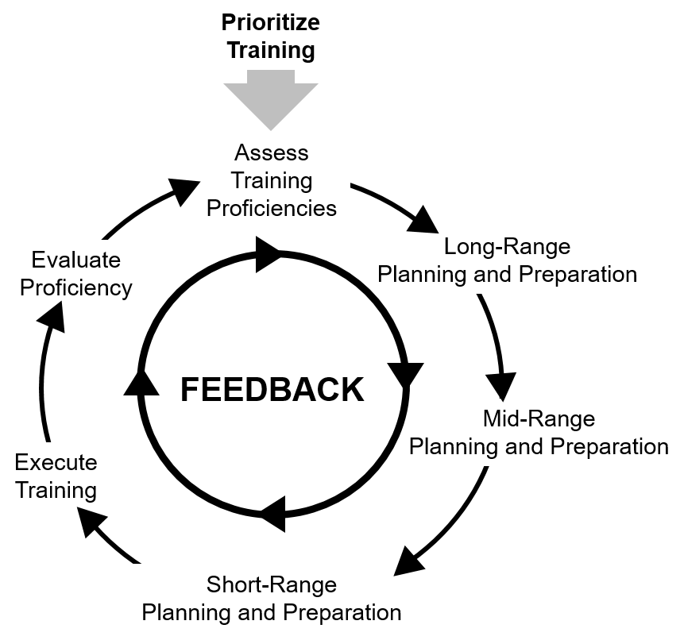


The Training Management Cycle
Prioritize
Training
Activities
Prioritize Training
Planning and Preparation
Training Execution
Training Evaluation
Training Assessment
Assess Training Proficiencies
Long Range Planning and Preparation
Evaluate Proficiency
FEEDBACK
Planning Horizons
Long-Range
Mid-Range
Short-Range
Execute Training
Mid Range Planning and Preparation
Fig. 1-2 FM 7-0
Short Range Planning and Preparation
Continuous Feedback
Notes:
REFERENCE: FM 7-0, Training, June 2021.
INSTRUCTOR NOTES:
Build the slide as indicated; time your oral description with the appearance of the cycle. Manage time effectively to prevent loss of instructional time and information.
Instructor must practice building this slide prior to class execution to reduce interference with class time.
ASK:
Who has actually seen a picture of the army training management cycle?
Suggested Answer: Answers will vary. Lead the students to understand that the training management cycle is the Army’s framework for managing training.
This diagram provides 2 views of the Training management cycle. The first view is from FM 7-0. The second view is a build that intends to provide information in a format that participants can relate to. The participants need to understand the feedback uses the chains of support/command.
Emphasize the information the leader will be responsible for obtaining and presenting training information in all 3 of the planning cycles. e will discuss later short-range planning and preparation, execution and evaluation as the components and planning horizon they will participate in.
SCRIPT -
(During the slide build) If you were to open FM 7-0, figure one dash two, you will see this picture. It does look a bit complicated. And admittedly, kind of difficult to imagine your role in this cycle as a newly Commissioned Officer. (Build)
Let’s try simplify the picture to focus on your area of emphasis. We will discuss the 5 distinct framework activities, 3 training planning horizons and the continuous feedback mechanism. (Build)
To manage training at the platoon level you, as a future platoon leader, must understand the relationship of the Training Management Cycle to all phases of training and what your responsibilities are within each step of the cycle.
Especially, you will need to grasp how to read and apply the planning horizons for training and how to effectively integrate training guidance, goals and objectives of leader two echelons higher than your small unit.
To prioritize training is the responsibility of the Commander, yet you play a role, with the unit NCOs, in providing advice to the Commander on how and on what to prioritize training efforts so that your small units and platoon are made battle ready and capable of executing your war fighting functions.
The three training proficiencies we will discuss in our lesson plan govern how tasks are prioritized, these prioritized task are METs, Weapons and Collective Live Fire. These three become the basis for long range planning and preparation that can be found in the Company’s Annual Training Guidance, as it is built on higher echelon Training Guidance.
That guidance progressively leads to mid-range and short- range planning and preparation and ultimately training execution and then evaluation.
Feedback is a continuous process that enables you to provide input to the Commander from a variety of sources on the stages of the training planning process.
As an organizational leader, you are expected to obtain valid feedback from available resources which inform how you provide guidance, direction, and leading in training development and execution.
Prioritize training is the responsibility of the commander. (Build) The resulting assessments are expressed in terms of 3 training proficiencies that we have previously discussed: METs, Weapons and Collective Live Fire. (Build) These three become the basis for long range planning and preparation that can be found in the Company’s Annual Training Guidance. That guidance progressively leads to mid-range and short- range planning and preparation and ultimately training execution and then evaluation.
As we progress what occurs with feedback? (Build) Feedback is still there and it is a continuous process for commander to receive input from a variety of sources throughout the Training Management Cycle. It is not a closed circular loop as the diagram may indicate, but a continuous loop open to feedback throughout all the training planning horizons to include the actual execution and evaluation of training.
We don’t expect every individual to be providing feedback to the commander. (Build) You, as a newly Commissioned Officer, are expected to obtain valid feedback from your subordinates and provide a consistent flow of feedback to the Commander. And there are a variety of other sources of feedback to the Commander, that are necessary to inform the Commander’s Assessment, see FM 7-0, Fig. 5-1.
What are your questions in the army’s training management cycle?
Are there any questions?
Next slide

Slide 12
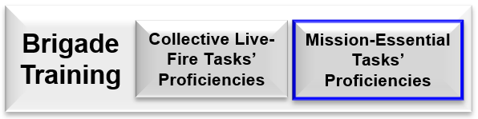
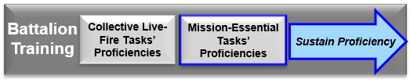



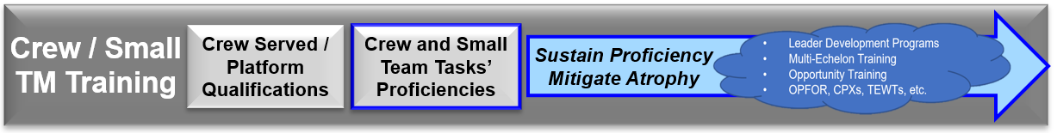

The Building Blocks of Training
Endstate
Top Guidance / Priorities
Building Proficiency Over Time
Assess – Record - Report Training
Start of LRTP
Long Range Planning
Prioritize - Execute - Evaluate
Notes:
REFERENCE: FM 7-0, Training, June 2021.
INSTRUCTOR NOTES:
Build the slide as indicated; time your oral description with the appearance of the cycle. Manage time effectively to prevent loss of instructional time and information.
Instructor must practice building this slide prior to class execution to reduce interference with class time.
SCRIPT –
(1st Click enter – Brigade Block and Top-Down Guidance arrow appears) The Building Blocks of Training start with the higher echelon publication of training and is to the lower echelons of the unit as priorities are identified and Allocate the necessary training time and resources to enable subordinate organizations to train to standard. Most non-staff training is executed at the platoon and below.
(2d Click enter – Battalion Block and start of Long-Range Training Plan LRTP appears) Once the Battalion receives higher echelon training guidance it commences to build the LRTP which will incorporate the LTRP of all assigned subordinate
(3d Click enter – Company Block appears)
(4th Click enter – Platoon Block appears)
(5th Click enter – Squad Block appears)
(6th Click enter – Green Arrow appears)
As you observe this portion of the slide you will note that each subordinate echelon commences building their own LRTP. Part of building the LRTP and identifying training priorities, objectives, and events is the use of the Task Crosswalk to identify and select those task critical for nesting subordinate training plans with higher echelon plans in support of mission requirements.
Furthermore, as you look here you will see the green arrow which indicates that in a typical brigade; 70-80% of training should occur at organizational level and below, 10-15% at company, and 5-10% at battalion and brigade. This is crucial for your ability to manage training at the T-C-B level. for both understanding and executing training management as a T-C-B Command Team. NCOs are foundational in the planning and execution of training as they both train and oversee training at this level.
Key to the training plan is higher echelon Commander training guidance. It must include the requirements for the three training proficiencies for subordinates and the MET training priorities and objectives.
Prioritizing training acknowledges that units cannot achieve or sustain fully trained proficiency on every task simultaneously due to limitations of time and/or the availability of training resources.
Commanders use a prioritized training approach to optimize limited training time and resources to achieve proficiencies based on their unit’s mission.
Commanders need to understand that the bulk of unit training occurs at the Company and organizational levels. Allocate the necessary training time and resources to enable subordinate organizations to train to standard. Most non-staff training is executed at the organizational and below.
(7th Click enter – Crew/Small Unit Training Block appears)
(8th Click enter – Individual Block and Building Proficiencies and End State Arrows appears)
Leaders at all levels are responsible for training. In this example the Squad to Individual blocks show that they are the foundational blocks for unit training and form mission readiness and success. The better the training at these levels the better trained and ready higher echelon units are.
The training plan you design and manage should show how a unit builds proficiency over time. Adequate time must be allocated to the lowest echelons in order to establish a solid foundation.
Once the desired proficiency for the unit is attained, the unit must sustain proficiency.
This is what the Arrow shows. Building and maintaining training proficiencies requires resources, time, and leader management of all aspects of training. Leaders must be capable of assessing and evaluating training, refining efforts, recording and reporting training in a manner that allows the events and associated record to serve as building blocks for future training events.
Are there any questions?
Next slide

Slide 13
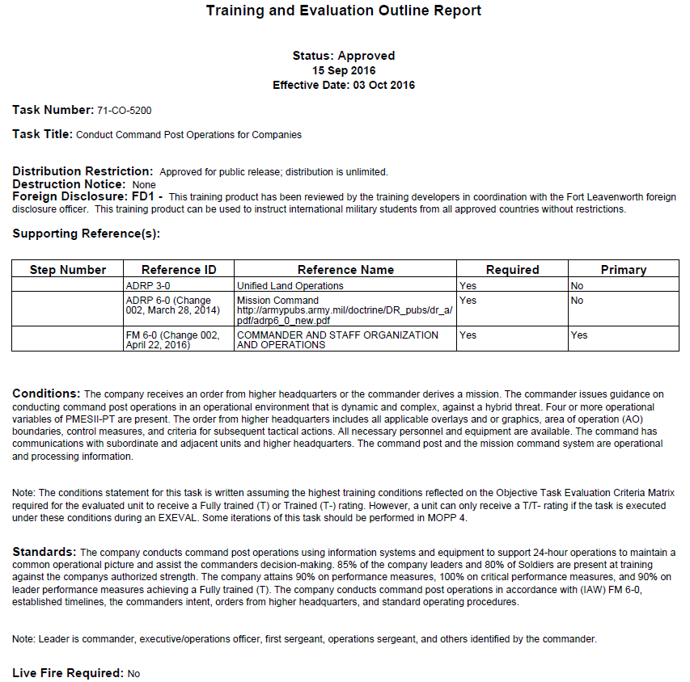
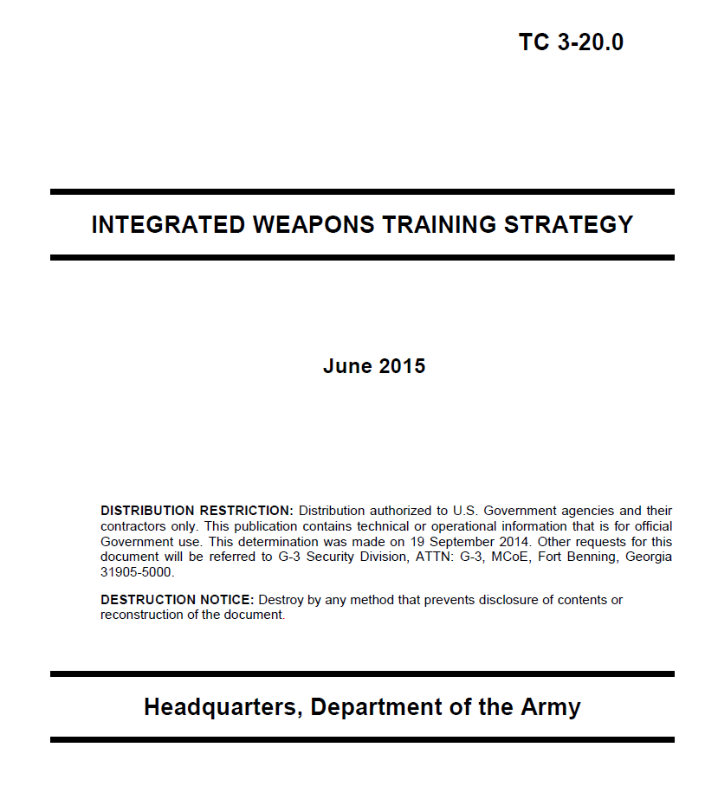
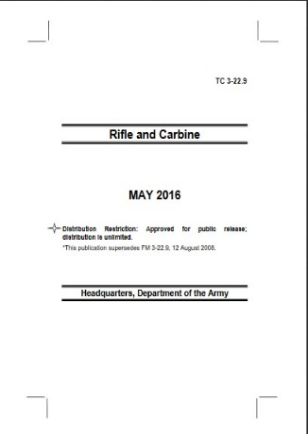
Train to Standard
Training & Evaluations Outlines (T&EOs)
The Army's source for task standards
  References and identifies the “Task, Conditions and Standards”
  Leader Statement
  Objective Task Criteria Matrix
  Performance Steps and Measures
  Supporting Collective Tasks
  Supporting Individual Tasks
Training Circulars
June 2019
Collective and Individual
Weapons
The Unit 1SG and NCOs ensure that all task training is developed, enforced,
maintained and executed according to published standards based
Notes:
REFERENCE: FM 7-0, Training, June 2021.
INSTRUCTOR NOTES:
Course instructor must be familiar with the T&EO and TCs in order to effectively teach this slide and respond effectively to questions that may arise.
SCRIPT -
The Army is a task and standards-based institution. A standard is the minimum proficiency required to accomplish a task under a specified set of conditions which reflect the dynamic complexities of operational environments to include cyber, electronic warfare, and hybrid threats.
Leaders continue to train high priority tasks even after units achieve standards. They do this by increasing the complexity of task conditions, the levels of stress and by maximizing repetitions and sets until task mastery is achieved.
All Army Training is performance oriented and evaluated against established standards. found in applicable Army and branch proponent publications. Those publications include but are not limited to Training and Evaluation Outlines (T&EOs) and Training Circulars (TCs).
These publications provide fixed Army standards for tasks. During Training, leaders progressively adjust task conditions and add realism and complexity to increase task difficulty and achieve near-operational conditions.
Commanders, First Sergeant’s, and noncommissioned officers ensure that all training is conducted to standard. This is accomplished by ensuring leaders are trained, competent, and certified.
Good trainers and leaders know and use all available training resources. As opportunity allows or requires it, trainers provide as many repetitions as required to achieve intended results.
As discussed earlier, the T&EO guides the task prioritization and training execution processes. It is introduced here due to its value in the task prioritization and task training processes.
The TC along with other proponent specific authoritative documents provide standards that you will need to consult as you develop training standards, goals and objectives. On this slide you note the Integrated Weapons System (IWTS) and the Rifle and Carbine TC’s are shown as examples.
Are there any questions?
Next slide

Slide 14
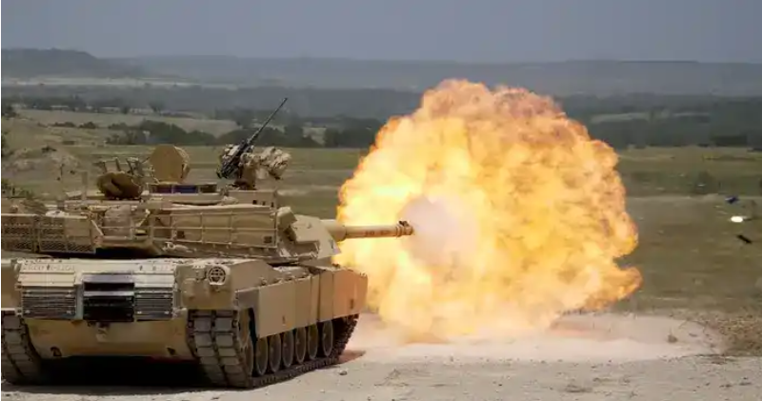
Training Proficiency: Beyond the T Rating
    Task Mastery: Training until you can’t do it wrong!
Notes:
REFERENCE: FM 7-0, Training, June 2021.
INSTRUCTOR NOTES:
As an instructor be prepared to discuss the differences that exist between the Training Proficiency Ratings (T,P,U) and task mastery.
SCRIPT -
Leaders train to standard by allocating sufficient time to train tasks. When the unit achieves task standards in less time than expected, it can conduct more iterations of the task by changing the conditions, moving on to the next task, or moving on to a more complex task.
By doing so unit Commanders and First Sergeants can assure that assigned tasks can move task proficiency towards task mastery.
Task Mastery is not a training proficiency rating but a concept. To reach mastery leaders at all echelons must fully understand the selected task to be trained, its component parts, its underlying principles, its importance, and how the task supports the larger mission.
To build task mastery, T-C-B Command Teams will focus on sequencing training from task fundamentals at individual, crew, squad, and platoon levels then progressing to more complex and higher-level collective tasks.
Furthermore, Task Mastery goes beyond executing a task to standard. It is the pursuit of excellence in task accomplishment through consistent and progressive repetition of a task or set of tasks.
It entails successfully executing multiple iterations of a task under the most challenging and dynamic conditions while constantly adjusting for changes in the operational environment and making the best use of resources.
Are there any questions?
Next slide

Slide 15

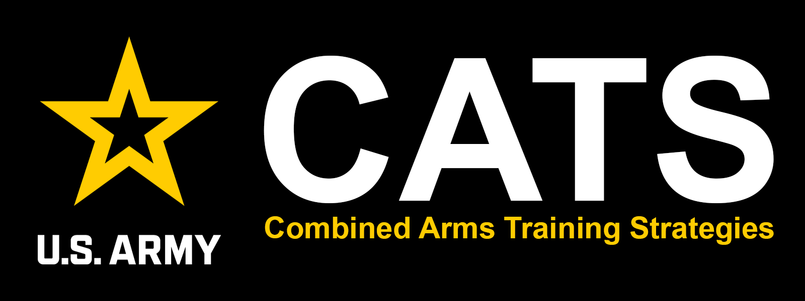

Training Enablers
Notes:
REFERENCE: FM 7-0, Training, June 2021, The Army Training Network at https://atn.army.mil/.
INSTRUCTOR NOTES:
Remind students that access will require a CAC capabilities, and for some activities the user will require permissions from the Unit DTMS Manager to gain access and input/edit data. Once authorized access to ATN the user can enter the system and conduct searches that will assist the leader in prioritizing, planning and preparing, and executing
SCRIPT -
The Army Training Network (ATN) is part of the Army Training Management System (ATMS) and consists of web-based application and centralized databases.
These web-based-tools aid the leader in prioritizing, planning and preparing, executing, recording, and, just as important, evaluate and assess training at the individual and collective levels. ATN enables unit leaders at all echelons to gain access to Army and branch doctrine, processes, and varied resource materials from a singe access point.
For the purposes of the training development and task searches user can utilize many digital tools and widgets the ATN, DTMS, and CATS pages are important:
Combined Arms Strategies (CATS). The pages provide you varied ways that you can search for all related tasks- individual, collective, and supporting tasks.
CATS provides the user with recommendations on who, what, and how often to train, and, as well, provides fundamental planning, and event information to include training aids, devices, simulators, and simulations (know at TADSS); training gates; multi-echelon training events; major resources; and a purpose, outcome, and recommended execution guidance.
DTMS enables leaders to perform some of the following functions:
Review the higher Commander’s training guidance and disseminate other training documents
View and review unit METLs
Manage the UTP calendar
Manage mandatory, individual, collective, and deployment training tasks and requirements
We will discuss these further in the coming slides.
Are there any questions?
Next slide

Slide 16
The Army Training Network
  A single web-based portal to all-things-Army training:
    Task Search: collective and individual
    Doctrine & Unit Training Management (UTM)
    Additional resources and training management products
    Links to other Army websites and more
    Digital Job Book
    Small Unit Leader Tool
Notes:
REFERENCE: FM 7-0, Training, June 2021; The Army Training Network at https://atn.army.mil/.
INSTRUCTOR NOTES:
You must have a significant familiarity with ATN and DTMS so that you can both aid the students in understanding how these digital training management systems work, but also to address any significant questions that arise, and to have the ability to correct misconceptions or misunderstanding.
Inform the students that they can access the DTMS User Guide and DTMS Quick Reference Guide through the ATN homepage. These instruments provide users with the specific details on how to use all facets of DTMS.
Inform them they can also access the tutorials for utilizing DTMS through the DTMS Knowledgebase on ATN at https://atn.army.mil/unit-training-management-(utm)-en/dtms-knowledge-base.
Inform the students that they can request DTMS training for their designated DTMS managers and users. This will increase the training capabilities of the unit.
SCRIPT -
As previously noted, the Army Training Network (ATN) is part of the web-based application and centralized databases.
ATN enables unit leaders at all echelons to gain access to Army and branch doctrine, processes, and varied resource materials from a singe access point whether it is through the Combined Arms Strategies (CATS), Digital Training Management System (DTMS), the Small Unit Leader Tool (SULT), the Digital Job Book (DJB), and Mission Essential Task Lists (METLs) to name a few.
Searches can be for known tasks or yet-to-be-identified tasks by utilizing the multiple features of ATN. Here the user can search for both designed and assigned tasks.
Unit leaders can access the ATN at https://atn.army.mil/. It bears repeating that all users of these digital tools will require a CAC capabilities, and for some activities the user will require permissions from the Unit DTMS Manager to gain access and input/edit data.
Once authorized access to ATN the user can enter the system and conduct searches that will assist the leader in prioritizing, planning and preparing, and executing training.
Are there any questions?
Next slide.

Slide 17
The Digital Training Management System
DTMS provides a snapshot of unit training, planned and completed
Additional Capabilities:
  Training schedules
  Soldier ITRs that populates with Soldier Training Data
  Unit Training and Readiness Dashboards
  AARs
  Full spectrum digital training management tools and resources
  Importing and Exporting of training reports and forms
  Export to Outlook
Required:
  MET assessment
  Weapons qualification (I/CS)
  ACFT/APFT and height/weight
  SHARP face-to-face task
  Army Warrior tasks (selected)
Notes:
REFERENCE: FM 7-0, Training, June 2021; The Digital Training Management System (DTMS) at https://dtms.army.mil/.
INSTRUCTOR NOTES:
You must have a significant familiarity with ATN and DTMS so that you can both aid the students in understanding how these digital training management systems work, but also to address any significant questions that arise, and to have the ability to correct misconceptions or misunderstanding.
Inform the students that they can access the DTMS User Guide and DTMS Quick Reference Guide through the ATN homepage. These instruments provide users with the specific details on how to use all facets of DTMS.
Inform them they can also access the Tutorials for utilizing DTMS through the DTMS Knowledge Base on ATN at https://atn.army.mil/unit-training-management-(utm)-en/dtms-knowledge-base.
Inform the students that they can request DTMS training for their designated DTMS managers and users. This will increase the training capabilities of the unit.
SCRIPT -
The Digital Training Management System (DTMS) is a system for capturing training planned and completed – from individual Soldier to the unit level, and higher echelon depending on your Command setting
DTMS assists with implementing doctrine, tactics, techniques and procedures outlined in FM 7-0, Training. It provides leaders with an end-to-end view of current unit training status - at all echelons.
DTMS assist Commanders, First Sergeants, and NCO leaders at each point in the training management process to plan and prepare, execute, and assess training. It also maintains a Soldier's training history from hire to retire. Furthermore, it will allow users to communicate and coordinate across the chain of command. It also features calendars to plan and schedule training.
DTMS provides a digital version of the Soldier's individual training record to better inform training management decisions and reduce manual data entry as new Soldiers arrive and Soldiers move to other units.
For Commanders, First Sergeants, and training managers, DTMS provides an easily accessible record of training. It enables T-C-B Command Teams formulate a training plan and synchronize it with Army doctrine. Additionally, users can quickly query unit, platoon, and individual records to track the status of any unit or individual training, to include weapons qualification, physical training, mandatory training, and other training completion information.
For all Soldiers, DTMS reduces manual data entry by recording data in a database that communicates with other systems to automatically update records.
Finally, DTMS is maintained by the Training Management Directorate (TMD) at Fort Leavenworth, Kansas. It is a subordinate organization of the Combined Arms Center – Training (CAC-T), which manages training support and training development programs.
Are there any questions?
Next Slide

Slide 18
The Combined Arms Training Strategies
CATS: task-based, event-driven training strategies designed To assist the unit commander in developing a unit training plan
TO&E
(Table of Organization and Equipment)
Written strategy designed around capabilities contained in TO&E
Task Sets
Group of Collective Tasks that logically train together during a training event
Designed to train the TS, presented in C-W-R
Events
HQDA Standard METL is focus of training strategy
Build and sustain proficiency
Unit Task List
(UTL)
A proponent-approved list of collective tasks the unit should be able to perform
Notes:
REFERENCE: FM 7-0, Training, June 2021; The Army Training Network, Combined Arms Training Strategies (CATS) at https://atn.army.mil/ATNPortalUI/CATS/.
INSTRUCTOR NOTES:
If time and classroom dynamics allow, demonstrate the CATS ATN Viewer and DTMS CATS Planning Tools live.
SCRIPT -
The CATS Program is governed by Army Regulation (AR) 350-1, Army Training and Leader Development. As discussed earlier, CATS is a critical tool for providing you with crucial recommendations on who, what, and how often to train on tasks- collective and individual.
The CATS is foundational as a planning tool for training event design and execution. This will include training aids, devices, simulators, and simulations (TADSS), training gates, multi-echelon training events, major resources, as well as purpose, outcome, and recommended execution guidance.
The CATS user can search for both designed and assigned tasks. The CATS program consists of three components: the combined arms training strategy, the ATN CATS Viewer, and the DTMS CATS Planning Tool.
Users can access the CATS Knowledge Base either through the CATS program or via the Unit Training Management system at https://atn.army.mil/unit-training-management-(utm)-en/cats-knowledge-base.
The planning tool allows unit leaders and trainers to tailor the baseline unit information within the training strategy to develop a unit specific training plan.
CATS begin with the proponent and a CATS analyst conducting an analysis based on the missions, functions, and capabilities as stated in the unit’s TOE.
User can generate a Unit Task List: Collective Tasks (UTL). The UTL is every collective task the unit should be able to perform to other tasks that is expected of operational units such as deploy/redeploy, protection, sustainment, gunnery, etc. etc.
Selected tasks are then grouped into Task Sets for tasks that can logically be trained together to obtain proficiency in a desired capability, task set names typically correspond with the desired capability.
Task Sets recognize that there are usually many tasks performed when a unit executes a capability or function while recognizing that some tasks are more important than others.
Task Sets are then associated with events and depicted on a schedule in accordance with Sustainable Readiness cycles resulting in a Combined Arms Training Strategy.
Are there any questions?
Next Slide.

Slide 19

Check on Learning
Notes:
REFERENCE: FM 7-0, Training, June 2021.
INSTRUCTOR NOTES:
Determine if students have gained familiarity with the material discussed by soliciting student questions and answers. Ask the students questions and correct misunderstandings.
1. The Check on Learning in this presentation includes questions and answers (solutions) for the instructor ONLY.
2. Determine if students have gained familiarity with the material discussed by soliciting student questions and explanations.
SCRIPT -
We will now conduct a Check on Learning. Do not answer until prompted to.
ASK:
1. What are the two crucial principles for Army training? (ref: FM 7-0, Chap 1, para 1-5 to 1-7 )
Answer: Commanders are the primary trainers, NCOs train individuals, crews, and small teams; advise commanders on all aspects of training.
2. What are the major components of the Training Management Cycle? (ref: FM 7-0, Chap 1, para 1-23)
Answer: Prioritizing, Planning and Preparing, Executing, Evaluating, Assessing
3. What is the name of the Army digital clearinghouse for training? (FM7-0, Chap 4, para 4-37, Appendix D, D-1)
Answer: The Army Training Network.
Are there any questions?
Next slide.

Slide 20
Review Summary
We reviewed the importance of training management at the T-C-B level
We reviewed the 9 Principles of Training and the critical role of Commanders and 1SGs in training management
We reviewed the building blocks of training development
We reviewed the importance of Army standards for successful training plans..
We reviewed critical digital training enablers
Notes:
REFERENCE: FM 7-0, Training, June 2021.
INSTRUCTOR NOTES:
SCRIPT -
During this lesson we discussed by way of review:
The importance of training management at the T-C-B level.
The 9 Principles of Training and the critical role of Commanders and 1SGs in training management.
The building blocks of training development.
The importance of Army standards for successful training plans.
And finally, we reviewed critical digital training enablers.
Are there any questions?
Next slide.

Slide 21
LSA 2
Review Prioritizing Training Tasks
at the T-C-B Level
Notes:
REFERENCE: FM 7-0, Training. June 2021.
INSTRUCTOR NOTES:
The Instructor must read and be familiar with FM 7-0, the focus of the lesson plan is: constructing training at the organizational level by understanding the importance of training proficiencies, training proficiency rating assessments, and the importance of the principles of training as a key feature of employing training management at the organizational level.
Use this time to transition to the second lesson: LSA 2- Review Prioritizing Training Tasks for the T-C-B Level
SCRIPT -
As Commanders and First Sergeants you must understand the Army Training Proficiencies and proficiency ratings system and their impact on training development. Furthermore, you will need to understand the task crosswalk process from the small unit level to the T-C-B level so that you can prioritize your training efforts to meet your mission requirements whether designed or assigned.
Are there any questions?
Next slide.

Slide 22
Prioritizing Training
Units cannot simultaneously achieve or sustain trained proficiency on every collective task due to limitations of time or the availability of training resources.
Leaders at all levels prioritize training to optimize time and resources.
Command teams determine and establish task proficiency priorities linked to unit mission requirements.
The fundamentals of shoot, move, communicate, and survive are the basis for training prioritization.
Notes:
REFERENCE: FM 7-0, Training, June 2021.
INSTRUCTOR NOTES:
SCRIPT -
Commanders, in collaboration with the First Sergeant, will assume risk by clearly articulating which lower priority tasks will be trained later.
Published training guidance provide subordinate Commanders and leaders a clear vision of the higher echelon Commander training expectations are and thus give subordinate unit Command Teams direction, purpose, and the motivation necessary to train effectively.
As the 1SG you will receive that guidance from the Commander as a follower, and then, as a leader, translates that guidance to subordinate echelon leaders.
This translation is done in terms that are appropriate for the T-C-B NCOs and issues instructions that best meet Commander’s intent. T-C-B Command Teams utilize a prioritized training approach to optimize limited training time and resources to achieve proficiencies based on their unit’s mission.
Commander dialogue with the next higher echelon commander determines training priorities on mission requirements. The 1SG serves as the senior enlisted training and resource coordinator, and the lead integrator with outside organizations and entities.
Similarly, Commanders, with their T-C-B 1SGs, determine and establish training priorities in preparation for operational deployments, a combat training center rotation, or daily services for installation support. Prioritized training must link to the unit’s mission.
Every unit is unique, but the fundamentals of shoot, move, communicate, and survive apply to all types of formations and serve as the basis for prioritization.
Commanders and leaders will therefore focus training on their unit’s prioritized METs to optimize limited training time and resources. We will discuss these with the next slide.
Are there any questions?
Next slide.

Slide 23
Prioritizing Training
Training Proficiencies
Mission Essential Tasks
Trained
Untrained
Collective Live Fire
Trained
Practiced
Practiced
Untrained
Weapons Qualifications
Qualified
Qualified
Qualified
Task Proficiency Ratings
T
Trained: T (Advanced Task Proficiency)
P
Practiced: P (Basic Task Proficiency)
U
Untrained: U (Cannot Perform Task)
Notes:
REFERENCE: FM 7-0, Training, June 2021; AR 350-1, Army Training and Leader Development (2017); Selected T&EOs and TCs where applicable.
INSTRUCTOR NOTES:
SCRIPT -
We have already noted this, but I must emphasize that unit training programs acknowledge the principle that units cannot achieve or sustain fully trained proficiency on every task simultaneously.
Commanders, and leaders, will therefore focus training on their unit’s prioritized METs to optimize limited training time and resources. The three prioritized training proficiencies are Mission Essential Tasks, Weapons Qualification, and Collective Life-Fire.
MISSION ESSENTIAL TASKS (METs) –
Commanders identify the METs that must be resourced and trained to the ‘T’ proficiency rating. Targeting key METs is based on mission requirements (concept plan or operation plan and future expected missions) approved by the next higher echelon commander.
METs can also be identified when a unit is given an assigned mission that is outside their standardized mission. For example, a Field Artillery Battalion tasked to conduct base defense operations or route recon in support of a higher echelon mission.
WEAPONS QUALIFICATION PRIORITIZATION –
The commander considers the priority of weapons qualification training based on qualification frequency specified by AR 350-1, current qualification status of the unit’s organic weapons (individual, crew-served, platform), and the unit mission.
This consideration drives the commander’s determination of which weapons systems have priority for training. All Soldiers are expected to qualify on their assigned weapons.
However, some Soldiers have a system as their primary weapon such as a radar or sensor. These systems will also require Soldier qualification.
COLLECTIVE LIVE-FIRE PRIORITIZATION –
The commander determines collective live-fire prioritization based on the organization’s mission, capabilities, and directed requirements by senior commanders.
It is imperative that as leaders you recognize that training is accomplished, training proficiency ratings are achieved based on your assessment.
You can determine the assessment using various means and methods of evaluation and assessment, but it is your responsibility to identify the rating the training is to receive.
On this slide you see a glimpse of the three training proficiency ratings, we will discuss them with the next slide.
Are there any questions?
Next slide.

Slide 24
Collective Task Proficiency Ratings
T
Trained: T (Advanced Task Proficiency)
Unit is trained
Attained advanced task proficiency free of significant shortcomings
Shortcomings require minimal training to meet the standard
P
Practiced: P (Basic Task Proficiency)
Unit is practiced
Attained basic task proficiency with shortcomings
Shortcomings may require significant training to meet standard
U
Untrained: U (Cannot Perform Task)
Unit is untrained
Unit cannot perform the task
Shortcomings require significant training to achieve standards
The unit is trained when it achieves the proficiencies specified by the commander
Notes:
REFERENCE: FM 7-0, Training, June 2021; Selected T&EOs and TCs where applicable.
INSTRUCTOR NOTES:
The standards shown on this slide are the only ratings utilized by commanders to assess training.
ASK:
1. What does it mean that a unit is trained when it achieves the training proficiency rating assessed by the commander?
Suggested answer: Unit training is limited by training resources and time, and thus cannot achieve and fully sustain MET proficiency on all METs simultaneously. Therefore, units reach a “T” proficiency when the commander assess that they are trained and have been assessed as having attained advance task proficiency free of significant shortcomings and meet published Army standards. Based on identified and prioritized METs.
SCRIPT -
Training that is observed is given one of three ratings. Only commanders can give their units a training proficiency rating based on their understanding of the success or failure of the trained task to meet objective and observable criteria.
Commanders will dialog with their First Sergeant in order to gain an accurate assessment of training, needs for retraining, and identification of training efforts to sustain to maintain proficiency. The Three Ratings are:
Trained: T (Advanced Task Proficiency). A Trained proficiency rating means a unit has attained advanced task proficiency free of significant shortcomings. The unit’s shortcomings require minimal training to meet the Army standard.
Practiced: P (Basic Task Proficiency). A Practiced proficiency rating means a unit has attained basic task proficiency with shortcomings. The unit’s shortcomings may require significant training to meet the Army standard.
Untrained: U (Cannot Perform Task). An Untrained proficiency rating means a unit is unable to perform the assigned task. The unit, therefore, will require additional training on the task to achieve the Army standard, and achieve the rating the Commander designates as the goal for the task and training event.
Training which fails to meet the training goal(s), training objective(s), or Army standard(s) will be retrained until the tasked is trained in accordance with the Commander’s designated training goals and objectives in order to attain the Commander’s specified training proficiency rating.
Are there any questions?
Next slide.

Slide 25
Prioritizing Additional Tasks
  Individual tasks: NCOs identify and train MOS-specific tasks, Army Warrior tasks, and physical readiness training
  Leader tasks: Tasks designed for leaders to develop subordinate leaders
  Supporting collective tasks: Support other collective tasks. Can be trained separately or concurrently
  High-payoff tasks: Support more than one MET or battle task. Identifying these leads to training efficiency
  Local and HQDA Required training tasks: These include Soldier certifications, AR 350-1 requirements, and local training directives
Notes:
REFERENCE: FM 7-0, Training, June 2021; AR 350-1, Army Training and Leader Development (2017); Local Command Policy.
INSTRUCTOR ONLY:
Ensure that participants are aware that staff task training will be accomplished at the HHT-HHC-HHB levels and in dialog with higher echelon unit XOs who posses staff training responsibilities.
The higher echelon Squadron-Battalion (Group-Regiment-Brigade) XO selects Staff Battle Tasks in the same manner, training on those staff collective and individual tasks that are crucial to their unit’s Mission-Essential Tasks.
SCRIPT -
As T-C-B Command teams some of you will be assigned to a unit that has staff and other elements that will require specialized training. As part of the task prioritization process you will also integrate other task priorities into your unit training plans and programs.
You may need to dialogue with your higher echelon Commander, as well as the Executive Officer and S3 to identify which additional tasks will need to be included in the training plan.
Some of these include but are not limited to:
PRIORITIZING INDIVIDUAL TASKS
Task prioritization continues as noncommissioned officers identify and prioritize the individual tasks Soldiers train. These include military occupational specialty (known as MOS)-specific tasks, Army warrior tasks, and physical readiness training. Prioritization of tasks ensures the right tasks to train nest from the highest echelon to the lowest.
PRIORITIZING LEADER TASKS
Leaders develop subordinate leaders through focused leader development activities to include the selection and prioritization of leader tasks. Senior leaders ensure the selection and prioritization of leader tasks nest in the echelon’s prioritized METs or battle tasks and are reflected in the organization’s leader development program.
PRIORITIZING STAFF TASKS
Battalion and higher staffs select staff battle tasks in the same manner. They select those staff collective and individual tasks that support the unit’s METs through training. The senior member of each staff section approves staff battle tasks.
SUPPORTING COLLECTIVE TASKS
METs and battle tasks may be trained individually or combined with other collective tasks to create more robust training events. Collective tasks that support other collective tasks (MET, battle task, or another collective task) are supporting collective tasks. Although units may train supporting collective tasks in conjunction with METs and battle tasks, leaders do not consider these supporting collective tasks when determining the MET or battle task proficiency rating. Each collective task is evaluated based on its own training and evaluation outline.
HIGH-PAYOFF TASKS
High-payoff tasks are tasks that support more than one of the organization’s METs or battle tasks. The skills and proficiencies an organization achieved while training on a high-payoff task transfers to other METs or battle tasks that it supports. Such skills and proficiencies are key to multi-echelon training. Leaders recognize and capitalize on the training efficiencies gained by identifying high-payoff tasks.
LOCAL AND HQDA REQUIRED TASKS
These tasks focus on any special certifications a Soldier many need to fulfill duties and positions, for example drivers, safety, medical and Chaplain certifications, law enforcement and other. This also include how Command teams implement AR 350-1 training requirements, and any local directives that prepare Soldiers and units to fulfill their mission.
Are there any questions?
Next slide.

Slide 26
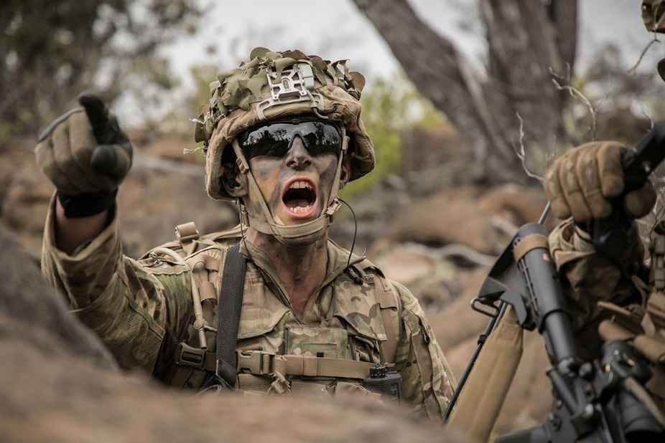
Prioritizing Tasks Below the T-C-B Level
Below company (small units)
continue the process of prioritizing the tasks that are crucial to the execution of the company Mission Essential Tasks (METs) – these
are also know as Battle Tasks
The process of prioritizing
tasks continues down thru each echelon – to include identifying the individual tasks Soldiers train
Notes:
REFERENCE: FM 7-0, Training, June 2021.
INSTRUCTOR NOTES:
SCRIPT -
Leaders of Echelons below company continue the process of prioritizing the collective tasks they train that support the company METs – these are Battle Tasks.
A battle task is a platoon or lower echelon collective task that is crucial to the successful accomplishment of a company, battery, or troop mission essential task. An organization’s battle tasks can include high-payoff tasks or battle drills.
The relationship of the subordinate leadership teams with the T-C-B Command Team in critical of the matter of identifying and prioritizing METs to train.
The platoon leader identifies the battle tasks that support the T-C-B mission-essential tasks. Squad battle tasks must link to a platoon battle task. This process continues to lower echelons with noncommissioned officer leaders determining the battle tasks that apply to their echelon (squad/team/crew).
At the lowest echelon, individual tasks to include Army Warrior tasks, MOS-specific tasks, and crew drills are identified. The T-C-B Commander, in collaboration with the 1SG, approves subordinate echelon battle tasks.
Battle tasks must progressively link to higher echelon (for example Squad to Team to Platoon to T-C-B) battle tasks in a manner that meet the higher echelon Commander priorities and objectives.
Task prioritization continues as noncommissioned officers identify and prioritize the individual tasks Soldiers train. These include military occupational specialty (known as MOS)-specific tasks, Army warrior tasks, and physical readiness training. Prioritization of tasks ensures the right tasks to train nest from the highest echelon to the lowest.
As it pertains to the prioritization of collective tasks, METs and battle tasks may be trained individually or combined with other collective tasks to create more robust training events. Collective tasks that support other collective tasks (MET, battle task, or another collective task) are Supporting Collective Tasks.
Although units may train supporting collective tasks in conjunction with METs and battle tasks, leaders do not consider these supporting collective tasks when determining the MET or battle task proficiency rating. Each collective task is evaluated based on its own T&EO, which we discussed earlier.
Are there any questions?
Next Slide.

Slide 27
Identify Training Objectives
  Training objectives for the event - MET/battle task T&EOs
  Refined as needed through each planning horizon
  Review current MET proficiency ratings, identify target rating
  Review previous similar training events:
    AARs and event planning
    records can provide additional insights based on how the event was executed previously.
    Ask the following:
        What can be improved?
        What should be sustained?
  1. Identify the METs and or Battle Tasks for training during the event.
  2. Identify the required training proficiency by task at the end of the event.
Training Objectives Mission Statement for Conduct an Attack
Task(s) Focus:
Conduct an Attack, Armor & Mech Inf Co Tm (ABCT) (17-CO-1094)
Desired End State:
Achieve a ‘P’ proficiency rating in the collective task Conduct an Attack (17-CO-1094) in preparation for the BN FTX.
Notes:
REFERENCE: FM 7-0, Training, June 2021.
INSTRUCTOR NOTES:
ASK:
1. What does it mean that a training objective must be both a) measurable, and b) specific? Explain.
Answer: Various. Allow for guided discussions. Be prepared to correct any misconceptions.
2. How could you design a training objective that meets both criteria?
Answer: Various. Allow for guided discussions. Be prepared to correct any misconceptions.
SCRIPT -
A training objective is a statement that specifies the desired outcome of a training event. Commanders define training objectives for each training event by clearly identifying the tasks, conditions and standards as well the expected outcome based on Commander’s guidance.
When initial planning objectives are defined, they are briefed to the higher-level Commander. After the briefing, you may need to refine specific actions to complete prior to training execution. This includes a review of the training objectives to ensure the objective is still valid.
On this slide you see an example training objective which serves as the initial training objective. That is, at this stage in the planning process, the final training objective may be different than the initial training objective.
The initial training object provides a focus and desired end state, along with its desired proficiency rating. The training objective must be developed for each training event by clearly identifying the tasks, conditions, and standards, as well the expected outcome.
Further you will identify the proficiency level that is required at the conclusion of training. This is the minimal amount of information required before a Commander and 1SG can place the training event on the calendar.
Think of training objectives as you think of tactical objectives: They are focused on the effects the Commander is trying to achieve. The Commander-approved training objectives specify the task proficiency ratings to achieve for each training event.
Training objectives help the unit focus on what needs to be accomplished during each event and how the event contributes to the overall attainment of the Commander’s end state.
The training objective can be a simple statement of goals for the event or could be as complex as aligning the collective tasks to train along with the anticipated final assessment of these at the end of the event.
Training objectives are reviewed during the unit training meetings and can be refined up to and including the day of execution.
Remember, Commanders may need to change or refine training objectives for future events based on their assessment of previous training or input from subordinate leaders.
Are there any questions?
Next slide.

Slide 28
Identify Training Resources
  Primary Resources:
  Ranges/training areas/facilities
  Class I - X
  Airspace requirements
  TADSS
  Transportation requirements
  OPFOR and O/C support
  Training enablers: Med, Maintenance, slice elements (FIST, FA , mortars) Know your installation training resource cycles – DPTMS
  Secondary Resources:
Training area (TA) identification and coordination
Training facilities: Sim Centers, unit conduct-of-fire trainer, aviation simulators, classrooms, and the like
Coordinating training support not on the installation
Locking-in school slots
Proponent developed Expert Badges: Infantry, Medical, Soldier
CATS and Historical data is the best estimate for resources
This includes those resources that must be requested/reserved well in advance
Notes:
REFERENCE: FM 7-0, Training, June 2021.
INSTRUCTOR NOTES:
SCRIPT -
While planning a training event, Commanders, 1SGs, and responsible personnel begin requesting major resources like time, land, medical, and ammunition. Commanders must identify, request and track resources early in the planning process.
It’s important to know what is available and how and when to schedule these resources. Just as important, as the T-C-B leadership team you also must be familiar with local policies for requesting resources for planned training.
Units/installations may enforce strict guidelines for requesting resources like ammunition, land and ranges so it’s critical for the commander to understand the resources required to execute a training event and request them early.
Typically, once a unit’s LRTP is approved, commanders can begin requesting major resources like land and ammo.
ASK:
What are some of the unique or scarce resources the unit may need to request well in advance?
Suggested Answer: Answers will vary based on participant experiences.
The items shown on the slide are just some of the unique or scarce resources that may need to be considered while developing the LRTP.
Commanders at echelon must ensure that all requested resources are available for the designated training event. Lack of or diminished quantities of resources can corrupt the training process, if not undermine task accomplishment.
As you review this slide:
Other long-range preparations include identifying training resources requiring long-lead times for coordination, which may include the following: (read through bullets)
Tracking training resources using the T-Week (Active), or T-Month (Reserve and NG) concepts are key to coordinating and managing the actions necessary to ensure training resources are available when training begins.
Additionally, you will identify subsequent or aggregate training is required to complete training tasks. Methods to do so include, but is not limited to:
a. AR 350-1, Appendix F (Mandatory Training)
b. New Equipment Manuals, Tech Manuals and SOP’s
c. Leader Development Requirements
d. Local Command Training Requirements
e. Administrative Tasks/Events based on Warning Orders (WARNOs), Operations Orders (OPORDs), and Fragmentary Orders (FRAGOs), Army Directives
f. Available Time Management Cycle schedules (Red or Amber cycles when possible)
Another, and more likely resource, is the T&EO which will require that as a leader you understand how to read, interpret and apply both specified and implied tasks. Any an all supporting tasks to be executed in tandem with the MET may require additional or separate forms of resourcing to accomplish.
Organizational leaders should exercise caution so that myopia doesn’t take hold of the planning process and important, though secondary, details get lost. This is where the importance of leader dialogue, review of past training AARs – training evaluations is critical.
Are there any questions?
Next slide.

Slide 29

The Task Crosswalk
A Task Crosswalk links lower echelon tasks to a higher echelon task based on mission requirements
  Allows units to prioritize the tasks most important to train at each echelon
  Provides leaders a means to analyze requirements and resources
The foundation of unit collective training proficiency is individual Soldier proficiency
X
II
Guidance
I
Prioritized Task
Notes:
REFERENCE: FM 7-0, Training, June 2021.
INSTRUCTOR NOTES:
SCRIPT -
Echelons below T-C-B will prioritize the collective tasks they train which support the T-C-B Mission-essential tasks (MET). As a Command team you will remember that the Task Crosswalk is the method used by Army units to identify and prioritize the task proficiencies to be trained.
Furthermore, as this slide demonstrates the crosswalk process is a top-down, and bottom-up movement as all organizational elements work to identify and prioritize tasks for training.
The prioritization process begins when higher echelon command training guidance is published. Subordinate units upon receipt of higher echelon guidance will begin to identify the selected higher prioritized task proficiencies and then conduct a task crosswalk to identify their T-C-B task proficiencies.
Care is exercised to ensure that lower tasks nest/link with higher tasks based on mission requirements.
At the T-C-B level, you as the Command Team will collaborate with Platoon Leaders.
Platoon leaders conduct a task crosswalk to begin their process of prioritizing training on the collective tasks, battle tasks, and individual tasks that directly support their Troop-Company-Battery (TCB) prioritized mission-essential tasks (METs).
Just as Platoon battle tasks must link to selected T-C-B mission essential tasks, Squad battle tasks must link to a platoon battle tasks.
The T-C-B Commander, with the input of the 1SG, ultimately approves subordinate echelon battle tasks.
This process continues, as the slide demonstrates, by the approval of identified tasks at higher echelons and in support of published training guidance and directives provided through Commander dialogue.
Let’s take another look at the crosswalk process.
Are there any questions?
Next Slide.

Slide 30
The Task Crosswalk Process
Step 1: Select prioritized higher-echelon MET or battle task to crosswalk.
Step 2: Select subordinate collective tasks.
Step 3: Select individual tasks.
Notes:
REFERENCE: FM 7-0, Training, June 2021; ADRP 1-03 The Army Universal Task List, October 2015.
INSTRUCTOR NOTES:
Give participants time to look at the slide as you begin to discuss each step.
SCRIPT -
Let’s take a more detailed review of what steps comprise the Task Crosswalk.
As a three-step process, conducting a crosswalk yields a prioritized list of focused tasks within the task proficiencies that you must train at echelon to achieve success at your assigned/designed mission.
The Task Crossway is described in the following manner:
Step 1: Select the prioritized higher echelon MET or Battle Task to crosswalk. Selecting a MET is not too difficult. The company commander’s training guidance is the primary source document for selecting a MET to crosswalk. The identified company MET can then be found on ATN.
Step 2: Select Subordinate Collective Tasks. Leaders identify tasks at their echelon that best supports their higher echelon task. Identified tasks and their prioritization are then approved by the next higher echelon to ensure their nesting with their mission. When practicable, leaders will select high-payoff task which support more than one MET or Battler Task.
Step 3: Select Individual Tasks. NCOs at the lowest unit echelon are the key leaders who select individual Soldier tasks which support their prioritized collective tasks. The selected tasks form, when trained, the foundation allowing Soldiers to execute effectively collective training at the next echelon. As in Step 2, when practical, leaders select high-payoff task which will support more than one MET or battle task.
As we discussed earlier in our time, there are various resources that aid the crosswalk process. These are some of the digital methods you as a leader can utilize:
The Army Training Network (ATN) has task search functions which provide links and tabs to navigate this web-based digital tool allowing the user to select T&EOs, digital leader tools, and other digital training management tools.
Training and Evaluation Outlines (T&EOs) have been addressed previously. However, T&EOs provide a list of supporting collective tasks and supporting individual tasks for the selected MET. They are good source but should not be considered exhaustive.
Army doctrinal training publications are crucial documents for all training tasks at all echelon of Army units. Whether MOS and proponent related, or Soldiers Manual of Common Tasks (SMCT), which provide common tasks Soldiers must perform at specific skill levels these documents are essential for understanding the training task and end state.
Individual Critical Task Lists (ICTL) are another set of tools that Platoon Leaders, in collaboration with the Platoon Sergeant, can develop prioritized, subordinate, and supportive training tasks list. These ensure that Soldiers achieve and sustain proficiency in their assigned MOS. The ICTL can be found on the Central Army Registry (CAR) website.
As the T-C-B Command Team you will work together because it is your responsibility to identify and prioritize the battle tasks that best support your T-C-B prioritized METs.
Though working in collaboration for effective training, you who are selected as the T-C-B Commanders are responsible for the proper nesting of battle tasks to METs.
Are there any questions?
Next slide.

Slide 31
The Task Crosswalk Process
07-CO-1256 | Conduct an Attack by Fire - Company | MET
07-PLT-1342 | Conduct Tactical Movement | PBT
07-PLT-3000 | Conduct Support by Fire - Platoon | PBT
07-PLT-3027 | Integrate Direct Fires - Platoon | PBT
07-PLT-3036 | Integrate Indirect Fire Support - Platoon | PBT
07-PLT-9013 | Conduct Actions on Contact - Platoon | PBT
07-PLT-3000 | Conduct Support by Fire - Platoon | PBT
061-283-1005 | Conduct Precision Adjust Fire mission – Ind task used as SBT | SBT
071-326-5610 | Conduct Movement Techniques – Ind task used as SBT | SBT
07-SQD-1256 | Conduct an Attack by Fire - Squad | SBT
07-SQD-3000 | Conduct Support by Fire - Squad | SBT
07-SQD-9032 | Treat Casualties - Squad | SBT
07-SQD-9033 | Evacuate Casualties - Squad | SBT
5 Platoon Battle Tasks
6 Squad Battle Tasks
Notes:
REFERENCE: FM 7-0, Training, June 2021; ADRP 1-03 The Army Universal Task List, October 2015; Selected MET T&EO.
INSTRUCTOR NOTES:
SCRIPT -
Determine Individual Tasks that support the MET and Battle Tasks. Analyze each Platoon and Squad Battle Task for the Individual Tasks necessary to ensure the success of the Battle Tasks/ Company MET
Firstly, start with the identified company MET leaders and responsible NCOs will conduct a task crosswalk.
On this slide we see how T-C-B sized units to prioritize the tasks most important to train at each echelon (note the straight down arrow that identifies how this process starts and, in the direction of, how it flows). This ensures leaders select the right tasks that best support the unit training mission.
As noted in the previous slides platoon actions, and ultimate small unit actions will be identified that contribute to executing the company MET.
As platoon, and small unit actions are identified, the battle tasks will be identified by name and number, and by echelon. Note that the platoon tasks are identified in yellow, and the squad tasks are identified in red.
As the platoon leader responsible to developing a training plan to meet this task requirement it is imperative that you understand the importance of the next two steps and the linkage to the identified company MET.
Secondly, identified squad battle tasks must link to a platoon battle task (note the up arrow from SBT to PBT).
Thirdly, platoon battle tasks must link to a company MET (note the up arrow from SBT to PBT). The task crosswalk also provides leaders a means to analyze training time requirements and resources to train before progressing to the next level of training.
As you review these identified tasks, you will note that a platoon or lower echelon collective task that is crucial to the successful accomplishment of a company, battery, or troop mission-essential task is called a battle task.
These tasks they link prioritized mission-essential-tasks to the prioritized collective tasks trained below the company level. As battle tasks, these identified tasks include an organization’s high-payoff tasks or battle drills.
It bears repeating that Platoon leaders with the assistance of their platoon sergeant identify and prioritize the battle tasks that best support their company’s prioritized METs.
This process continues to lower echelons with noncommissioned officers determining the prioritized battle tasks that best apply to their echelon (such as squad, team, or crew).
Platoon leaders and their NCOs must take account for the individual tasks at the Company level and work their way down to ensure nesting for individual tasks. The supporting individual tasks are listed on the collective task T&EOs to include each company MET and for all the supporting battle tasks at echelon
Company Commanders are responsible for the proper nesting of battle tasks to METs.
In the development or training plans and events the platoon leader must remain cognizant that Senior leaders ensure the selection and prioritization of leader tasks nest in the echelon’s prioritized METs or battle tasks and are reflected in the organization’s leader development program.
METs and battle tasks may be trained individually or combined with other collective tasks to create more robust training events. Collective tasks that support other collective tasks (MET, battle task, or another collective task) are supporting collective tasks.
Although units may train supporting collective tasks in conjunction with METs and battle tasks, leaders do not consider these supporting collective tasks when determining the MET or battle task proficiency rating.
Each collective task is evaluated based on its own training and evaluation outline.
High-payoff tasks are tasks that support more than one of the organization’s METs or battle tasks. The skills and proficiencies an organization achieved while training on a high-payoff task transfers to other METs or battle tasks that it supports.
Such skills and proficiencies are key to multi-echelon training. Leaders recognize and capitalize on the training efficiencies gained by identifying high-payoff tasks.
Are there any questions?
Next slide.

Slide 32

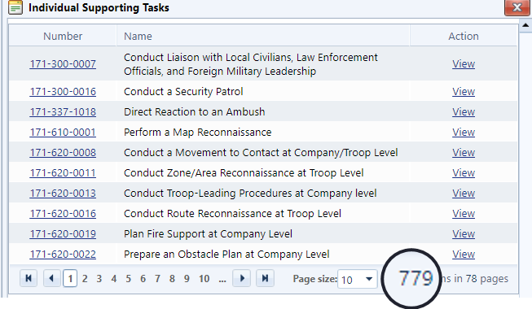











The Task Crosswalk Process
?
Unit Task List Individual Supporting Tasks
Individual Critical Task List
-
+
?
-
-
!
!
+
+
!
Over 1,000 Individual Task To Train
?
Warrior Tasks
Legend
? What to train
! Priorities
+ Add Tasks
- Subtract Tasks
Task Analysis
Process
Your Challenge is Determining Individual Tasks to Train
Notes:
REFERENCE: FM 7-0, Training, June 2021; ADRP 1-03 The Army Universal Task List, October 2015; Selected MET T&EO.
INSTRUCTOR NOTES:
This is a build slide. The PCC instructor must practice building this slide prior to class. This will allow the instructor to develop their unique method of presenting the data shown on this slide.
Utilize the question below to solicit dialogue with participants. Tap into previous experiences to direct the conversation while building the slide.
SCRIPT -
ASK:
Why is determining individual tasks trained SO important? Explain.
Suggested Answer: As we review the MET for an Infantry Battalion, let’s look at how many tasks a basic rifleman could be expected to train. BUILD
The Unit Task List has 779 individual tasks; let that sink in for a minute. BUILD
Now we add 71 Army Warrior Tasks. BUILD
Now add any individual task that the Infantry proponent has deemed “Critical” and we are well on our way to 1,000. BUILD
A thousand individual tasks – how many of you can say you will allot time for each of your rifleman to train on a thousand individual tasks in 2021? BUILD
Not any of the team/squad/platoon/company tasks – just individual ones – that is why this crosswalk coupled with solid training guidance is SO important.
Are there any questions?
Next slide.

Slide 33
Task Prioritization Summary
Subordinate leaders conduct a crosswalk to prioritize training on the collective tasks, battle tasks and individual tasks that directly support their unit’s mission-essential tasks.
The task crosswalk process is a 3-step process that links lower echelon tasks to a higher echelon task based critical/crucial actions necessary to support higher tasks.
Commanders and leaders at all levels focus training on the resulting tasks to optimize limited training time and resources.
The MET to Individual Task Crosswalk then allows leaders to select task to train through all the echelons that are focused based on Commander priorities.
Notes:
REFERENCE: FM 7-0, Training, June 2021; AR 350-1, Army Training and Leader Development (2017) October 2015; Selected MET T&EO.
INSTRUCTOR NOTES:
This is a review summary of task prioritization. It is not to be viewed as the LSA Review Summary, that comes later.
Allow participants to read the slide.
When asking questions be mindful of time constraints and be ready to correct misconceptions about the process. Ensure that the Q&A stays on track and does not digress into a complaint session.
SCRIPT -
ASK:
1. Which of these summary point stands out to you? Explain.
Suggested Answer: Answer vary based on experiences of the participants.
2. Do you have an experience where failure to prioritize tasks created training problems? What would you need to do to avoid them as you take command?
Suggested Answer: Answers will vary based on experience.
Are there any questions?
Next Slide.

Slide 34
Check on Learning
Notes:
REFERENCE: FM 7-0, Training, June 2021.
INSTRUCTOR NOTES:
1. The Check on Learning in this presentation includes questions and answers (solutions) for the instructor ONLY.
2. Determine if students have gained familiarity with the material discussed by soliciting student questions and explanations. Ask the students questions and correct misunderstandings.
SCRIPT -
We will now conduct a Check on Learning. Do not answer until prompted to.
ASK:
The task Crossway as a Three-Step process links higher echelon tasks to lower echelon tasks based on____________? (ref: FM 7-0, Appendix B, para B-2 to B-6)
Answer: Mission requirements.
2. What are the three training proficiency ratings and who is responsible to assign them? (ref: FM 7-0, Chap 1, para 1-3 to 1-4)
Answer: T-trained, P-practiced, and U-unable to perform task; Commanders.
3. Why do Commanders and First Sergeants utilize the T&EO for training? (ref: FM 7-0, Appendix D, D-2 to D-3)
Answer: a. Commanders use T&EOs to help assess collective task proficiency as part of feedback
b. 1SGs and other NCO leaders use T&EOs to observe and evaluate task performance, and to prepare and practice task execution.
Are there any questions?
Next slide.

Slide 35
Review Summary
We learned how to prioritize tasks and the three task proficiencies
Wed learned the three Training Proficiency Ratings
We learned the steps and purpose of the task crosswalk
We learned that Army leaders set the task priorities
We learned that there are challenges to task prioritization and how to navigate through them
Notes:
REFERENCE: FM 7-0, Training, June 2021.
INSTRUCTOR NOTES:
SCRIPT -
During this lesson we learned:
We learned how to prioritize tasks and the three task proficiencies
Wed learned the three Training Proficiency Ratings
We learned the steps and purpose of the task crosswalk
We learned that Army command team leaders set the task priorities
We learned that there are challenges to task prioritization and how to navigate through them
Are there any questions?
Next slide.

Slide 36
LSA 3
Review Planning for Training
at the T-C-B Level
Notes:
REFERENCE: FM 7-0, Training, June 2021.
INSTRUCTOR NOTES:
The Instructor must read and be familiar with FM 7-0, the focus of the lesson plan is: planning for training at the T-C-B level and understanding the importance of training proficiencies, how command guidance at all echelons, and the planning horizons drive the development and management of training.
Remind these leaders that adjustments to training, feedback, and attention to detail are foundational to creating effective and successful training plans.
Use this time to transition to the first lesson: LSA 3- Review Planning for Training at the T-C-B Level
SCRIPT -
ASK:
1. What have you found to be the biggest obstacles to planning training at the T-C-B level? Explain.
Suggested Answer: Answers will vary based on participant experiences and positions held.,
2. What are methods you used to focus planning efforts to overcome the obstacles presented? Explain.
Suggested Answer: Answers will vary based on experiences and positions held.
Are there any questions?
Next slide.

Slide 37
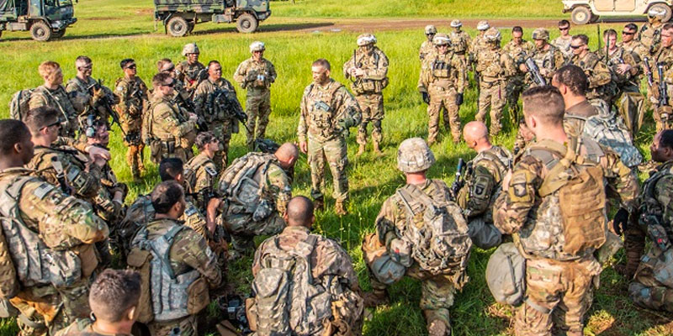
Training Guidance
What it is:
Prioritized tasks with target proficiency
Weapons Prioritization
Collective Live Fire task and
echelon
Time to accomplish
Training mission statement
Commander’s intent for training
Other guidance
Long-Range Training Plans (LRTP)
Notes:
REFERENCE: FM 7-0, Training, June 2021; Higher Echelon Commander Training Guidance, Local Command Training Guidance.
INSTRUCTOR NOTES:
Inform participants that training guidance is the specific training direction all Commanders provide to subordinate leaders to identify the training goals, objectives, training proficiencies and proficiency ratings that subordinate units must attain and when to attain it.
SCRIPT -
Commanders and 1SGs must provide clear and concise guidance on what is trained, when it is trained, who is trained and why – task and purpose.
Published training guidance provides subordinate commanders and leaders a clear vision of their higher echelon Commanders training expectations.
When communicated, these expectations will provide training direction for their subordinate unit purpose, and motivation necessary to train effectively.
Senior leaders develop and communicate training guidance quarterly, semi-annually, and annually.
National Guard and Reserve Component senior leaders communicate training guidance annually. Over a set period, they provide clear and concise guidance on what is trained, when it is trained, who is trained, and why they train —task and purpose.
Commanders at echelon need to account for higher headquarters training directives and time management system to ensure that they nest and link their training to meet the higher Commander’s intent.
At the T-C-B level as the leadership team you will analyze higher echelon Command Training Guidance to understand expectations and training directives.
Furthermore, you will do this to determine how your unit can best support the stated goals and objectives of higher echelon training program.
Published training guidance starts a parallel and collaborative 360-degree planning process.
As the T-C-B leadership team it is your responsibility to gather supporting references, doctrine, and training publications that will inform your training planning process.
These references provide the most current sources of information such as doctrine, technical manuals, unit SOPs, and on-line resources.
Additionally, as a unit Commander you will gather information on installation-level training resources to determine what they are, their availability, their location, and the requirements to secure them.
Throughout the planning process you will conduct Azimuth Checks. These are vital for ensuring that training objectives are being met.
In addition, they focus training efforts on achieving the MET proficiency and desired proficiency rating/assessment.
As the T-C-B Command Team you will clearly articulate what lower priority tasks will be trained later. Your published training guidance will provide your subordinate leaders your training expectations.
Throughout the planning process Commanders center efforts at all planning horizons on the published annual training guidance (ATG), which will include the long-range training calendar.
As an aside, mid-range and short-range planning and preparation are also connected to the published ATG.
Mid-range training guidance is published semi-annually as semi-annual training guidance (SATG) and quarterly as quarterly training guidance (QTG).
Utilizing Commander-to-Commander dialogues, which occur both formally and informally, will assist you to adjust your plans to optimize training plans and training.
Unit Commanders issue guidance to their staff in the development of long-range training plans and then issue training guidance (in the form of ATG) to subordinate Commanders.
When issuing ATG, Commanders must leave sufficient time for subordinate units to develop their own Long-Range Training Plans.
Are there any questions?
Next Slide

Slide 38
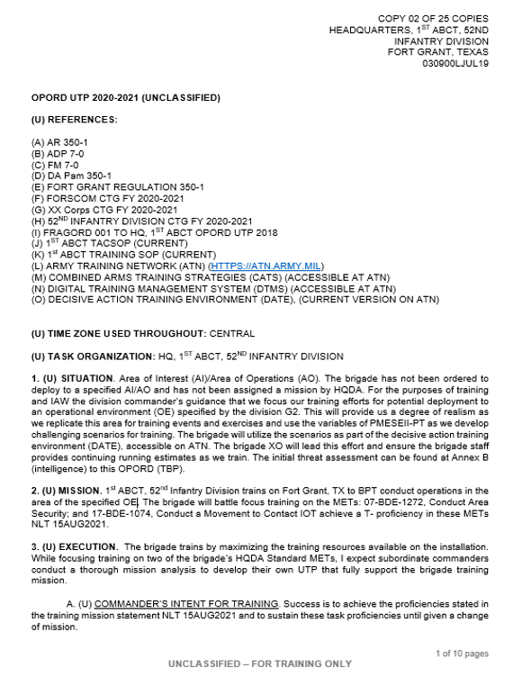
Training Guidance Considerations
  Commander-to-commander dialogues
  Current training plans
  Changes to training proficiencies:
  current vs. desired level
  4. Publication of senior headquarters
  annual training guidance (ATG)
  5. Other Changes:
      Change of unit mission
      Training resource allocation
      OE/threat conditions
  6. Additional tasks to train
Notes:
REFERENCE: FM 7-0, Training, June 2021. Appendix J.
INSTRUCTOR NOTES:
Allow the students time to review the slide, hit the key points you think are critical for training guidance.
SCRIPT -
When considering long-range planning and preparation Commanders must also consider the following practical concepts some key elements of developing training guidance include what is on the slide, but also will include:
1. Higher headquarters training guidance and training requirements: Commanders for higher headquarters training directives and time management to ensure that they nest their training to meet the higher Commander’s intent.
2. Time management system: Commanders prioritize training, time management system is a method of protecting allocated training time and resources for subordinate units and accounting Army requirements that detract from training.
3. Allocate the necessary training time and resources to enable subordinate organizations to train to standard: This is key to the success of any training program. Failure to properly allocate resources disrupts training unnecessarily.
4. Multi-echelon training: This training technique that allows for the simultaneous training of one or more echelons on different or complementary tasks.
5. Training environments: Conducting all training events in a live environment is impractical and not always possible; whenever possible leverage all training environments—live, virtual, and constructive.
a. Live training is executed in field conditions using tactical equipment.
b. Units execute virtual training using computer-generated simulators (gaming is a subset).
c. Constructive training using computer models and simulations to exercise command and staff functions.
Risk management. Training, especially in a live environment, carries an inherent risk to Soldiers, equipment, and the physical environment. Training effectively mitigates risk by putting in place a system to continuously monitor risk mitigation.
Finally, there may be additional planning considerations including:
1. The unit’s prioritized mission-essential tasks, weapons qualifications, and collective live-fire tasks to train.
2. The required proficiencies (T or P) to achieve.
3. When (date) training proficiencies must be achieved.
4. An operational environment to replicate in training.
5. Time management system (Green, Amber, Red).
6. Unit training events.
7. External evaluation (known as EXEVAL) expectations and schedule.
8. Collective live-fire, gunnery, and frequency requirements.
9. Individual training guidance such as AWT Training (including warrior tasks and battle drills) and low-density MOS training.
10. Physical training focus.
11. Leader development planning.
12. Leader certification.
13. Long-range training calendar.
14. Additional guidance at the discretion of the commander.
Are there any questions?
Next slide.

Slide 39
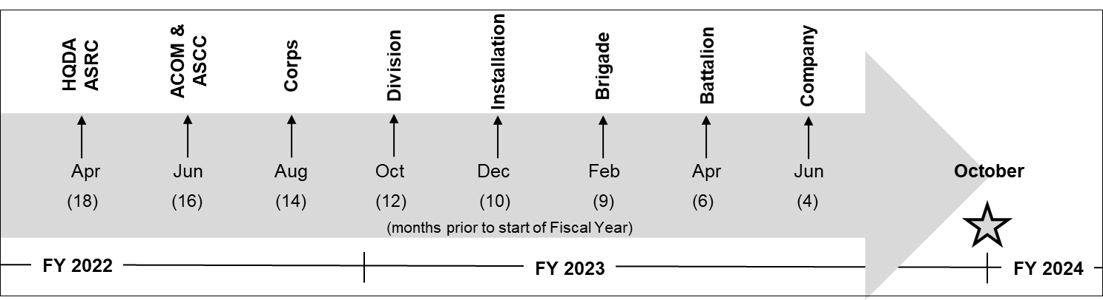
Guidance Publication Timelines
Notes:
REFERENCE: FM 7-0, Training, June 2021.
INSTRUCTOR NOTES:
The slide is a build. As you discuss the publication timeline you will click the enter button to show the Month (XX) of publication, and then click the enter button again to show the Oct of FY XX as the training plan execution date.
Instructor must be familiar with the Three Army Compo’s – Active, Reserve, and National Guard - design for the forces and the interoperability of the three in support of the Army mission to fight and win our nations wars.
SCRIPT –
Training guidance is published at echelon commencing at 18 months prior to training plan execution date of October 1 of the designated FY. In this diagram the publication of guidance commences at HQDA in June of 2022.
As the T-C-B Command team you will publish your training guidance at four (4) months in June of 2023 prior to training plan execution day of Oct 1, FY 2024.
As we have noted in throughout this lesson there are significant differences between the Three (3) Army Compo’s. It is imperative that you understand the training process for your specific compo so that you can effectively accomplish your training objectives and goals.
ASK (if applicable):
What Army Compo are you in, and what are potential challenges that you will face that are unique to your compo that the others will not face?
Suggested Answer: Answers will vary based on experiences, compo, and leadership roles(s). Guide the discussion, accordingly, and be prepared to correct all misconceptions.
Senior leaders develop and communicate training guidance quarterly, semi-annually, and annually. RC senior leaders communicate training guidance annually.
Over a set period, they provide clear and concise guidance on what is trained, when it is trained, who is trained and why — task and purpose.
As you review this slide concerning the publication of training guidance note that the publication cycle refers to Regular or Active Army component units. .
This cycle is different from Reserve and National Guard organizations due to demographic disbursement of units, and the training time differences.
Both the Regular Army and Reserve Component (RC) share the same training doctrine, share procedures, and train to the same standard. However, the training environment, planning horizons, and time available to train differ for RC units.
Geographic dispersion of units affects the Reserve Component training environment increasing the complexity for these units to accomplish training.
Reserve units must account for additional resource considerations when determining training areas—either a Regular Army or Reserve Component training installation—to accomplish training to standard.
The Reserve Component Commanders prioritize available training days and synchronize resources over extended planning horizons, often over the span of several years.
To mitigate this, Reserve Component units rely on a training month approach, T-Month, concept like the T-Week framework.
1. Army Commands and Army Service Component Commands, after participating in the ASRC, issue their ATG no later than 16 months prior to the beginning of the fiscal year.
2. Corps after integrating the ACOM’s guidance into their ATG, publish it no later than 14 months prior to the start of the FY.
3. Divisions publish their ATG to subordinate organizations after incorporating the Corps’ guidance NLT 12 months prior to the beginning of the FY.
4. Brigades issue ATG NLT 9 months prior to the start of the FY.
5. Battalions issue ATG NLT 6 months prior to the beginning of the FY.
6. T-C-B elements issue ATG NLT 4 months prior to the start of the FY.
Are there any questions?
Next Slide.

Slide 40
Planning Horizons
Long-Range - Annual
Mid-Range - Semi-Annual / Quarterly
Annual training guidance (ATG):
Formal document published with a training calendar depicting training events sequenced with resources over time to reach desired proficiency
Short-Range - T Week
Semi/quarterly training guidance (SATG/QTG- SATB/QTB):
Formal events to refine the execution of the annual training guidance
Weekly training meetings:
Formal meetings to establish and publish training schedules beginning at (T-6)
Notes:
REFERENCE: FM 7-0, Training, June 2021, Appendix E.
INSTRUCTOR NOTES:
SCRIPT -
In order to develop and execute training that enables a unit to fulfill its mission requirement Commanders at echelon must develop viable and strategic long-range train plans.
Command Teams accomplished by forecasting training events, resources, and opportunities through all three planning horizons.
Commanders, First Sergeants and subordinate leaders plan training one echelon down and ensure training two echelons down is evaluated and assessed.
At all echelons when developing a training plan always take into consideration the training goals and priorities of Commanders two echelons higher than you.
Consequently, the training planning process is comprised of Three Planning Horizons:
1. Long Range Planning Horizon.
Planning guidance begins early. As we have discussed, as you look at the diagram you will note that guidance for active Army units is published at higher echelons beginning 16 months prior to the FY training is to commence and follows down to the Troop-Company-Battery level at 4 months prior.
As a top-bottom, then bottom-up process, note that once training plans are developed the lower echelon plan is rolled up with the next higher gaining approval from the next echelon Commander.
It is critical that you recognize that the planning horizons are different for the Three Army Components – Active, Reserve, and National Guard.
For Reserve units they publish guidance starting 18 month prior, Brigade at 10 months prior, and battalions at 6 months prior.
The nature of the Reserve and National Guard training environment increases the complexity of reserve training planning.
2. Mid-Range Planning Horizon.
Mid-range planning and preparation relies on the approved ATG. It ensures resources are coordinated for and confirmed prior to training events.
The mid-range horizon depends on semi-annual and quarterly refinement and execution of the annual training guidance (known as ATG).
Some of the critical activities that occur during mid-range planning and preparation include— Published semi-annual training guidance (SATG) and quarterly training guidance (QTG).
Semi-annual training briefings (SATBs) and quarterly training briefings (QTBs) provide periodic updates of subordinate unit training progress to senior commanders.
Semi-annual training briefings and quarterly training briefings are provided to the commander two levels above.
As T-C-B Command Teams build their desired training plans, they begin by utilizing higher echelon commander training guidance provided formally (published, dialogues and briefings) and informally (dialogues and briefings).
Higher echelon training guidance is crucial to your efforts in building long- and mid-range calendars which will serves as the foundation for building your short-range calendar.
3. Short Range Planning Horizon.
T-C-B units and below manage training through the short-range planning horizon primarily through T-C-B training meetings.
In this planning horizon, training schedules are approved and published, final pre-execution checks and coordination are conducted, and supplies are delivered.
The Training-Week (T-Week) framework is a planning technique that aligns the weeks prior to and after a training event to the actions or activities that must be accomplished.
For example, ‘T Week’ is the week of execution, ‘Week T-6’ is six weeks prior to execution, and ‘Week T+1’ is the week following execution.
Organizational unit training schedules are the culmination of long-, mid-, and short-range planning and preparation. Any changes to training or the training calendar will require the approval of the next higher echelon commander, except in the case of basic administrative changes.
In order to execute effective and successful training changes should be kept to a minimum and made for limited reasons to include the prevention of risk or injury, mission failure or if the changes will significantly enhance the training experience.
The Training-Week (T-Week) framework is a planning technique that aligns the weeks prior to and after a training event to the actions or activities that must be accomplished.
For example, ‘Week T’ is the week of execution, ‘Week T-6’ is six weeks prior to execution, and ‘Week T+1’ is the week following execution
The Reserve Component commanders prioritize available training days and synchronize resources over extended planning horizons, often over the span of several years.
To mitigate this, Reserve Component units rely on a training month approach, T-Month, concept like the T-Week framework.
At the Troop-Company-Battery level when developing a training plan leaders always take into consideration the training goals and priorities of Commanders two echelons higher than their unit of assignment.
Are there any questions?
Next Slide.

Slide 41
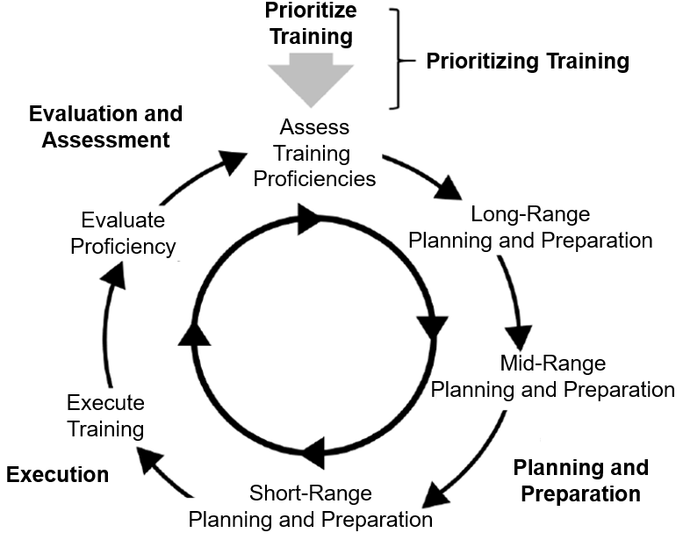
Planning and Preparation
The Commander and First Sergeant conduct planning and preparation tasks assisted by key leaders in the unit.
The standards required to achieve task proficiency are prescribed in Army training and evaluation outlines for tasks and applicable weapon system publications.
The planning process begins with the commander providing principal inputs: prioritized mission-essential tasks, weapons qualification, collective live-fire tasks, and the commander’s assessment of the unit’s training proficiencies.
Planning in the training management cycle aligns prioritized training tasks with resources over time.
The commander plans training one echelon down and ensures training two echelons down is evaluated.
Notes:
REFERENCE: FM 7-0, Training, June 2021.
INSTRUCTOR NOTES:
Allow students to review the slide and then have a brief discussion.
SCRIPT -
You will note that once training plans are developed the lower echelon, the plans are then nested into the next higher plain and upon approval from the next echelon Commander becomes the basis for unit training events.
The Commander conducts long-range planning and preparation to determine the training required to progress from the unit’s current state of training proficiency to the desired proficiency level.
There are several key considerations for Long-Range planning and preparations they include but are not limited to:
Determine the training required to progress from the unit’s current state of training proficiency to the desired proficiency level.
Sequences training events with resources over time to determine who, what, when, and where to train. This includes External Evaluations (EXEVALS), leader development and leader certification programs, and training calendars.
Ensures coordination and actions needed to secure long-lead time resources are accomplished prior to training.
The approved training plan becomes a contract between the senior and subordinate Commanders. It represents the senior Commanders’ commitment to resourcing subordinate unit training and to protect it from un-programmed training distracters. The subordinate Commander commits to conducting the training as briefed or with approved modifications.
When approved, the long-range training plan is published as Annual Training Guidance to subordinate, higher, and other affected commands, as necessary. The format of the annual training guidance is at the discretion of the Commander and includes the long-range training calendar.
The unit’s prioritized METs/weapons qualifications/collective live-fire tasks to train and the date when training proficiencies must be achieved. To include Collective live-fire, gunnery and frequency requirements.
The operational environment (OE) to replicate in training.
Time management cycle.
Are there any questions?
Next slide.

Slide 42
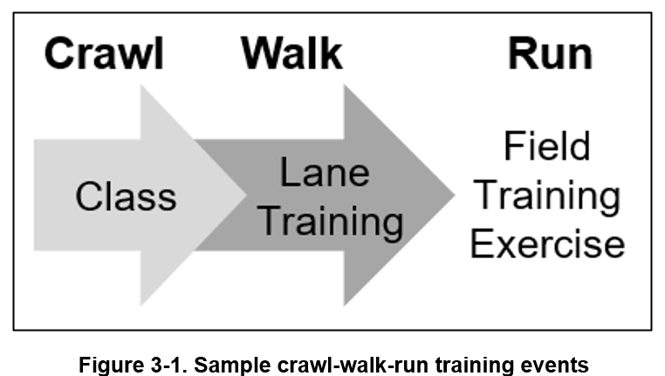
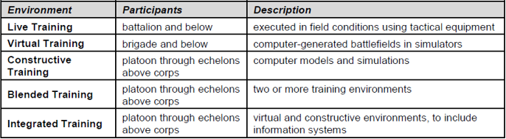
Planning and Preparation
Higher echelon training guidance and requirements
Time management system
Training events and environments
Army Training Sequencing system
Allocate the necessary training
time and resources to enable subordinate organizations to train to standard
Notes:
REFERENCE: FM 7-0, Training, June 2021.
INSTRUCTOR NOTES:
Allow the students the opportunity to read/review this slide.
Present this as another way to look at the Training Management process and the design and implementation of training at the T-C-B echelon and below.
SCRIPT -
ASK:
What do you view to be key points from this slide? Explain.
Suggested Answer: Allow for dialogue and asks follow on questions to continue the dialogue.
Are there any questions?
Next slide.

Slide 43
Time Management System
Time Management System:
Green-Amber-Red
Green cycle: Units have training resource priority and focus on unit collective training.
Amber cycle: Units have training resource priority behind green cycle units.
Red cycle: Units in red cycle are the primary organizations executing directed support taskings.
"We want to reinforce that we train to standard – not to time. This means that commanders must make time for subordinate units to re-train – and do it again until they get it right, and never get it wrong”
General (R) Michael Garrett
Former FORSCOM CG
Time Management is a method of protecting allocated training time, personnel, and resources. It is critical that Commanders and 1SGs utilize this system.
Notes:
REFERENCE: FM 7-0, Training, June 2021.
INSTRUCTOR NOTES:
SCRIPT -
It is the Commander's responsibility, allied with the guidance and advisement of the 1SG, to defend their organization’s approved training from un-forecasted requirements and to underwrite associated risk to lower priority missions, all leaders involved in the training process have a role in the prevention of training distractors.
T-C-B Command Teams execute this responsibility by allocating the necessary training time and resources to enable subordinate organizations to train to standard.
The Fight to Train principle of the Nine Principles of Training, when effectively executed, separates great trainers and trained units from others.
The Army time management systems is a tool that aids you in the Fight to Train principle as you can prioritize and sequence training in a way that allows you as a Command Team to build your training tasks from simple to complex, while doing so when training resources and opportunities are optimal.
One method utilized in which leaders can protect training is by the utilization of a time management system. The most common time management system is the Green-Amber-Red (G-A-R) Time Management Cycle.
As you project training events so your unit can train to desired proficiency, effective management of scarce resources comes into play. Time must be forcefully managed and strategically allocated to ensure subordinate units have ample time to become proficient in support of the higher unit.
Training leaders don’t just seek to be task proficient; they seek Task Mastery as a goal.
As a result, such requires organizational leaders at echelon to develop and execute training, and, when needed, retraining to build and sustain individual ad collective skills and unit capabilities in support of higher echelon mission requirements.
Higher echelon Commanders account for all organizations within their command and utilize an equitable time management system based on unit training priorities and missions.
ASK:
1. We have already discussed the G-A-R Time Management Cycle; do you have any questions about it?
Answers to this will vary based on the needs and understanding of the students. Guide discussion if needed. DO NOT get eclipsed by time asking this question-and-answer time.
The complexity of tasks can be a major factor in how much time is needed to conduct an effective training event for those tasks. Allowing subordinates to have not only “white” space on a calendar, but “Green Space” is important.
Green space is available time on the calendar when the unit can conduct complex, prime-time training.
The next slide will provide you with a sample view of the training schedule utilizing the Time Management Cycle
Are there any questions?
Next Slide

Slide 44
Long-Range Planning Calendar
CPX
Block Leave
Green Cycle
Red Cycle
Amber Cycle
Red Cycle
BN Range Week
BN Gunnery
Services (Recovery)
STAFFEX
Add Time Management Cycle
Amber Cycle
Red Cycle
Amber Cycle
Red Cycle
Green Cycle
Services
STAFFEX
SQD IND TNG
SQD IND TNG
LFX
LFX
STAFFEX
STAFFEX
Green Cycle
Amber Cycle
Green Cycle
SQD IND TNG
LFX
STX
BN Range Week
BN Gunnery
Services (Recovery)
STX
CPX
Green Cycle
STAFFEX
CPX
STAFFEX
CPX
SQD EXEVAL
STX
STX
PLT EXEVAL
STX (Conduct an Attack)
STX (Conduct an Attack)
CO EXEVAL
Add SQD level events to calendar
Add PLT level events to calendar
Add CO level events to calendar
Add BN level events to calendar
BDE and BN Staff add
STAFFEX’s and CPX’s
Add BDE level events to calendar
Notes:
REFERENCE: FM 7-0, Training, June 2021.
INSTRUCTOR NOTES:
This is a build slide on how the Time Management System applies to a training calendar from the Brigade echelon down to the Squad level.
Instructor should practice building this slide in order to hit the key points of the slide based on using the time management system and the use of training events by echelon.
Remind the participants of the importance of creating the calendar in accordance with higher echelon and local Garrison policies in order to better formulate their training calendar.
As you build and walk the slide through to completion the instructor must be able to identify the color codes and how the color coding improves the calendar and makes it an easy reference guide for managing training events.
SCRIPT -
Are there any questions?
Next Slide.

Slide 45
The Eight Step Training Model
Step 1
Step 2
Step 3
Step 4
Step 5
Step 6
Step 7
Step 8
Plan the training event
Train and certify leaders
Recon training sites
Issue the Operations Order (OPORD)
Rehearse
Train
Conduct after action reviews
Retrain
What are the specific and measurable training objectives?
Are the necessary resources identified and coordinated to train?
When will guidance and direction be provided to subordinates?
Is enough time allocated for training?
Are required resources identified to train effectively?
Are the potential hazards identified and associated risks eliminated or mitigated?
Are evaluation plans developed that support the tasks trained?
When and where will rehearsals be conducted to ensure plans are synchronized and actions are understood by subordinates?
Who will supervise rehearsals to ensure those responsible to execute the rehearsal are prepared and organized?
Who will conduct rehearsals for the Opposing Forces (OPFOR) leaders and personnel?
Was the executed training and tasks observed and evaluated?
Were the training objectives trained until proficiency was achieved?
Did the participants perform tasks, and trainers evaluate performance against published standards?
Are certification requirements established?
Are leaders and trainers certified to lead and conduct the training?
When will personnel certify to perform the task to standard?
When will the Opposing Forces (OPFOR) leaders trained and certified?
When will the leaders perform reconnaissance of training sites?
Were any observations and potential issues prior to training execution reported?
Have training locations been verified that they can support the training event?
Were the site scheduling and coordination issues resolved?
Were after action reviews (AARs) are conducted during and after the training event?
Was AAR feedback provided to the unit Commander to help assess task proficiency?
Were lessons learned discussed, recorded, and shared with other units and leaders?
Did the reviews help improve unit training as well as the unit’s tactics, techniques, and procedures (TTPs)?
Does the order specify responsibilities, timelines for execution, tactical scenarios, and other key information?
Does the order Identify the tasks to train, training objectives, the training mission, and the methods to execute the training?
Do subordinates have all available information to prepare and execute the training event?
Are expected outcomes and training objectives understood?
Were tasks not performed to standard, retrained and re-evaluated until the standard was achieved?
Were units not allowed to depart the training event until tasks were trained to standard and training objectives were met?
Notes:
REFERENCE: FM 7-0, Training, June 2021.
INSTRUCTOR NOTES:
Give students time to review the slide as you discuss the varied steps. Note that under the color codes allows for easier identification of critical actions and sub-steps for each Training Model step.
SCRIPT -
Training models are an effective technique for small units (company and below) to plan and prepare a training event. They provide a logical and reliable framework of activities and actions for small-unit leaders to plan and prepare, execute, and evaluate single training events.
A commonly used and effective model for managing all aspects for training events is the 8-Step Training Model; the premier training model for the US Army.
Although the steps are listed in numerical order, you do not need to lock yourself into the given sequence. For example, leader training may not occur until the leaders are available independent of the event planning sequence provided by the 8-step training model.
The instructor must go into the details below to explain each step. The details for the 8-Step Training Model are provided below:
Step 1: Plan the training event.
Leaders develop specific and measurable training objectives based on the Commander's guidance. They identify and coordinate the resources necessary to train and provide guidance and direction to subordinates.
Leaders allocate and ensure Soldiers have enough time for training as well as identify the required resources to train effectively. They identify potential hazards and eliminate or mitigate associated risks. Lastly, leaders develop evaluation plans that support the tasks trained.
Step 2: Train and certify leaders.
Certification requirements are established, and leaders and trainers are certified to lead and conduct the training. Certified personnel must have detailed knowledge of the training subject matter and have performed the task to standard themselves. This step also includes training and certifying opposing force (OPFOR) leaders.
Step 3: Recon training sites.
Leaders perform reconnaissance of training sites and report back observations and potential issues prior to training execution. Leaders verify that training locations can support the training event and enable the unit to accomplish its training objectives. They contact site support personnel and solve scheduling and coordination issues.
Step 4: Issue the operation order (OPORD).
This order specifies responsibilities, timelines for execution, tactical scenarios, and other key information necessary to execute the training event. Leaders identify the tasks trained, training objectives, the training mission, and the methods to execute the training.
Leaders ensure subordinates have all available information to prepare and execute the training event. A successful training event relies on all leaders understanding the expected outcome and remaining focused on the training objectives.
Step 5: Rehearse.
Leaders conduct rehearsals to ensure plans are synchronized and actions are understood by subordinates. Leaders supervise rehearsals to ensure those responsible for training are prepared and organized. This step includes conducting rehearsals necessary for OPFOR leaders and personnel.
Step 6: Train.
Training is executed, tasks are observed and evaluated, and training objectives are trained until proficiency is achieved. As participants perform tasks, trainers evaluate performance against published standards.
Step 7: Conduct after action reviews.
After action reviews (AARs) are conducted during the planning process, executed training and upon training event completion. AAR feedback is provided to the unit Commander to help assess task proficiency.
Lessons learned are discussed, recorded for future use, and shared with other units and leaders. These reviews help improve unit training as well as the unit’s tactics, techniques, and procedures (TTP).
Step 8: Retrain.
Tasks not performed to standard are retrained and re-evaluated until the standard is achieved. Units do not depart the training event with tasks not trained to standard and training objectives not met.
Are there any questions?
Next slide.

Slide 46
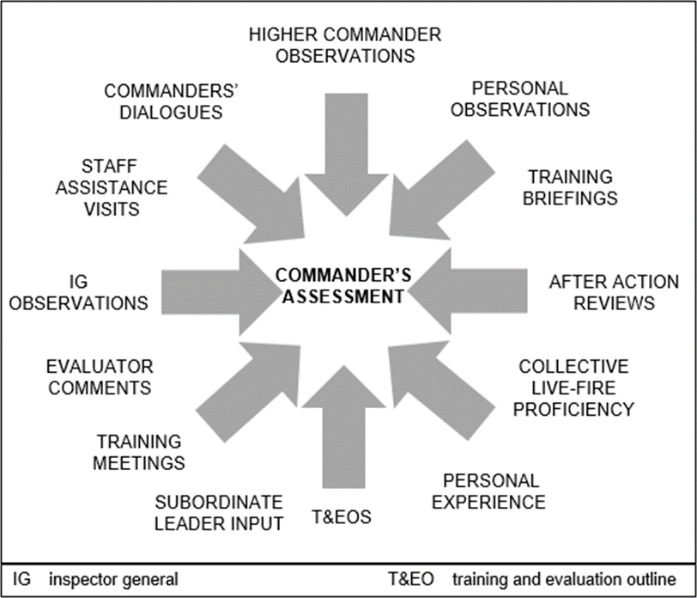
Evaluation and Assessment
1. Undergirds the commander's judgment of the organization's training proficiency.
2. Requires accuracy and objectivity
when observing a training effort.
3. It is a continuous process based
on a wide variety of inputs and
feedback.
4. Commanders and 1SGs ensure
supporting evaluation plans exists
for training events.
5. External evaluations (EXEVALs)
are directed and resourced by the
Commander two echelons above
the evaluated unit.
Notes:
REFERENCE: FM 7-0, Training, June 2021.
INSTRUCTOR NOTES:
Highlight the Evaluation and Assessment diagram. Emphasize its 360-degree nature especially how the identified entities provide evaluation and that these evaluations, formal and informal, guide how the Commander, in consultation with the 1SG, assess training in light of current and desired training proficiency ratings.
SCRIPT-
ASK:
1. Evaluation and assessment is a continuous process based on a wide variety of inputs and feedbacks. Where does this input and feedback come from?
Suggested Answer: Soldier, subordinate leader, and noncommissioned officer observations and evaluations, external reports and inspections, after action reviews, and senior leader observations.. FM 7-0, para 5-1)
2. What critical insights do 1SGs and subordinate NCOs provide in the evaluation and assessment of training?
Suggested Answer: Answers will vary based on past positions and experiences.
During evaluation planning commanders ensure a supporting evaluation plan exists for training events. This plan provides trained and certified evaluators with a process to observe and record task proficiency.
Evaluators record the results of their observations and provide them to the commander at the conclusion of training as part of feedback.
When it comes to external evaluations (EXEVALs) they are directed and resourced by the commander two echelons above the evaluated unit. Leaders outside the evaluated unit’s chain of command conduct these evaluations.
EXEVALs are conducted down to platoon level, but at the commander’s discretion can be conducted below platoon. The selected collective tasks to validate become EXEVAL training objectives.
The EXEVAL exercises unit command and control, communications, movement, and operations against an actual or simulated opposing force in a replicated operational environment. (See appendix H and AR 350-1 for additional information on EXEVALs.)
Are there any questions?
Next slide.

Slide 47
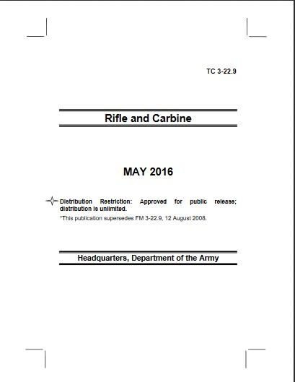
Evaluation
  T&EOs are the principal reference for task standards and TCs are the principal reference for weapons qualification standards.
Training & Evaluations Outlines (T&EOs)
Training Circulars
June 2019
Weapons
Collective and Individual
Notes:
REFERENCE: FM 7-0, Training, June 2021.
INSTRUCTOR NOTES:
If needed allow for further discussion by addressing any noted lack of understanding.
SCRIPT –
All training is evaluated. Evaluation is the objective observation of performance measured against standards. Presentation of the evaluation observations can be provided through formal or informal means.
For individual tasks (Army warrior and military occupational specialty tasks), drills, other collective tasks, and collective live-fire tasks, training and evaluation outlines (T&EOs) are the reference for task standards. For weapons qualification standards, the applicable weapon system publications (TCs) are the principal reference points.
The commander relies heavily on evaluation results when assessing proficiency. 1SG and NCO involvement in this process is a signal feature as they provide direct oversight for the execution of training according to published standards.
Evaluations can be executed using internal or external assets. The evaluation of training occurs during the execution phase of training events as well as during the planning and preparation phases as leaders continually find ways to improve unit tactics, techniques, and procedures. Additionally, leaders use evaluations as opportunities to coach and mentor subordinates.
Are there any questions?
Next slide.

Slide 48
Check on Learning
Notes:
REFERENCE: FM 7-0, Training, June 2021.
INSTRUCTOR NOTES:
1. The Check on Learning in this presentation includes questions and answers (solutions) for the instructor ONLY.
2. Determine if students have gained familiarity with the material discussed by soliciting student questions and explanations. Ask the students questions and correct misunderstandings.
SCRIPT -
We will now conduct a Check on Learning. Do not answer until prompted to.
ASK:
What are the three planning horizons for Army training? (ref: FM 7-0, Chap 3, para 3-3 to 3-6)
Answer: Long-range, Mid-range, and Short-range.
2. What is the premier training model used by the Army, and why? (ref: FM 7-0, Chap 3, para 3-21)
Answer: The 8-Step Training model, it provide a logical and reliable framework of activities and actions for small-unit leaders to plan and prepare, execute, and evaluate single training events.
Are there any questions?
Next slide.

Slide 49
Review Summary
We learned about the centrality of Training Guidance for training planning
We learned about the Training Planning Horizons
We learned about the importance of time management for planning training
We reviewed the 8-Step Training Model and its influence on training management
We reviewed the importance of evaluation and assessment for training management
Notes:
REFERENCE: FM 7-0, Training, June 2021.
INSTRUCTOR NOTES:
SCRIPT -
During this lesson we learned:
About the centrality of Training Guidance for training planning
About the Training Planning Horizons
About the importance of time management for planning training
We also reviewed the 8-Step Training Model and its influence on training management
Lastly, we reviewed the importance of evaluation and assessment for training management
Are there any questions?
Next slide.

Slide 50
LSA 4
Review the Communication of
Training Priorities at the T-C-B Level
Notes:
REFERENCE: FM 7-0, Training, June 2021.
INSTRUCTOR NOTES:
The Instructor must read and be familiar with FM 7-0, the focus of the lesson plan is: constructing training at the organizational level by understanding the importance of training proficiencies, training proficiency rating assessments, and the importance of the principles of training as a key feature of employing training management at the organizational level.
Use this time to transition to the first lesson: LSA 4 – Review the Communication of Training Priorities at the T-C-B Level
SCRIPT -
Successful training not only requires that predictable, sustainable, and targeted training is developed, it also requires that unit Soldiers at all levels understand what the training year will look like.
Communicating the training priorities of the T-C-B means that leaders and Soldiers are aware of the goals, objectives, and expectations of Commanders at all echelon for training to meet mission requirements. This can be done in formal or informal ways.
For the purpose of this portion of the Pre-Command Course, we will limit ourselves to the formal and published means to do this.
Are there any questions?
Next slide.

Slide 51
“Training in all its phases must be intensive . . . it must be intelligently directed so that every individual, including the last private in the ranks, can understand the reasons for the exertions he is called upon to make”
General Dwight D. Eisenhower
Notes:
REFERENCE: FM 7-0, Training, June 2021.
INSTRUCTOR NOTES:
Allow students to read the slide while you talk.
SCRIPT -
As your review this quote by Eisenhower,
ASK:
1. In your experience, is Eisenhower correct about training? Why or Why not?
Suggested Answer: Varied based on participant experiences.
Are there any other questions?
Next slide

Slide 52
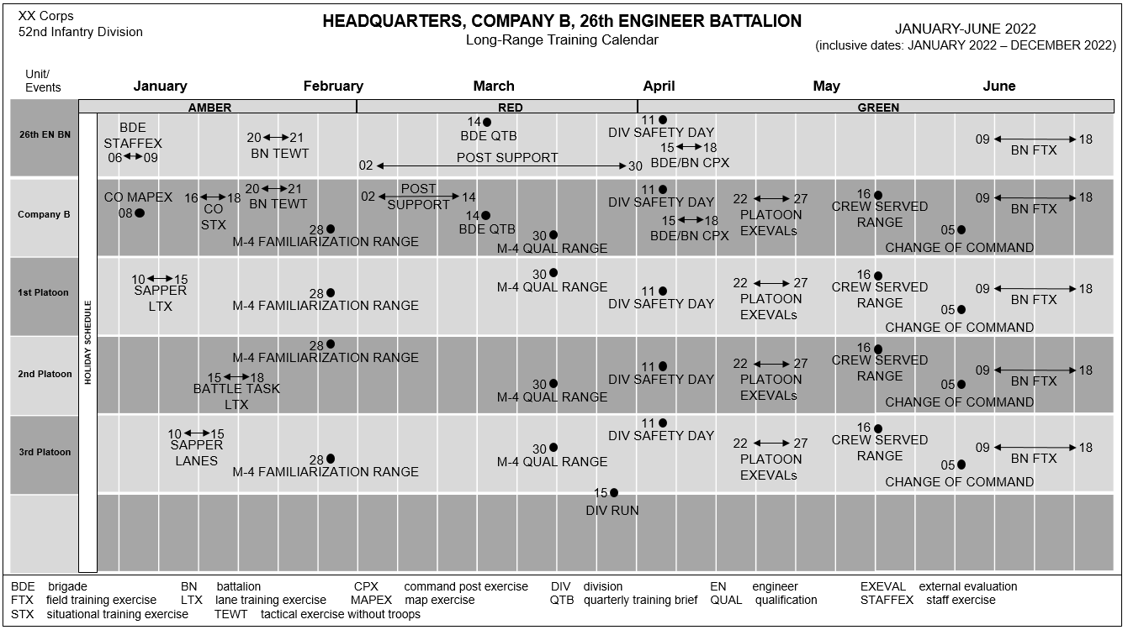
Approved Training Guidance
Notes:
REFERENCE: FM 7-0, Training, June 2021.
INSTRUCTOR NOTES:
This slide is a build slide
SCRIPT -
There is a significant need to publish the Long-Range unit training plan. Without a plan you can never fully capitalize on training resources, synchronize efforts, or foster a predictable weekly schedule that enables Soldiers and leaders to meet expectations and understand their responsibilities.
(1st Click enter - the Training Plan OPORD shows)
The Training Plan OPORD is a strategic method to communicate the Long-Range training plan to all subordinates. I provides a clear snapshot of the 5Ws of training, identifies resources, methods for evaluation and assessment, prioritized training tasks and desired training proficiency assessments among other training data.
The OPORD will demonstrate the depth of the long-range training plan while identify key leaders/trainers.
(2d Click enter – The Training Calendar shows)
As the slide indicates, Approved Training Guidance is documented and includes a training calendar. Placing events on a calendar is not a plan or guidance, it is just a component of the overall planning process.
Are there any questions?
Next slide.

Slide 53
Battle Rhythm
Establishing a training battle rhythm helps formalize and regulate the flow and sharing of training information across the command
  Training activities
  Meetings
  Briefings
  Conferences
  Reports
Training Battle Rhythm activities include:
Training resource synchronization conferences
Publishing training guidance (ATG, SATG, QTG)
Training briefings (QTB/SATB/ATB)
Training meetings
Commander-to-commander dialogues
Publishing company training schedules
T-Week coordination
Notes:
REFERENCE: FM 7-0, Training, June 2021.
INSTRUCTOR NOTES:
SCRIPT -
As it pertains to planning and executing training a method used by Commanders at echelon is the establishment of a unit’s Training Battle Rhythm. One express purpose of the battle rhythm is formally integrated and synchronize training activities, meetings, briefings, conferences, and reports and other training related activities. Establishing a training battle rhythm helps sequence and formalize these activities to regulate the flow of and sharing of training information across the command.
This slide demonstrates what a Platoon Training might identify as three essential elements to the training management activities of small unit echelons.
Training Battle Rhythm activities will include but are not limited to:
Training Meetings –
At all echelons training meetings are conducted to refine training guidance and training calendars. At battalion and brigade levels, these meetings focus on overall annual training guidance progress and ensuring training resources for subordinate companies are coordinated and available when training begins.
Company and below units manage training in the short-range planning horizon primarily through company training meetings.
We will discuss platoon level meetings in more depth on the next slide.
2. Training Schedule –
At echelons, the organizational training schedule is integrated with higher echelon training schedule(s).
At minimum, the schedule will include:
The Date-Time-Group of training (start and end).
Target audience for the training.
Tasks trained (task title and numbers for reference).
Trainer (primary and alternate).
Uniform and equipment.
Training location.
References (such as FM 6-22 and TC 7-101).
Authentication (organizational approving authority signatures).
3. T-Week Coordination –
The Training-Week (T-Week) framework is a planning technique that aligns the weeks prior to and after a training event to the actions or activities that must be accomplished. For example, ‘Week T’ is the week of execution, ‘Week T-6’ is six weeks prior to execution, and ‘Week T+1’ is the week following execution.
As we discussed in a previous lesson, the T week construct is a backward planning method. The T-6 to T+1 provided is a snapshot for training activities to be discussed at the training meeting corresponding to the 6 week lock in of the training schedule.
Other T week activities can be included but a separate event planning meeting is encouraged due to the time constraints and resources available. The addition of the T+1 to our graphic is necessary to include training just completed.
Remember that any significant changes to the training calendar/schedule require higher echelon Commander approval. Administrative changes require no such approval.
Are there any questions?
Next Slide.

Slide 54
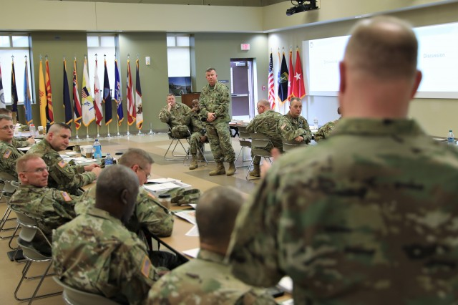
Annual Training Briefs
Training briefings provide approval of long-range training plans and periodic updates of lower echelon unit training progress to higher echelon commanders.
Annual (ATB); Semi Annual (SATB); Quarterly (QTB) are given to the commander two levels above
Annual training briefings (ATB) for RC units are presented to the next higher commander
Notes:
REFERENCE: FM 7-0, Training, June 2021.
INSTRUCTOR NOTES:
SCRIPT -
The second feature of the Training Battle Rhythm that we will discuss centers on conducting training briefs at all echelons. Like Training guidance, training Briefs are conduct at the Annual (ATB), Semi-Annual (SATB), and Quarterly (QTB) sequences.
One express purpose of the training briefs is formal integration and synchronization of training management, to include reporting on training activities to higher echelon leaders..
These establishing briefing main the sequencing and formalization of training management activities, which regulates the flow of and sharing of training information across the command relationship.
The commander two levels up approves the subordinate unit’s long-range training plan. This approval and commander-to-commander contract is normally part of the ATB, and includes higher echelon Commander approval for subordinate unit:
Current training proficiency assessment
Mission-essential task prioritization/weapons qualification guidance/collective live-fire requirements
Long-range training plan, ensuring it is nested within the higher unit’s training plan, is resourced appropriately, and can accomplish the subordinate unit’s progression to the designated level of training proficiency.
This approved plan becomes a contract between the commanders. The subordinate commander agrees to execute the plan and the higher commander agrees to protect and resource the plan.
Battalion commanders brief the division commander and company commanders brief the brigade commander. The briefings are designed to discuss past, present, and future training expectations and to approve any necessary modifications to the annual training guidance.
The briefing results in a training contract or agreement between the senior and subordinate commanders consisting of two parts:
First, upon approval of the subordinate commander’s plan, the senior commander agrees to provide resources and protect the subordinate unit from unprogrammed training distracters.
Second, the subordinate commander agrees to execute the approved training to standard.
Included in the training plan that is part of the briefing process is the Unit Leader Development Plan. Leaders create leader development plans focused on improving and sustaining subordinate leader skills and attributes as unit training progresses. This planning is also discussed during training meetings and ATBs, SATBs, and QTBs.
Are there any questions?
Next Slide.

Slide 55
Semi-Annual and Quarterly Training Briefs
A by-quarter refinement and execution of the long-range plan progress
Validate and confirms requirements and resources for current and next quarter
Leader development and leader certification
Refine training guidance (if required)
ATG
published
LRTP
Briefing
SATB
QTB
SATB
QTB
TRC
TRC
TRC
TRC
Training Meetings
(at echelon)
Commanders’
Dialogues
(throughout)
QTB quarterly training briefing TRC training resource conference
ATG Training Guidance
Notes:
REFERENCE: FM 7-0, Training, June 2021.
INSTRUCTOR NOTES:
SCRIPT -
Semi-Annual (SATB) and Quarterly Training Briefs (QTBs) are Mid-range training planning and preparation briefings to obtain feed back on the long-range training plan.
It ensures resources are coordinated for and confirmed; focuses on a by-quarter refinement and execution of the long-range plan. And like the ATB, results in a contract for future training.
Battalion commanders brief the division commander and company commanders brief the brigade commander. The briefings are designed to discuss past, present, and future training expectations and to approve any necessary modifications to the annual training guidance.
Some of the critical activities that occur during mid-range planning and preparation:
Leader development plan development.
Installation training resource conference attendance. These conferences provide home station units visibility of training resource usage and scheduling on the installation. Attendance gives unit leaders and training planners opportunities to review, coordinate and secure these major resources (such as ranges, training areas, simulators, etc..) for future training. They also help de-conflict potential scheduling issues between using units.
Execution of T-Week actions and pre-execution checks.
ASK:
1. What other critical activities or training data should you include in the training briefings?
Suggested Answer: Answers will vary based on participant experiences. Allow for discussion.
Are there any questions?
Next Slide.

Slide 56
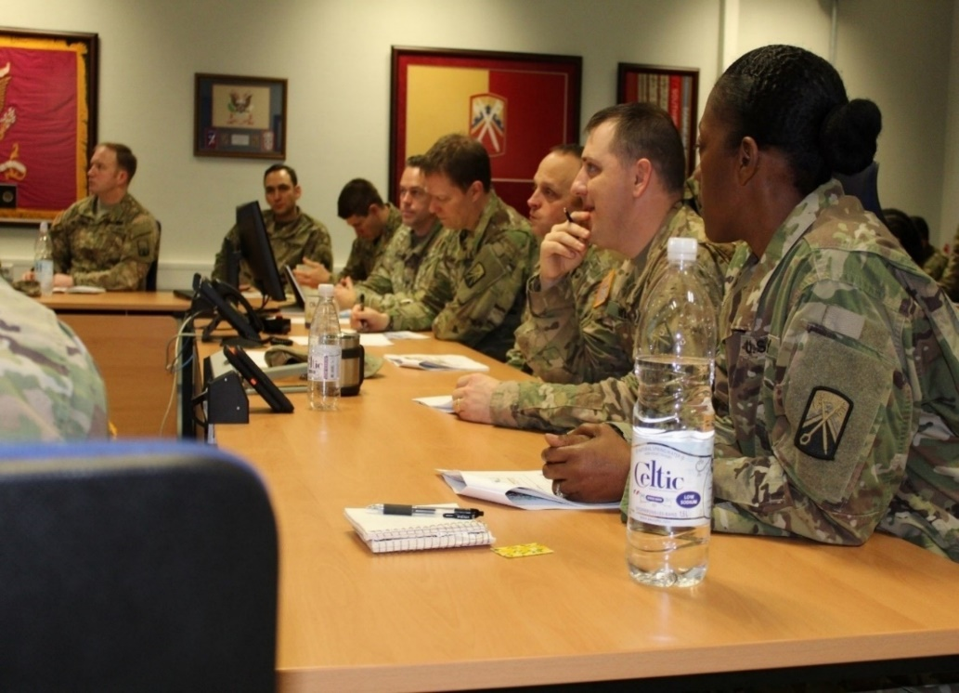
Weekly Training Meetings
Central focus - Training Issues, such as:
  Previous week training – finalize
  Commander Assessment to validate
  Upcoming events
  Short-range events and priorities:
  a. From T-6 to T-1
    b. Short-range training guidance
    c. Publish training schedules at T-6
    d. Rehearsal, finalize resources
    e. Leader certification, training gates
  f. Mid-range (T-16 to T-7)
  g. Upcoming PME courses
Notes:
REFERENCE: FM 7-0, Training, June 2021.
INSTRUCTOR NOTES:
SCRIPT -
As your review the slide, note that training meetings at the T-C-B level are regulated by higher echelon and local policy. Thus, the meetings are set to meet the synchronization and coordination needs of the unit leadership.
They are also utilized to provide training guidance and training calendar refinement, as required.
Company Training Meetings discuss a wide variety of training related topics and issues to include mid-range training, previous weeks training, and leader development efforts that align with higher echelon guidance, unit mission requirements, and other pertinent issues related to training efforts.
Furthermore, the T-C-B training meeting will address short-range planning and preparation, training calenda changes and other relevant data.
Some questions these meetings address include, but are not limited to, –
a. How do we direct training to ensure we meet objectives based on current assessment?
b. What adjustments or refinements need to take place to ensure we attain the desired training proficiency rating?
c. Is the current training regimen capable of successfully attaining its desired end state?
d. Do we have sufficient resources to execute the training, or do we need to request more?
e. What is the Commander’s short range training guidance that provide priorities and resources (including time)?
f. Do we need to Rehearse the execution for the training events?
g. Are the resources finalized?
h. Are the Leaders Certified?
i. Did we meet the requirements revealed by the Training Gates (T&EO)?
j. Is the 6-week draft Training plan validated and approved?
Organizational leaders conduct organizational training meetings to coordinate the training efforts of the organizational. organizational meetings have three objectives:
One, To gather information from subordinate leaders on the training proficiency of battle tasks and Soldier individual task and battle drill proficiencies.
Two, To discuss preparations for upcoming training.
Three, To solicit ideas for future training requirements.
Are there any questions?
Next Slide.

Slide 57
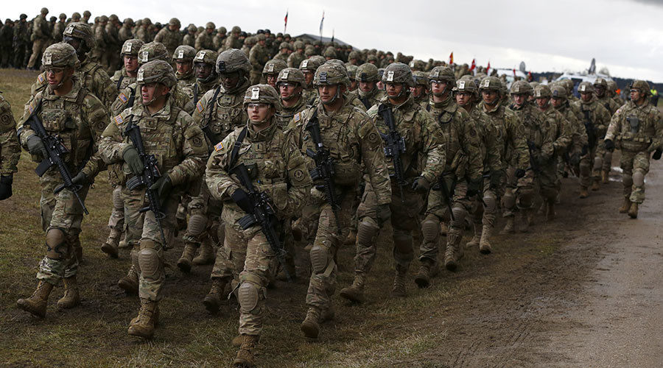
Short-Range Planning
  Short-range preparations include the following activities:
  Continue weekly training meetings
  Monitor preparations
  Leader training and certification
  Verify and review training objectives
  Prepare and review task T&EO
  Recon training site(s)
  Other preparations as determined
  by training guidance, goals, and,
  objectives
Short-range planning and preparations are complete
when the unit is ready to execute training
Notes:
REFERENCE: FM 7-0, Training, June 2021.
INSTRUCTOR NOTES:
SCRIPT -
Short-range planning refines specific actions to complete prior to training execution.
As you review the slide, there are some additional short-range planning preparations to consider which will include, but not be limited to some of the following activities—
Monitor T-Week activities and pre-execution checks.
Continue to train and certify leaders.
Convoy clearances submitted and approved.
All classes of supply resourcing requests submitted and ready for pickup.
Orders issued.
Conduct rehearsals.
Draw equipment and supplies to include training aids devices simulators and simulations.
Complete safety risk assessments.
Conduct pre-combat checks and inspections.
ASK:
1. In your experience what are the challenges that arise when you are preparing to execute training? Explain.
Suggested Answers: Answers will vary depending on participant experiences. Lead and Manage the dialogue in accordance with time.
Are there any questions?
Next slide

Slide 58
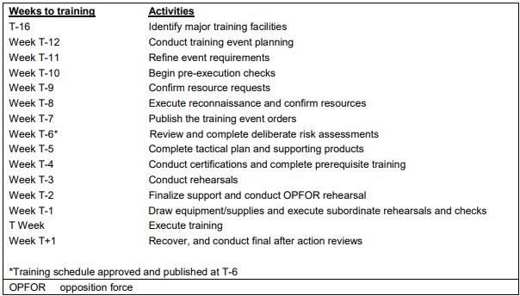
Training Week Framework
A planning technique that identifies critical actions and activities to accomplish prior to each training event
National Guard and Reserve units' aggregate activities utilizing a T-Month time management schedule
Notes:
REFERENCE: FM 7-0, Training, June 2021.
INSTRUCTOR NOTES:
SCRIPT -
This slide depicts the Training-Week (T-Week) framework. As a planning technique The T-Week framework is a means to view training by identifying training that occurred the week(s) prior to and after scheduled training events to the actions or activities that must be accomplished.
For example, ‘Week T’ is the week of execution, ‘Week T-6’ is six weeks prior to execution, and ‘Week T+1’ is the week following execution. .Units develop and tailor their own T-Week actions and timelines based on local command requirements.
As it was mentioned previously, I just want to review the T week construct and how it is a backward planning method. The T-6 to T+1 provided is a snapshot for training activities to be discussed at the training meeting corresponding to the 6 week lock in of the training schedule.
Other T week activities can be included but a separate event planning meeting is encouraged due to the time constraints and resources available. The addition of the T+1 to our graphic is necessary to include training just completed.
For the other Army Components, the use of the T-Month is used and presents unique challenges for training. These components, due to demographic and resourcing challenges will aggregate activities based on their drilling schedules, whether by the month or by their Two-Week ADT events.
Units develop and tailor their own T-week actions and timelines based on local command requirements. These principles apply to the T-Month methodology as well.
Are there any questions?
Next Slide.

Slide 59
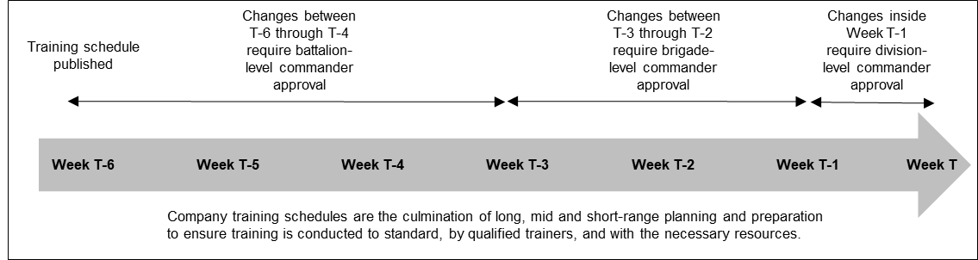
Training Schedules at the T-C-B Level
Company training schedules ensure training is conducted on time, by qualified trainers and with the necessary resources.
They are approved by the battalion commander and published no later than Week T-6 (RA), or T-90 days (NG and Reserve).
At a minimum, company training schedules include the following information:
Date and time of training.
Attendees.
Tasks trained.
Trainer (primary and alternate).
Uniform and equipment.
Location (training areas or facilities).
References (FMs, TCs, etc.)
Authentication: company commander signature and battalion commander signature when approved.
Notes:
REFERENCE: FM 7-0, Training, June 2021.
INSTRUCTOR NOTES:
SCRIPT -
This slide is another snapshot of the Training Meeting.
In review, at echelon, training schedules are the culmination of long, mid, and short-range planning and preparation.
The development and publication of training schedules ensure that training is conducted on time, by qualified trainers and with the necessary resources.
They are priorities of work tied to timelines.
Organizational leaders at echelon develop and publish draft training schedules no later than 6 weeks prior to training.
The relevant organizational leader signs and then higher echelon Commanders approves training schedules no later than 6 weeks prior to training execution.
Training schedules are posted in common areas or are provided to Soldiers.
Are there any questions?
Next slide.

Slide 60
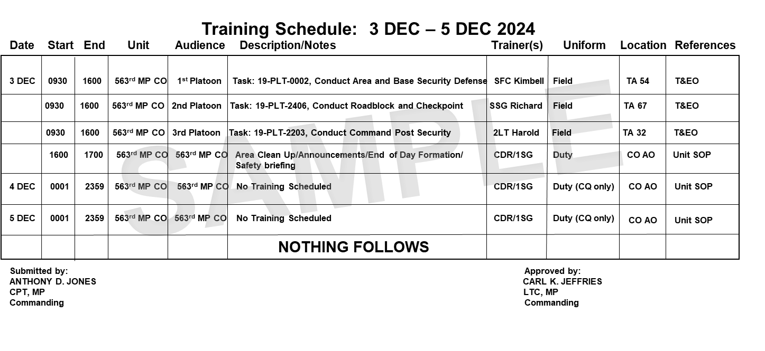




Training Schedules at the T-C-B Level
T-6
Weeks
T-5
Weeks
T-4
Weeks
T-3
Weeks
T-2
Weeks
T-1
Week
T
Week
Culmination of LRTP
Authenticated
Approved
Published & Posted
Notes:
REFERENCE: FM 7-0, Training, June 2021.
INSTRUCTOR NOTES:
Begin the lesson with the question; build the slide and introduce the 4 main points for Training Schedules from FM 7-0
ASK:
1. Where do we get the priorities of work and when do we have to associate the timelines with those priorities?
Suggested Answer: The priorities were determined during the LRTP process, and the times are associated with these previously determined priorities 6 weeks prior to training; dates were set during the LRTP process, but execution timelines are not required for long/mid range planning.
Training schedules are developed during the short-range planning horizon.
SCRIPT:
Company training schedules are the culmination of long-, mid-, and short-range planning and preparation.
During long-range planning, the company commander sequences training events with resources over time to determine who, what, when, and where to train to ensure coordination and resources.
Company training schedules ensure training is conducted on time, by qualified trainers, and with the necessary resources. Company training schedules are priorities of work tied to timelines. Company commanders develop training schedules no later than 6 weeks prior to training.
The T-C-B Commander signs, and the Battalion Commander approves training schedules no later than 6 weeks prior to training execution, generally at the conclusion of the weekly battalion training meeting.
Training schedules are posted in company common areas and are provided to Soldiers.
The role of the Company Commander in the development of the Training Schedule and the approval authority of the Battalion Commander. This authentication process is a driven lower to higher.
T-Week, the week of training execution is not included in the determining when to publish the training schedule; there are essentially 7 weeks of training schedules published and posted.
Company training schedules ensure training is conducted on time, by qualified trainers, and with the necessary resources. Company training schedules are priorities of work tied to timelines.
Training schedules are posted in company common areas and are provided to Soldiers. At a minimum, company training schedules include the following information:
. Date and time of training (start and end).
. Attendees.
. Tasks trained (task title and numbers for reference).
. Trainer (primary and alternate).
. Uniform and equipment.
. Location (such as training areas or facilities).
. References (such as FM 6-22 and TC 7-101).
. Authentication (company commander signature and battalion commander signature when approved).
The list above is meant to describe the minimum data the Training Schedule function of DTMS requires. Local policy may provide for further training data requirements.
For example, some organizations use SharePoint for Training Schedules that are tailored to meet organizational needs that may exceed the minimum recommended content.
Are there any questions?
Next slide.

Slide 61
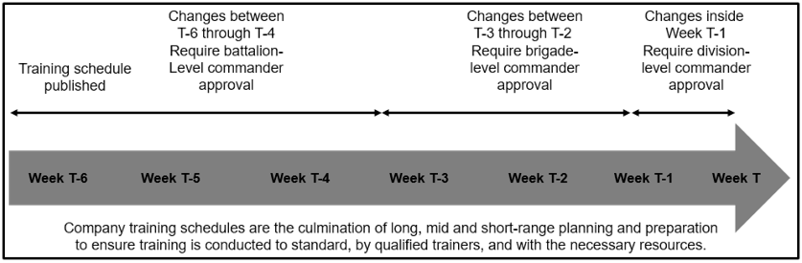
Changes To Approved Training Schedules
Substantive changes between Weeks T-6 through T-4 require Battalion Commander approval.
Changes between Weeks T-3 through T-2 require brigade Commander approval.
Changes inside Week T-1 requires division Commander approval.
Notes:
REFERENCE: FM 7-0, Training, June 2021.
INSTRUCTOR NOTES:
SCRIPT -
To enable predictability and consistent quality execution, events codified in a training schedule should not change.
However, there are instances where changes to training schedules are sometimes unavoidable and must be approved by higher commanders, but to the greatest extent possible, commanders keep changes to a minimum:
a. Changes between T-6 and T-4 require BN Commander approval.
b. Changes between T-3 and T-2 require BDE Commander approval.
c. Changes inside T-1 require DIV Commander approval.
Continuous changes withing two weeks of training execution is an indication of significant T-C-B leadership failure to accurately plan unit training, and/or an indication of a critical failure for the next higher Commander to protect subordinate units from un-forecasted distracters.
ASK:
1. What does repeated changes to the training calendar mean for training and leadership? Explain.
Suggested Answer: Continuous changes withing two weeks of training execution is an indication of significant T-C-B leadership failure to accurately plan unit training, and/or an indication of a critical failure for the next higher Commander to protect subordinate units from un-forecasted distracters.
2. Do you agree with the assessment of failed leadership when repeated changes to the calendar are made? Explain
Suggested answer: Will vary based on participant experiences. Manage dialogue to make effective use of allotted time.
Are there any questions?
Next slide.

Slide 62
Check on Learning
Notes:
REFERENCE: FM 7-0, Training, June 2021.
INSTRUCTOR NOTES:
Determine if students have gained familiarity with the material discussed by soliciting student questions and answers. Ask the students questions and correct misunderstanding.
The Check on Learning in this presentation includes questions and answers (solutions) for the instructor ONLY.
Determine if students have gained familiarity with the material discussed by soliciting student questions and explanations. Ask the students questions and correct misunderstandings.
SCRIPT -
We will now conduct a Check on Learning. Do not answer until prompted to.
ASK:
1. Training battle rhythms are established to _____________________ AND _____________________ prioritized training activities? (ref: FM 7-0, Chap 3, para 3-2)
Answer: Integrate and Synchronize
2. What is the center of gravity of unit training management? (ref: FM 7-0, Appendix E, para E-4)
Answer: Company training meetings.
Are there any questions.
Next Slide.

Slide 63
Review Summary
We learned Training Briefs at Echelon synchronize all Training Management efforts
We learned that key leader involvement in briefings and meetings are central to training efforts
We learned that training schedules at echelon provide snapshots of training efforts.
Notes:
REFERENCE: FM 7-0, Training, June 2021.
INSTRUCTOR NOTES:
SCRIPT -
In this block of instruction:
We learned that Army Training Briefs at Echelon serve to synchronize training management efforts
We learned that key leader involvement in training meeting is critical to training coordination, resourcing, and execution.
We learned that training schedules provide units at echelon a snapshot of training efforts to meet mission requirements.
Are there any questions?
We will now move into the second Practical Learning Activity of our lesson, Planning Long-Range Training.
Next slide.

Slide 64
Learning Activity:
Written Exam Practical Exercise
Notes:
REFERENCE: FM 7-0, Training, June 2021.
INSTRUCTOR NOTES:
Instructor will pass out exam to each attending student.
Instructor will designate a test turn in location in the classroom.
Instruct students on what they should do upon test completion.
SCRIPT-
We will now conduct a final check on learning by completing a practical exercise, a 20-question written test.
Instructor will read or explain the following:
You are about to take the practical exercise as part of the PME Course Material.
This exercise will test your understanding of materials discussed in this lesson. You must answer all 20 questions correctly (100%) to receive a Go.
You will have 25 minutes to complete this exercise. You may not discuss, work with, or help any other student during the duration of the exercise.
You may use any notes that you took or available references.
Please fill out the administrative date prior to turning in your exercise sheets for review.
When you complete your test please turn in, upside down to (the designated location) for grading.
Are there any questions?
You may now begin

Slide 65
Final Check on Learning and Review
We reviewed how to configure and implement training management at the T-C-B level
We reviewed how to identify T-C-B training tasks and priorities
We learned how to organize training at the T-C-B level using the 8-Step Training Model
We learned how to organize training at the T-C-B level by executing briefs and meetings to synchronize and coordinate training
We developed T-C-B long-range training plans to execute training based on tasks identified by the task crosswalk
Notes:
REFERENCE: FM 7-0, Training, June 2021.
INSTRUCTOR NOTES:
Determine if students have gained familiarity with the material discussed by soliciting student questions and answers. Ask the students questions and correct misunderstanding.
The Check on Learning in this presentation includes questions and answers (solutions) for the instructor ONLY.
Determine if students have gained familiarity with the material discussed by soliciting student questions and explanations. Ask the students questions and correct misunderstandings.
SCRIPT -
We will now conduct a Check on Learning. Do not answer until prompted to.
ASK:
1. Where will you discover the standards required to achieve task proficiency? (ref: FM 7-0, Chap 3, 3-1)
Answer Training and Evaluation Outlines.
2. Whose approval is required to change the organizational training schedule when the unit is at T-1 Week? (ref: Fm 7-0, Chap 3, 3-18)
Answer: Division Commander.
3. Identify some training techniques that you, as organizational leaders, can utilize to achieve task standards? (ref: FM 7-0, Chap 4, 4-23 to 4-28)
Answer: Drills, Lane Training, Opportunity Training, Sergeants Time Training.
Let’s conduct a Final Review.
In our time together we learned that Army training is a deliberate, planned, resourced and executed program led by Commanders and organizational leaders at all echelons ensuring that Army units are capable, confident, and ready to fulfill mission requirements when called upon to fight and win our nations wars. As organizational leaders this is accomplished because:
We learned how to configure and implement training management at the T-C-B level
We learned how to identify T-C-B training tasks and priorities
We learned how to organize training at the T-C-B level using the 8-Step Training Model
We learned how to organize training at the T-C-B level by executing briefs and meetings which synchronize and coordinate training efforts and resources.
We developed T-C-B long-range training plans to execute training tasks identified through the three-step task crosswalk process.
Are there any questions?
Next slide.

Slide 66
This concludes the lesson:
Review Army Training Management at the
T-C-B Level
150T-L70PCC v2.0
Questions?
Notes:
REFERENCE: FM 7-0, Training, June 2021.
INSTRUCTOR NOTES:
SCRIPT -
This concludes our lesson, Review Army Training Management at the Troop-Company-Battery Level.
Do you have any questions?
Students are encouraged to participate in a private feedback dialogue with instructor, to refine mastery of lesson objectives or address related topics.

