Slide 1
LSA 9:
Coaching
Notes:
Begin by asking pointed question to get concrete knowledge of the class:
Example questions
What is the primary role of a coach?
What are the two types of coaches?

Slide 2
ACTION:
Demonstrate knowledge of Army service Rifle preliminary marksmanship instruction.
CONDITION:
In a classroom environment, given TC 3-22.9, Rifle and Carbine.
STANDARD:
Identify how to apply and train Rifle Marksmanship utilizing the US Army Service Rifle in accordance with applicable command guidance, TC 3-22.9 Rifle and Carbine and TC 3-20.0 Integrated Weapons Training
Strategy.

Slide 3
INTRODUCTION
Safety Considerations:
Risk Assessment:
Environmental Considerations:
Evaluation:
Notes:
Safety Considerations: Fire escape plan should be reference
Risk Assessment: Low
Environmental Considerations: Keep tops on bottles when not in use and remember to remove all trash from the classroom.
Evaluation: You will be evaluated formally on written examinations which you must achieve a minimum of 70% to continue the course.

Slide 4
COACHING
The process of having a Soldier observe the firer to look for shooting errors that the firer themselves may not consciously know they are making
Two types of coaches exist:
The Experienced Coach
The Peer Coach

Slide 5
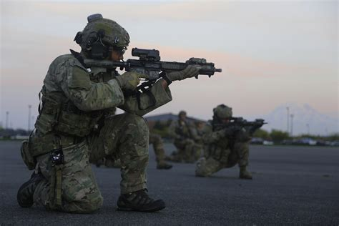
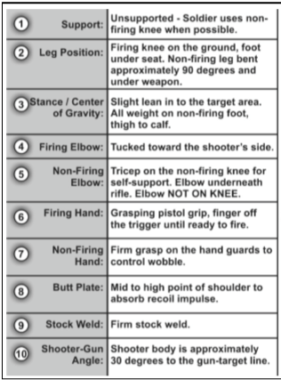
STABILITY
Combinations of Support
Notes:
For the coach to observe how stable the shooter is, they may have to move to different sides of the shooter. To observe the shooter’s non-firing elbow (to ensure it makes contact with the ground), the coach will need to be on the shooter’s non-firing side. To observe the cant of the weapon (the sights on the weapon should be pointing towards 12 o’clock position, not 11 or 1 o’clock positions), the coach will need to watch the relationship of the front sight to the barrel from behind the shooter. The coach should look for all the other aspects of good positions as outlined in chapter 6 of this publication. The coach should also observe the total amount of weapon movement on recoil. A good stable position will have minimal movement under recoil.

Slide 6
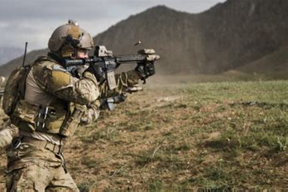
AIMING ACTIONS
1. Weapon Orientation
4. Point of Aim
2. Sight Alignment
5. Desired Point of Impact
3. Sight Picture
Notes:
The Soldier orients the weapon in the direction of the detected threat. Weapon orientation includes both the horizontal plane (azimuth) and the vertical plane (elevation). Weapon orientation is complete once the sight and threat are in the Soldier’s field of view.
Determining the aspects of the firer’s aiming (sight picture, sight alignment, point of focus) requires dialogue between the firer and the coach. Often, a shooter will not realize his aiming errors until he discovers them on his own.
The technique of having the firer call his shots should also be used. This technique involves calling the point on the target where the sights were located at the moment of firing and matching the point called with the impact locations on the target. Calling the shot helps the firer learn to focus on the front sight during the entire firing process.

Slide 7
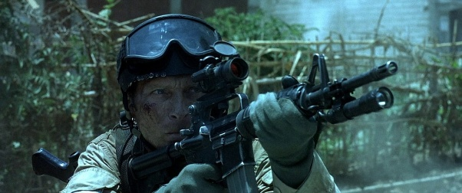
FOLLOW-THROUGH SEQUENCE
4. Sight picture adjustment
1. Recoil management
2. Recoil Recovery
5. Engagement Assessment
3. Trigger/ Sear Reset
Notes:
The ideal position to observe trigger squeeze is from the non-firing side because the coach will have a better view of the speed of pull, finger position on the trigger, and release or pressure on the trigger after firing. The coach can look from behind the shooter to observe the barrel for lateral movement caused by slapping the trigger during firing.

Slide 8
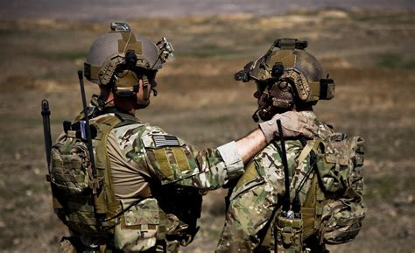
COACH and SHOOTER DIALOGUE
1. Determine shooters Point of Aim (POA)
5. Determine Shot Process interruptions during course of fire
2. Determine Shooters desired Point of Impact (POI)
6. Critique Control (Trigger Squeeze), (Follow-Through Sequence)
3. Position Critiques (8 components of support)
4. Aiming Critiques (Aiming Sequence)
Notes:
All firing happens at the weapon. This means that the coach should be focused solely on the shooter during firing and not on what is happening down range.
There is no way for a coach to observe only the bullets impact on target and know what errors the firer made. The coach must watch the shooter during firing to determine errors and use the impacts to confirm their assumptions.
For a coach to properly observe all aspects of firing they must be able to observe the shooter, safely, from both sides and the back. There is no prescribed coaching
position. Coaching requires a relaxed atmosphere with open communication between the firer and the coach.

Slide 9
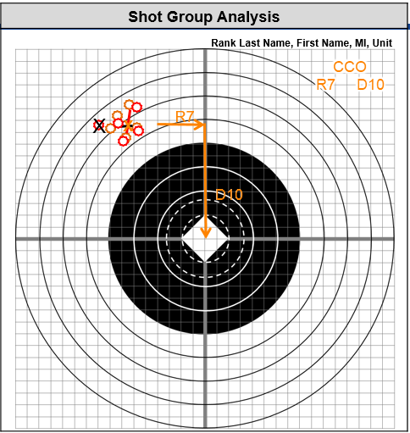
Target Marking Best Practices:
Determine Quadrant (POA vs. POI)
Determine shot group size
Mark shot group holes
Determine MPI
5. Write Sight Used on target
6. Write down corrections in Clicks of adjustment.*
*Note: When marking corrections use:
R=Right
L=Left
U=Up
D=Down
Notes:
Shot group analysis involves the firer correlating the shots on paper with the mental image of how the shots looked when fired. An accurate analysis of the shot group
cannot be made by merely looking at the holes in the paper. It is more important to observe the firer than to try and analyze the target. All firing takes place at the weapon,
and the holes in the paper are only an indicator of where the barrel was pointed when the rifle was fired. When coaches are analyzing groups, they must question the firer
about the group to make a determination of what caused the placement of the shots.

Slide 10
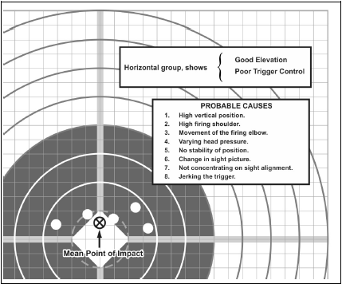
Notes:
Shot group analysis involves the firer correlating the shots on paper with the mental image of how the shots looked when fired. An accurate analysis of the shot group
cannot be made by merely looking at the holes in the paper. It is more important to observe the firer than to try and analyze the target. All firing takes place at the weapon,
and the holes in the paper are only an indicator of where the barrel was pointed when the rifle was fired. When coaches are analyzing groups, they must question the firer
about the group to make a determination of what caused the placement of the shots.

Slide 11
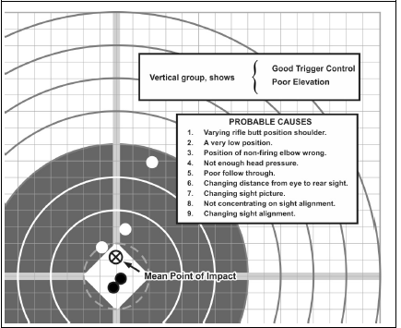
Notes:
Shot group analysis involves the firer correlating the shots on paper with the mental image of how the shots looked when fired. An accurate analysis of the shot group
cannot be made by merely looking at the holes in the paper. It is more important to observe the firer than to try and analyze the target. All firing takes place at the weapon,
and the holes in the paper are only an indicator of where the barrel was pointed when the rifle was fired. When coaches are analyzing groups, they must question the firer
about the group to make a determination of what caused the placement of the shots.

Slide 12
CHECK ON LEARNING
COACHING
What are the two types of coaches?
Peer and Experience
Where should the coaches eyes be during the shot process?
On the shooter and weapon
What are the key topics the shooter and coach dialog cover?
Determine shooters Point of Aim (POA)
Determine Shooters desired Point of Impact (POI)
Position Critiques (8 components of support)
Aiming Critiques (Aiming Sequence)
Determine Shot Process interruptions during course of fire
Critique Control (Trigger Squeeze), (Follow-Through Sequence)

