Slide 1

Ranger Leadership Panel
Expectations
Attitudes
Priorities
Continued Growth/ Self Development

Slide 2
Topics of Interest
LT Timelines 3
BN Positions/ Broadening 3
Counseling 4
EIB 5
Training Event Planning 6
Maintenance 7
Property Management 8
Reaching out to BCs 9
Performance 10
Important Links 11
Reading List 12
Lessons Learned at RS 13
Common RS Pitfalls 14
How to Operate in Chaos 15
Purchases Prior to Showing Up 16
Aim 2.0 Marketplace Tips 17
Staff Time 18
Platoon Leader Time 19
Executive Officer Time 20
Other LT Positions 21

Slide 3
11A LT Timelines
0-9 months/ 0-1 year: IBOLC, Ranger, Unit specific schools
1-2 years: Assistant Staff Officer and/ or Platoon Leader
2-3 years: Platoon Leader, Specialty PL, XO
3-4 years: Specialty PL, XO, Staff Primary, MCCC
4-5 years: MCCC, BDE/ BN Staff
5-6 years: BDE/ BN Staff, CMD
6-7 years: BN Staff, CMD, post CMD
PreCCC Broadening
RASP 2/ 75th
ARTB
Old Guard
SF XO
ROTC Instructor
Recruiting Command
Basic Training/ 198th BDE
General’s Aide
Aim/ MILPER Specific
YAS Deployment
SFAS & VTIP Window
PreCMD Broadening
ARTB
CTC OC/T
SFAB Staff*
Basic Training CMD (non-KD)
Egypt/ Korea/ other
Future’s Command
ROTC Instructor*

Slide 4
Counseling
PSG
SLs and TLs/VCs
Initial – Unit values, standards and expectation by position, individual goals, and clear policies on SHARP, EO, Hazing/ Bullying, Alcohol/ Drug Abuse, Fraternization.
Follow Up – Quarterly and Event Based

Slide 5
EIB
3 Weeks total: qualify with expert qual, packet, & PT test
Train Up Week
Practice Test Week
Test Week
  PT Test: 49 PUs, 59 SUs, 4 mile run at 32 min or less
  Weapons Lane: 10 Tasks (RTTs)
  Patrol Lane: 10 Tasks (Call for fire, Range Card, etc)
  Medical Lane: 10 Tasks (Often the hardest lane for LTs)
  Land Nav: Both day and night graded courses
  12 Mile Ruck with M4 functions check at the end

Slide 6
Training Event Planning
8 Step Training Model
Leader/ Support pax Certification & Qualification
Land and Ammo – XO and S3
Food, Water and Latrine Request – XO
Range/ Training Area* Contract – PL & Range Control
Range/ Training Area Recon – PL
Clear Tasking Roster and Sync Mat – PL
Medical Coverage – CO Medic
Training/ Range Items (TSC)
CONOP that articulates these things ^

Slide 7
Maintenance
Vehicle
5988 control, vet, scan, and tracker update weekly
Track fault follow through with XO/ Mechanic on 5988 and tracking part arrival date
Do as much as you can to build rapport with CO mechanic
Weapons
Same
Follow up with armorer for status, especially items at higher maintenance echelon
You own MAL in conjunction with PSG and PLT armorer
Commo
Same. It applies to handheld radios and vehicle comms
Check internal comms for each vehicle
Have a master tracker & follow up

Slide 8
Property Book
Assume that the last PL had major errors/ liabilities he is hiding, especially if he/ she is trying to manipulate you to avoid full transparency
Binder > SHR with all end items signed up front > a tab for each end item by LIN with TM listing BII, annotated 2062/ BOM, according shortage annex, and sub hand receipt from you to property holder > monthly SHRs in back
When doing your layouts have a master BOM for each item you inventory
  Have the property holder build his subhand receipt while you do your inventory and have him immediately sign it
  Use this master to base all future layouts against to determine new shortages
  Submit shortage annex to supply. Update all when supply gives you your needed shortages
  Expect to conduct layouts with BII: As leaders change position, after field events, & commander’s 10% monthly cyclic inventories

Slide 9
Reaching Out to BCs
Email > Hard Copy
Keep things short, positive, and open ended
  4-5 Sentences
  I am _____, and I am excited to be a member of the ____ team
  I am coming with _____, _____, etc
  Include Report Date (I just finished Ranger School and should be set to arrive ___)
  Can include hobbies
  Please let me know if there is anything specific I can do to prepare before I report. (ex. reading list)
  Looking forward to learning/leading during my time with ____
Avoid position specifics or follow-on desires (save for initial counseling)
If you know you are going to a section or company, email that staff primary or company commander

Slide 10
Performance
8 hours of sleep a night minimum
  Track your sleep with a Fitbit, Garmin, or whoop
Talk to a nutritionist
  most gyms on post have one or can point you to a free military resource
Consider a strength coach or conditioning coach
  can be found at your on-post gym
Get serious about fitness
  CrossFit and running(best way to set yourself apart)
Find a hobby
  Playing basketball or volleyball on Sunday afternoons in a public park
  Finding a local Men’s/ Women’s club team for a sport your played in high school/college
  Finding a church community in your specific faith
Get counseling for mental health issues or to help your marriage
  Ask the Chaplin about Military and family life counseling its free and your chain of command will never know

Slide 11
Important Links
Snipping tool (Shift/windows key/S) all at once
  Can also be found if you search it in the tools bar
Commercial Imagery
  https://maps.army.mil
  https://Pixtoday.net
  https://www.agc.army.mil
  https://map.nga.mil
Microsoft Web App:
  https://www.ohome.apps.mil

Slide 12
Reading List
Military
The Generals
On Killing
Relentless Strike
This Kind of War
Closing with the Enemy
Call Sign Chaos
The Military Leader
Scipio Africanus
Battlegrounds
Ordinary Men
The Mediations
Grant
Seven Pillars of Wisdom
Other
Primal Leadership
7 Habits of Highly Effective People
Boundaries for Leaders
Good to Great
Getting to Yes
Difficult Conversations
Deep Survival
Blink
Why We Sleep
Liar’s Poker
Winning the War in Your Mind
Classics*

Slide 13
Lessons Learned at Ranger School
It takes a team – you just learned how to collaborate with strangers under extreme circumstances, don’t stop.
Do not panic
Planning and Preparation – two keys to victory
Resiliency – overcome, not succumb, to adversity
Shape your environment – do not be shaped by it
Fail, Learn, Progress
Continued self development – bearing the tab

Slide 14
Common RS Pitfalls to Correct
Brief TLPs by Phase
  Integrate PSG/ SLs in planning process
Task Org: Think Breaches/ SOSRA for PLT Ops
  ASLT 2: Likely Local SBF with a follow-on task
  Get away from SBF/ M240 point fire, search between TRPs
  Security Elements: Close enough to support. Can shift positions by phase. Think about 360 security with minimal manning.
ORP: Security Element or Cache Rucks
PL
  Manage Transitions between squads and phases of operation
  Reporting
  Managing enablers and assets
  Standardization across squads and shifting responsibility between squads

Slide 15
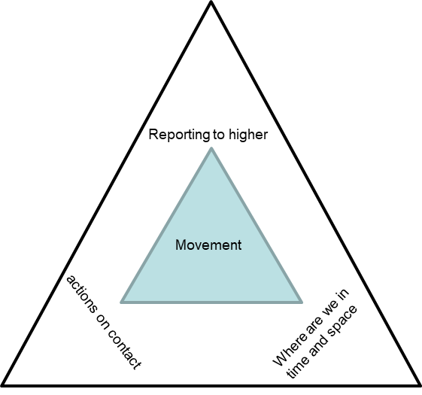
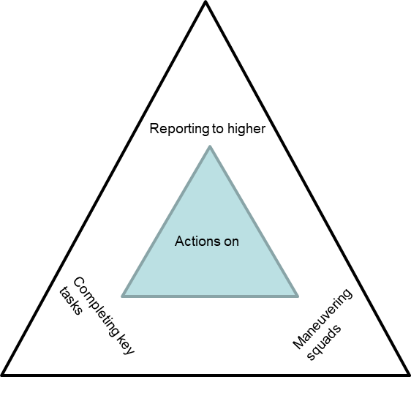
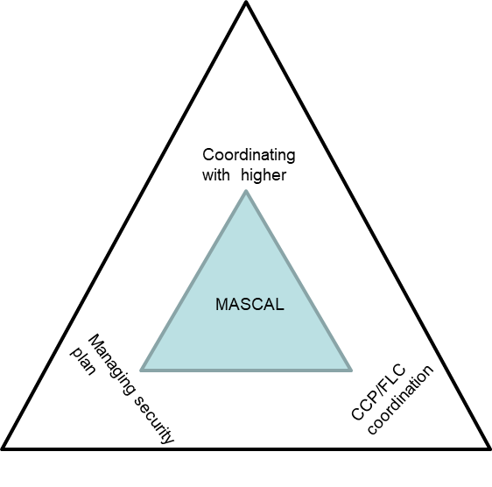
How to Operate in Chaos

Slide 16
Possible Purchases for new LTs
For the Office
A small work laptop and hotspot service on your phone. You can get one for about $150 on amazon. Usually, you will have one working laptop for your platoon and the rest of the platoon will need to use it.
CAC Reader(put your name on it)
Calendar planner or company LRC printed off
Erasable pens
Consider - work out equipment
For the field
Extra PC/Patches
Smoker's jacket & Solid black skiing gloves that are warm/waterproof
Sew up your Ruck and FLC before you show up
A jet boil
GPS (Garmin 401)
Knife or Gerber for the field
Nice knee pads
A good admin pouch (find a balance)

Slide 17
Aim 2.0 Marketplace Tips
Build your Reference List
  Update reference POCs with each marketplace
  Make sure your references will advocate for you
Have a well written Aim Resume
  Tailor your experience to match the mission set of where you would like to go
  Highlight things not reflected on your ORB
Do a full ORB scrub for accuracy
  This is often the primary document you will be judged by
  Have an up-to-date DA Photo
You Must Be Respectfully Aggressive
  The first 72 hours can be the most critical in your market
  Craft and send a respectful email to the unit POC introducing yourself and asking for an interview
  Have back up plans if your first choice is full

Slide 18
Staff Time
AAS3
  Own specific piece of the S3: Ammo, Land, USR, DTOs, etc.
  Own BN training: Gunnery, PLT LFX, deployments, etc.
AS3
  You manage the S3 sections (^, schools, DTMS, TAC PLT)
  Likely own CUOPS (SRTC) or FUOPs (LRTC/ OPORDs)
S4
  Own all things supply and property: Monthly SI/ Cyclic, GPCs, Orders, Lateral Transfers, etc.
  Own movement: all pre-CTC coords come through you
AS2
  Anywhere from BN newsletter/ SITREP to running the S2
S1
  Own: Awards, Evaluations, HR metrics, personnel actions/ moves, Aim marketplaces, etc.

Slide 19
Platoon Leader Time
Manage and Improve PLT PT
Manage PLT Property and Equipment
Manage PLT Personnel Actions, DTMS, MEDPROs, Certifications, Legal, all things readiness
To counsel subordinate leaders and ensure counseling for junior soldiers is being conducted (scrub and manage packets)
Create and supervise combat training for the PLT (SGT’s time and collective level)
Maneuver PLTs in training and in combat
Manage morale and culture in PLT and support SFRG
Plan and execute Company level Training (SQD LIFX)
Hold CO Additional duties (UMO, CBRN, ENVIRON)

Slide 20
Executive Officer Time
Mentor Platoon Leaders & Treat it Like Your Company
Resource Training Events
  Land & Ammo: S3
  Latrines: S4
  Hot Chow or MREs: FSC
  Training Aids: Post Training Support Center
Maintenance
  Manage 5988 flow and fault/ parts on order tracking for vics, radios, weapons, etc.
  Brief status of all NMC equipment in maintenance briefs
  Dispatch vehicles as needed
Property & Supply
  Be CO PBO: adhere to S4 layout schedule & L.T.s
  Track and fill shortages through supply
  Closely monitor any property holder changes
Manage HQ Section
  Own all things for: Commo, training room, supply, and armsroom sections

Slide 21
Other LT Positions
Scout PL
Mortar PL
BN Adjutant
  Manage the BC’s calendar and events
Maintenance PL
BDE Adjutant
BDE Positions
Division Positions

Slide 22
EMAILS
Email.mil@army.mil; nextemail.mil@army.mil;

