Slide 1
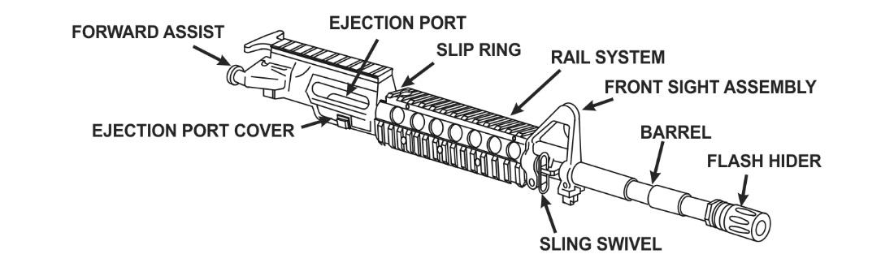
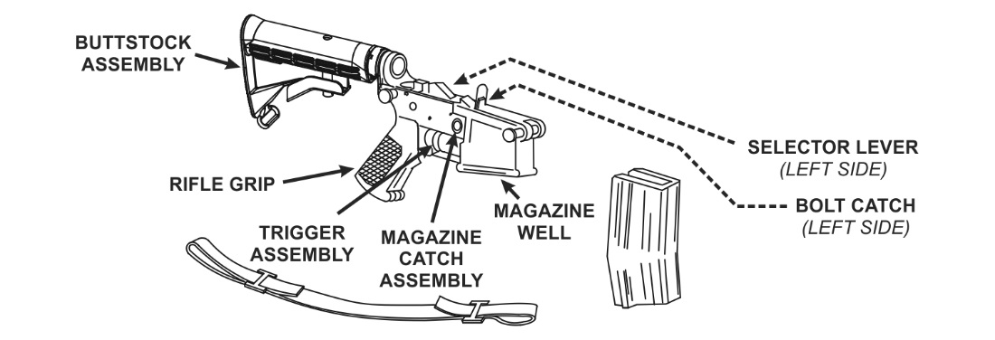
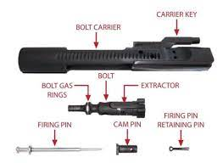
Primary function:
Personal weapon
Length Buttstock closed: 29.75 inches
Length Buttstock open: 33.0 inches
Weight, with 30 round magazine: 7.50 pounds
Bore diameter: 5.56mm
Maximum effective range: 3600m
Area target: 600 meters
Point target: 500 meters
M4A1 Upper Receiver
Functions check a. Place selector lever on SAFE. b. Pull charging handle to rear and release. c. Squeeze the trigger. Note: Hammer should not fall. d. Place selector lever on SEMI. e. Squeeze the trigger. Note: Hammer should fall. f. Hold the trigger to the rear and charge the weapon. g. Release the trigger smoothly and evenly until the trigger is fully forward. Note: A metallic click should be heard. h. Squeeze the trigger. (M16A3 and M4A1 only) Note: Hammer should fall. p. Place the selector switch on AUTO q. Pull the charging handle to the rear, charging the weapon. r. Squeeze the trigger. Note: Hammer should fall. s. Hold the trigger to the rear. t. Charge the weapon again. u. Fully release the trigger then squeeze it again. Note: The hammer should not fall because it should have fallen when the bolt was allowed to move forward during the chambering and locking sequences. (M16A2, M16A4, and M4 only) Note: Hammer should fall. i. Place the selector lever on BURST j. Charge the weapon one time. k. Squeeze the trigger. Note: Hammer should fall. l. Hold the trigger to the rear. m. Charge the weapon three times. n. Release the trigger. o. Squeeze the trigger. 7. Place weapon on safe
M4A1 Lower Receiver

Slide 2
Rules of firearms safety Treat every weapon as if it is loaded Never point the weapon at anything you do not intend to destroy Keep your finger off the trigger until ready to fire Ensure positive identification of the target and its surroundings
Weapons control status Weapons hold: engage only if engaged or ordered to engage Weapons tight: Engage only if target is positively identified as enemy Weapons free: Engage targets not positively identified as friendly
Weapons safety status Green: The weapon’s magazine is removed, its chamber is empty, its bolt is locked open or forward, and the selector is set to SAFE Amber: A magazine is locked into the magazine well of the weapon, the bolt is forward on an EMPTY chamber, the ejection port cover should be CLOSED, and the selector should be set to SAFE Red: The weapon’s magazine is inserted, a round is in the chamber, the bolt is forward and locked, the ejection port cover is closed, and the selector is set to SAFE. Black: A magazine is locked in the magazine well, the bolt is forward with a Round chambered, the ejection port cover is CLOSED or OPEN, Selector is on Fire and the Shooter’s Finger is on the Trigger because they have initiated their Shot Process
Functional elements of the aiming process Weapon orientation Sight alignment Sight picture Point of aim Desired point of impact
The Shot Process: The basic outline of an individual engagement sequence all firers consider during an engagement, regardless of the weapon employed.
Sight picture: the alignment of the sights of a firearm with the target as seen by the firer Sight Alignment: The process of lining up rear and front sights. Point of aim: Point of aim is the exact spot that the shooter has lined up their sights Point of impact: Where the round actually impacts
Three stages of ballistics Internal: Internal ballistics begin from the time the firing pin strikes the primer to the time the bullet leaves the muzzle External: is the study of the physical actions and effects of gravity, drag, and wind along the projectile’s flight to the target. Terminal: The science of the actions of a projectile from the time it strikes an object until it comes to rest (called terminal rest)
Functional elements of the shot process Stability, Aim, Control, Movement
Two movement techniques Vertical, Horizontal
Three components of weapons handling The soldier, the weapon, the environment
8 Cycles of function Feeding Chambering Locking Firing Unlocking Extraction Ejection Cocking
Immediate action TAP! RACK!! REASSESS!!!
Aiming: When looking through your sights the target shout always be blurry
The M4/M4A1 5.56mm Carbine is a lightweight, gas operated, air cooled, magazine fed, selective rate, shoulder fired weapon with a collapsible stock
Four functions of stability Support, Muscle relaxation, Natural point of aim, Recoil management

