Slide 1

2ABCT SHARP
Annual Training
Module 1- Prevention

Slide 2
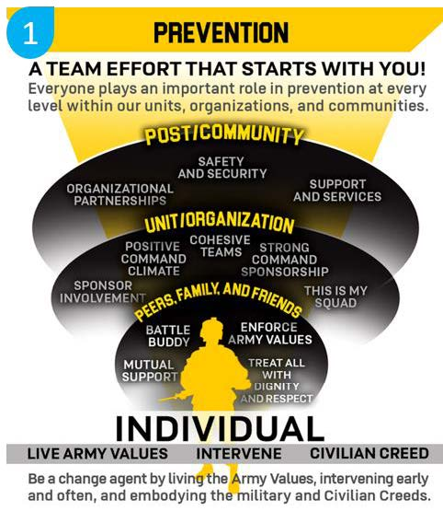
Module 1
Prevention

Slide 3
A Comprehensive
Approach
Four Layered Approach
  It starts within an Individual doing their part to live and uphold our Army Values and Army Ethic
  The second layer of Peers, Friends, and Family
  The third layer of Unit/Organization
  The outside layer, Post/Community
To help prevent Sexual Assault or Harassment you must understand risk factors for each layer to help you identify the problem before it begins
Notes:
Prevention requires a comprehensive approach that incorporates multiple, reinforcing activities implemented and sustained over time. Successful prevention requires everyone’s involvement and commitment. It starts within everyone doing their part to live and uphold our Army Values and Army Ethic.
Peers, Friends, and Family, within Figure 3-1, depicts the individual’s closest social circles that are typically the most influential to the individual
Unit/Organization, depicts the surrounding work environment. Developing a positive command climate is vital, as well as establishing a strong command sponsorship program and encouraging leader involvement at all levels
Post/Community, represents the broader environment in which we live and work. Communities that establish and maintain safety and security through policies and programs, make the support and services readily available, and communicate their importance and accessibility, create a positive environment in which people have a sense of belonging and a shared responsibility to contribute

Slide 4
Individual Risk
Factors
Individual Risk Factors that may cause someone to become a perpetrator of Sexual Assault or Sexual Harassment
  Alcohol and drug use
  Delinquency
  Empathic deficits
  General aggressiveness and acceptance of violence
  Coercive sexual fantasies
  Suicidal behavior
  Prior sexual victimization or perpetration

Slide 5
Peers, Friends, and
Family Factors
Peers, Friends, and Family Factors that may cause someone to become a perpetrator of Sexual Assault or Sexual Harassment
  Family environment characterized by physical violence and conflict
  Childhood history of physical, sexual or emotional abuse
  Poor parent-child relationships, particularly with fathers
  Association with sexually aggressive, hyper-masculine, and delinquent peers
  Involvement in a violent or abusive intimate relationship

Slide 6
Unit/Organization
Factors
Unit/Organization Risk Factors that may cause someone to become a perpetrator of Sexual Assault or Sexual Harassment
  Unit/organizational norms that support sexual violence and sexual entitlement
  Unit/organizational norms that maintain women’s inferiority and sexual submissiveness, and/or promote a culture of homophobia
  Weak Command policies and disciplinary actions related to sexual violence
  High levels of crime and other forms of violence within the organization

Slide 7
Post/Community
Factors
Post/Community Risk Factors that may cause someone to become a perpetrator of Sexual Assault or Sexual Harassment
  Poverty or financial hardship
  Lack of employment opportunities
  Lack of institutional support from police and/or judicial system
  General tolerance of sexual violence within the post/community
  Weak community sanctions against sexual violence perpetrators (offenders not being held accountable)

Slide 8
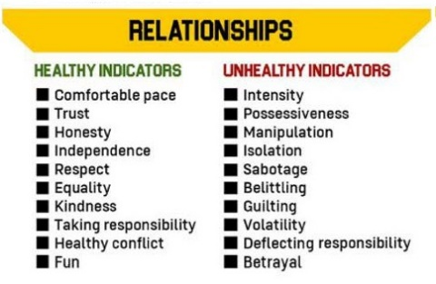
Healthy vs. Unhealthy
Relationships
Notes:
Healthy relationships bring out the best in you and make you feel good about yourself.
Some characteristics and behaviors of healthy relationships include:
Honesty – You can be truthful and candid without fearing how the other person will respond.
Trust – Confidence that your partner won’t do anything to hurt you or ruin the relationship.
Independence – You have space to be yourself outside of the relationship.
Respect – You value one another’s beliefs and opinions, and love one another for who you are as a person.
Equality – The relationship feels balanced and everyone puts the same effort into the success of the relationship.
Kindness – You are caring and empathetic to one another, and provide comfort and support.
Fun – You enjoy spending time together and bring out the best in each other.
Healthy Conflict – Openly and respectfully discussing issues and confronting disagreements non-judgmentally.
Taking Responsibility – Owning your own actions and words.
Intensity – When someone expresses very extreme feelings and over-the top behavior that feels overwhelming.
Possessiveness – When someone is jealous to a point where they try to control who you spend time with and what you do.
Manipulation – When someone tries to control your decisions, actions or emotions.
Isolation – When someone keeps you away from friends, family, or other people.
Sabotage – When someone purposely ruins your reputation, achievements, or success.
Belittling – When someone does and says things to make you feel bad about yourself.
Guilting – When someone makes you feel responsible for their actions or makes you feel like it’s your job to keep them happy.
Volatility – When someone has a really strong, unpredictable reaction that makes you feel scared, confused or intimidated.
Betrayal – When someone is disloyal or acts in an intentionally dishonest way.
Deflecting Responsibililty - When someone repeatedly makes excuses for their unhealthy behavior.

Slide 9
Continuum of Harm

Slide 10
Continuum of Harm cont…
A professional work environment promotes trust and contributes to unit readiness. Leaders must remain aware of warning signs and act when necessary.
This illustration demonstrates how SH/SA degrade a unit or organization’s readiness. The stair-stepped, colored boxes show the decline of a unit’s readiness from green to red.
The silhouette Soldiers/Civilians depict the available personnel in a unit. The dark silhouettes represent personnel that are ready and capable to execute the mission. The grayed silhouettes depict Soldiers or Civilians that engage in and/or are affected by sexual assault or harassment who may still be present in the unit. However, their readiness and the readiness of the unit is compromised due to several reasons including investigations, medical appointments, support meetings, and the emotional effects of lack of trust, Esprit de Corps, respect, etc. The transition of the silhouettes from black to gray demonstrates how these events degrade the unit’s ability to complete its wartime mission.
When observing early warning signs or more serious behaviors along the continuum, leaders must intervene early and often to maintain a professional work environment.

Slide 11
Background
Green box = Professional Work Environment
  This is based on mutual trust and respect
  Leaders serve as the center of gravity for the unit climate by actively discouraging sexist comments, sexual harassment, and sexual assaults.
On the next slide we will discuss how the listed tenants make a unit healthy and create a positive environment.

Slide 12
Positive Tenants
• Engaged Leadership
• Army Values
• Good Order & Discipline
• Dignity & Respect
• Ethical Standards
• Accountability
• Safe Environment
• Warrior Ethos

Slide 13
Early Warning
Signs
Below are examples of misconduct that can be identified as early warning signs in your unit
  Sexting
  Cat Calls
  Sexual Innuendo
  Cornering/Blocking
  Sexually Oriented Cadence
  Unsolicited Sexually Explicit Text/Email
  Domestic Violence
Notes:
As members of the Army team, individuals’ interactions offline and online reflect on the Army and its values. Soldiers or DA Civilians who participate in, condone misconduct, whether offline or online, may be subject to criminal, disciplinary, and/or administrative action. Leaders are required to respond to this type of behavior. Contractor employee misconduct will be referred to the employing contractor through applicable contracting channels for appropriate action.
This misconduct will deteriorate your team and move it out of the green.

Slide 14
The Orange
Section
Contains behaviors that can border between sexual harassment and the criminal offenses of sexual assault. CID or law enforcement will determine if it is sexual assault.
• Sending Unsolicited Naked Pictures
• Unsolicited Kissing
• Bullying
• Hazing

Slide 15
The Red
Section
Represents an unhealthy environment that is sexual assault. The behaviors in this area are criminal offenses that CID will investigate. Let’s discuss the following behaviors and their early warning signs:
• Rape
• Sexual Assault
• Abusive Sexual Contact
• Aggravated Sexual Contact
Notes:
Let's talk about the behaviors listed from top to bottom and how early warning signs and sexual harassment left unchecked or without correction and can create an environment where sexual assault could occur. Mission readiness will be degraded due to loss of manpower, productivity, cohesion, and confidence in leadership. Once this point has been reached leadership engagement must occur. Leadership engagements can emphasize standards and trust to enforce the commander’s intent to refocus the organization. As we progress through the training, pay attention to the definitions for the following illegal acts:

Slide 16
The Grey
Section
The gray box at the bottom represents the notion that leader engagements and intervention opportunities are present throughout the continuum.
IT IS IMPORTANT TO NOTE that units are frequently moving throughout the continuum. If a unit finds itself in the yellow to red zone of the continuum, they can reverse the movement by taking swift and appropriate action.
Where do you see your current or former unit on this continuum graphic?
Notes:
If leaders and Soldiers engage and intervene when they recognize a negative behavior, the cycle may be interrupted or broken, and a unit can start moving towards the green box (mission ready unit). It is also important to remember that SARCs and VAs are the SMEs that are available to take all reports of sexual harassment/assault.

Slide 17
SHARP
POCs
DoD SAFE Hotline
877-995-5247
Fort Riley 24/7 SHARP Hotline
785-307-9338
Brigade SARC
785-307-2090
Brigade VA
785-307-8842

