Slide 1


Command Responsibility
for Leader Development
158-SCP-0001
Company Commander / First Sergeant Course
Notes:
Leaders have a directed responsibility to develop their subordinates. At the Army Profession Forum in December 2019, GEN James C. McConville, the 40th Chief of Staff of the Army (CSA), stated his philosophy and attitude: “People First, Army Priorities (readiness, modernization, reform), and Winning Matters. He then tied Readiness at the tactical level to cohesive teams that are highly trained, disciplined, and fit and elaborated on building cohesive teams, explaining his concept of, ‘this is my squad’.” His comments reinforced how leader development programs contribute to unit cohesion, resilience, and agility to improve readiness. This is how he tied leader development to one of his top priorities.
Now, let’s think for a moment. How do you think leader development was prioritized at your last assignment?
Instructor Note: Pause to allow students to reflect.
Tell me, where do you place leader development in your priority?
Instructor Note: Let a few students provide their opinions and discuss.
If the Army places leader development on the top rung of priorities, don’t you think the command team should as well?
Facilitator Action: show slide 2, References.
Facilitator Note: Slide 2 shows the references used to develop this course.

Slide 2
References
ADP 6-22: Army Leadership and the Profession
FM 6-22: Leader Development
ATP 6-22.1: The Counseling Process
ATP 6-22.6: Army Team Building
AR 600-100: Army Profession and Leadership Policy
ADP 7-0: Training
DA PAM 350-58: Army Leader Development Program
The Army Leader Development Strategy 2013
Notes:
Instructional Lead In: How many times over the past couple years have you thought I wish I had had more time to prepare for this mission? How many times have you coordinated or worked with Soldiers that you knew they needed more time to develop so they could accomplish the mission with better results? Leader development gets to the core leadership competencies to lead, develop, and achieve.
Question: What is your definition of leader development?
Expected response: Responses will vary. However, FM 6-22, para 1-2 indicates that Leader Development is the deliberate, continuous, sequential, and progressive process founded in Army Values that grows Soldiers and Army Civilians into competent and confident leaders capable of decisive action. Leader development is achieved through the life-long synthesis of knowledge, skills, and experiences gained through the training and education opportunities in the institutional, operational, and self-development domains.
It is critical that you understand and are able to execute the basic concepts of Army leader development. This lesson will provide you the basis from which to build that knowledge and provide you resources to go to that will assist you. Leadership development is key to our Army’s future success.
Facilitator Action: show slide 3, TLO

Slide 3
Terminal Learning Objective
Action | Demonstrate Command Responsibility for Leader Development.
Condition | As an incoming Company Commander or First Sergeant attending the pre- command course, tasked to analyze organizational leader responsibilities, using an organizational-level leadership perspective in notional, tactical, and operational environments, given references, practical exercises, and classroom discussion.
Standard | Students will demonstrate their command responsibility for leader development in accordance with FM 6-22 and AR 600-100. Demonstration will include: Fundamentals of Leader Development Counseling Team Building Leader Development Tools
Notes:
Facilitator Talking Points: This lesson will build on existing knowledge of leadership and the responsibility to develop subordinates.
Concrete Experience

Slide 4
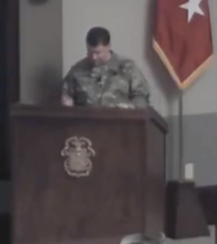
Leader Development Programs
Notes:
Publish and Process:
Facilitator Action: Select the link to play the video https://www.youtube.com/watch?v=t10KIAHynoE&feature=youtu.be
Describe your reaction to the video.
Why is professional development important?
Facilitator Note: Leader development is a fundamental mission of all Army leaders at all levels and cohorts (NCO, Officer, Warrant Officer, and Army Civilian) and a responsibility of the organization/unit.
Facilitator Action: show slide 5, Leader Development Doctrine

Slide 5
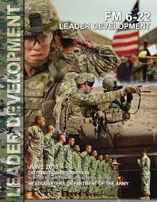
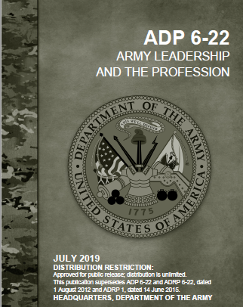
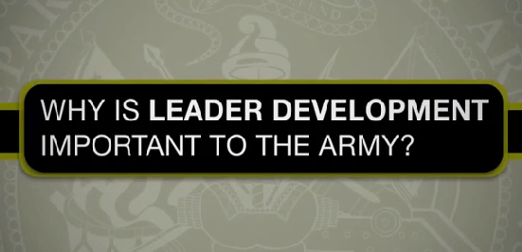
Leader Development Doctrine
Provides a common framework in language and expectations
Defines a fundamental set of leader attributes and competencies common to all cohorts and leader levels
Aligns leader development activities (institutional, operational, and self-development domains)
https://capl.army.mil/
https://www.youtube.com/watch?v=M_xvKoAKU28&feature=player_embedded
Notes:
Facilitator Talking Points: The purpose of FM 6-22 is to provide a common language and expectations the Army has on developing leaders, and examples/ideas of how to do it. Like all doctrine, it gives a “what right looks like.”
The focus of FM 6-22 is for leaders in all cohorts (Officer, Warrant Officer, NCO, and Army Civilian) at all levels (BDE and below)
FM 6-22 integrates shared knowledge from around the Army, Sister Services and even the business world through systematic and scientific research.
FM 6-22 incorporates not only doctrine, but real experiences from leaders in the field and shared best practices.
The manual is full of excerpts from Army Leaders and examples of products from units across the Army.
It speaks to the formal and informal ways we can develop leaders. How do you currently develop leaders within your organizations? Everything we do is developing leaders.
The FM 6-22 provides ideas, example products, experiences, and best-practices were taken from around the Army and are shared within the manual.
It provides a common language and expectations. There is no need to guess what each attribute/competency means. The FM defines each broken down by developmental need, standard, and strength. (Chapter 6)
It provides a guide for developing oneself and/or others and breaks down each attribute/competency with learning and development tools/activities on how to provide/gain feedback, self-study, and practice.
Check on Learning
Question: What is the definition of Leader Development?
Expected response: Leader development is the deliberate, continuous, and progressive process – founded in the Army Values – that grows Soldiers and Army Civilians into competent, committed professional leaders capable of decisive action.
Question: Which publication provides the framework for leader development?
Expected response: FM 6-22: Leader Development
Facilitator Action: show slide 6, Leader Development Tenets.

Slide 6
Leader Development Tenets
• Strong commitment by the Army, superiors, and individuals to leader development
• Clear purpose for what, when, and how to develop leaders
• Supportive relationships and culture of learning
• Three mutually supportive domains (institutional, operational, and self-development) that enable education, training, and experience
• Providing, accepting, and acting upon candid assessment and feedback
Notes:
Facilitator Talking Points: Leaders have a directed responsibility to develop their subordinates. AR 600-100: Army Leadership states that “every leader will ensure the physical, moral, personal, and professional wellbeing of subordinates; build cohesive teams and empower subordinates; teach, coach, and counsel subordinates; develop their own and their subordinates’ skills, knowledge, and attitudes; and foster a healthy command climate.” Leaders must be committed to the development of others and themselves. In the operational domain of the Leader Development Model, it is the leaders within the force that are responsible for leader development not only through day-to-day training, but through a systematic, deliberate, and planned leader development program or programs.
Development depends on having a clear purpose for what, when, and how to develop. A clearly established purpose enables leaders to guide, assess, and accomplish development.
Supportive relationships and a culture of learning recognize that for development to occur, a willingness to engage with others must exist. Leaders must balance leader development against organizational requirements and mission performance. In operational units and other organizations, development can occur concurrently with training and mission performance, especially when leaders create an environment that places real value and accountability on leader development activities.
Leaders help individuals realize that individual commitment to career-long learning is essential to development. Army senior leaders set the conditions for the Army to develop leaders. Professional military education (PME) and other institutional schooling is an essential part of the Leader Development Model. Simultaneously, leaders at all levels create conditions in their organizations that maximize the development of subordinate leaders by teaching them, training them, and providing the supporting experiences they need to grow as leaders. Self-development bridges the gaps between the operational and institutional domains and sets the conditions for continuous learning and growth. Self-knowledge is an important part of a leader’s development, and is an individual’s responsibility but it is important for leaders to set conditions and support self-development.
Feedback is necessary to guide and gauge development. Formal and informal feedback based on observation and assessment provide information to confirm or increase self-awareness about developmental progress. The Army established performance monitoring, evaluation reports, coaching, mentoring, and growth counseling processes to engage leaders and individuals.
Facilitator Action: show slide 8, Program Development

Slide 7
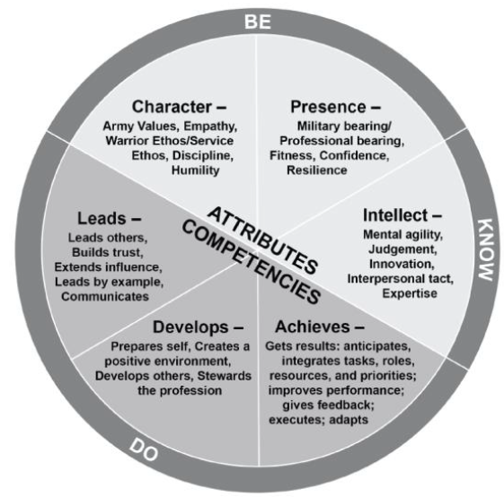
Leadership Requirements Model
Illustrates the expectations of every leader (NCO, Officer, DA Civilian)
Attributes: the desired internal characteristics of a leader (Be/Know)
Competencies: skills and learnable behaviors the Army expects leaders to acquire, demonstrate, and continue to enhance (Do)
Notes:
Facilitator Talking Points: Attributes are the desired internal characteristics of a leader – what the Army wants leaders to be and know.
Competencies are skills and learnable behaviors the Army expects leaders to acquire, demonstrate, and continue to enhance – what the Army wants leaders to do. The pie chart represents the idea that you cannot be a whole and complete leader without all the attributes and competencies. While you may use some more than others depending on the situation or environment, all will be present and essential.
The LRM is:
Universal as it applies across all levels of authority and levels of responsibility
Enduring as it is portable across time regardless of resources, demands, requirements, priorities, and strategies
Inclusive as it applies to leaders in all cohorts (military/civilian, officer/enlisted, active/guard/reserve) within the Army
Question: What is an attribute (definition), and what are the three attribute categories in the LRM?
Expected response: A desired internal characteristic of a leader/What the Army wants leaders to be and know; Character, Presence, Intellect.
Question: What is a competency (definition), and what are the three competency categories in the LRM?
Expected response: A skill and/or learnable behavior the Army expects leaders to acquire, demonstrate, and continue to enhance/What the Army wants leaders to do; Leads, Develops, Achieves.
Facilitator Action: show slide 8, Program Development

Slide 8
Program Development
• Is a Command responsibility
• Must nest with higher headquarter’s guidance
• Defines roles and responsibilities
• Uses the Operations Process
Operations Process
Notes:
Facilitator Talking Points: Chapter 2 of FM 6-22: Leader Development describes in detail how to cultivate leader development programs within your organizations.
Commanders are responsible for training and leader development in their units, and for providing a culture in which learning takes place. They must deliberately plan, prepare, execute, and assess training and leader development as part of their overall operations. Commanders and leaders must integrate leader development into their organizational training plans or leader development programs.
Organizational leader development programs must nest in purpose and guidance of the higher organization’s plan. Plans should provide guidance to subordinate units yet all them the freedom to determine practices and schedules most conducive to their missions. Variations in programs will occur across echelons depending on the type and size of the organization.
The Army holds commanders accountable for unit leader development by regulation (see AR 350-1), and accountability can be included as part of the organizational inspection program (AR 1-201). Responsibility for leader development cuts across all leader and staff roles. Efficient implementation of leader development programs depends on a clear definition and allocation of responsibilities across leaders and staff both in and outside the organization.
Example roles and responsibilities might be:
Each leader develops subordinates.
The senior warrant officer, NCO, and Army Civilian leaders take ownership for their cohorts’ leader development in the organization.
Each leader (as well as those who aspire to positions of leadership) takes responsibility for their own leader development.
Leader development is an ongoing process intended to achieve incremental and progressive results over time. An opportunity for leader development exists in every event, class, assignment, duty position, discussion, physical training formation, briefing, and engagement.
Developing a leader development program follows the same steps used in the operations process (ADP 5-0). Once the commander’s understanding is established and a plan is developed, it directs preparation and execution of the unit’s leader development program. The commander and unit leaders lead the execution of the program and assess its progress. It is a living document; as the program creates change and as leaders develop, the plan can be updated.
Facilitator Action: show slide 9, Program Development- Understand

Slide 9
Program Development - Understand
Use formal assessments and/or leader observations
Develop a vision statement
Establish goals and an end state
Notes:
Facilitator Talking Points: To aid in understanding, command teams can use formal assessments such as command climate surveys, training center after action reviews (AAR) take-home packages, and command inspection program results to focus on conditions indicating unit strengths and developmental needs.
There might not always be existing formal assessments to use, or the unit mission or composition may change so those sources may no longer apply. In these cases, leaders align goals with their observational assessments and any changes to organizational mission and goals.
The Army Campaign Plan and the intent in higher and sister organizations’ leader development plans are just some of the several sources to inform decisions about setting the desired future end states for leader development. The most important and enduring outcomes are stated in a statement of vision or intent, depending on the preference of the commander.
Discuss the supporting areas of leader development programs on a separate white board.
Each leader development program has four mutually supporting purposes:
1. Accomplish the mission.
2. Improve the organization.
3. Enable personnel to be able to perform their current duties.
4. Develop leaders for future responsibilities and other assignments.
Different from unit training plans, the leader development plan addresses long-term outcomes for individuals and the organization. Goals and end states should address these four areas.
Leaders who recognize and approach leader development as a process are able to balance the long-term needs of the Army, the short-term needs and career needs of their subordinates, and the immediate needs of their organizations to determine how and when to integrate leader development opportunities in already busy schedules.
Facilitator Action: show slide 10, Program Development- Plan/Prepare

Slide 10
Program Development – Plan/Prepare
Selection of leader development activities
Program that fits both individual and unit schedules
Formal, semiformal, and informal practices
Notes:
Facilitator Talking Points: To start the planning process, the leadership goes through a conceptual process to consider how to achieve its desired end state. The end state and enduring purpose help guide the detailed phase of planning that involves the selection of activities to emphasize the unit’s program.
The activities cover both unit and individual development for short-term and long-term development.
How can we structure a leader development program using the following factors?
Instructor Note: Ask the class for ideas on how to structure leader development programs using the following factors on the white board. The intent is to get them thinking of how they would create their unit’s leader development programs.
Phases of a leader’s cycle within the unit
Reception
Integration
Utilization
Assignment rotation within the unit
Transition
-Unit cycles
Sustainable readiness model (old term: ARFORGEN cycle)
Deployment schedule
Green-amber-red time management and training cycles
-Cohort programs
Sergeant’s time
Preparation for Soldier and NCO excellence boards
NCO professional development
Warrant officer professional development
Officer professional development
Command team
Civilian leader development seminars
Combined leader development programs
-Developmental focus – common core for the teams and all leaders
- Command climate (AR 600-20)
Mission command principles (ADP 6-0)
Core leader competencies and attributes (ADP 6-22)
Essential characteristics of the Army Profession (ADP 6-22)
Performance qualities, such as adaptability, resilience, versatility, and creativity
Core unit mission and functions
-Developmental focus – career paths for groups of leaders
Career leadership responsibilities (DA PAM 600-3, 600-25, Army Civilian Training, Education, and Development System (ACTEDS))
Career Management Field
Functional Area
Army Civilian Career Programs
Successful programs integrate formal, semiformal, and informal practices. Policy or regulation direct formal techniques. Addressed in doctrine, semiformal activities are commonly practiced and may be required, but failure to conduct them does not carry punitive consequences. Informal leader development consists of opportunities with a focus on learning.
Examples for techniques to enable learning are: formal – Individual development plans, performance counseling, evaluations, inspection programs, etc. Semi-formal – 5 year plans, mentoring, etc. Informal – Day-to-day observations, sensing sessions, 5-minute feedback, indirect questioning, etc. Examples for techniques for developmental activities and opportunities include: Formal – broadening assignments, AARs, PME courses, structured self-development, etc. Semiformal – unit talent management, developmental/rotational assignments, OPD/NCOPD, team building events, etc. Informal – Broadening tasks (casualty assistance/notification officers, staff duty, food service duty, etc.), professional reading/writing programs, excellence competitions, reflective journaling, etc.
Facilitator Action: show slide 11, Program Development

Slide 11
Program Development – Execute/Assess
Leader development program as a living document
Unit leader development programs and IDPs
Assessment of vision and end states
Higher headquarters’ responsibilities
Notes:
Facilitator Talking Points: Once completed, the leaders distribute the leader development plan throughout the unit to direct program preparation and execution. The program is a way to emphasize leader development and desired outcomes for individuals and units. Reviewed, assessed, and updated periodically, the plan is a living document. Leaders commit to creating an open learning environment where leader develop becomes second nature when they integrate leader development into daily administrative and training events, as well as deployed operations. Execution of the leader development program can become a regularly reported item in reviews, situation reports, and training briefs.
The leadership team sets, directs, and leads the organizational goals, shaping the conditions for individual development. Individual leader development is based on the interest and the effort of individuals who develop others and themselves. It is up to each individual to learn, grow, and develop as an Army professional. An individual’s IDP is a personal version of a unit leader development program. Ideally, individuals and their raters work together to develop the IDP.
Leaders assess implementation and execution against the established vision and end states. Assessments provide useful information on how well the end states are being achieved and identifies areas for adjustment.
Check on Learning
Question: What are the five steps of the Operations Process?
Expected response: Understand, Plan, Prepare, Execute, and Assess
Question: What is an IDP?
Expected response: An Individual Development Plan is a personal version of a unit leader development program.
Facilitator Action: show slide 12, Fundamentals of Development
Revise slide

Slide 12
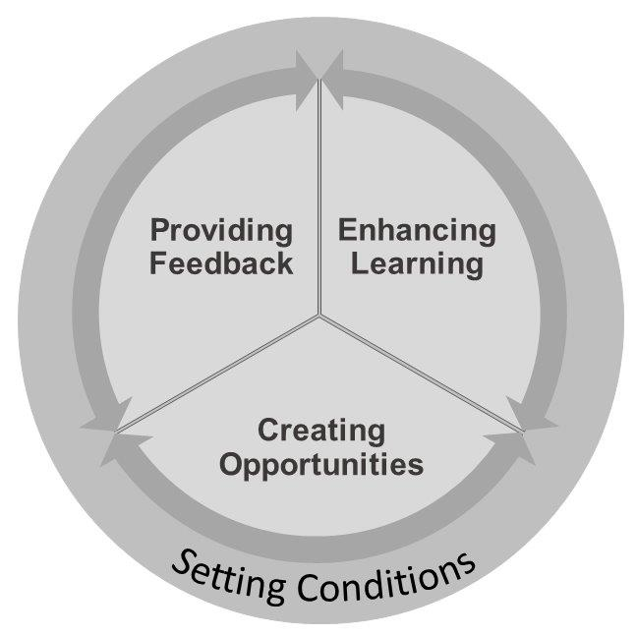
Fundamentals of Development
Notes:
Facilitator Talking Points: The fundamentals of development simplify and span the formal leader development activities that the Army has advocated, such as assessing, counseling, coaching, mentoring, broadening, and team building. The fundamentals are common across formal, semiformal, and formal leader development activities and serve to reinforce an Army development culture and a developmental mindset. Other sources provide guidance on techniques associated with the formal activities, such as AR 623-3 on the evaluation process, ATP 6-22.1 on the counseling process, ADP 6-22 on leadership and profession, AR 621-7 and DA PAM 600-3 on broadening, and ATP 6-22.6 on team building.
Setting the conditions for leader development. Leaders personally model behaviors that encourage leader development, create an environment that encourages on-duty learning, apply principles that accelerate learning, and get to know the leaders in the organization.
Providing feedback on a leader’s actions. Provide opportunities for observation, assessment, and feedback. Immediate, short bursts of feedback on actual leader actions enhance leader development in operational assignments as well as regular counseling.
Enhancing learning. Use leaders as role models in the organization. Encourage mentoring, training, reflection, and study. Learning from other leaders is one of the most effective and efficient methods of development.
Creating opportunities. Modify position assignments to challenge leaders. Be deliberate about the selection and succession of leaders. Integrate leader development across day-to-day activities. Evaluate its effectiveness.
Facilitator Action: show slide 13, Setting Conditions

Slide 13
Setting Conditions
Establishing a culture that promotes leader development
Creating a learning environment
Knowing your subordinates
Building trust and communicating roles
Notes:
Facilitator Talking Points: Establishing a culture that promotes leader development throughout the organization is necessary. The culture is affected by leaders who share a mindset that leader development is important and is achievable as part of what they do every day. Leaders need to designate and protect time for leader development and develop a culture that encourages and rewards professional development. Leaders setting the example for what is important through what they do (counseling, mentoring, etc.) and what they emphasize (rewards, recognition, feedback) is essential to developing a pro-development culture.
Leaders establish a learning environment by encouraging subordinates to take reasonable risks, grow, and develop on their own initiative and gain knowledge of subordinates in the organization as individuals with unique skills, abilities, backgrounds, and goals. Be receptive to individuals’ input, recommendations, and advice, and shut down others who belittle someone’s suggestion to take a different or creative approach. Good leaders back subordinates trying to do the right thing and learn something new at the same time. A positive leadership climate encourages a learning environment.
Being a role model for leader development is essential. Leaders who model the following leader actions encourage effective development in others and signal that leader development is valued:
Encourage development
Encourage learning
Promote learning from mistakes
Encourage innovation
Allow for risk taking and encourage exercise of disciplined initiative
Encourage effective decision-making
Be aware of personal reactions during times of crisis. Before making off-the-cuff remarks, leaders should collect their thoughts and ask themselves what they want less-experienced leaders to learn from this reaction to crisis.
Subtle actions on the leader’s part build trust and communicate the role of trainer and developer. Experienced leaders use the following techniques to create a developmental culture:
Be present to observe enough key activities without smothering the leader.
Take an indirect approach…allow the subordinate to understand what is going well and what needs improvement without directing. The opposite of an indirect approach is micromanaging.
Give each leader a fresh, objective start. Observe and assess each leader on individual merit.
For effective leader development, individual relationships with each subordinate are necessary. Leaders who interact with subordinates on and off duty better understand their subordinates’ backgrounds and experiences. Likewise, leaders must avoid establishing or being perceived as having improper relationships. Getting to know subordinates communicates a genuine interest in them as individuals. This builds confidence and generates trust.
As a part of professional growth counseling and feedback sessions, leaders should help subordinates design an Individual Development Plan (IDP). IDPs enable developing an objective approach to professional development. The Army Career Tracker (ACT) provides the central location to develop and track IDPs over a service career for both military members and Army Civilians.
Facilitator Action: show slide 14, Providing Feedback

Slide 14
Providing Feedback
Leaders observe subordinates and provide developmental feedback.
Effective feedback accelerates subordinate development.
Leaders should provide immediate feedback that encourages positive behavior.
Time and frequent observations help leaders build confidence.
Notes:
Facilitator Talking Points: A leader’s ability to provide feedback to subordinates will significantly contribute to their development. It will enhance and accelerate learning from the day-to-day work experience – the most valued and effective environment for leader development. Providing accurate feedback starts with planned observation and accurate observation and assessment.
The first step to having a legitimate role in a subordinate’s leader development process is to observe them. To use available time productively plan to:
See them challenged by a developmental need.
See them excel by applying a personal strength.
Observe their actions during critical times of unit performance.
See them reach their limits of strength and endurance.
Observe decision-making and conduct.
Observe their effect on subordinate leaders and Soldiers.
See them relaxed and available for conversation.
Do not draw a lasting impression of a leader from a single observation. It usually takes multiple observations before a pattern of behavior emerges.
While training briefs are full of metrics to assess unit performance, they do not provide leaders with an assessment of their leadership behaviors.
A good leadership assessment:
Speaks to the leader behaviors that contributed to the unit’s performance
Combines perception and reality, with reality best confirmed by multiple sources
Occurs through two-way communication between leader and led
Has a common language defined by the doctrinal language of ADP 1 and ADP 6-22
Effective commanders observe training, participate in operations, and interact with subordinates and their units. Personnel other than the commander or rater, such as peers, trainers, operations officers, first sergeants, etc, make observations contributing to leader development.
The three key components that ensure observations are accurate and descriptive are:
Observations are planned around key events
Observations for patterns of behavior
Recording important observations immediately
Use words that depict action
Link to effects and outcomes
When observing leadership, it is important to frame observations in a context consistent with Army doctrine. A way to capture observations and assessments is to use a quick, accurate, and complete way to take notes that make for an effective feedback session such as situation, observation, associate and assess, and reinforce and recommend (SOAR) format. Figure 3-3 and Paragraph 3-31 of FM 6-22 provide an example and definitions of SOAR feedback notes. Chapter 6 of FM 6-22 provides performance indicators for the competencies and attributes in ADP 6-22.
Day-to-day informal feedback makes sitting down with subordinates for developmental counseling much easier. This informal feedback develops a shared understanding of the subordinate’s strengths and developmental needs. ATP 6-22.1 provides extensive guidelines on the counseling process. The timing of a discussion of leadership observations can be critical and a deciding factor between whether perceiving a situation as evaluative or developmental. Consider whether delivery should occur during an action, at a break in action, or at the end of the day or even completion. If done at the completion of an event, at a minimum, provide a “heads up” about a situation or circumstance to be discussed. This allows the leader an opportunity to reflect and prepare to listen and receive feedback. This approach reduces the likelihood the subordinate will be preoccupied, nervous, or defensive.
An effective way to deliver an observation is to take an indirect approach.
Confirm the situation
Ask for a self-assessment
Clarify and come to an agreement
Add your observations
Leaders can also raise questions that will prompt subordinates to think about how to act or respond in the future, and be sure to provide reinforcement on what the subordinate is doing correctly. Leaders should avoid delivering some kinds of feedback to a subordinate, such as vague and general ideas, using absolutes or generalities, observations applied to general traits or the total person, and untimely feedback that the leader is unable to apply.
It is also important for leaders to learn from the delivery of their observations and realize it takes practice. It is helpful after an interaction for leaders to reflect on their delivery.
Facilitator Action: show slide 15, Enhancing Learning

Slide 15
Enhancing Learning
Positive role models and emulation of leadership behaviors
Benefits of mentorship
Guided discovery learning
Study of the profession
Notes:
Facilitator Talking Points: Applying practices to enhance learning will make development more effective. Enhancing learning draws on the developmental value from learning opportunities. Learning from experience can be enhanced by facilitating what an experience means. Practical approaches to enhance learning include leader role models, mentoring, guided discovery learning, and individual group study. These practices are not events that come up on a schedule, they are powerful ways to integrate and promote learning in the day-to-day operations of the organization.
Because leaders vary in skill and experience level, an effective way to learn is directly from unit role models. Positive role models exhibit leadership behaviors that others should emulate. Supervisors should identify role models for each key position (such as company commander or platoon sergeant) and may want to identify role models possessing special skills that other leaders need to master.
Mentorship is the voluntary developmental relationship that exists between a person of greater experience and person of lesser experience that is characterized by mutual trust and respect (AR 600-100). A mentor is a leader who assists personal and professional development by helping a mentee clarify personal, professional, and career goals and develop actions to improve attributes, skills, and competencies. Mentor-mentee relationships work best when they are voluntary and if they occur outside the chain of command.
Guided discovery learning is an advanced technique that experienced leaders employ to help the subordinate learn. It involves the use of indirect feedback that places more responsibility on the leader to identify his or her own strengths and developmental needs. Guided discovery learning techniques are an effective way to deliver leadership observations; these techniques include:
Positive reinforcement
Open-ended questioning
Multiple perspectives
Scaling questions
Cause and effect analysis
Recovery from setbacks
Use experience
Leader development processes in the organization should establish an expectation for each leader to spend personal time seeking sources of knowledge and opportunities to grown and learn. Some ways to promote self-study is through professional reading and writing programs.
Facilitator Action: show slide 16, Creating Opportunities

Slide 16
Creating Opportunities
Create challenging experiences to create a culture of development.
Leaders foster an attitude that leadership positions are not automatic appointments.
Succession is a developmental activity that should be planned.
Track career development and management.
Notes:
Facilitator Talking Points: Leaders foster a positive culture by providing a supportive command climate that values member involvement and learning. Likewise, the selections for and responsibilities of key positions of leadership have implications for developing leaders far into the future. Integrating these efforts into a holistic program will establish lasting operating norms. Selection and screening of leaders can be useful in leader development efforts. Forming leadership teams where strengths in one complement developmental needs in another is a common selection goal. Developing leaders is often about preparing them for responsibilities in the next position.
Challenging experiences are characterized by pressure, complexity, novelty, and uncertainty. Challenge creates learning situations that are interesting and motivating. Not all leaders develop on the same timelines. Supervising leaders should be willing to adjust how much time each subordinate stays in position.
Supervising leaders should foster an attitude that leadership positions are not necessarily automatic appointments. It is a privilege, not an entitlement, to serve in a leadership position. Selections for key leadership positions require thorough consideration. Each step in the screening and selection process should narrow the field of acceptable candidates. These processes fall within the realm of talent management, which complements leader development.
Succession planning is a developmental activity for the individual leaders that focus on deliberate planning to provide opportunities for experience in key developmental assignments and to prepare for future assignments beyond the unit. Senior leaders plan the systematic rotation of subordinates within the organization so that trained and qualified leaders are ready to assume vacancies, proven leaders move on to positions of greater responsibility, and marginal leaders receive opportunities to improve. Moving leaders in and out of positions should be a factor of unit performance, Army need, and individual leader development goals and readiness.
Individuals should understand and actively manage their own career paths while supervisors should consider the career paths and influence their subordinates to gain breadth in development. Commanders and other senior leaders should encourage their developing subordinates to take challenging assignments.
Question: What are the fundamentals of development?
Expected response: Setting Conditions, Providing Feedback, Enhancing Learning, and Creating Opportunities
Question: How can a leader establish a culture of learning/leader development?
Expected response: Leaders who share a mindset that leader development is important and achievable is shown by what they do every day to establish a culture of leader development. They need to designate and protect time for leader development and encourage and reward professional development. Leaders should also set the example for what is importation through what they do and what they emphasize.
Question: What is the definition of mentorship?
Expected response: Mentorship is the voluntary developmental relationship that exists between a person of greater experience and a person of lesser experience that is characterized by mutual trust and respect.
BREAK: Allow the students to take a 10-minute break.
Facilitator Action: transition to the next topic and show slide 17, Counseling.

Slide 17
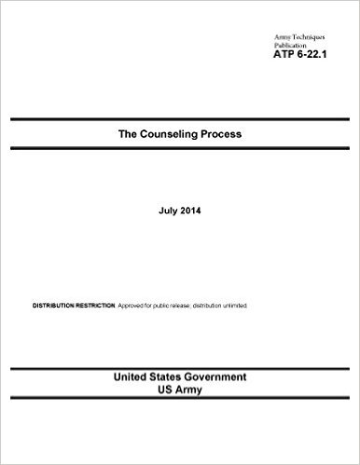
Counseling
Types of Counseling
  Event
  Performance
  Professional Growth
Fundamentals of Counseling
  Counselor qualities
  Counseling practices
  Accepting limitations
  Addressing resistance
  The four-stage counseling process
  Counseling approaches and techniques
Notes:
Facilitator Talking Points: Counseling is the process used by leaders to review with a subordinate his or her demonstrated performance and potential. Counseling, one of the most important leadership and professional development responsibilities, enables Army leaders to help Soldiers and Army Civilians become more capable, resilient, satisfied, and better prepared for current and future responsibilities. Counseling is required of leaders and occurs at prescribed times.
ATP 6-22.1 provides a doctrinal framework for counseling subordinates and consists of two chapters.
- Chapter 1 addresses the types of developmental counseling: event, performance, and professional growth
- Chapter 2 addresses counseling fundamentals supporting effective counseling
Counselor qualities
Counseling skills
Counseling practices
Accepting limitations
Addressing resistance
The four-stage counseling process
Counseling approaches and techniques
Event oriented counseling involves a specific event or situation. It also addresses events such as noteworthy duty performance, and issue with performance or mission accomplishment, or a personal issue.
Performance counseling is the review of a subordinate’s duty performance during a specific period. The leader and the subordinate jointly establish performance objectives and clear standards for the next counseling period. The counseling focuses on the subordinate’s strengths, areas to improve, and potential. Performance counseling is required under the officer, NCO, and Army Civilian evaluation reporting systems (see AR 623-3 or AR 690-400).
Professional growth counseling includes planning for the accomplishment of individual and professional goals. During the counseling, leader and subordinate conduct a review to identify and discuss the subordinate’s strengths and weaknesses to create an individual development plan that builds upon those strengths and compensates for (or eliminates) shortcomings.
Army leaders must demonstrate qualities such as respect for subordinates, self-awareness, cultural awareness, empathy, and credibility to be effective counselors. Leaders also must have the basic counseling skills of active listening, responding, and appropriate questioning.
Dominating the session by talking too much, giving unnecessary or inappropriate advice, not truly listening, and projecting biases and prejudices all interfere with effective counseling. Competent leaders avoid rash judgments, stereotyping, losing emotional control, inflexible counseling methods, or improper follow-up. Leaders should be open to new ideas and thoughts.
Army leaders cannot help everyone in every situation. Army leaders should recognize their personal limitations and seek outside assistance when required. When necessary, leaders refer a subordinate to an outside agency for more qualified help. Leaders should also respect an individual’s preference to contact outside support agencies.
Resistance in counseling may stem from either the leader or subordinate and may occur in several ways. Leaders may preempt potential subordinate resistance by opening the counseling session with a discussion of the purpose of the session, expectations of the session, and how they relate to the subordinate’s short- and long-term goals. Once a leader understands that counseling subordinates is a significant leader responsibility in developing subordinates’ potential, leader reluctance to counsel can be overcome through preparation and improving counseling skills.
Instructor Note: On a separate white board, list the four-stage counseling process.
Effective Army leaders use a four-stage counseling process:
-Identify the need for counseling
-Prepare for counseling
-Conduct the counseling session
-Follow-up
An effective leader approaches each subordinate as an individual. Different people and different situations require different counseling approaches. Army leaders may employ three major approaches to counseling: nondirective, directive, or combined.
The leader can select from several techniques when counseling subordinates. These techniques may cause subordinates to change behavior and improve their performance. Some types of counseling techniques used during the nondirective or combined approach include suggesting alternatives, recommending, persuading, and advising. Techniques used during the directive approach include corrective training and commanding.
Check on Learning
Question: What is the doctrinal publication on counseling?
Expected response: ATP 6-22.1 The Counseling Process
Question: What are the types of counseling?
Expected response: Event, performance, and professional growth.
Facilitator Action: transition to next topic and show slide 18, Team Building.

Slide 18
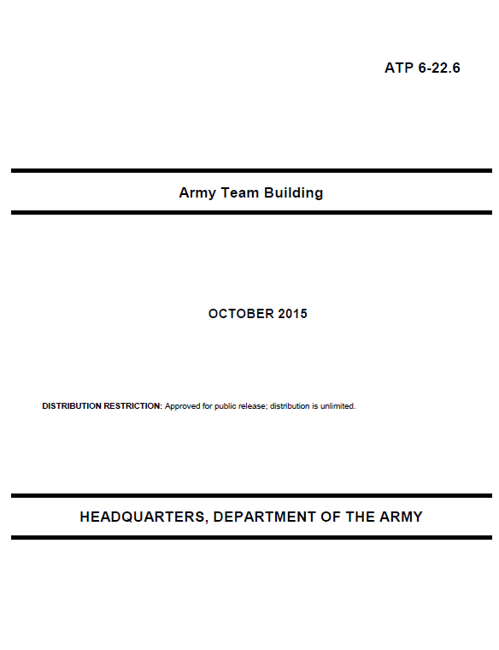
Team Building
Team building stages
  Formation
  Enrichment
  Sustainment
Categories
  Internal teams
  External teams
Notes:
Facilitator Talking Points: Building cohesive teams through mutual trust is a principle of mission command and an essential skill for Army leaders. ATP 6-22.6 expands upon this principle by offering fundamentals of team building and specific techniques for building and maintaining effective teams. The ATP describes the major activities of Army team building and provides a method for team assessments.
Army organizations rely on effective teams to complete tasks, achieve objectives, and accomplish missions. The ability to build teams through mutual trust and maintain effective, cohesive teams throughout military operations is an essential skill for commanders, staffs, and all Army leaders.
Team leaders assemble the team and provide the team direction. The formation stage is important because the team members get to know one another, exchange some personal information, and make new friends. Formation begins with receiving new team members. Having a good experience when joining an organization makes it easier for a new member to fit in and to contribute to the team effort. The principle work for the team during the formation stage is to create a team with a clear structure, goals, direction, and roles so that members begin to build trust, understand how to collaborate, and learn to communicate effectively.
During the enrichment stage, the team members build commitment to the team. Team members feel an increasing acceptance of others, recognizing that the variety of opinions and experiences make the team stronger, and thus, there is increased cohesion and collaboration. The enrichment stage focuses on how to strengthen relationships and motivate team members. During this stage, team members develop accountability focused at the team rather than the individual level. Team members begin to develop shared competence and shared confidence.
At the sustainment stage, team members will do what is necessary without direction. The team’s attitude about its capabilities elevates motivation and increases its ability to overcome adversity. Effective team leaders will watch for signs of complacency and intervene with it occurs by reinforcing good interaction practices and holding the team to the standard. Learning how to manage conflict is important in all of the stages of team building, but it is especially relevant in the sustainment stage. When conflict arises or trust is broken, team members disregard commitments, team members are not accountable, or work goes undone. At this point, the leader steps in and gets the team back on track.
Question: What kind of teams have you been a part of? How did you move through the team building stages?
Response: Answer will vary. Students should stress that building and maintaining effective teams is essential to mission command. The Army is a team of teams composed of numerous organizations with one overarching common mission: win the nation’s wars.
Internal teams are teams comprised of leaders, Soldiers, and DA Civilians assigned to a specific unit or organization. Internal teams are the most common types of teams. These teams do not include individuals from outside organizations, unified action partners, or other nations. Internal teams have leaders who possess formal leadership authority by virtue of their assignment to positions of responsibility. Internal teams accomplish specific missions or tasks and typically have an established structure.
External teams are teams whose members are from different organizations, cultures, agencies, or backgrounds and who bring specific knowledge, skill, and attitudes to the team. Most leaders do not have the option to select their team members. These teams have members with different expertise and can cross boundaries such as distance, time zones, functions, or cultures. In external teams, the members most often do not have authority over one another, come from different cultures and levels of experience, and may have separate agendas. They usually work by influencing and co-opting others through strong relationships and mutual benefits. Some examples include a security force assistance team, a working group, or a provincial reconstruction team.
Question: What is the doctrinal publication on team building?
Expected response: ATP 6-22.6 Army Team Building
Question: What are the stages of team building?
Expected response: Formation, enrichment, and sustainment
Facilitator Action: show slide 19, Leader Development Tools

Slide 19

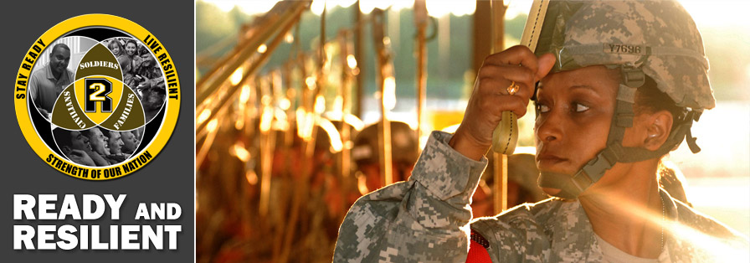
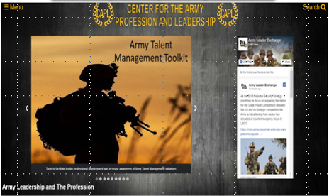
Leader Development Tools
Center for the Army Profession and Leadership
  https://capl.army.mil
Army Career Tracker
  https://actnow.army.mil
Army’s Ready & Resilient Campaign
  www.army.mil/readyandresilient
Notes:
Facilitator Talking Points: The Army Career Tracker (ACT) is a leadership development tool that integrates training and education into one personalized, easy-to-use website. Users can search multiple Army education and training resources, monitor their career development, and receive personalized advice from their supervisor and Army leadership. Users can identify and select mentors, create Individual Development Plans, and create personal and professional goals for the near, mid, and long-term.
The Ready and Resilient (R2) Campaign integrates and synchronizes multiple efforts and initiatives to improve the readiness and resilience of the Total Army – Soldiers (active duty, Reserve, and National Guard), Army Civilians, and Families. It provides capabilities to commanders and leaders to enable them to achieve and sustain personal readiness, foster an environment of trust, and optimize human performance in environments of uncertainty and persistent danger.
CAPL offers case studies, vignettes, videos, doctrine, and other products for leadership, leader development, the Army profession, and the integration of ethics.
Reflection/Summary (5 minutes)
Facilitator Action: show slide 20, Reflection/Summary, and use the questions to reflect and summarize with the learners.

Slide 20
Summary
Leader Development is your responsibility.
Use doctrine, available tools, and other publications to guide your program development and implementation.
Notes:
Summary: In summary, leader development is essential to the Army and is the responsibility of all domains (institutional, operation, and self-developmental).
Army leader development doctrine is there to assist and guide you in implementing your leader development programs. Take the time to read and understand ADP 6-22 and FM 6-22 to get a more in-depth understanding of leader development and the requirements of the unit leadership.
Possible questions:
How will you use this information in the future?
How is leader development different for you now that you are a company commander or 1SG?

Slide 21
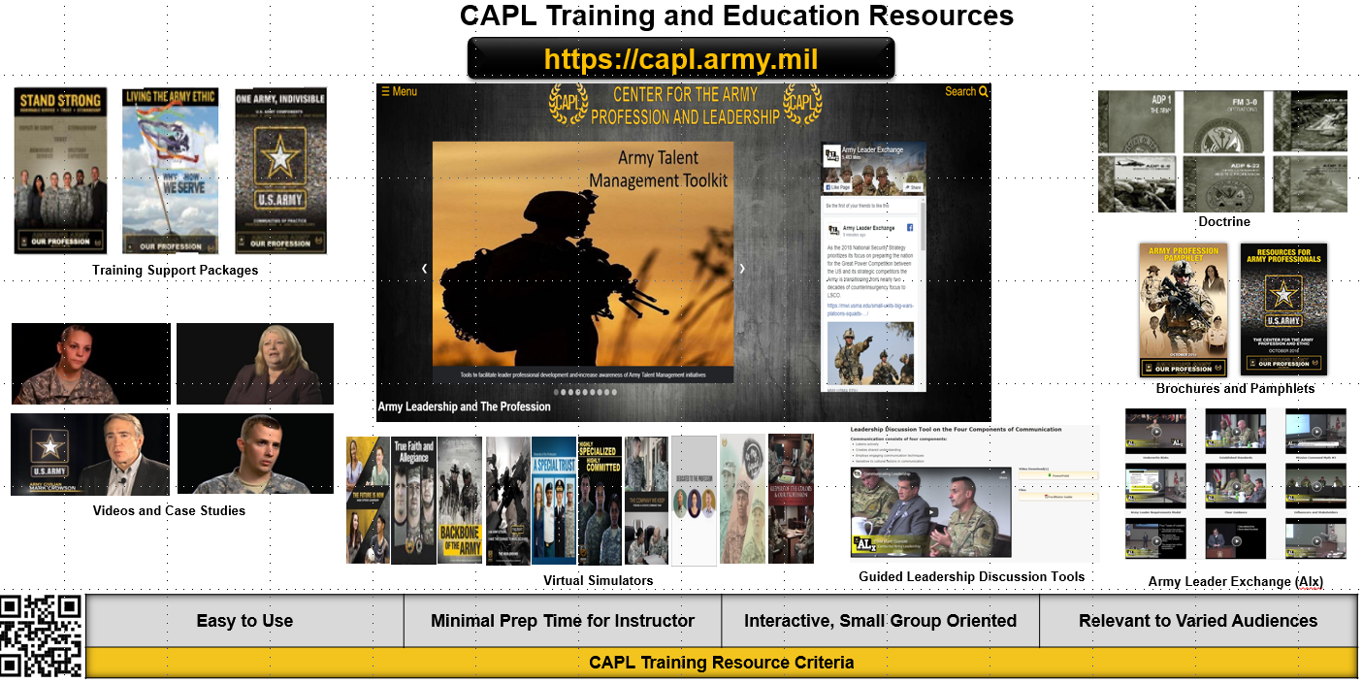
Center for The Army Profession and Leadership Resources

