Slide 1
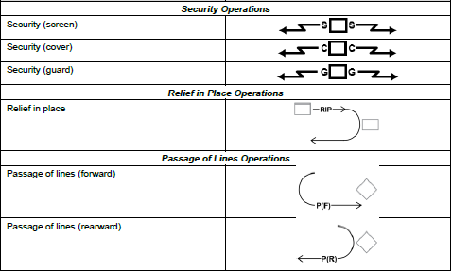
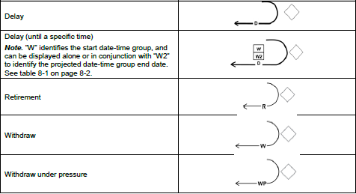
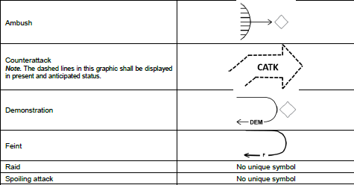
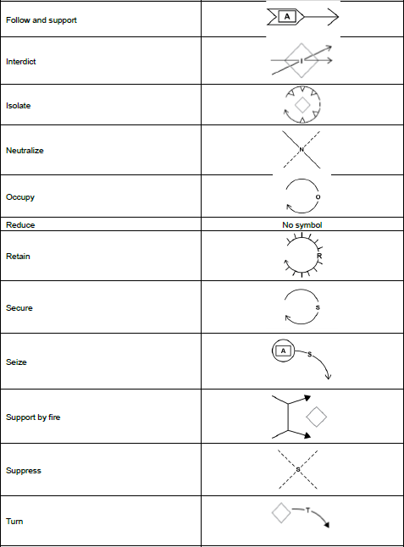
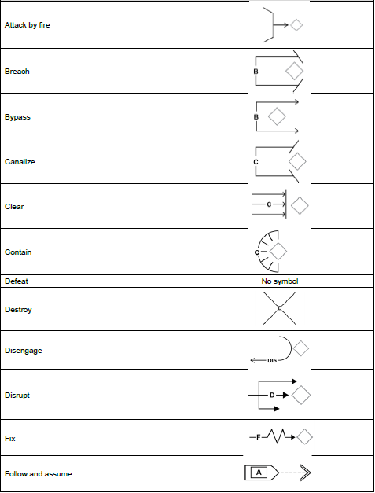
Enemy Tasks
Ambush- A surprise attack by fire from concealed positions on a moving or temporary halted enemy.
Attack- An offensive operation of coordinated movement supported by fire, conducted to defeat, destroy, neutralize, or capture the enemy.
Attack by Fire- Fires (direct or indirect) to destroy the enemy from a distance, normally used when the mission does not require or support occupation of the objective. This task is normally given to the supporting effort and as ctr attk option for a reserve in the defense. The cmdr must specify intent of fire (destroy, fix, neutralize, suppress)
Block- To deny enemy access to a given area or to prevent enemy advance in a given direction or AA. It may be for a specified time and units may have to retain terrain.
Breach- To break through or secure a passage through natural or man-made obstacle.
Bypass- To maneuver around an obstacle, position, or enemy force to maintain the momentum of advance. Unreported obstacles or bypassed enemy are reported up.
Canalize- The use of existing or reinforcing obstacles or fires to restrict enemy operations in a narrow zone.
Contain- To stop, hold, or surround enemy forces, or to keep the enemy in a given area and prevent his withdrawing.
Cover- Offensive or defensive actions to protect the force.
Defeat- To disrupt or nullify the enemy commander's plan and overcome his will to fight, thus making him unwilling or unable to pursue his adopted COAs and yield to friendly Cmdr's will.
Destroy- Physically rendering an enemy force combat-ineffective unless reconstituted.
Disrupt- To integrate fires and obstacles to break apart an enemy's formation and tempo, interrupt his timetable, cause premature commitment, or piecemealing forces.
Exploit- Take full advantage of success in battle and follow up on initial gains, designed to disorganize the enemy in-depth.
Feint- An offensive action involving contact with the enemy to deceive him about the location or time of actual main offensive action.
Fix- To prevent the enemy from moving any part of his forces either from a specific location or for a specific period of time by holding or surrounding them to prevent withdrawal.
Guard- To protect the main force by fighting to gain time, while observing and reporting information.
Interdict- An action to divert, disrupt, delay, or destroy the enemy's surface military potential before it can be used effectively against friendly forces.
Isolate- To seal off an enemy from his sources of support, to deny freedom of movement, and prevent contact with other forces.
Neutralize- To render the enemy or his resources ineffective or unusable.
Protect- To prevent observation, engagement, or interference with a force or location.
Reconnoiter- To obtain, by visual observation or other methods, information about activities and resources of an enemy.
Rupture- To create a gap in enemy defensive positions quickly.
Screen- To observe, identify and report information, and fight in self protection.
Support by fire- Where a force engages the enemy by direct fire to support a maneuvering force using overwatch or by establishing a base of fire. The supporting force does not capture enemy or terrain. (Usually give as occupy SBF and task is fix, suppress, etc)
Terrain Oriented Tasks
Clear- The removal of enemy forces and elimination of organized resistance in an assigned zone, area, or location by destroying, capturing, or forcing the withdrawal of enemy forces that could interfere with the unit's ability to accomplish its mission.
Control- To maintain physical influence by occupation or range of weapon systems over the activities or access to a defined area.
Occupy- To move onto an objective, key terrain or other man-made or natural terrain without opposition and control the entire area.
Reconnoiter- To secure data about the meteorological, hydrographic, or geographic characteristics of a particular area.
Retain- To occupy and hold a terrain feature and ensure it is free of enemy occupation or use.
Secure- To gain possession of a position or terrain feature, with or without force and to prevent its destruction or loss to enemy action. The attacking force may or may not have to physically occupy the area.
Seize- To clear a designated area and gain control of it.
Friendly Oriented Tasks
Breach- To break through or secure a passage through a natural or friendly obstacle.
Counter-reconnaissance- All measures taken to prevent hostile observation of a force, area, or place.
Disengage- To break contact with the enemy and move to a point where the enemy cannot observe nor engage the unit by direct fire.
Displace- To leave one position and take another. Forces may be displaced laterally to concentrate combat power in threatened areas.
Exfiltrate- The removal of personnel or units from areas under enemy control.
Follow- The order of movement of combat, combat support, and combat service support forces in a given combat operation.
Follow and Assume- An operations in which a committed force follows a force conducting an offensive operation and is prepared to continue the mission of the force it is following when that force is fixed, attrited, or otherwise unable to continue. Such a force is not a reserve but is committed to accomplish specified tasks.
Follow and Support- A committed force follows and supports mission accomplishment of a force conducting an offensive operation. Not a reserve, but is committed to - Destroying bypassed units, relieve in place any direct pressure or encircling force that is halted to contain an enemy, block enemy reinforcements; secure LOCs, guard EPWs, key areas, and installations; secure key terrain; and control refugees.
Link up- A meeting of friendly ground forces.

Slide 2
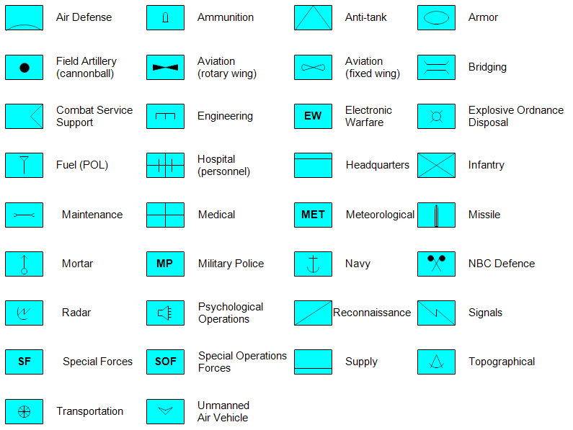
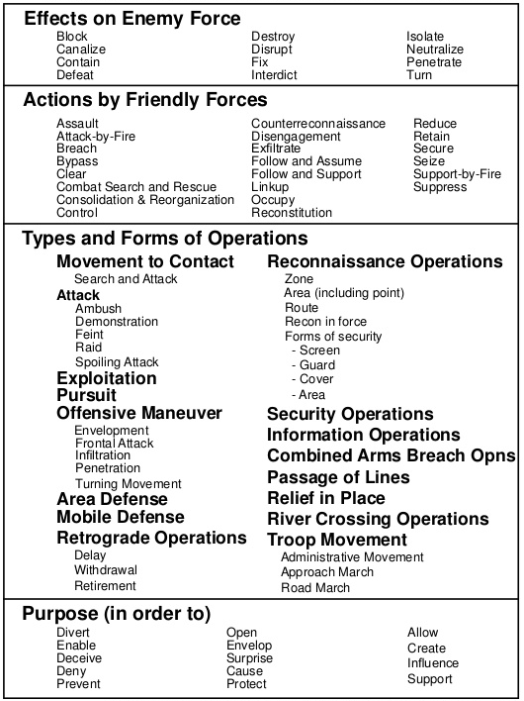
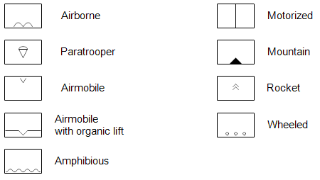
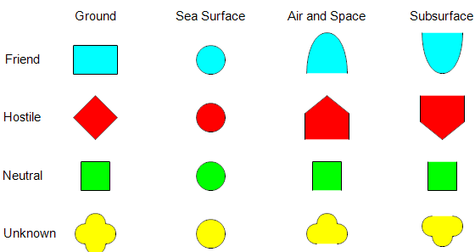
Missile Launcher
AD Missile Launcher
Theater AD Missile
T
Surface to Surface
Missile
AT Missile
Single Rocket
Launcher
Multiple Rocket
Launcher
Antitank
Rocket Launcher
BN/Squadron
Rifle / Automatic
Weapon
Co/Btry/Trp
Corps
Grenade Launcher
PLT/DET
Division/Wing
Mortar
Section
Brigade
Squad
Regiment/Group
Howitzer
Howitzer SP
LAV
Antitank Gun
Ground Vehicle
Recoilless AT Gun
Utility Vehicle
Armored Ground
Vehicle
A
Semi
Direct Fire Gun
Tank
Direct Fire Gun SP
Truck
Tank Retriever
Mine Clearing
Vehicle
AD Gun
APC
Radar
APC Retriever
Dozer
Armored Infantry
Vehicle
Earthmover
C2V / ACV
Civilian Vehicle
CIV
Armored Combat
Service Support Vic

Slide 3
Tactical Mission Graphics
ENY
Ambush
Follow and Assume
Support by Fire
Contain
WP
Follow and Support
Withdrawal
Under pressure
Attack by Fire
Counterattack
Interdict
RIP
Secure
Relief in Place
Block
Counterattack by Fire
D
Isolate
Air Assault
Delay
Breach
272100Z SEP
D
Attack Helo
Delay until specified time
Retain
Neutralize
Bypass
Destroy
Axis of Supporting Attack
Seize
Penetrate
Canalize
Disrupt
Axis of Main Attack
R
Retirement
Direction of Supporting Attack
Fix
W
Clear
Occupy
Withdrawal
C
C
G
G
S
S
Direction of Main Attack
Cover
Guard
Screen

