Slide 1
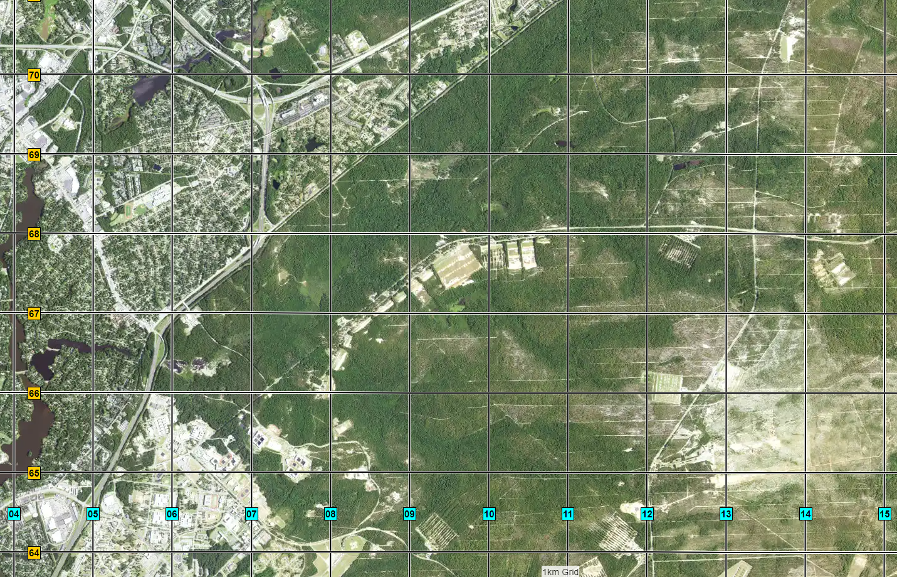
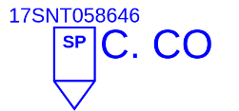



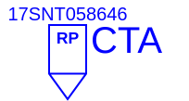
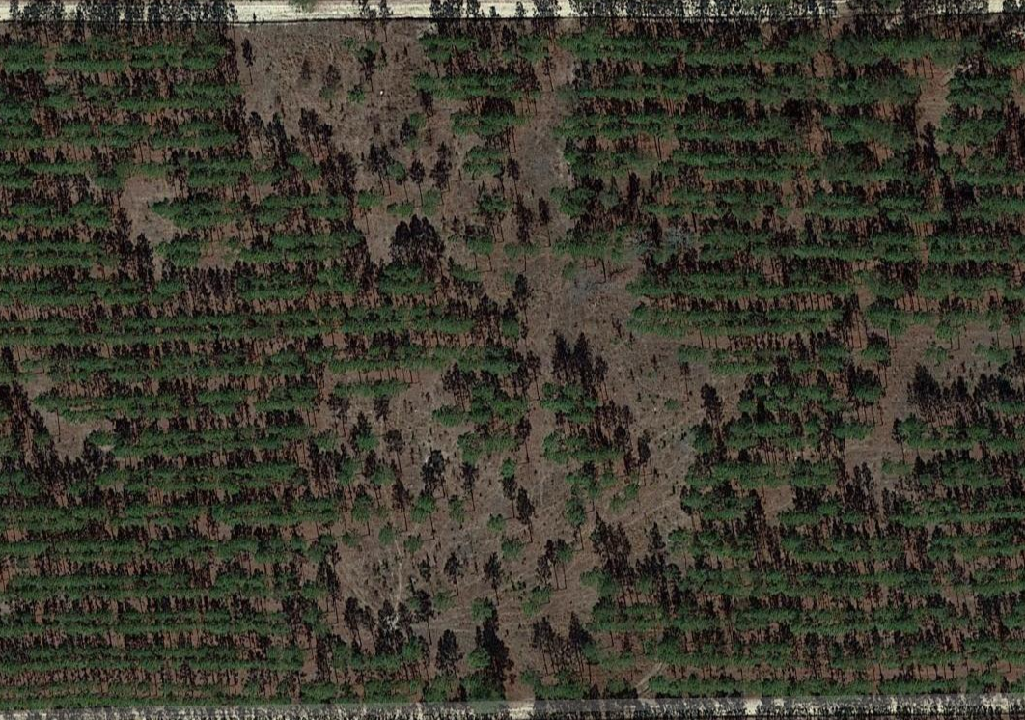




C CO – THE ANVIL
Mission: C/1-13 IN conducts FTX 2 - THE ANVIL from 09JAN23 to 11JAN23 IVO 17SNT058646 IOT reinforce skill level I tasks in a field environment.
N
Concept of Operations:​
Phase I (Preparation): Takes place from 01DEC22 to 09JAN23, beginning with cadre recertification on ANVIL tasks prior to VBL Ship Ops and ending with the company PCC prior to movement.
Phase II (Movement): Begins NLT 090645JAN23 and ends upon dismount at TA 12A. The Company conducts a motor movement from the CTA to ST. LO. Company completes a short FM to TA 12A to establish patrol bases.
Phase III (Occupation): Begins upon establishment of patrol bases at TA 12A NLT 090900JAN23 and ends at 091300JAN23 once Drill Sergeants have reviewed Hammer tasks and learning objectives with their PLTs.
Phase IV (Execution): Begins NLT 091300JAN23 and ends NLT 092000JAN23. Platoons conduct lanes that train and assess react to Direct/Indirect, CBRN, Break Contact, Squad/Team movement, and TCCC. Land Navigation begins NLT 100430JAN23 with stand-to and prep for FM to St. Lo Land Navigation course and ends upon arrival back at patrol bases at 102330JAN23. Trainees will be given land navigation instruction and then broken up into teams to be tested on both day and night land navigation fundamentals and application and then return to TA 12A for PB Ops.
Phase V (RTB): Begins NLT 110430JAN23 and ends NLT 110900JAN23. Trainees will police call TA 12A and stage for FM3 back to Charlie Co CTA to conduct reconsolidation and recovery. The Company conducts a tactical road march for 7.5 miles at a 20 min/mile pace, executing a 15 minute long halt after 45 minutes, and additional 10 minute short halts every 50 minutes.
Phase VI (Recovery Ops): Begins NLT 11J0900AN23 and ends NLT 111700DEC23. The PLTs conduct a layout of equipment/SI and assesses trainee status. Personnel and equipment accountability reported to C6/C7. A company AAR is conducted at the CTA.
Timeline:
DAY 1:
0430: Wake Up/Hygiene
0645: Bus movement to TA
0830-0900: Breakfast
0900-1300: Patrol Base Ops/ Hammer Refresher(Chow @ 1200, while conducting security)
1300-1800: STX Lanes (AICS following iterations)
1800-1900: Dinner
1900-2000: PB Ops
2000-2200: NVG Lanes
2200-0600: PB Ops/Rest Plan (Probing ops until 0030)
DAY 2:
0430-0600: Wake Up/Hygiene/Stand-to
0600-0700: Breakfast
0700-0800: FM to St. Lo
0800-1130: Land Nav Refresher
1130-1230: Lunch MRE
1230-1630: Day Land Nav
1715-1800: Dinner Hot A’s
1800-1900: Land Nav Retrain / Day into Night
1900-2100: Night Land Nav
2100-2115: PCC& PCI / Stage for FM to TA
2115-2300: FM to TA 12A
2330-0430: Rest Plan
DAY 3:
0330: Wake Up/Hygiene/ Fill HFP
0345-0400: Accountability/ PCC & PCI
0400-0430:MORE Meal/PD/HSD
0445-0500: Stage FOOM 4, 1, 2, 3
0500-0700: FM3
0700-0715: Foot Checks/l/AICS
0715-800: Breakfast
0800-UTC: Recovery Ops
Sustainment:
CL I: Day 1: M-M-A (32 boxes MRE / 8 boxes MORE); MORE meals prior to SP
Day 2: M-M-A (32 boxes MRE / 8 boxes MORE); MORE meals throughout day
Day 3: M-M-A (32 boxes MRE / 8 boxes MORE); MORE meals throughout day
CL III: Resupply POL on 09JAN23. POL will be resupplied daily at designated BN fuel points when vehicle is at 50% threshold
Class V: 3300 x 5.56 blank, Pyro, (Each Trainee will be issued 40x rounds of 5.56mm Blank ammunition for training purposes. Cadre will have pyro, OPFOR weapons (M4’s with BFA’s & blank 5.56mm)
Class VII: 4x BRICs, 5x ASIP, 4 Rescue Randy's, x1 Boom Cannon
1x LMTV, 1x 1-Ton Water Buffalo, GSA Van, 1x HMMWV
Class VIII: 4x Litters, 4x CLS bags, Heating Tent, Wet Bulb, 4x Foot Care Kit
N
P: Radio | A: Cell Phones | C: BRIC | E: Runner | EMS: 751-91111
PLAN | CERT LEADERS | RECON | OPORD | REHEARSE | EXECUTE | AAR | RETRAIN
01DEC22 | 17DEC22 | 05JAN23 | 14DEC22 | 08JAN23 | 09JAN23 | 11JAN23 | 11JAN23

Slide 2



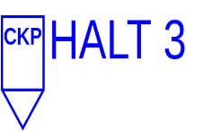
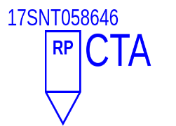
FM3 – TA12A to CTA
Distance:
7.5 Miles
Scheme of Maneuver:
SP at TA 12A and utilize tank trails and fire breaks hand railing Wildcat Rd, Dixie Rd, and Range Rd to arrive at CTA.
Concept of the Operation:
Company conducts tactical foot march for 7.5 miles at a 20min/mile pace.
Conduct long halt at CP1 (15min halt).
Conduct short halts at CP2 and CP3 (10min halt).
Lead Vehicle: 1 Ton w/Water Buffalo (Driver: DS Carey/TC: DS Cain)
Rear Vehicle: Co Van is recovery vehicle (Driver: DS Westmoreland/TC: DS Moret)
N
PLAN | CERT LEADERS | RECON | OPORD | REHEARSE | EXECUTE | AAR | RETRAIN
01DEC22 | 17DEC22 | 05JAN23 | 14DEC22 | 08JAN23 | 09JAN23 | 11JAN23 | 11JAN23

