Slide 1
LSA 4:
Aiming Devices
Notes:
Begin by asking pointed question to get concrete knowledge of the class:
Example questions
What are the common aiming devices used in the army?
What is MOA?

Slide 2
ACTION:
Demonstrate knowledge of Army service Rifle preliminary marksmanship instruction.
CONDITION:
In a classroom environment, given TC 3-22.9, Rifle and Carbine.
STANDARD:
Identify how to apply and train Rifle Marksmanship utilizing the US Army Service Rifle in accordance with applicable command guidance, TC 3-22.9 Rifle and Carbine

Slide 3
INTRODUCTION
Safety Considerations:
Risk Assessment:
Environmental Considerations:
Evaluation:
Notes:
Safety Considerations: Fire escape plan should be reference
Risk Assessment: Low
Environmental Considerations: Keep tops on bottles when not in use and remember to remove all trash from the classroom.
Evaluation: You will be evaluated formally on written examinations which you must achieve a minimum of 70% to continue the course.

Slide 4
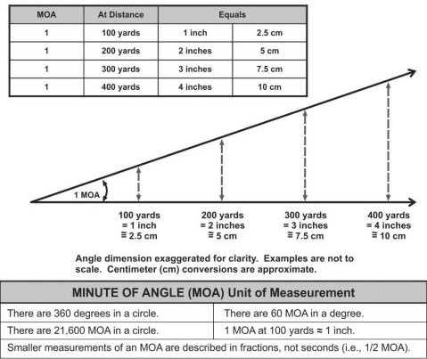
AIMING DEVICES
UNITS OF ANGULAR MEASUREMENT - MOA
Notes:
A minute of angle (MOA) is an angular unit of measurement equal to 1/60th of a degree. The most common use of MOA is when describing the distance of change required when zeroing a weapon. One MOA equals 1.047 inches per 100 yards.
For most applications, a Soldier can round this to 1 inch at 100 yards or 1.1 inches at 100 meters to simplify their arithmetic.

Slide 5
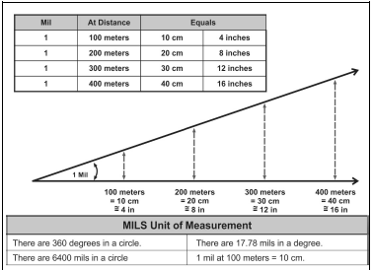
AIMING DEVICES
UNITS OF ANGULAR MEASUREMENT - MIL
Notes:
The mil is a common unit of angular measurement that is used in direct fire and indirect fire applications. This mil to degree relationship is used when describing military reticles, ballistic relationships, aiming devices, and on a larger scale, map reading and for indirect fire.

Slide 6
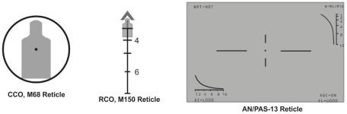
AIMING DEVICES
RETICLES
4
6
6
Notes:
A reticle is a series of fine lines in the eyepiece of an optic, such as a CCO, TWS, or RCO used as a measuring scale with included aiming or alignment points.
Reticles use either mils or minute of angle for their unit of measurement.

Slide 7
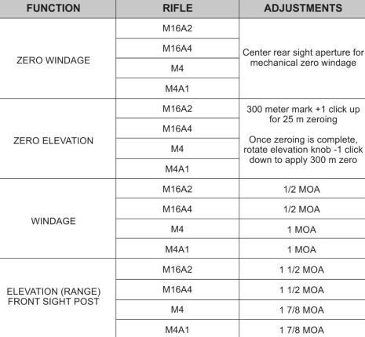
AIMING DEVICES
CARRYING HANDLE IRON SIGHTS
Notes:
Front sight: elevation (zero)
Rear sight: Windage and Elevation (distance)
Set rear sight elevation to have 4 MOA of clicks below 300 meter mark
200 meter: ~2MOA below 300 meter mark
0-2 (large) aperture (0.200” vs. 0.070”)~2.5MOA below

Slide 8
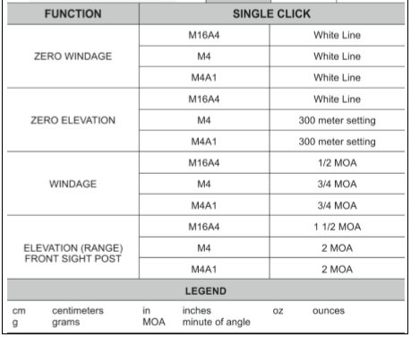
AIMING DEVICES
BACK UP IRON SIGHT (BUIS)
Notes:
Front sight: elevation (zero)
Rear sight: Windage and elevation (distance)
Set rear sight elevation to have 4 MOA of clicks below 300 meter mark
200 meter: ~2MOA below 300 meter mark
0-2 (large) aperture (0.200” vs. 0.070”)~2.5MOA below

Slide 9
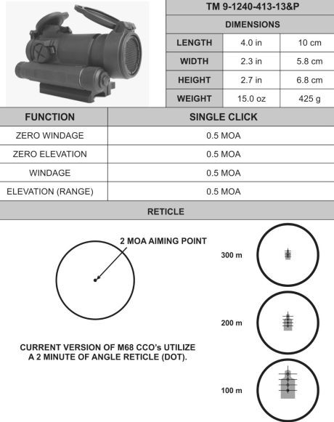
AIMING DEVICES
M68 CLOSE COMBAT OPTIC (CCO)
Notes:
2 MOA dot (older versions 4 MOA dot)
Clicks: 0.5 MOA
Use both eyes open
Can be used with front cap on (occluded eye aiming)

Slide 10
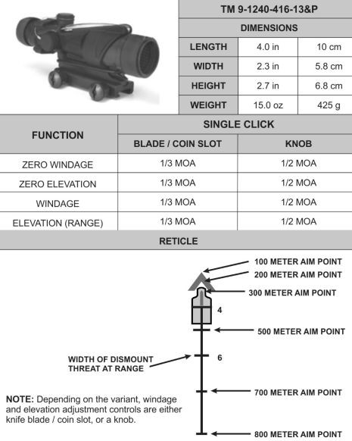
Aiming Devices
M150 RIFLE COMBAT OPTIC (RCO)
Notes:
ACOG (Advanced Combat Optical Gunsight
6 MOA chevron (TA31)
Fiber optic increases reticle illumination in bright light (cover with tape as needed)
Tritium illuminates in dark
Other reticles exist

Slide 11
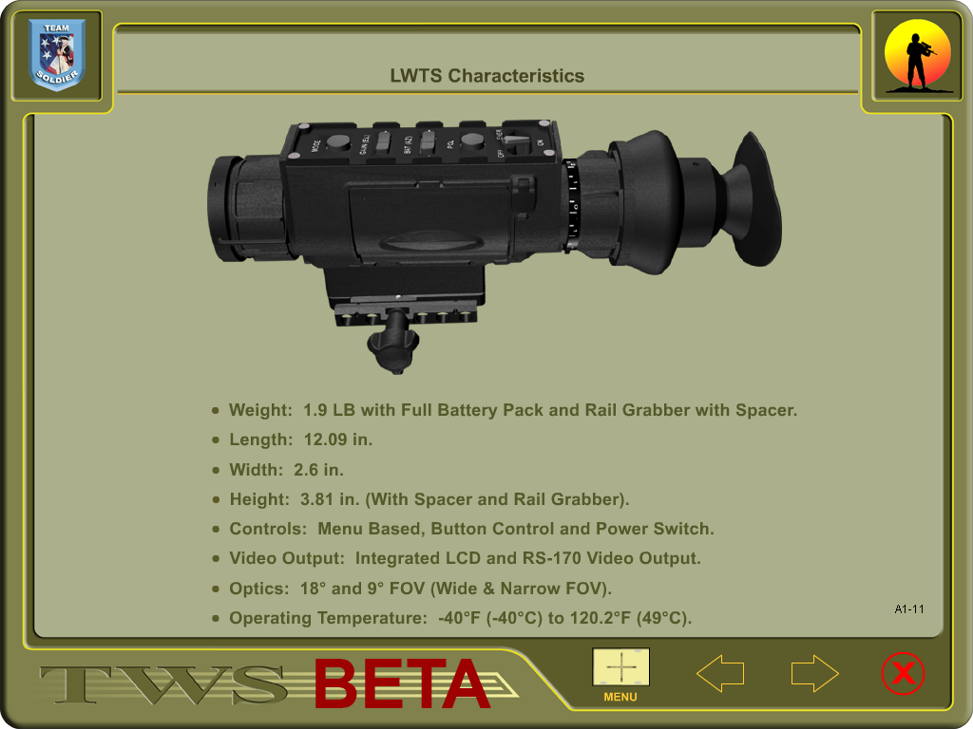
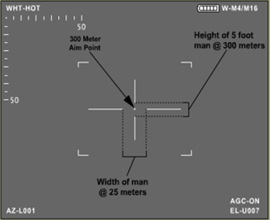
AIMING DEVICES
PAS-13D LIGHT WEIGHT THERMAL SYSTEM
TM 11-5855-324-10
DEMENSIONS
LENGTH | 12.9 in | 32.7 cm
WIDTH | 2.6 in | 6.06 cm
HEIGHT | 3.81 in | 9.67 cm
WEIGHT | 1.9 lbs. | 861.8g
ADJUSTMENTS
WFOV 1click=2.5 cm @ 25M
NFOV 2 click=1.25cm@ 25m
OP TEMP | -40ºF | 77ºF | 120.2ºF
Batt. Life
Lithium AA (L91) | 6.9 hrs. | 13.8 hrs. | 13.8 hrs.
E. Mode | 4.5 hrs. | 9.0 hrs. | 9.0 hrs.
Notes:
Military grade weapon thermal weapon sights are designed with the following ADVANTAGES:
● Small and lightweight.
● Real-time imagery. Devices provide real-time video of the thermal scene immediately after power on.
● Long-lasting battery life. Low power consumption over time.
● Reliable. Long mean time between failures (MTBF).
● Quiet. The lack of a cooling element allows for a very low operating noise level.
● One optic fits on multiple weapons. The use of the ARS rail mounting bracket allows for the same optic to be used on other weapons.
● The F- and G-models attach in front of other aiming devices to improve their capabilities and eliminate the zeroing procedures for the device.
These devices have limitations that Soldiers should take into consideration, particularly during combat operations. The PRIMARY DISADVANTAGES are:
● Cannot interpret (“see”) multispectral infrared. These systems view a specific wavelength for emitted radiation (heat variations), and do not allow viewing of all aiming and marking devices at night.
● Reliance on rechargeable batteries and charging stations. Although the batteries are common and have a relatively long battery life, additional equipment is required to charge them. If common non-rechargeable (alkaline) batteries are used, a separate battery adapter is typically required.
● Cannot interpret thermal signatures behind glass or water effectively.
● Thermal systems cannot always detect friendly marking systems worn by dismounts.

Slide 12
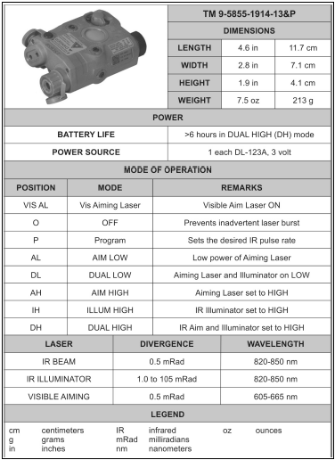
ADVANCED TARGET POINTER ILLUMINATOR
AIMING LIGHT (ATPIAL) AN/PEQ-15
Notes:
Pointers, illuminators, and laser devices for small arms weapons emit a collimated beam of IR light for precise aiming and a separate IR beam for illumination. These devices operate in one single mode at a time, as selected by the user. The laser is activated by a selector switch on the device or by a remote mechanism installed on the weapon. The basic two modes or functions are:
● Pointer. When used as a pointer or aiming device, a small, pin-point beam is emitted from the device. The IR beam provides an infrared visible point when it strikes an object or target. The IR beam operates in the 400 to 800 nanometer wavelength and can only be seen by I2 optics, such as the AN-PVS-7 or -14 night vision devices.
● Illuminator. Typically used to illuminate a close quarters area as an infrared flood light. The illuminator provides a flood-light effect
The AN/PEQ-15 ATPIAL is a multifunctional laser that emits both a visible and IR light for precise weapon aiming and target/area illumination.
● Visible light – can be used to boresight the device to a weapon without the need of night vision goggles. A visible red-dot aiming laser can also be selected to provide precise aiming of a weapon during daylight or night operations.
● Infrared laser – emit a highly collimated beam of IR light for precise weapon aiming. A separate IR-illuminating laser can be adjusted from a flood light mode to a single point spot-divergence mode.
CAUTION:
The AN/PEQ-15 can be used during force-on-force training in the low power modes only. High power modes can be used on live-fire ranges exceeding 220 meters only.
The ATPIAL visible and IR aiming lasers are co-aligned. A single set of adjusters moves both aiming beams, and the user can boresight/zero using either aiming laser.

Slide 13
CHECK ON LEARNING
AIMING DEVICES
What are the two common units of measurement?
● Minute of Angle (MOA)
● Milliradian (MIL)
What are the most commonly used aiming devices ?
● Iron Sight  Optics  Thermal  Pointer  Illuminator.  Laser
What are the reticle types most commonly used?
● Red Dot
● Bullet Drop Compensator
● Stadia Reticle (Stadiametric Reticle)
Notes:
Range overmatch provides a tactical engagement buffer that accommodates the Soldier’s time to engage with precision fires. For example, a Soldier that has the capability to effectively engage personnel targets at a range of 500 meters will have range overmatch of 10 to 20 percent over a threat rifleman. That 10 to 20 percent range difference is equivalent to a distance of 40 to 80 meters, which is approximately the distance a maneuvering threat can traverse in 15 to 40 seconds

