Slide 1
Introduction - i
Notes:
Ready and Resilient
Company Commander and First Sergeant PCC
Introduction
i
Introduction
Welcome to the Ready and Resilient module of the Company Commander and First Sergeant Pre-Command Course, part of a series of PME resilience modules that is designed to prepare Soldiers and leaders for the unique demands of military life and the challenge of operating in the garrison environment, operational deployments, and combat.
These resilience modules focus on building and sustaining individual and organizational resistance to adversity and strengthening mental toughness through leader skills, behaviors, and actions that can be learned, mentored, and practiced.
Leaders participate in the Ready and Resilient Company Commander and First Sergeant Pre-Command Course and discuss the principles and concepts of resilience, effective leader actions, and behavioral health. Leaders have always been responsible for taking care of Soldiers; being resilient is not a new concept, it has always been a fundamental part of being a leader.
Recommendations for Selecting an Instructor:
Choose a Performance Expert (PE) if you have an R2 Performance Center on your installation.
Choose a former CDR and/or 1SG (preferably someone who is a Master Resilience Trainer) to lead the training because they have both “been there and done that” and will have credibility.
Choose a Master Resilience Trainer (MRT) who is an excellent presenter and who has been active in his or her company to lead this training.
Instructor Guidance:
Before presenting this lesson, instructors must thoroughly prepare by studying this lesson: PowerPoint Presentation (Notes View has the Instructor SmartGuide).
Prior to instructing the module, make copies of handouts for each person.

Slide 2
SmartGuide Format - ii
Notes:
ii
Trainer’s Guide Format
Ready and Resilient (CCFSPCC)
Trainer’s Guide Format
The Trainer’s Guide has been designed to be user-friendly while containing as much information as possible to help you present the Ready and Resilient: Company Commander/First Sergeant Pre-Command Course.
A content guide can be found in the Notes section on the PowerPoint, this will be visible to the presenter in the Presenter View. Numbered Italics
briefly describe the key points that must be covered to meet the intent of the slide. These are followed by more details or instructions.
The key points tell you what you need to do, while the extra notes explain how to do it.
When you start preparing to train each module, you should read all of the detailed information. When you become more familiar with the material, the highlighted key points will be enough to remind you how to train each slide effectively.

Slide 3
SmartGuide Format - iii
Notes:
iii
The table below explains the meaning of the symbols used throughout the guide.
Ready and Resilient (CCFSPCC)
Symbol Represents Explanation
 Timing
This symbol indicates the amount of time allotted for a given section of the material.
◎ Target / Intent
This symbol indicates the main function or rationale for a given slide.
1. Key Point
Numbers and text highlighted in yellow are used to indicate the main points that must be addressed in order to meet a given slide’s target / intent.
Sample Script
Bullets are used to elaborate on key points by providing a potential script that the trainer can use.
[TEXT] Note to Trainer
Bracketed text indicates a note to the trainer which is not intended to be read aloud. These provide hints on how to present the material and tips to avoid potential issues that may arise within a given topic.
Multimedia
This symbol indicates the use of supplementary audio/video files. To avoid down-time or technical difficulties, keep an eye out for these and plan accordingly.
 Handouts
This symbol indicates that the participants will use handouts at a given point in the module. To avoid down-time, keep an eye out for these and plan accordingly.
Exercise
This symbol indicates the start of an exercise or activity. To avoid down-time, keep an eye out for these and plan accordingly.
[?] Discussion Question(s)
This symbol identifies when there is a non-rhetorical discussion question(s) in the instructional content that follows.

Slide 4
Terminal Learning Objectives - iv
Notes:
iv
Ready and Resilient (CCFSPCC)
The task is to conduct the Ready and Resilient module for the CCFSPCC.
The conditions are, given a classroom environment, future Company Commanders and 1SGs, Army policies and regulations, and embedded training scenarios.
The standards are to encourage leaders to develop a Command philosophy that integrates and supports the Army Ready and Resilient (R2) mission and a culture of trust by
Identifying components of the Army’s R2 mission
Incorporating R2 considerations into all decision-making
Empowering subordinate leaders to help maintain effective R2 programs IAW DoD and Army regulations and policies
Explaining the importance of developing and maintaining a culture of trust within the organization
Tasks Conditions Standards
Tasks Conditions Standards
The task is to conduct the Ready and Resilient module for the CCFSPCC.
The conditions are, given a classroom environment, future Company Commanders and 1SGs, Army policies and regulations, and embedded training scenarios.
The standards are to encourage leaders to develop a Command philosophy that integrates and supports the Army Ready and Resilient (R2) mission and a culture of trust by
Identifying components of the Army’s R2 mission
Incorporating R2 considerations into all decision-making
Empowering subordinate leaders to help maintain effective R2 programs IAW DoD and Army regulations and policies
Explaining the importance of developing and maintaining a culture of trust within the organization

Slide 5
Ready and Resilient
Company Commander and First Sergeant Pre-Command Course
Notes:
Record your own notes here:
Ready and Resilient (CCFSPCC)
1
Ready and Resilient (CCFSPCC): 2 Hours
Introduce yourself and the module.
1. Introduce yourself.
[NOTE: Let the leaders know who you are and how you came to be teaching them the Ready and Resilient CCFSPCC.]
Welcome to the Ready and Resilient, or R2, module of the Company Commander/First Sergeant Pre-Command Course.
My name is __________________ and I will be your instructor for this lesson.
I will be teaching and facilitating throughout this module.
The module is designed to further prepare you for the human aspects of leading your company.
2. Introduce students to the lesson.
I’ll be guiding you through this module, but success depends upon you.
Your participation, your experiences, your questions, and your perspectives are essential to making this course meaningful and relevant.
The topics we will cover are informed by the latest research in effective leadership and resilience in military applications.
I am looking for you to actively participate in small- group and large-group discussions.
During these, you will be able to hear others’ perspectives and experiences and share your own.

Slide 6
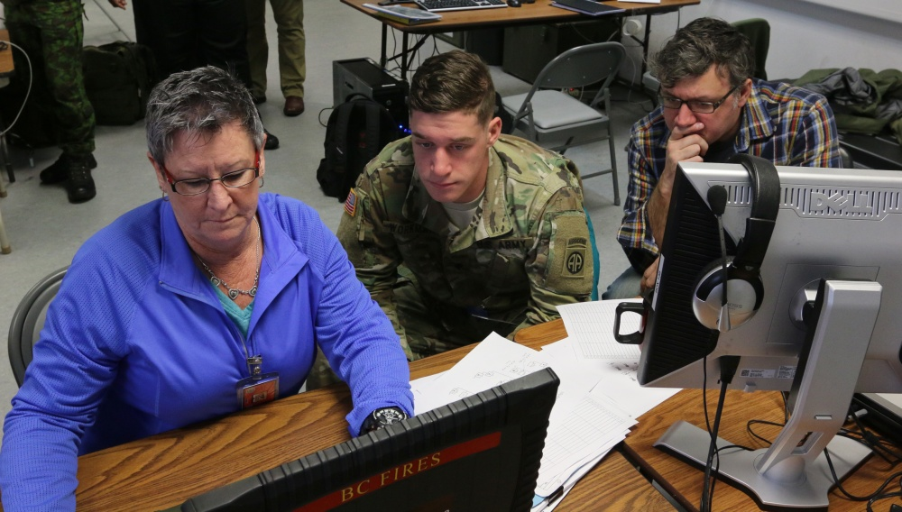
Ready and Resilient (R2)
“Our people must be physically, psychologically, socially, and spiritually ready and resilient to thrive in military life’s uncertainties, or at least be prepared to thrive. Leaders must understand the importance of this softer science of readiness.”
~COL Tammie Pettit, I Corps R2 Director
Notes:
Record your own notes here:
3
Ready and Resilient (CCFSPCC)
Discuss the quote about R2.
1. Discuss the quote. [?]
Soldiers are typically highly trained in specialty skills, but may not be as proficient in the softer skills of readiness.
These are often the elements that lead to non-deployability and are harder to prevent.
[ASK] What are some of these softer skills?
[NOTE: Allow for some discussion.]

Slide 7
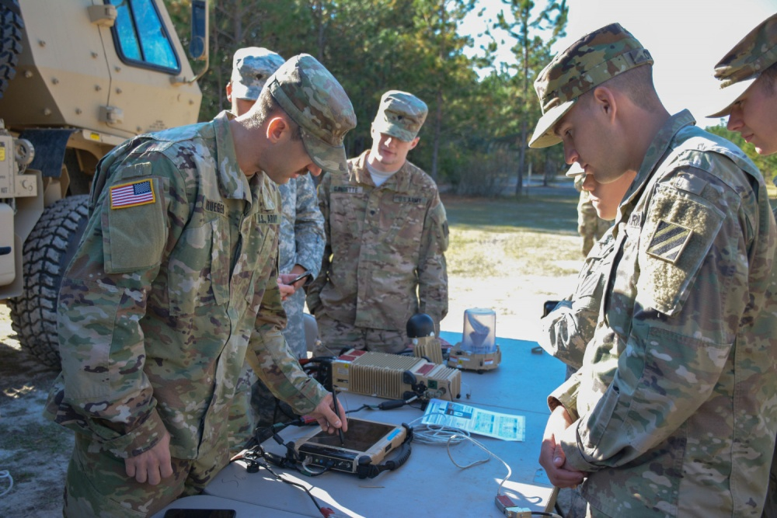
Training Overview
Leadership
Culture of Trust
Empower Subordinate Leaders
Notes:
Record your own notes here:
5
Ready and Resilient (CCFSPCC)
Introduce the training overview for the CCFSPCC.
1. Introduce the training overview.
In this course, we will be focusing on leadership and two specific ways you can impact your company to improve readiness and resilience.
Understanding what trust is and how it works will help shape your decision-making throughout your time in command and responsibility.
Developing a culture of trust in your unit is crucial to your success and is foundational for this module.
This concept will be interwoven throughout this module.
We will also talk about how you can empower your subordinate leaders – including your MRTs – to grow as teachers, coaches, and mentors that will hopefully promote and reinforce a culture of trust.

Slide 8
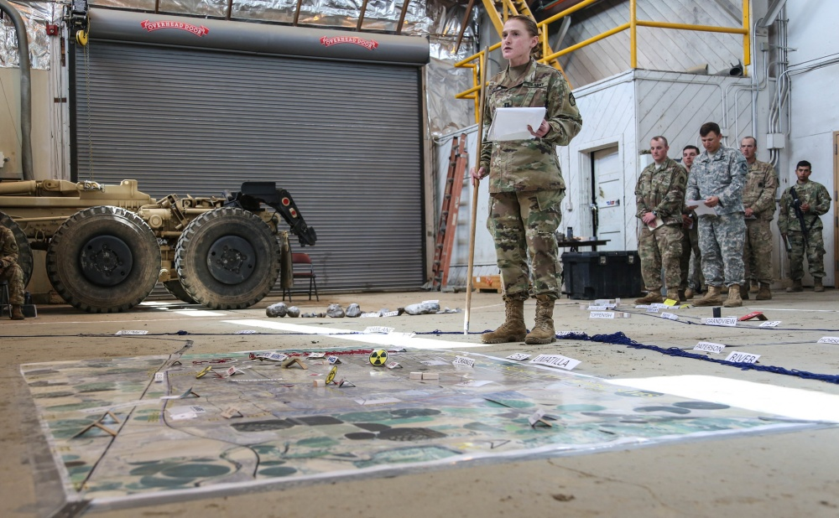
Leadership
Leadership is a great responsibility…
…and a great privilege.

Notes:
Record your own notes here:
Ready and Resilient (CCFSPCC)
7
◎ To provide a foundation for the training.
[SLIDE BUILDS]
1. Provide an opportunity to discuss upcoming responsibilities as CDR/1SG. [?]
Here is your first opportunity to start participating.
You will have a lot of responsibilities as a CDR or a 1SG.
[ASK] What responsibilities are you looking forward to?
[NOTE: Allow for some discussion.]
[ASK] What responsibilities are not quite as exciting to think about?
[NOTE: Allow for some discussion.]
With those lists you created, it’s safe to say that you can anticipate a great deal of responsibility and many challenges as you take on your new role.
You have been provided the opportunity to lead from the front and bring the Army Values to life in your unit.
[CLICK TO ADVANCE]
2. Encourage leaders to consider the privilege of leadership and the legacy they will leave. [?]
We’ve discussed some of the general responsibilities of leadership but we should also keep in mind that leadership is a privilege.
Your selection as CDR or 1SG affords you the opportunity to make a lifelong impact on those you lead.
Let’s take a moment and consider how you will use this privilege to improve your organization and the Army as a whole.
Think about the influence you have to lead, develop, and achieve.
You set the tone for the culture in your company.
It is your turn to think more about what you want for your Soldiers.
Keep in mind that your influence doesn’t stop with your Soldiers – for many of them – they will carry your influence home with them to their Families.
 [NOTE: Pass out the handouts if you haven’t already.]
Take time with your counterpart or someone who has the other role to discuss each question on the legacy page and write down a few notes.
[NOTE: Allow 5-8 minutes for pair discussions.]
That was the start of the conversation about the legacy you hope to leave.
Hopefully this module will help you think through how you will engage with Soldiers in your unit, work with your counterpart, and grow because of the situations you face.
Although it is true that there are protocols for dealing with certain situations, it is also true that dealing with many of the challenges of life do not have an SOP.
This module is focused on the human aspect of leading.
Let’s take a look at how the Army Resiliency Directorate is working to facilitate the growth and development of Soldiers throughout their careers.

Slide 9
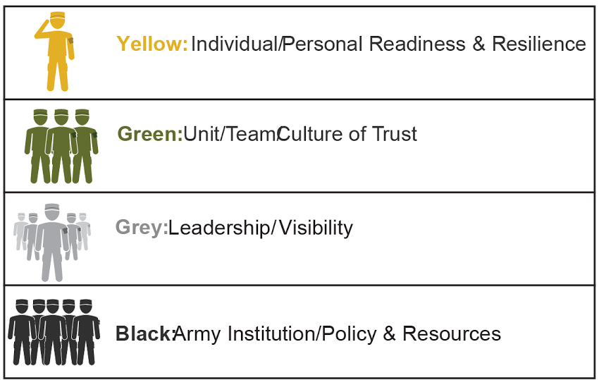
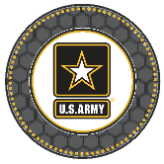
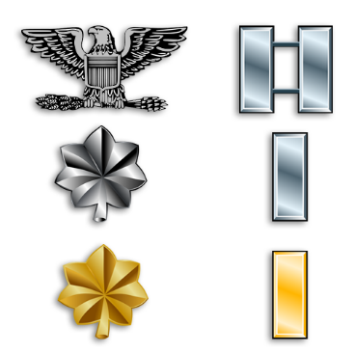
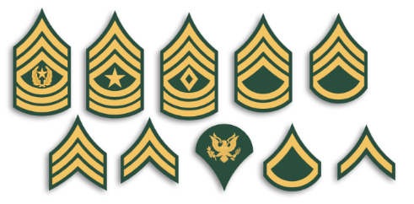



R2 Soldier for Life Lifecycle
Provide guidance to commanders to integrate R2 skills in long-term training plans; identify opportunities based on unit needs; Leverage SMEs at R2 Performance Centers
Use evaluation tools to provide guidance for targeted R2 skills straining for subordinate units; Lever SMEs at R2 Performance Centers
Quality assurance of Platoon Leaders re: R2 skills implementation; Leverage SMEs at R2 Performance Centers
Quality assurance of Squad Leaders re: R2 skills implementation
Embed basic R2 skills within the Total Army Concept (Soldiering Tasks, MOS tasks)
Execute Targeted Training based on Commander Assessment
Engage - Inprocessing
Use foundational (self-regulation) R2 skills with targeted Soldier and Officer tasks
R2 Efforts
Entry to Service
IMT
Initial Military Training
Move to
Installation
Unit
Squad
Leaders
Platoon
Leaders
Company
Leaders
Battalion
Leaders
Brigade
Leaders
R2 Coaching/Integration/Skill Reinforcement encouraging personal & professional growth
Notes:
Record your own notes here:
9
Ready and Resilient (CCFSPCC)
Explain the ARD Soldier for Life Lifecycle.
1. Explain the Army Resiliency Directorate’s lines of effort.
Within ARD, there are four lines of effort: performance enhancement, resilience, substance abuse, and suicide prevention.
2. Explain how R2 training is integrated within the Soldier lifecycle.
Thinking about a Soldier’s life cycle in the Army, you see the timeline starting with “entry to service” and moving through the various schools that Soldiers attend.
The goal of R2 curriculum is to target the development of the mind and body by training specific concepts and skills to improve wellbeing, relationships, and performances.
ARD’s strategy is to target Soldiers throughout their Army-career life cycle so at the entry level, the Soldier is focused on him or herself.
When moving to positions of leadership, Soldiers will have courses that focus on applying the psychological concepts and skills as they teach, coach, counsel, mentor, and manage.
Finally, as leaders move to positions of strategic leadership, they will focus on how to develop a resilient organization.

Slide 10

Who’s On Your R2 Team?
Installation Capabilities
Performance Experts (PEs)
Community Ready and Resilient Integrator
Risk Reduction Program Coordinator
Ready and Resilient Program Manager
Suicide Prevention Program Manager
Substance Abuse Program Manager
Unit Assets
Master Resilience Trainers (MRTs)
UPL
Notes:
Record your own notes here:
Ready and Resilient (CCFSPCC)
11
◎ Introduce installation and unit assets with an R2 mission.
[SLIDE BUILDS]
1. Briefly discuss installation-level assets with an ARD mission focus.
This is a list of R2 resources that are primed to support you in your leadership role.
We are going to focus on 2 specific roles within your ARD team – PEs and MRTs.
[CLICK FOR BOLD]
At the installation level, there are Performance Experts, or PEs for short.
All PEs have a graduate degree in sport or performance psychology, and their expertise is in helping leaders and Soldiers apply the concepts in any type of performance (e.g., BRM, APFT, STX lanes, FTX, EFMB, test taking).
They are available to facilitate the application and coaching of mental skills.
2. Discuss unit-specific assets with R2 capabilities.
You have specific unit assets as well.
Master Resilience Trainers are leaders who have been through a 2-week course to learn positive and performance psychology concepts and skills.
Their current capabilities include teaching the 14 resilience skills; however, the MRT program is evolving so changes are coming.
When it comes to the readiness and resilience of your Soldiers, 1 PowerPoint a month is not going to be a quick fix for your company.
These resilience concepts and skills need to be intentionally applied.
3. Discuss Deployment Cycle Resilience Training
In addition to resilience training, your MRT is able to be trained to teach the mandatory Deployment Cycle Resilience Training (DCRT), formerly Battlemind.
This training prepares Soldiers, leaders, and Spouses for the transitions they will face through the deployment cycle.
If you have Soldiers in your unit who will deploy for more than 90 days, this training is required for Soldiers 1-6 months before deployment, +/- 1 month of redeployment, and 3-6 months after redeployment.
The training for Spouses is mandatory to offer; however, you cannot mandate that Spouses attend.
Facilitated discussion topics include: expectation management, communication, adjustments after redeployment, help-seeking behaviors, and growth through the deployment.
This training has shown to decrease depression, anxiety, and PTSD symptoms as well as improve sleep.
Let’s think about how you can empower your MRT to not only live these skills and concepts, but to teach, coach, and mentor them too.

Slide 11
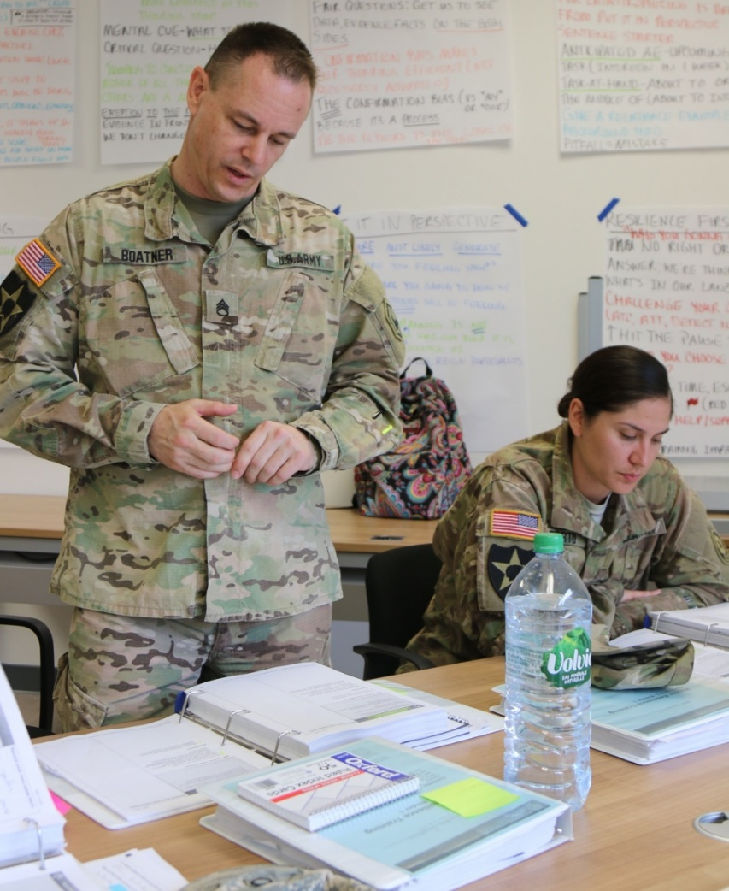
How to Develop Your MRT
How can you use your MRT team to benefit your unit?
Start early and discuss expectations with your MRT team to apply and coach concepts and skills
Integrate your MRT team into training meetings so they can figure out which competencies they may target for specific events
Bring in Performance Experts to demonstrate and mentor your MRT
Know the MRT’s limits (may need to utilize BH or Performance Experts) and use them accordingly
Notes:
Record your own notes here:
Ready and Resilient (CCFSPCC)
13
Discuss ways to develop and involve your MRT in leading a cohesive, resilient, and high-performing organization.
1. Discuss the importance of starting early and discussing your expectations of MRT.
[NOTE: You may use the video to cover this topic.]
MRTs are prepared to conduct resilience training, but there is much more that they can offer whether they know it or not.
One way that you can empower your MRTs—some of your subordinate leaders—to apply these concepts and skills is by discussing your expectations with them.
Be as specific as possible about what you want to achieve.
For example, you might want them to figure out what could be applied through hip pocket training the week prior to the M16 range.
An MRT may encourage Soldiers to focus on some or all of the fundamentals of marksmanship while on the on the range rather than focusing on their missed shots.
For example, if/when a Soldier misses a target, he or she might have thoughts like “I should have hit that target, now I’m going to bolo this range.”
This thought drives frustration and causes the Soldier to tense up potentially contributing to more missed shots.
Refocusing on breathing or sight picture changes a Soldier’s thought and these thoughts may decrease frustration and tension in muscles.
This is foundational to MRT— Thoughts drive Emotions and Reactions.
2. Highlight the benefit of having an MRT support in training and strategy meetings.
If your MRTs are primed to apply their skillsets, it will be beneficial to have them in training meetings as they can provide insight into how to integrate the skills you want your unit to develop or enhance.
For instance, your company has a 12-mile ruck march coming up.
Your MRT might anticipate Thinking Traps that Soldiers might fall into before and during the event. Thoughts like:
I’m never going to finish. (Always, Always, Always)
My leaders didn’t prepare me for this. (Them, Them, Them)
An MRT could do some opportunity training to discuss these and how to take other perspectives, building self-awareness, and improving self-regulation.
Afterward, the MRT could provide comments in the AAR to reinforce training principles.
3. Discuss the importance for MRTs to use reach back capabilities if necessary.
Your MRTs may not have the confidence to apply these skills without the PowerPoint in the background.
To help guide them, one option would bring in a PE from the R2 Performance Center to demonstrate how to do this and mentor your MRT while supporting your company.
Another option is to ask the MRT to reach back to the R2 Performance Center to get input from the PEs.
Explain the importance of recognizing your MRT’s limits.
Just as it is important for the MRTs to know their limits, you should also know their limits.
It would be unwise to place your MRTs in circumstances that are more complex than they are trained to handle.
Always consult your MRT and apply your own professional judgement in situations that may warrant a greater specialization.
Let’s start thinking about trust.

Slide 12
Fact or Fiction
Competence is always the primary factor in trust.
Fact
OR
Fiction
Notes:
Record your own notes here:
Ready and Resilient (CCFSPCC)
15
Establish that trust is based on a combination of factors that are equally important.
1. Explain that competence is not the primary factor but one of the factors in trust. [?]
[ASK] Look at the statement on the slide. Do you think this statement is fact or fiction?
[NOTE: Allow for some discussion.]
If you said fiction, you are correct.
[NOTE: If they answer the question below, skip it.]
[ASK] How might someone be very competent at certain tasks, but not someone you would trust?
[NOTE: Allow for some discussion.]
Competence is very important, but it must be combined with character and commitment.

Slide 13
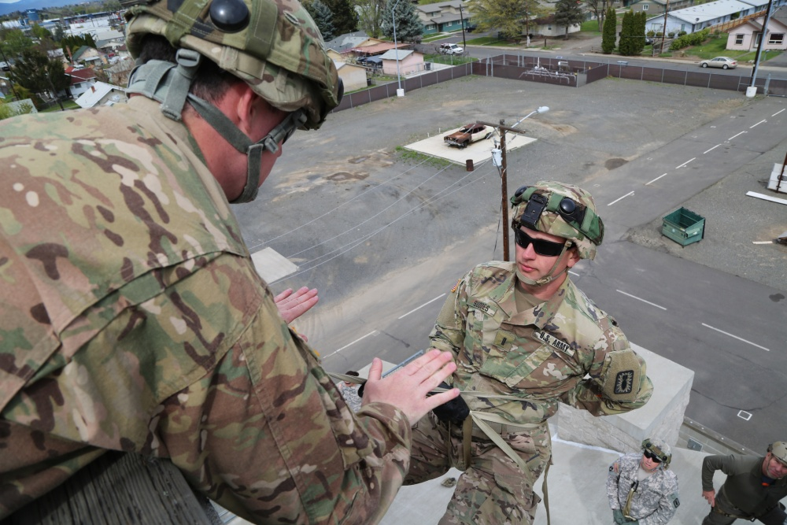
Trust
Why do your Soldiers trust you?
Why does your Command trust you?
Trust—the assured reliance on the character, ability, strength, or truth of someone or something (ADP-1)
What might happen in a company if the CDR and 1SG don’t trust each other?
What might you observe when a unit has a high level of internal distrust?
Notes:
Record your own notes here:
Ready and Resilient (CCFSPCC)
17
◎ Introduce trust as a foundation of relationships and the impact of trust lost between the CDR and 1SG.
[SLIDE BUILDS]
1. Define trust and its role in the foundation of relationships. [?]
[ASK] Why do your Soldiers trust you?
[ASK] Why do your superiors trust you?
[NOTE: Allow for some discussion. Categorize each answer into one of the following categories
Sets personal example for trust
Takes direct action to build trust
Sustains a climate of trust
These are categories from ARDP 6-22 under leader competency Builds Trust.]
[CLICK TO ADVANCE]
Trust is defined as “the assured reliance on the character, ability, strength, or truth of someone or something.”
You are in a challenging position because you have competing elements above and below you.
It is imperative that you, as a command team, be able to trust each other.
2. Discuss the potential impact on the unit if the CDR and 1SG don’t trust each other. [?]
[CLICK TO ADVANCE]
[ASK] What might happen in a company if the CDR and 1SG don’t trust each other?
[NOTE: Allow for some discussion. Answers should include
Splitting and general lack of cohesion
Breakdown in communication
Suspicion and doubt
Inefficient work
Favoritism and unethical behavior]
[CLICK TO ADVANCE]
[ASK] What might you observe when a unit has a high level of internal distrust?
[NOTE: Allow for some discussion.]

Slide 14
Elements of Trust
Trust
Character
Competence
Commitment
Notes:
Record your own notes here:
Ready and Resilient (CCFSPCC)
19
Introduce elements of trust from Army doctrine.
1. Introduce elements of trust from various Army resources.
Character, competence, and commitment are three elements of trust.
You have seen or will see these during a CAPE brief.
We want to continue the discussion in contexts specifically related to resilience and leadership.
If you demonstrate these 3 elements to others, you are more likely to be trusted.
Trust is earned.
You cannot order your Soldiers to trust you.
You can order them to obey you because of your rank and role.
Another way to think about this: are you willing and able to work for another’s best interest?
If so, people are more likely to trust you.
[NOTE: Connect any comments made about why people trust you, why you trust people, or other relevant feedback you have received so far. Examples include: Army Values could reflect character, getting the job done efficiently could reflect competence.]
This information on trust is derived from several Army resources which are identified in the handout you will receive at the end of class.
Let’s start with character.

Slide 15
Elements of Trust
Trust
Character
Competence
Commitment
Notes:
Record your own notes here:
Ready and Resilient (CCFSPCC)
21
◎ Define character and its role as a part of leadership and trust.
1. Define character and its part in leadership.
Character is comprised of a person’s moral and ethical qualities.
Character is what helps determine what is right and gives a leader motivation to do that regardless of the circumstances or consequences.
An informed ethical conscience consistent with the Army Values strengthens leaders to make the right choices when faced with tough issues.
Character is critical.
If you have internalized the Army values, they will often guide your behaviors without you even being aware of it.
2. Explain the relationship between character in trust within the command team.
If you know that your command team counterpart will act unwaveringly in accordance with the Army Values, you have a better idea of what to expect.
If you and your counterpart have differing opinions, this is a great time to have a conversation about priorities, values, and beliefs to maintain transparency and build trust.
3. Discuss ways to develop character in subordinate leaders and Soldiers using the Army Values. [?]
An essential leadership challenge is to encourage your subordinate leaders and your Soldiers to live these values.
[ASK] What are strategies that you know have helped Soldiers internalize the Army Values?
[NOTE: Allow for some discussion and encourage participants to make note of useful strategies mentioned.]
Becoming a person and leader of character is a process involving day-to-day experience, education, self-development, developmental counseling, coaching, and mentoring.
While individuals are responsible for their own character development, leaders are responsible for encouraging, supporting, and assessing the efforts of their people.
Leaders of character develop through continual study, reflection, experience, and feedback.

Slide 16
Elements of Trust
Trust
Character
Competence
Commitment
Notes:
Record your own notes here:
Ready and Resilient (CCFSPCC)
23
Highlight the element of competence as it relates to trust.
1. Define competence.
Being able to do your job in the Army is important— technical and tactical proficiency are foundational to being a good Soldier, NCO, or Officer.
The ability to perform your job (commensurate with skill level) and properly respond to threats to your safety and the safety of others is expected of every Soldier in every situation.
In some jobs, survival is inherently at risk.
We place more trust in people who are competent rather than those who are incompetent.
As leaders, you are expected to be prepared for both foreseen and unforeseen challenges.
You may not have a specific competency when an unexpected challenge arises, but you know the Army and you should know your Soldiers well enough to deal with that challenge.
Your demonstrated problem-solving abilities can help you effectively navigate many of these situations.
2. Explain that pursuing greater levels of competence is expected throughout leaders’ Army careers.
Another expectation within the Army is that you continue to deepen and broaden your knowledge of the Army, your unit’s mission and equipment, and other subjects/factors.
These can lead to increased competence just like you’ve done with your knowledge and skills since your first day in Initial Military Training.
As you continue to increase your leadership competence, you will be able to mentor subordinate leaders more effectively and influence their growth so they will be able to better impact their Soldiers in effective ways.
Leaders must lead from the front.
Set the example.
Leaders who stay a safe distance from risk destroy their subordinates’ trust and confidence in them.
Trust may take time to build.

Slide 17
Elements of Trust
Trust
Character
Competence
Commitment
Notes:
Record your own notes here:
Ready and Resilient (CCFSPCC)
25
Highlight the element of commitment as it relates to trust.
1. Define commitment. [?]
Gen Odierno the 38th Chief of Staff of the Army said, “We will foster a continued commitment to the Army Profession, a noble and selfless calling founded on the bedrock of trust.”
Commitment is an Army professional’s resolve to contribute honorable service to the Nation and accomplish the mission despite adversity, obstacles, and challenges.
[ASK] What is the difference between compliance and commitment?
[NOTE: Allow for answers.]
Demonstrating commitment requires the resilience to cope with, recover from, and learn from setbacks.
Commitment generally produces longer-lasting and broader effects.
Whereas compliance only affects a follower’s behavior, commitment reaches deeper—changing attitudes, beliefs, and behavior.
Just like Soldiers may have a “check the block” attitude about some tasks, you may also find yourselves falling into that trap. too.
[ASK] What can you do when you find yourself modeling compliance rather than commitment to your Soldiers, subordinate leaders, and job?
[NOTE: Allow for responses.]
2. Describe how commitment is grown and modeled.
Commitment grows from an individual’s desire to gain a sense of control and develop self-worth by contributing to the organization.
When a leader builds responsibility among followers, they will likely demonstrate more initiative, personal involvement, and creativity.
Depending on the influence objective, leaders can strengthen commitment by reinforcing followers’ identification with the nation (loyalty), the Army (professionalism), the unit or organization (selfless service), the leadership in a unit (respect), and to the job (duty).
When people see you are going to be consistent and have committed to the person or organization, their trust for you deepens.
They see your behaviors day in and day out and they are confident that you will maintain these behaviors.

Slide 18
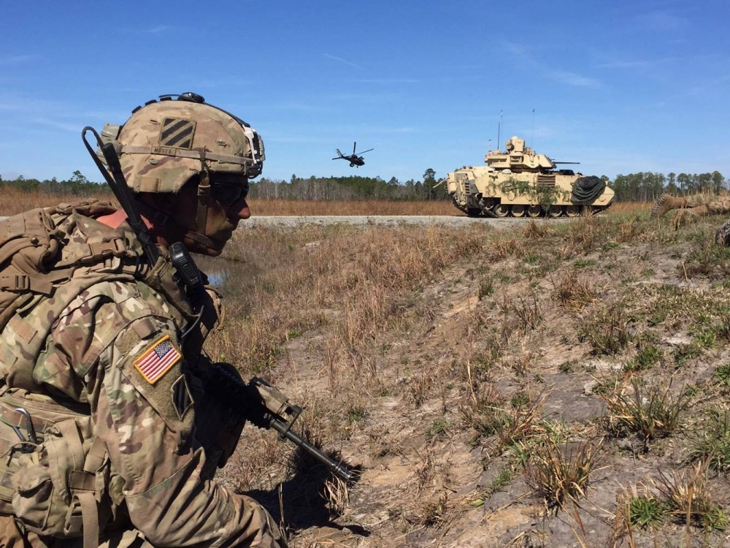
Elements of Trust
Perceptions matter
Notes:
Record your own notes here:
Ready and Resilient (CCFSPCC)
27
Explain that the perceptions others have of how you balance the elements of trust will inform the degree to which they trust you.
1. Explain that others’ perceptions of how you demonstrate character, competence, and commitment impact how much they trust you.
How people perceive you regarding character, competence, and commitment will lead to their estimation of your trustworthiness.
This perception is not built on your work performance alone but also on how you interact with the community, your Family and friends, and your presence on social media.
Because trust is relational, communication and accountability are critical.
When there are breakdowns in communication, trust is often a casualty.
Accountability is important for all 3 elements of trust.
Soldiers need to know that you are working to build and maintain trust.
As we already discussed, you cannot order others to trust you.
You can order them to obey you because of your rank and role.
Trust is earned.
It’s not always that easy, though, as complications do arise in relationships.
In fact, some people are less likely to trust because of their own experiences.
In such cases, it may take longer to build trust, and you may have to figure out the elements of trust that are most important to them.

Slide 19
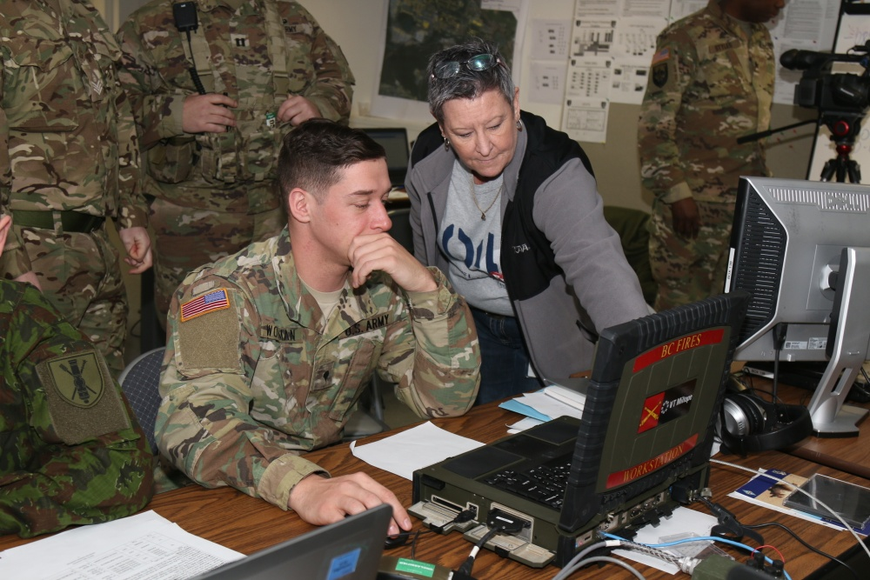
Fostering a Culture of Trust in Your Unit
Consistently
  Include trust as a topic in professional development and performance counseling
  Be candid with communication
  Balance mission with the welfare of Soldiers and their Families
  Know others’ baselines and respond to variations
  Give trust to get trust
Notes:
Record your own notes here:
Ready and Resilient (CCFSPCC)
29
Discuss ways to foster a culture of trust, define and explain “baselines”, and discuss the risk involved in trust.
1. Identify actions that can foster a culture of trust.
[NOTE: You may use the video in place of teaching the Key Points. Discuss the questions in Key Points 3 and 4.]
On the screen, there is a list of things you can and should do to make trust part of the battle rhythm of your unit.
As you look at this list, you can see that character, competence, and commitment are implied throughout the list.
2. Explain how to foster trust with Families.
Having the trust of your Soldiers is crucial.
Having the trust of their Families is also key to successful company leadership (FM 6-22, Table 7-31).
Considering your decisions in order to balance mission accomplishment with the welfare of Soldiers and their Families.
Ensuring subordinates’ and their Families’ health, welfare, and development are provided for.
Speaking with the team (unit) and their Families to determine how you can better serve them.
3. Discuss the effects that a challenging Family can have on the unit and ways to manage the situation. [?]
[ASK] What are the effects on a company with a particularly challenging Family? How will you and your subordinate leaders deal with this?
[NOTE: Allow for some discussion. Answers should include
Effects can be division between Soldiers and their Families
Soldiers being distracted from work
Reduced productivity and dependability on the Soldier which impacts daily operations, training, and readiness
Managing is part of the art of leadership
MRT training might be helpful for the Spouse as well as a leader Spouse (of the same gender) taking a coach or mentor role
If the following point is not discussed, make sure it is discussed.]
Foster positive behaviors in Families.
If you highlight these behaviors, they may echo through the company.
4. Discuss baselines. [?]
Notice also that there is a relational aspect of trust when considering communication, and in knowing and responding to variations in baselines.
Let’s talk more about baselines and their importance for any leader or Soldier.
A baseline can be defined as simply a reference point, a basis for future comparison.
Your familiarity with how someone you routinely interact with, their normal level of functioning and productivity, attitude, level of involvement, range of emotion, etc. informs their “baseline”.
[ASK] Why is it important to determine your counterpart’s, subordinate leaders’, Soldiers’, and loved ones’ baselines?
[NOTE: Allow for some discussion. Answers should include
So you know what normal looks like
So you can see if there are variations]
Another way to phrase this is attunement.
Being attuned means you know what makes them tick, you know what a good day looks like, and you know what a bad day looks like.
Deviations from baseline may indicate that a person is experiencing life challenges they may need help with.
Likewise, behavior inconsistent with a baseline might indicate personal growth and maturity.
In either case, recognizing and responding to changes will build the trust connection.
Consider if you are attuned to your counterpart, your subordinate leaders, your Soldiers, and your loved ones.
5. Discuss the risk inherent in trust.
Giving trust is a risk.
Often in order to be trusted as a leader, you have to show that you are willing to take a risk and trust your junior leaders…first.
By leaning on them and enlisting their help, you are demonstrating trust in them.
Of course, blind trust is not always wise so do your due diligence before deciding who to trust with what.

Slide 20
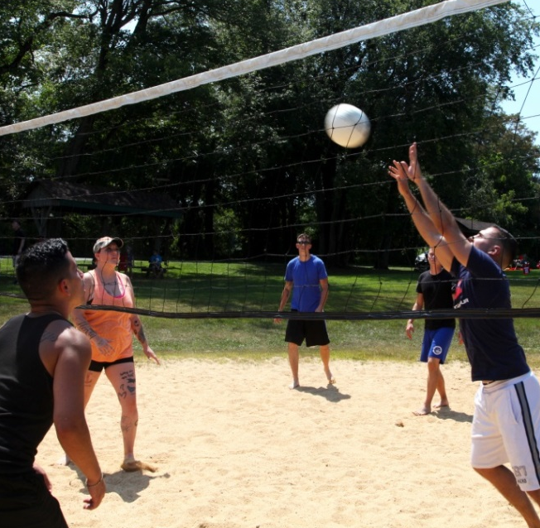
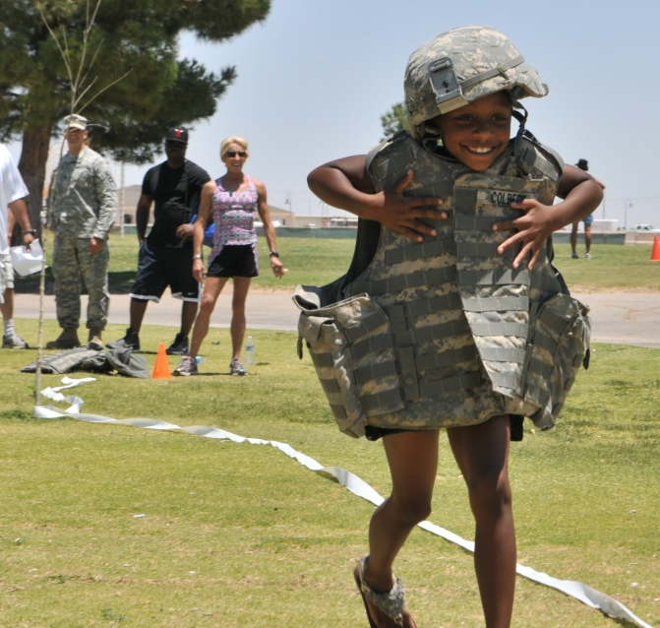
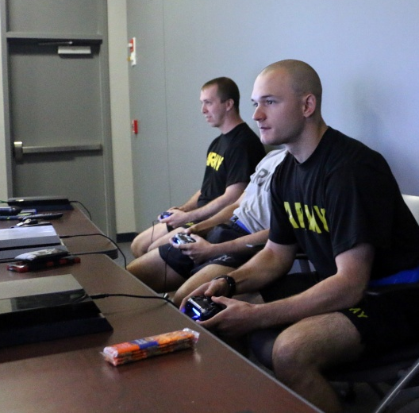
What Would You Do If…
It’s your Organizational Day and your counterpart insists that all Soldiers participate in two of the physical activities or competitions. He/She expresses the desire to treat everyone equally and expects everyone to participate. Your counterpart’s perspective is: “No special privileges for anybody – strength and competition are the Army way!”
What would you do?
Notes:
Record your own notes here:
Ready and Resilient (CCFSPCC)
33
Discuss the leader challenge scenario related to fairness.
1. Read and discuss the leader challenge scenario. [?]
[NOTE: Have a volunteer read the scenario on the slide.]
[ASK] What do you think about this method of developing strengths and capabilities of Soldiers?
[NOTE: Allow for discussion.]
[ASK] What are potential issues with this strategy?
[NOTE: Allow for discussion.]
This leader is concerned about fairness.
Standards are needed in the Army.
[ASK] How might Soldiers who don’t enjoy these types of physical and competitive activities perceive this requirement?
[NOTE: Allow for responses.]
Fairness is a good standard—so is everyone pulling together—but that doesn’t always mean treating everyone the same.
An Org Day setting is a great time to encourage Soldiers to share those talents.
2. Discuss the potential consequences of a lack of flexibility. [?]
An Organizational Day is designed to increase esprit de corps and bonding, so it should be inclusive and not just focused on physical activities.
The leader in this example is holding everyone to the same requirements in a non-critical circumstance.
This could erode trust with some Soldiers who don’t see that you have their best interests in mind.
[ASK] What might be some consequences of this rigid thinking that can sometimes mimic fairness?
[NOTE: Allow for discussion. Answers should include
Soldiers feeling uncared for
Decrease in esprit de corps
Soldiers feeling stressed rather than enjoying the day
Fear of performance-related judgement/letting their buddies down
Social isolation]
3. Discuss ways to make “mandatory fun” fun. [?]
[ASK] What are some ways to make “mandatory fun” more fun for all involved?
[NOTE: Allow for discussion. Answers may include
A fun land navigation challenge, scavenger hunt, or card game is also great addition since they are not just about strength, coordination, and stamina.
Having Soldiers working the grill, serving food, or doing face painting for children are other ways to encourage participation.]
Today's Army requires a wide range of talents, and not all involve brute strength or athletic prowess.
Alternate, less physical events can be great for including Families.
One way to build trust is to ask for and consider input from Soldiers.
Soldiers’ perceptions of you will be part of your legacy.

Slide 21
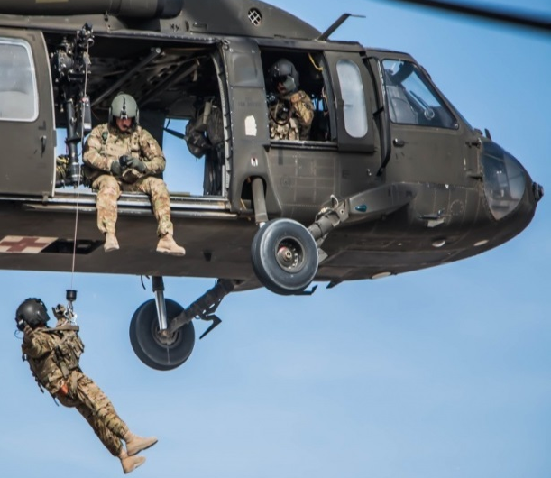
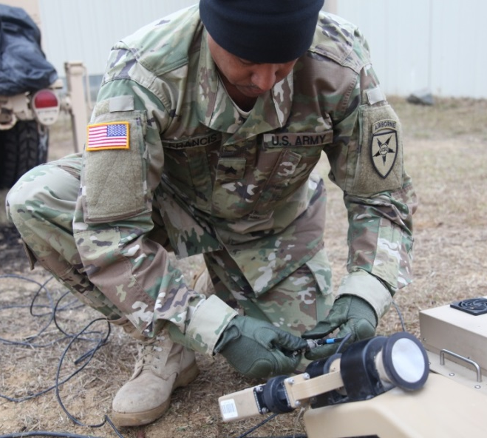
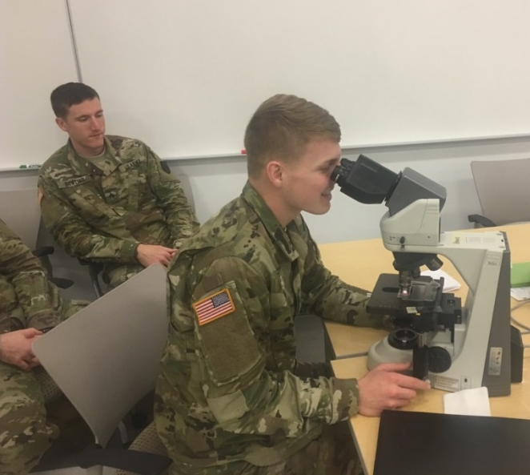
What Would You Do If…
You see your counterpart always calling on the same 4 or 5 NCOs and Soldiers to get things done and set the standards.
What would you do?
Notes:
35
Record your own notes here:
Ready and Resilient (CCFSPCC)
◎ Introduce the leader challenges scenario as a basis for a discussion on favoritism.
1. Read and discuss the scenario. [?]
[NOTE: Have a participant volunteer to read the scenario on the screen aloud.]
[ASK] What do you think about this method of developing strengths and capabilities of Soldiers?
[NOTE: Allow for discussion.]
[ASK] What are potential issues with this strategy?
[NOTE: Allow for discussion.]
This leader values competence and efficiency.
He or she may genuinely want to inspire the unit, but might also be taking an easier path.
Choosing and recognizing the same people over and over might be perceived as favoritism and could also lead to burnout for the select few.
It also doesn't give others a chance to step up and grow.
2. Discuss leader and Soldier development and the impact on the culture of trust. [?]
Leadership in the Army isn’t just about recognizing the top talent; it’s about leader and Soldier development and motivating and helping the team to excel, including those who might have to work harder to get there.
[ASK] How do you recognize the strengths/ progression of all Soldiers without losing sight of Army standards?
[NOTE: Allow for discussion. Answers may include
Showing genuine interest in true competence
Not handing out a trophy to all, but recognizing that those who are improving benefit from your acknowledgement, whether one-on-one or in front of a group
Effective Praise, Effective Criticism]
[ASK] What happens to the readiness and the culture of trust in your unit if you favor efficiency over development and growth?
[NOTE: Allow for discussion. Add any below points not addressed.
We spread ourselves too thin increasing the probability of multiple “single points of failure.”
Soldiers become complacent or apathetic, or begin to look for opportunities to leave.
People will to see “pockets” of trust and oceans of favoritism.]
3. Discuss balancing efficiency with Soldier development. [?]
[CLICK TO ADVANCE]
[ASK] How do you balance efficiency and developing the Soldiers in your unit?
[NOTE: Allow for discussion. Add any below points not addressed.
Pair the more experienced and efficient with the lesser experienced so that tasks are completed in a timely manner but all gain practice and experience.
Assign non-mission critical tasks deliberately to allow Soldiers to develop new skills and abilities that they can then build upon.
Mission-critical, high-profile, and high-stakes tasks can go to anyone who is prepared. Share the opportunities in order to develop competence and trust.]

Slide 22
Fact or Fiction
Once breached, trust can be restored.
Fact
OR
Fiction
Notes:
Record your own notes here:
Ready and Resilient (CCFSPCC)
37
Establish that once lost, trust is difficult to restore.
1. Facilitate a brief discussion on the restoration of trust using the fact or fiction statement on the slide. [?]
Look at the statement on the slide.
[ASK] Do you think this statement is fact or fiction?
[NOTE: Allow for some discussion.]
The correct answer is fact.
Repairing breached trust is not impossible but it’s not always easily done.
The methods for doing so depend upon the type of trust breach.
Let’s look at different ways that trust might be breached and strategies to mitigate them.

Slide 23
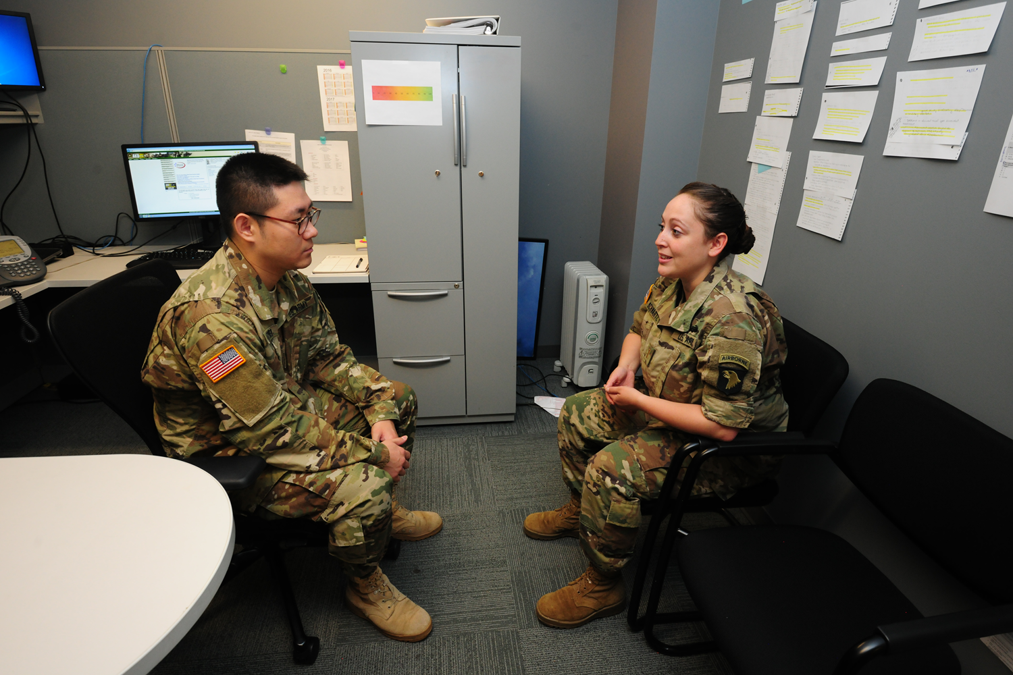
Mitigation Strategies
Trust can be lost when any of the trust elements are breached.
What are some examples of a breach of
  Character?
  Competence?
  Commitment?
It’s not easy to regain or repair lost trust, but it can be done.
Notes:
Record your own notes here:
Ready and Resilient (CCFSPCC)
39
Discuss ways to mitigate the consequences of breaches of trust. [SLIDE BUILDS]
1. Discuss the types of trust breaches and some examples of each. [?]
Trust can be lost when any of the elements of trust are breached.
Character—particularly integrity—and competence are the most common reasons for lost trust.
Character breaches are harder to mend because they are seen as a lack of integrity, which most people believe is difficult or impossible to change.
[ASK] What are some examples of character breaches?
[CLICK TO ADVANCE]
[NOTE: Allow for some discussion. Some examples might be
Lying
Coercion
Covering up others’ misdeeds
Manipulation
Deceptive actions
Inappropriate relationships
Misappropriation of government money]
Competence breaches are more easily forgiven, since people can typically build competence.
However, there are some competence breaches that would be major breaches in trust.
[ASK] What are some examples of a competence breaches?
[CLICK TO ADVANCE]
[NOTE: Allow for some discussion. Some examples might be
APFT failure
Avoiding problems and not making on-the-spot corrections
Loss of accountability of personnel and/or property
Leaders not training their Soldiers well
Routine personal issues (marital, Family, or other)]
Commitment breaches may also be serious and increase the likelihood of lost trust.
[ASK] What are some examples of commitment breaches?
[CLICK TO ADVANCE]
[NOTE: Allow for some discussion. Some examples might be
Fail to fulfill obligations to Soldiers or Families
Being distracted by competing interests
Fail to prepare for meetings or trainings
Quitting when things get tough]
With any breach in trust, you may find yourself looking for more evidence of breaches from that same person.
[ASK] How can trust be restored after it is breached?
[NOTE: Allow for some discussion.]
2. Explain some characteristics of restoring trust.
Apologies can repair competence breaches but are much less effective in integrity breaches.
Remorse is important in all apologies.
If remorse isn’t perceived, the person who was wronged will have a much tougher time rebuilding trust.
Individuals and groups differ in how they respond to trust issues, though groups are inconsistent—at times they are more forgiving, at other times social contagion, otherwise known as “mob mentality” makes them less forgiving.

Slide 24
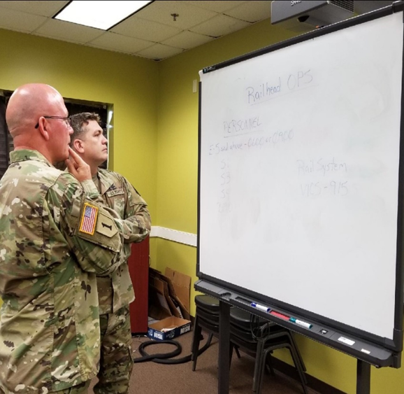
NTC Preparation
The BN is preparing for an upcoming NTC rotation. With that comes the added demands on the company, and your Soldiers have been working hard and for long hours preparing vehicles, weapon systems, personal equipment, and loading connexes. Railhead operations begin on Monday. Despite the fact that your company is ahead of schedule, the CDR wants to bring in the PLs, PSGs, SLs, and TLs tomorrow (Saturday) to inspect progress and discuss requirements for when railhead ops begin.
Notes:
Record your own notes here:
Ready and Resilient (CCFSPCC)
41
◎ To introduce the NTC preparation scenario as a basis for the values and communication discussion.
1. Introduce the NTC preparation vignette.
Shifting gears a bit, let’s look more closely at the CDR/1SG relationship.
[ASK] Would someone please volunteer to read this vignette about NTC preparation?
We’ll have some discussion afterward.

Slide 25
NTC Preparation
1SG says “Sir, all requirements to date have been achieved and all the Soldiers and NCOs could use the weekend to decompress and rejuvenate before railhead ops begin. Their morale is starting to degrade. I’m hearing about more ‘shamming’ and complaining.”
The CDR states, “The company should be prepared to support the battalion in any way possible and if our company is squared away, this will allow us to be ready in case of additional taskings. With the right management strategies, our Soldiers should be able to do everything asked of them.”
Notes:
Record your own notes here:
Ready and Resilient (CCFSPCC)
43
◎ To continue the NTC preparation scenario as a basis for the values and communication discussion.
1. Continue the NTC preparation vignette.
I need another volunteer to finish the vignette.

Slide 26
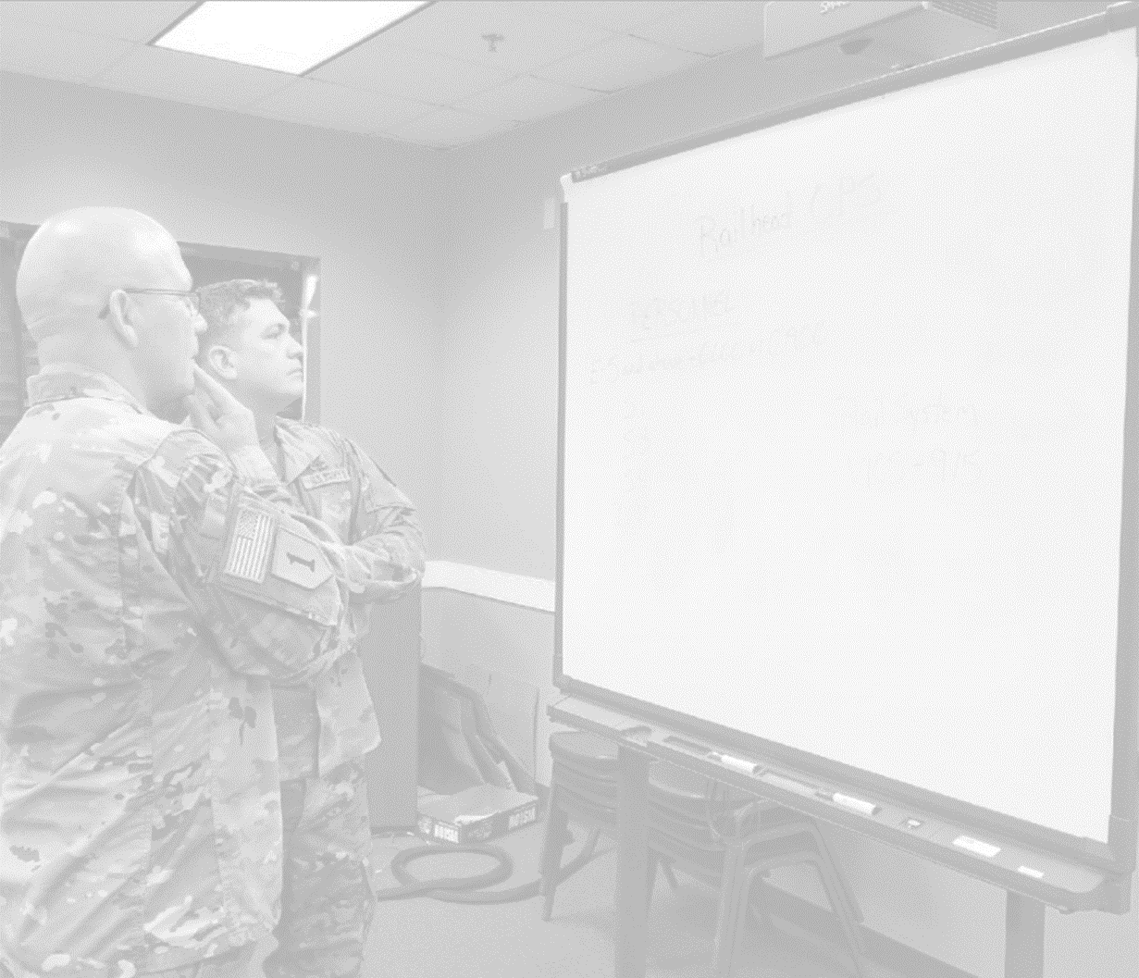
NTC Preparation
CDR: What are the 1SG’s priorities, values, and beliefs related to this situation? If you were the 1SG, how would you communicate with the CDR?
1SG: What are the CDR’s priorities, values, and beliefs related to this situation? If you were the CDR, how would you communicate with the 1SG?

Notes:
◎ Discuss the importance of communication in managing conflicting priorities.
1. Facilitate the discussion about the priorities, values, and beliefs of the CDR and 1SG in the vignette. [?]
You just heard the initial vignette, and now it’s time to use your mental agility to think about the situation from each other’s point of view.
As a pair—a CDR and 1SG—please answer the question designated for you.
[NOTE: Set up the pair discussion.]
[ASK] CDRs, thinking like the 1SG in the vignette, what are the 1SG’s priorities, values, and beliefs related to the situation?
If you were the 1SG, how would you communicate with the CDR?
[ASK] 1SGs, thinking like the CDR in the vignette, what are the CDR’s priorities, values, and beliefs related to this situation?
If you were the CDR, how would you communicate with the 1SG?
[NOTE: Allow for pair discussions. Debrief with the full class. Answers should include: The CDR wants to develop and execute plans and be prepared for expected and unexpected challenges. The 1SG wants to care for people and balance the mission and welfare of the Soldiers.]
2. Highlight that the CDR and 1SG’s values are aligned, but their priorities are not.
In this circumstance, the leaders’ values are aligned but their priorities are not.
Both want a certain outcome, but have different opinions on how to accomplish this.
As a command team, it is critical to be a united front; therefore, sorting out these disagreements in private is important.
It is critical to take these moments to have transparent communication, like we talked about earlier.
Potentially your counterpart has received info either the BN CDR or the CSM that is impacting his/her priorities too.
When you start to understand another person’s priorities, values, and beliefs, you start to develop the foundations for good communication and trust.
Record your own notes here:
45

Slide 27

Metacognition
Thinking about your thinking…
Notes:
Record your own notes here:
Ready and Resilient (CCFSPCC)
47
◎ Discuss the importance of self-reflection.
1. Explain metacognition and its value to leaders and teams.
When you consider your own priorities, values, and beliefs, this is metacognition, or—thinking about your thinking—and is found in FM 6-22, P. 5-2, Pa. 5-11.
Through this reflection, your self-awareness, self-regulation, and preparedness for challenging situations should improve.
Reflecting on your thinking style (e.g., your preferences, your experiences, your knowledge, other factors that shape your decision-making) will allow you to be more aware of why you do what you do (or don’t do what you don’t do.)
Recognizing the influences that shape your decisions allows you to have more clarity and control particularly when decisions are needed in haste.
The problems you encounter on a daily basis are more complex and nuanced than what we can provide in a vignette; however, it is beneficial to invest time to reflect on situations, problems, solutions, assumptions, and plans to figure out your thought patterns and strategies.
This can improve understanding, visualization, and decision-making.
When you have conflict with your counterpart, take a tactical pause at an appropriate time to think beyond the circumstance to what’s driving the conflict and then have a conversation about that.
The metacognition questions in FM 6-22 and others that challenge your thinking are valuable to use as individuals, with your counterpart, with subordinate leaders, and with Soldiers.

Slide 28
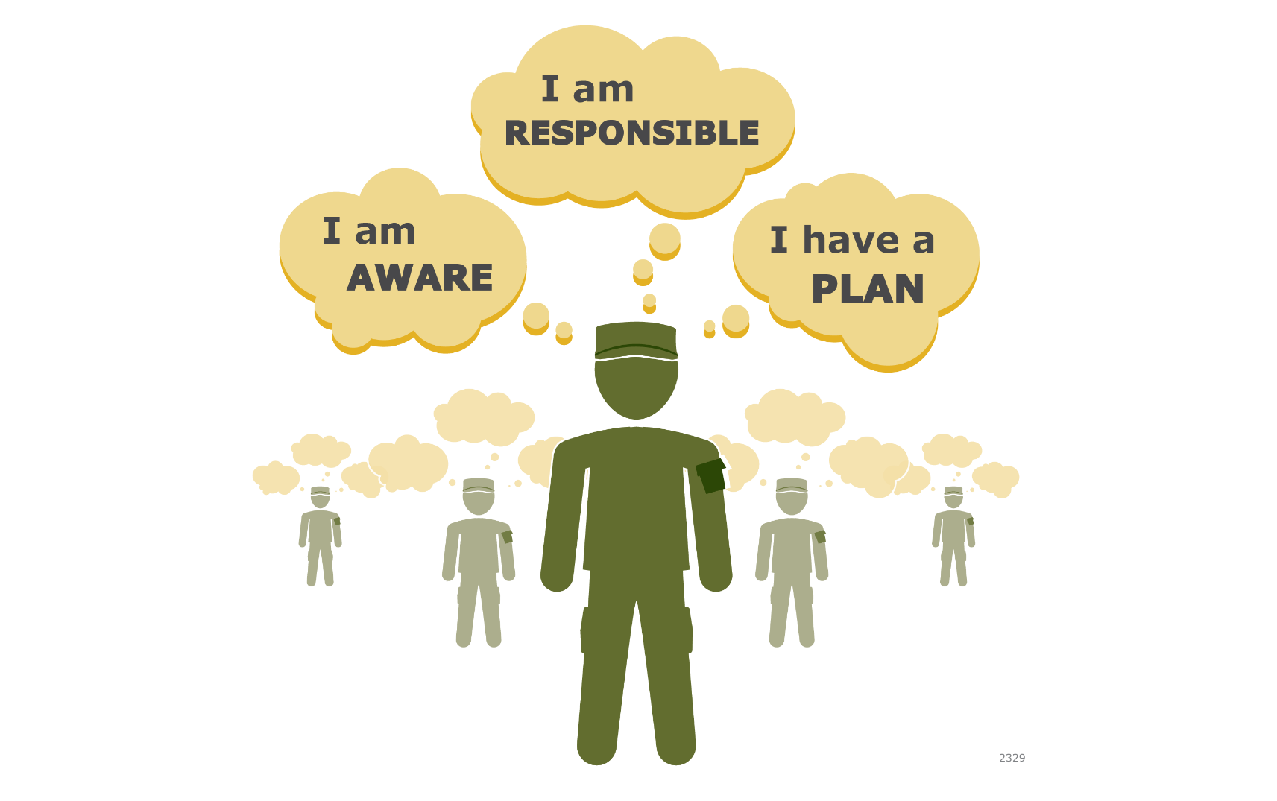
Engage
Notes:
Record your own notes here:
Ready and Resilient (CCFSPCC)
49
◎ To introduce Engage.
1. Briefly introduce Engage and its 3 components. [?]
When we talk about Engage training, we’re talking about a leadership tool that can be used to change the trajectory of a situation.
[ASK] Has anyone participated in Engage training?
[NOTE: Allow for responses. If anyone says yes, ask the next two questions
What was your response?
What were your Soldiers’ responses?]
This is a leadership tool that can be used in many different situations – from social isolation to substance abuse to performance improvement.
It can be used to change the trajectory of minor incidents and complex, high-stakes situations.
There are three components necessary to facilitate a change for a better outcome of a potentially bad situation.
2. Discuss the component of Awareness. [?]
First, everyone needs to be aware of alerts that indicate someone may be at risk either internally or externally (i.e., physical, cognitive, emotional, social, spiritual alerts).
[ASK] How would you teach and/or inspire your Soldiers to develop this awareness?
[NOTE: Allow for responses.]
3. Discuss the component of Responsibility. [?]
Second, it is important to recognize one’s responsibility.
Many times, when something is not right, Soldiers expect someone else do something.
The reality is that all Soldiers have a responsibility to do something.
[NOTE: Ask the following questions rhetorically.]
What does it mean to never leave a fallen comrade (from the Soldier’s Creed)?
Does that mean we have to wait for them to fall or should we try to help them avoid falling?
Do we wait for our buddies to walk into an ambush so we can save them from it?
Or does it make more sense keep them from the ambush?
When Soldiers internalize and live the Army Values, they will take responsibility.
We have discussed ways to help Soldiers internalize them.
Finally, Soldiers should have a plan to engage by taking direct and/or indirect actions.
4. Discuss the component of Plan. [?]
Plans can be very simple or more complex depending on the circumstance.
It’s important to think through any intervention strategy to enable the highest-yield, lowest-risk outcome.
[ASK] How will you teach/inspire your Soldiers to plan to take direct and/or indirect actions?
[NOTE: Allow for responses.]
[ASK] How might your methods be different for Soldiers and NCOs?
[NOTE: Allow for responses.]

Slide 29
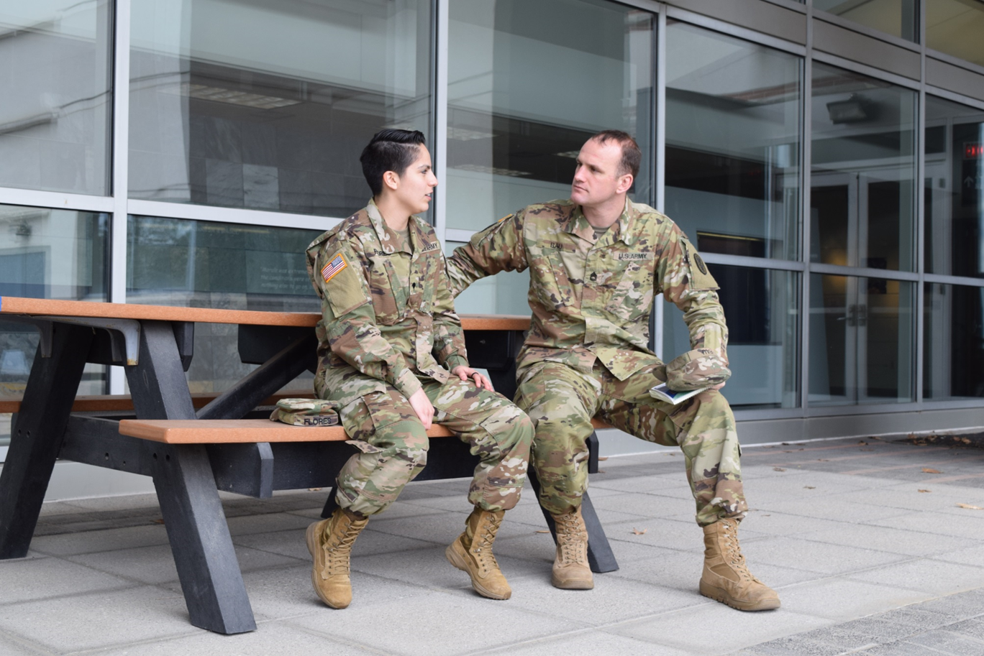
Specific Opportunities to Engage
Reintegrate- to restore elements into an entity; to restore to unity.
  One size does not fit all
  Develop a menu
What are some situations when reintegration happens in a unit?
Notes:
Record your own notes here:
Ready and Resilient (CCFSPCC)
51
◎ Introduce and define reintegration.
1. Introduce and define reintegration.
Let’s discuss some specific situations and ways that you can take direct or indirect action to guide Soldiers, subordinate leaders, and your unit.
The definition of reintegration is to restore elements into an entity, to restore to unity.
At any point in time, you may have Soldiers assigned to your company that are geographically separated.
This could be the result of opportunities to excel, personal circumstances, or a negative outcome of their own or someone else’s poor choices.
In any case, as diligent and perceptive leaders, you may want to develop a plan to take direct or indirection action to help reintegrate a Soldier upon their physical return to your unit.
2. Transition to slide about specific reintegration situations. [?]
Naturally each circumstance has its own dynamics so there is not a one-size-fits-all strategy for reintegration.
It’s beneficial to view this discussion as leading to a menu of items you can choose from to build your own reintegration strategy.
[ASK] What are some situations when reintegration happens in your unit?
[NOTE: Allow for some answers.]

Slide 30
Reintegration Scenarios
1. Failed an Army
school or
qualification?
How would you work to reintegrate a Soldier who…
5. Attempted suicide?
2. Is returning from
medical leave
(e.g., giving birth)?
4. Succeeded in a national/international competition
3. Was under investigation?

Notes:
53
Record your own notes here:
◎ Discuss reintegration scenarios.
1. Discuss other sorts of unit absences that might be served well by a reintegration strategy. [?]
[NOTE: Acknowledge if they discussed any of these situations when answering the question on the previous slide.]
Keep in mind, the first step is being aware that there might be challenges in these situations.
The second step is to recognize your responsibility as a CDR or 1SG.
The third step is to develop the plan and that is what you will discuss.
2. Discuss direct and indirect actions leaders can take to facilitate reintegration.
Here are five specific situations when you may want to engage directly or indirectly to facilitate a smooth reintegration.
 [NOTE: Assign each group 1 of the scenarios.]
With 3-4 others, discuss direct and indirect actions you would take to facilitate reintegration of the Soldier in the situation.
Then we’ll discuss your answers with the large group.
The scenarios are intentionally vague because each situation is unique.
Take 2-3 minutes to discuss how you would reintegrate the person back into the unit.
[NOTE: Allow 2-3 mins and then begin the full group discussion.]
Let’s start with scenario 1.
Share your plans for direct and indirect actions.
[ASK] How would you reintegrate a Soldier who failed an Army school or qualification? You put trust in that person to send him or her.
[NOTE: Facilitate this discussion.]
[ASK] How would you reintegrate a Soldier who is returning from medical leave?
[NOTE: Facilitate this discussion.]
[ASK] How would you reintegrate a Soldier who is under investigation?
[NOTE: Facilitate this discussion.]
[ASK] How would you reintegrate a Soldier who had phenomenal success at a major national or international competition?
[NOTE: Facilitate this discussion.]
[ASK] How would you reintegrate a Soldier who attempted suicide?
[NOTE: Facilitate this discussion.]

Slide 31
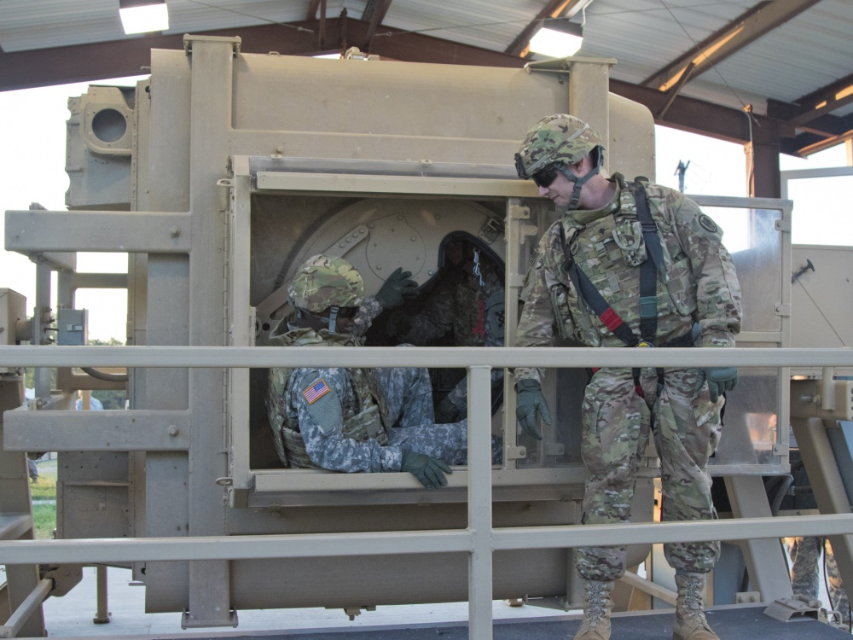
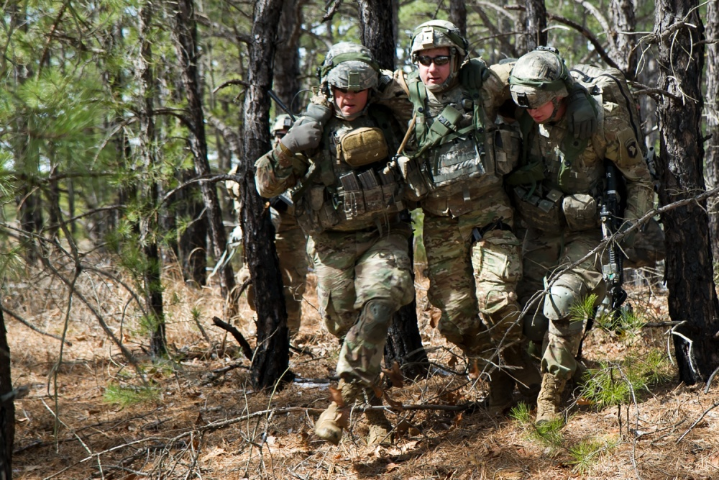
The Impact of Trust on Reintegration
If your unit has a strong trust culture, what would you expect during a reintegration situation?
If your unit does not have a strong trust culture, what would you expect during a reintegration situation?

Notes:
Record your own notes here:
55
◎ Highlight the difference a unit with a strong culture of trust makes on the reintegration effort.
1. Discuss what reintegration might look like based on the level of trust in the company. [?]
In your small groups, discuss answers to both questions.
Take 2-3 minutes to discuss your respective question.
 [NOTE: Allow 2-3 mins and then begin the full group discussion. Highlight any reference to character, competence, or commitment.]
[ASK] Let’s start with the first question. If your unit has a strong culture of trust, what might you expect during a reintegration situation?
[NOTE: Facilitate this discussion. Some answers might include: Encouragement from peers and leaders, transparency, authentic commitment to restoring trust, and moving forward. Once you feel they’ve made a strong case, move on to the next question.]
[ASK] How about the second question? If your unit does not have a strong culture of trust, what might you expect during a reintegration situation?
[NOTE: Facilitate this discussion. Some answers might include: Inappropriate jokes, name-calling, unnecessary restrictions and identification, unwillingness to let them lead, dismissing input, relying too much on those who excel.]

Slide 32
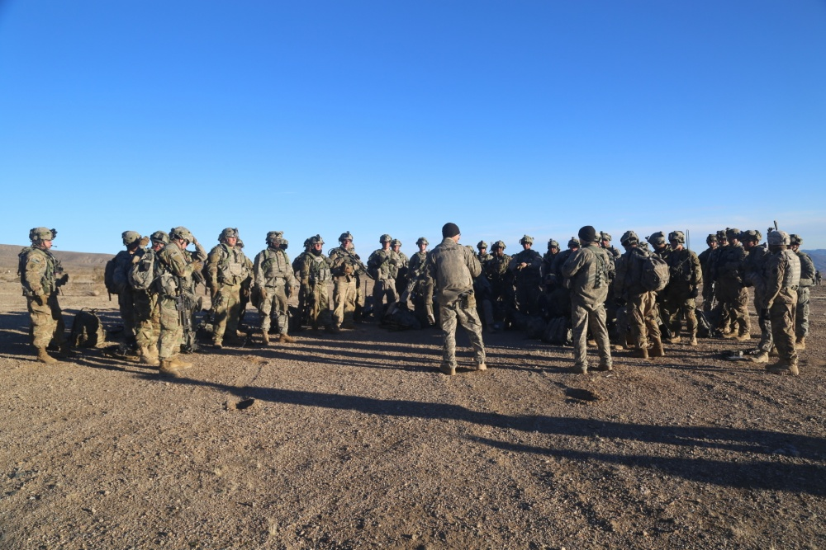
Implementation Strategy


Notes:
Record your own notes here:
Ready and Resilient (CCFSPCC)
57
◎ Discuss strategies for modeling the trust elements of character, competence, and commitment.
1. Discuss how to model character, competence, and commitment to develop a culture of trust in your new company. [?]
Trust is a valuable commodity and it needs to be in our awareness at all times.
As you think about setting the tone for your company and work to intentionally develop a culture of trust, this could reap huge rewards for the unit.
Take a look at your handout again.
You have 3 more questions on the back of your sheet to discuss with your original partner.
Jot down some notes.
[NOTE: Allow a few minutes for CDR/1SG teams to discuss.]
[ASK] Beyond what you are already doing, how are you going to model character, competence, and commitment to foster a culture of trust?
[NOTE: Solicit responses for group discussion.]
[ASK] How are you going to mentor your subordinate leaders and Soldiers to be trustworthy?
[NOTE: Solicit responses for group discussion.]
[ASK] In particular, what is your specific plan to challenge, develop, and empower your MRT? The return on investment in your unit could be immeasurable.
[NOTE: Solicit responses for group discussion.]

Slide 33
R2 Handouts and Contact Information
Ready and Resilient Performance Centers
(R2 Centers)
R2 Training Team or Public Affairs:
usarmy.pentagon.hqda-dcs-g-1.list.r2pao@mail.mil
ARD Group Mailbox:
usarmy.pentagon.hqda-dcs-g-1.list.r2training@mail.mil
Notes:
Record your own notes here:
Ready and Resilient (CCFSPCC)
59
◎ Provide contact information for R2 Performance Centers and ARD’s group mailbox.
1. Describe the content of the handout they receive.
 [NOTE: Pass out the handout with the trust citations.]
The handout that you are receiving contains the references for the content related to trust.
2. Provide contact information for R2 Performance Centers and the ARD Group Mailbox.
If you have more questions about R2, please contact your local R2 Performance Center.
[NOTE: Not all installations have a local R2 Performance Center; however, command teams may contact the one that is closest.]
Here are the phone numbers and ARD’s group mailbox.

Slide 34
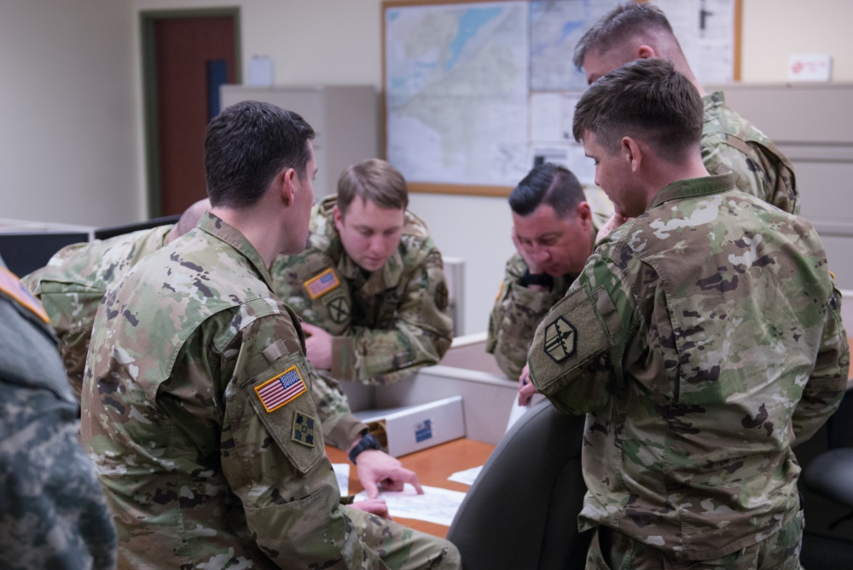
Legacy
Responsibilities & Privileges

Notes:
Record your own notes here:
Ready and Resilient (CCFSPCC)
61
◎ Discuss the impact of leaders’ attitudes, behaviors, and decisions on the fulfillment of responsibilities and legacy.
1. Discuss the impact the everyday attitudes, behaviors, and decisions will have on those they lead.
As we talked about earlier, your new role increases your level of responsibility, but the opportunities for you to impact others increases greatly too.
Your everyday attitudes, behaviors, and decisions have an impact on those you lead as you fulfill your responsibility to the Nation to sustain your company at a level of proficiency required to perform its wartime mission.
Balancing technical and tactical requirements while enriching the lives of your Soldiers’ and their Families through tough training, camaraderie, opportunity, and looking out for their well-being is your charge.
How you do this will be your legacy.
2. Discuss the importance of being intentional about leading with their legacy in mind. [?]
[NOTE: Ask questions below rhetorically.]
[ASK] Think about some of your leaders
What made them great?
Or not so great?
Was it their knowledge?
Their actions?
Their experience?
Their interactions with you or with others?
Their consistency?
Now look back at the legacy side of your handout from the beginning of the module.
What you brainstormed may end up being your legacy—the enduring outcome of the time you spent in command or responsibility at this level.
Take a couple minutes right now to review and add or amend your answers based on what we have discussed.
[NOTE: Allow them 1-2 minutes to reevaluate their answers.]
It will take work—deliberately demonstrating character, competence, and commitment, and holding your leaders and Soldiers accountable too.
It becomes habit after time.
Being intentional by living the Army Values and building a culture of trust every day will pay dividends in your unit and in the lives of your Soldiers and their Families forever.
Remember, you are not on your own; you have your counterpart and your subordinate leaders to help make the greatest positive impact on the Soldiers in your unit.

Slide 35
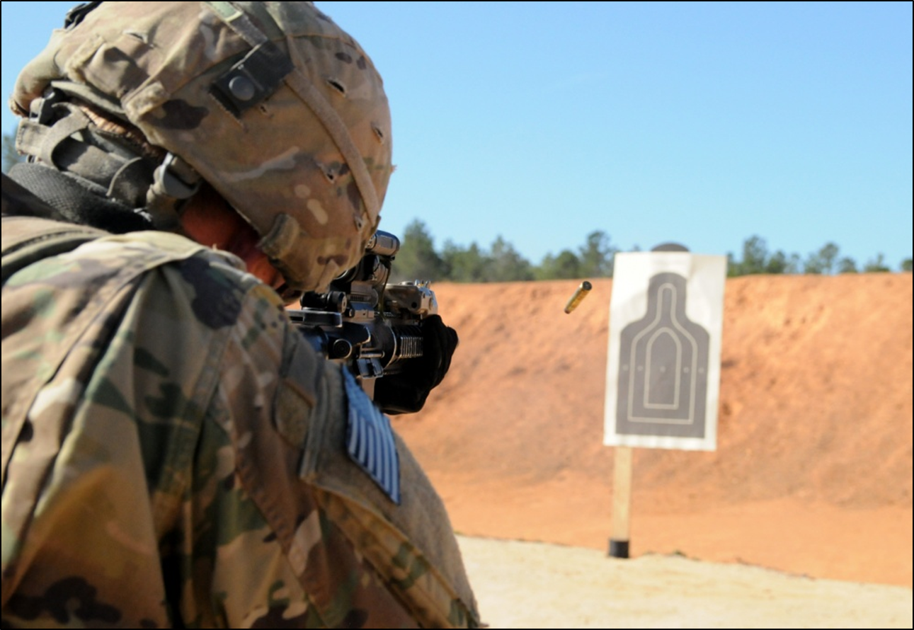
Conclusion
Thanks for your participation!
Notes:
Record your own notes here:
Ready and Resilient (CCFSPCC)
63
◎ Conclude the training.
1. Conclude the training.
This concludes the Ready and Resilient module of the Company Commander First Sergeant Pre-Command Course.
Thank you for your time and participation during this module.
Thank you also in advance for the investment you will make in those under your command and responsibility.

Slide 36
Notes:
Adams, B. D. Bruyn, L. Ee., & Chung-Yan, G. (2002). Creating a measure of trust in small military teams. Department of National Defence, Defence Research and Development Canada – Toronto, paper produced on a PWGSC contract. Retrieved from http://www.dtic.mil/cgi-bin/GetTRDoc?AD=ADA436363
Allen, C. D. & Braun, W. R., III (2012, January 24-27). Trust: Implications for the Army Profession. Paper presented at a conference for the International Society for Military Ethics (ISME), 24-27 January 2012, San Diego, CA, pp. 73-85. Retrieved from https://www.academia.edu/8013596/Trust_Implications_for_the_Army_Profession
Center for the Army Profession and Ethic, Mission Command Center of Excellence, U.S. Army Combined Arms Center, TRADOC. (2011, July 11). The Army Ethic: White Paper. Retrieved from http://cape.army.mil/repository/white-papers/Army-Ethic-White-Paper.pdf
Cook, K., Levi, M., & Hardin, R. (Eds.). (2009). Chapter 8: Trust and Credit. Whom Can We Trust?: How Groups, Networks, and Institutions Make Trust Possible. Russell Sage Foundation. Retrieved from http://www.jstor.org/stable/10.7758/9781610446075
Cooper, C. (n.d.). Research update: Trust and leadership must go hand-in-hand. Retrieved from https://www.bus.miami.edu/_assets/files/executive-education/leadership-institute/trust-research.pdf
Kim, P.H., Dirks, K.T., & Cooper, C.D. (2009).The repair of trust: A dynamic bi-lateral perspective and multi-level conceptualization. Academy of Management Review, 34(3), 401-422.
MacCoun, R. J. & Hix, W. M. (2010). Unit cohesion and military performance, Chapter 5. Sexual Orientation and U.S. Military Personnel Policy: An Update of RAND's 1993 Study (137-165). Santa Monica, CA: RAND. Retrieved from: https://www.law.berkeley.edu/files/csls/Unit_Cohesion_and_Military_Performance_Ch5_MacCoun_Hix.pdf
Moelker, R. & Olsthoorn, P. (2007). Virtue ethics and military ethics. Journal of Military Ethics, 6(4), 257-258.
Olsthoorn, P. (2011). Military ethics and virtues: An interdisciplinary approach for the 21st century. New York: Routledge.
Robinson, P. (2007). Ethics training and development in the military. Parameters,37(1), 23-26.
Ruark, G. A., Orvis, K. L., Horn, Z., & Langkamer, K. L. (2009, October). Trust as Defined by U.S. Army Soldiers. Proceedings of the Human Factors and Ergonomics Society Annual Meeting 53: 1924-1928.
Ready and Resilient
Company Commander/First Sergeant Pre-Command Course
Modules Citations
64

Slide 37
Notes:
R2 CCFSPCC Modules Citations (continued)
65
Stephen M. R. Covey with Rebecca R. Merrill (contributor). The Speed of Trust: The One Thing That Changes Everything. New York: Free Press, 2008.
Video (Five Waves of Trust): https://www.youtube.com/watch?v=HjMNWr_qqfM 2 min 50 seconds
Video: https://www.youtube.com/watch?v=u6VqcgDtjCo 2 min 38 sec.
Savolanien, T. (2008, March 24-26). Organizational Trust and Leadership as Driving Forces for Innovativeness. Paper presented at Proceedings of the 13-ICIT, International Conference on ISO9000 & TQM. Retrieved from https://www.academia.edu/508791/Organizational_Trust_and_Leadership_as_Driving_Forces_for_Innovativeness
Sweeney, P.J., Thompson, V., & Blanton, H. (2009). Trust and influence in combat: An interdependence model. Journal of Applied Social Psychology, 39(1), 235-264
Toffler, P. A. (2016, August 1). INFORMATION PAPER: FY 17-18 America’s Army – Our Profession Theme, “One Army, Indivisible.” Retrieved from http://cape.army.mil/repository/aaop/one-army-indivisible/one-army-indivisible-info-paper.pdf
U.S. Department of the Army. Army Leadership. Army Doctrine Reference Publication 6-22. Washinton, DC: U.S. Department of the Army, August 1, 2012.
U. S. Department of the Army. Mission Command Center of Excellence. (2015). Building mutual trust between soldiers and leaders. Fort Leavenworth, KY: U.S. Department of the Army.
U.S. Military Academy. (2014, October 14). Evidence of Good Character: Living Honorably and Building Trust (Honorable Living White Paper). Retrieved from http://www.usma.edu/strategic/Shared%20Documents/Honorable%20Living%20White%20Paper.pdf
Vadell, J. (2008). The role of trust in leadership: US Air Force officers’ commitment and intention to leave the military. (Doctoral dissertation). Retrieved from http://www.bookpump.com/dps/pdf-b/9422964b.pdf
Video (Establishing Trust in Your Organization: What an Army Colonel Learned on the Ground): http://www.kellogg.northwestern.edu/trust-project/videos/ogrady-ep-3.aspx, 4 min 30 sec.
Video (Measuring Trust: Through Competence—or Warmth?): http://www.kellogg.northwestern.edu/trust-project/videos/waytz-ep-3.aspx 3 min 34 sec.

Slide 38
Notes:
Ready and Resilient (CCFSPCC)
66

