Slide 1
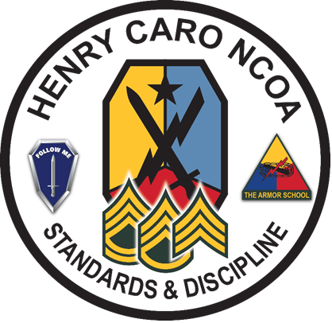
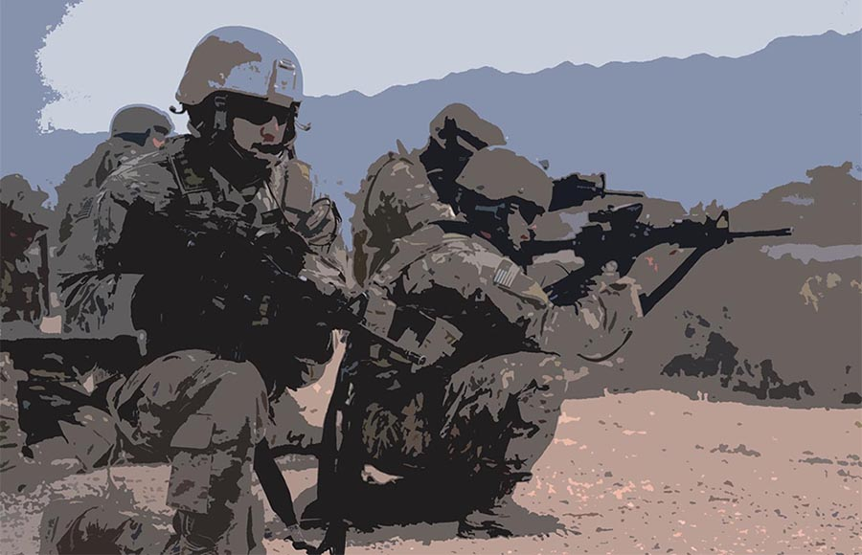
Patrolling
071-NRRAD065
Developed by:​
Maneuver COE, DOTD, TEDD​
for Infantryman ALC
Last Revised: 17 APR 2023

Slide 2
Terminal Learning Objective
Action: Conduct patrolling missions.
Conditions: As a small unit leader in a Company conducting tactical operations as part of a larger force. You receive an Operations Order (OPORD) or Fragmentary Order (FRAGO) specifying the Commander's Critical Information Requirements (CCIR) and Named Areas of Interests (NAI). You must supervise your patrol within your Area of Operations (AO) to obtain information on the CCIR and NAIs. Additional maneuver, sustainment support assets may be available.
Standard: Supervise the patrols by determining the type of patrol that needs to be conducted, planning the patrol, conducting rehearsals, issuing an OPORD or FRAGO, initiating movement, monitoring patrol progress, maintaining mission command, and reporting information to higher headquarters and Score at least 70% on the Tactics Assessment.

Slide 3
Administrative Data
Safety Requirements: None
Risk Assessment Level: Low
Environmental Considerations: None.
Evaluation: Tactics Assessment, Checks on Learning, and Practical Exercises

Slide 4
Patrol
A patrol is a detachment sent out by a larger unit to conduct a specific mission that operates semi-independently and return to the main body upon completion of mission.
Patrolling fulfills the Infantry’s primary function of finding the enemy to engage him or report his disposition, location, and actions.
Patrols act as ground sensors or early warnings for larger units and the planned action determines the type of patrol.

Slide 5
Patrol (cont)
A patrol can consist of a unit as small as a fire team but are usually squad and platoon-sized.
For larger combat tasks such as for a raid, the patrol is sometimes a company.
The planned action determines if the patrols are combat and reconnaissance.
Regardless of the type of patrol, the unit needs a clear task and purpose.

Slide 6
Purpose of Patrolling
Gathering information on the enemy, on the terrain, or on the populace.
Regaining contact with the enemy or with adjacent friendly forces
Engaging the enemy in combat to destroy him or inflict losses.
Reassuring or gaining the trust of a local population.
Preventing public disorder.
Deterring and disrupting insurgent or criminal activity.
Providing unit security.
Protecting key infrastructure or bases.

Slide 7
Patrol Organization
Headquarters Element
Aid and Litter Team
Detainee Teams
Surveillance Team(s)
En-Route Recorder
Compass and Pace Man
Assault Team(s)
Support Team(s)
Breach Team(s)
Search Team(s)

Slide 8
Types of Patrols
Combat: Patrols that depart the main body with the clear intent to make direct contact with the enemy are called combat patrols.
  Raid Patrols
  Ambush Patrols
  Security Patrols
Reconnaissance: Area, Zone, and Route.

Slide 9
Initial Planning and
Coordination
Troop-Leading Procedures
Coordination Activities
  Changes & updates to enemy situation
  Best use of terrain
  Light and weather
  Change in friendly situation
  Attachments
  Local LZ
  Departure & re-entry points

Slide 10
Coordination (Cont)
  Fire support data
  Rehearsal areas & time
  Special equipment and ammo
  Transportation requirements
  Signal plan
  Coordination with other units
  Assist with other platoon activities

Slide 11
Complete the Patrol Plan
Essential and Supporting Tasks
Key Travel and Execution Times
Primary and Alternate Routes
Signals
Challenge and Password
Location of Leaders
Action on Enemy Contact
Contingency Plans

Slide 12
Departure from Friendly Lines
Coordination
Planning

Slide 13
Patrol Base Activities
Use
Site Selection
Planning Consideration
Security Measures
Occupation
Priorities of Work

Slide 14
Rally Points
Selection of RPs
Types of RPs
  Initial RP
  En route RP
  Objective RP
  Re-entry RP
  Near-and-Far side RP

Slide 15
Leader’s Reconnaissance
of the Objective
Establish ORP
During Reconnaissance
  Pinpoint Objective
  Select Security, Support, and Assault Positions
Plan Time to
  Return to ORP
  Complete Plan
  Disseminate Information
  Issue Orders and Instructions
Reentry of Friendly Lines

Slide 16
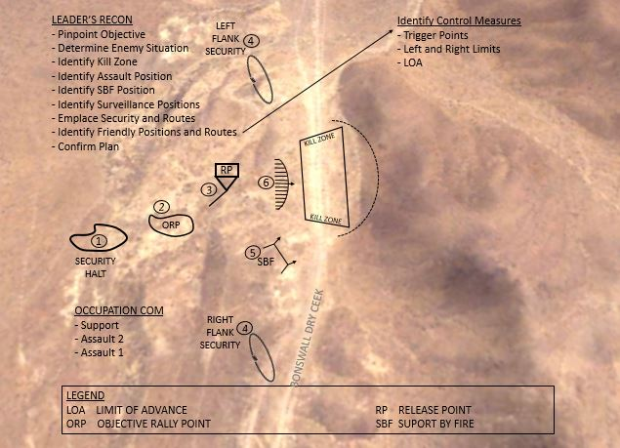
Leader’s Reconnaissance

Slide 17
Combat Patrols
A combat patrols provides security and harasses, destroys, or captures enemy troops, equipment, or installations
Types:
Raid
Ambush
Security

Slide 18
Raid
A raid is a surprise attack against a position or installation for a specific purpose other than seizing and holding the terrain.
Characterized by -
Phases

Slide 19
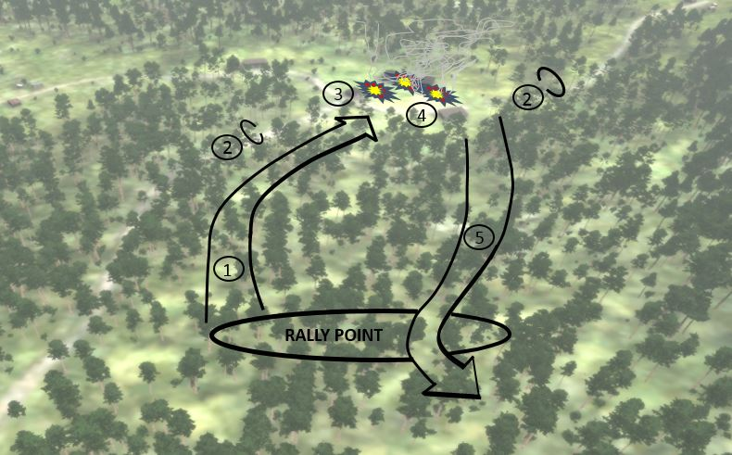
Raid

Slide 20
Ambush
An ambush is a surprise attack from a concealed position on a moving or temporarily halted target. An ambush patrol does not need to seize or hold any terrain. It can include an assault to close with and destroy the target, or an attack by fire only.
Types of ambushes:
  Point
  Area
Based on time - Hasty or Deliberate

Slide 21
Security
A security patrol is sent out from a unit location when the unit is stationary or during a halt to search the local area, detect any enemy forces near the main body, and to engage and destroy the enemy within the capability of the patrol.
This type of combat patrol is normally sent out by units operating in close terrain with limited fields of observation and fire.

Slide 22
Combat Patrol Planning
- Assault elements accomplish the mission during actions on the objective.
- Support elements suppress or destroy enemy on the objective in support of the assault element.
- Security elements assist in isolating the objective

Slide 23
Reconnaissance Patrols
A reconnaissance patrol collects information to confirm or disprove the accuracy of information previously gained.
The intent for this type of patrol is to move stealthily, avoid enemy contact, and accomplish its tactical task without engaging in close combat.

Slide 24
Three Common Types of
Reconnaissance Patrols
Area reconnaissance patrol
Route reconnaissance patrol
Zone reconnaissance patrol

Slide 25
Area Reconnaissance
Focuses only on obtaining detailed information about the terrain or enemy activity within a prescribed area.
Reconnaissance begin with the patrol in the ORP, and end with a dissemination of information after a linkup of the patrol’s subordinate units.

Slide 26
Route Reconnaissance
Detailed information about trafficability on the route and all adjacent terrain
Detailed information about an enemy activity or enemy force moving along a route
Sites for emplacing hasty obstacles to slow enemy movement
Obstacles, CBRN contamination, and so forth

Slide 27
Zone Reconnaissance
A zone reconnaissance is conducted to obtain information on enemy, terrain, and routes within a specified zone.
Zone reconnaissance techniques include the use of moving elements, stationary teams, or multiple area reconnaissance actions.

Slide 28
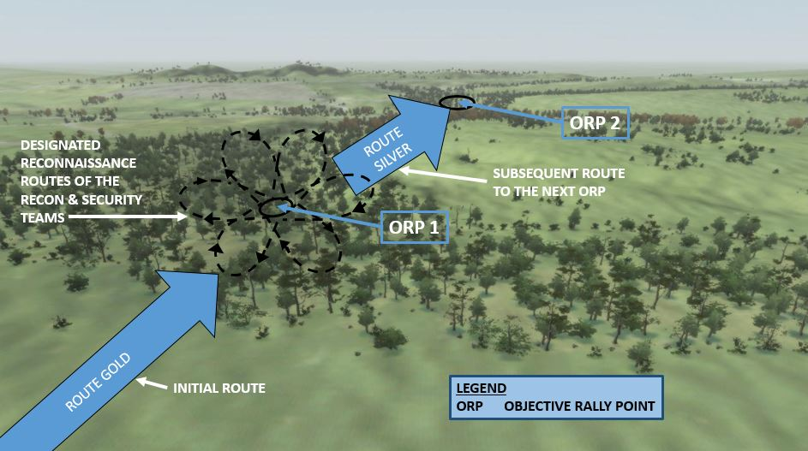
Fan Method

Slide 29
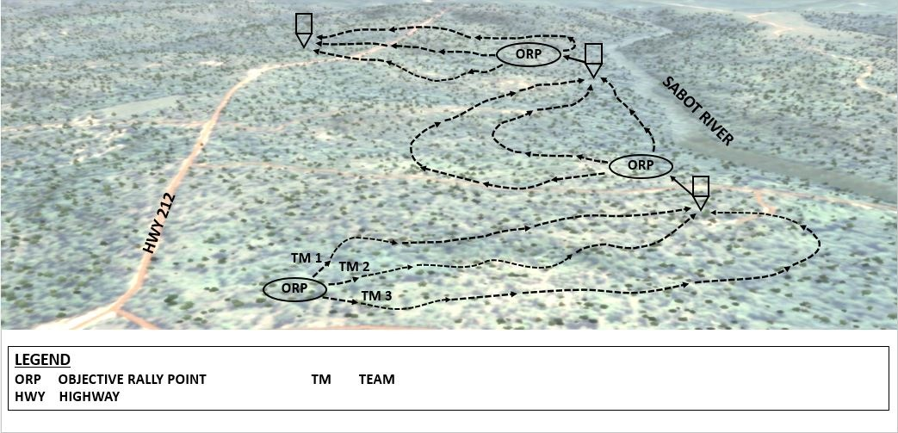
Box Method

Slide 30
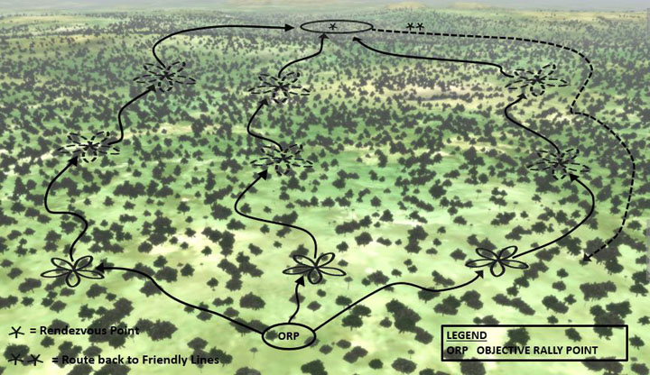
Converging Route Method

Slide 31
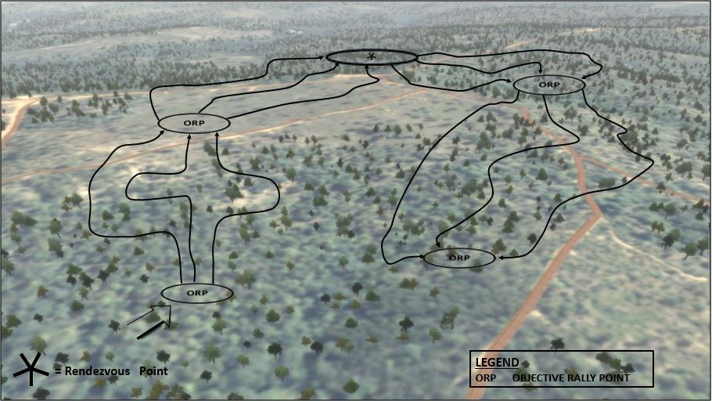
Successive Sector Method

Slide 32
Briefings and Orders
Environment
Mine and IED Threat
Operations Update
Mission & Tasks
Locations & Route
Posture
Action on Contact
ROE & ROI
Commo Plan
Electronic Countermeasures
Uniform & Equipment
Medical
Attachments
  Interpreters
  Police
  Specialists types
  Female Soldiers
  Dog Handlers

Slide 33
Other Types of
Reconnaissance Patrols
Contact Patrol
Presence Patrol
Tracking Patrol

Slide 34
Urban Patrolling
Considerations
Mounted patrolling
Dismounted Patrolling
Strengths and weaknesses

Slide 35
Questions?

Slide 36
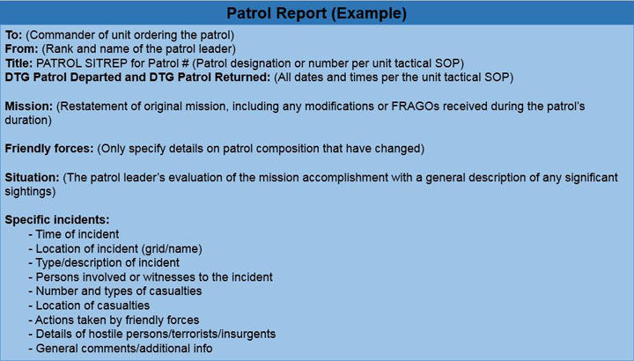
Patrol Report

Slide 37
Summary
Planning Considerations
Combat Patrols
Reconnaissance Patrols
TTPs / Lessons Learned
PE

