Slide 1
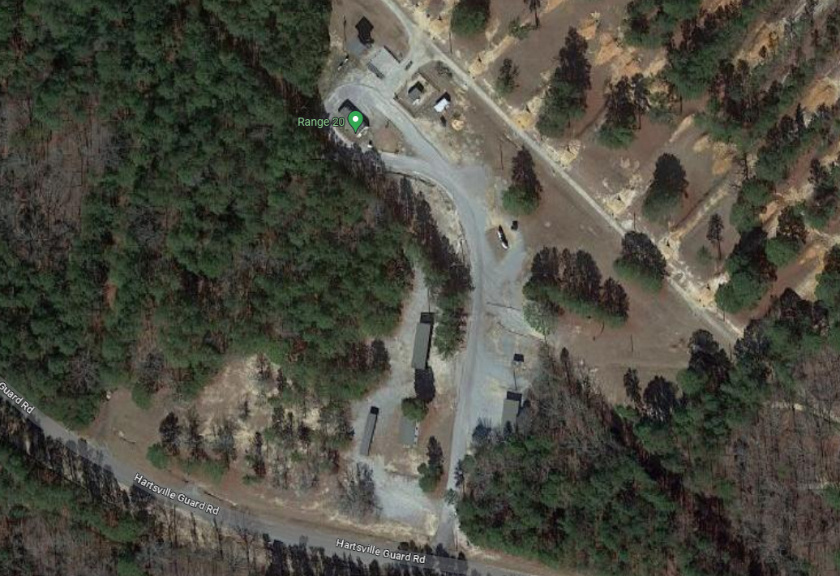
C CO – BMS
CUI
Mission: C/1-13 IN conducts Battle-March-Shoot at Range 20 on 020900-1200OCT2023 IAW BCT POI, Bayonet Handbook, and safety protocols, providing Trainees a simulated Operational Environment to better prepare them to meet the challenges faced during a time of war.
Concept of Operations:​
Phase I (Preparation): will be executed from 20-26 MAR and include BUIs pre qual and qual, CCO group and zero, and CCO EST. Phase will end upon PCC/PCIs complete and staged for movement on 020815OCT23.
Phase II (Movement): Will begin at completion of all PCC/PCI NLT 020815OCT23 and end upon arrival of Range 20. At 0845 MM will begin from C CO CTA to Range 20.
Phase III (BMS Execution): Begins once patrol bases are occupied NLT 020915OCT23 and ends NLT 021230OCT23.
- Squads of 16 will exvil their patrol base when called upon and move to station 1. They will execute 113 collective power jumps and take contact upon completion of the exercises.
- Upon taking contact, the squad will fire team bound to station 2 evacuate two rescue randys on litters and 6 ammo cans to station 3.
- At Station 3 the squad will conduct conduct 113 airsquats and load the gear on the 1-ton.
-Station 4 Trainees will conduct 113 8-count T pushups
- Once the pushups are completed the squad will be rodded onto the range where they will conduct a qualification
4
3
1
2
Uniform:
IOTV
FLC
Eye Pro
Ear Pro
M4 Rifle
PC
Manning:
Station 1- DS Carver
Station 2- DS Russaw
Station 3- DS Moret
Station 4- DS Cain
Range entrance- SDS Carey, SDS Gruber
1-Ton- SPC NJ, DS Fulmore
Safeties- DS Westmoreland, SDS Rhodes, DS Trimble, DS Hallman, DS Consolver
P: Radio | A: Cell Phones | C: BRIC | E: Runner | EMS: 751-91111

